Slide 1
Computer Forensics Infosec Pro Guide
Ch 16
Documenting Your Findings with Reports
Revised 5-11-15

Slide 2
Forensic Tools
The "report" feature in your forensic tool is NOT sufficient
It's too dry and technical, and too long
Attach it as an appendix to your report
Only the opposing expert will look at it

Slide 3
Documenting Your Findings

Slide 4
Areas to Cover
Who asked you to undertake the investigation
What you were asked to do
What you reviewed
What you found
What your findings mean

Slide 5
Who Asked You to Undertake the Investigation
You need this record for yourself, as well for your client
You may need to answer questions about this report years later
Someone may try to bury the investigation later
Questions may come up about whether you were properly authorized

Slide 6
What You Were Asked to Do
Suspect may claim that they were unfairly targeted, with:
Human resources review
Improper termination lawsuit
The most common type of lawsuit an internal forensic examiner may get involved with
Union employees may have contractual restrictions on discipline/termination

Slide 7
What You Reviewed
Specify exactly what evidence you reviewed
Example: a laptop
Who used the laptop
Network name
Laptop make, model, serial #
OS
"Evidence in your possession" may refer to a forensic image, not the original device

Slide 8
What You Found
Describe what you found in plain English
Avoid technical jargon
Your client needs to be able to understand it
Your client is not an expert; it's your job to convert technical babble to clear, comprehensible conclusions

Slide 9
Example Findings
The Internet history records were deleted the day before we forensically imaged the computer
The Internet history records were recovered from the deleted space on the disk
The Internet history records revealed regular access to adult web sites during work hours
The login records show that Jim Smith was the only user logged into this computer during those times

Slide 10
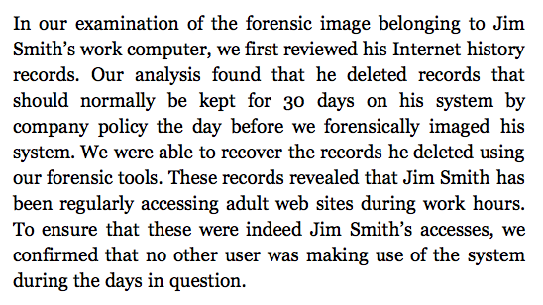
Example Narrative

Slide 11
What Your Findings Mean
Conclusions
An expert witness is not a journalist
It is not your role to present evidence and let readers draw their own conclusion
You are an expert, and are being hired to state an expert opinion on what the findings mean
State your own personal opinion
Just make sure you can justify it with evidence

Slide 12
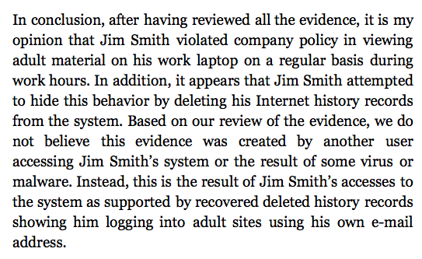
Example Conclusion

Slide 13
Types of Reports

Slide 14
Types of Reports
You must know who your audience is
If report is only for the person who requested it to make a decision, an informal report may be suitable
If report details the impact of an incident, such as malware or an intrusion, an incident report may be required
If report is meant for internal review by human resources and legal, a formal internal report is likely required

Slide 15
Types of Reports
Declaration and affidavit are the most formal types of reports, to be used in court

Slide 16
Informal Report
Can be just an email containing your conclusions
However, make sure it captures the topics detailed earlier:
Who requested the work
What was requested of you
Your conclusions
Even an informal report can be used in litigation

Slide 17
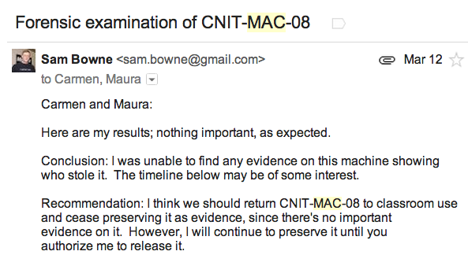
Example Informal Report

Slide 18
Incident Reports
Cover impacts and exposure of data that may have occurred because of an incident
Typically focused on malware and intrusions
Ensure you have all the details discussed at the beginning of this chapter
Report may be passed on to regulators or legal entities in compliance with breach notification laws

Slide 19
Internal Reports
More traditional
Three major areas
Executive Summary
Findings
Technical Details
"Technical details" will contain screenshots of artifacts, excerpts from recovered data, and evidence to support your conclusions

Slide 20
Declaration
A legal document
A sworn statement
Will likely be submitted into materials used in a formal legal matter
Will likely be critiqued by opposing computer forensic experts
Be careful—you may face legal penalties for making false statements
Resist pressure to slant your conclusions

Slide 21
Declaration is Public
Unless it is sealed, your declaration is a public document
Anyone in the future can examine it and question you about it
You will have to live with what you've written for the rest of your career

Slide 22
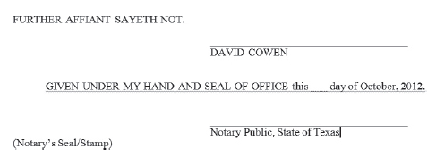
Affidavit
Similar to a declaration
Signed in the presence of a notary public
Title should be "Affidavit of Your Name"
Signature block shown below

Slide 23
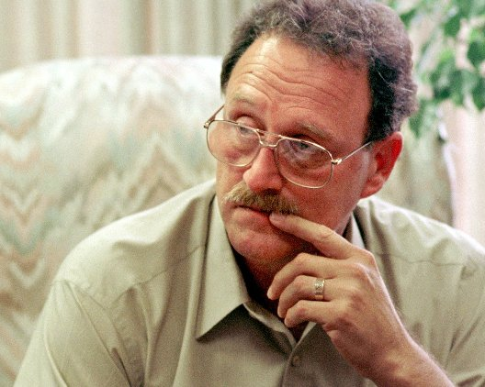
Fred Zain
Hired by W Va. police in 1977 based on falsified credentials
Flunked or barely passed chemistry
Gained a reputation for being able to solve extremely difficult cases
Looked on as a "god" by W Va. district attorneys
Image from herald-dispatch.com

Slide 24
Warning Signs
In 1985, an FBI agent told state police Zain had failed basic forensic courses
Two workers claimed to have seen Zain record results from blank plates
These complaints were ignored
Zain gained a reputation for being "pro-prosecution"

Slide 25
DNA Evidence
In 1997, Zain's examination of semen and his testimony led to the conviction of Glen Woodall
Sentenced to 335 years in prison
In 1998, DNA testing proved Woodall was innocent
Woodall's defense team found serious errors in Zain's work

Slide 26
1993 Report from Supreme Court of W Va.
Zain had
Misstated evidence
Falsified lab results
Reported scientifically implausible results
Resulted in as many as 134 wrongful convictions in Virginia
A Texas investigation found at least 180 more such cases in Texas

Slide 27
Zain's Trial
Charged with fraud
Trial put on hold after he was diagnosed with liver cancer
He died in 2002 while awaiting his second trial for obtaining money under false pretenses
Links Ch 16a, b, c

Slide 28
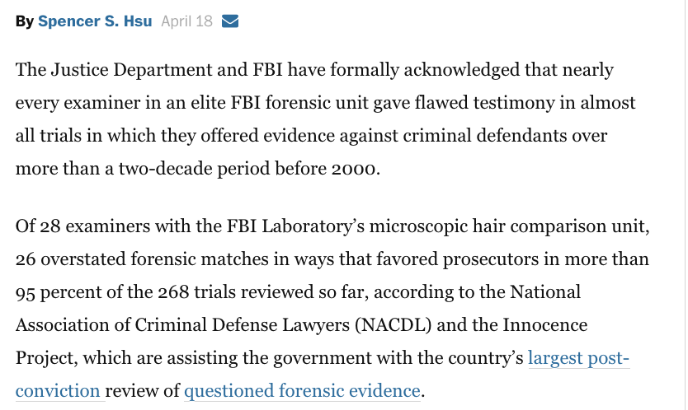
From 2015, link Ch 16d

Slide 29
Explaining Your Work

Slide 30
Define Technical Terms
Such as forensic image, unallocated space, carved file, slack space, file fragment
Definition may be in a footnote, or after a sentence using the term
Provide Examples in Layperson Terms
Example: slack space is like leftover old programs on a VHS tape

Slide 31
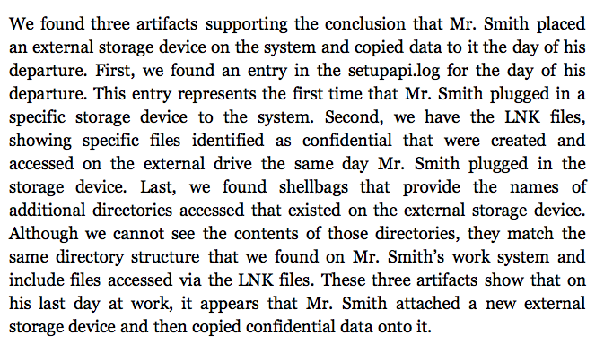
Explain Artifacts

Slide 32
Computer Forensics Infosec Pro Guide
Ch 17
Litigation and Reports for Court and Exhibits

Slide 33
Legal Terms
Litigation – the judicial process
Plaintiff – the person or company that initiated the lawsuit (in civil cases)
Defendant – the person or company being sued (in civil cases)
In criminal cases, the plaintiff is always the government

Slide 34
Legal Terms
Outside counsel – the law firm a company hires to represent it in court
Discovery – plaintiffs and defendants ask each other for documents
eDiscovery – Electronic discovery
Responsive document – relevant to the request

Slide 35
Legal Terms
Admissibility – Determination whether a piece of evidence or statement should be entered into court record
Evidence is inadmissible if it is:
Privileged communication
Attorney-client work product
Irrelevant to the proceeding
Hearsay
Unable to be authenticated

Slide 36
Legal Terms
Attorney-client privilege – Email sent between an attorney and a client is exempt from discovery unless a judge rules otherwise
Work product – drafts and materials used in support of a lawyer's work on a lawsuit
Remember, this is all up to a judge
Items you regard as privileged or responsive may be ruled otherwise by a judge

Slide 37
What Type of Witness Are You?

Slide 38
Witness
Someone called upon to testify in a court of law or a deposition
Must have first-hand knowledge of event
You personally witnessed the event you are testifying about
If you heard the information from someone else, it's hearsay

Slide 39
First-Hand Knowledge
As a forensic examiner, you personally reviewed an image or tested an artifact to prove its meaning
An expert witness is allowed to rely on other people's statements, which otherwise would be considered hearsay evidence
That is the only exception to the first-party knowledge rule

Slide 40
Fact Witness
The most common role for a first-time computer forensic examiner
Your job is to attest to facts about how you obtained evidence
Plus anything you personally experienced that cannot be re-created from the forensic image

Slide 41
Fact Witness
Your Role
Bear witness to facts you personally know
Your first-hand knowledge makes your forensic images admissible
Limits of Testimony
Qualifications: your education, certifications, and experience
Events that occurred around the facts you are testifying about

Slide 42
Fact Witness
Discovery and Admissibility
Your correspondence with attorneys are not discoverable because of attorney-client privilege
You can speak candidly in your emails with attorneys
Notes of reports you made involving the investigation will be discoverable, if you make reference to them in your testimony
You may be asked to provide chain-of-custody documents you created

Slide 43
Expert Consultant
Advises outside attorneys on technical details
You will not be called on to testify or to give a deposition
Your Role
An advisor. You will have access to all materials generated in the lawsuit, even protected ones
You can advise the legal team on technical issues
Limits of Testimony
You should not be called on to testify

Slide 44
Expert Consultant
Discoverability and Admissibility
Expert consultants enjoy full privilege regarding emails and documents created while advising the legal team
They are work products and thus inadmissible unless ruled otherwise

Slide 45
Expert Witness
Review evidence, testimony, and facts of the case
Form an opinion
Deliver that opinion in a formal written report and through testimony
Both in a deposition and at trial

Slide 46
Deposition
Testimony recorded by a court recorder
Lawyers from plaintiff and defense are present and take turns asking questions
You cannot ask questions at a deposition
During a break, you can advise your legal team of questions you think they should ask you

Slide 47
Expert Witness
Your Role
Designated by your legal team
They will formally designate you as an expert on a specific topic, such as "computer forensics"
The opposing legal team will also know who you are
You will form an opinion based on the evidence in the case, testimony, and facts in the case
And defend that opinion when challenged

Slide 48
Daubert Standard
A US Federal standard for expert witnesses
To qualify as an expert, you must show knowledge of the subject based on experience, education, or training
Voir Dire – questioning an expert witness in court to qualify him or her
Used in most states
California has been a special case, but apparently it now uses this standard, since 2013 (Links Ch 17a, 17b)

Slide 49
Expert Witness
Limits of Testimony
You can be questioned about your experience, education, training, past opinions, past testimony, current opinions, and anything else a judge deems relevant
Also regarding discussions with attorneys and your client

Slide 50
Expert Witness
Discoverability and Admissibility
As of Dec. 2010, experts' emails and report drafts are no longer automatically discoverable in federal court
But they may be discoverable in state courts
Ask your legal team about the rules before sending emails or report drafts

Slide 51
Expert Witness
Don't rush into being an expert witness
All your prior testimony as an expert witness is admissible every time you testify (unless it is sealed)
If you act as an expert witness before you are ready, you may contradict yourself and have a jury instructed to ignore your testimony
That will follow you for the test of your career
Acting as an expert witness is a common goal, but don't do it until you are ready

Slide 52
Special Master
Appointed by a judge to answer a question for the court
When the parties in a lawsuit can't agree on a fundamental fact of the case
Or can't answer a judge's question to his or her satisfaction

Slide 53
Special Master
Your Role
Agent of the court
Judge gives special master the authority to
Request evidence
Request people to attend depositions
Conduct on-site inspections to find the truth
Report
Role ends with a report to the judge
Details findings and answers the court's question

Slide 54
Special Master
Limits of Testimony
Special masters are not deposed
They deliver their reports directly to the judge
Discovery and Admissibility
The master's report is available for both parties to review
The master's work product is typically only for the judge's review

Slide 55
Neutral
A third party who plaintiff and defendant agree to engage and review evidence
Not selected by the judge
No authority to demand production of any data

Slide 56
Neutral
Your Role
Engaged when there's a contested piece of evidence
One party wants to review it
Does not trust the other party to disclose it fully
Rather than giving a "hostile expert" full access to the evidence,
Evidence given to a neutral expert
Neutral expert reviews the data and reports findings

Slide 57
Neutral
Limits of Testimony
Neutrals typically do not give testimony
Unless their work is questioned
Discoverability and Admissibility
Neutrals are not retained exclusively by either party
No emails or documents created by the neutral should be considered privileged, unless otherwise agreed to

Slide 58
Writing Reports for Court

Slide 59
Declarations in Support of Motions
Begins with name of lawsuit and what party you are working for
Otherwise same as described in chapter 16

Slide 60
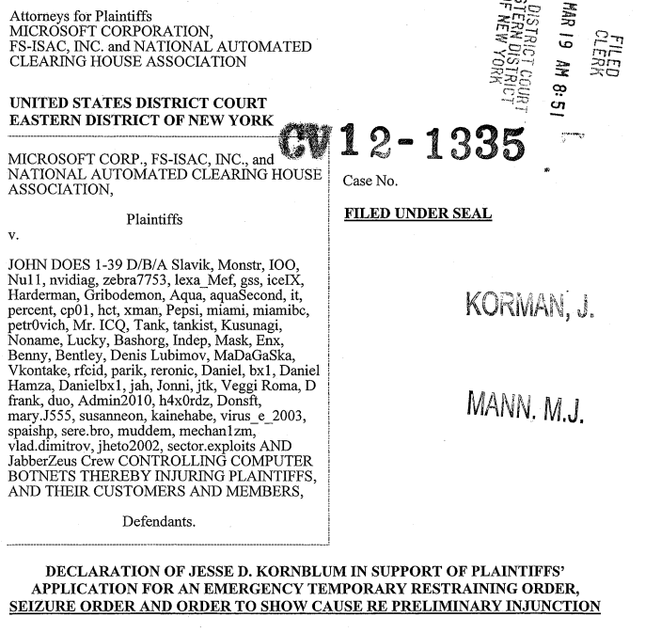
Links Ch 17c, Ch 17d

Slide 61
Expert Reports
Strict requirements; must state:
Who retained you
Your educational background
Any training you have received
Any certifications you hold
What experience you have
What other cases you've testified in as an expert witness
What you are paid for your work as an expert witness
What you have reviewed in forming your opinion

Slide 62
Creating Exhibits
Exhibits are supporting documents included with your report
An alternative to trying to embed spreadsheets, images, or other artifacts within the report
Exhibits can be printed out or stored on a CD, DVD, or other storage device and provided with the report
May be included in report in PDF or TIFF format, or saved as a separate file in its native format

Slide 63
Working with Forensic Artifacts
If exhibit is self-explanatory, it can be presented alone
Otherwise, include a description within the exhibit itself
Don't leave room for misunderstanding of the exhibit
That can be used against you

