Slide 1
CNIT 124: Advanced Ethical Hacking
Ch 13: Post Exploitation
Part 1

Slide 2
Topics
Meterpreter and Scripts
Metasploit Post-Exploitation Modules
Railgun
Local Privilege Escalation
Local Information Gathering
Lateral Movement
Pivoting
Persistence

Slide 3
Meterpreter and Scripts

Slide 4
Help
help at meterpreter prompt
Shows all meterpreter commands
command –h
Help about a specific command
help command
Help about a specific command

Slide 5
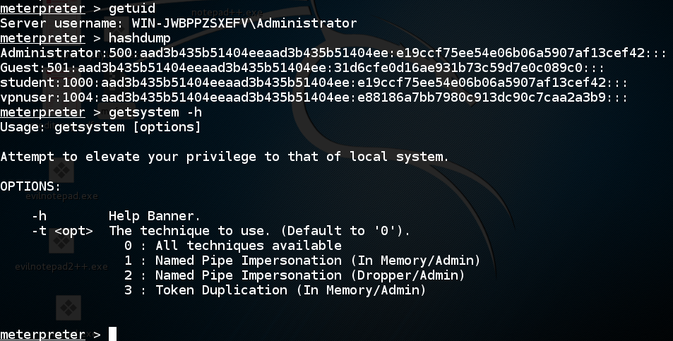

Slide 6
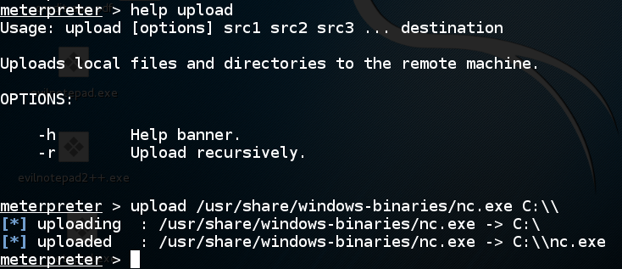
Upload
Must use two backslashes to symbolize one
"Escaping" in Linux

Slide 7
Windows Binaries in Kali 2

Slide 8
Project 15: RAM Scraping

Slide 9
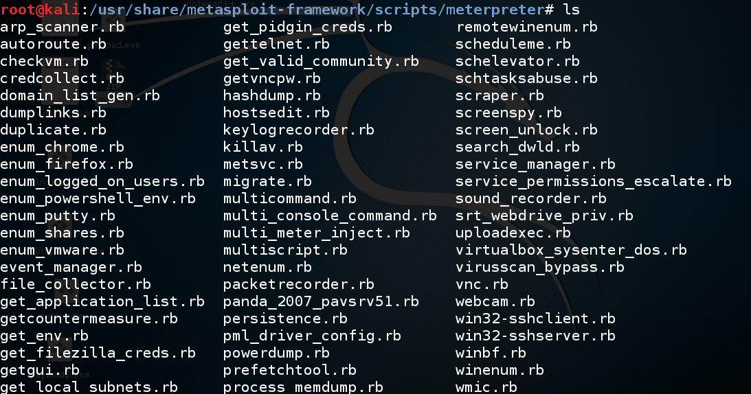
Meterpreter Scripts

Slide 10
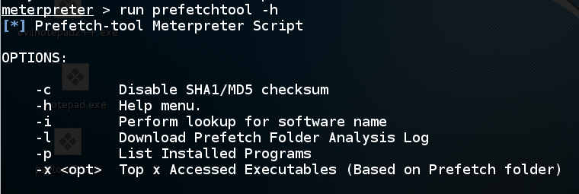
Getting Help
run script -h

Slide 11
Metasploit Post-Exploitation Modules

Slide 12
Controlling Metasploit Sessions
sessions
lists sessions
sessions -i 1
Starts interaction with session 1
background
preserves a session, returns to the msf> prompt
exit
closes a Meterpreter session

Slide 13
Post-Exploitation Modules

Slide 14
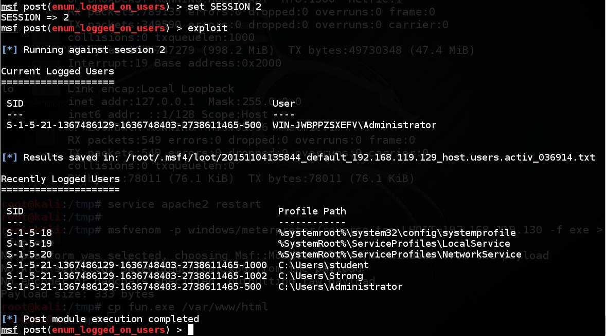
"Strong" Account Used in 2013

Slide 15
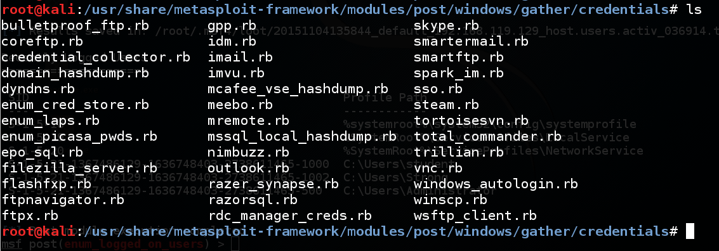
Gathering Credentials

Slide 16
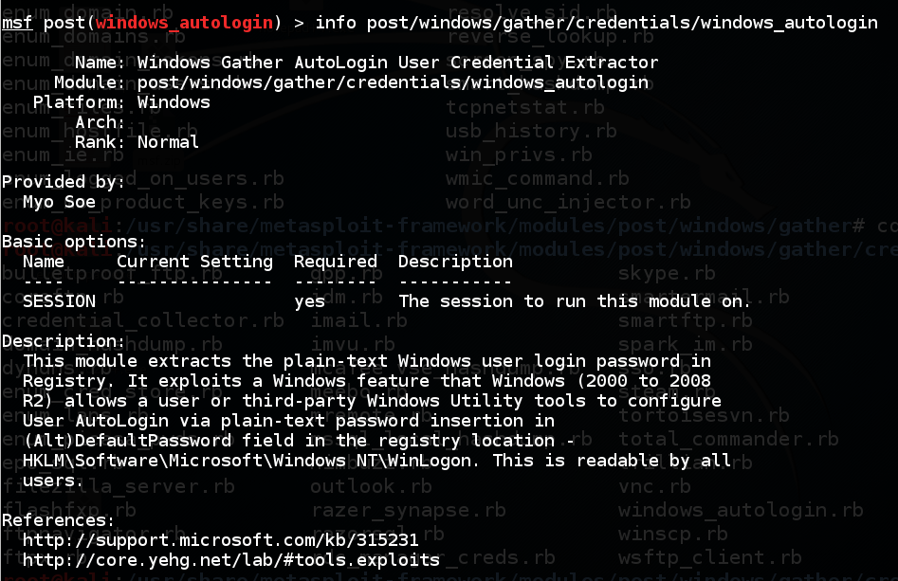
Autologon Password

Slide 17
Not On By Default

Slide 18
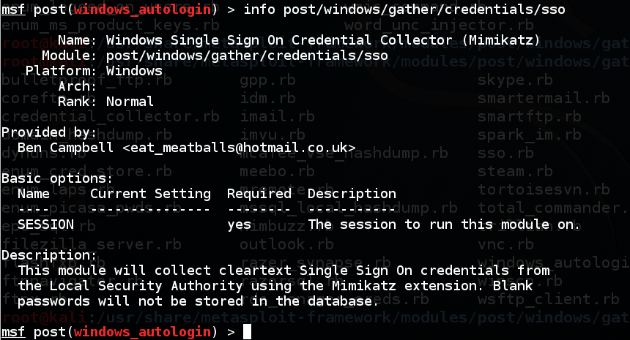
sso (MimiKatz)

Slide 19
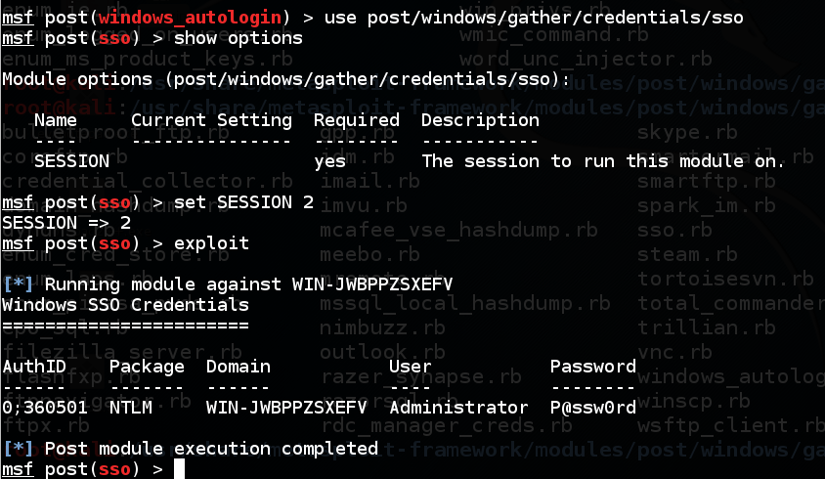
On By Default ☺

Slide 20
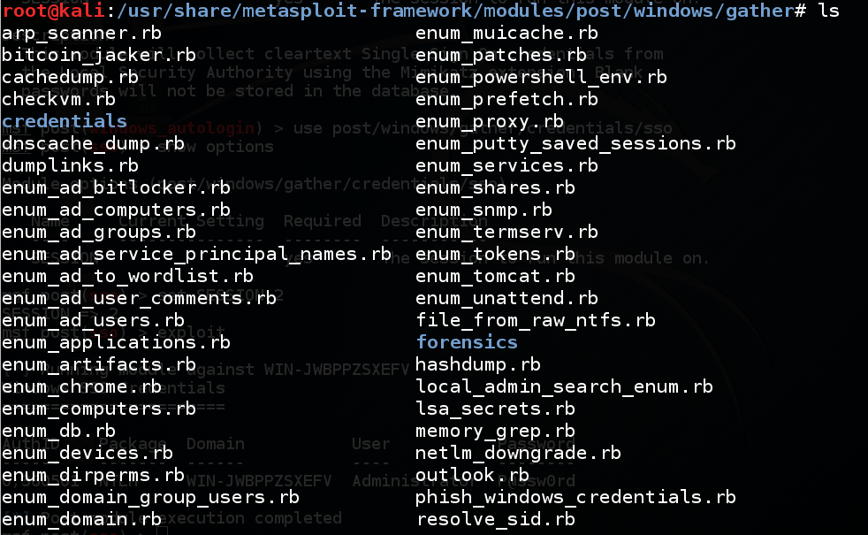
Gather Modules

Slide 21
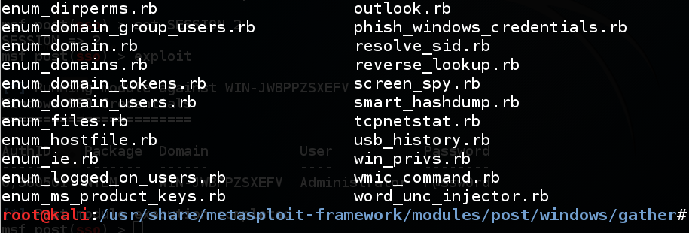
More Gather Modules

Slide 22
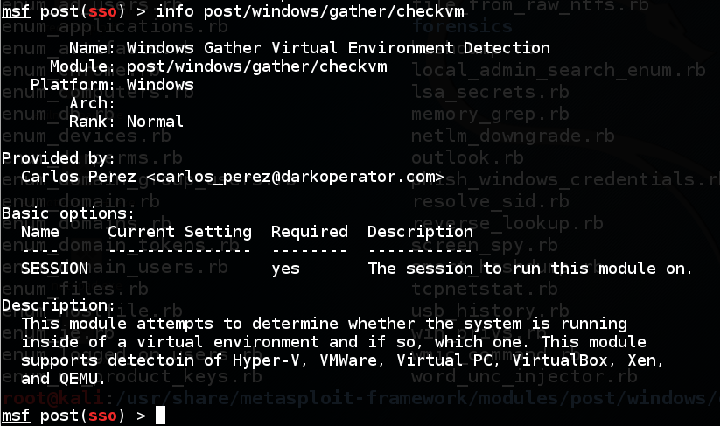
CheckVM

Slide 23
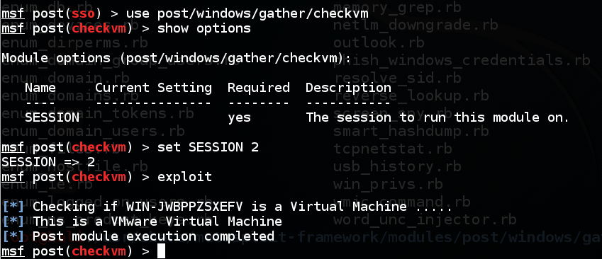
It Works!

Slide 24
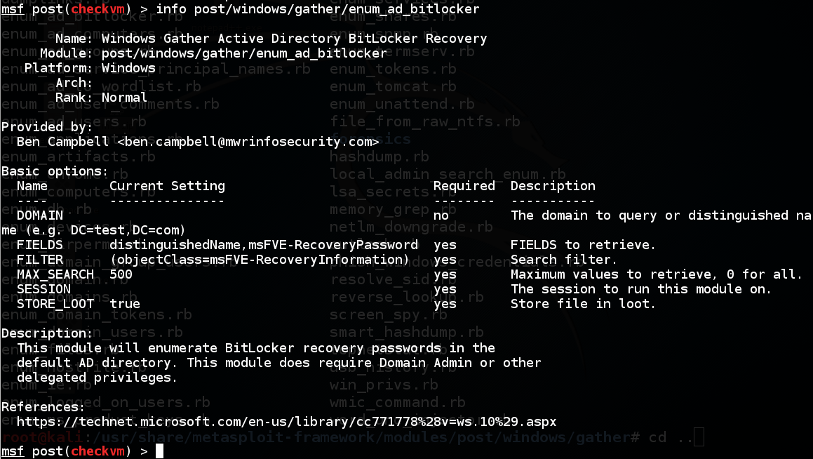
BitLocker Recovery Passwords

Slide 25
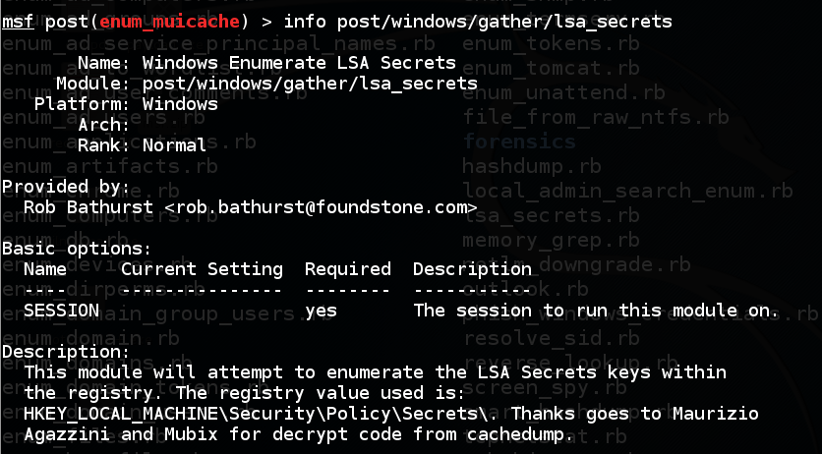
LSA Secrets!

Slide 26
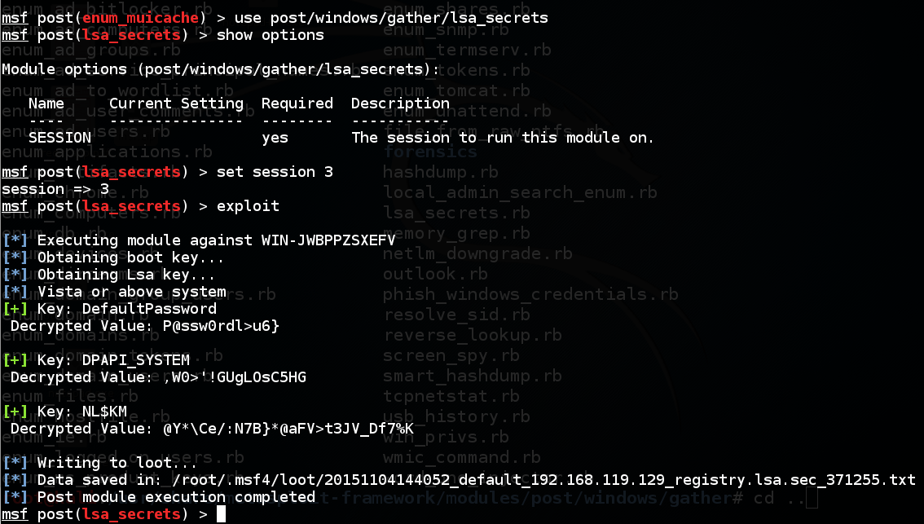
Works on Server 2008!

Slide 27
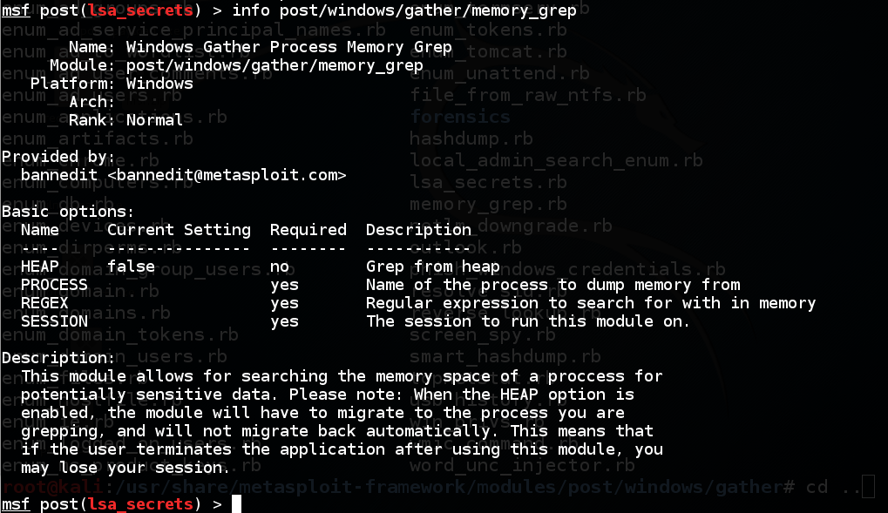
memory_grep

Slide 28
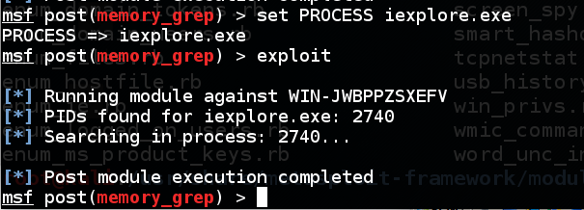
Looks Good But Fails

Slide 29
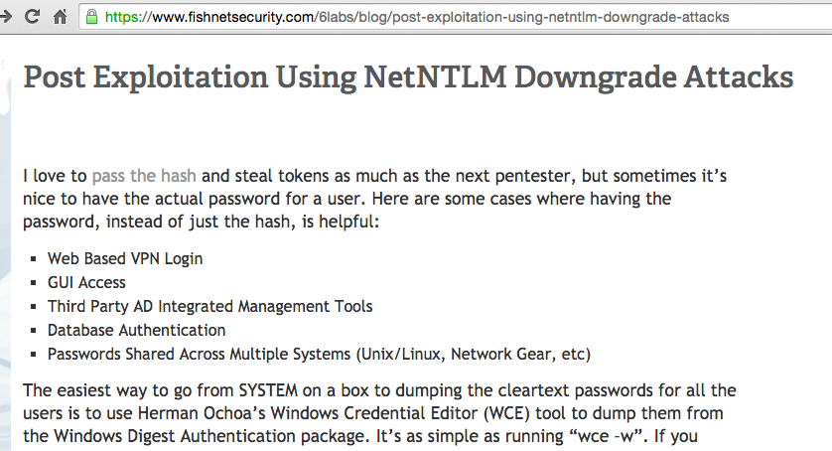
An alternative to using MimiKatz
Metasploit SMB Listener (Link Ch 13b)

Slide 30
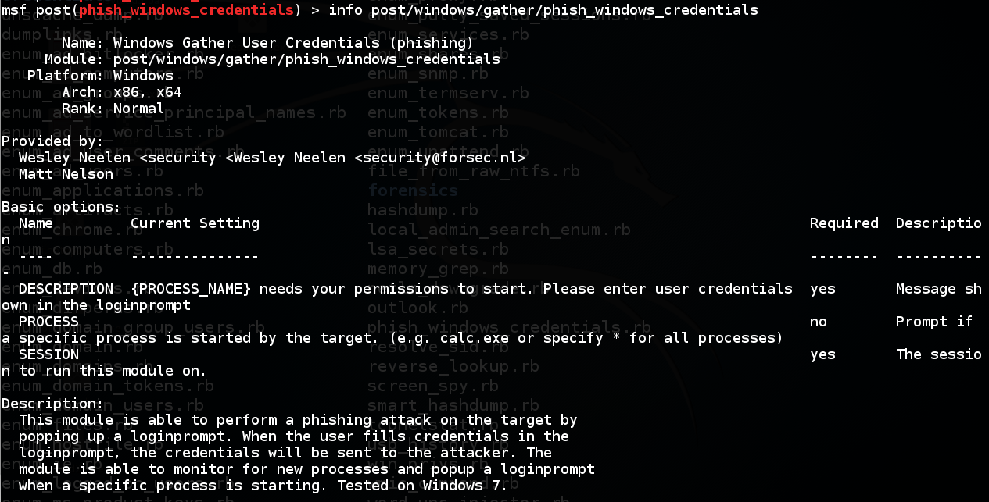
Phishing

Slide 31
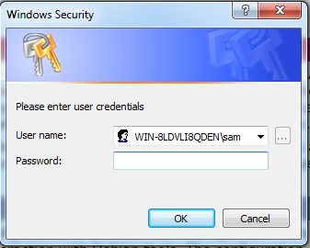
Fails on Win 7 and 2008
Won't run at all on Win 2008
On Win 7, this box pops up all the time but the password never appears in Metasploit
Must restart Windows to make it stop

Slide 32
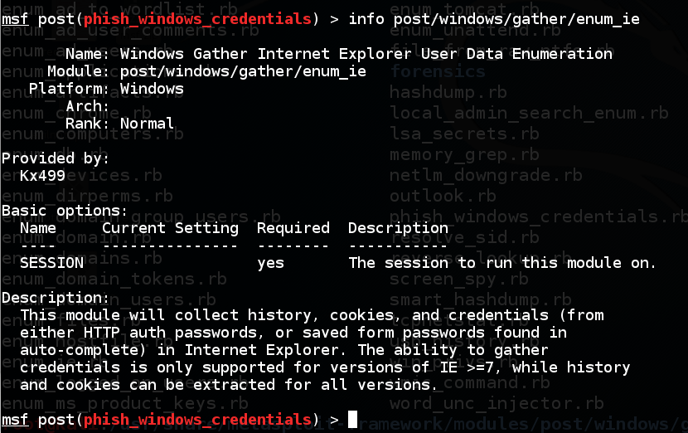
enum_ie

Slide 33
Fails
Gets no passwords or cookies from Win 7 or Win 2008
Does get some Web history links from IE 7 on Win 2008

Slide 34
Prefetch Folder
Has the last 128 programs launched
With dates and user ID
Used by Windows to preload frequently-used applications
Important for forensics

Slide 35
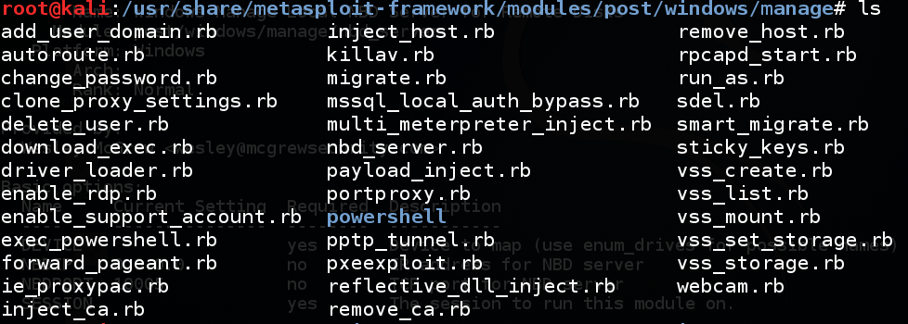
Management Modules

Slide 36
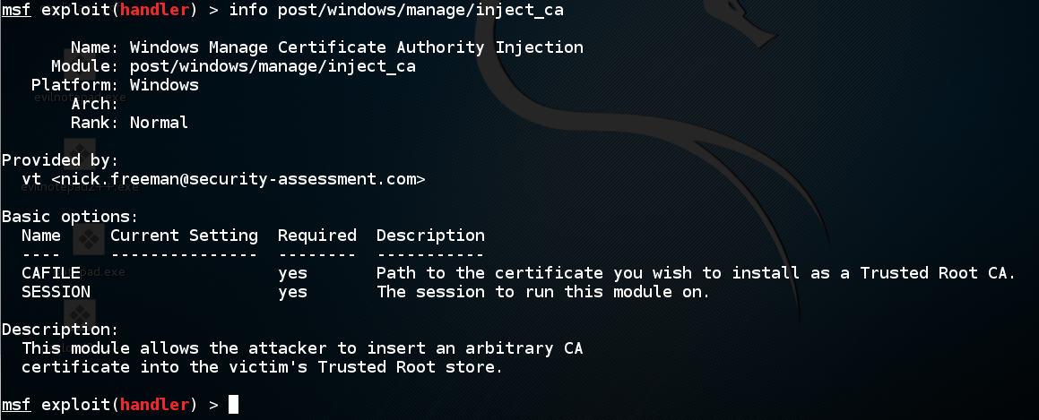
inject_ca
Subverts HTTPS ☺

Slide 37
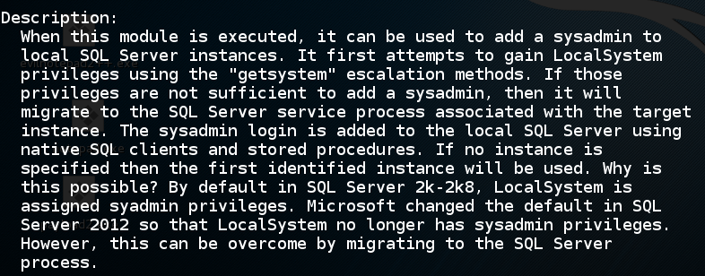
MS SQL Auth Bypass

Slide 38
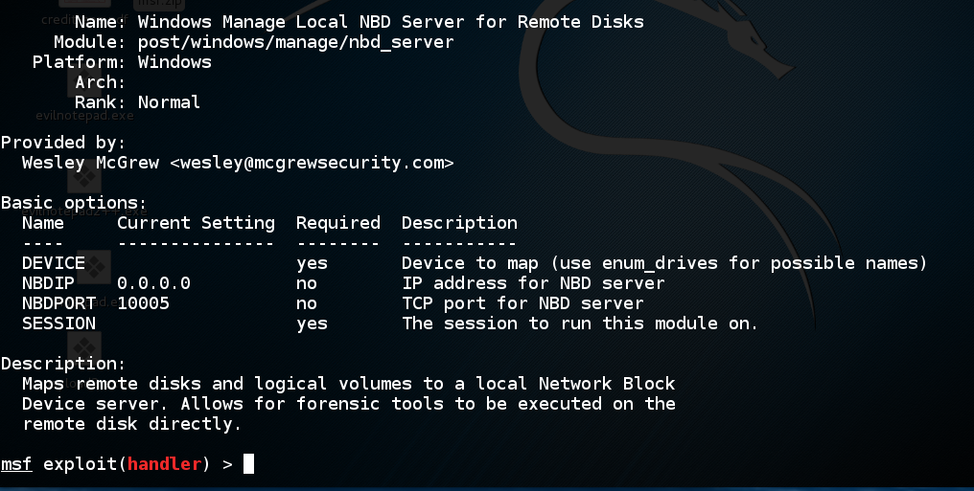
Forensic Image of Target
Harvest deleted files

Slide 39
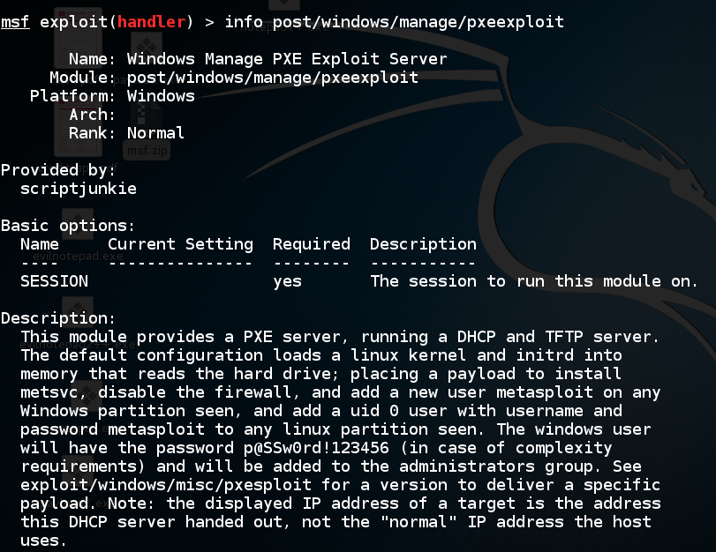
Exploit PXE Pre-eXecution Boot

Slide 40
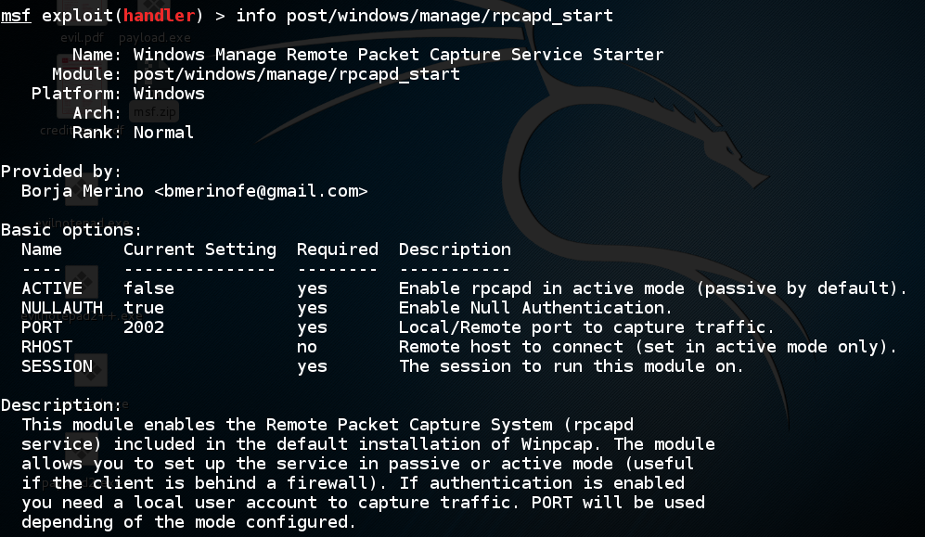
Remote Packet Capture

Slide 41
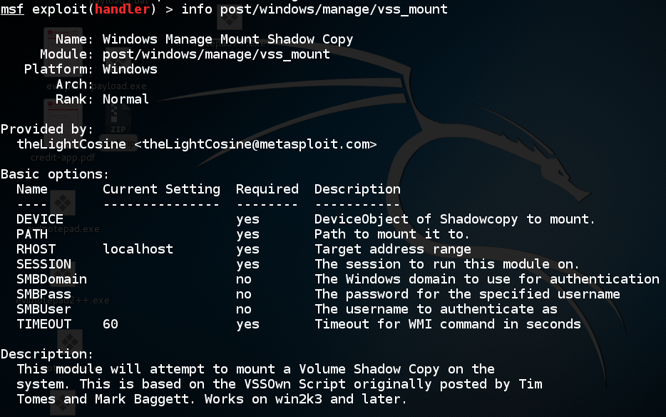
Look in Shadow Copies (Restore Points)

Slide 42
Find Open Outgoing Ports

Slide 43
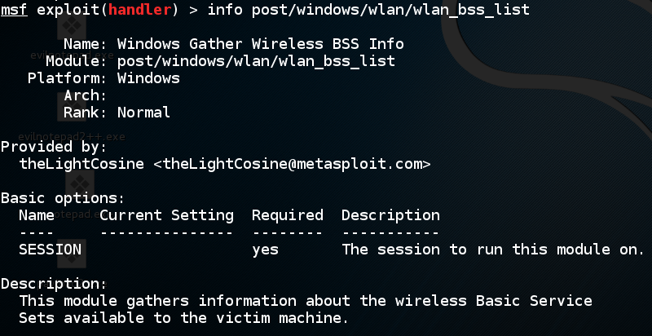
Find Wireless Networks

Slide 44
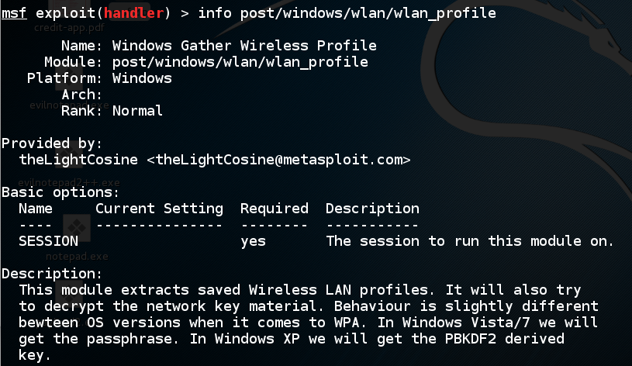
Steal WPA Keys

Slide 45
Railgun

Slide 46
Allows Direct Access to Windows APIs
API: Application Program Interface

Slide 47
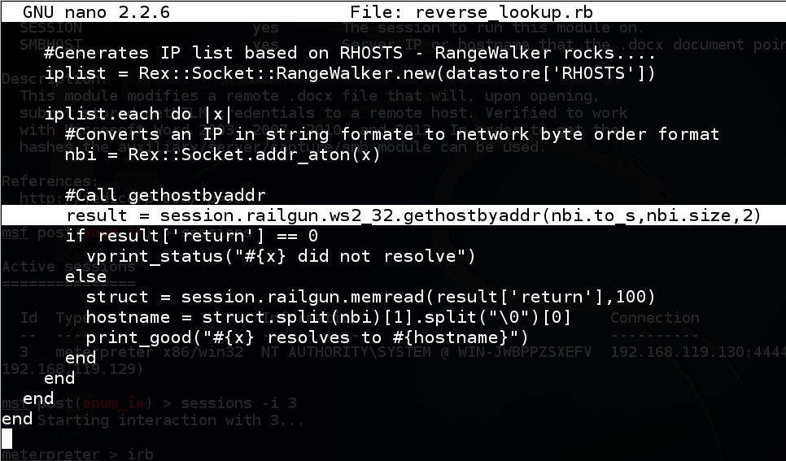
reverse_lookup uses Railgun

Slide 48
Local Privilege Escalation

Slide 49
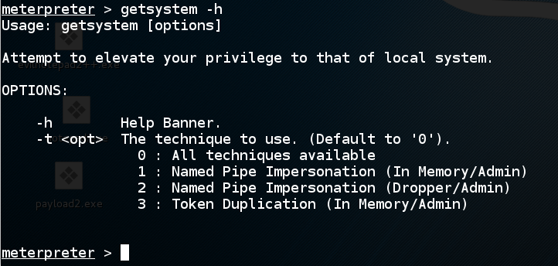
getsystem
Tries to elevate to SYSTEM on Windows

Slide 50
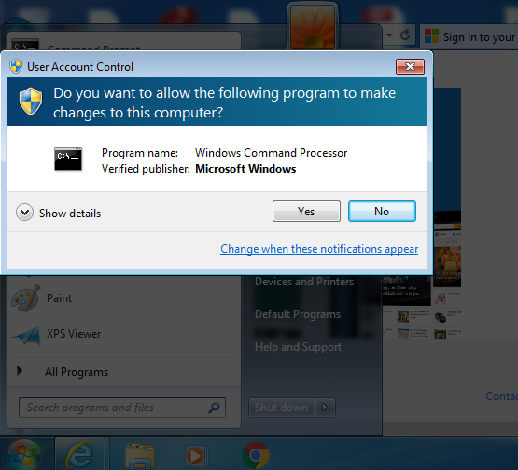
User Account Control (UAC)
Pops up when something needs administrator privileges

Slide 51
UAC Blocks getsystem
On Win 7

Slide 52
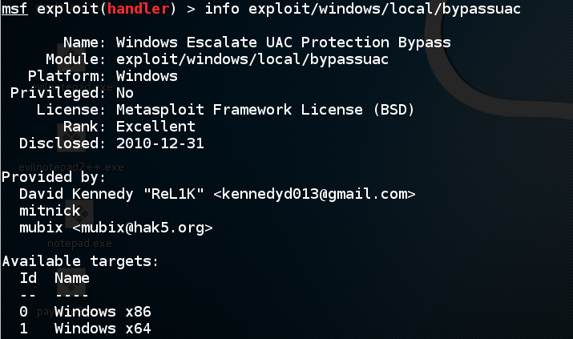
Bypassing UAC

Slide 53
Process Injection

Slide 54
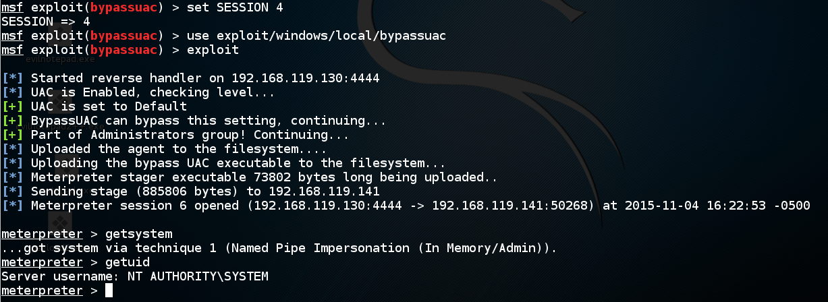
Worked on Win 7!

