Slide 1
CNIT 125: Honeypot and Malware Presentation
Alan Wennersten
Jeffrey Tom

Slide 2
Overview
What is a Honeypot/Why we chose Honeypot for the project
Dionaea
Configuration
Modern Honeypot Network
Walkthrough/screenshots
Malware
Analyzing captured binaries
IP Addresses

Slide 3
What is a Honeypot?/Why we chose Honeypots
decoy system set up to capture information about an attacker for analysis and defense.
high interaction- use real operating systems and applications.
low interaction-emulate services and allow limited interaction with attacker and malware.
Why we chose a honeypot:
malware analysis

Slide 4
Dionaea
Successor to the Nepenthes honeypot project.
Developed under the Honeynet Project’s 2009 Summer of Code.
Low interaction honeypot, offering limited services.
Designed to trap malware payloads for analysis
Scientific name for the Venus Flytrap plant.

Slide 5
Dionaea
Python scripting language
LibEmu to detect malware payloads
supports IPv6 and TLS

Slide 6
Dionaea
Protocols offered by Dionaea
Server Message Block (SMB)
Hypertext Transfer Protocol (HTTP)
File Transfer Protocol (FTP)
Trivial File Transfer Protocol (TFTP)
Structured Query Language-(MS SQL and MySQL)
Voice over Internet-Session Initiation Protocol (SIP)

Slide 7
Dionaea
Issues with Dionaea
No longer supported!
Developer’s website is down:
http://dionaea.carnivore.it/
but can be installed from github or other websites
https://github.com/rep/dionaea
NMAP now fingerprints Dionaea

Slide 8
Our Configuration
Amazon AWS EC2 instance
Ubuntu 14.04

Slide 9
Modern Honeypot Network
honeypot management system
free, open source from Threatstream
easily deployed
https://github.com/threatstream/mhn

Slide 10
Modern Honeypot Network
Supported honeypots
Amun
Conpot
Dionaea
ElasticHoney
Glastopf
Kippo
p0f
Shockpot
Snort
Suricata

Slide 11
Modern Honeypot Network
Dashboard
statistical information about previous 24 hours
top 5 IPs
top 5 ports attacked
top 5 honeypots (if multiple honeypots installed)
top 5 sensors
top 5 attack signatures (Snort)

Slide 12
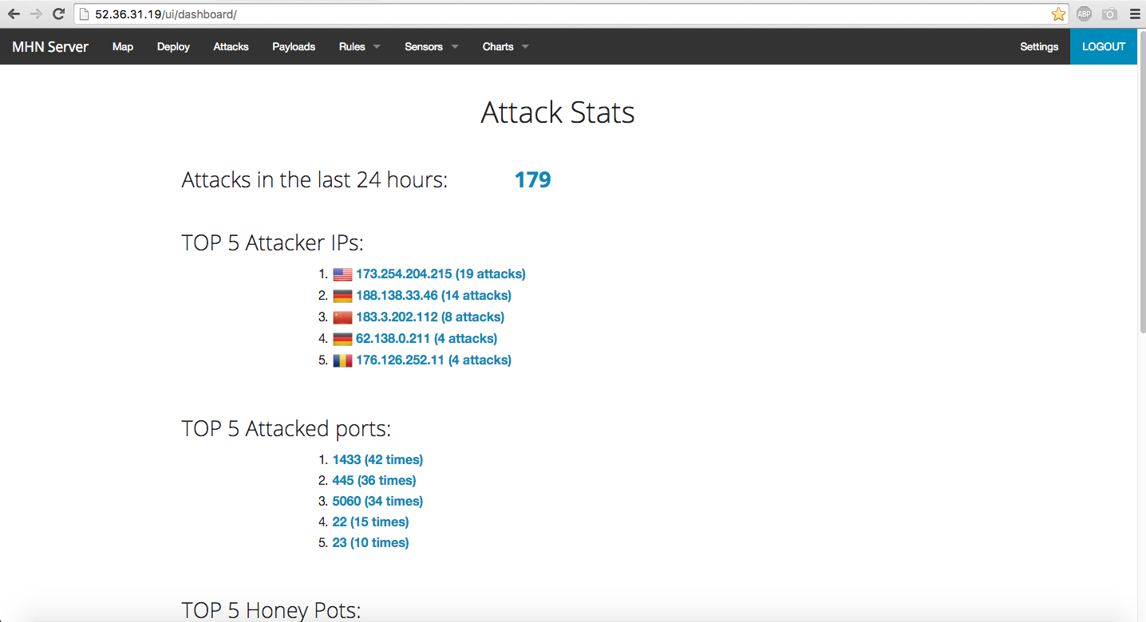
Modern Honeypot Network

Slide 13
Modern Honeypot Network
Attacks Report
lists IP address of attacker, destination port, protocol used and honeypot being attacked

Slide 14
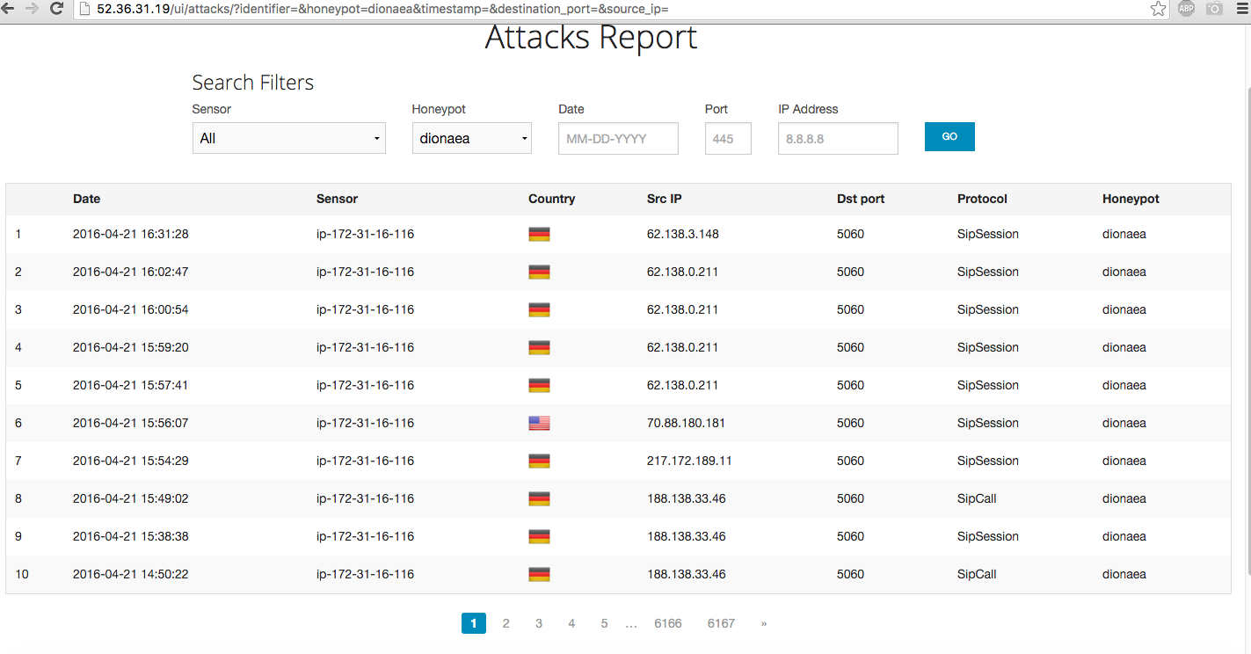
Modern Honeypot Network

Slide 15
Honey Map
Graphical representation of attacks
Uses MaxMind to geolocate IP addresses of attacking servers.
honeymap

Slide 16
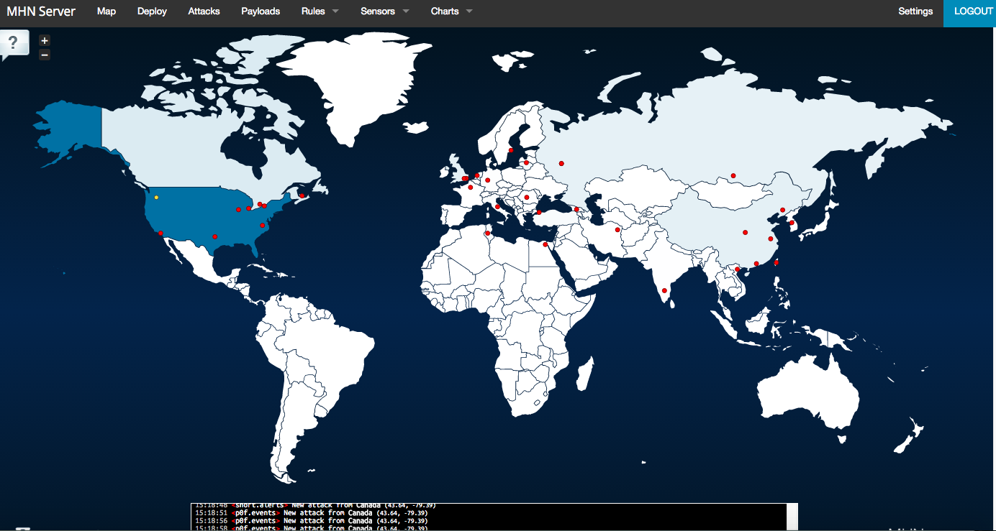
Honeymap

Slide 17
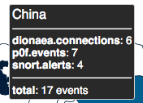
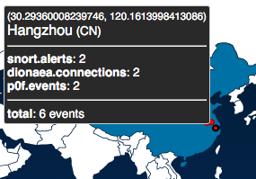
Honeymap
additional information by mousing over attack indicator or country.

Slide 18
Payloads Report
Shows payloads delivered to honeypot.
Could be malware (Dionaea) or intrusion (Snort)
Shows sending IP, destination IP, sending port, destination port, malware hash or signature

Slide 19
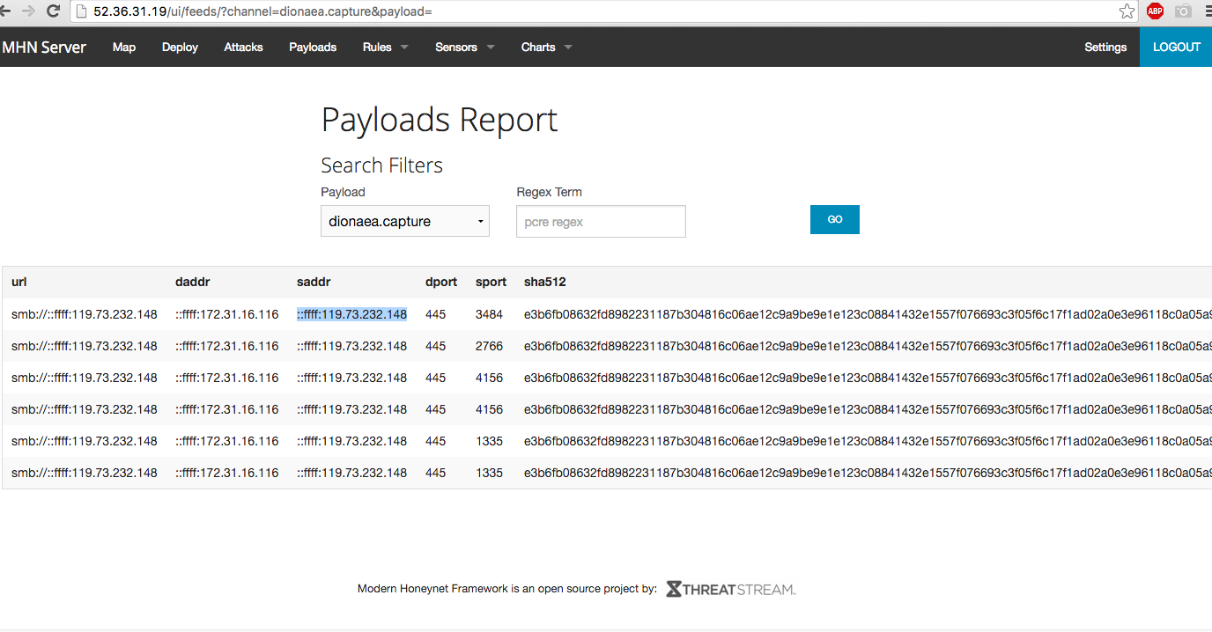
Payloads Report

Slide 20
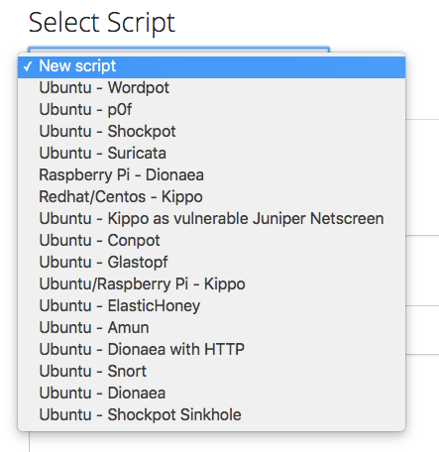
Adding Additional Honeypots to MHN
Very easy to implement through the Deployments page.
Add from pre-populated list or script your own honeypots.

Slide 21
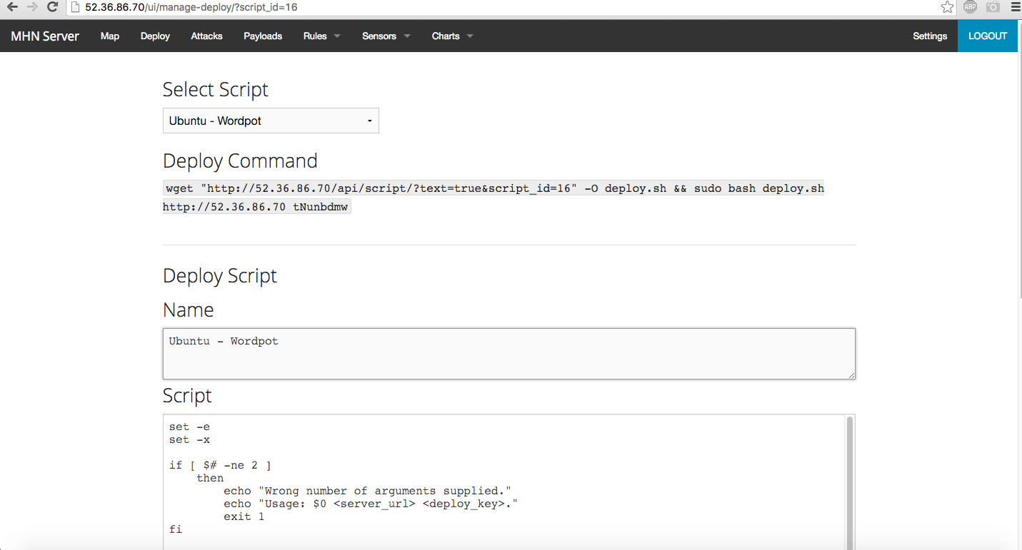
Adding Additional Honeypots to MHN

Slide 22
Analyzing data collected by the Dionaea honeypot

Slide 23
We have 154,174 events
in our honeypot.
Now what?

Slide 24
Threat Intelligence
Better understanding of attackers (threat actors): identity, motivations, capabilities
In principle, helps defenders mitigate active attacks and prevent future attacks
Actual value of TI is debatable (Norse Security, RIP)

Slide 25
Anazlyzing Captured Binaries

Slide 26
REMnux
REMnux (Reverse-Engineering Malware) Linux distro
Created & maintained by Lenny Zeltser
Ubuntu base
Collection of malware analysis tools

Slide 27
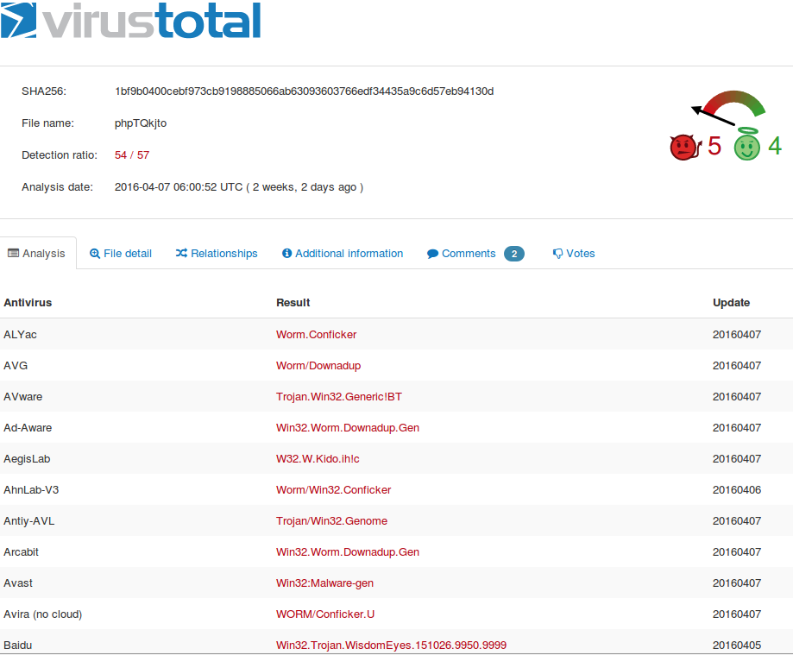
VirusTotal
Good, but manual file uploading is tedious

Slide 28
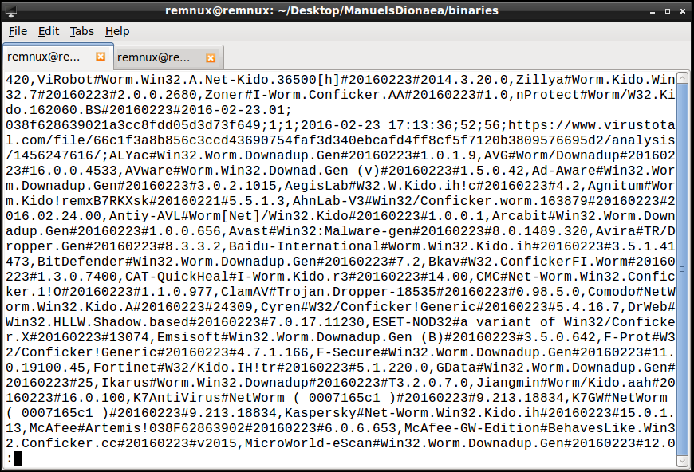
virustotal-search.py
By Didier Stevens
Uses VirusTotal public API to search binary hashes

Slide 29
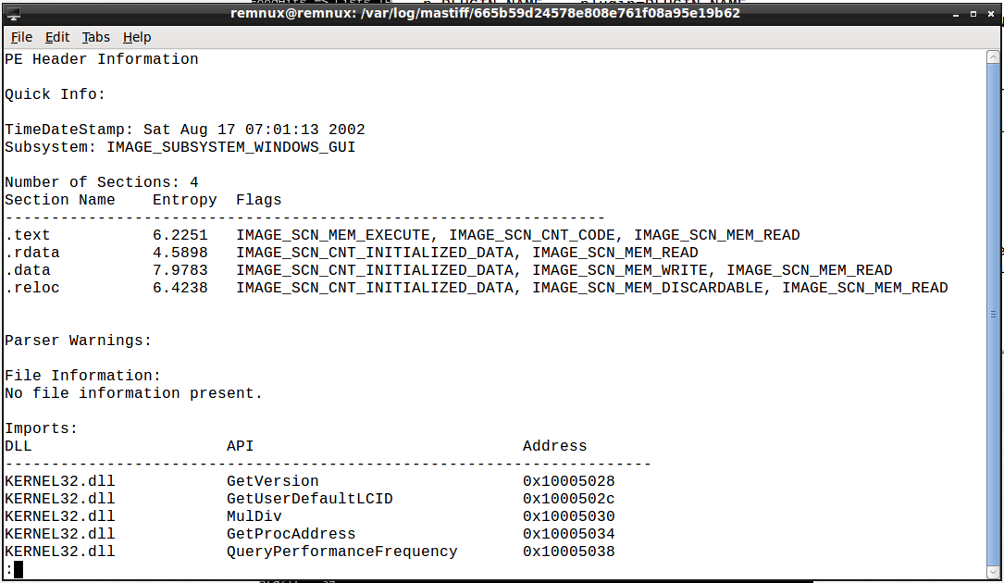
MASTIFF
Comprehensive static analysis and data extraction

Slide 30
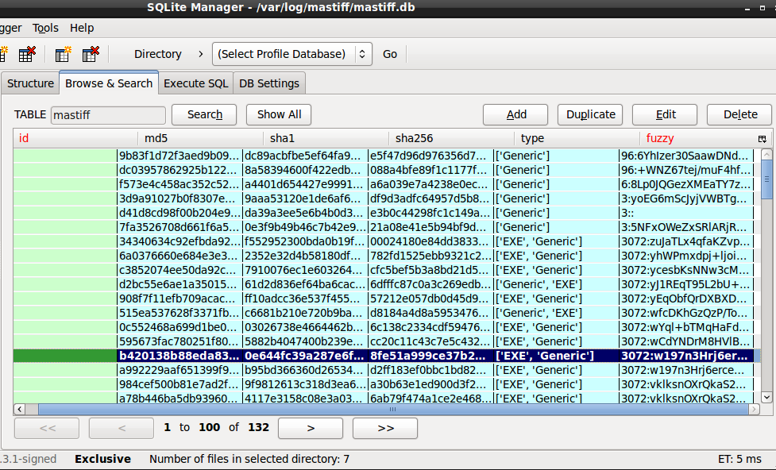
MASTIFF
MASTIFF outputs SQLite file

Slide 31
Fuzzy Hashing
Compensates for polymorphic malware code
Uses spamsum, a locality-sensitive hashing algorithm
We can use it to determine that nearly all of the selected binaries are Conficker variants

Slide 32
IP Addresses

Slide 33
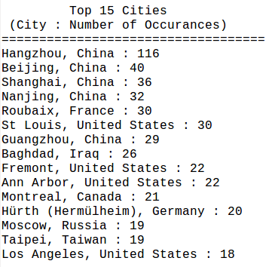
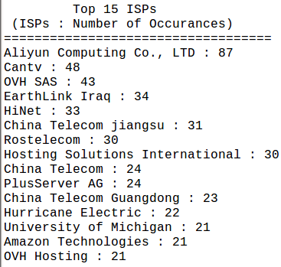
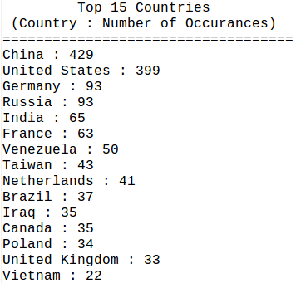
Just-Metadata
OS intel gathering and IP metadata tool
Includes Shodan, threat feeds, VirusTotal, IP Whois

Slide 34
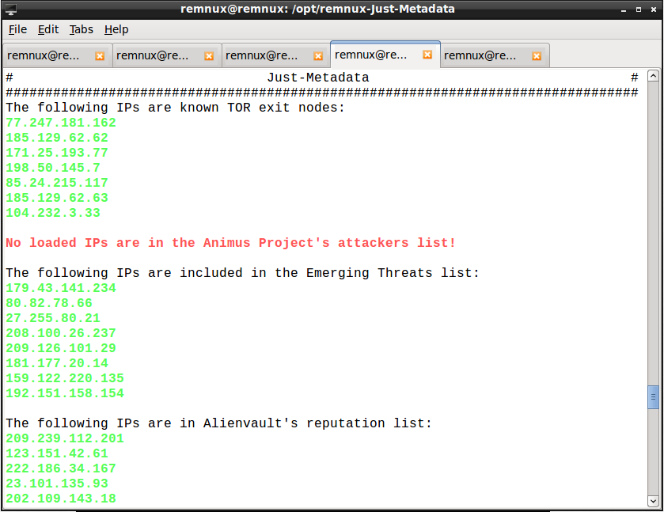
Just-Metadata
Threat stream data

Slide 35
Honeypot IP Adress
52.38.132.134

Slide 36
Questions

