Slide 1
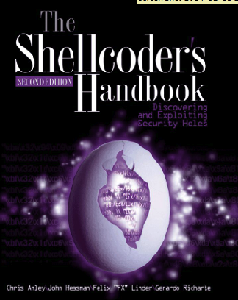
CNIT 127: Exploit Development Ch 6: The Wild World of Windows

Slide 2
Topics
Win32 API, DLLs, and PE Files
Heaps
Threading
DCOM
Exception Handling
Debuggers

Slide 3
Win32 API, DLLs, and PE Files

Slide 4
Windows API (Application Programming Interface)
In Linux, a programmer can talk directly to the kernel with open() or write() syscalls
But in Windows the kernel is only accessible through the Windows API
Contains many functions, such as CreateWindowEx
See link Ch 6a

Slide 5
DLLs (Dynamic Link Libraries)
Pre-compiled library code
Loaded as needed when executable files run
You can see loaded DLLs with Process Explorer
View, Lower Pane View, DLLs
Link Ch 6b

Slide 6
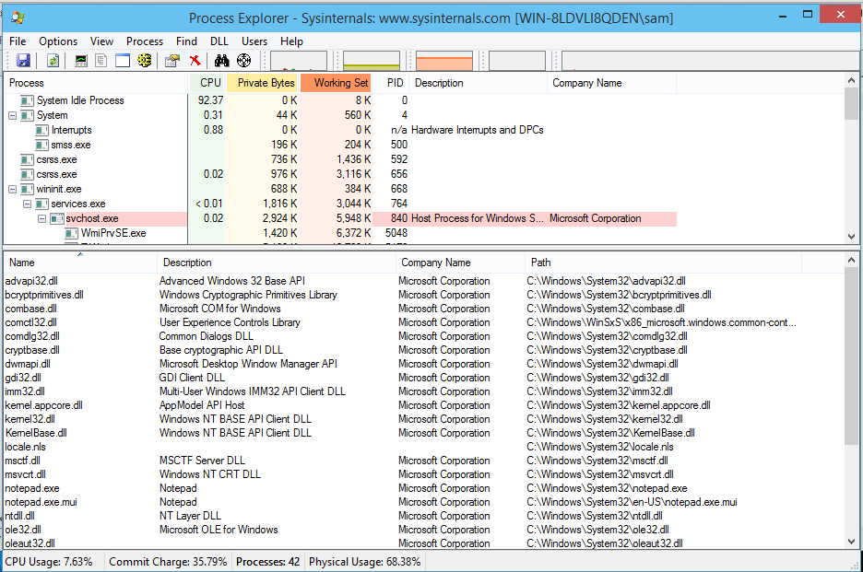

Slide 7
PE (Portable Executable) Files
Format used for .EXE and .DLL files
And some other extensions (link Ch 6c)
Can be loaded on every 32-bit Windows version
Contains information about all required DLLs
Easy to see with PEView (link Ch 6d)

Slide 8
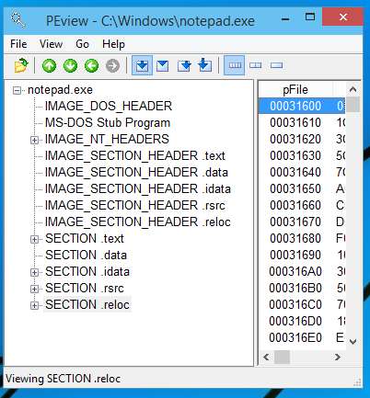

Slide 9
Sections of a PE File
.text – instructions to execute
.data – global variables
.idata – Import descriptors
.rsrc – Resources (icons, etc.)
.reloc – Relocation data

Slide 10
Relocating PE Files
DLLs have a Base Address
This is where they are designed to load
But two DLLs might have the same Base Address
And both be used by the same EXE
One of them must be moved "Rebased"
This process uses the .reloc section

Slide 11
Imports and Exports
Imports
Functions the program needs to use from other code (usually DLLs)
Exports
Functions this program offers for others to use (usually EXEs)

Slide 12
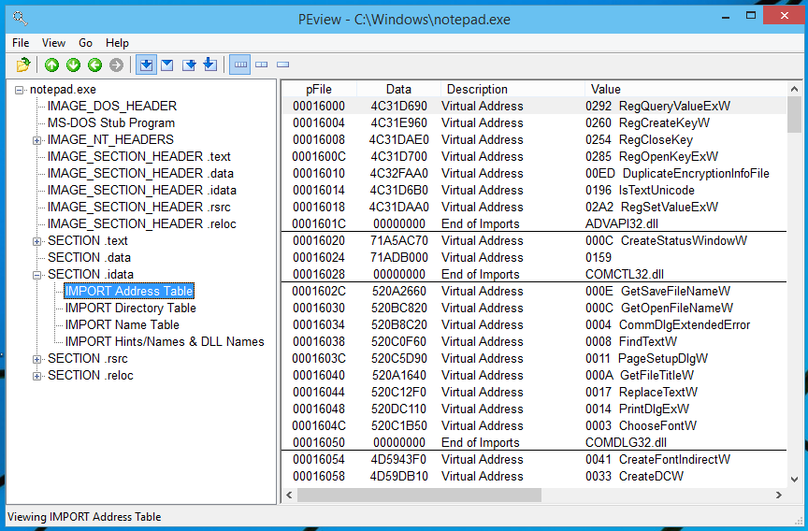
Notepad.exe Imports

Slide 13
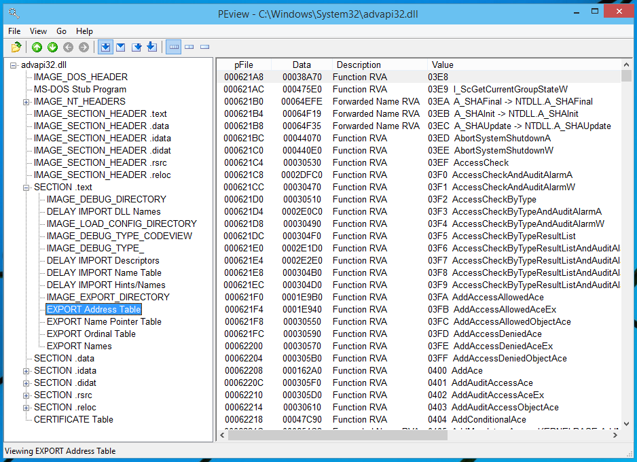
Advapi32.dll Exports

Slide 14
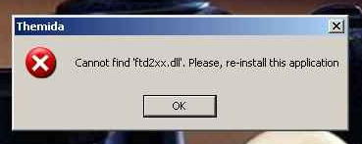
DLL Loading
When an EXE launches, Windows hunts for the required DLLs
Looking first in the current working directory
This allows a developer to include a DLL version other than the one in C:\Windows\System32
Leads to DLL Hell; users may need to adjust PATH to resolve DLL version conflicts

Slide 15
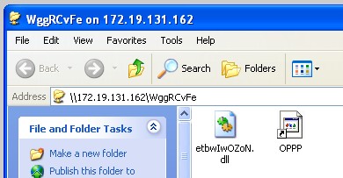
Stuxnet: LNK 0day
Loaded a DLL from a USB thumbdrive
Took over the machine as soon as the icons appear
Link Ch 6h

Slide 16
Relative Virtual Address (RVA)
Windows EXE processes are loaded into 0x00400000 by default
This is a Virtual Address, only visible to each process
RVA is used to aid in rebasing DLLs
Loading them in non-preferred locations

Slide 17
Example of VA
Link Ch 6g

Slide 18
Heaps

Slide 19
Many Heaps
Heap is used for temporary storage of data
Via malloc() and free()
Linux uses one heap, but Windows uses many heaps
Each DLL that loads can set up its own heap
Heap corruption attacks are very confusing

Slide 20
Threading

Slide 21
One Process, Many Threads
Each process is subdivided into threads
Processor time slices are allocated to threads, not processes
This allows a single process to operate more efficiently
If one thread is waiting for something, other threads can keep moving

Slide 22
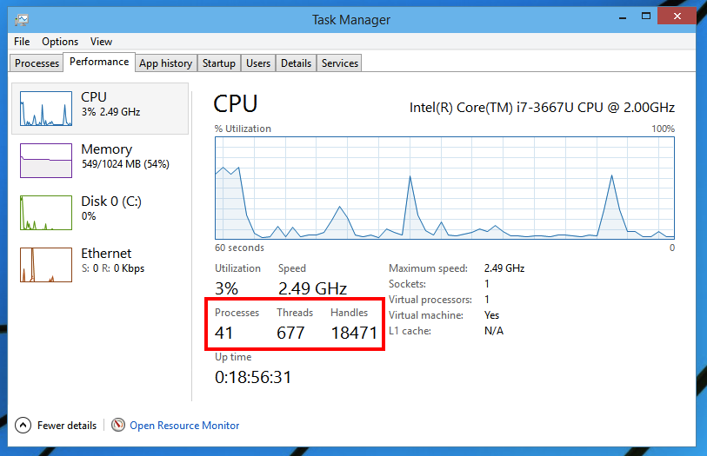
Threads in Task Manager

Slide 23
Handles
Handles are pointers to objects like open files
Each thread has many handles
You can view details about every thread with Process Explorer

Slide 24
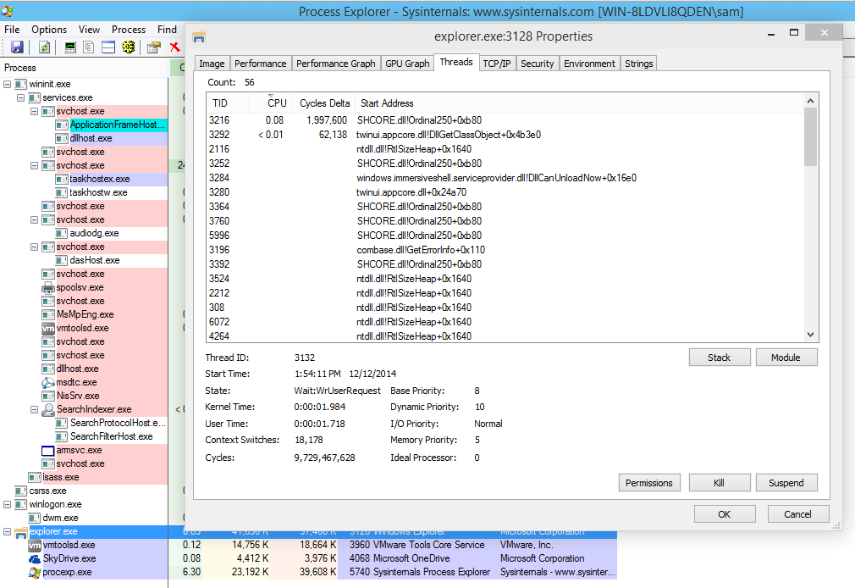

Slide 25
The Genius and Idiocy of the DCOM (Distributed Common Object Model) and DCE-RPC (Distributed Computing Environment / Remote Procedure Calls)

Slide 26
Follow the Money
Microsoft's business model is to distribute binary packages for money
You can build a complex application by purchasing third-party COM modules from vendors
And tying them together with Visual Basic

Slide 27
COM Objects
Can be written in any supported language
Interoperate seamlessly
BUT a C++ integer is not the same as a Visual Basic integer
So you need to define the input and outputs with an IDL (Interface Description Language) file

Slide 28
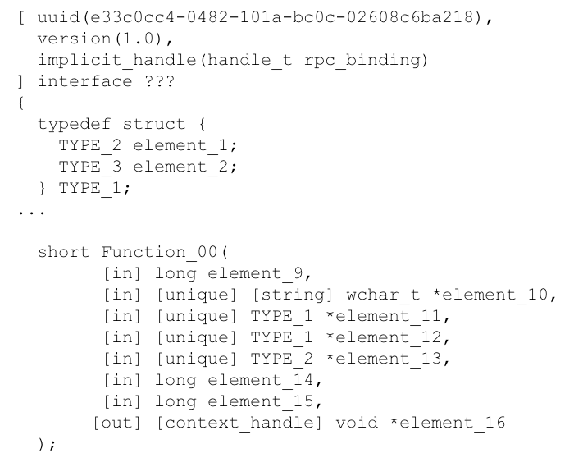
DCOM Interface Description Language (IDL) File

Slide 29
DCOM IDL File
Specifies arguments and return values for a particular function
In a particular interface defined by UUID, also called a GUID
GUID is 128 bits long; 32 hex characters

Slide 30
Two Ways to Load a COM Object
Load directly into process space as a DLL
Launch as a service
By the Service Control Manager (services.exe)
Running as a service is more stable and secure
But much slower
In-process calls are 1000 times faster than calling a COM interface on the same machine but in a different process

Slide 31
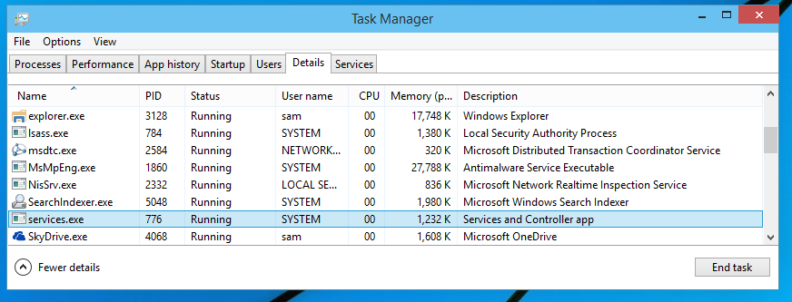
Service Control Manager (SCM)
Appears in Task Manager as services.exe

Slide 32
DCOM Calls
Microsoft's priority: make it easy for developers to write software
A simple registry or parameter change tells a program to use a different process
Or even a different machine
A process can call a COM interface on a different machine on the LAN
10x slower than calling a COM interface on the same machine

Slide 33
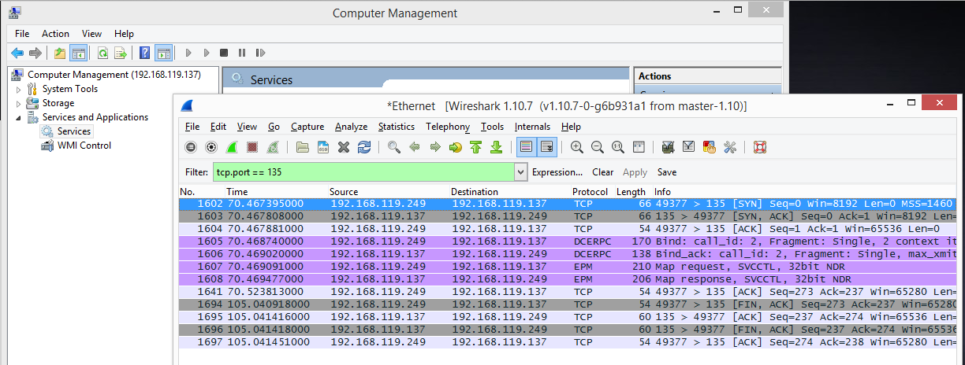
RPC Endpoint Mapper
Listening on port TCP 135

Slide 34
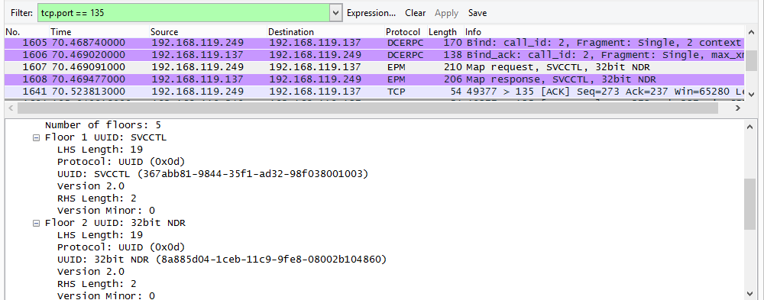
Maps to UUID Values

Slide 35
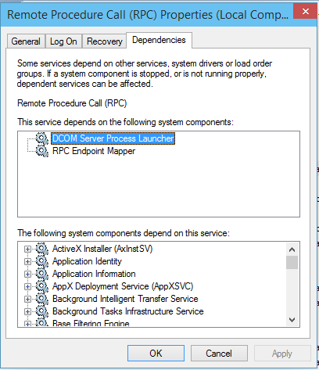
Components that Depend on RPC
Open Services
Double-click "Remote Procedure Call"

Slide 36
Security Implications
Code can be designed to run in a trusted environment
Calling DLLs that are included in your application, or Microsoft DLLs
And easily adapted to run in an untrusted environment
Listening on a network port

Slide 37
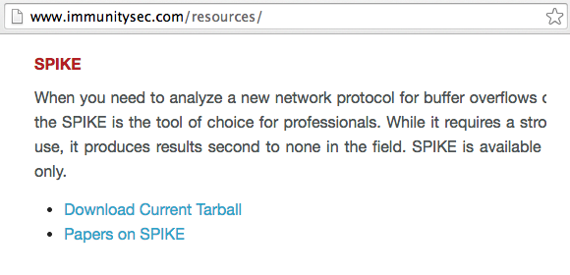
DEC-RPC Exploitation
Recon, fuzz, and exploit with Dave Aitel's SPIKE and other tools

Slide 38
Tokens and Impersonation

Slide 39
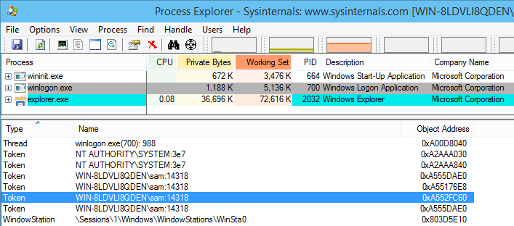
Token
A token is a 32-bit integer like a file handle
Defines user rights

Slide 40
Exploiting Token Handling
Attacker can create threads and copy any available token to them
There are typically tokens available for any user that has recently authenticated

Slide 41
Exception Handling

Slide 42
Structured Exception Handler (SEH)
When an illegal operation occurs, such as
Divide by zero
Attempt to execute non-executable memory
Attempt to use invalid memory location
The processor sends an Exception
The OS can handle it, with an error message or a Blue Screen of Death
But the application can specify custom exception handlers

Slide 43
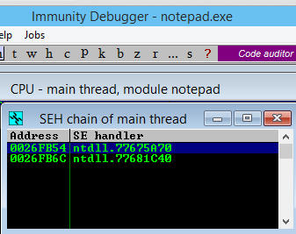
SEH in Immunity Debugger

Slide 44
Exploiting the SEH
Overwrite the pointer to the SEH chain
Overwrite the function pointer for the handler on the stack
Overwrite the default exception handler

Slide 45
Debuggers

Slide 46
Three Options
SoftICE
Old, powerful, difficult to install
WinDbg
Use by Microsoft
Can debug the kernel, using a serial cable
Or Ethernet, for Win 8 or later
UI is terrible
OllyDbg
Very popular but apparently abandoned

Slide 47
OllyDbg
OllyDbg version 1.10 is very nice
OllyDbg 2.x is terrible, giving false results, and useless
No later version seems to be available

Slide 48
Immunity Debugger

Slide 49
Immunity Debugger
Based on OllyDbg
Still alive and under development
Used by many exploit developers

Slide 50
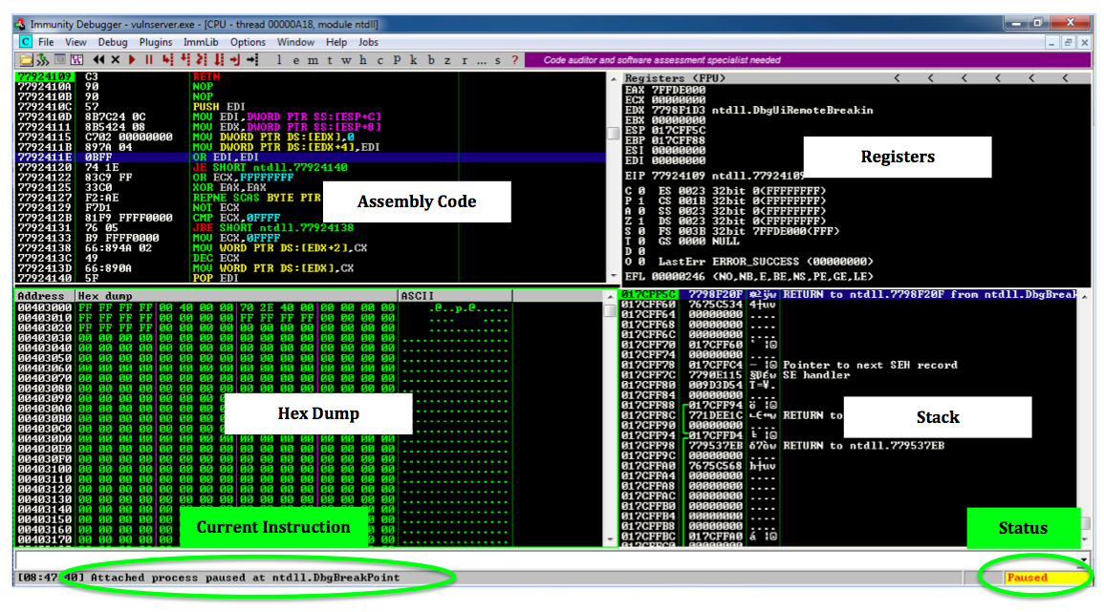
Immunity Debugger

