Slide 1
The Worst Mobile Apps
DEF CON 28

Slide 2
Whoami
Instructor, City College of San Francisco
Founder, Infosec Decoded. Inc.
Trainer at DEF CON, HOPE, Black Hat, etc.
Web: samsclass.info
Twitter: @sambowne

Slide 3
Summary
Mobile app security standards are poor
iOS apps are just as bad as Android apps
APIs are even worse
Where is management?
Require common-sense security!

Slide 4
OWASP Mobile Top Ten

Slide 5
The Worst Apps

Slide 6
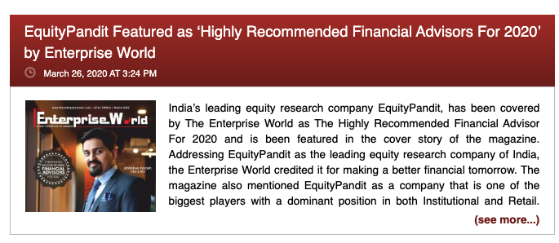
Equity Pandit

Slide 7
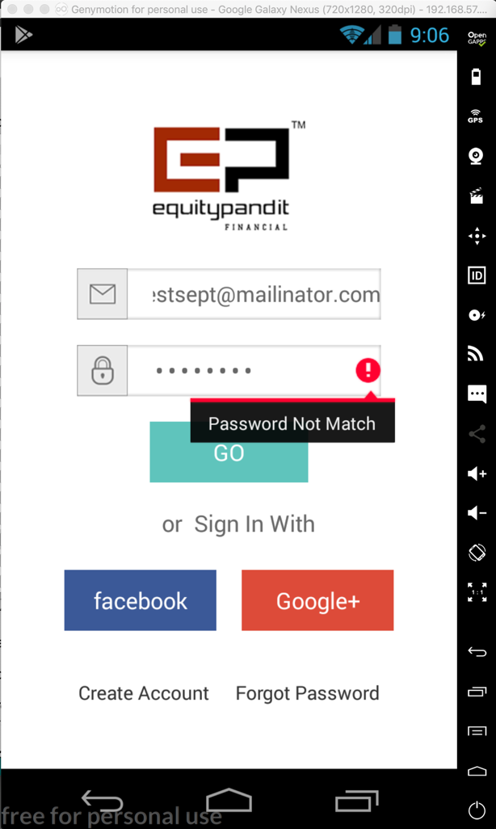
Stores passwords locally
Transmits them in plaintext
Exposes every user's password in the API

Slide 8
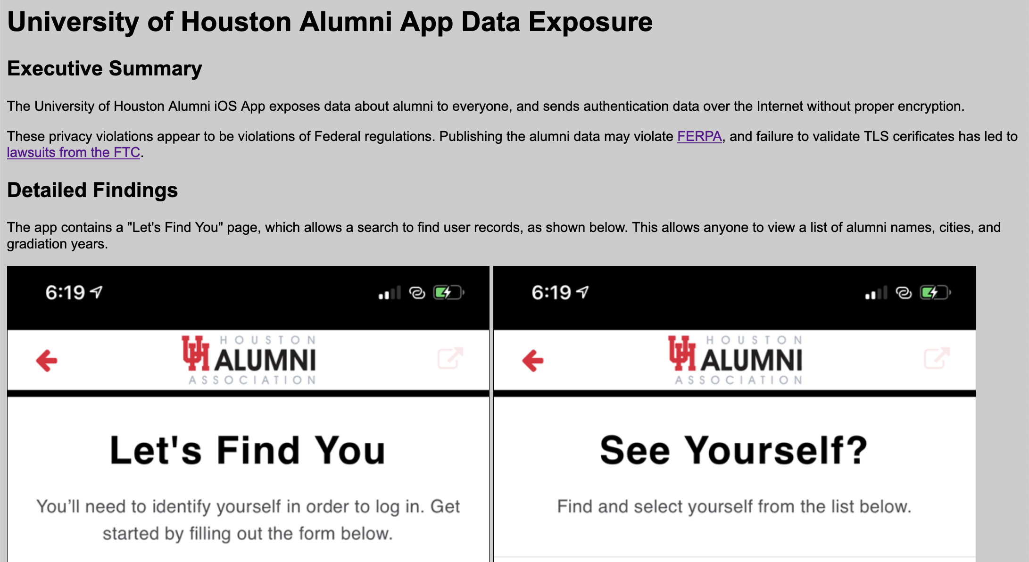

Slide 9
Transmits Entire Database

Slide 10
Android Apps

Slide 11
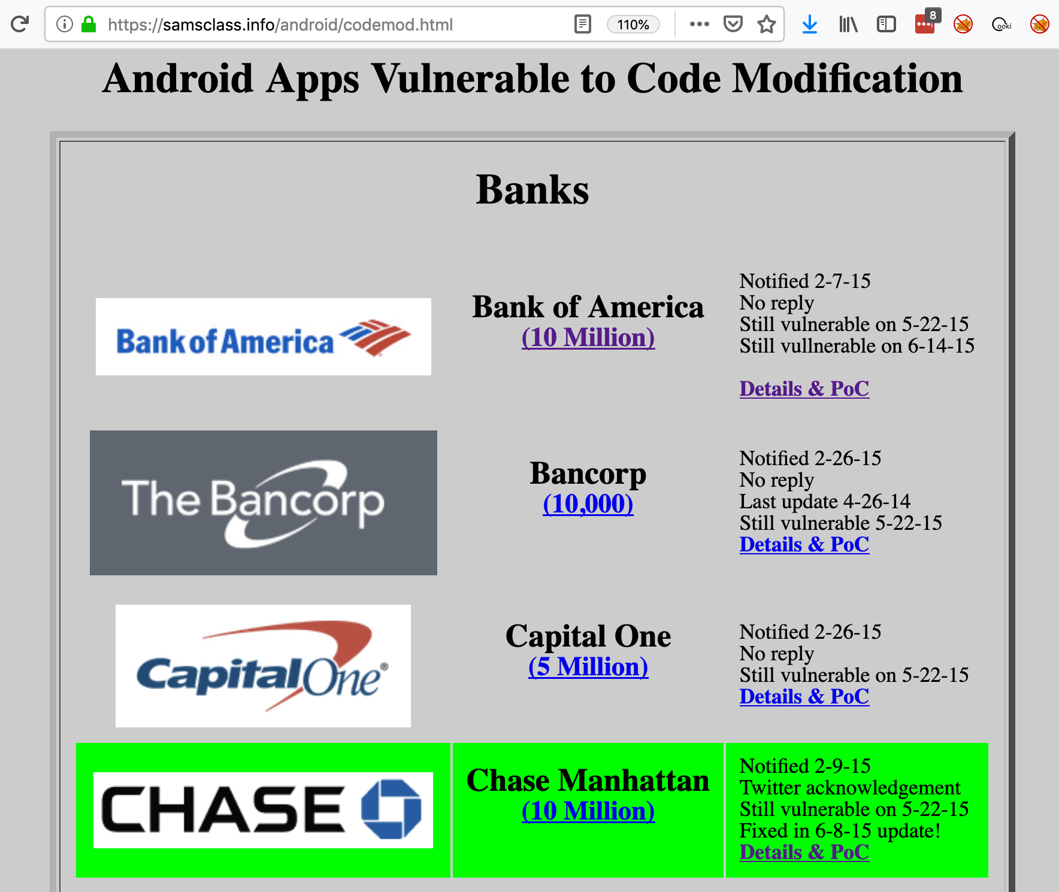

Slide 12
Code Modification
Most Android apps are easy to reverse-engineer and modify
Because their Java code is compiled to Smali

Slide 13
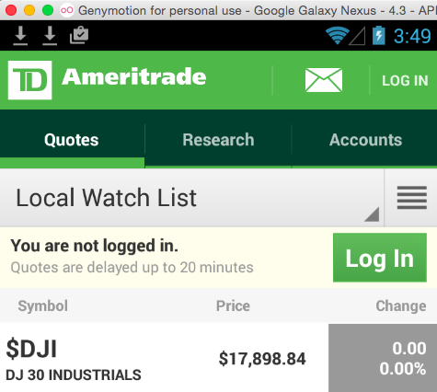
TD Ameritrade App

Slide 14
TD Ameritrade App
Puts password in syslog
Visible to all apps on the device
(Fixed in later versions)

Slide 15
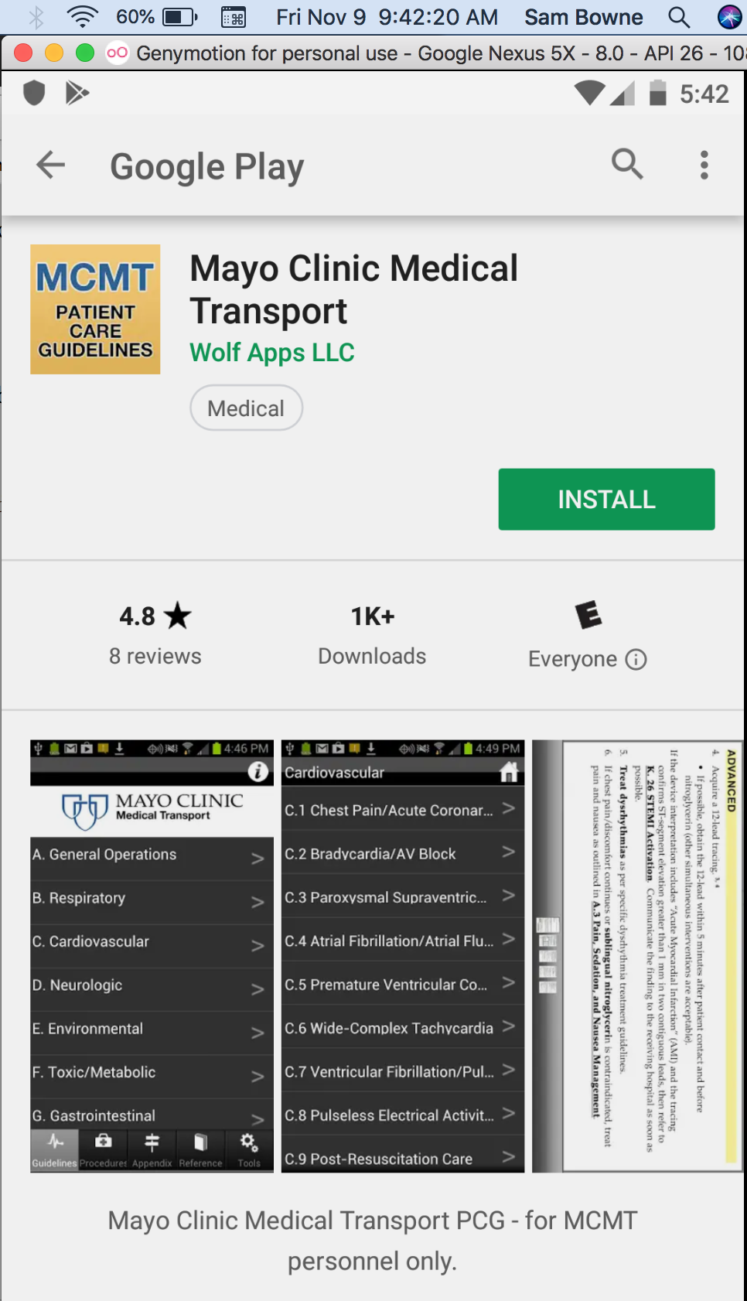
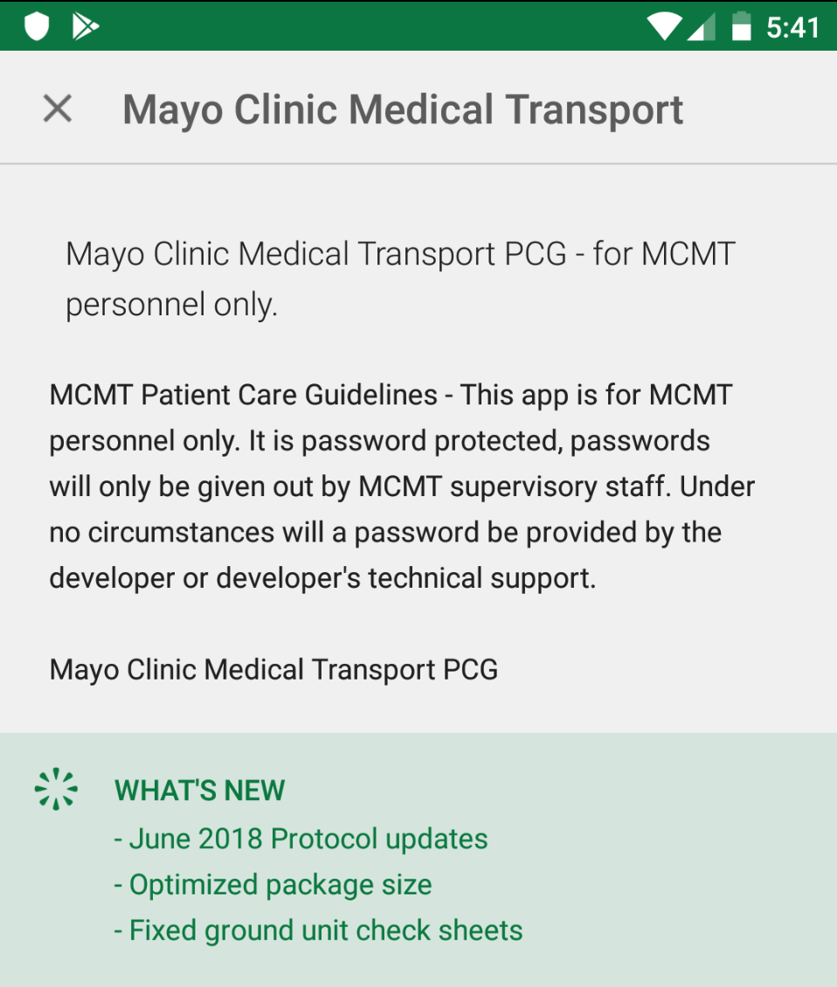
Mayo Clinic
Medical Transport

Slide 16
Mayo Clinic Medical Transport
Pull app from phone with adb
Unpack with apktool

Slide 17
Mayo Clinic Medical Transport
grep for secretpassword
Disclosure
I notified the developer about this in June of 2015. He told me to get lost.

Slide 18
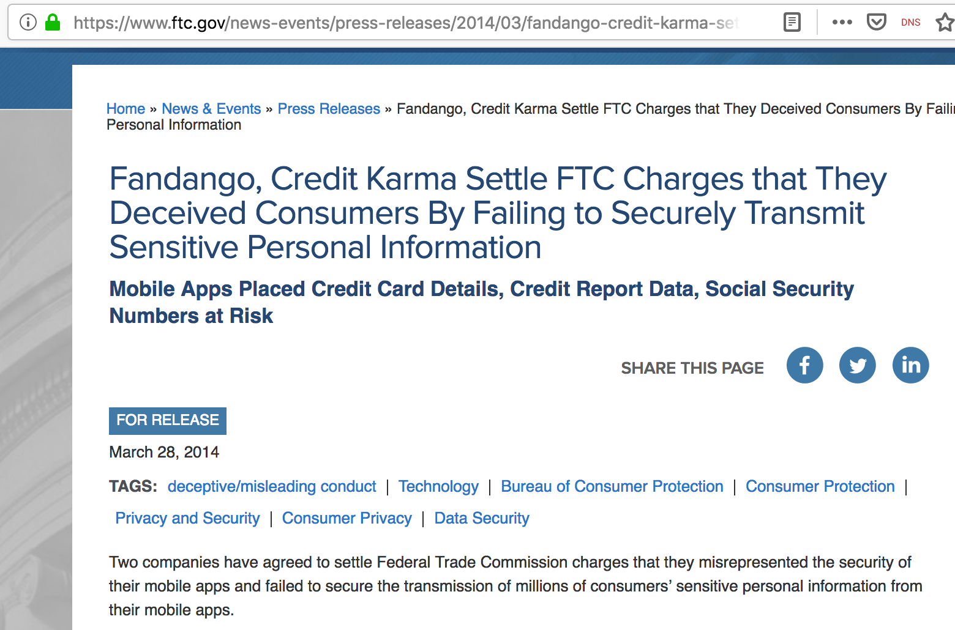
FTC Lawsuit Settlement

Slide 19
Passwords on a Phone

Slide 20
Persistent Login
Users remain logged in even after shutting off their phone
How does the app remember who you are?

Slide 21
Target == GOOD

Slide 22
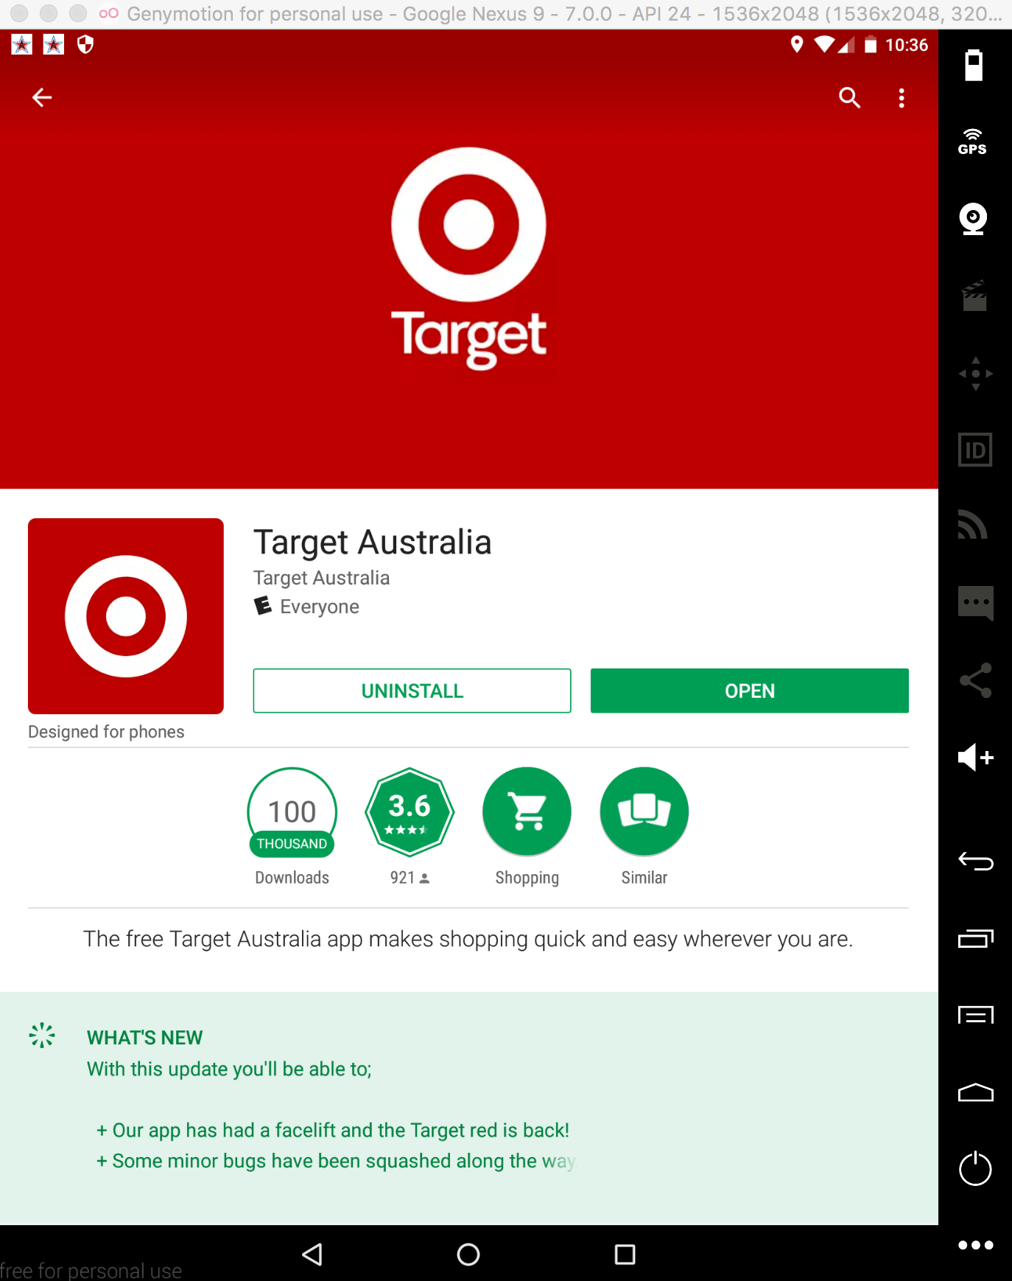
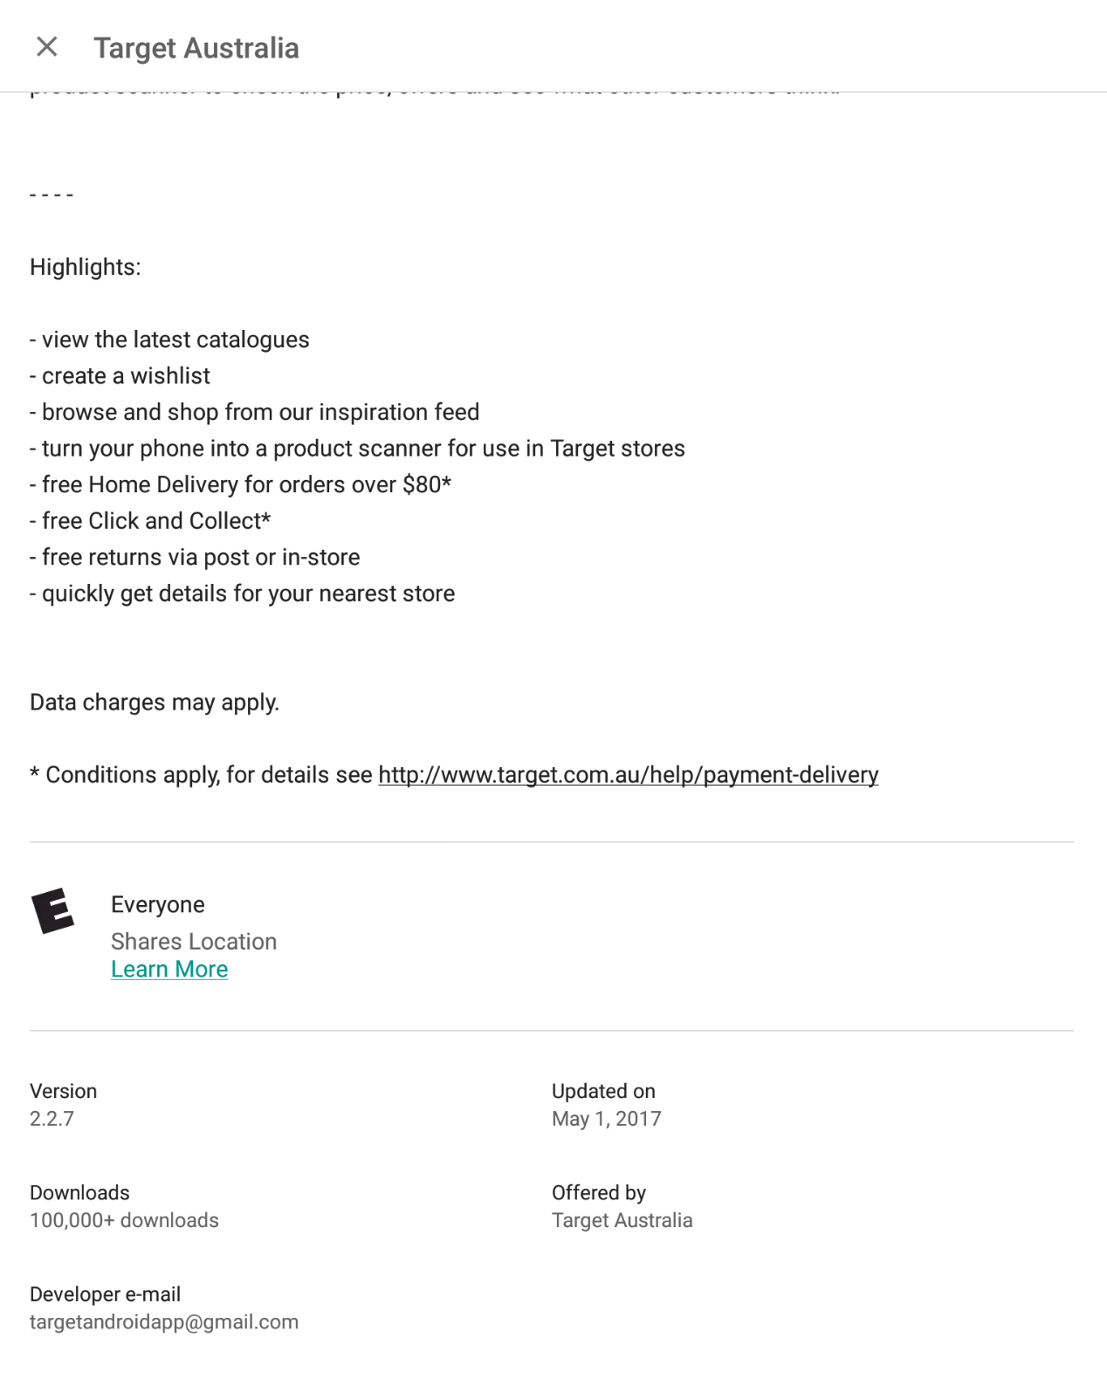
Target AU Android App

Slide 23
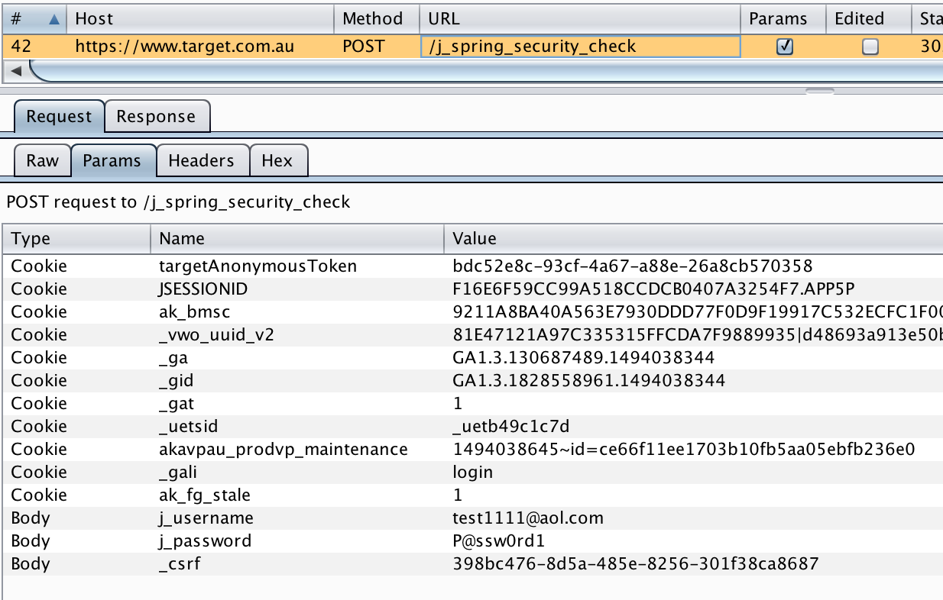
User Login

Slide 24
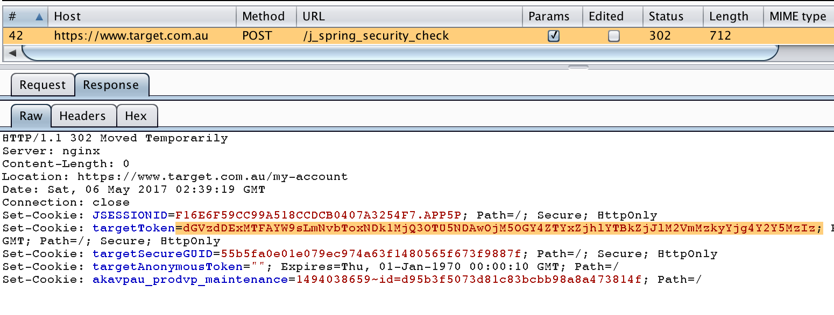
Server Response
Random Number, stored in a cookie
THIS IS THE RIGHT WAY

Slide 25
Staples == BAD

Slide 26
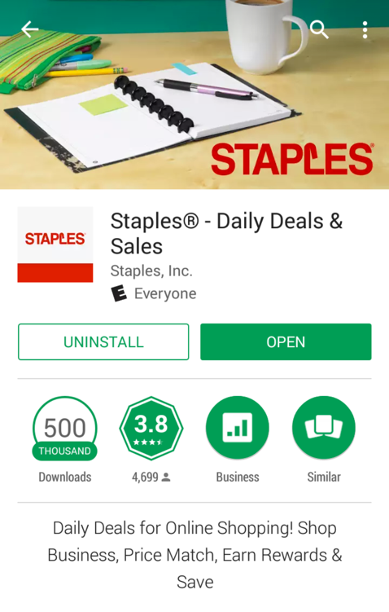
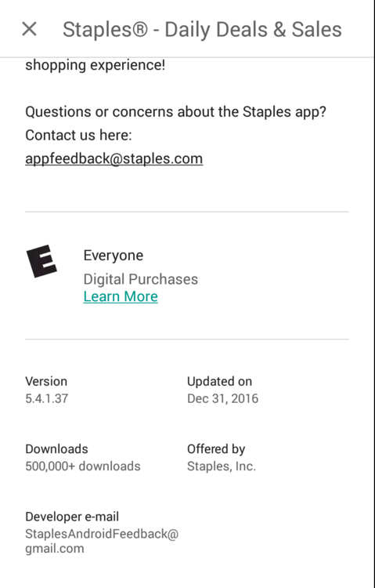
Tested in Jan 2017

Slide 27
Locally Stored Password
<string name="encryptedPassword">
CT9SVzhhRaufBzCvmwENWQ==
</string>
Right away this shows a problem
WHY store the password?

Slide 28
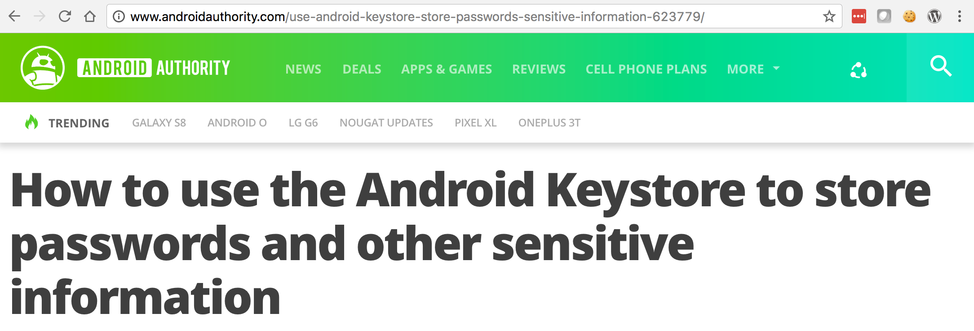
Best way: Don't. Use a cookie
Use Android KeyChain
Encrypt with with a public key
Private key is kept secret on a server
Encrypt with with a private key
Private key is "hidden" on the phone
Store data unencrypted on the phone

Slide 29
Special Password
<string name="encryptedPassword">
5V/uOkjK/Pxnb8yo7OdXzuVf7jpIyvz8Z 2/MqOznV84Chyt5lFv9LDpXXmJq9fUx
</string>
aaaaaaaaaaaaaaaaaaaaaaaaaaaaaaaaA123
32 identical characters at beginning

Slide 30
Decode
p = '5V/uOkjK/Pxnb8yo7OdXzuVf7jpIyvz8Z2/MqOznV84Chyt5lFv9LDpXXmJq9fUx'
>>> p.decode("base64").encode("hex")
'e55fee3a48cafcfc676fcca8ece757cee55fee3a48cafcfc676fcca8ece757ce02872b79945bfd2c3a575e626af5f531'
e55fee3a48cafcfc676fcca8ece757cee55fee3a48cafcfc676fcca8ece757ce02872b79945bfd2c3a575e626af5f531

Slide 31
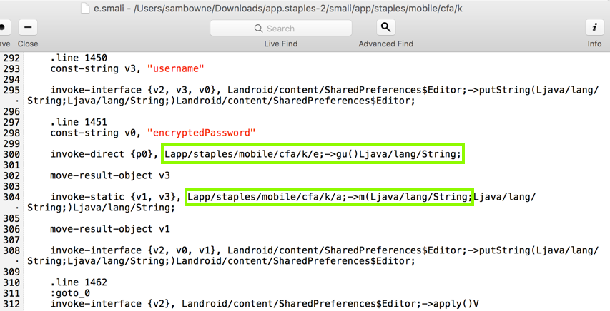
Read Smali Code

Slide 32
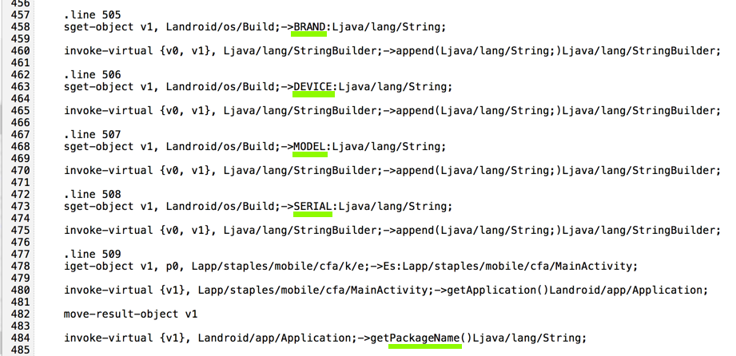
Constructing the Key

Slide 33
Final Key

Slide 34
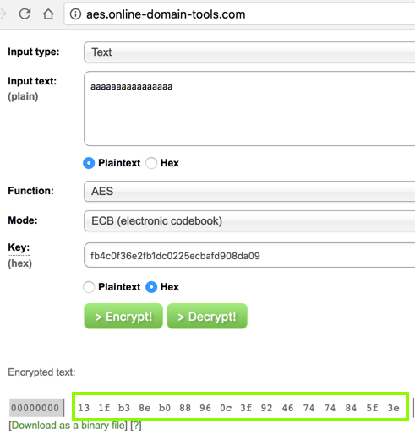
Encryption Test

Slide 35
Notification
Notified Jan 2, 2017
Automated response said it would be fixed
No response to follow-up email
April 13 -- Staples became homework

Slide 36
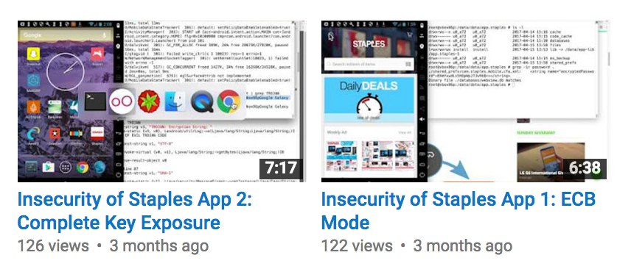
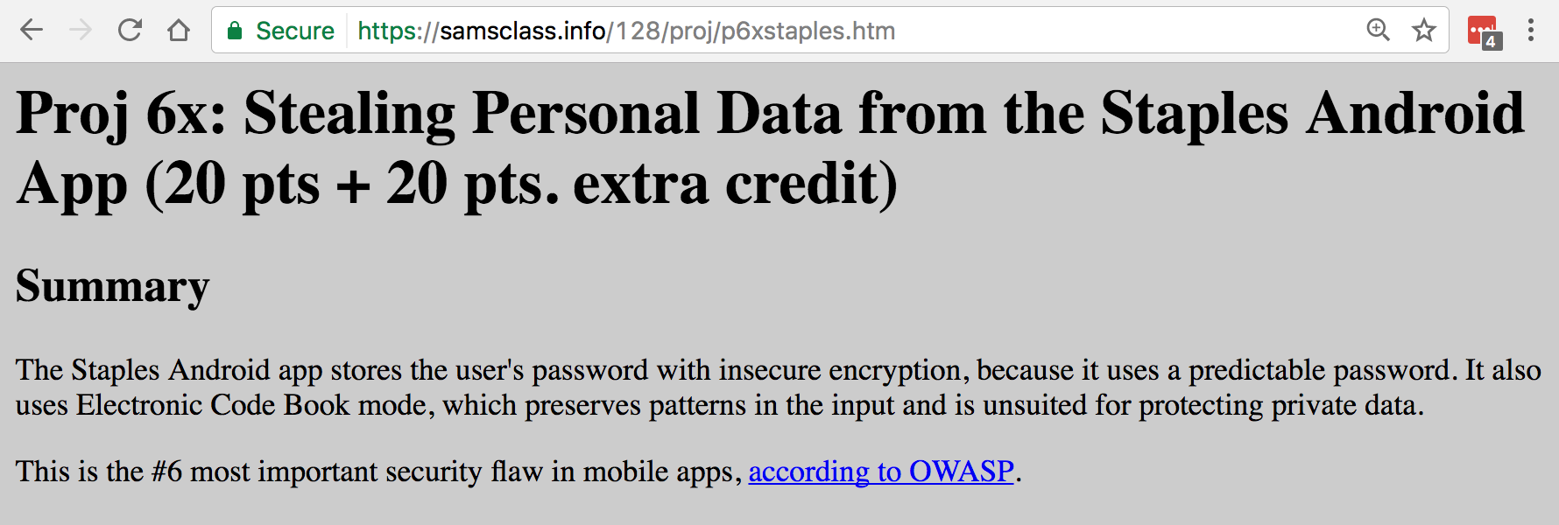

Slide 37
Notification
Fixed by May 9, 2017

Slide 38
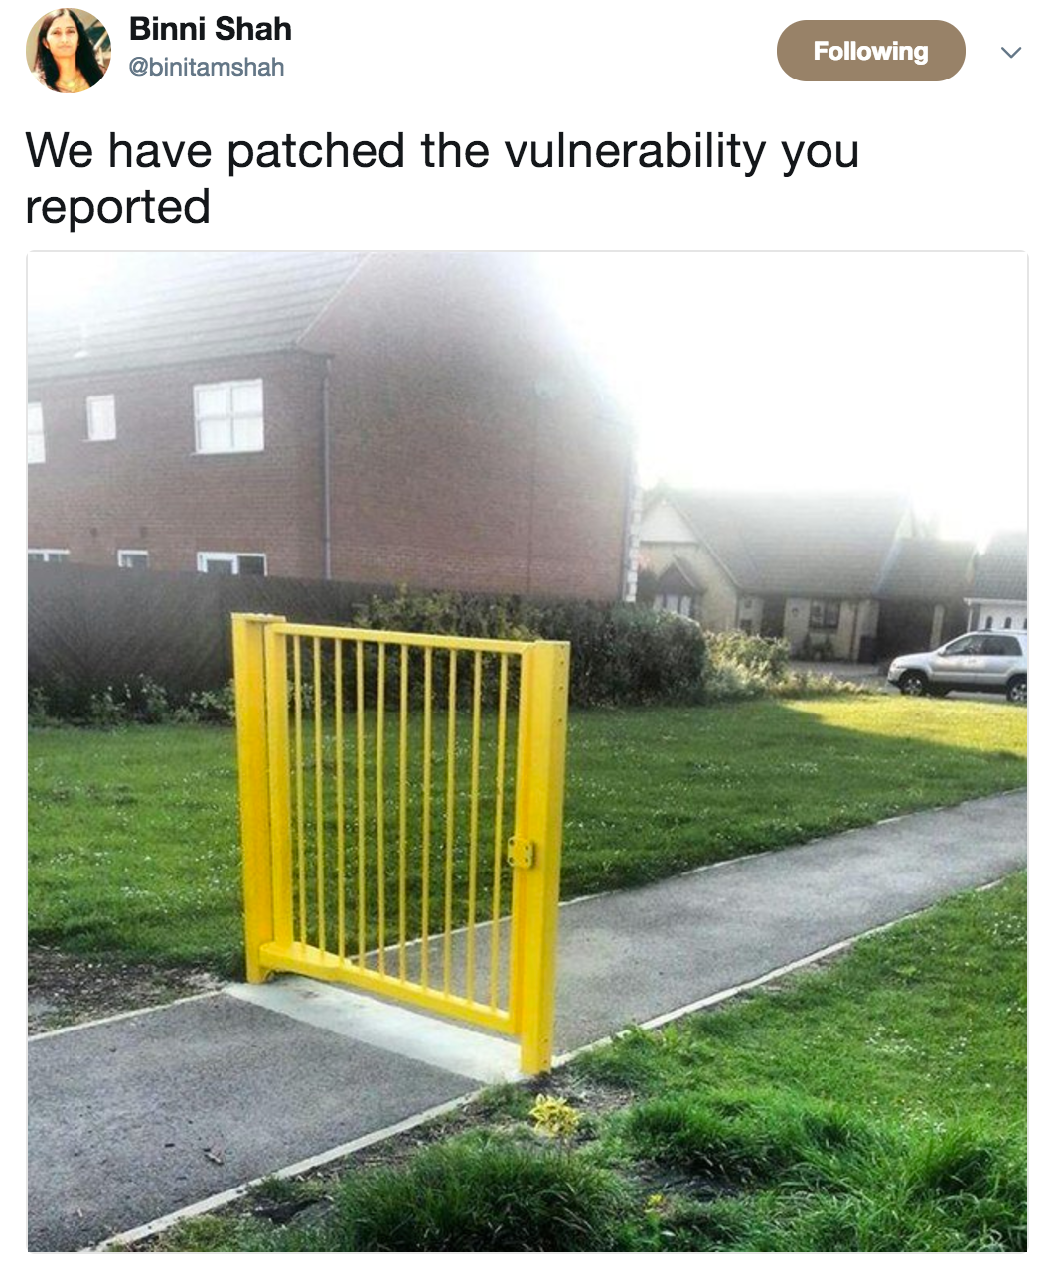

Slide 39
Plaintext Password Storage

Slide 40
Plaintext Login

Slide 41
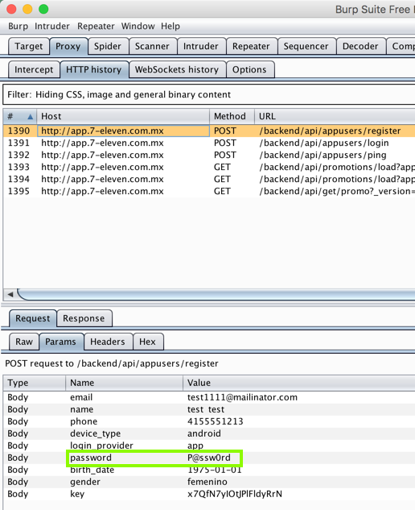

Slide 42
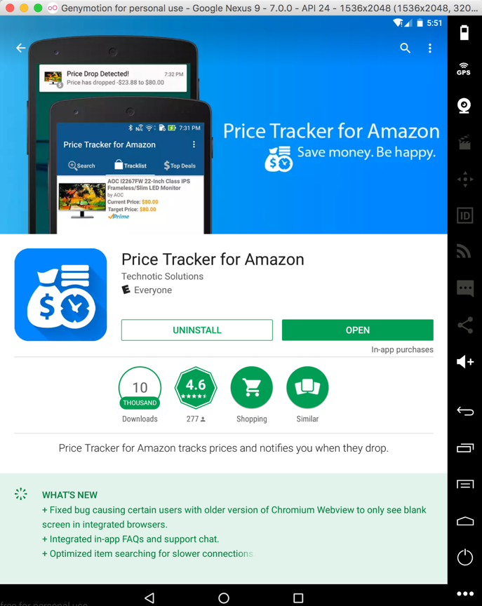
Broken SSL

Slide 43
A Feature, Not a Bug

Slide 44
Password Stored with Reversible Encryption

Slide 45
Home Depot
Locally stored password is encrypted

Slide 46
Complete Decryption

Slide 47
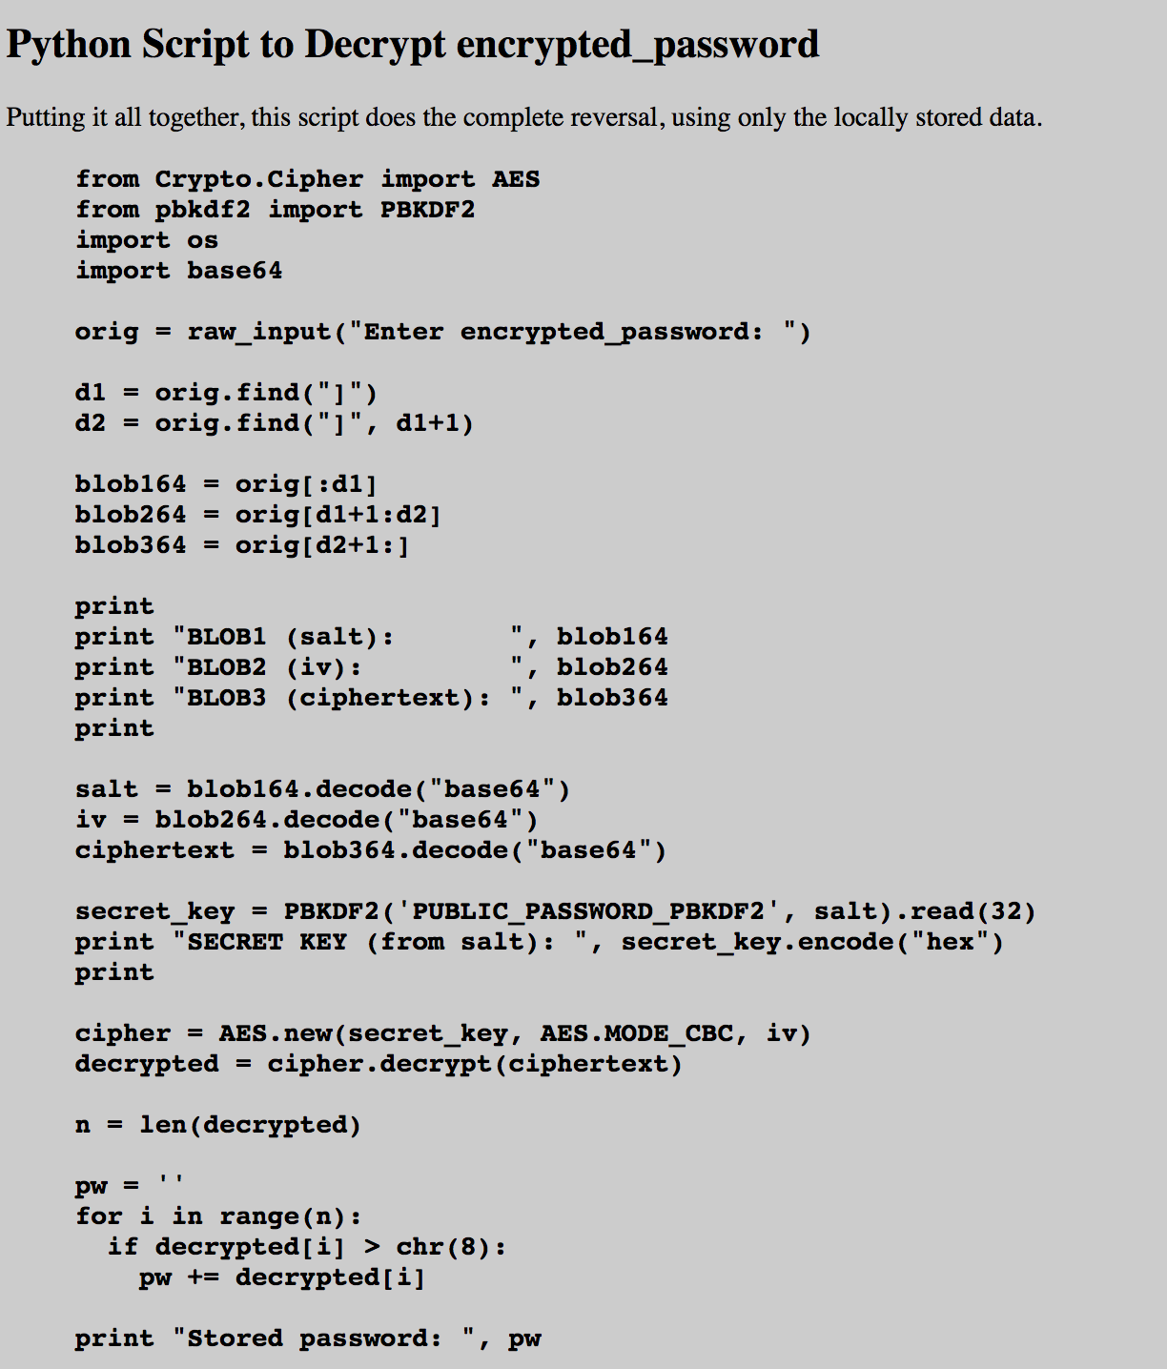

Slide 48
Walgreens

Slide 49
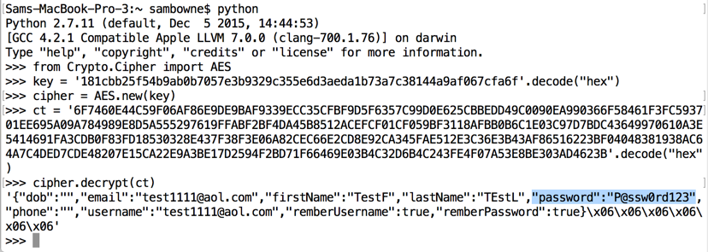
Walgreens

Slide 50
Multiple Vulnerabilities

Slide 51
Fixed

Slide 52
iOS Apps

Slide 53
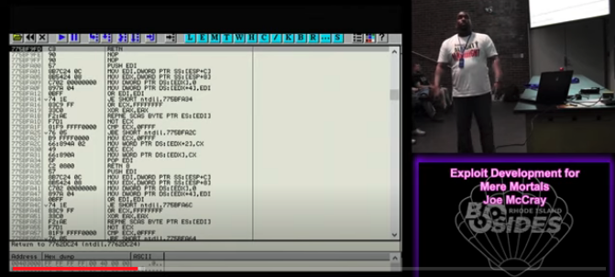
Reverse Engineering is not so hard

Slide 54
Georgia Weidman
Complete step-by-step to a buffer overflow that works

Slide 55
CCSF Class

Slide 56
axi0mx

Slide 57
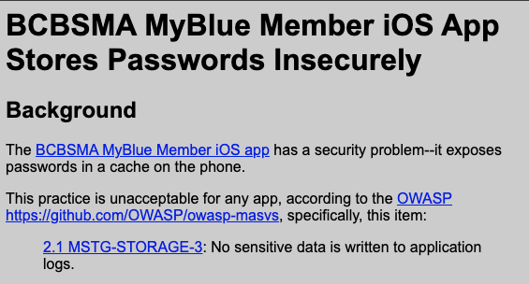
Blue Cross

Slide 58
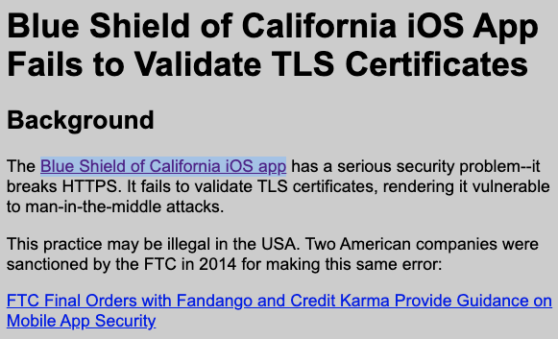
Blue Shield

Slide 59
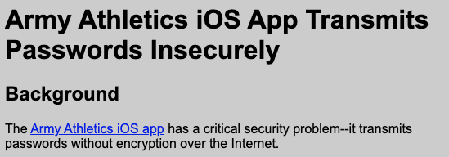
West Point

Slide 60
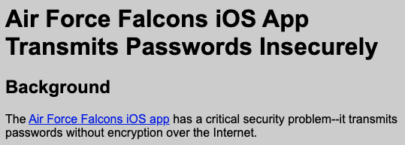
Air Force

Slide 61
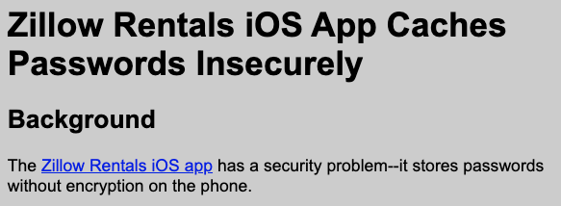
Zillow

Slide 62
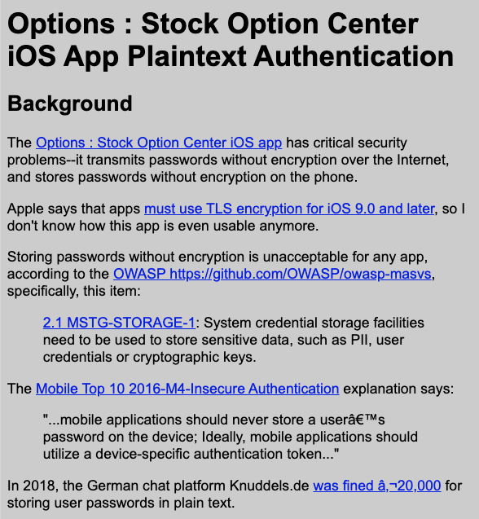
Plaintext Transmission

Slide 63
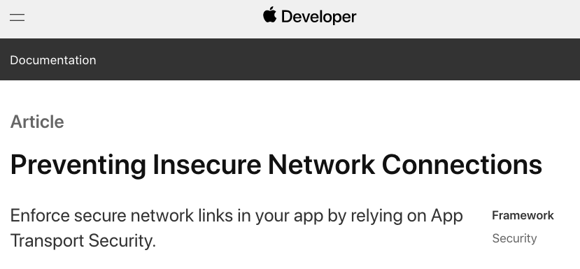

Slide 64
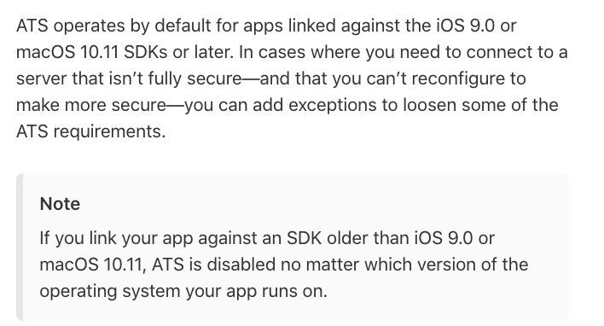

Slide 65
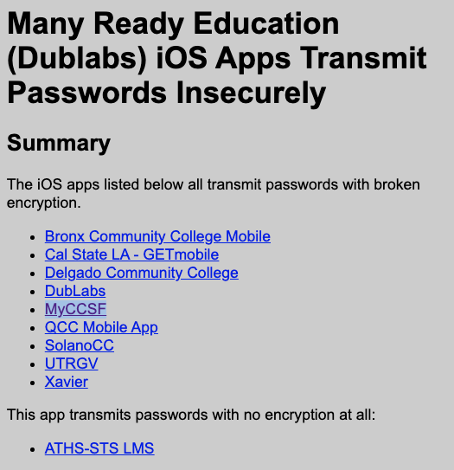

Slide 67
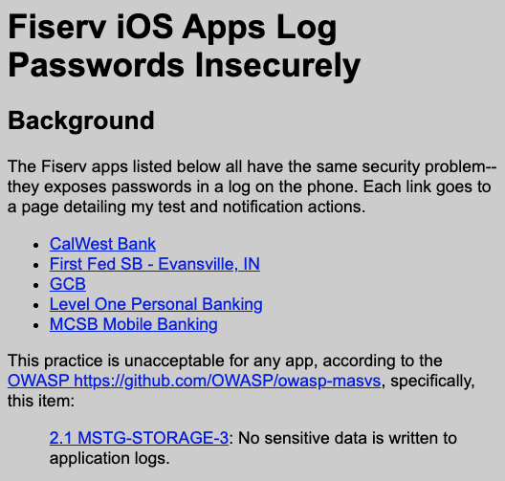

Slide 69
Management Review
Do you need this data?
Is it encrypted?
What algorithm?
Where is the key?
All materials freely available at samsclass.info

