Slide 1
Ch 1: The Mobile Risk Ecosystem
CNIT 128:
Hacking Mobile Devices

Slide 2
The Mobile Ecosystem

Slide 3
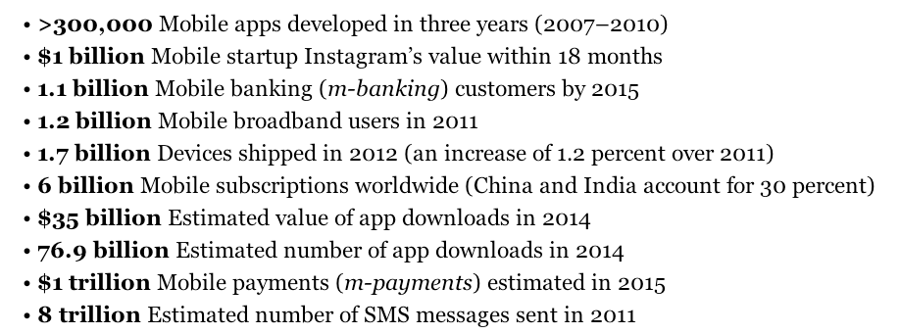
Popularity of Mobile Devices

Slide 4
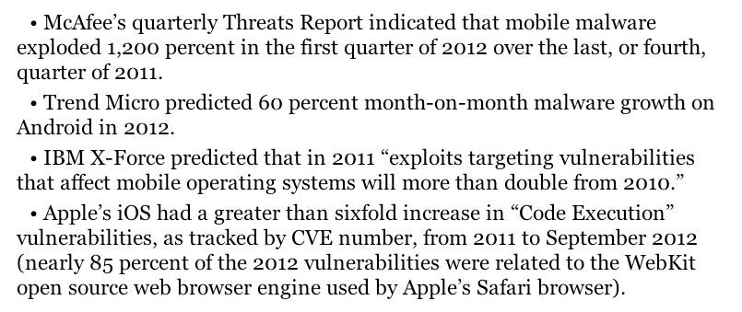
Insecurity of Mobile Devices

Slide 5
The Mobile Risk Model

Slide 6
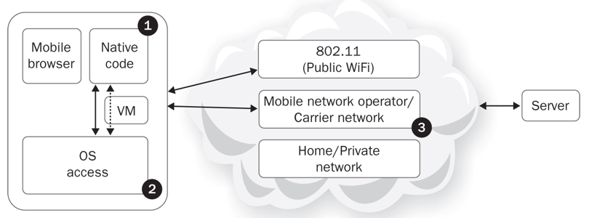
Mobile Network Architecture

Slide 7
1. Native Code
Some languages like Java operate in a virtual machine
Run in a sandbox
Limited access to resources
Other languages like Objective-C run directly on the OS
More access to resources
Less safe

Slide 8
2. OS Access
Software running in a browser has limited access to the OS
Libraries
File system access
Interprocess communications
System calls

Slide 9
3. Internet Access
Mobile devices commonly use the mobile carrier's network and public WiFi networks to connect to the Internet
Increased opportunity for Man-in-the-Middle (MiTM) attacks
Most mobile threats are variations on MiTM
MiTB (Man in the Browser)
MiTOS (Man in the OS)

Slide 10
Risk Model
Identify stakeholders
Enumerate assets
Find relevant risks

Slide 11
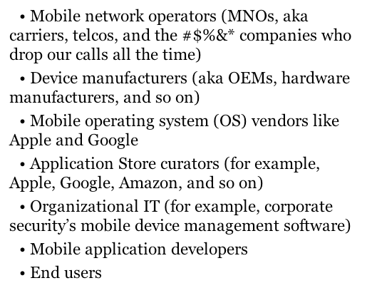
Stakeholders

Slide 12
Assets
OS manufacturer values phone as a source of revenue
Threats include
Apps that may crash the OS
Users who may jailbreak the phone
Users value their privacy
Threats include
The OS which may send data back to the carrier for "statistical purposes"
Apps preloaded by the MNO which might send data out

Slide 13
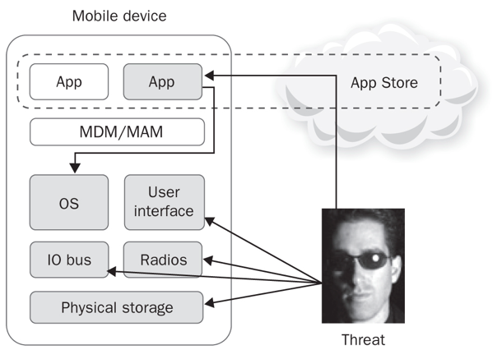
Attack Surfaces

Slide 14
Attack Surface
Physical theft
Access to the user interface, physical storage, IO Bus, and radios
App publication
Trojan horse or other malware
Access to OS resources
Interprocess communication
Phone may be jailbroken/rooted
App permissions may be weak
User may allow excessive permissions

Slide 15
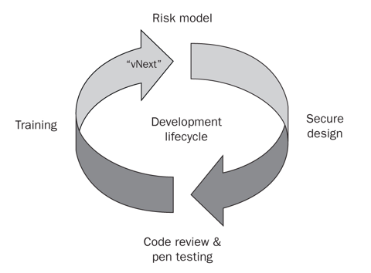
Security in Development Lifecycle

Slide 16
Special Risks
Mobile devices are connected to many networks
Often insecure or unknown ones
Mobile devices are used for personal, private purposes
Banking, selfies, SMS messages, phone calls

Slide 17
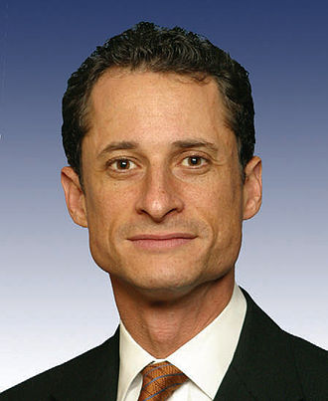
Anthony Weiner
Member of US House of Reps.
Destroyed his political career with sexting scandals
Link Ch 1a

Slide 18
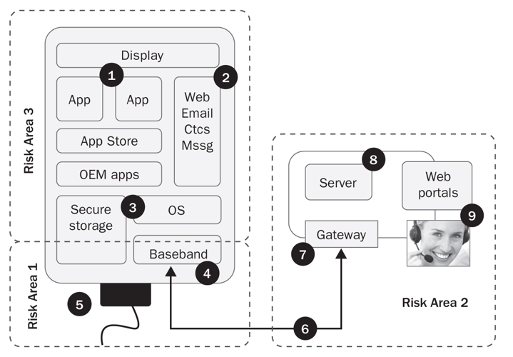
Areas of RIsk

Slide 19
1. Physical Access
Attacker with physical access to the device can overcome almost any security barrier
Rooting/Jailbreaking continues to be popular
Neither Apple nor Google can stop it
No information stored indefinitely on a mobile device can be regarded as secure

Slide 20
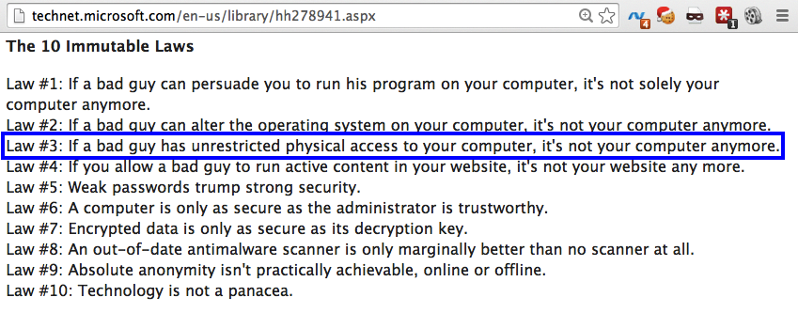
The 10 Laws of Security
Link Ch 1b

Slide 21
5. USB Port
USB connection gives direct access to the phone's storage, in "debug" mode
Commonly used by law enforcement to collect all data from a phone

Slide 22
4. Baseband Attack
If an attacker can get close to your phone, she can:
Trick your phone into connecting to a rogue cellular base station
Baseband stack of radio chip hardware and firmware
WiFi, Bluetooth, GPS, Near Field Communication (NFC), etc.

Slide 23
2. Web, Email, Contacts, SMS
8. Most code is on the server side of apps
Most bugs and security errors are there too
9. Tech support will often give attackers access to your account or device with a phone call
Social engineering

Slide 24
Mat Honan
Hackers social-engineered Amazon and Apple for password resets
Google account deleted
AppleID broken into
Wiped iPhone, iPad, and MacBook
Link Ch 1c

Slide 25
Axway API Gateway
Linux-based server
Performs protocol translation
Can block attacks
Recommended by author
Links Ch 1d, 1e

Slide 26
App Risks

Slide 27
App Risks
Apps are the primary attack surface for mobile devices
Major security issues
Fragmentation
Sensitive information leakage
"Secure" on-device storage
Weak authentication
Failure to properly implement specs
BYOD

Slide 28
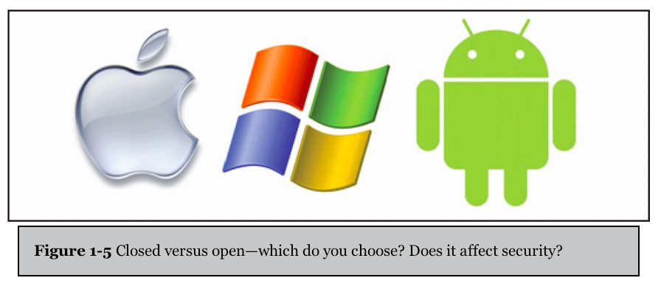
Open v. Closed Platforms

Slide 29
Open v. Closed Platforms
Apple is closed and more secure
Code must be signed by Apple to run
Has Address Space Layout Randomization (ASLR)
Better code sandbox
No shell
Android is open and less secure
Custom OS versions for each device manufacturer
Updates often blocked by MNOs

Slide 30
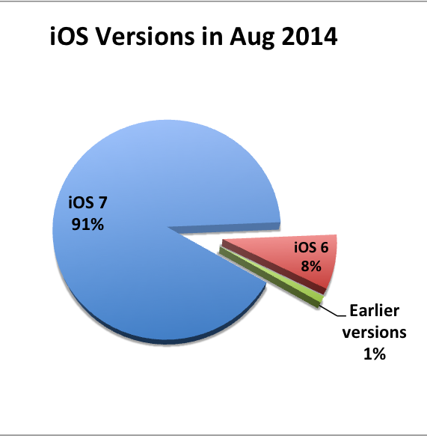
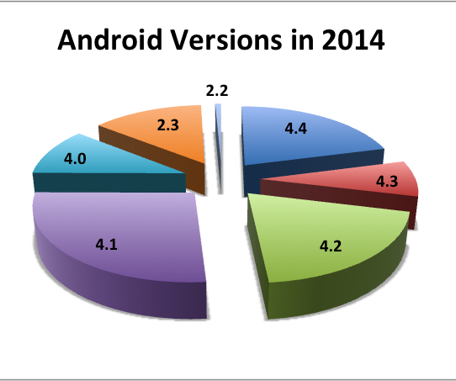
Fragmentation
Updates are essential for security
Very big problem for Android
Link Ch 1f

Slide 31
App Store Security
Before appearing in the App Store, apps are
Manually reviewed by Apple for flaws and malware
Screened with a static analyzer
Apps run in a sandbox
Memory is segmented

Slide 32
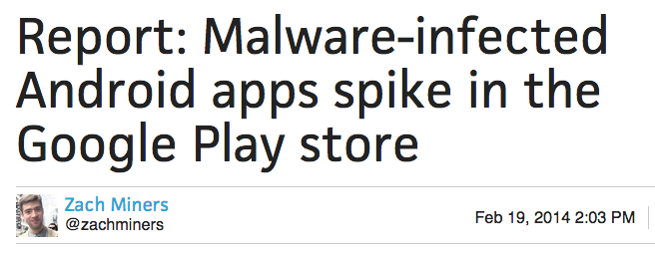
Google Marketplace "Security"
More than 42,000 apps in Google Play contain information-stealing trojans as of 2013
Link Ch 1h

Slide 33
Installing Apps from Untrusted Sources (Side-Loading)
Android devices can install apps posted directly to the Web by developers
Not screened by Google at all

Slide 34
Android Antivirus
Many options
Pick one and use it
Link Ch 1i

Slide 35
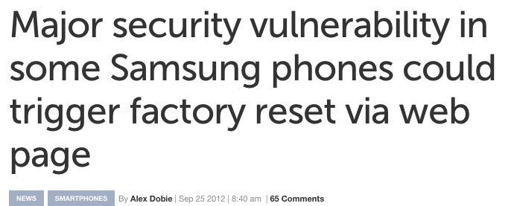
Custom Software from Device Manufacturers
Samsung added a TouchWiz overlay to some Android devices
Introduced a serious vulnerability
Link Ch 1j

Slide 36
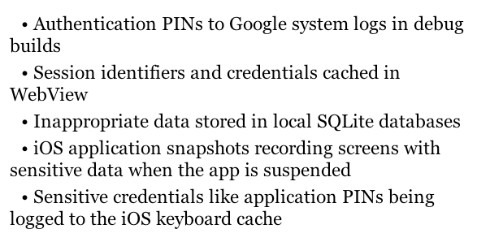
Sensitive Information Leakage
Real issues found in mobile devices

Slide 37
dmesg
Samsung devices stored sensitive user-input data into device driver logs (the "dmesg" buffer)
Those logs could be read by non-root users and other apps

Slide 38
Software that sends information about device usage back to the carrier for "quality of service monitoring"
Apparently including keylogging
Concerns emerged that this data was excessive and not handled properly
Link Ch 1l

Slide 39
Input Validation
Many attacks rely on input to one app that does unexpected things when passed on to another app
Javascript injection to run code, including "eval"
URL query strings that execute application functions

Slide 40
"Secure" On-Device Storage
All data on a mobile device is at risk
Balance value of data with the risk
Poor software has stored
Hard-coded passwords
AES encryption keys

Slide 41
Advice for Storing Sensitive Data
Don't do it (if possible)
Use existing storage facilities
Like iOS KeyChain
Much safer than custom code
Use specially designed hardware to store secrets
SE (Secure Element) chip can be embedded in device, or on a SIM or SD card
Good security, if implemented correctly
Link Ch 1m

Slide 42
Weak Authentication
Falsely assume that tokens on the mobile device are secret
Mobile Device Number (MDN)
Allowed password resets without a security question
Popular authentication standards
Oauth
SAML
Security will be analyzed in chapter 6

Slide 43
Exposed ICC-ID Numbers
Ch 1n

Slide 44
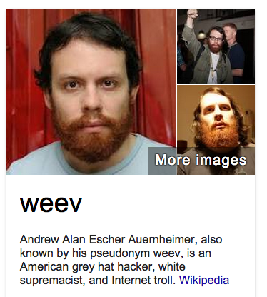
Weev
Sentenced to 41 months in prison for the AT&T "hack"
Released early because the venue (New Jersey) was improper
Link Ch 1o

Slide 45
Failure to Properly Implement Specs
Using cleartext username and password in a "WS-Security" header (link Ch 1p)
Leaving debug mode on in production systems
SSL certificate validation disabled
Fast development leads to insecure code
Speed to market is valued more highly than security

Slide 46
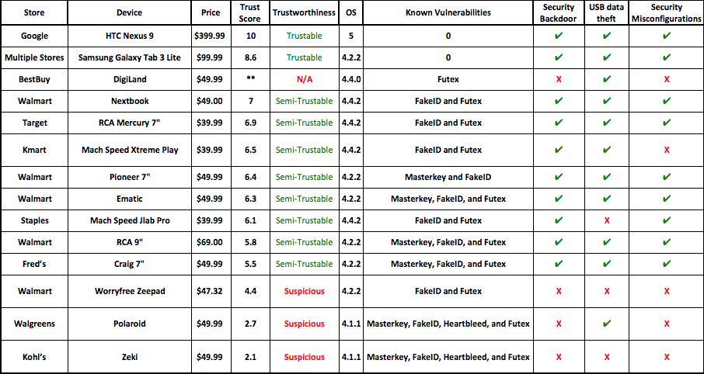
Android Tablet Vulnerabilities
Link Ch 1q

Slide 47
BYOD
Bring Your Own Device to work
Recommendation
Keep sensitive data on servers
Only put nonsensitive data on mobile devices

Slide 48
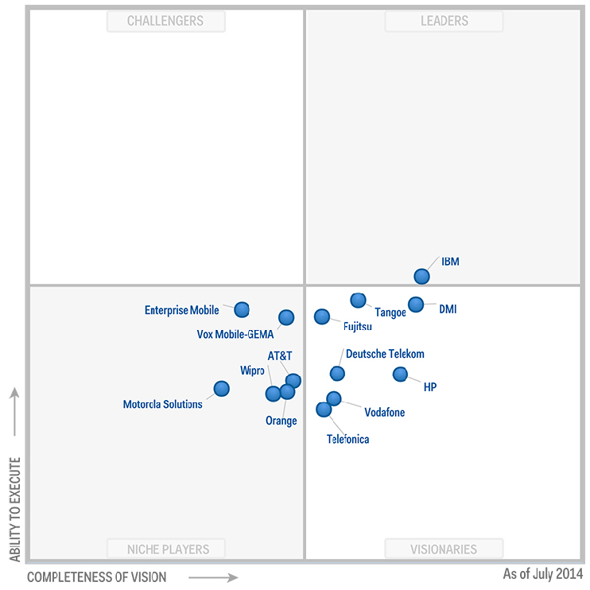
Mobile Device Management (MDM)
Enterprise solutions to centrally administer mobile devices
Important but immature field
Link Ch 1r

Slide 49
Key Countermeasures for App Developers
Architecture and design
Align architecture with value of assets in play
Input/Output validation
Caching and logging
Disable or mitigate logging of confidential data
Error handling
Don't just fail-open; enforce security checks

Slide 50
Key Countermeasures for App Developers
Device loss or capture
Prepare for phone theft
Enable remote wipe of your data
Server-side strength
Implement strong controls
Application-level protections
Strengthen self-help password reset system

