Slide 1
Ch 4: Android
CNIT 128:
Hacking Mobile Devices
rev. 2-18-15

Slide 2
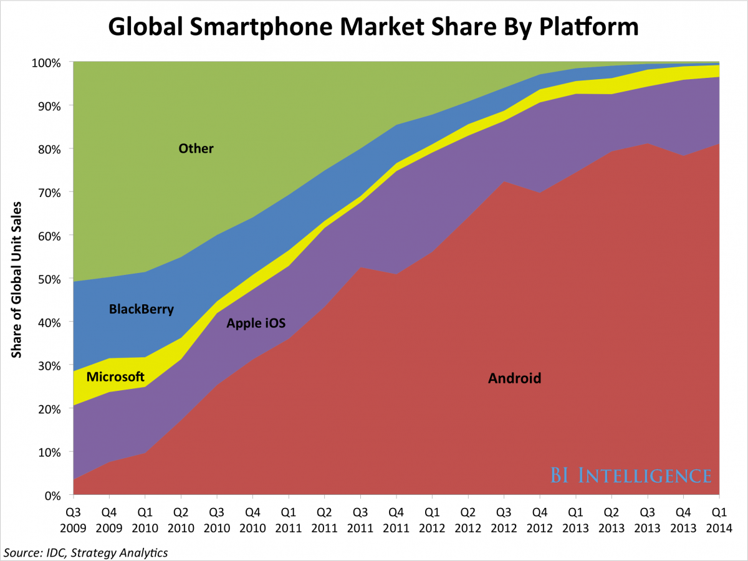
Android is #1
80% market share in 2014
Link Ch 4a

Slide 3
Open Source
Android itself is open source (Link Ch 4b)
But the Google apps included with most Android phones are closed-source
Many device manufacturers and carriers modify Android
Closed-source device drivers and apps
Leads to fragmentation: two devices with the same hardware but different carriers can be running very different software
More total sales, many different Android devices

Slide 4
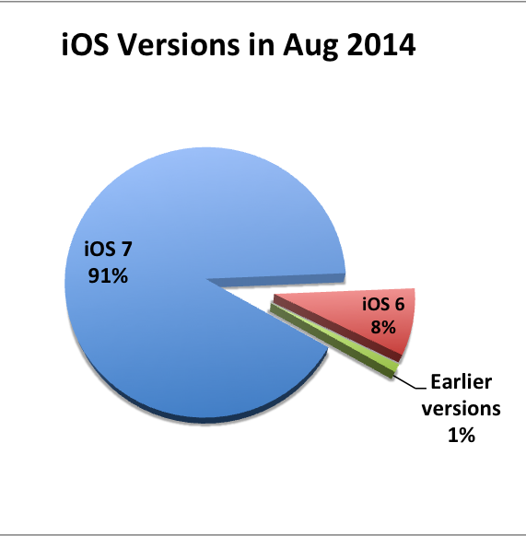
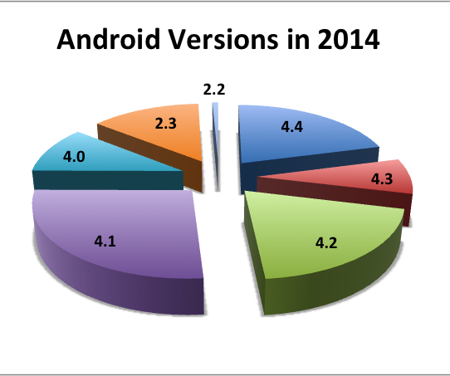
Fragmentation
Updates are essential for security
Very big problem for Android
Link Ch 1f

Slide 5
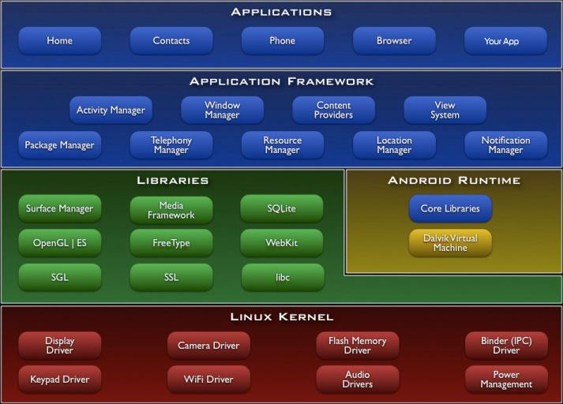
Android Architecture

Slide 6
Linux Kernel
A way for applications to interact with devices
Manages processes and memory
Android versions prior to 4.0 used 2.6 Linux kernel
Later versions use 3.x Linux Kernel

Slide 7
Libraries
OpenGL (for 2D/3D graphics)
SQLite for databases
WebKit (for rendering Web pages)
Others
Written in C/C++
Also Dalvik VM and core Java libraries
All this together is called the "Android Runtime" component

Slide 8
Application Framework
A way for Android apps to access
Telephone functionality
Creating UI (User Interface) elements
GPS
File system
Important in Android security model

Slide 9
Apps
Usually Written in Java
Compiled to Dalvik bytecode using the Android Software Development Kit (SDK)
Can also be written in C/C++
Using Native Development Kit (NDK)

Slide 10
Security Model

Slide 11
Permission Based
Apps must be explicitly granted permission to take action
Permissions enforced in two places
Kernel level
Application Framework level

Slide 12
Kernel Permissions
Each app has a unique user ID
File ownership based on User ID
Can only access the resources and functionality it has explicit permissions for
This is "sandboxing"
Apps cannot access resources of other apps
Apps cannot access hardware components they have not been given permission to use

Slide 13
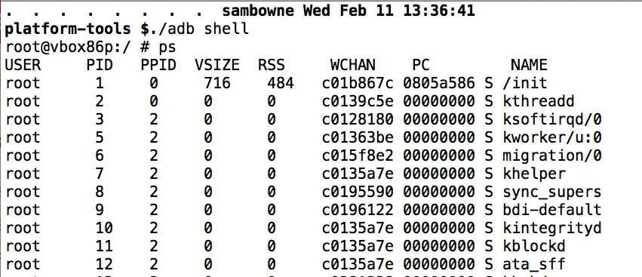
Viewing Users with ps
System processes run as root

Slide 14
Viewing Users with ps
Apps run as u0_a1, u0_a2, etc.
Permissions for data directories

Slide 15
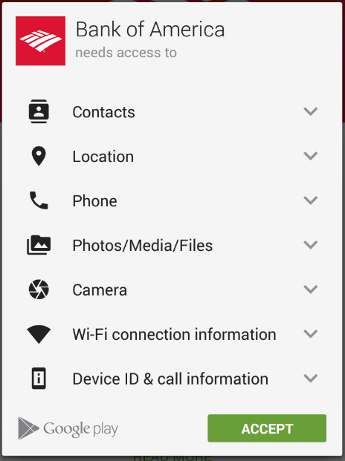
Application Framework Access Control
App must declare a permission for each component it accesses in its manifest file
AndroidManifest.xml
Permissions are shown to the user at install time
User can chose whether to allow the permissions
If not, the app can't be installed
Once installed, the app has only those permissions, such as android.permission.INTERNET

Slide 16
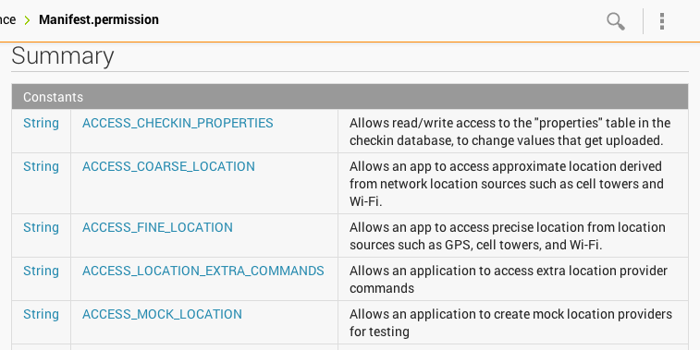
Many Permissions are Available
Link Ch 4d

Slide 17
Permission Categories
Normal
Low-risk
Don't require explicit approval from users at install time
Dangerous
Require explicit approval from users at install time

Slide 18
Permission Categories
Signature
Defined by an application in its manifest
Functionality exposed by applications that declare this permission can only be accessed by other applications that were signed by the same certificate
signatureOrSystem
Same as Signature, but applications installed on the /system partition can also access this functionality

Slide 19
App Signing
All apps must be signed to be installed
Android allows self-signed certificates
Developers can generate their own signing certificates
The only security mechanisms that use signatures are the signature or signatureOrSystem permissions

Slide 20
Address Space Layout Randomization (ASLR)
Added in Android 4.0
Makes it more difficult to exploit memory corruption issues
Randomizes locations of key memory sections
Such as stack and heap
In 4.0, several locations, including the heap were not randomized
Android 4.1 has full ASLR

Slide 21
No eXecute (NX) Bit
Added in Android 2.3
Allows you to set the heap and stack as nonexecutable
Helps prevent memory corruption attacks

Slide 22
Application Components

Slide 23
Four Components
Activities, Content providers, Broadcast receivers, Services
Entry points: ways the user or another app on the same device can enter
The more components that are exported, the larger the attack surface
Component header will contain this line: android:exported="true'

Slide 24
Intents
Applications primarily use intents
Asynchronous messages
To perform interprocess, or intercomponent, communication

Slide 25
Activities
Define a single screen of an applications user interface
Android promotes reusability of activities
This saves developers time and work
Increases the attack surface of an app

Slide 26
Content Providers
Exposes ability to query, insert, update, or delete application-specific data
to other apps and internal components
App might store data in SQLite database or a flat file
Calling component won't know what storage method is used
Poorly written content providers may expose data or be vulnerable to SQL injection

Slide 27
Broadcast Receivers
Respond to broadcast intents
Apps should not blindly trust data from broadcast intents
It could be from a hostile app or a remote system

Slide 28
Services
Run in the background
Perform lengthy operations
Started by another component when it sends an intent
Services should not blindly trust the data contained within the intent

Slide 29
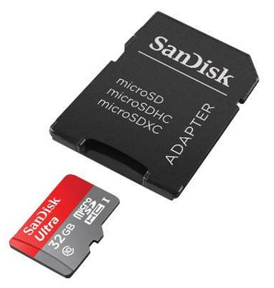
Data Storage
Internal storage in nonvolatile memory (NAND flash)
Private to one app
External storage on an SD card
Also NAND flash, but removable
Available to all apps
Image from amazon.com

Slide 30
File Types
Apps are free to create any type of file, but the API comes with support for
SQLite databases
Shared preference files in an XML-based format
SQL injection attacks are a risk, via intents or other input

Slide 31
NFC (Near Field Communication)
Radio communication, including
NFC tags
Some RFID tag protocols
Contactless smart cards
Mobile devices
Short range: a few cm
image from newegg.com

Slide 32
NFC in Android
Introduced in 2010 with Gingerbread
Expanded in 2.3.3 to support a variety of NFC formats
Card Emulation mode came In 2.3.4
An NFC reader can read data from the Secure Element (SE) within the phone
Card emulation is not exposed via the Android SDK
Only Google or carriers have this capability

Slide 33
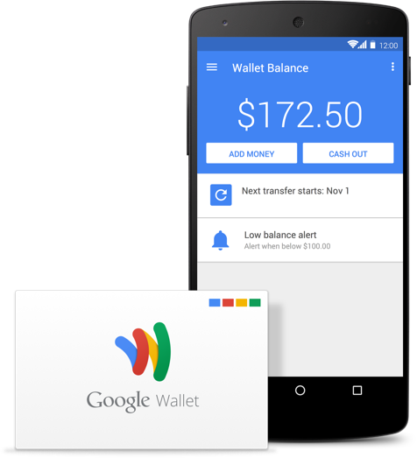
Google Wallet
Lets you use your phone for a credit card
Released with Android 2.3.4

Slide 34
NFC Peer-to-Peer
Allows two NFC-enabled devices to communicate directly
Android Beam allows users to share data by tapping their devices together
NFC tags are also used in advertisements

Slide 35
Android Development

Slide 36
SDK (Software Development Kit)
Allows developers to build and debug Android apps
Runs on Windows, Mac OS X, or Linux
In Dec., 2014, Google released Android Studio
A full IDE (Integrated Development Environment)
Links Ch 4e, 4f

Slide 37
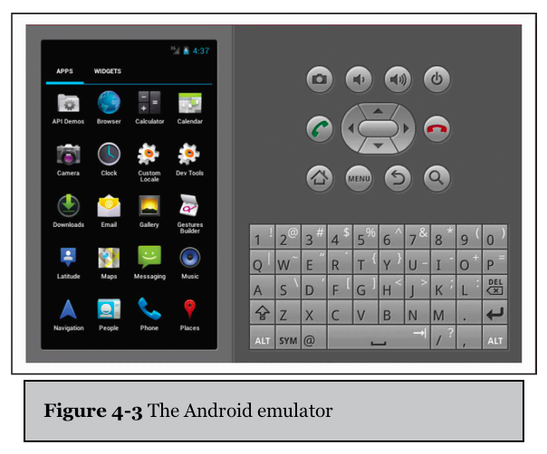
Android Emulator
Helps developers test apps without an actual mobile device
Simulates common hardware
ARMv5 CPU
SIM card
Flash memory partitions

Slide 38
Value of the Emulator
Allows developers and researchers to test Android apps quickly in different versions of Android
Drawbacks
Android Virtual Device (AVD) cannot send or receive phone calls or SMS messages
But it can emulate them, and send them to other AVDs
Can define an HTTP/HTTPS proxy to intercept and manipulate Web traffic

Slide 39
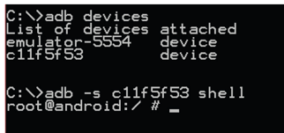
Android Debug Bridge
Command-line tool
Allows you to communicate with a mobile device via a USB cable or an SVD running within an emulator
Connects to device's daemon running on TCP port 5037

Slide 40
Useful ADB Commands
push
Copies a file from your computer to the mobile device
pull
Copies a file from the mobile device to your computer
logcat
Shows logging information on the console
Useful to see if an app or the OS is logging sensitive information

Slide 41
Useful ADB Commands
install
Copies an application package file (APK) to the mobile device and installs the app
Useful for side-loading apps (so you don't have to use Google Play)
shell
Starts a remote shell on the mobile device
Allows you to execute arbitrary commands

Slide 42
END OF PART 1

Slide 43
Rooting

Slide 44
Root
The root user can directly access system resources
Bypassing the permissions checks normally required
Giving the app that runs as root full control over the device and other apps running on it

Slide 45
GingerBreak (CVE-2011-1823)
Gains root on
Many Gingerbread (Android 2.3.x) devices
Some Froyo (2.2.x)
Some Honeycomb (3.x.x)

Slide 46
How Gingerbreak Works
Vulnerability in volume manager daemon
/system/bin/vold
Method DirectVolume::handlePartitionAdded
Sets an array index using an integer passed in
Does not check for negative integers
Using negative values, exploit can access arbitrary memory locations

Slide 47
How Gingerbreak Works
Exploit writes to vold's global offset table (GOT)
Overwrites several function calls
such as strcmp() and atoi()
With calls to system()
Then another call to vold to execute an app via system(), with vold's elevated privileges

Slide 48
GingerBreak
Packaged into several rooting tools
Such as SuperOneClick
And some one-click rooting APKs
Malicious app could include GingerBreak as a way to gain elevated privileges on a device

Slide 49
GingerBreak Countermeasures
Update your device
GingerBreak exploit was fixed in Android 2.3.4
But some manufacturers/carriers allow updates
Antivirus apps should detect the presence of GingerBreak
An alternative

Slide 50
Ice Cream Sandwich init chmod/chown Vuln
Vuln introduced with Ice Cream Sandwich (4.0.x) in init
If the init.rc script has an entry like this
mkdir /data/local/tmp 0771 shell shell
Even if the mkdir failed, init would set the ownership and permissions for the shell user
The ADB user

Slide 51
Symlink
If /data/local is writable by the shell user,
Creating a symlink to /system there allows the ADB user read/write access to the /system partition
ADB user can add files to /system, such as su
Thus gaining root access to a device

Slide 52
Ice Cream Sandwich init chmod/chown Countermeasures
Keep devices updated
Make sure Android debugging is turned off
And keep device locked, so attacker can't turn it on

Slide 53
Decompiling and Disassembly

Slide 54
Static Analysis
Source code is generally kept confidential by app developers
A binary, compiled app can be analyzed by disassembling or decompiling them, into
Smali assembly code (used by Dalvik VM), or
Java code

Slide 55
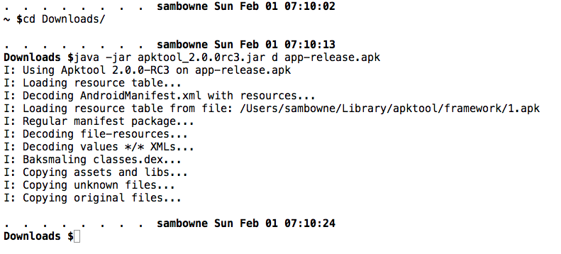

Slide 56
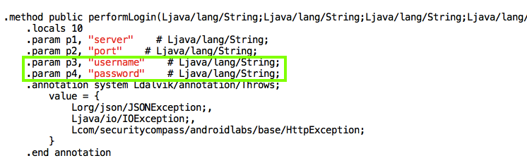
Java v. Smali Code

Slide 57
Building & Signing an App

Slide 58
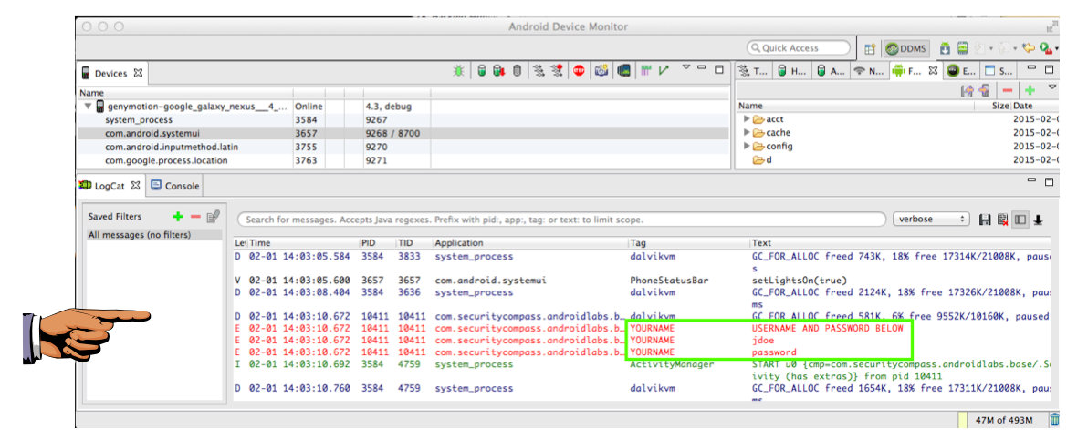
Monitoring the Log

Slide 59
Attacks via Decompiling and Disassembly
Insert Trojan code, like keyloggers
Find encryption methods & keys
Change variables to bypass client-side authentication or input validation
Cheat at games

Slide 60
Link Ch 4z43

Slide 61
Decompiling, Disassembly, and Repackaging Countermeasures
Every binary can be reverse-engineered
Given enough time and effort
Never store secrets on the client-side
Never rely on client-side authentication or client-side validation
Obfuscate source code
ProGuard (free) or Arxan (commercial)

Slide 62
DashO – Powerful Obfuscator

Slide 63
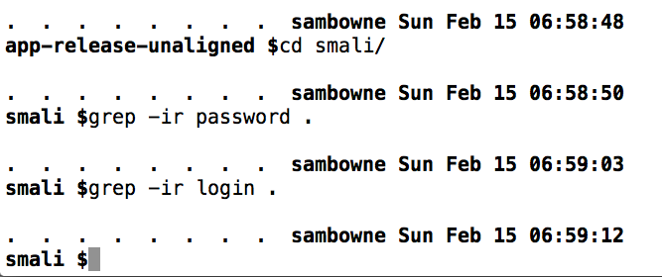
All Strings Concealed
BUT it costs $2000

Slide 64
Intercepting Network Traffic "Man in the Middle" (MITM) Attacks

Slide 65
HTTP Traffic
Trivial to intercept
No protections
Any hacker in a coffeehouse can do it with
ARP poisoning
A rogue access point like the WiFi Pineapple
Very difficult for the end user to detect

Slide 66
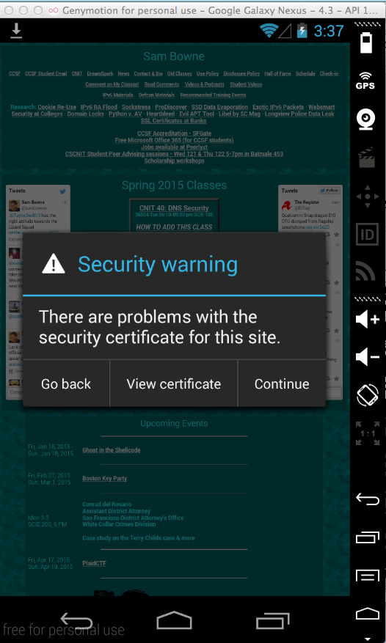
HTTPS
Specifically designed to prevent MITM attacks
Only very powerful adversaries like nation-states or big corporations can get real Certificate Authority certificates
Without one, targets will see a warning like this

Slide 67
Problems
End-users are not often aware of the difference between HTTP and HTTPS
The mobile app may not display any information about the connection
Mobile apps don't always verify all the security features in HTTPS, so users get less protection

Slide 68
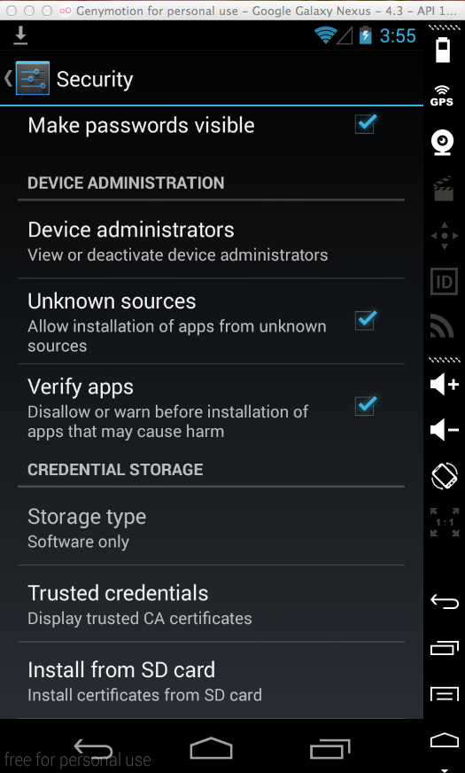
Auditing HTTPS Traffic
If you want to see HTTPS traffic, you must import your proxy's certificate into your test mobile device
With "Install from SD Card" option in Settings

Slide 69
Manipulating Network Traffic Countermeasures
Don't disable certificate verification and validation
Often done during development and debugging for convenience
May be left that way when app is distributed
Example of trust chain

Slide 70
Certificate Pinning
Adds another layer of verification to certificates
Browser knows which CA should validating sites
Either by consulting a whitelist maintained by Google, or
Remembering which CA was used the first time the site was used
Warns user if CA changes
Link Ch 4z62

Slide 71
Don't Trust the Client
Any data from the client may be malicious
Perform strict input validation and output encoding on the server side

Slide 72
Intent-Based Attacks

Slide 73
Intents
Primary inter-process communication (IPC) method used by Android apps
Intents can start internal components, or pass data to them, or go to other apps
Those are called "External Intents"
Links Ch 4z62-64

Slide 74
Code to Send an SMS Intent
Receiving app needs an "Intent Filter" like
android.provider.Telephony.SMS_RECEIVED
If an app is not running, receiving an Intent starts it
Malicious intents can launch other apps, and inject data into them

Slide 75
Command Injection Example
A test app saves files on the SD card, with this Intent Filter

Slide 76
Method to Create File
Executes a shell command, injecting the filename from the calling app

Slide 77
Command Injection
Suppose the calling app sends a filename of:
"MyFIle.txt; cat /data/data/com.test/secrets.xml > /sdcard/secrets.xml"
The exploit will expose any secrets the test app can access

Slide 78
Command Injection Countermeasures
Don't make Intents "exported" unless they are really needed by other apps
Leave them internal to their own app
Perform input validation on all data received from intents
Block special characters like ";" and ">" in a filename

Slide 79
Command Injection Countermeasures
Custom permissions will warn the user that an App has permissions when it is installed
Not much use, in practice
Signature-level permissions
Require any app that wants to send intents to be signed with the same key as the receiving app
That is, from the same company
This can be defeated by re-signing the app

Slide 80
NFC-Based Attacks (Near Field Communication)
Image from techmoran.com

Slide 81
Malicious NFC Tags
An NFC tag can contain a URL pointing to a malicious site
Such as a WebKit exploit
Tags are cheap to buy online
Can be written to by any NFC-enabled phone

Slide 82
From www.slideshare.net/chunkai1312

Slide 83
NFC Attacks
Attackers can make poster with malicious tags
Or replace tags on existing posters
Or overwrite NFC tags in place
If the tag was not properly write-protected
Tag could send user to Google Play
Tag could directly attack an app that uses NFC with unexpected input

Slide 84
Malicious NFC Tag Countermeasures
Keep NFC disabled when you aren't using it
Unfortunately, there's no way to tell if a tag is malicious without reading it
Unless there is evidence of tampering
Developers need to validate data from NFC
Tags must be write-protected

Slide 85
Attacking Apps via NFC Events
Android allows apps to create fake NFC Intents
Creating a fake NFC tag
There's an NFCDemo App
So a vulnerable NFC-using app could be exploited even without an NFC tag

Slide 86
NFC Event Countermeasures
Validation of data received from NFC tags
Custom permissions, or making the Activity private, won't work here
App must receive NFC intents from an external source

Slide 87
Information Leakage

Slide 88
Leakage via Internal Files
Each app has a unique User Identifier (UID) and Group Identifier (GID)
App runs as that user
But an app can create a file set to
MODE_WORLD_READABLE or
MODE_WORLD_WRITEABLE
That file would be visible to all apps on the device, and could be sent to the Internet by any app with INTERNET permission

Slide 89
Android SQLite Journal Information Disclosure (CVE-2011-3901)
SQLite engine created its rollback journal as globally readable and writeable
Normally deleted after each transaction
But setting improper permissions allows hostile apps on the same device to read
Personal info., session tokens, URL history, etc.

Slide 90
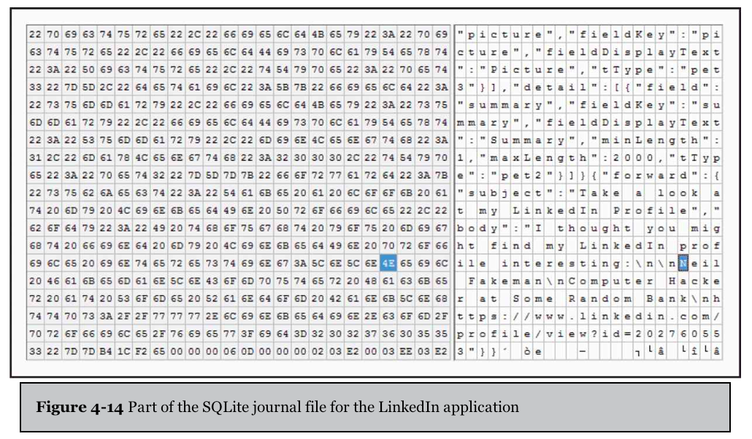
LinkedIn App's Rollback Journal

Slide 91
SQLite Journal Information Disclosure Countermeasures
Install latest patches
App developers should avoid creating world-readable or world-writeable files

Slide 92
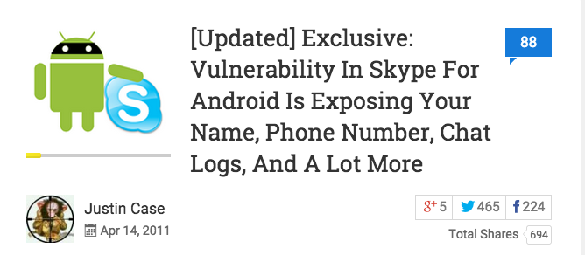
Skype App stored personal data in world-readable files
Link Ch 4z65

Slide 93
Leakage via External Storage
Files stored on the SD card
Or the emulated SD card
Are globally readable and writeable to every app on the device
Apps should only store data they want to share on external storage

Slide 94
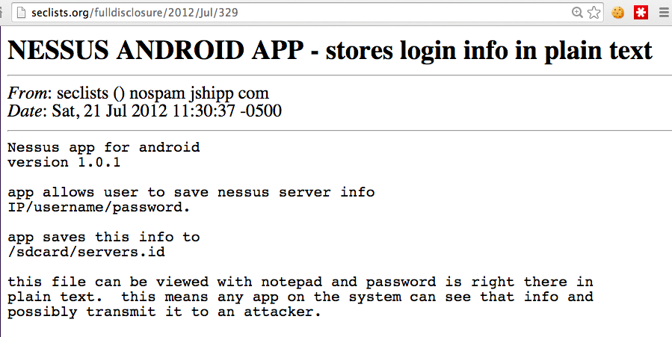
App seems to never have been updated, and later removed from the Google Play Store
Links Ch 4z66-67

Slide 95
Nessus Information Disclosure Countermeasures
Credentials should not be stored in plaintext
They should be encrypted
One good system is AES
Key from Password-Based Key Derivation Function 2 (PBKDF2)
Using a password from the user and a device-specific salt

Slide 96
Information Leakage via Logs
Every app can read the logs, if it requests the android.permission.READ_LOGS permission at install time
Some developers don't realize this and put sensitive information into the logs

Slide 97
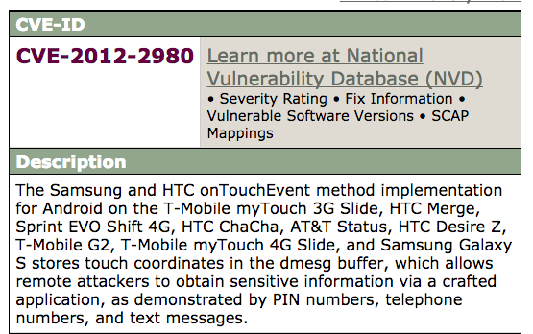
Link Ch 4z68

Slide 98
Facebook SDK Information Disclosure in the Log
Facebook promptly patched it
Link Ch 4z69

Slide 99
Facebook SDK Information Disclosure Countermeasures
Update Facebook SDK to latest version
App developers should not log any sensitive information

Slide 100
Information Leakage via Insecure Components

Slide 101
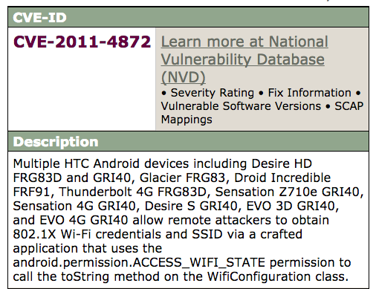
Link Ch 4z70

Slide 102
content:// URI Scheme Leaks Contents of SD Card
Link Ch 4z71

Slide 103
content:// URI Scheme Information Disclosure Countermeasures
Patched poorly in 2.3, and re-patched in 2.3.4
End user can do these things:
Use a different browser, such as Opera
Disable JavaScript in the Android browser (impractical)
Unmount the SD card (impractical because many apps need it)

Slide 104
General Mitigation v. Information Leakage
Logs
Don't log sensitive info.
Files, shared preferences, and SQLite databases
Don't store sensitive info. in plaintext
Don't create globally readable or writeable files
Don't store sensitive info. on SD card without encrypting it properly

Slide 105
General Mitigation v. Information Leakage
WebKit (WebView)
WebView is the Android class that displays Web pages in WebKit
Apps should clear the cache periodically if it's used to view sensitive websites
App can disable caching

Slide 106
General Mitigation v. Information Leakage
WebKit (WebView) continued
WebKit stores sensitive data in the app's data directory, including
Previously entered form data
HTTP authentication credentials
Cookies
On a non-rooted device, other apps won't be able to steal data from the WebKit data store
But if a phone is stolen and rooted, that data can be taken

Slide 107
General Mitigation v. Information Leakage
Inter-Process Communication (IPC)
Don't expose sensitive info. via broadcast receivers, activities, and services exposed to other apps
Don't send sensitive data in intents to other processes
Make components nonexportable

Slide 108
General Mitigation v. Information Leakage
Networking
Don't use network sockets for IPC
Use TLS to transmit sensitive data
CarrierIQ did this (next slide)
Link Ch 4z72

Slide 109
HTC IQRD Android Permission Leakage

