Slide 1
Data Breaches and Password Hashes
Silicon Valley Code Camp
Oct 5, 2013

Slide 2
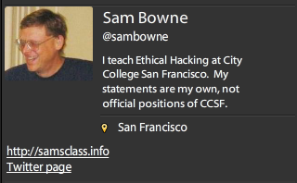
Bio

Slide 3
What is a Breach?

Slide 4
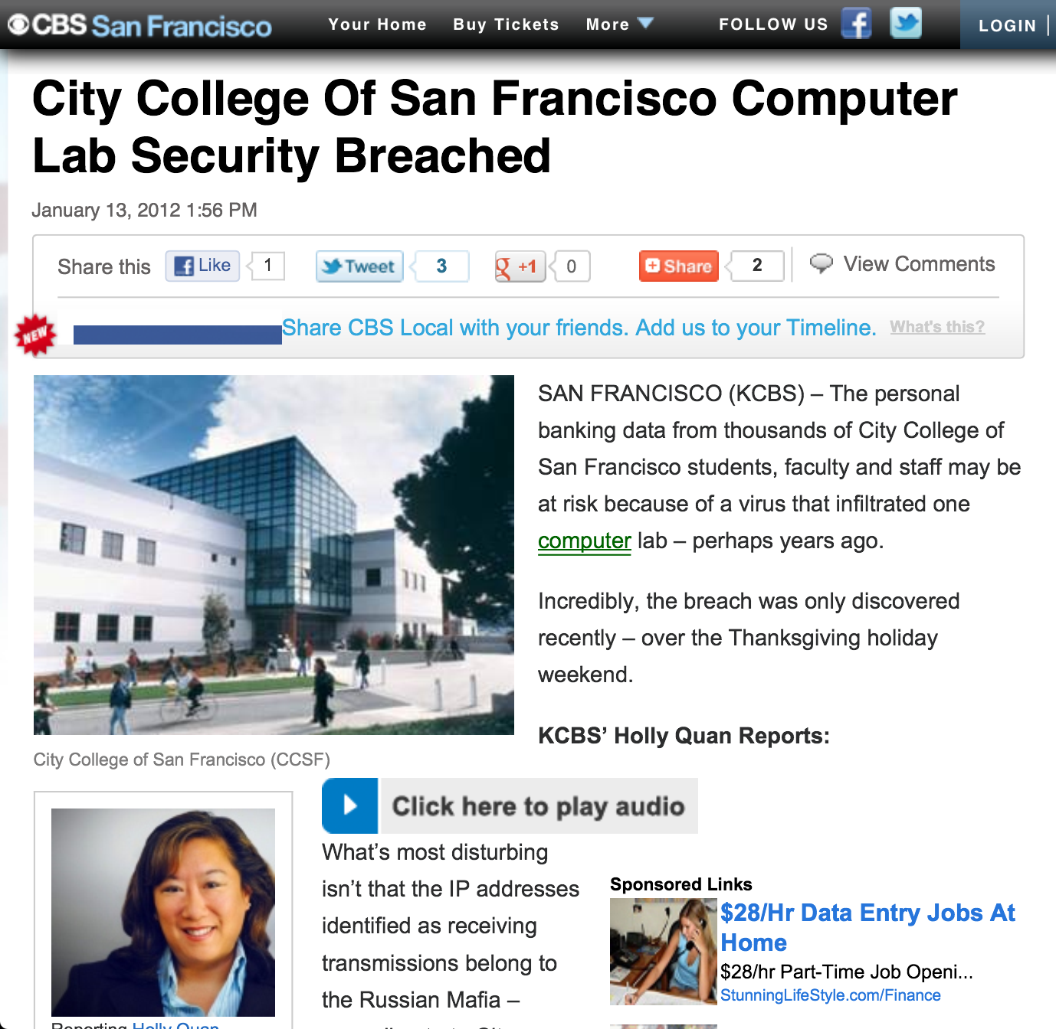

Slide 5
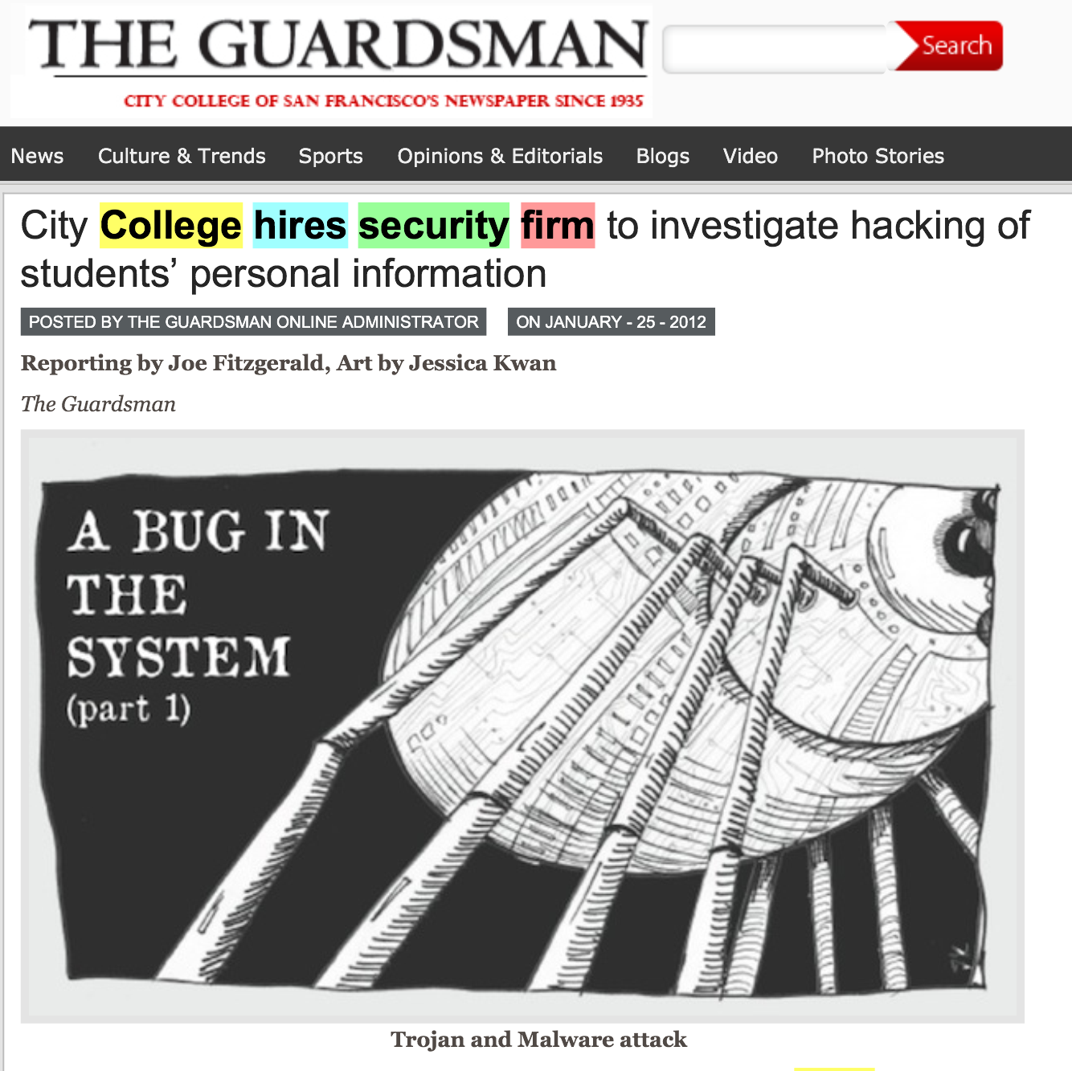

Slide 8
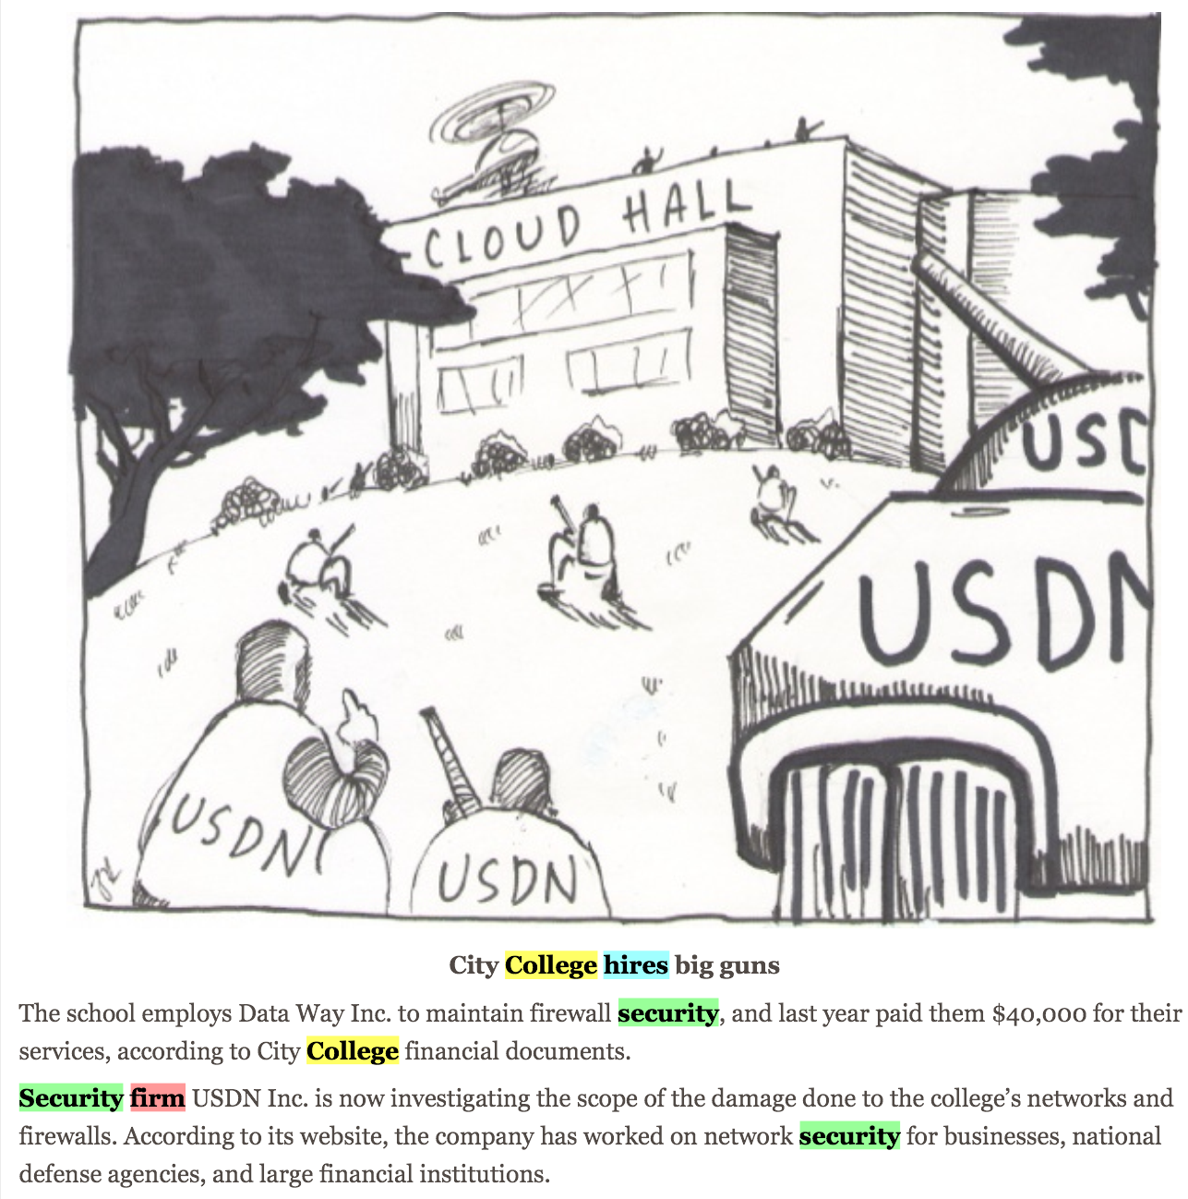

Slide 11
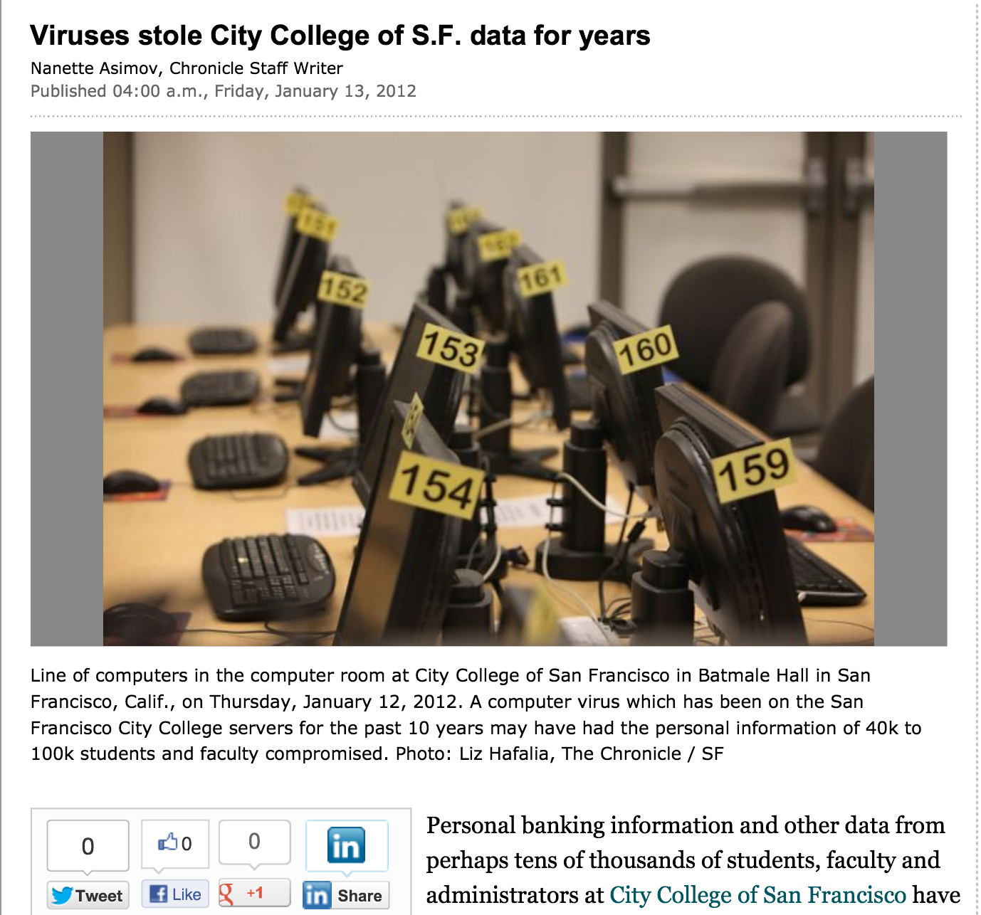

Slide 12
Threats
Outside attacks
Insider threat
Deluded Insider Threat

Slide 13
Security at CCSF
Two generations of complete hardware replacement in the last ten years
McAfee Enterprise antivirus
Deep Freeze
Palo Alto layer 7 firewall

Slide 14
Security Audits
There was a security audit and remediation process performed in 2007-2008 by a contractor
I did another security audit in 2010 with my CISSP students
No major problems found

Slide 15
Evidence for these "Viruses"
A report was supposedly prepared by USDN in Nov 2011, but we were never able to get a copy of it at all
The presentation from the CTO that went to the press was in Jan. 2011
We finally got a partial report on Jan. 31, lacking the appendices that were the evidence
"Proprietary and Confidential" but later published in the newspaper

Slide 16
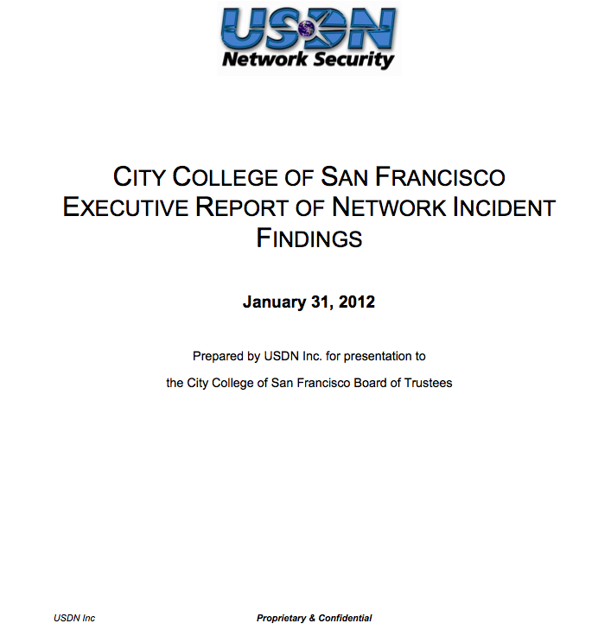

Slide 17
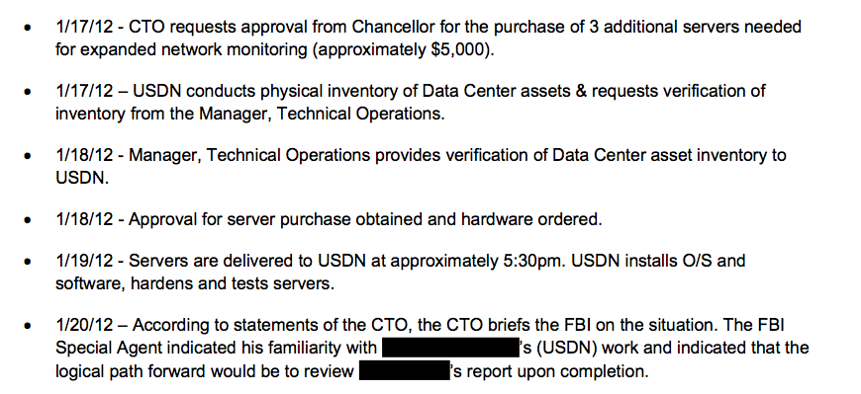
Wait, the FBI?

Slide 18
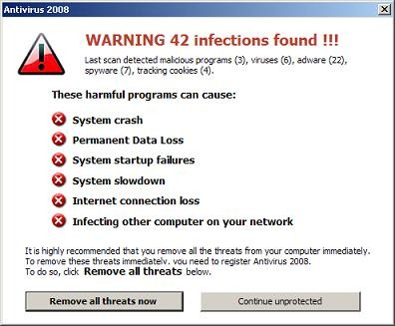
You are a manager, and a contractor says you have a scary virus infection. Who do you call immediately?
Upper management
Your IT Staff
Tell no one, keep it a secret
The FBI
The San Francisco Chronicle

Slide 19
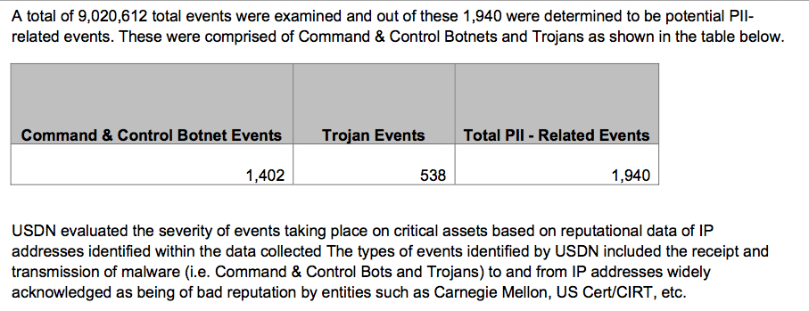

Slide 20
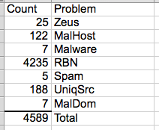
The List
On April 3, we finally got a list of the "infected machines"
Direct inspection of samples showed no real infections

Slide 21
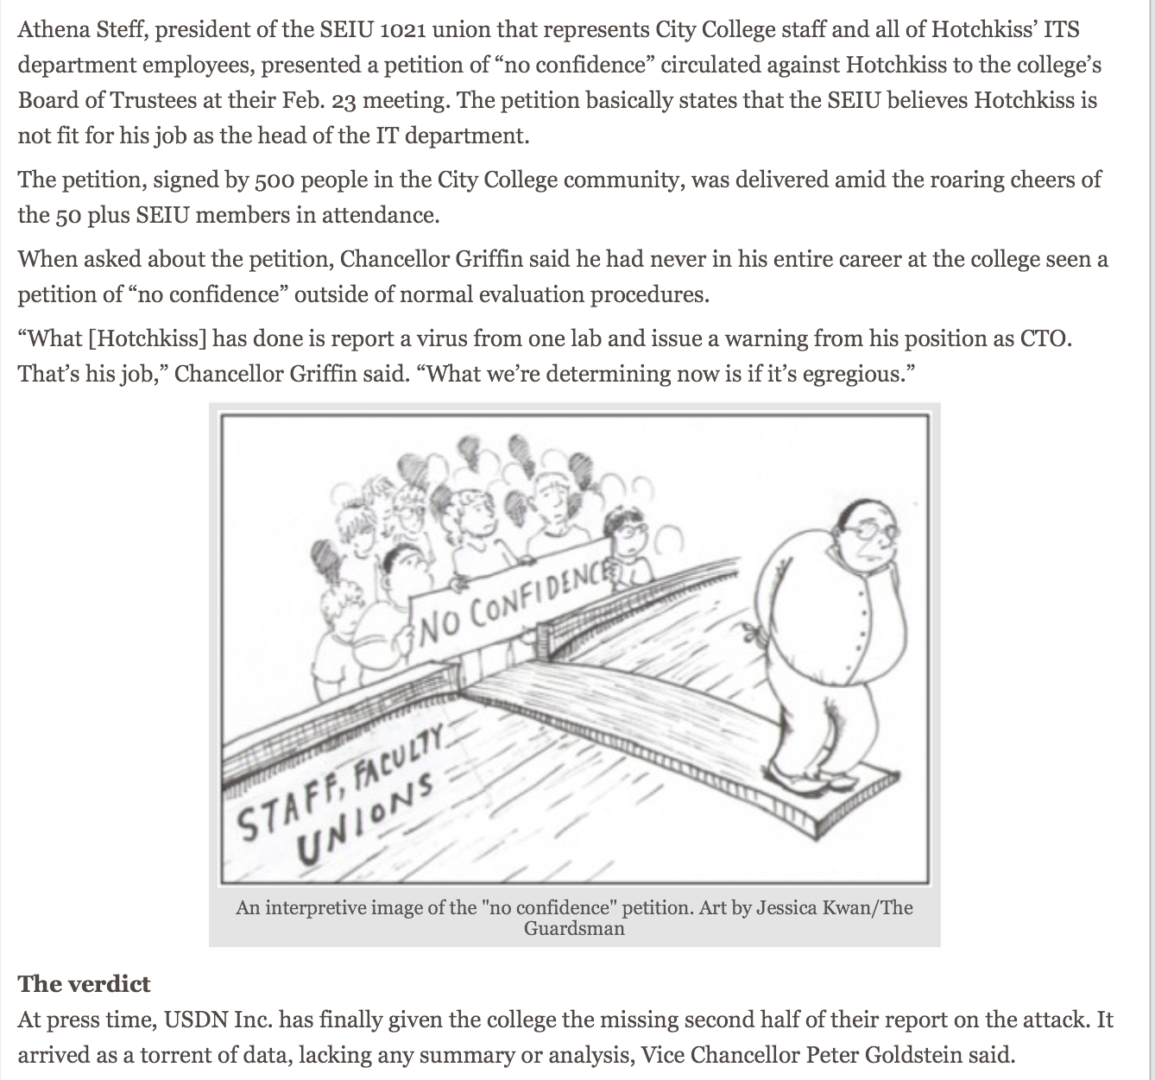

Slide 22
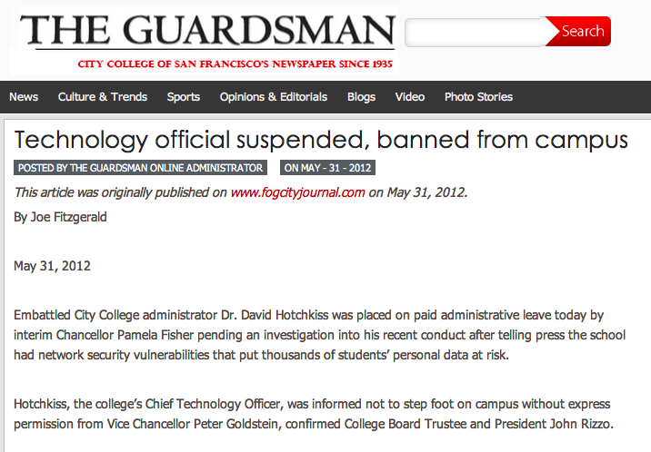

Slide 23
How Does a Real Breach Happen?

Slide 24
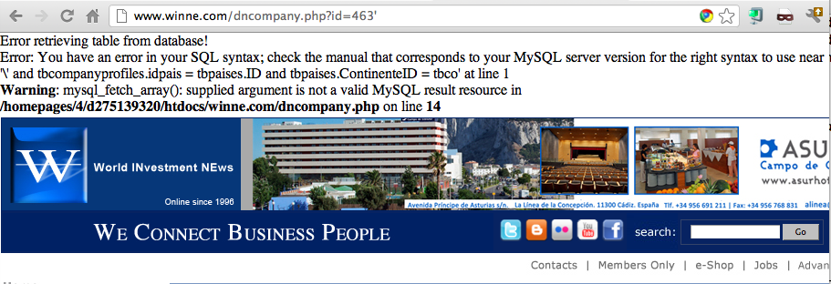
Example SQL Injection Vulnerability

Slide 26
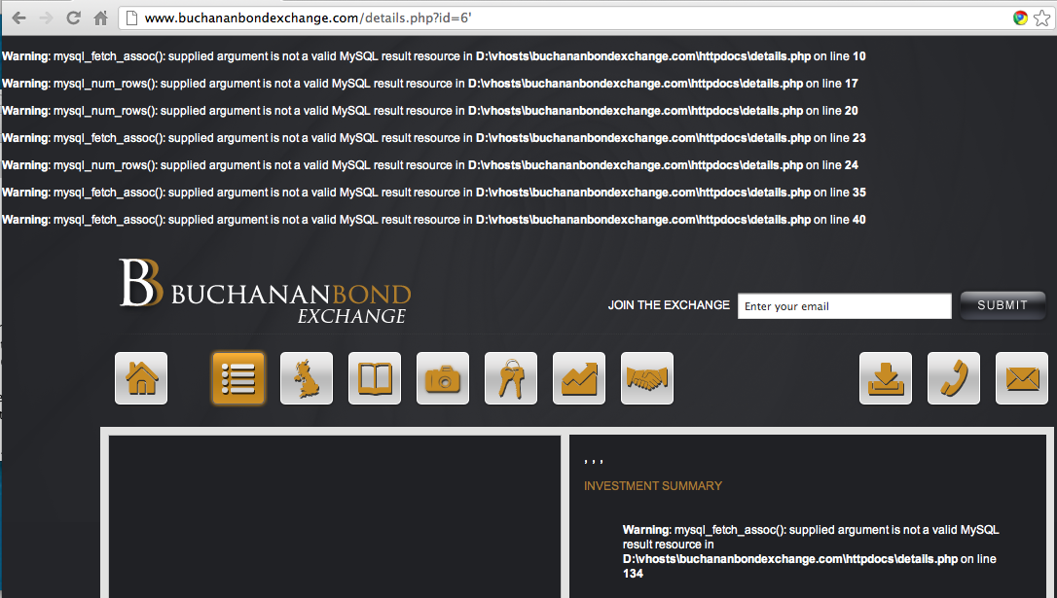

Slide 27
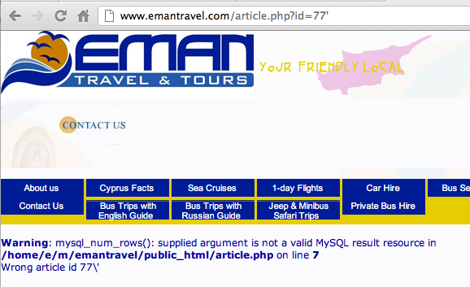

Slide 28
The Commands Used to Steal the Data

Slide 29
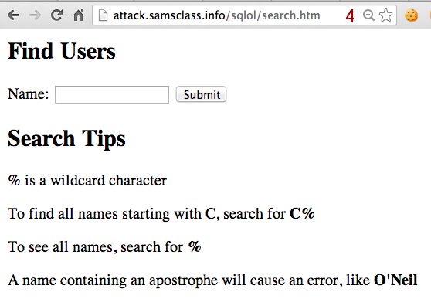
Demo

Slide 30
Vulnerable

Slide 31
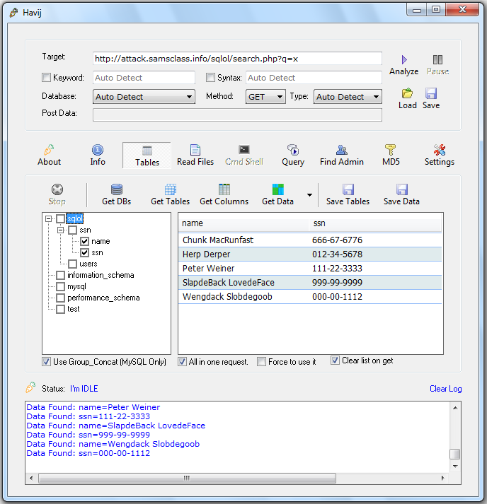
Havij

Slide 32
Analysis of Stolen Data Dumped by TEAMGHOSTSHELL on Aug 25, 2012

Slide 33
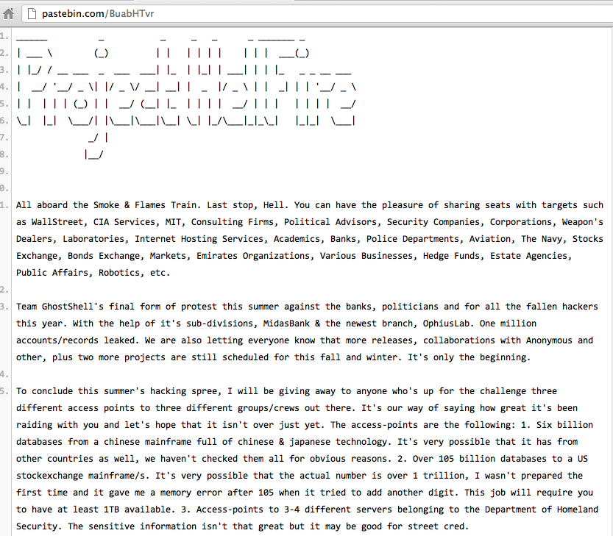

Slide 34
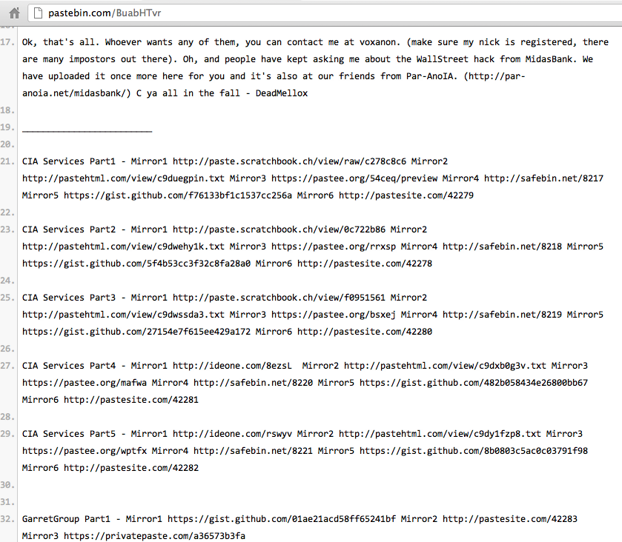

Slide 35
Password Storage: Awful Beyond Belief
Plaintext, obvious, all the same

Slide 36
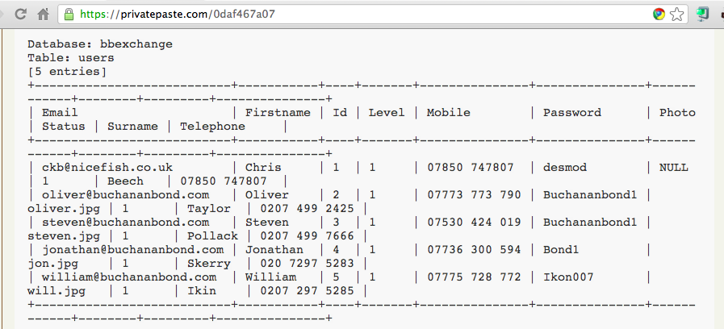
Plaintext Passwords, Easily Guessed

Slide 37
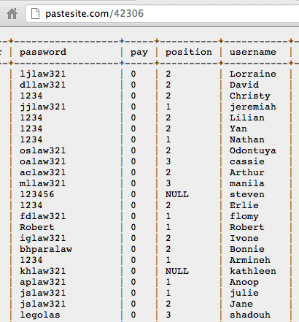

Slide 38
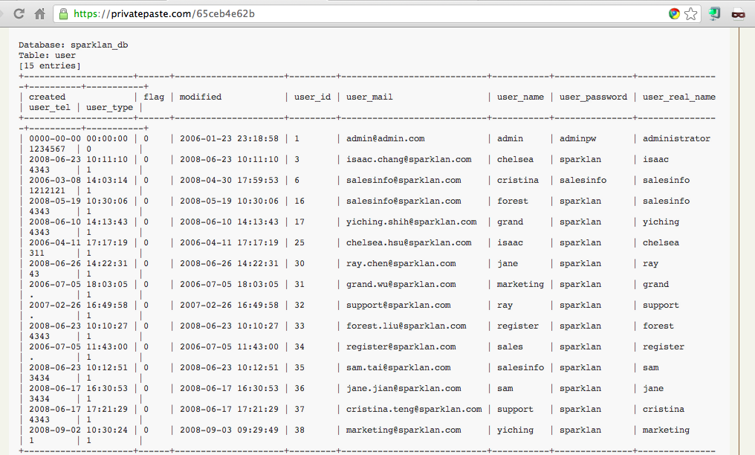
Sparklan Passwords

Slide 39
Beforward Transactions with PII

Slide 40
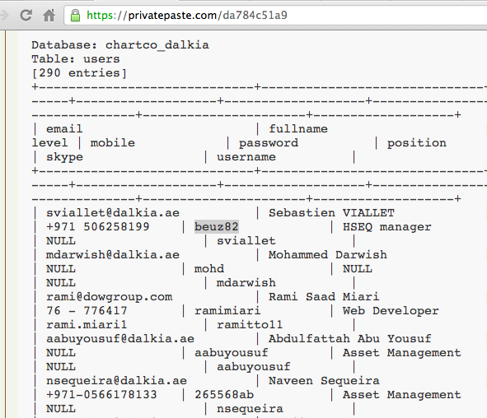
Plaintext Passwords

Slide 41
Password Storage: BASE64
Obfuscated, not hashed

Slide 42
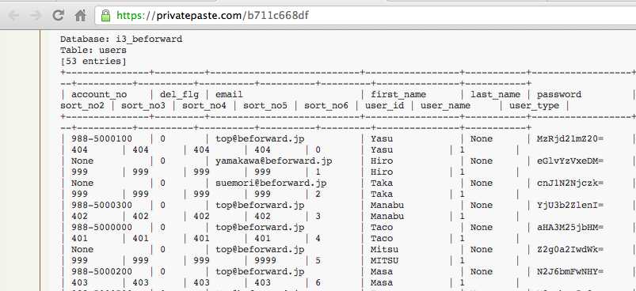
Beforward.jp

Slide 43
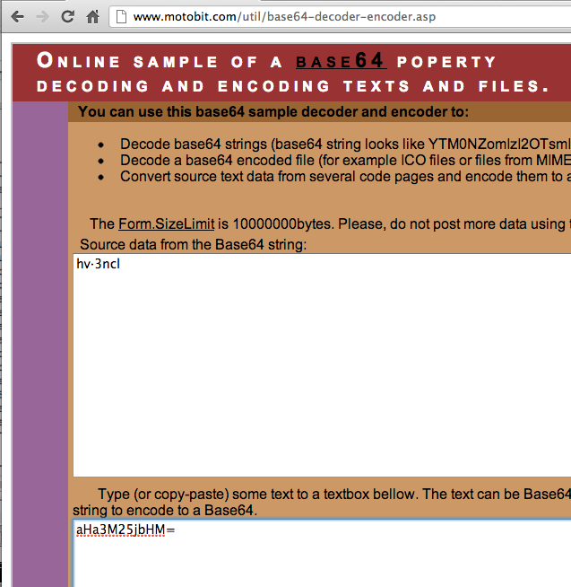
BASE64 Encoding

Slide 44
Password Storage: Unsalted MD5 or SHA-1
Real hashing, but very easy to crack

Slide 45
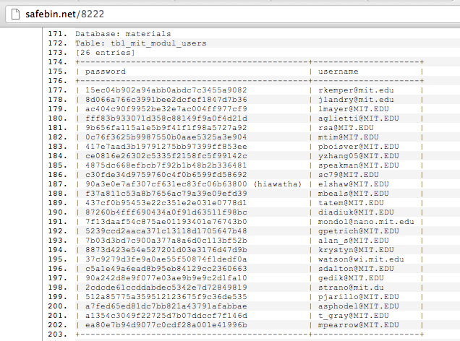
MIT – MD5 Password Hashes

Slide 46
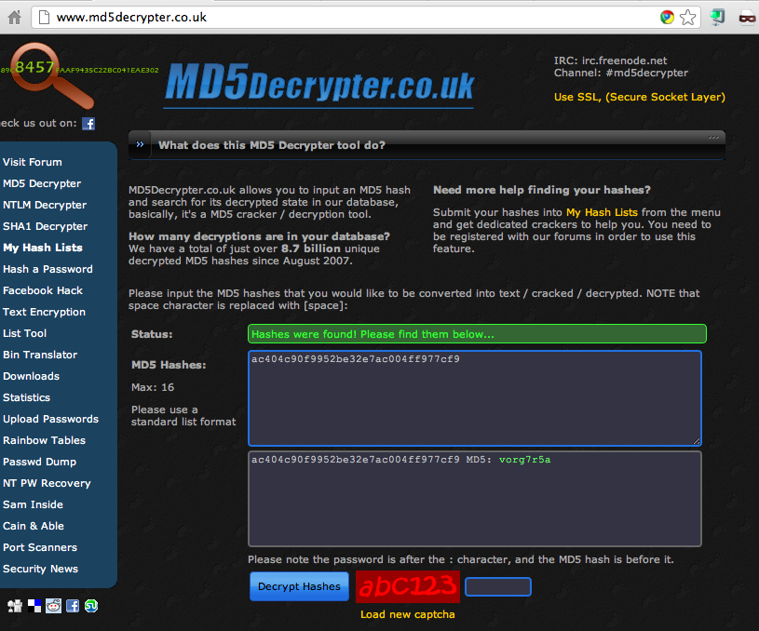

Slide 47
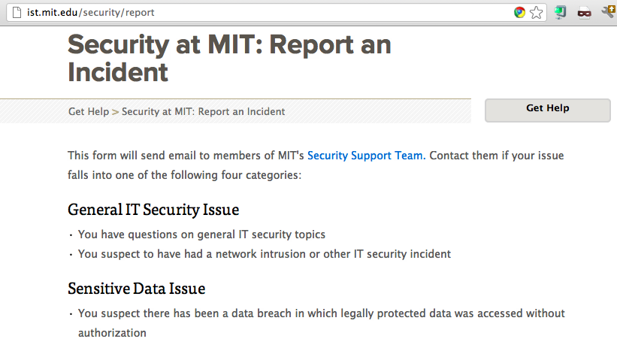

Slide 48
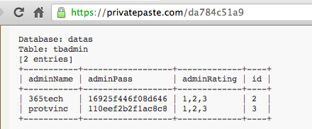
MySQL323 Password Hashes

Slide 49
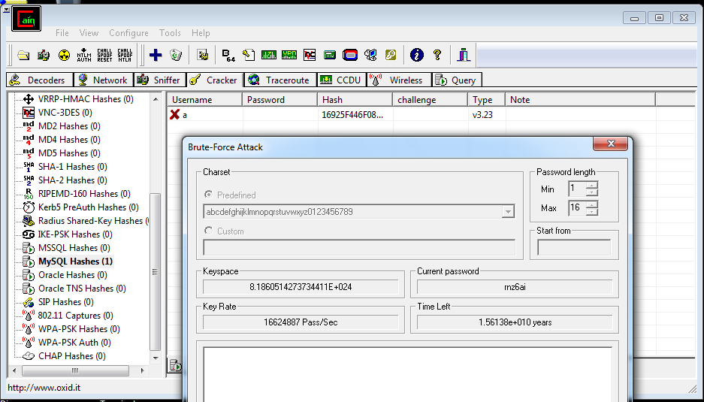
Cracking Hashes with Cain

Slide 50
SHA-1 Hash

Slide 51
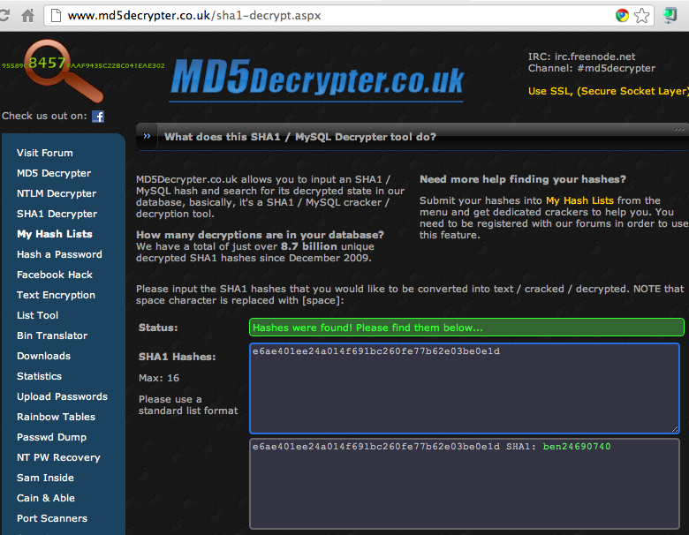
Cracked!

Slide 52
MySQL 5 Password Hashes

Slide 53
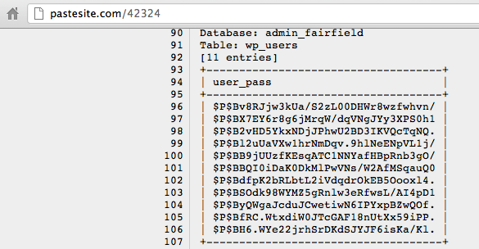
Wordpress Password Hashes

Slide 54
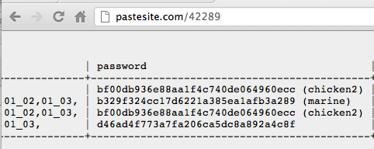
Relative Space

Slide 55
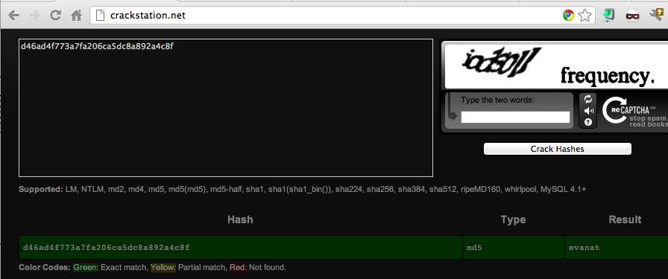
Cracked!

Slide 56
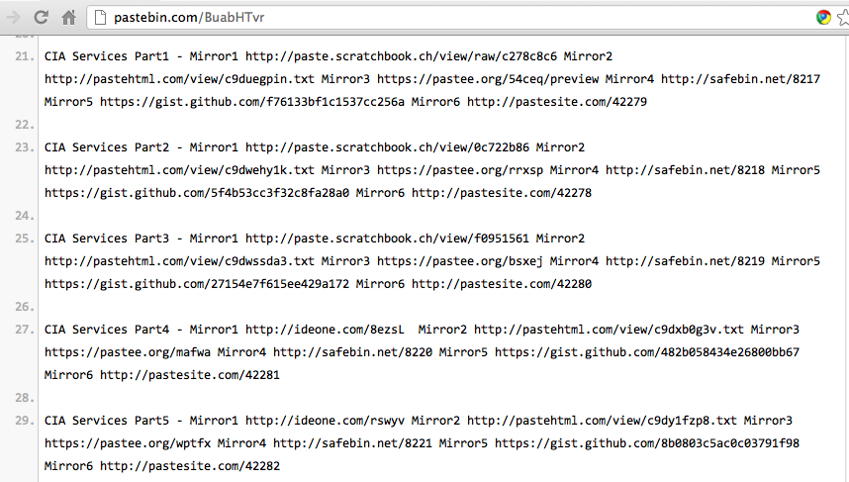

Slide 57
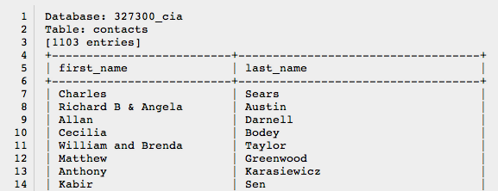
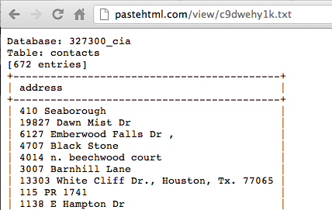
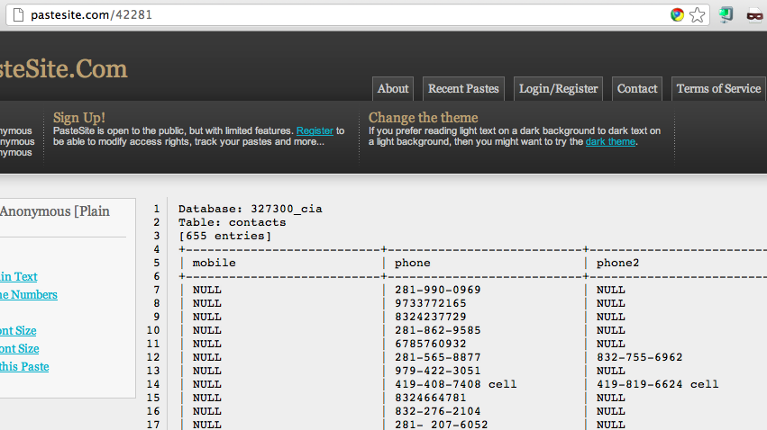

Slide 58
Password Hashing Algorithms

Slide 59
Hashing Passwords
Three essential steps
One-way hash function
MD5, SHA-1, SHA-256, etc.
Salt
Random characters added to each password
Prevents rainbow-table attack
Stretching
Repeat the hash function many times (typically 5000)
Make it take 50 ms to calculate the hash
Minimally slows login
Makes attack MUCH slower

Slide 60
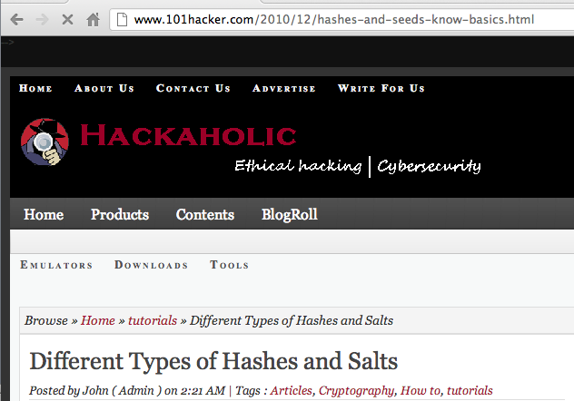

Slide 61
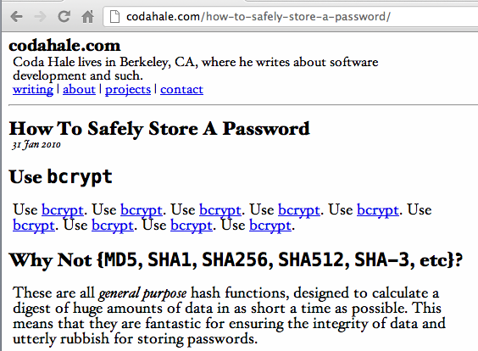
The Right Way

Slide 62
Popular Password Hashes
Type | Projected time to crack 1,000 hashes* | Hash Function | Salt (# chars) | Stretching (# rounds)
Drupal 7 | 1.7 years | SHA-512 | 8 | 16385
Linux (Debian) | 58 days | SHA-512 | 8 | 5000
Wordpress 3.5.1 | 17 hours | MD5 | 8 | 8193
Windows (all current versions) | 5.4 min | MD4 | None | 1
Joomla | 4.6 min | MD5 | 16 | 1
Calculation assumes the passwords are found in a dictionary of 500,000 guesses
One virtual machine running Kali
A clusters of GPUs would be much faster

