Slide 1
PowerShell
Class 2
Substituting for Doug Spindler
1-23-14

Slide 2
Notes are Online
http://pacitpros.org/ccsf

Slide 3
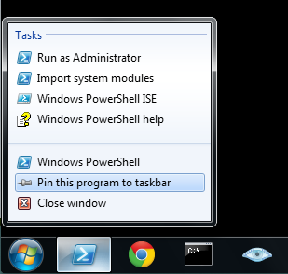
Pin PowerShell to Taskbar
Start
Search for PowerShell
Open it
Right-click taskbar button, "Pin this program to taskbar"
"Run as Administrator" in Windows 7

Slide 4
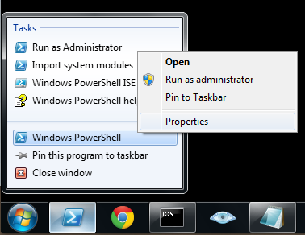
Run as Administrator
Right-click taskbar button
Right-click "Windows PowerShell"
Click Properties
Click Advanced
Check "Run as Administrator"
Click OK, OK

Slide 5
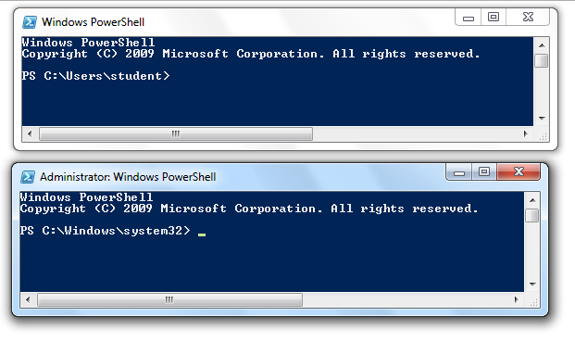
Checking Administrator Status
Look at the top of your PowerShell window
  The "title bar"
It should start with "Administrator"

Slide 6
Case Insensitive
GET-DATE is same as get-date
LS is same as ls
  Surprise for Linux users
Use Notepad to save commands

Slide 7
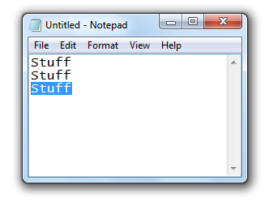
Copy and Paste in Notepad
Click & drag to highlight text
Ctrl+C to copy
Ctrl+V to paste
This is the standard for Windows, but, unfortunately, NOT in PowerShell (or DOS)

Slide 8
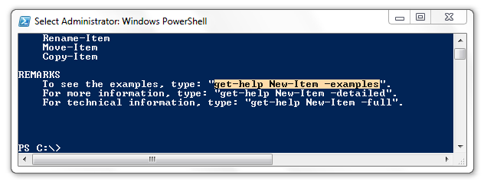
Copy and Paste in PowerShell
Click & drag to highlight text in Powershell
Press Enter to copy
Right-click to paste
Ctrl+C cancels a command, it does not copy

Slide 9
Keyboard Shortcuts
Tab Completion
  Very useful, prevents misspellings
  Can hunt for commands
  Try get-c Tab
    Tab again for next alphabetical command
    Shift-Tab to go backwards through the alphabet
Up-arrow history
  VERY handy to fix incorrect commands, or to construct similar commands

Slide 10
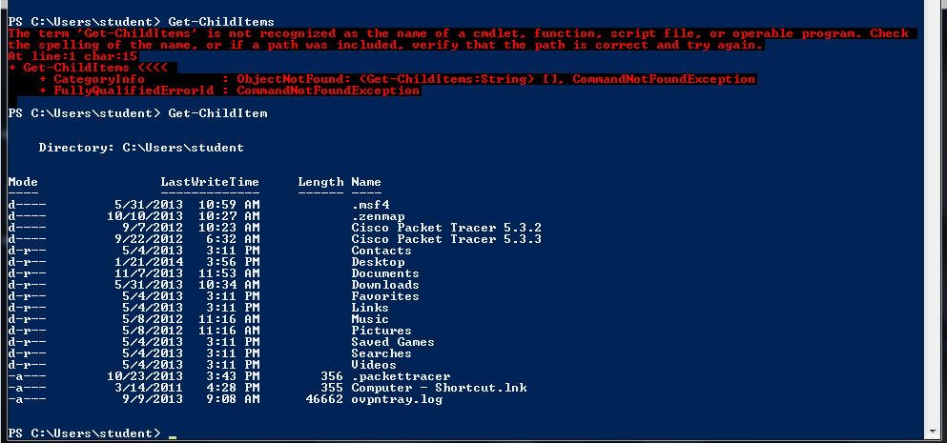
Red Letters = ERROR

Slide 11
DOS Commands
Clearing the screen:
  cls
  cls /? for help
clear works in Linux and PowerShell but not in DOS

Slide 12
DOS Commands
Working directory
  cd does nothing (unlike Linux)
  cd .. goes to the parent directory
  cd \ goes to the root of the current drive
  cd \Temp goes to C:\Temp (if current drive is C:)
  chdir Same as cd

Slide 13
DOS Commands
DIR
Shows contents of current directory
Required often, since you don't have a window showing the contents of the working directory
  dir Normal directory listing
  dir /w Wide output (doesn't work in PS)
  dir /p One page at a time
  dir W* Show files and folders starting with w
  dir /? Help

Slide 14
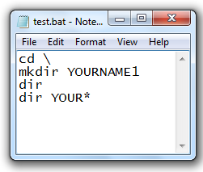
DOS Commands
copy a b Copy file a to file b
mkdir C:\foo Creates directory C:\foo
Demo
Run in CMD
Run in Powershell
Save as .BAT file
Run .BAT file

Slide 15
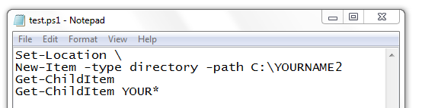
Translating DOS to PowerShell
Use Get-Help command
command can be in DOS, Powershell, or Linux

Slide 16
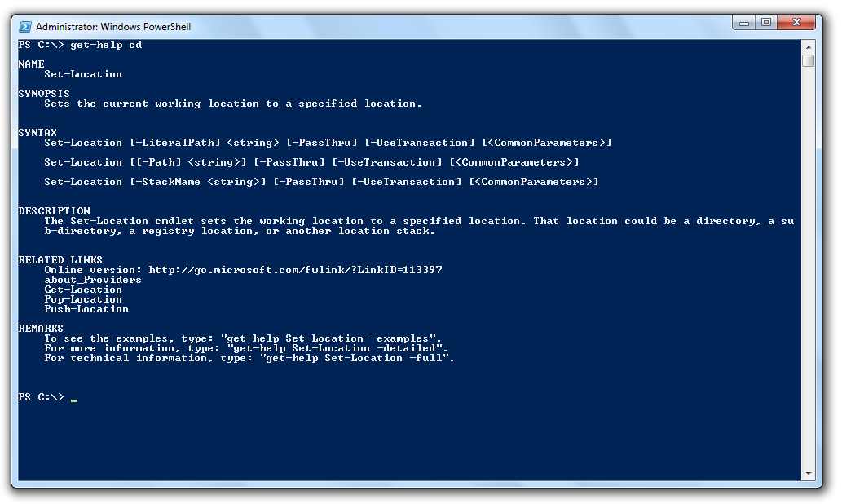
Get-Help CD
Read the whole thing
  Append | more for large help pages
Note examples at bottom

Slide 17
Help
get-help (General)
get-help location (More specific.)
get-help get-location (Even more specific.)
get-help about_locations (And even more specific.)
get-help get-* list of all the uses of get (This changes as Microsoft adds more commands..)
Look at the difference between
  get-help get-location –examples
  get-help get-location –detailed
  get-help get-location –full

Slide 18
The PS verbs Get, Set and New
Get – Retrieves or Gets information.
Set – Establishes or Sets a parameter.
New – Creates a new item.

Slide 19
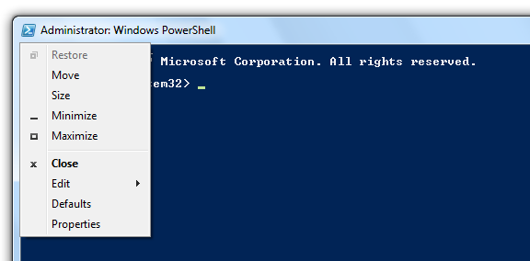
Customizing the PowerShell Window
Click the icon in the upper left, Properties
Can adjust fonts, colors, etc.

Slide 20
iClicker Questions

Slide 21

Which button launches PowerShell?
A B C D E

Slide 22
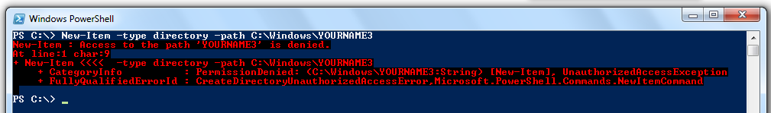
What's wrong here?
Syntax is incorrect
Wrong PowerShell Version
Must open a different Powershell window
Must use CMD to do this
Nothing is wrong, the command worked

Slide 23
Which of these is not a valid PowerShell verb?
Get
Run
Set
New
None of the above

Slide 24
What action pastes code into PowerShell?
Ctrl+V
Enter
Right-click
Left-click
None of the above

Slide 25
What action cancels the current command?
Ctrl+V
Enter
Ctrl+X
Left-click
Ctrl+C

Slide 26
What keypress completes a command automatically?
.
Enter
Tab
Logo
Up-arrow

Slide 27
What keypress repeats a previous command?
.
Enter
Tab
Logo
Up-arrow

Slide 28
What can you add to a command to stop it scrolling off the screen?
| more
/ more
/p
| less
More than one of the above

Slide 29
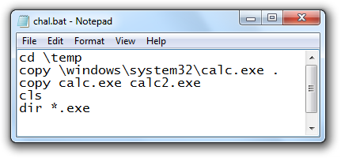
Challenge
Convert to PowerShell

Slide 30
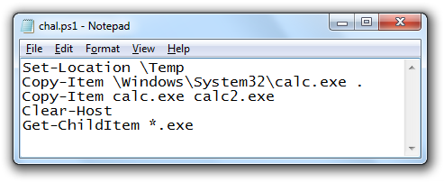
Answer

