Slide 1
NSLOOKUP
CNIT 102
Substitute lecture
3-6-14
Sam Bowne

Slide 2
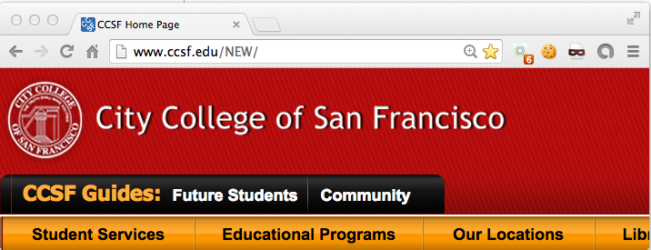
Domain Name System
Converts a domain name like www.ccsf.edu
to an IP address like 147.144.1.212

Slide 3
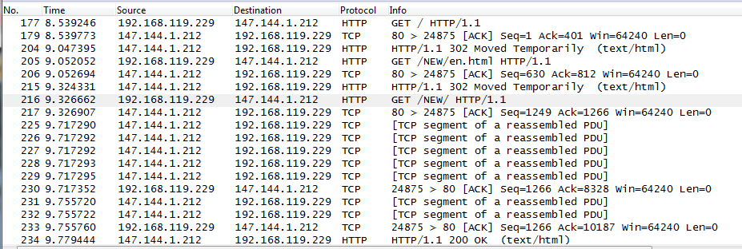
Wireshark
Shows traffic going to server at 147.144.1.212

Slide 4
DNS Resolution
Packets in Wireshark show DNS Query and DNS Response

Slide 5
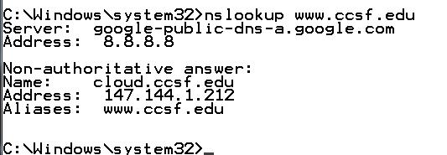
NSLOOKUP
Performs a DNS resolution
  Without loading a Web page
  Useful to test DNS operations
Simplest way
  nslookup domain.com

Slide 6
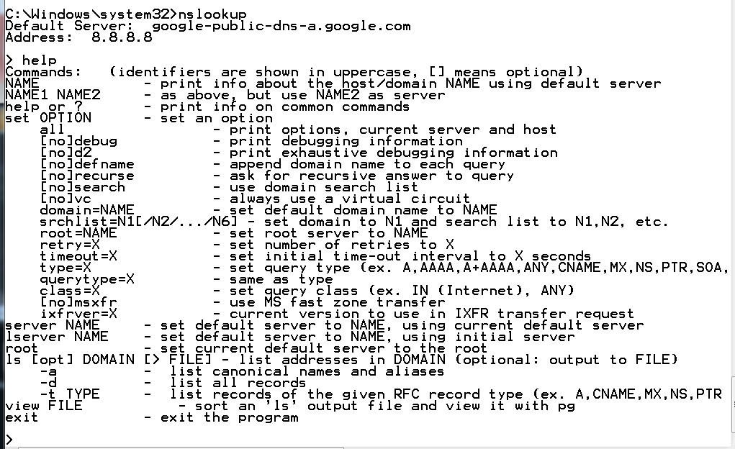
NSLOOKUP in Interactive Mode

Slide 7
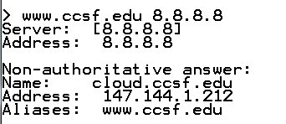
Specify Server

Slide 8
Free Public Servers
Google
  8.8.8.8
  8.8.4.4
OpenDNS
  208.67.222.222
  208.67.220.220

Slide 9
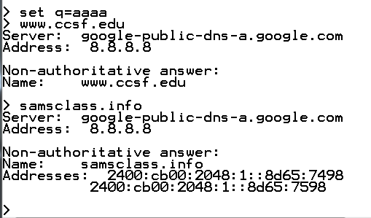
Set Querytype
aaaa = IPv6

Slide 10
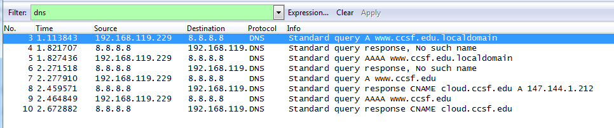
What NSLOOKUP Does
First it tries to find the domain on your local network
Then it tries the Internet

Slide 11
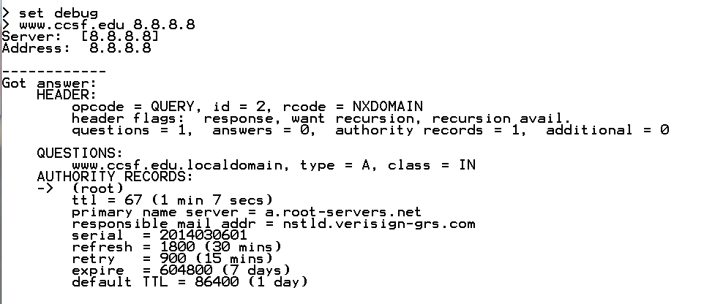

Slide 12
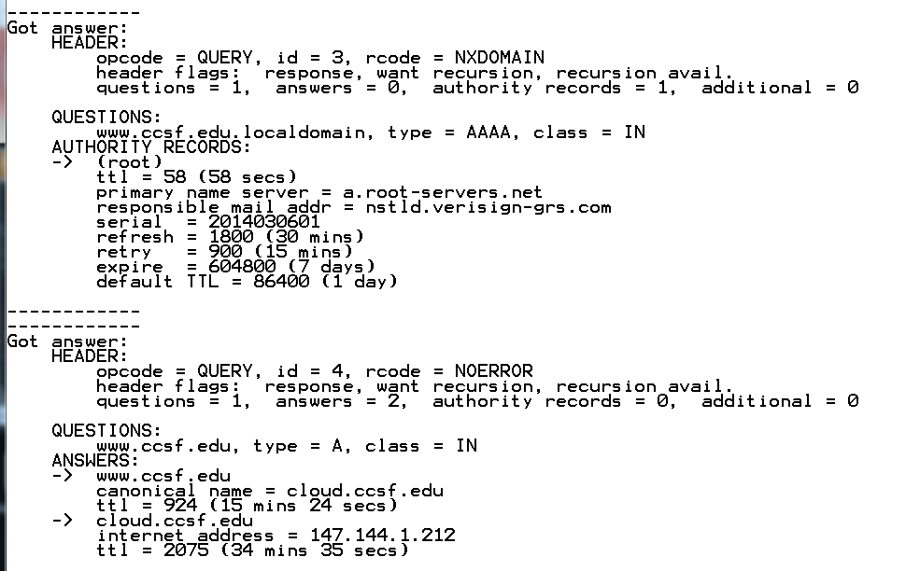
Debug Mode

Slide 13
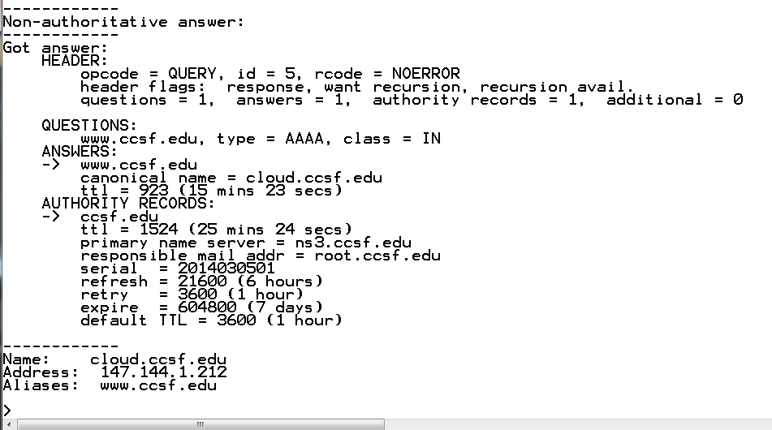

Slide 14
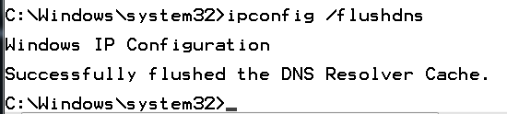
Clearing the DNS Cache

Slide 15
Setting the DNS Server
Start, type CONNECTIONS in Search box
Click "View network connections"
Right-click "Local Area Connection"
Click Properties
Double-click "Internet Protocol Version 4 (TCP/IPv4)"

Slide 16
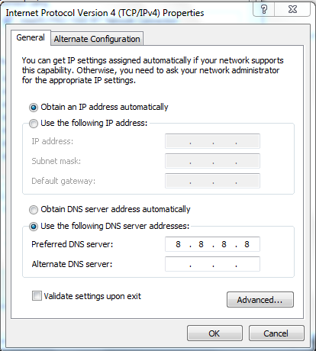
Setting the DNS Server
Must click "OK" twice for settings to take effect

Slide 17
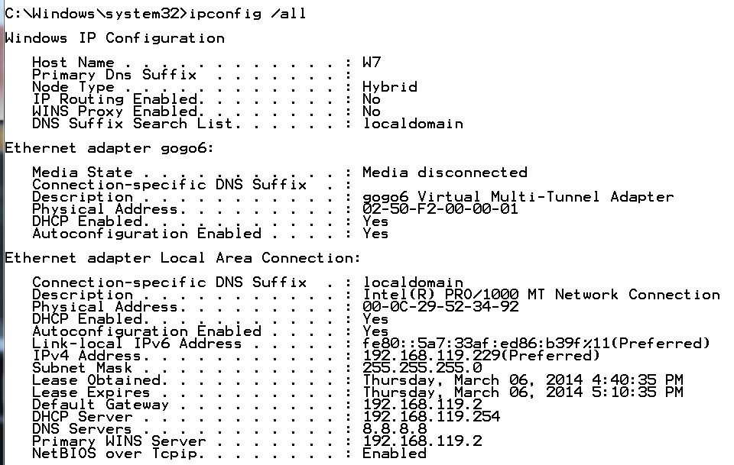
Viewing the DNS Server in the Command Line
IPCONFIG /ALL

