Slide 1
CompTIA Network+ N10-006
Authorized Cert Guide
Chapter 11
Network Management

Slide 2
Foundation Topics
Maintenance Tools
Configuration Management
Monitoring Resources and Reports

Slide 3
Managing a Network
What are some of the more common tools used to physically maintain a network?
What components are involved in configuration management?
What sorts of network monitoring tools are available to network administrators, and what types of information are included in various logs?

Slide 4
Maintenance Tools
Many network problems can be reduced through proper installation and configuration. Multiple hardware and software tools are available to help diagnose, isolate, and resolve issues.

Slide 5
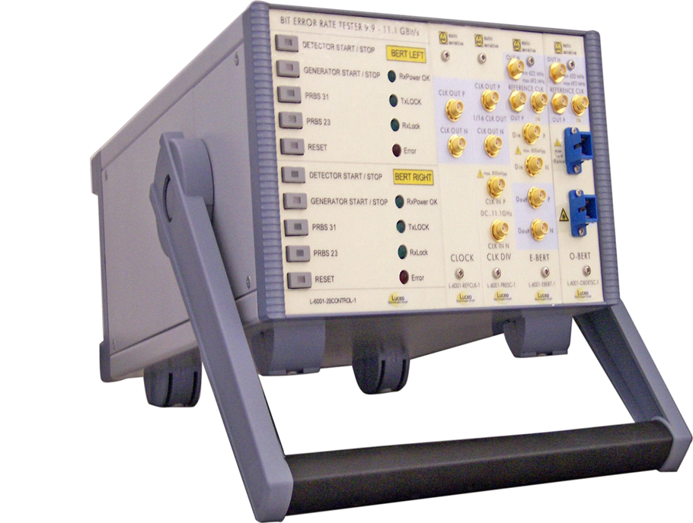
Bit-Error Rate Tester (BERT)
The bit-error rate tester generates patterns at one end of a link and analyzes the received patterns for errors.

Slide 6

Butt Set
The butt set is a piece of test equipment typically used by telephone technicians to check for dial tone or verify that a call can be placed from the line. Its usefulness for network technicians is limited.
Notes:
The name comes from the device’s capability to butt into (interrupt) a telephone conversation.

Slide 7
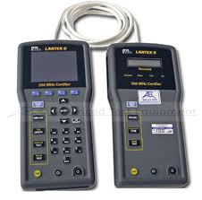
Cable Certifier
Used with existing cable to determine its category (Cat 3, Cat 5, Cat 6, and so on) or test data throughput.

Slide 8
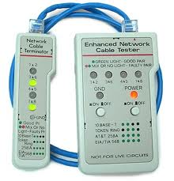
Cable Tester
Tests the conductors in an Ethernet cable. Verifies continuity for each wire in the cable and the pinouts of the connectors.

Slide 9
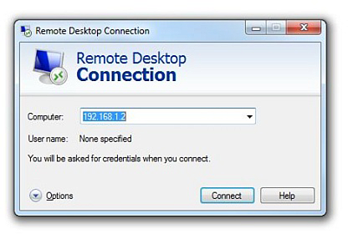
Connectivity Software
Remote connectivity software enablesyou to access the network via a PC that is located on a remote network.
Examples of this software include the following:
RealVNC
GoToMyPC
Microsoft Remote Desktop Connection

Slide 10
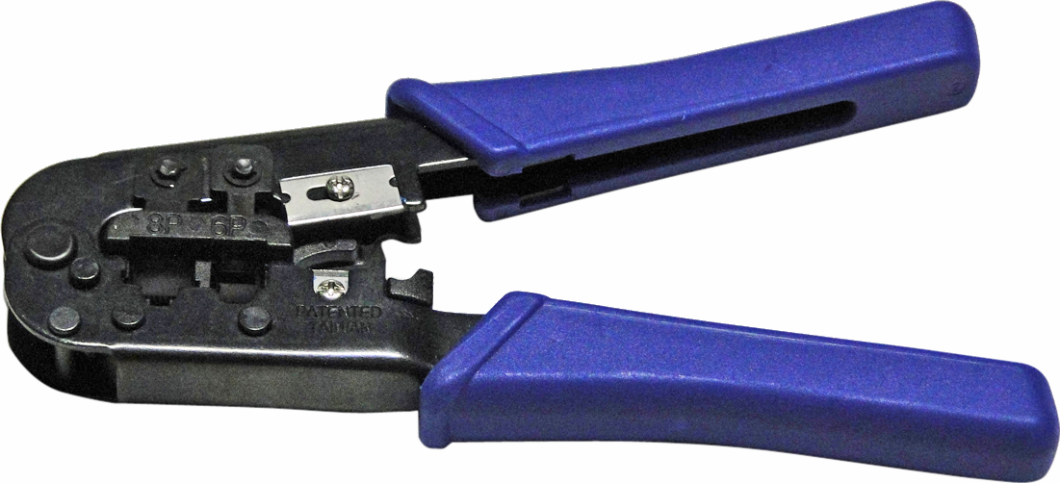
Crimper
A crimper is used to attach a connector to the end of a cable. This allows you to make your own cables of nonstandard length.
Notes:
The crimper pictured would be used to crimp an RJ-45 connector to a UTP cable. A different style crimper can be used with coax cables.

Slide 11
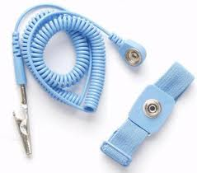
Electrostatic Discharge (ESD) Wrist Strap
The ESD wrist strap allows static buildup in your body to be discharged into a grounded object instead of into electrical components that could be damaged.

Slide 12
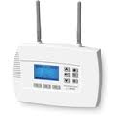
Environmental Monitor
An environmental monitor sends alerts if the temperature or humidity in a room changes above or below configured thresholds.

Slide 13
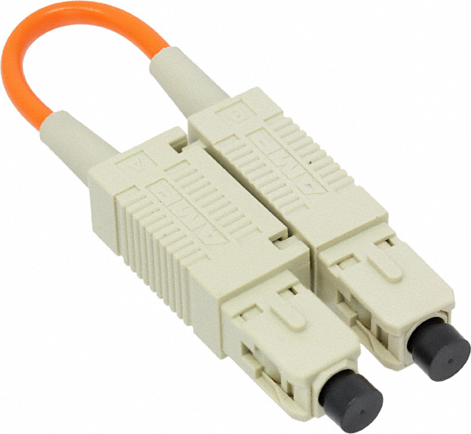
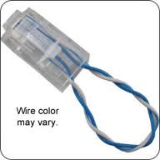
Loopback Plug
A loopback plug connects the transmit pins (or fibers) to the receive pins (or fiber) to test network interfaces.

Slide 14

Multimeter
A multimeter is used with copper cabling to verify continuity (like a cable tester) or that voltage is being applied.

Slide 15
Protocol Analyzer
A protocol analyzer is also known as a network sniffer.
Traffic can be captured from the network and then reviewed for problems in the communication between devices.
It can be a standalone device, but it is usually software running on a laptop computer. Wireshark is an example of a protocol analyzer.

Slide 16
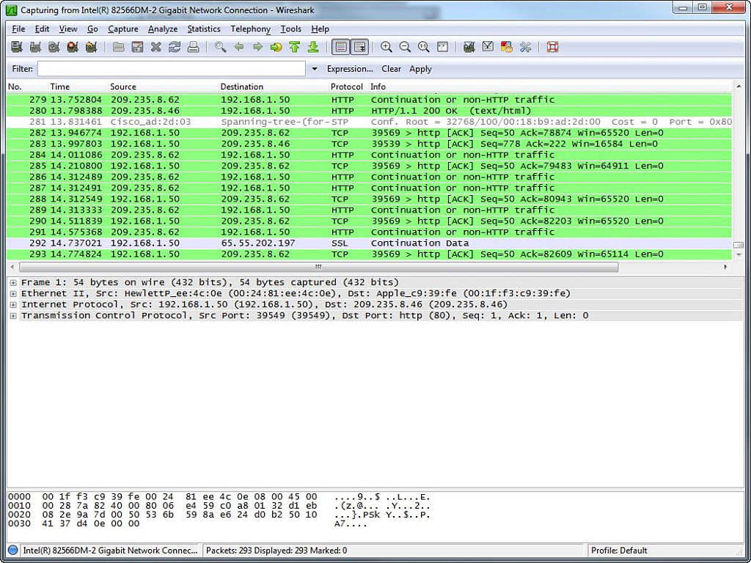
Wireshark
Protocol Analyzer Software

Slide 17
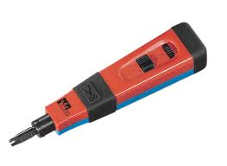
Punch-Down Tool
Used to terminate wires on a punch-down block without stripping off the insulation

Slide 18
Throughput Tester
A throughput tester is a network appliance that typically has multiple network interfaces and can generate high volumes of pseudo-random data.
It can be used on prototype networks to observe how the network performs under a heavy load. It can also be used on production networks to determine the actual throughput of the existing network.

Slide 19
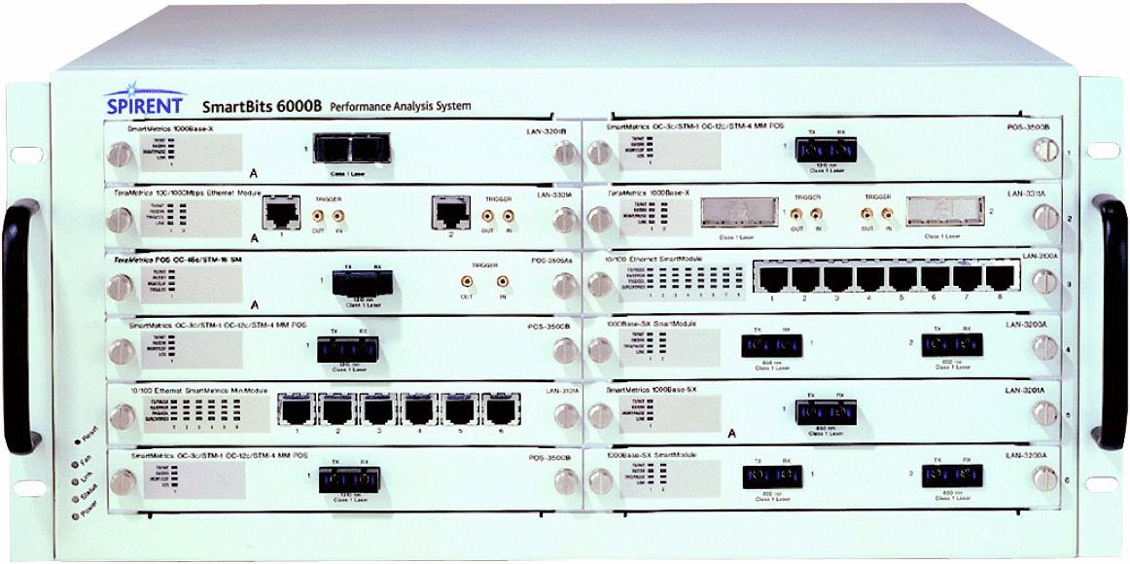
Throughput Tester

Slide 20
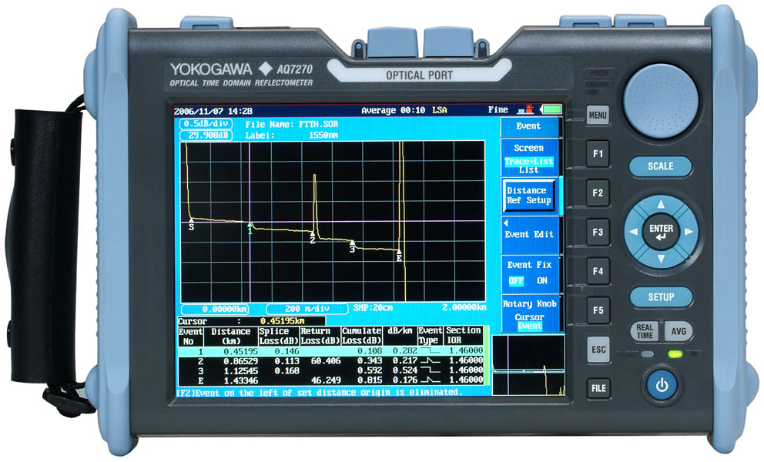
Time Domain Reflectometer /
Optical Time Domain Reflectometer
A time domain reflectometer (TDR) is used to locate breaks in copper cables and provide an estimate of where the break is.
An optical time domain reflectometer (OTDR) does the same thing for fiber-optic cables.

Slide 21
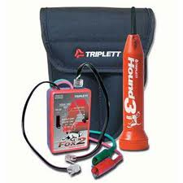
Toner Probe
A toner probe allows you to place a tone generator at one end of a connection and use the probe on a punch-down block to audibly detect to which pair of wires the tone generator is connected.

Slide 22
Configuration Management
Configuration management (CM) focuses on maintaining up-to-date documentation of a network’s configuration.
Procedures in CM include the following:
Asset management
Baselining
Cable management
Change management
Network documentation

Slide 23
Monitoring Resources and Reports
Examples of monitoring resources and reports include the following:
Syslog server
Simple Network Management Protocol (SNMP) server
Event Viewer logs
Network sniffer packet captures

Slide 24
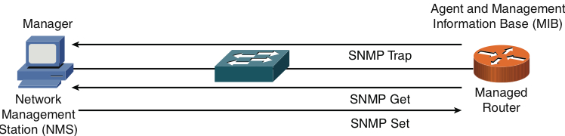
Simple Network Management Protocol (SNMP)
An SNMP manager can send information to (SET), request information from (GET), or receive unsolicited information from managed devices (TRAP), such as routers, switches, and servers.

Slide 25
SNMP
SNMPv1 and SNMPv2c use community strings to gain access to a device. If left to the default community strings of public (read-only) or private (read-write), devices could be compromised.
SNMPv3 addressed these weaknesses with three primary security enhancements:
Integrity
Authentication
Encryption

Slide 26
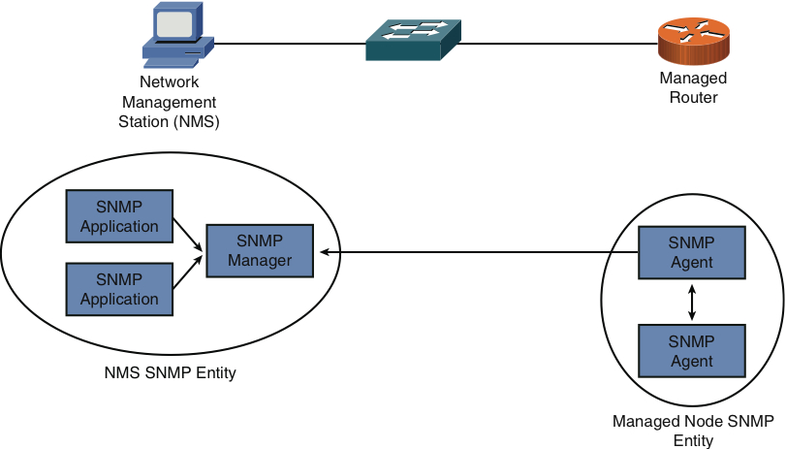
SNMPv3 Entities

Slide 27
Syslog
Routers, switches, and servers can send their log information to a common syslog server. This allows administrators to better correlate events.
There are two primary components in a syslog logging solution:
Syslog servers
Syslog clients

Slide 28
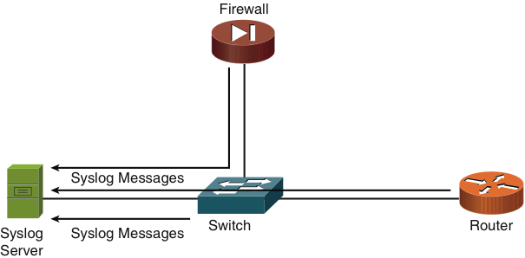
Sample Syslog Clients

Slide 29
Syslog Security Levels
Level | Name | Description
0 | Emergencies | The most severe error conditions, which render the system unusable
1 | Alerts | Conditions requiring immediate attention
2 | Critical | A less-severe condition, as compared to alerts, which should be addressed to prevent an interruption of service
3 | Errors | Notifications about error conditions within the system thatdo not render the system unusable
4 | Warnings | Notifications that specific operations failed to complete successfully
5 | Notifications | Nonerror notifications that alert an administrator about state changes within a system
6 | Informational | Detailed information about the normal operation of a system
7 | Debugging | Highly detailed information (for example, information about individual packets), which is typically used for troubleshooting purposes

Slide 30
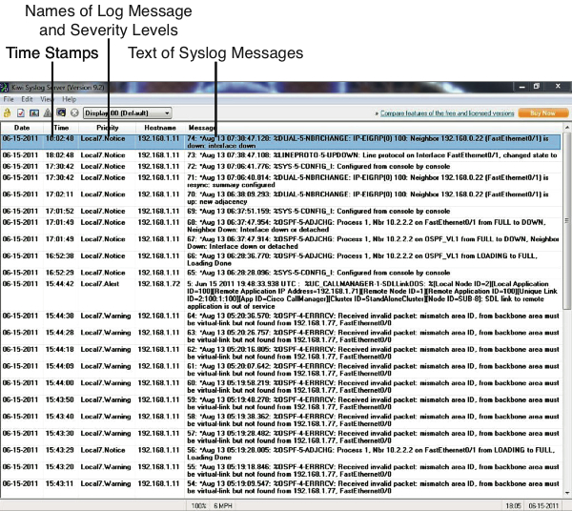
Structure of a Syslog Message

Slide 31
Logs
The operating systems running on network clients and servers can also produce logs. Microsoft Windows provides an Event Viewer application that enables you to view the following log types:
Application logs
Security logs
System logs

Slide 32
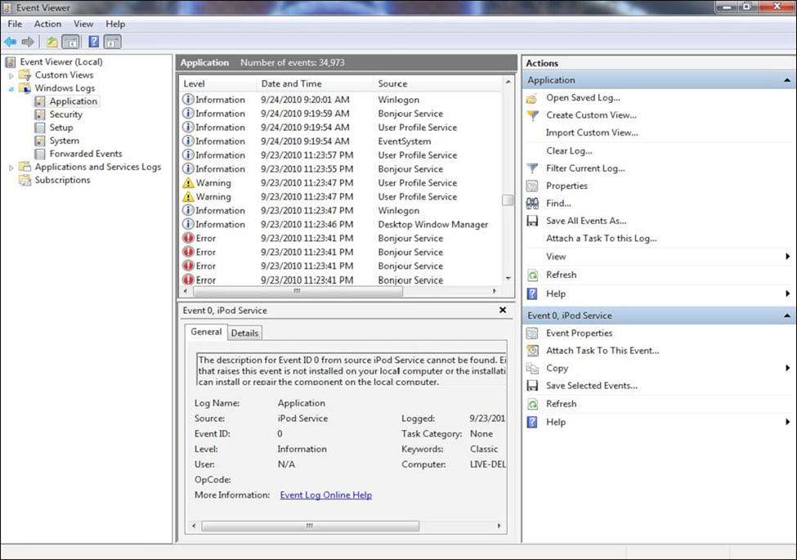
Application Log

Slide 33
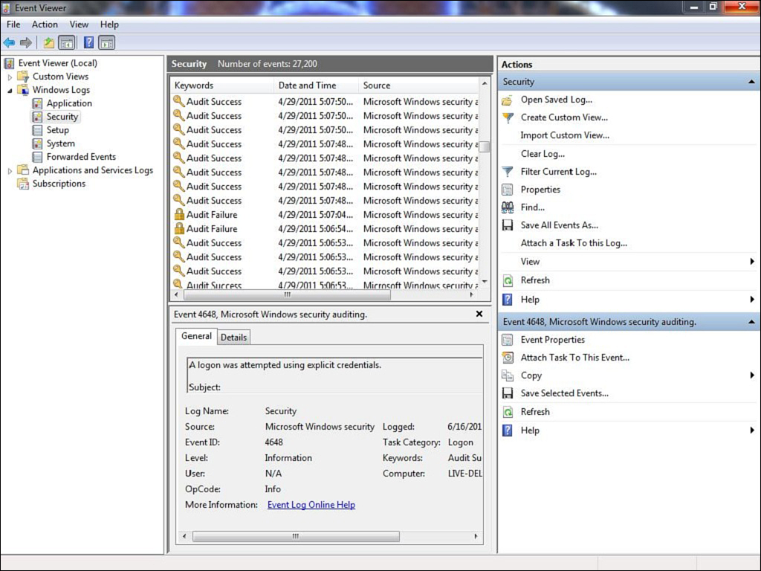
Security Log

Slide 34
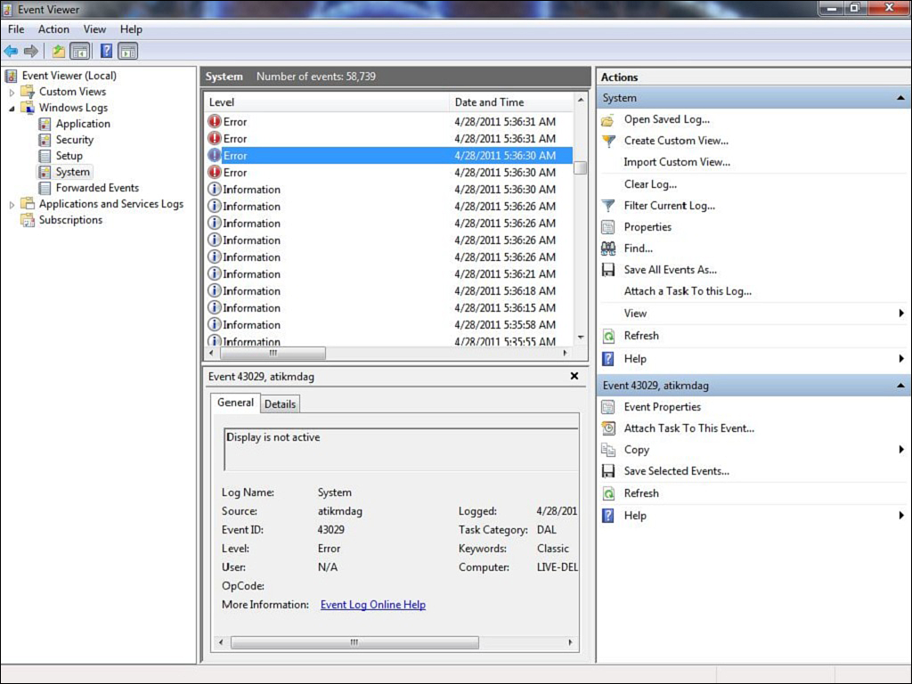
System Log

Slide 35
Summary
Maintenance Tools
Cable and wiring testers and tools
Remote-access software
Protocol analyzer software
Environmental monitoring
Configuration Management
Monitoring Resources and Reports
SNMP
Syslog
Logs

