Slide 1
CompTIA Network+ N10-006
Authorized Cert Guide
Chapter 12
Network Security

Slide 2
Foundation Topics
Security Fundamentals
Defending Against Attacks
Firewalls
VPN
Intrusion Detection and Prevention

Slide 3
Securing a Network
What are the goals of network security, and what sorts of attacks do you need to defend against?
What best practices can be implemented to defend against security threats?
What are the characteristics of various remote-access security technologies?
How can firewalls be used to protect an organization’s internal network, while allowing connectivity to an untrusted network, such as the Internet?
How can virtual private networks (VPNs) be used to secure traffic as that traffic flows over an untrusted network?
What is the difference between intrusion prevention and intrusion detection systems, and how do they protect an organization from common security threats?

Slide 4
Network Security Goals
The three primary goals of network security are as follows:
Confidentiality
Integrity
Availability
This is commonly called the CIA triad.
Notes:
Confidentiality – implies keeping the data private
Integrity – ensures that data has not been modified in transit
Availability – means that the data is accessible when needed

Slide 5
Confidentiality
One method for providing confidentiality is through encryption. Encryption ensures that data can only be decoded by the intended recipient.
Encryption has two basic forms:
Symmetric encryption
Asymmetric encryption

Slide 6
Symmetric Encryption
Symmetric encryption implies that the same key is used by both the sender and receiver of a packet. Examples of symmetric algorithms include the following:
DES (Data Encryption Standard)
    Developed in the mid-1970s
    56-bit key
    Considered weak today
3DES (Triple DES)
    Uses three 56-bit keys (168-bit total)
AES (Advanced Encryption Standard)
    Preferred symmetric encryption standard
    Available in 128-bit, 192-bit and 256-bit key versions

Slide 7
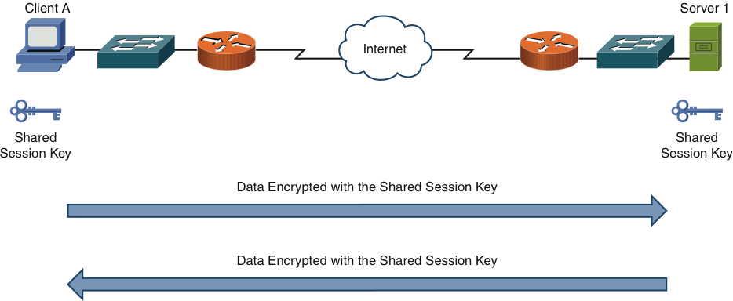
Symmetric Encryption Example

Slide 8
Asymmetric Encryption
Asymmetric encryption uses different keys for the sender and receiver of a packet.
The most popular implementation of asymmetric encryption is RSA. The RSA algorithm is commonly used with a public key infrastructure (PKI). The PKI system is used to encrypt data between your client and a shopping website, for example.

Slide 9
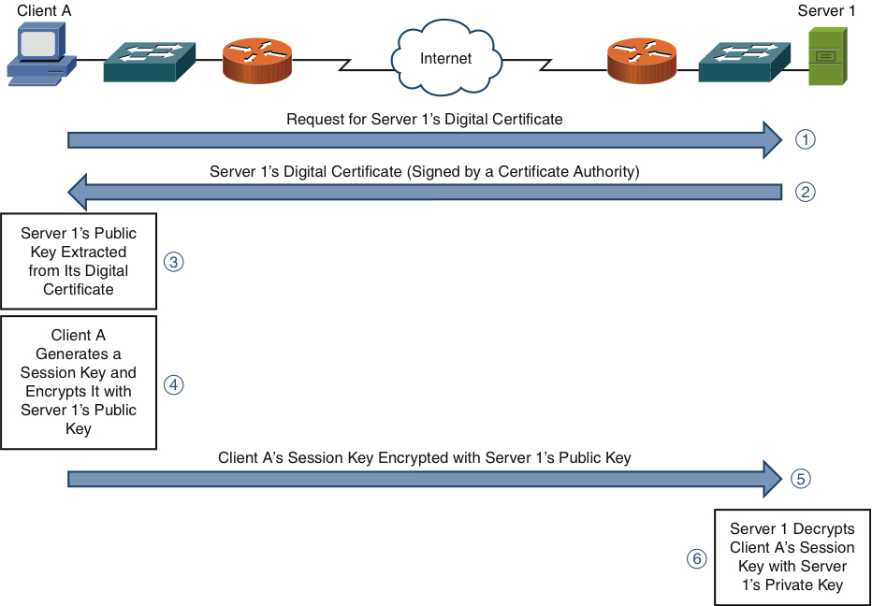
Asymmetric Encryption Example

Slide 10
Integrity
Data integrity ensures that data has not been modified in transit. It might also verify the source originating the traffic.
Examples of integrity violations include the following:
Defacing a corporate web page
Altering an e-commerce transaction
Modifying electronically stored financial records

Slide 11
Integrity
One approach to providing data integrity is through hashing.
Sender runs a string of data through an algorithm.
    The result is a hash or hash digest.
The data and the hash are sent to the recipient
The recipient runs the data through the same algorithm and obtains a hash.
The recipient compares the two hashes. If they are the same, the data was not modified.

Slide 12
Integrity
Two of the most common hashing algorithms are the following:
Message digest 5 (MD5): Creates 128-bit hash digests
Secure Hash Algorithm 1 (SHA-1): Creates 160-bit hash digests
Challenge-Response Authentication Mechanism Message Digest 5 (CRAMMD5) is a common variant of HMAC often used in e-mail systems.

Slide 13
Availability
Availability measures data’s accessibility.
Examples of how a network’s accessibility can be compromised include the following:
Crashing a router or switch through improperly formatted data.
Flooding a network with so much traffic that legitimate requests cannot be processed. This is called a denial of service (DoS).

Slide 14
Categories of Network Attacks
Each of the security goals (confidentiality, integrity, and availability) is subject to different attack types:
Confidentiality attack: Attempts to make confidential data viewable by an attacker
Integrity attack: Attempts to alter data
Availability attack: Attempts to limit the accessibility and usability of a system

Slide 15
Confidentiality Attack Tactics
Examples of confidentiality attack tactics include the following:
Packet capture
Ping sweep and port scan
Dumpster diving
Wireless interception
Wiretapping
Social engineering

Slide 16
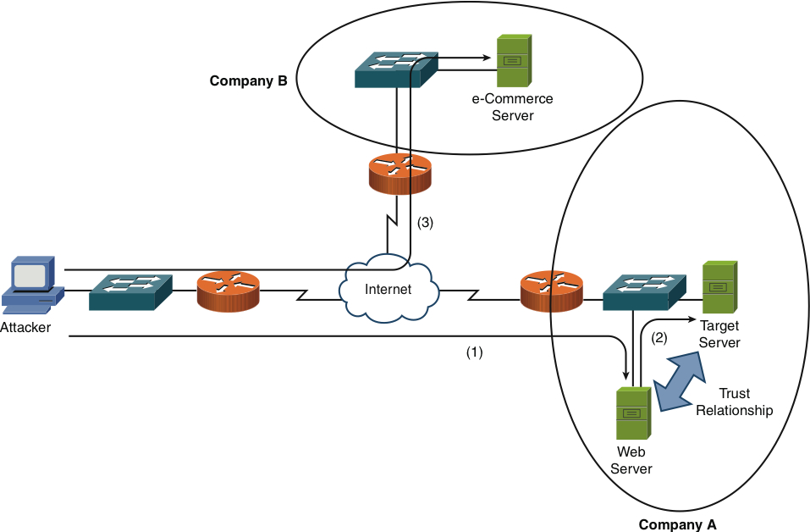
Confidentiality Attack Example

Slide 17
Integrity Attack Methods
Examples of integrity attack methods include the following:
Man-in-the-middle
Salami attack
Data diddling
Trust relationship exploitation
Password attack
Botnet
Session hijacking

Slide 18
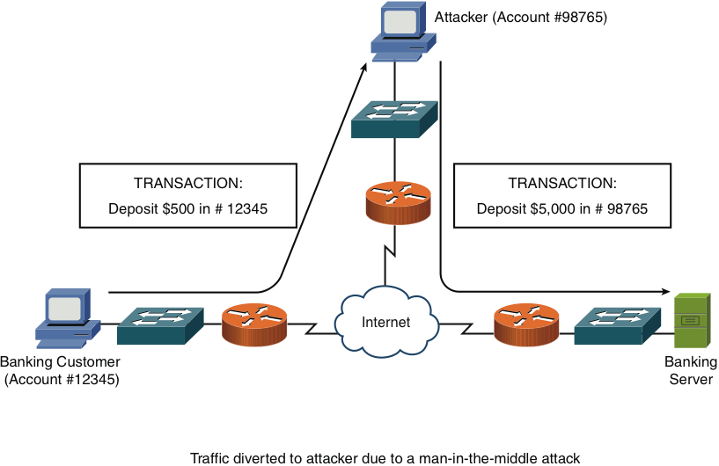
Integrity Attack Example

Slide 19
Availability Attack Types
Types of availability attacks include the following:
Denial of service (DoS)
TCP SYN flood
Buffer overflow
ICMP attacks
Electrical disturbances
Physical environment attacks

Slide 20
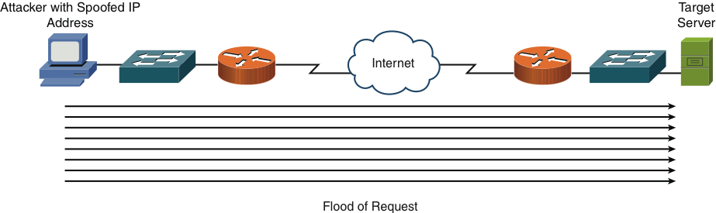
DoS Attack Example

Slide 21
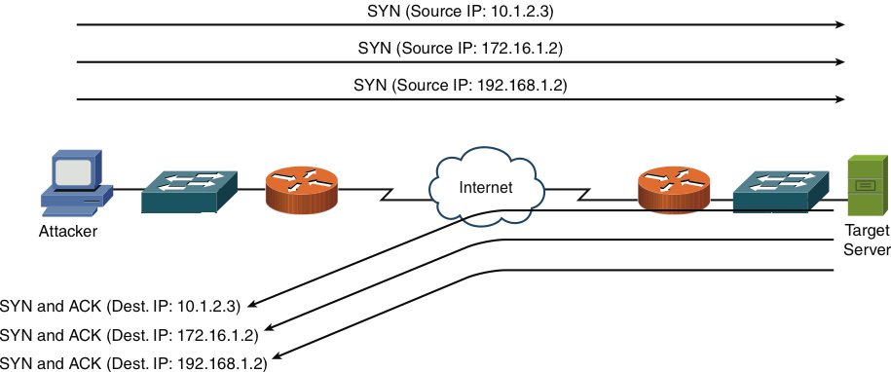
TCP SYN Flood Attack Example

Slide 22
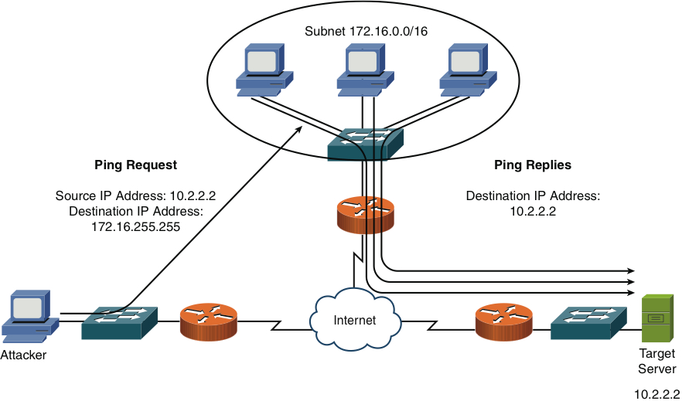
Smurf Attack Example

Slide 23
Electrical Disturbances
An availability attack can be launched by interrupting or interfering with electrical service available to a system. Examples include the following:
Power spikes
Electrical surges
Power faults
Blackouts
Power sag
Brownout
An uninterruptable power supply (UPS) or backup generator can combat these threats.

Slide 24
Physical Environment Attacks
Computing equipment can be damaged by influencing the physical environment, including the following:
Temperature
Humidity
Gas
These threats can generally be mitigated through physical restrictions and monitoring.

Slide 25
Defending Against Attacks
Several areas require best practices to successfully defend a network against attacks, including the following:
User training
Patching
Security policies
Incident response
Vulnerability scanners
Honey pots and honey nets
Access control lists
Remote-access security

Slide 26
User Training
Many attacks can be thwarted through user training. Examples of security issues that users should be educated on include the following:
Social engineering awareness
Virus transmission dangers
Password security
E-mail security

Slide 27
Patching
A patch is designed to correct a known bug or fix a known vulnerability in an application or program. In general, patches should be implemented as they become available. (An update differs from a patch by adding new features.)

Slide 28
Security Policies
Lack of a security policy, or lack of enforcement of an existing policy, is one reason for security breaches. Security policies serve multiple purposes, such as the following:
Protecting an organization’s assets
Making employees aware of their obligations
Identifying specific security solutions
Acting as a baseline for ongoing security monitoring
A common component of a corporate security policy is the acceptable use policy (AUP).

Slide 29
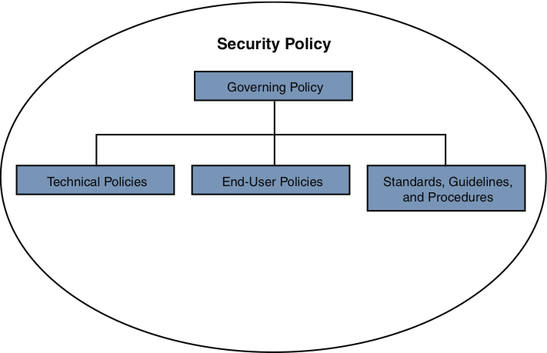
Components of a Security Policy

Slide 30
Incident Response
How an organization reacts to a security violation is called its incident response. Prosecuting computer crimes can be very difficult. Similar to noncomputer crimes, successful prosecution relies on proving three things:
Motive
Means
Opportunity

Slide 31
Vulnerability Scanners
Your network should be periodically tested to verify that your network security components are behaving as expected or to detect unknown vulnerabilities. Applications that conduct these tests are called vulnerability scanners.
Two examples are as follows:
Nessus
Nmap

Slide 32
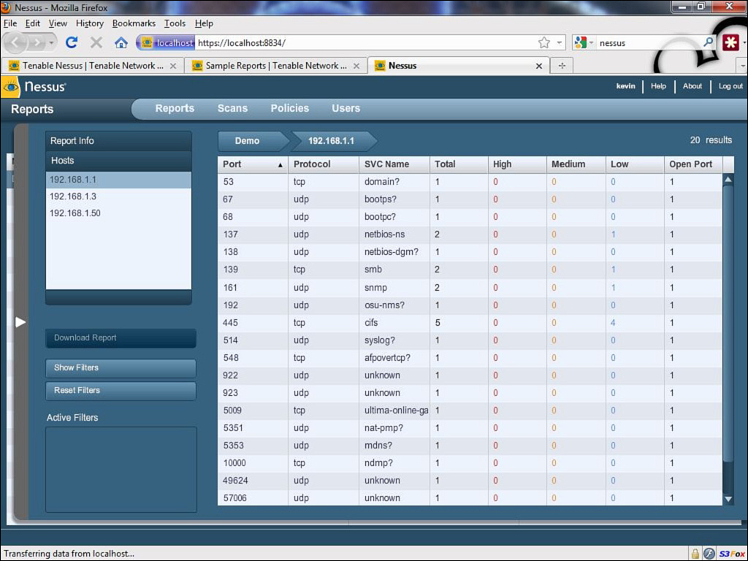
Nessus

Slide 33
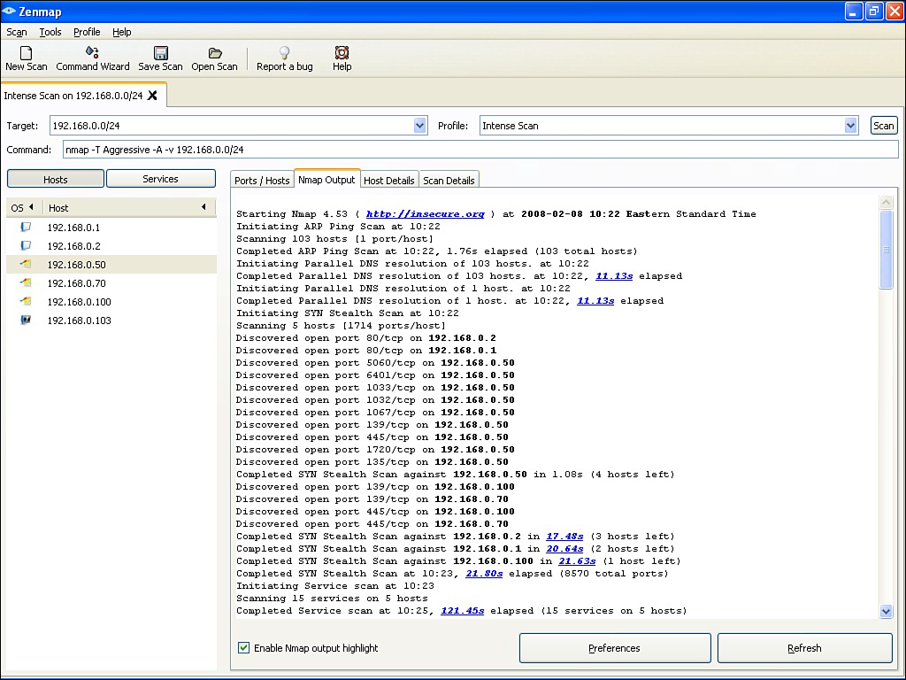
Nmap

Slide 34
Honey Pots and Honey Nets
A honey pot acts as a distracter. A system designated as a honey pot appears to be an attractive target. Attackers then use their resources attacking the honey pot, leaving the real servers alone.
Honey pot: Single machine
Honey net: Multiple honey pots
A honey pot/net can also be used to study how attackers conduct their attacks.

Slide 35
Access Control Lists
An access control list (ACL) is a set of rules, typically applied to router interfaces, that permit or deny traffic.
ACL filtering criteria include the following:
Source IP
Destination IP
Source port
Destination port
Source MAC
Destination MAC

Slide 36
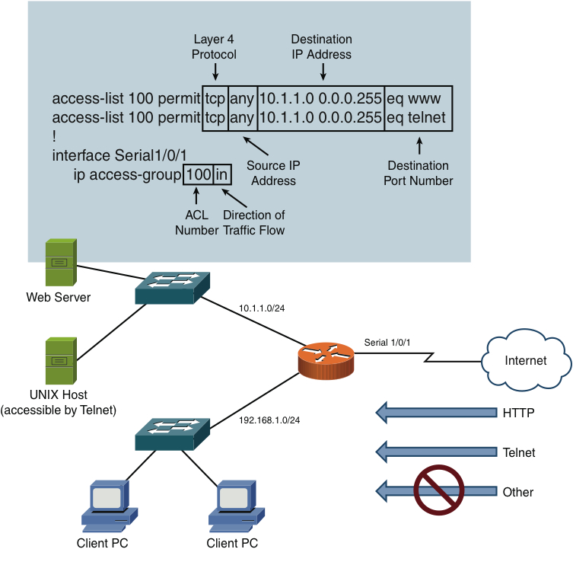
ACL Example

Slide 37
Remote-Access Security
Remote-access security controls access to network devices such as routers, switches, servers, and PCs. Examples are shown in the following table.
Method | Description
SSH | Secure remote access via terminal emulator
RADIUS | Open standard, UDP-based authentication protocol
TACACS+ | Cisco proprietary, TCP-based authentication protocol
IEEE 802.1X | Permits or denies a wired or wireless client access to a LAN
Two-factor authentication | Requires two types of authentication: something you know, something you have or something you are
Single sign-on | Authenticate once and access multiple systems

Slide 38
Firewalls
A firewall defines a set or rules defining which types of traffic are permitted or denied through the device. A firewall can be either software or hardware. Many firewalls also perform Network Address Translation (NAT) or Port Address Translation (PAT).
There are two general categories of firewalls:
Packet-filtering firewall:
    Permits or denies traffic based on packet header
      Source and destination IP address/port number
    Looks at each packet individually
Stateful firewall:
    Inspects traffic as part of a session
    Recognizes whethertraffic originated from inside or outside the LAN

Slide 39
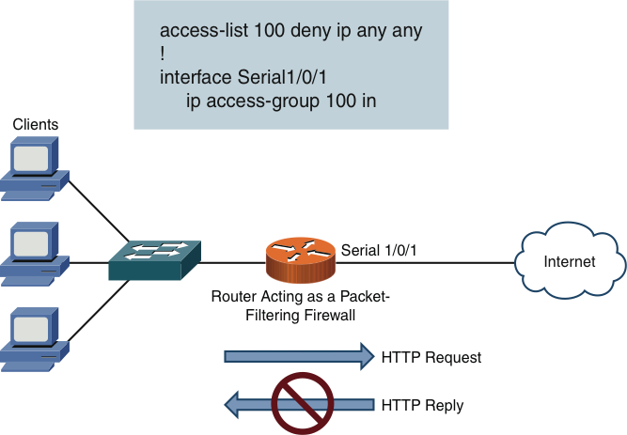
Packet-Filtering Firewall

Slide 40
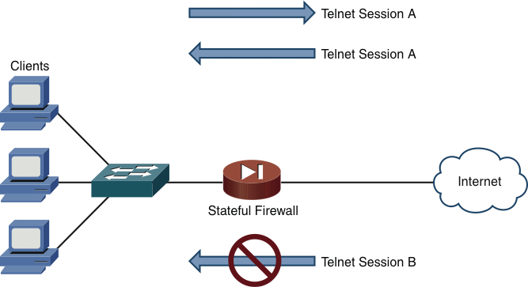
Stateful Firewall
Notes:
Return traffic for Telnet Session A is permitted because it originated from inside the LAN. Telnet Session B traffic is denied because it originated from outside the LAN without permission.

Slide 41
Firewall Zones
A firewall’s interface can be defined as belonging to different firewall zones. After the zones are created, you set up rules based on those zones.
Typical zone names include the following:
Inside: Connects to your corporate LAN
Outside: Typically connects to the Internet
DMZ: Connects to devices that should have restricted access from the outside zone (like web servers)

Slide 42
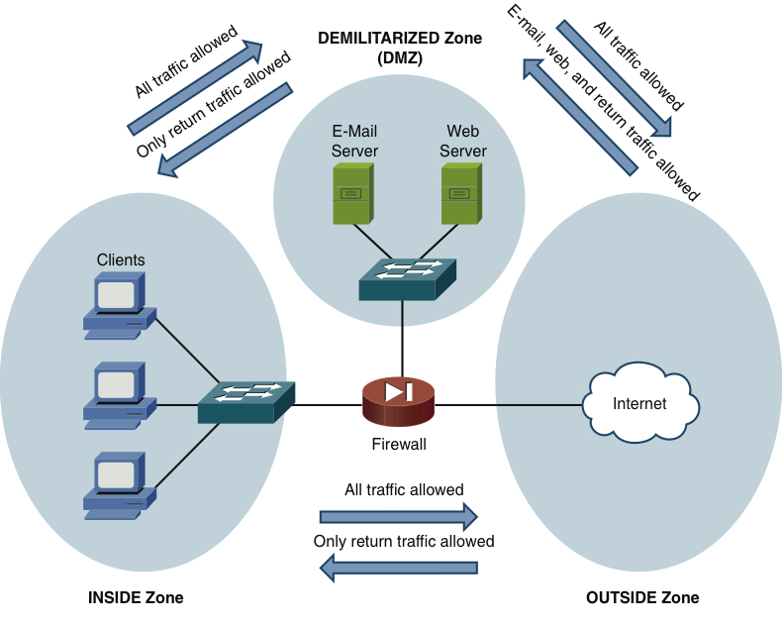
Firewall Zone Example

Slide 43
Virtual Private Networks (VPNs)
Many employees work in remote offices or telecommute. A virtual private network (VPN) allows users to securely connect to their main corporate network over an untrusted network (like the Internet).
There are two primary categories of VPNs:
Site to site: Interconnects two sites, as an alternative to a leased line, at a reduced cost
Client to Site (a.k.a. remote access): Connects a remote user with a site

Slide 44
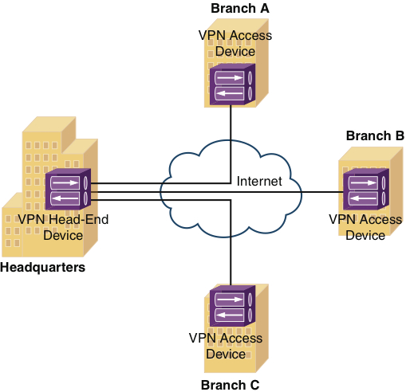
Site-to-Site VPN Example

Slide 45
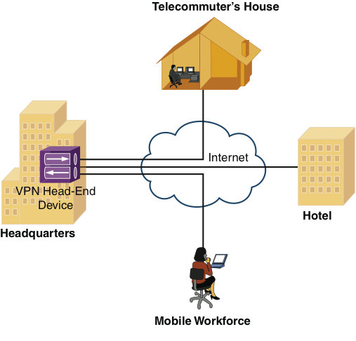
Client-to-Site VPN Example

Slide 46
Overview of IPsec
Although there are other types of VPN technologies, IPsec VPNs are the most common. IPsec (IP security) provides the following protections for VPN traffic.
Protection | Description
Confidentiality | Provided by data encryption.
Integrity | Ensures data was not modified in transit through hashing.
Authentication | Verifies that the parties are who they claim to be.

Slide 47
IKE Modes and Phases
One of the primary protocols used by IPsec is the Internet Key Exchange (IKE). IKE uses encryption between authenticated peers. IKE has three modes of operation:
Main mode
Aggressive mode
Quick mode

Slide 48
IKE Modes and Phases
The two primary phases of establishing an IPsec tunnel are as follows:
IKE Phase 1: Establishes encryption and authentication protocols between VPN endpoints to create the IKE Phase 1 tunnel
IKE Phase 2: Within the secure IKE Phase 1 tunnel, establishes encryption and authentication protocols between VPN endpoints to create the IPsec tunnel

Slide 49
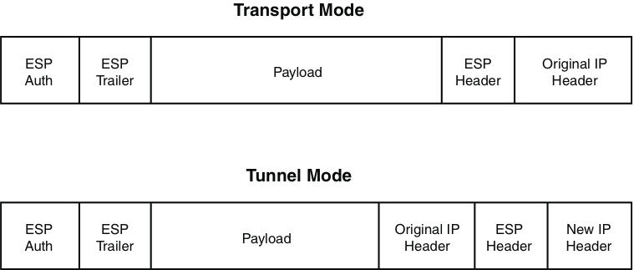
Transport Mode Versus
Tunnel Mode

Slide 50
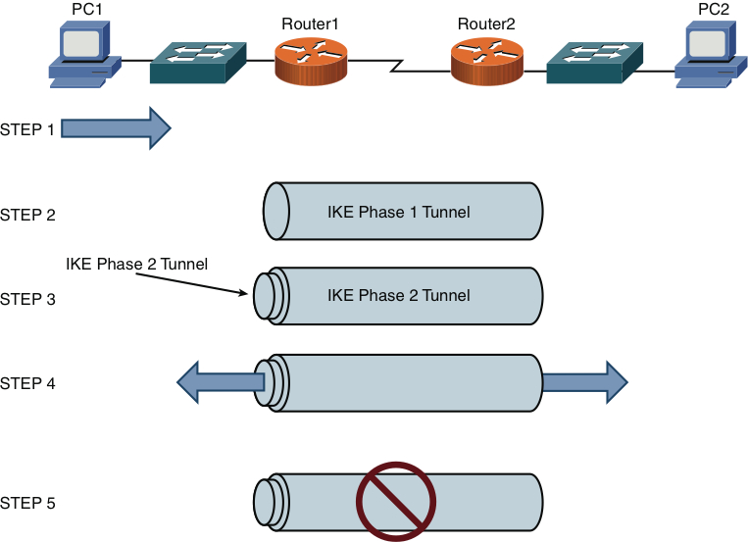
IPsec VPN Steps

Slide 51
Intrusion Detection and Prevention
When an attacker launches an attack against a network, an intrusion detection system (IDS), or intrusion prevention system (IPS), is often able to recognize the attack and respond appropriately.
Incoming data streams are analyzed for attacks using different detection methods, such as the following:
Signature-based detection
Policy-based detection
Anomaly-based detection

Slide 52
IDS Versus IPS
Both IDS and IPS devices recognize attacks, but they operate with some differences:
IDS
Operates parallel to the network
Passive device
Monitors all traffic and sends alerts
IPS
Operates in-line to the network
Active device
Monitors all traffic, sends alerts, and drops or blocks the offending traffic

Slide 53
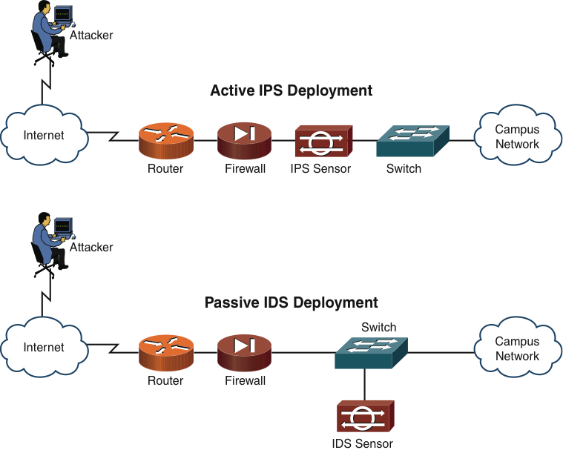
IDS and IPS Network Placement

Slide 54
Deploying Network-Based and Host-Based Solutions
Sensors dedicated as a network-based intrusion prevention system (NIPS) can work in tandem with a host-based intrusion prevention system (HIPS), which is software installed on a host.
A NIPS device might prevent a DoS attack, whereas a HIPS solution could focus on the protection of applications on a host.

Slide 55
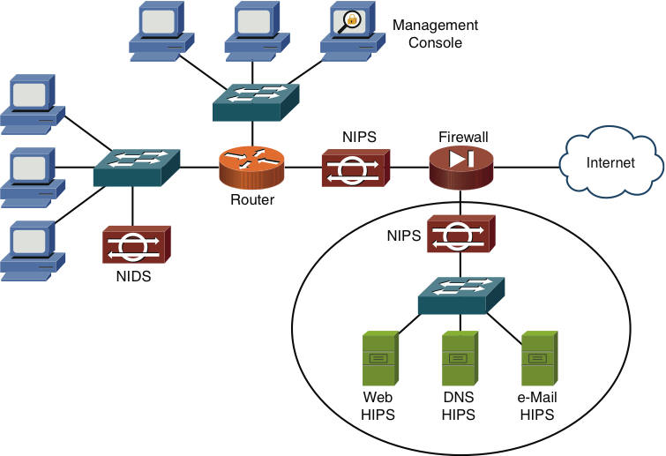
NIDS, NIPS, and HIPS
Deployment Example

Slide 56
Summary
Security Fundamentals
Confidentiality, integrity, and availability
Attack types
Defending Against Attacks
User training
Patching
Policies
Incident response
Vulnerability scanners
Honey pots and honey nets
ACLs and remote-access security

Slide 57
Summary
Firewalls
Software and hardware types
Inspection types
VPN
IKE modes and phases
Intrusion Detection and Prevention
Detection methods
Deployment types

