Slide 1
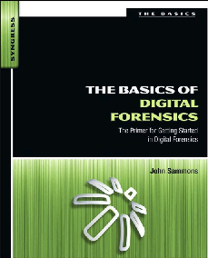
1. Introduction

Slide 2
Topics
What is Forensic Science?
What is Digital Forensics?
Uses of Digital Forensics
Role in the Judicial System

Slide 3
What is Digital Forensics?

Slide 4
Digital Evidence
Computers record evidence of everything you do, and also
  Cell phones
  ATM machines
  Web servers
  Email servers
  SMS systems
  etc.

Slide 5
Slow to Change
Attorneys and judges often know little about digital evidence
Digital forensic scientists must therefore be teachers as well as technical experts

Slide 6
Forensic Science
Forensics
  Application of science to solve a legal problem
Digital Forensics
  Application of computer science and investigative procedures
  Analysis of digital evidence
  Search authority
  Chain of custody
  Validation with mathematics
  Use of validated tools
  Repeatability
  Reporting
  Expert presentation

Slide 7
Items to Examine
Laptop and desktop computers
Mobile devices
Networks
Cloud systems
Video, audio, and images
  Authenticity, comparison, enhancement

Slide 8
Uses of Digital Forensics
Criminal investigations
  Child pornography
  Identity theft
  Homocide, sexual assault, robbery, burglary…
  Almost every criminal investigation
Civil litigation
Intelligence
Administrative matters

Slide 9
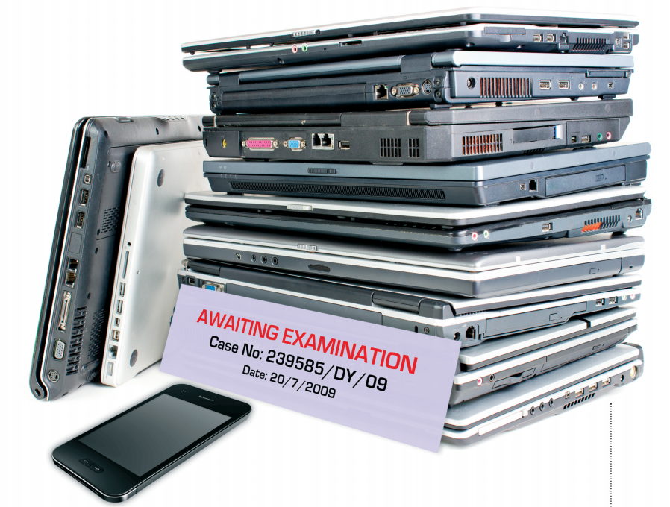
Forensics Backlog
"…there were massive backlogs within all police forces, to the point where it was six months to two years before some computers could be examined"
  Link Ch 1a on my Web page
  samsclass.info
  "CNIT 121"

Slide 10
Law Enforcement Paradigm
Police need to think of and seek out digital evidence
Seize
  Cell phones
  Gaming consoles
  Cameras
  Etc.

Slide 11
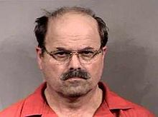
Bind. Torture. Kill.
Dennis Rader
  Respected citizen
  Also a serial killer
  Murdered ten people in Kansas from 1974 to 1991
He confessed in an anonymous letter to a newspaper
He offered to send police a floppy disk
  Police said it couldn't be traced

Slide 12
Metadata
Metadata on the RTF file he sent contained
  Dates
  Title: "Christ Lutheran Church"
  "Last Saved By:" Dennis
Christ Lutheran Church Wichita website showed Dennis Rader as President of Congregation Council

Slide 13
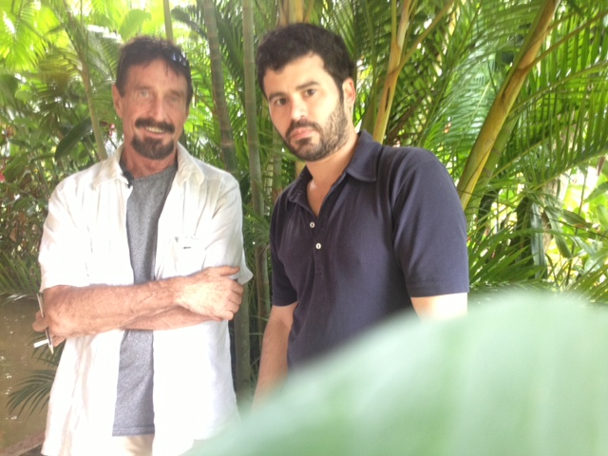
John Mcaffee
Fugitive from Belize police
Posed for a photo in Guatemala
Published on the Internet with GPS location metadata
Link Ch 1c

Slide 14
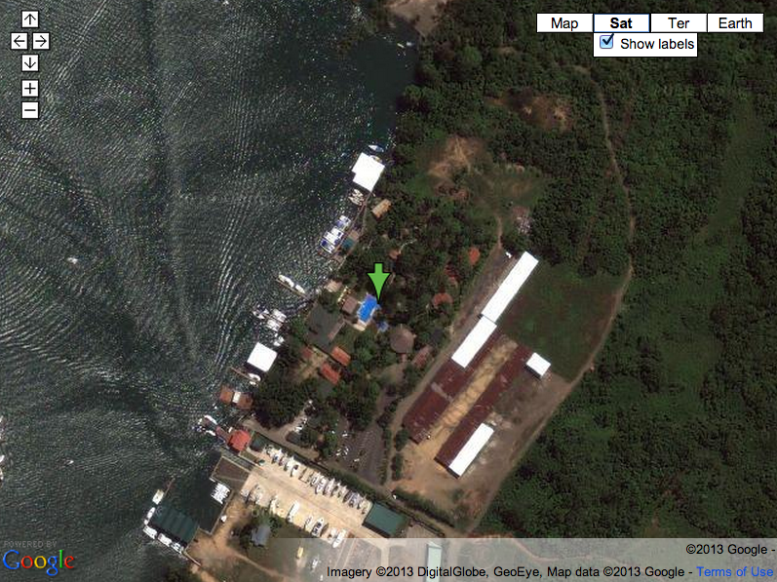

Slide 15
Civil Litigation
eDiscovery is a $780 million business
Hiring in San Francisco now
eDiscovery definition
  "any process in which electronic data is sought, located, secured, and searched with the intent of using it as evidence in a civil or criminal legel case"
Both parties are entitled to examine evidence
  This process is called "Discovery"

Slide 16
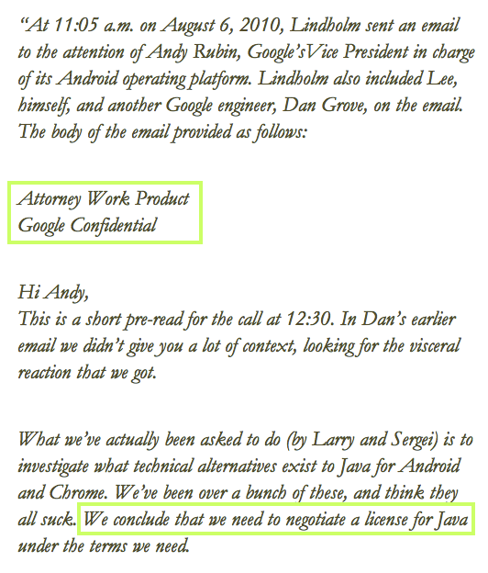
Google's Billion Dollar eDiscovery Error
This email was marked "Confidential" on some copies but not on others
Accidentally revealed as evidence
Link Ch 1d
(Google didn't actually lose the $1 billion)

Slide 17
Intelligence
Terrorists and foreign governments use digital tools and the Internet
US Military uses documents and media in the DOCEX and DOMEX processes

Slide 18
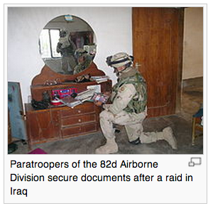
DOMEX
DOCEX (Document Exploitation)
  "Procedures used by the United States Armed Forces to discover, categorize, and use documents seized in combat operations"
  "Documents" includes
  digital media
DOMEX (Document and Media Exploitation)
  Use of documents by
  various agencies after
  collection
  Link Ch 1f

Slide 19

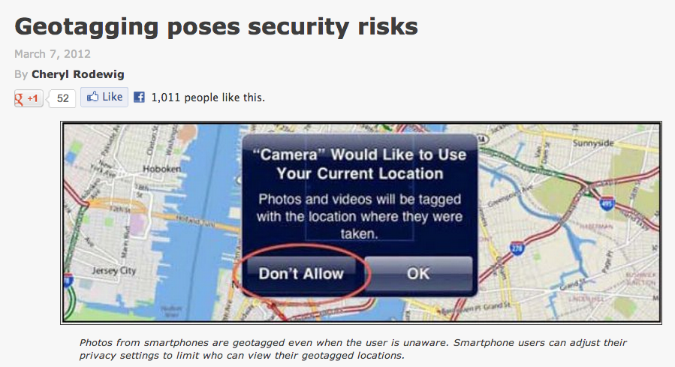

Slide 20
Real Aid to the Enemy
"…a real-world example from 2007. When a new fleet of helicopters arrived … in Iraq, some Soldiers took pictures ... From the photos that were uploaded to the Internet, the enemy was able to determine the exact location of the helicopters inside the compound and conduct a mortar attack, destroying four of the AH-64 Apaches."
  Link Ch 1d

Slide 21
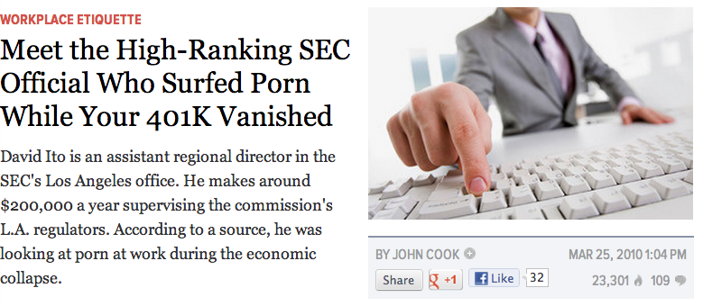
Administrative Matters
Digital evidence is used to detect policy violations
  Accessing forbidden websites at work
SEC Office of the Inspector General
  Firewall logs showed officials surfed porn at work
  Link Ch 1f

Slide 22
Locard's Exchange Principle
When perps enter or leave a crime scene, they will leave something behind or take something with them
  Such as DNA, fingerprints, hair, fibers, etc.
Also true of digital forensics
  Registry keys, log files, etc.

Slide 23
Scientific Method
Forensic science is new and procedures are still being developed
A scientist is normally regarded as objective, neutral, dealing only with facts
BUT forensic experts are hired by both prosecution and defense, and state expert opinions as well as facts

Slide 24
Organizations of Note

Slide 25

"brings together organizations actively engaged in the field of digital and multimedia evidence to foster communication and cooperation as well as to ensure quality and consistency within the forensic community"
  Link Ch 1h

Slide 26
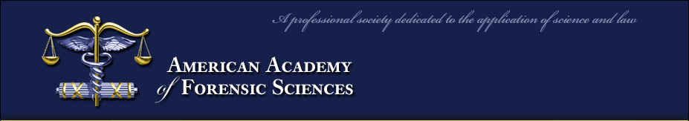
Premier forensic organization in the world
Develops standards of practice
6000 members, including directors of most federal crime labs
  Link Ch 1i

Slide 27

American Society of Crime Laboratory Directors/
Laboratory Accreditation Board (ASCLD/LAB)
ASCD/LAB accredited labs are the "gold standard" in forensics
They set standards and requirements for accreditation
  Link Ch 1j

Slide 28
NIST
(National Institute of Standards and Technology)
National Software Reference Library
  Known file signatures for operating system software and other items of no investigative value
Computer Forensic Tool Testing
  Link Ch 1l

Slide 29

Also develops standards for forensics
  Link Ch 1k

Slide 30

HTCIA
(not in textbook)
High-Tech Crime
Investigation Association
Organization of peace officers, investigators, prosecuting attorneys, and security professionals
But NOT criminal defense experts
  Link Ch 1g

Slide 31

Defense Lawyers
Understand their goals
Hurting the expert & freeing the client is a win for them
  Image from http://www.zazzle.com/lawyer_shark_trust_me_bumper_sticker-128101885100809676

Slide 32
Role of the Forensic Examiner in the Judicial System
Expert witness
  Qualified to render an opinion
  Must be effective communicators
  Must be teachers
Must be without bias
  Follow the evidence wherever it leads

