Slide 1

2. Key Technical Concepts
Part 2

Slide 2
Active, Latent, and Archival Data

Slide 3
Active Data
Data the operating system can "see" and use
Files and folders that appear in Windows Explorer
Reside in allocated space
Can be acquired by copying files

Slide 4
Latent Data
Data that has been deleted or partially overwritten
Invisible to OS
Does not appear in Windows Explorer
A bitstream or forensic image is required to acquire this data

Slide 5
Archival Data
Also called Backups
Commonly stored on
  External hard drives
  DVDs
  Magnetic tapes
  Cloud backup services like Iron Mountain or Symform

Slide 6
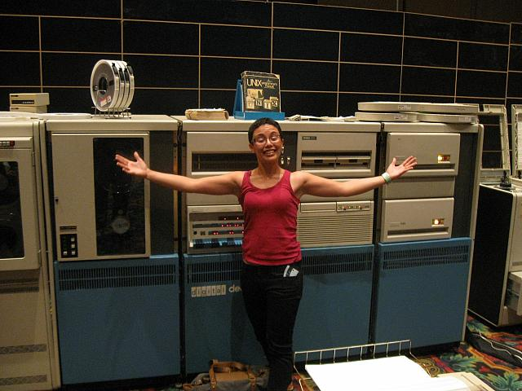
Legacy Archival Data
Made with software or hardware that is no longer in production
To acquire the data, you need to get old devices
  User's groups
  eBay
Image: PDP-11 at
Defcon 17
  Link Ch 2n

Slide 7
Computer File Systems

Slide 8
File System
Keeps track of used and free sectors
Location of each file
Filename
Last modified date
Permissions

Slide 9
FAT (File Allocation Table)
Oldest and simplest file system
FAT12 (for floppy disks)
FAT16 (2 GB max. partition size)
  4 GB on Win 2000 (link Ch 2p)
FAT32 (Common on USB drives)
  Not used on Windows XP or later
FATX for the X-Box
exFAT used for Windows CE
  Link Ch 2o

Slide 10
NTFS (New Technology File System)
Used by Win XP, 7, and Server
Advantages
  Journaling (recovers from errors)
  Encryption
  Permissions
  Uses B-Trees for fast searches

Slide 11
HFS+ (Hierarchical File System)
Used by Apple products
Also uses B-Trees
Related versions
  HFS
  HFSX

Slide 12
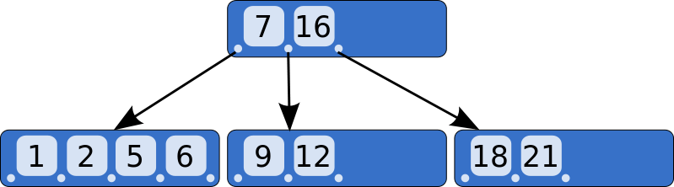
B-Tree
An way of storing objects so they can be searched quickly
  Image From Wikipedia

Slide 13
Allocated and Unallocated Space

Slide 14
Space on a Hard Drive
Allocated
  Active data
  In use
  Can be seen by OS
Unallocated
  No longer in use
  Slack space (Drive slack)
  Invisible to OS

Slide 15
Space on a Hard Drive
Host Protected Area and Device Configuration Overlays
  Hidden area on a hard drive
  Difficult to detect
  Not used by OS
  Stores device firmware and data
  Accessed by firmware update routines, which can be reverse engineered

Slide 16
Data Persistence
Old Data is Left in Slack Space
  Unallocated clusters
  Remains on drive until overwritten
  Can be years
Even an Overwrite may not get it all
  If the new file doesn't use all the sectors

Slide 17
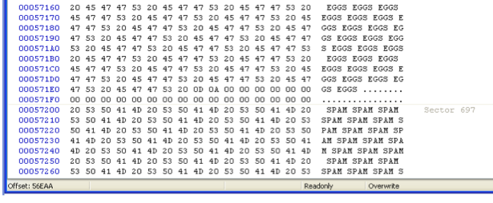
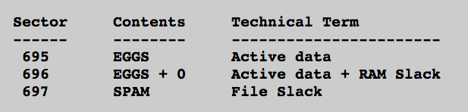
Project 2

Slide 18
Magnetic Drive Storage
Sector = 512 bytes
  All data is read and written a sector at a time
Cluster
  Varies, often 4096 bytes = 8 sectors
  OS can only use space a cluster at a time

Slide 19
Example
BIG file: 4000 bytes
  Written onto disk
  Nearly fills 8 sectors = 1 cluster
Delete BIG file
Save SMALL file on same cluster
  SMALL file: 1000 bytes
  Only uses 2 clusters

Slide 20
Drive Slack
Sector Before After
------ ------ ------
200 BIG SMALL
201 BIG SMALL
202 BIG BIG
203 BIG BIG
204 BIG BIG
205 BIG BIG
206 BIG BIG
207 BIG BIG

Slide 21
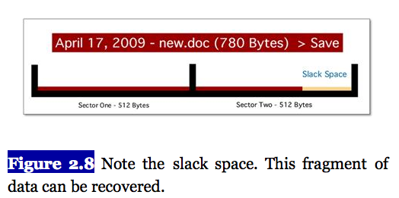
Error in Textbook
Discussion from Fig. 2.5 through 2.8 is wrong
Book says a 780 byte file only overwrites 780 bytes on disk, when it actually overwrites 1024 bytes

Slide 22
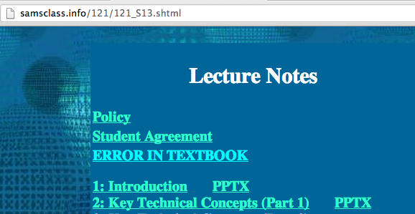

Slide 23
Page File (Swap Space)
Used for virtual memory
  Temporary storage when your computer runs out of available RAM
  Windows puts data here even when RAM is not full
  It also loads old data from swap back into RAM
  I once found something years old in my RAM

Slide 24
Potential Page File Contents
Passwords
Fragments of images or documents
Anything else from RAM
BUT there is no timestamp, so it will be hard to connect to a specific user or event

Slide 25
Hiberfil.sys
Contains entire RAM contents
  Filled when a computer hibernates

Slide 26
Whole Disk Encryption
Because of the Page file and the Hiberfil
  You can never be sure where your data is
Whole Disk Encryption
  The only way to be sure all your data is protected
  Microsoft BitLocker
  Apple FileVault
  TrueCrypt (Open Source)

Slide 27
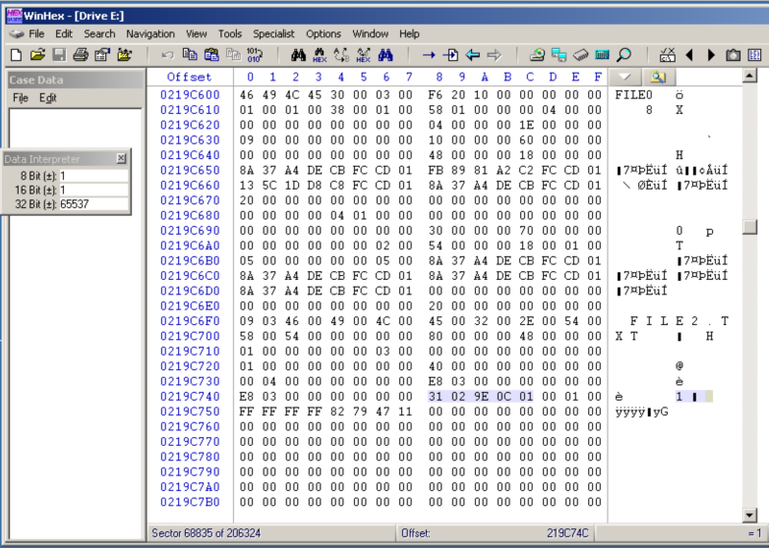
Project 8: NTFS Data Runs

