Slide 1
Notes from SWGDE "Best Practices for Computer Forensics", 2006

Slide 2
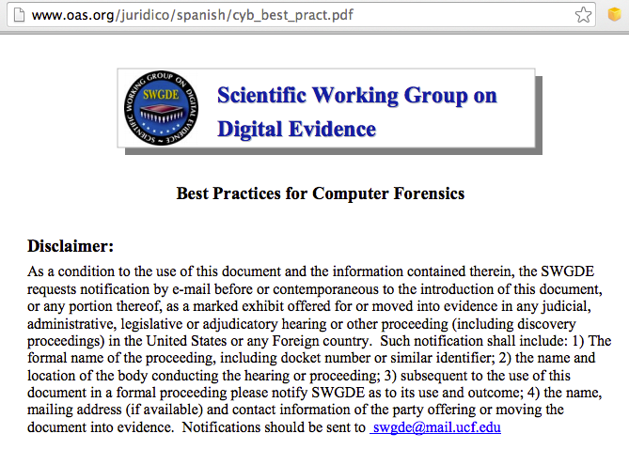
Based on this Document

Slide 3
1.0 Seizing Evidence
Must have legal authority
  Additional authority for additional evidence outside scope of the search
If evidence cannot be removed, image it at the scene
Remove all suspects, witnesses, and bystanders from the scene

Slide 4
1.0 Seizing Evidence
Solicit information from potential suspects, witnesses, LAN administrators, etc.
  Passwords, operating systems, screen name, email address
Search scene systematically and thoroughly
Searcher should be able to recognize the different types of evidence

Slide 5
1.1 Evidence Handling
If the computer is off, leave it off
If the computer is on, consider the potential of encryption
  If appropriate, image the machine before powering down
Assess the power need for devices with volatile memory
  E.g. cell phones, tablets, etc.

Slide 6
1.1 Evidence Handling
Document the condition of the evidence
  Photograph whole scene from several angles
  Close-up photographs of cables, serial numbers, etc.
Document connection of external components
Document any pre-existing damage to the evidence

Slide 7
1.1.1 Stand-alone Computer
(Non-Networked)
Disconnect all power sources
  Remove battery from laptops
Place evidence tape over power plug connector on the back of the computer

Slide 8
1.1.2 Networked Computer
Workstations
  Remove the power connector from the back of the computer
  Place evidence tape over the power plug connector on the back of the computer

Slide 9
1.2 Servers
Determine the extent of data to be seized
Capture volatile data if necessary
If shutdown is necessary, use the appropriate commands
Warning: Pulling the plug could severely damage the system; disrupt legitimate business; and/or create officer and department liability.

Slide 10
Evidence Handling
Package evidence to protect it from change
Maintain chain-of-custody
Packaging:
  Plastic/paper bags or sleeves
  Computer case sealed with evidence tape over access points and power connectors
  Devices with volatile memory should be packaged appropriately to allow for power to be maintained to the device

Slide 11
Evidence Handling
Care with transportation, to avoid
  Physical damage
  Vibration
  Magnetic fields
  Static electricity
  Large variations in temperature or humidity

Slide 12
2.0 Equipment Preparation
"Equipment" is non-evidentiary hardware and software used for imaging or analysis
Equipment must be monitored and documented to maintain proper performance
  Test equipment regularly

Slide 13
3.0 Forensic Imaging
Document the current condition of the evidence
Prevent exposure to toxic or dangerous substances on the evidence
Use write blockers
Use forensically sound and verifiable acquisition methods
  Hashes: MD5, SHA-1, etc.

Slide 14
3.0 Forensic Imaging
Capture "bit-stream" forensic image
Use properly prepared media when making forensic copies
  Ensure no commingling of data from different cases
Forensic image should be archived to media

Slide 15
4.0 Forensic Analysis/Examination
Review documents from requestor to determine necessary processes
Need legal authority, such as:
  Consent by owner
  Search warrant
  Other legal authority

Slide 16
4.0 Forensic Analysis/Examination
Preliminary considerations
  Urgency and priority of request
  Additional types of examination which may need to be carried out (e.g. fingerprints)
  Other evidence items that may need to be requested, such as removable USB drives
Examine copies, not original evidence
Logical and systematic examination

Slide 17
Recommended Civil Case Search Procedure
Look at USBSTOR first to see what other devices to request
Examine documents, photos, Internet history, email, desktop

Slide 18
Recommended Search Procedure
Start with keywords from description of case
  Name of suspect, company involved, etc.
Search for evidence by keyword
  Find more keywords in that evidence
Search using new keywords
When you aren't finding any new keywords, the search is done

Slide 19
4.1 Non-Traditional Technologies
Cell phones, PDA's, iPods, DVR's, gaming systems, etc.
Gather forensic images if possible
Non-traditional methods may be required
Validate procedures first if possible
Document all steps in methodology

Slide 20
5.0 Documentation
Evidence handling documentation
  Copy of legal authority
  Chain of custody
  Initial count of evidence items
  Information re: packaging and condition of evidence upon receipt by the examiner
  Description of evidence
  Communications regarding the case

Slide 21
5.0 Documentation
Examination documentation
  Case-specific
  Contain sufficient details to allow another competent forensic examiner to identify what has been done and assess the findings independently
Preserve documents

Slide 22
6.0 Reports
Reports should address the requestor's needs
Provide all information in a clear and concise manner

