Slide 1
Computer Forensics
Infosec Pro Guide
Ch 1
What is Computer Forensics?
Last modified 1-12-14

Slide 2
Computer Forensics
Determining the past actions that have taken place on a computer system
Using artifacts—files, settings, or system changes that occur when the user or the OS performs a specific action
Ex: Creation date of a user's home directory shows the first time that user logged in
Testing is essential—don't trust anyone else

Slide 3
What You Can Do with Computer Forensics
Recover deleted files
Find out what external devices have been attached
Determine what programs have been run
See what web pages users have viewed, their email, chat logs
SMS messages from phones
Find malware and determine what it has done

Slide 4
Computer Forensics Jobs
Expert witness for crime investigation
  Must choose prosecution or defense, difficult to change later
Incident Response (IR)
  Or DFIR (Digital Forensics, Incident Response)
  Including malware analysis
Data recovery
eDiscovery
  Collecting evidence as required by a court order during a lawsuit

Slide 5
How People Get Involved in Computer Forensics
Law enforcement
Military
College programs
IT and/or Infosec

Slide 6
Law Enforcement
"Innocent Images" (Child pornography) is a huge part of the FBI's work
  5,600 cases as of April 2012 (link Ch 1a)
Almost every crime investigation requires digital forensics
  Laptops, tablets, phones, GPS units, etc.

Slide 7
Top 3 FBI National Security Priorities
1. Protect the United States from Terrorist Attack
2. Protect the United States against Foreign Intelligence Operations and Espionage
3. Protect the United States against Cyber-Based Attacks and High-Technology Crimes
  Link Ch 1b

Slide 8
Military
First responders gather evidence in the field
Analysts work on it later in labs
Most military forensic examiners do not gain experience in testifying

Slide 9
University Programs
Relatively new
Often don't provide testimony experience
  This class won't
We focus on the technical issues in forensics

Slide 10
IT or Infosec Professionals
Computer security professionals are drawn into forensics by incident response
  How did attacker get into a system?
  What damage was done?
Other issues
  Stalking
  Inappropriate Web use
  Tracking emails

Slide 11
The Most Important Trait
Never rely on facts that can't be tested or verified
TEST IT YOURSELF
Stick to the evidence—just the facts
Don't trust your forensic tools
  Verify important findings with two tools
  A raw hex editor like HxD is a good second tool

Slide 12
Incident Response vs.
Computer Forensics
Incident Response examines a live running system
Computer Forensics classically focused on post-mortem analysis of a static disk image
A forensic image is a complete bitwise copy of an entire hard disk
  Or SSD, flash drive, RAM, etc.

Slide 13
RAM Analysis
Until recently, forensics focused on the hard disk and RAM was considered unimportant
This has reversed in the last few years
The projects reflect this
  First we do RAM analysis
  Hard disk images come later

Slide 14
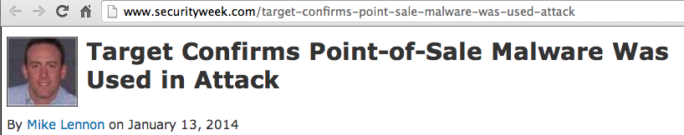
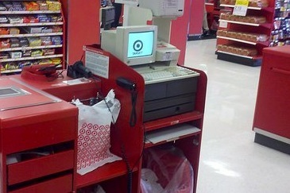
Target was hacked with RAM Scrapers
Credit card #s are unencrypted in RAM
  Link Ch 1c

Slide 15
How Computer Forensic Tools Work
Parse entire forensic image
Rebuilds active and deleted files
Presents them in an easy-to-use interface

Slide 16
Forensic Suites
All-in-one tools that do almost everything you need
Two famous, expensive commercial tools
  EnCase
    Used by many police departments
  FTK (Forensic ToolKit)
    Used by the FBI
Others
  ProDiscover (has a free version, runs on Windows)
  Sleuthkit and Autopsy (free, open-source, runs on Linux)

Slide 17
Specialized Tools
Do only one task
  File carving
    PhotoRec, Recuva, Disk Drill, Scalpel, Bulk Extractor
  Steganography tools
  Network traffic analysis
    NetWitness
  Malware analysis
    Mandiant Redline

Slide 18
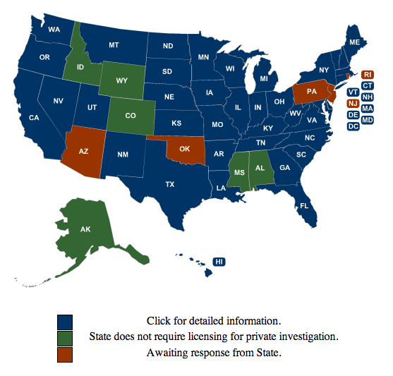
Professional Licensing
Some states require a private investigator license for forensic examinations
But CA doesn't
  Link Ch 1d

Slide 19
Computer Forensics
Infosec Pro Guide
Ch 2
Learning Computer Forensics

Slide 20
Training
Get good training with hands-on projects
Don't attempt to serve clients without proper training first
After this class, you can answer this question with YES:
  "Have you received formal computer forensics training?"

Slide 21
Vendor Training
Many classes available
  viaForensics for Android and iPhone
  Teel Technologies – how to remove NAND (flash) memory for physical inspection
  BK Forensics – free training on mobile devices
  X-Ways Forensics –recommended
    Links Ch 2a-2d

Slide 22

Vendor Certifications
EnCase Certified Examiner
FTK ACE (AccessData Certified Examiner)
Paraben Certified Mobile Examiner
SMART Certified Examiners
  Links Ch 2e-h

Slide 23
Vendor-Neutral Certifications
The International Society of Forensic Computer Examiners
  Certified Computer Examiner
High-Tech Crime Network
SANS
International Association of Computer Investigative Specialists
  Links Ch 2i-l

Slide 24
Costs
ENCE
  Requires 64 hours of computer forensics training or 12 months' experience
  Test costs $200; Guidance Software's ENCE training costs $2,500
FTK ACE exam is free online
  Requires a licensed copy of FTK ($2,000)
CCE exam costs $395
  You can use any tool you like

Slide 25
Stay Current
Constant research in new tools, techniques, issues, opportunities
Join Twitter!
Go to conventions
I like hacker cons
  BSidesSF is coming in Feb.
  BayThreat every December
  RSA (meh)

Slide 26
Forensics Conventions (Expensive)
HTCIA
  Quarterly meeting are free, but big convention is not
CEIC
Techno Forensics
Black Hat
SANS

Slide 27
Blogs
Hacking Exposed Computer Forensics Blog
SANS DFIR
Windows Incident Response
Forensics from the sausage factory
Forensic Focus Blog
  Links Ch 2n-q

Slide 28
Podcasts
Forensic 4cast
CyberSpeak
Inside the Core (Mac forensics)
  Links Ch 2r-t

Slide 29
Associations
High Tech Crime Investigators Association International
  Must not work for defense
Association of Certified Fraud Examiners
  Links Ch 2u-v

