Slide 1
Computer Forensics Infosec Pro Guide
Ch 10
Establishing the Investigation Type and Criteria
Modified 4-6-15

Slide 2
Topics
Types of Investigation
When Criteria Overlap
When no Criteria Match

Slide 3
Types of Investigation

Slide 4
Human Resources Cases
Employees:
Viewing porn at work
Wasting time on Facebook or playing games instead of working
Sexually harassing co-workers
Threatening coworkers
Having an affair with a co-worker

Slide 5
Simple Techniques
HR cases may not even require forensic tools
Logs from firewalls, proxies, and email systems may provide enough evidence to prove suspects' activities
One case was solved by just running Wireshark sniffing DNS requests
Creating proper forensic images is good practice, to allow further investigation later if it is warranted

Slide 6
Goals of an HR Case
Usually never goes to court
Suspect may not have broken any law, but just company policy
Typical result is termination of employment
You need enough proof to defend your work in case the employee sues the company for improper termination

Slide 7
Improper Termination
Firing
For false pretenses
In an unfair manner
In a way that is inconsistent with how other employees have been treated
Discrimination
Lawsuit typically seeks lost wages and damages
Rarely, also demands to be re-hired

Slide 8
Recordkeeping
Good records can defend the company against such lawsuits
Often the case will be dropped when the plaintiff sees that the evidence is undeniable
Retain your records
Work product
Documents produced during investigation
May be excluded from discovery during litigation

Slide 9
Disposal of Evidence
You need to develop a policy
Retain forensic image and data collected until
Case has been settled and client no longer needs data (can be up to a year later)
Case has run out of appeals and parties can no longer litigate (can be 3-5 years)
Plan to keep and maintain plenty of evidence storage space
Keep images organized so you can find them quickly years later

Slide 10
Administrator Abuse
Reading users' email
Finding salary of other workers
Using Remote Access Tools such as VNC to view others' computer screens
Using keyloggers
Accessing users' personal files
Stalking employees using PII
Running personal or side-job sites on company resources
Bypassing policy granting unfiltered Web access for prohibited activities

Slide 11
Goals of an Administrator Abuse Case
May end in civil or criminal charges
Termination of employment
Difficult to conceal an investigation from an administrator
May be reading emails of legal and HR department
Use telephone calls instead of email or other computer-based communications
Photograph administrator's desk before investigating; return all objects to original location

Slide 12
Stealing Information
Usually originated by Legal, not HR
Usually involve a current employee who is leaving the company
Employee takes data to their new employer, to give them an unfair advantage

Slide 13
Stealing Information
Sales person taking business contacts for use in another business
Employees taking bids on current, future, or former projects
Taking trade secrets to a competitor
Forwarding company emails to a personal account
Uploading data to file-sharing sites for later access
Wholesale backup of company systems to personal hard drives
External hacking into company systems

Slide 14
Goal of a Stealing Information Case
Civil litigation against the former employee
And possibly their new employer

Slide 15
Internal Leaks
Employee is not usually leaving the company
Employee needs to maintain access to secrets to leak them
First job is to identify the leaker

Slide 16
Data Loss Prevention (DLP)
Network appliances that monitor all traffic leaving the company, watching for credit card #s, SSNs, etc.
May also refer to Endpoint Protection
Full-disk encryption to prevent loss through stolen laptops
Log and limit access to external storage

Slide 17
Goal of Internal Leaks Cases
Identify the leaker and terminate them
May also charge them with civil or criminal charges

Slide 18
Keyloggers and Malware
Keylogger used by an employee
Keylogger used by a spouse
Malware that enters a system through employee's Internet use
Malware targeted at the company

Slide 19
Goals of Keylogger and Malware Cases
Determine
Who was infected
How it got on the system
What are the capabilities of the malware
If malware got onto the system, private information may already have been compromised

Slide 20
Malware Analysis
Static analysis
Examining malicious files to identify and/or reverse-engineer them
Dynamic analysis
Run malware in a safe virtual environment
Observe its behavior
CNIT 126: Malware Analysis
Not offered in Fall 2015, but probably in Spring 2016

Slide 21
When Criteria Overlap
One type of case may change into another
Administrator abuse turns to a HR case when the suspect is caught trying to sell information to another company
Document your findings
Keep the two cases separated in your records
Two sets of bookmarks in forensic tools
Easier to explain your actions later
Write your report with two sections, to prevent confusion
Get approval if scope of your investigation changes

Slide 22
When No Criteria Match

Slide 23
What to Investigate
Where should the evidence be?
Did this occur over a network?
Did this occur on a local system?
Drawing diagrams or charts can help
Discuss case with colleagues

Slide 24
Network Evidence
Consider all devices between the machines in question and the Internet—do they have logs?
Proxy logs
Firewall logs
IDS logs
IPS logs
Router logs (rarely useful)
Local firewall logs
Domain authentication logs
Internal email servers
VPN servers
DHCP logs

Slide 25
Local System
Antivirus logs
Desktop search indexes
List all files on a system
Event logs
Flash cookies
Windows Registry
Temporary Internet Files
Web browser history
Much, much more

Slide 26
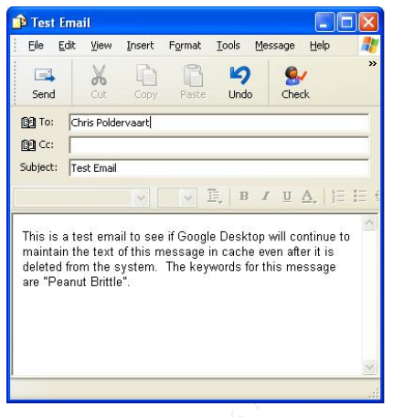
Google Desktop Search as an Analysis Tool (from 2006)
Google Desktop Search indexes the complete text contents of every file
Even encrypted and compressed ones if they are opened
Link Ch 10c
GDS was discontinued in 2011, but is still used by some people

Slide 27
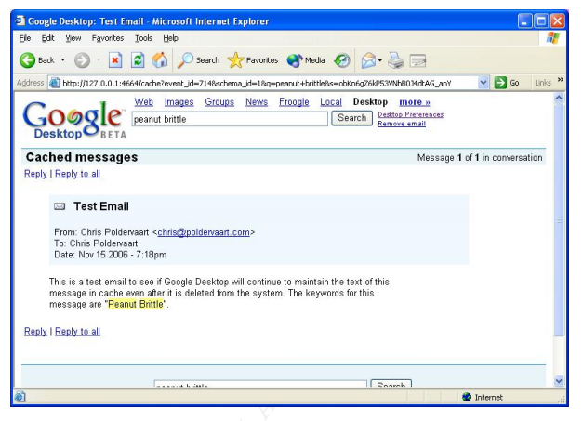
Deleted Files Remain in the Cache

Slide 28
SIFT Super Timeline
Gathers logs, history files, and more into a chart organized by time
Links Ch 10a, 10b

Slide 29
Computer Forensics Infosec Pro Guide
Ch 11
Human Resources Cases

Slide 30
Topics
Results of a human resource case
How to work a pornography case
How to work a productivity waste case

Slide 31
Results of a Human Resource Case

Slide 32
Termination
Main question: "Is there enough evidence to support termination of the employee for violating company policy?"
Policies vary, but generally
Viewing porn at work leads to termination
Playing games at work leads to reprimand or counseling
Employees making threats against others via email or instant messaging
Causes risk to the employer

Slide 33
How to Work a Pornography Case

Slide 34
Very Common
Viewing pornography is the most common unsavory activity an employee will do if they think no one is monitoring them
Easiest type of evidence to detect
Usually existence of pornography on a work system is enough evidence to warrant termination
Most employees will not sue after termination because of embarrassment

Slide 35
Employees working "anti-social hours" are more likely to view porn
Especially when unsupervised
Link Ch 11a (from 2013)

Slide 36
Pornography Case Study
Usually a simple review of Internet history and viewing of the images on his hard drive will reveal obvious evidence
If suspect is aware that they are being monitored
They may use privacy features to avoid leaving evidence

Slide 37
The Sluggish Network
Employees complained that the Internet was slow
Corporate IT director assigned staff to troubleshoot the problem
Bandwidth consumption reports on the firewall
Showed that the IT Director was visiting obvious porn sites 5-7 hours a day, despite the company content filter appliance

Slide 38
HR --> Legal --> Forensics
IT staff who found the logs took them to HR
HR contacted in-house counsel (legal)
In-house counsel determined that terminating the IT Director was likely to result in litigation
Contacted outside counsel
Outside counsel contacted a digital forensics company

Slide 39
Assignment
Conduct an investigation
Do all imaging covertly, during evening when employees are gone
EnCase Enterprise or FTK Enterprise with an agent to image over the network is very good for this, but expensive
IT Director was known to be aggressive and paranoid about people going near his work area

Slide 40
Black Bag Job
Careful nighttime operation
Leaves no evidence
Photograph the desk
Return everything just as you found it

Slide 41
Analysis
Imaged system
Internet history file showed 3-5 hours per day surfing porn
Conclusive evidence presented to HR Director
But HR Director wanted more proof
Review of content filter log showed that the IT Director had specifically excluded his IP address from content filtering

Slide 42
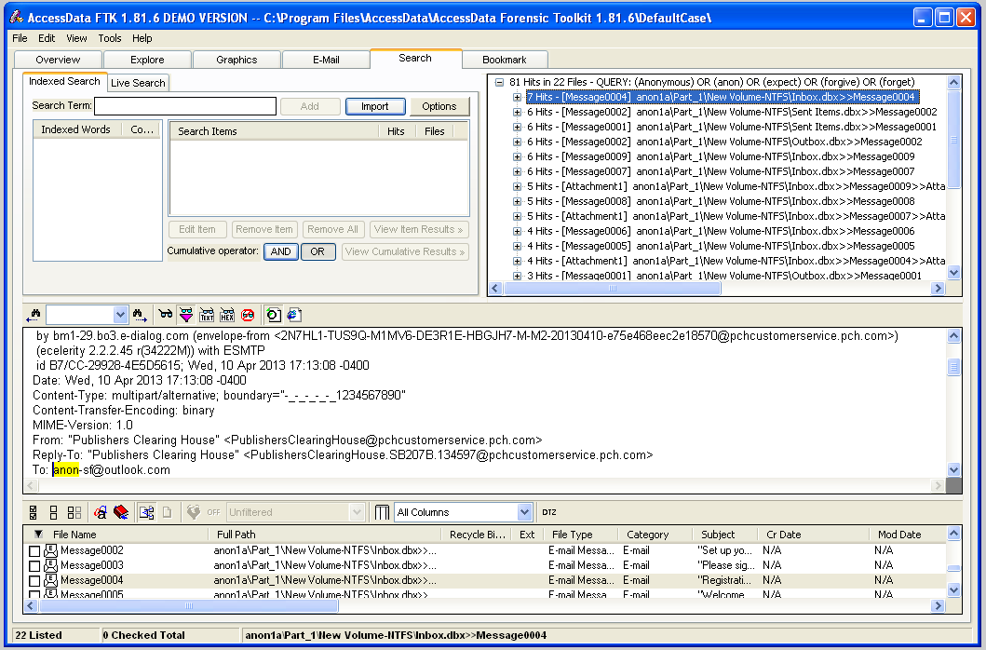
Analyzing Internet History with FTK
See projects 12 and 13

Slide 43
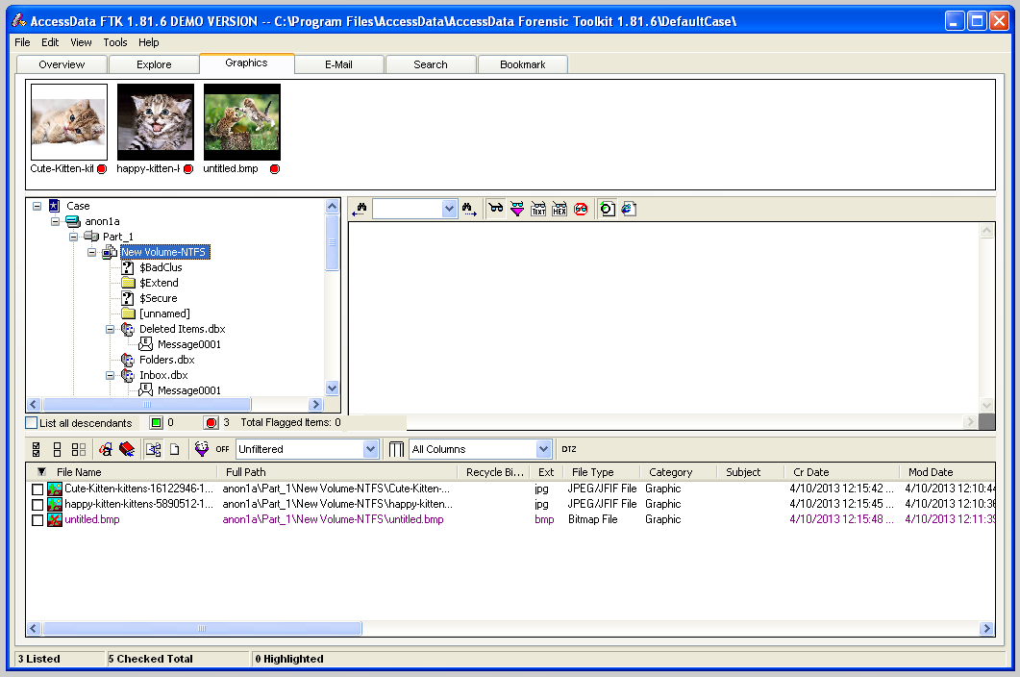

Slide 44
How to Work a Productivity Waste Case

Slide 45
Facebook
To determine time spent on Facebook and similar sites
Internet history file with URLs, timestamps, etc.
Internet Explorer 4-9 stored Internet History in index.dat files
No longer used in Internet Explorer 10 (default on Windows 8)

Slide 46
Facebook Chat
Facebook Chat files can be found by searching for "msgID"
Examine files of interest to find proper keywords for your case

Slide 47
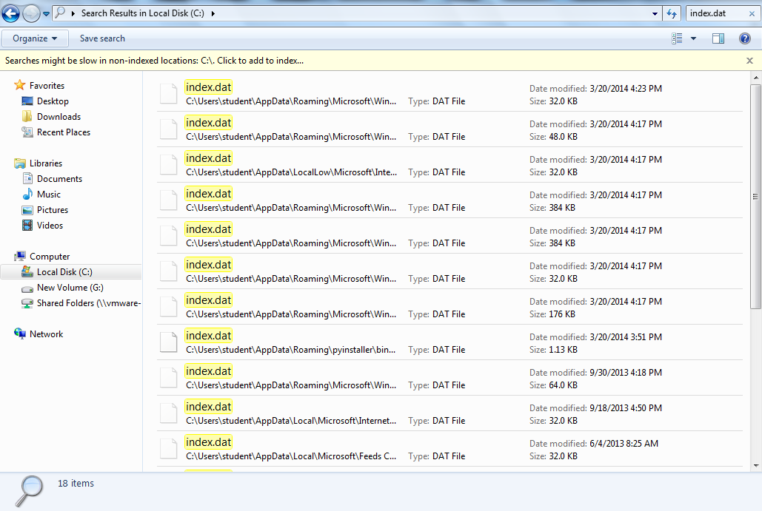
Index.dat Files on Windows 7 with IE 9
Show Protected Operating System Files

Slide 48
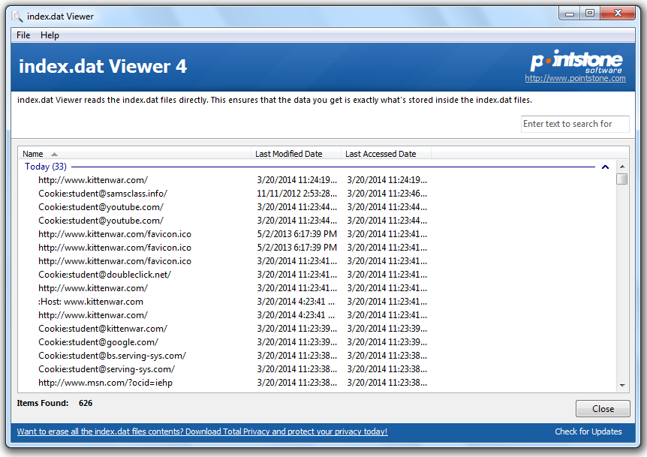
index.dat Viewer
Link Ch 11b

