Slide 1
Computer Forensics
Infosec Pro Guide
Ch 12
Administrator Abuse
Rev. 4-13-15

Slide 2
Topics
Challenges
Investigating an administrator running his own business out of his employer's network
Investigating an ex-administrator spying on his prior employer

Slide 3
Challenges

Slide 4
High Stakes
Administrator abuse is as bad as it gets
Challenges in analyzing data
  Admin has access and ability to erase evidence
  Can also watch email accounts to follow investigators
  Warn everyone in the investigation not to use any corporate-controlled systems to communicate
    VoIP phones, email, instant messaging, etc.
Massive damage inflicted on organization

Slide 5
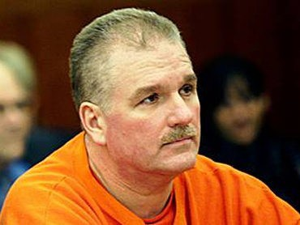
Terry Childs
Rogue San Francisco network administrator
  Link Ch 12a
  Image from http://cbssanfran.files.wordpress.com/2011/05/terry_childs.jpg?w=370

Slide 6
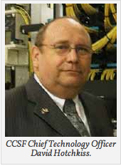
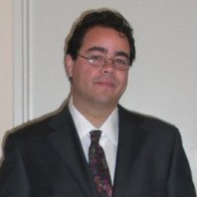
David Hotchkiss & Anthony Castillo
CCSF CTO and contractor who created a worldwide scandal with fake virus warnings
  Links Ch 12b, 12c
Anthony Castillo image from https://www.linkedin.com/in/drjazz

Slide 7
The Abuse of Omniscience
Administrators are paid to know everything
They have unlimited access
Network credentials
  username and password, or token, etc. required to gain access to servers, routers, security appliances, etc.
Security appliances
  Firewalls, content filters, data loss prevention systems, etc.

Slide 8
Greatest Weakness
Arrogance
  One suspect never deleted logs because he though no one was smart enough to find them
  Another failed to wipe data, thinking investigators wouldn't find it
  Administrators often leave evidence intact because they think they own "their systems"

Slide 9
Administrator's Role
Administrator manages
  Servers (physical and virtual)
  Workstations
  Routers and switches
  Firewalls
  Databases
  Email servers
  Authentication mechanisms

Slide 10
SIEM (Security Information and Event Manager)
SIEM systems maintain all the events and logs from systems in the network
A goldmine of evidence about network activities
BUT grab it fast because it's overwritten quickly

Slide 11
Canary Trap
(also called a Barium meal)
Giving false information to a suspected traitor
When the information leaks, you know its source
This can happen when the administrator takes action demonstrating knowledge of private executive emails

Slide 12
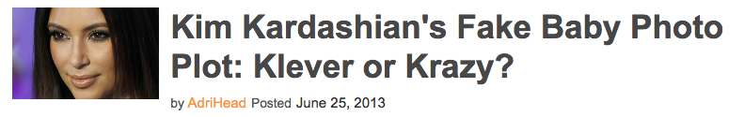
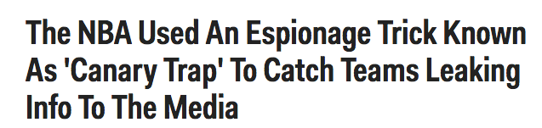
Famous Canary Traps
Link Ch 12e
Link Ch 12f

Slide 13
Investigating an administrator running his own business out of his employer's network

Slide 14
Spam Email
A woman got a spam email, with a link to a pornographic site
She examined the Email headers and found the originating IP and domain
Complained to the company
Company owner saw that the links led to pornography hosted on his company's network

Slide 15
IT Director
Owner asked IT director to investigate
No evidence that the servers had been compromised
No unusual content on any web server
No Further Action required
Owner was not satisfied; knew from news that hacking tracks are typically hidden

Slide 16
Private Investigator
Hired by owner to conduct a thorough threat assessment
PI hired a computer forensic contractor
Great care is needed to hide an investigation from an administrator this brazen

Slide 17
List of Possible Evidence
Make a list and update it as the investigation proceeds
  Web server itself
  Web server as an interface to other systems, like
  Databases and business applications
Web server is often the first point of breach
Attacker pivots to other systems from the compromised Web server

Slide 18
Web Server
Microsoft Internet Information Services (IIS)
Receives HTTP requests like GET and PUT
Allows directory browsing with WebDAV
Web content may be on other systems, such as a Distributed File System (DFS)
  A Web server in Miami may be serving content stored in Los Angeles
To recover deleted data, you need to locate the actual physical servers that held it
You may need to image many systems

Slide 19
Other Services
Web server can interface with
  Databases like Microsoft SQL Server
    Using ASP.NET, Java, PHP, etc.
  Email (Exchange)
Content management systems
  Wordpress, Joomla!, etc.
  Make custom Web pages based on database queries
  Personalized for each user

Slide 20
Investigating the Web Server
The Web server did not contain any pornographic material
But all five servers on the network were default installations of Windows Server 2000
  IIS on by default, so all five were actually Web servers
Pornography was on the file server
  In an obscure folder inside the Program Files folder
  Not officially regarded as a Web server

Slide 21
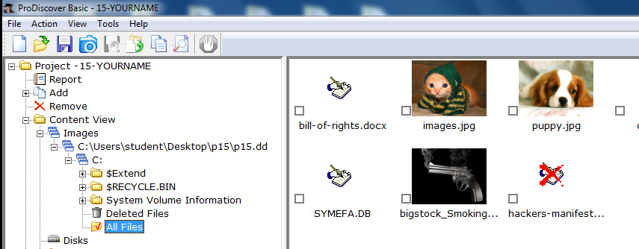
Forensic Technique
Image the file server
Look at the images in a forensic tool like FTK, EnCase, or ProDiscover
See the pornographic pictures

Slide 22
Web Root
Web servers serve content from a web root directory and its subdirectories
IIS uses C:\Inetpub\wwwroot by default
The web root can be changed

Slide 23
Virtual Servers
IIS can run multiple "virtual servers" with different web root directories and domain names
  sales.example.com
  support.example.com
  example.com
  another.com
They can each have a different IP address, or share the same IP address

Slide 24
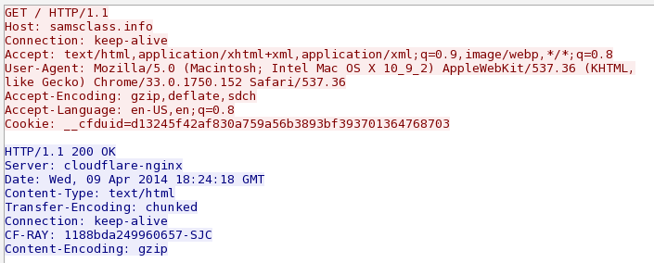
HTTP GET
Host: tells the server which site you want to see

Slide 25
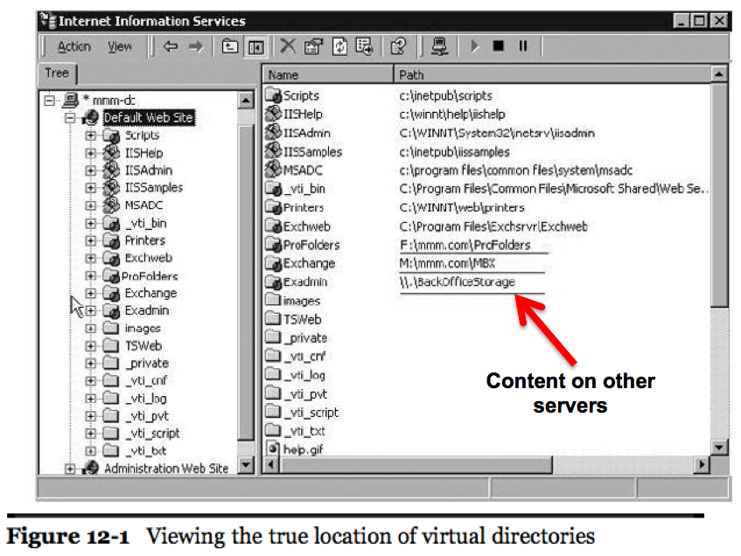

Slide 26
Databases
Source code for the pornography site contained calls to "Northwind Traders" database
A sample database included in Microsoft SQL Server 2000
Forensic tools cannot mount relational databases
Export data (.mdf) and log (.ldf) files from the forensic image

Slide 27
Recreate the Database
Mount the database on a separate SQL Server
Results: pornographic site user and credit card information was being maintained in the Northwind Traders database
Real data mixed with Microsoft sample data
Hidden in plain sight

Slide 28
Following Data Packets
Traced traffic to firewall
Firewall had four external IP addresses provided by ISP
One was assigned in DNS to the porn site instead of company email
Porn site's email server was on a different IP range at a remote commercial hosting company
These changes indicate that internal IT staff was complicit in the offense

Slide 29
More Images
With this evidence, the investigators got authorization to image all company computers
To find out who was involved
Network administrator's computer contained
  Several hits to the pornographic website's domain
  Also hits to the remote email server management interface
  Remnant copies of the porn site's inbox
  Emails from online payment system and customers

Slide 30
Confession
Confronted with this evidence, the network administrator admitted he owned the site

Slide 31
Investigating an ex-administrator spying on his prior employer

Slide 32
Private Investigator Calls
PI was hired to look for listening devices in a company's offices
Company suspected competitors were listening to their conversations
  Because a new competing company had emerged and taken many customers away
PI could not find any listening devices
Wanted computers scanned to see if they had been compromised

Slide 33
As If They're Reading Our Minds...
Five former long-term employees had recently resigned
Started a new competing company
Always one step ahead of the client company
Had knowledge of confidential business information

Slide 34
Initial Scope
Scope: Client determines what they are looking for and what they want you to determine
  Image several computers from high-ranking former employees
  Determine whether they had accessed critical client information to take with them to the competitor
  Find communications with the new company while they were still employed

Slide 35
Current Employees
Also received computers from the highest ranking current staff
  Determine whether they sere compromised in some fashion
  Such as with keyloggers or other malware
No evidence of compromise was found
Recommendation: network vulnerability assessment

Slide 36
Civil to Criminal
This case began as a civil investigation
At the end of the civil case, a criminal investigation was commenced by the FBI
Remember, your case can turn criminal
Keep good case records and chain-of-custody records to assist law enforcement in their use of your forensic images

Slide 37
Network Vulnerability Assessment
First indication of compromise
Outlook Web Access (OWA) logs
Network service accounts had been reading emails from
  Company president, CFO, legal counsel, marketing director, and more
  50 high-ranking staff members' emails

Slide 38
Network Service Accounts
  Corporate voicemail server account
  Blackberry Exchange Server account
  Database server account
Needed to explain to executives that it's not normal for a voicemail server to log into webmail sites
All the service accounts had network administration rights and were administrators over the mail server
  So they could read anyone's email

Slide 39
Web Server Logs
Exported from the forensic image
Imported into a relational database
Revealed that someone had been using those service accounts to access emails of executives nine months earlier
Source IP addresses were both external and internal
  Local addresses indicate that insiders were involved, or attacker used a VPN or other remote access

Slide 40
VPN Server
Captured a forensic image
Analyzed logs
The same external IP addresses documented in the webmail server logs had connected to the VPN server

Slide 41
Sequence of Events
  External client logs onto VPN server
  Assigned local IP address
  Starts a Webmail session to read executive's emails
In other cases, intruders connected directly from outside IP addresses to the webmail server's external interface
After messages were read, they were remarked as unread

Slide 42
IP Addresses
Some of the external IP addresses were tracked to the new company
Other addresses led to the home ISP addresses of the ex-employees

Slide 43
Scope of Damage
Document which emails had been accessed
  And what sensitive data had been compromised
OWA logs are the best place to find that information
  Record title of every email
  And every attachment that is opened
  Open URLs in a Web browser running an OWA session
  You can see email and attachments exactly as they were read by the user

Slide 44
Email Review
Thousands of emails to review
Re-created Exchange Server
Restored incremental backups to it
Passed URLS of emails and attachments through a Web browser with an automated process
Provided copies of every email and attachment that had been read to client

Slide 45
Attackers Exploited Insider Knowledge
Knowledge that those obscure service accounts all had domain administrative privileges
Knew how to log onto the VPN
Used PCAnywhere to take over client systems and cover their tracks
Knew where the front door and back door were

Slide 46
Ex-Administrator Instructions
He had set up all administrative permissions
Ex-Administrator was recorded leaving instructions to his replacement
  Never change passwords to the service accounts
  Because no one knows what it would break

Slide 47
Stepping Up Your Game

Slide 48
You v. Administrator
Your skills are pitted against the administrator's skills
Administrator has greater technical knowledge of the network you are trying to analyze
Be patient
Investigate in a methodical and logical manner
Administrator made mistakes and left some evidence behind

Slide 49
Mistakes
Clever
  Hid porn site on a back-end server
  Stored client transactions in a sample database
Mistake
  Didn't clean his own computer, and left behind all the Internet history files

Slide 50
Mistakes
Clever
  Used service accounts to access emails
  Hid tracks using VPN and PCAnywhere
Mistake
  Didn't delete IIS logs on the webmail server

Slide 51
Forensic Tools
There is no such thing as a "court-approved forensic tool"
What matters is
  Creating sound forensic images of the evidence you are preserving
  Can replicate the process you used to show another examiner
  So that examiner can reach the same conclusion

Slide 52
Outside Forensic Tools
Forensic tools and methods were used to obtain and preserve legally defensible data
Most of the real work was done outside forensic tools
Use the best method to analyze the data
  You are not limited to features in your forensic tool

