Slide 1
Computer Forensics
Infosec Pro Guide
Ch 13
Stealing Information
Updated 4-20-15

Slide 2
Topics
How to look for patterns and identify artifacts
How to determine where the data went
How to detect which data has been taken on external devices

Slide 3
Stealing Information
Theft of corporate information by a (soon-to-be) ex-employee

Slide 4
How to look for patterns and identify artifacts

Slide 5
What Are We Looking For?
Evidence of an employee stealing
  Correspondence
  Customer contacts
  Drawings
  Contracts
  Spreadsheets
  Emails
  Source code
  Other company-owned information

Slide 6
Patterns
Increase in user access to files
  Large number of files accessed in a single day
  Perhaps another set the day after
Files copied to removable storage
  USB, FireWire, eSATA, etc.
Or uploaded to file hosting or webmail sites
  If email is used, it won't be the corporate email
  It will be Yahoo! mail, Gmail, Hotmail, etc.

Slide 7
Email Artifacts
Most suspects believe that webmail leaves no trace on their computer
Commercial forensic tools have webmail analysis and carving features
  Search the drive image for the headers used by popular webmail systems
  Across active HTML files and deleted files

Slide 8
AJAX (Asynchronous JavaScript and XML) and JSON (JavaScript Object Notation)
Can update just part of a page at a time
Used in almost all Web 2.0 applications
Less email can be recovered, because artifacts are rewritten more quickly

Slide 9
Artifacts and What They Tell You
Webmail
  If suspect was sending attachments from the suspect's computer through a personal email account
LNK Files (Recent Items)
  Suspect was accessing files copied onto another drive
Shellbags
  What other directories exist on other drives identified from the LNK files

Slide 10
Artifacts and What They Tell You
USBSTOR Registry Key
  Make, model and serial number of an external storage device, and when it was last plugged in
Setupapi Logs
  The first time a storage device was plugged in
Log Fragments
  Text fragments in partially overwritten logs
  Activity showing what the suspect was taking

Slide 11
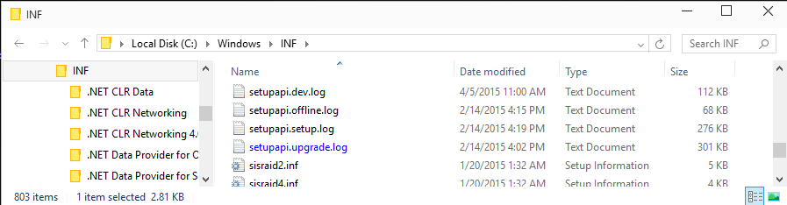
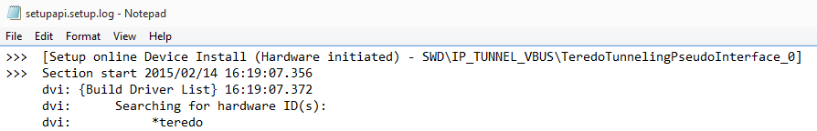
SetupAPI Logs in Windows 10 TP

Slide 12
Popular Webmail Finders
These products can help you find the most popular kinds of webmail for review
They search a forensic image and find all known webmail fragments
Internet Evidence Finder
  from Magnet Forensics (link Ch 13a)
Evidence Center
  From Belkasoft (link Ch 13b)

Slide 13
Inbox View
Often, one of the recovered HTML files will be the user's Inbox
Typically a static web page
Written to disk in its entirety
Shows sender, date, subject, and whether an attachment was included

Slide 14
Limitations
You can only recover what the suspect received from the web server
You cannot recover text typed into a form and sent up to the Web server

Slide 15
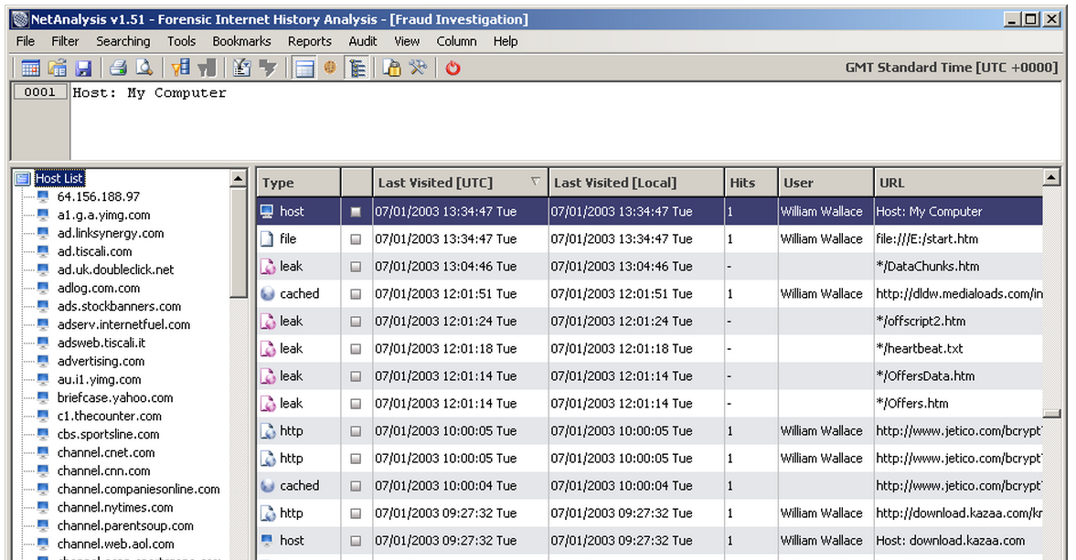
NetAnalysis
Examines browser history and cache
Link Ch 13c

Slide 16
BCC:
User may use corporate account but include BCC: copy to home account
Easily detected by examining Web server
Search of Internet history will usually find their home accounts

Slide 17
How to determine where the data went

Slide 18
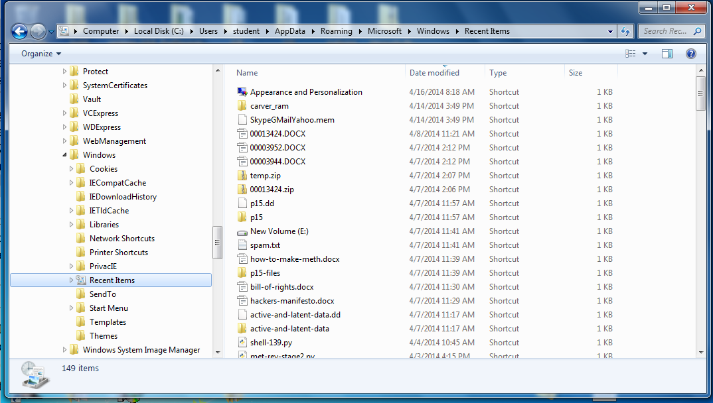
LNK Files (Recent Items)

Slide 19
LNK Files
Created whenever files or folders (sometimes) are opened in Windows, with this information
  Full path to the file, which can be on local drive, network share, removable media, etc.
  Type of drive the file is being accessed from
  File size
  Volume name and serial number of the drive from which the file is being accessed

Slide 20
Additional Information in LNK Files
MAC address of system where file is stored, if it's being accessed over the network
Date information
  When the associated file was created, modified, and accessed
  When the LNK itself was created, modified, and accessed

Slide 21
Recovered LNK Files
LNK files are found in both the active file system and the free space on the drive
Commercial forensic tools like FTK can recover LNK files from free space (Link Ch 13d)

Slide 22
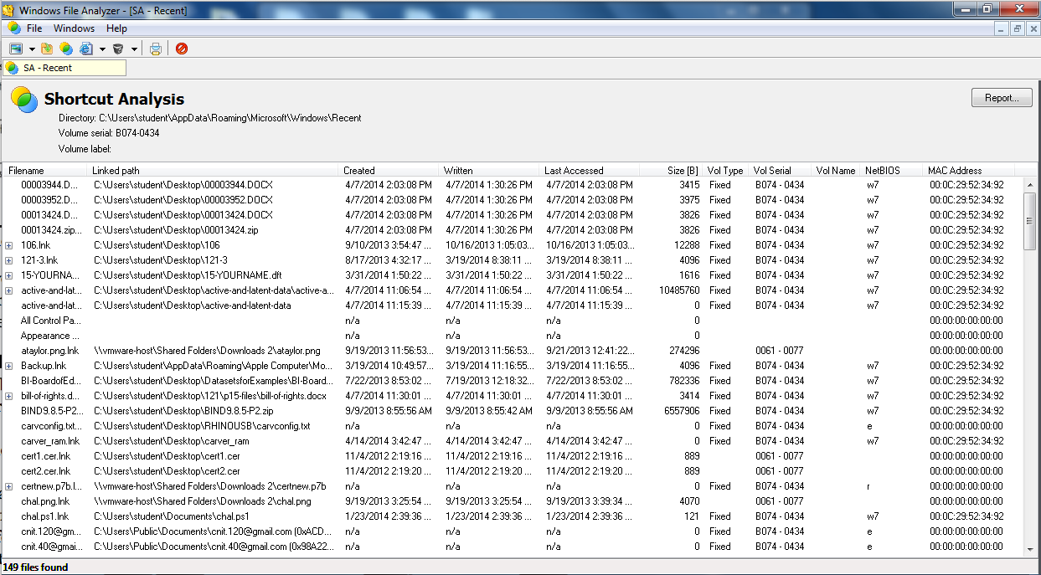
Windows File Analyzer
Link Ch 13i

Slide 23
Demonstration of Times
Create a folder and a file
Wait a while
Open it again
Examine LNK file timestamps
  Shows time LNK was created, accessed, modified
Analyze with Windows File Analyzer
  Shows time original file was created, accessed, modified

Slide 24
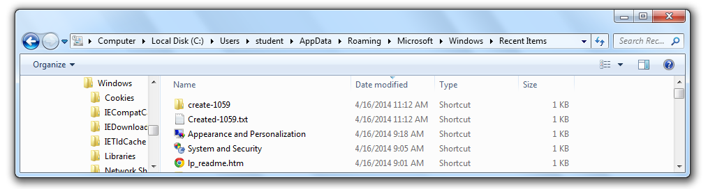
Folder and file created at 10:59
No LNK file created at that time
Folder and file opened at 11:12
LNK file created with timestamp 11:12

Slide 25
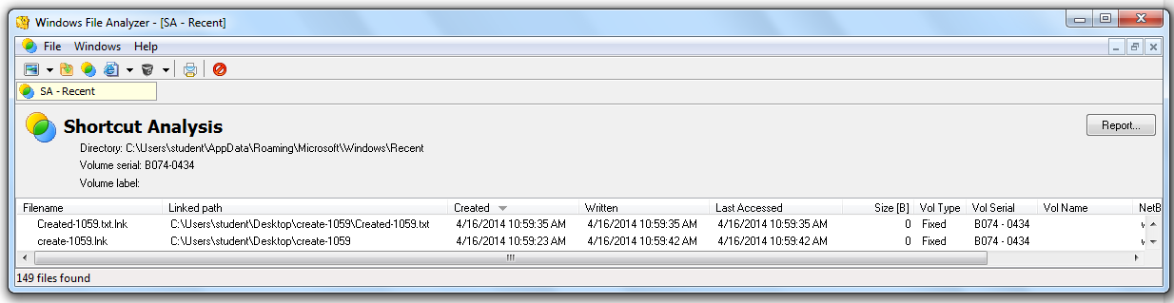
Windows File Analyzer shows the time the file was actually created: 10:59

Slide 26
Shellbags
Registry entries that store user preferences for folder display in Windows Explorer
Only folders that have been opened by the user appear in the shellbags
Shellbags are part of the user's profile, in these files:
  NTUSER.DAT and USRCLASS.DAT

Slide 27
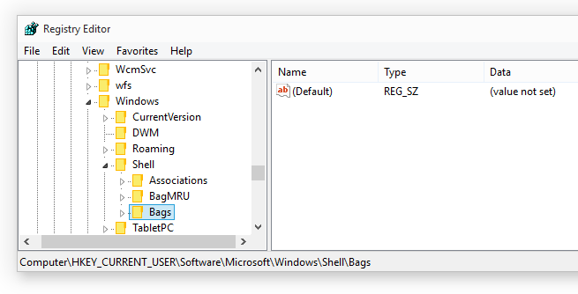
Shellbags in Windows 10 TP

Slide 28
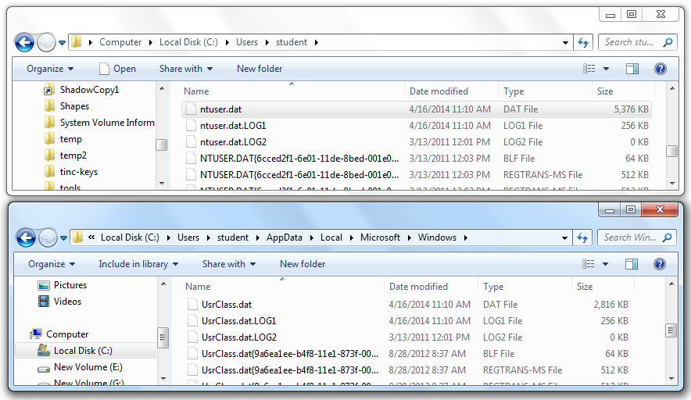

Slide 29
Shellbags v. LNK Files
LNK files show files that were opened, and possibly directories
Shellbags show every directory a user accessed whether the user opened a file or not

Slide 30
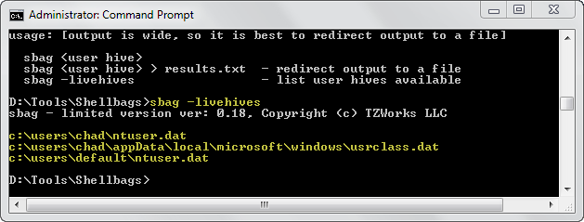
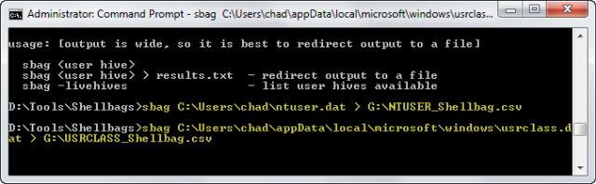
sbag (not free)

Slide 31
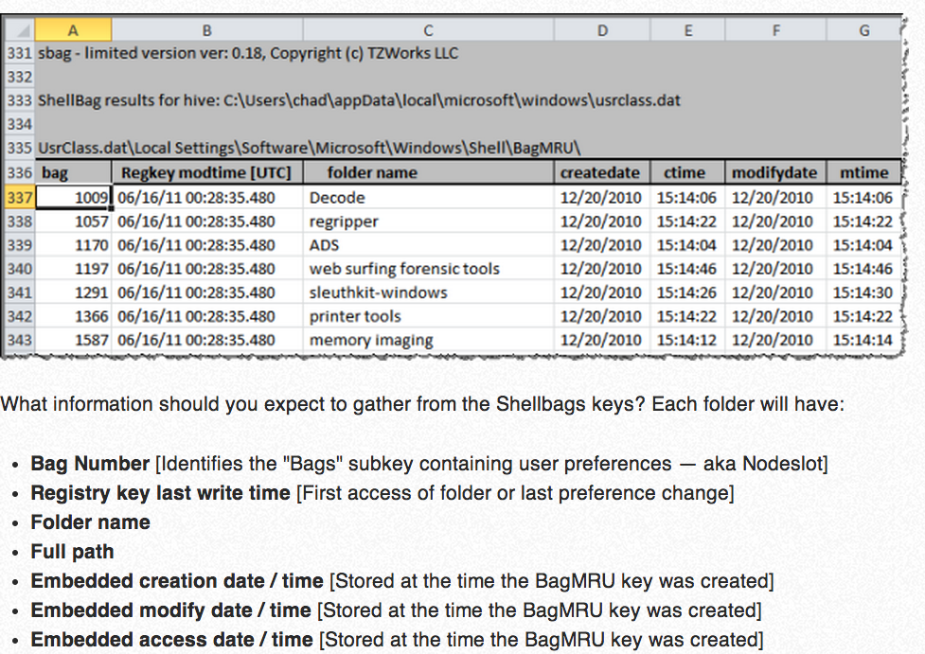
Images from SANS (link Ch 13k)

Slide 32
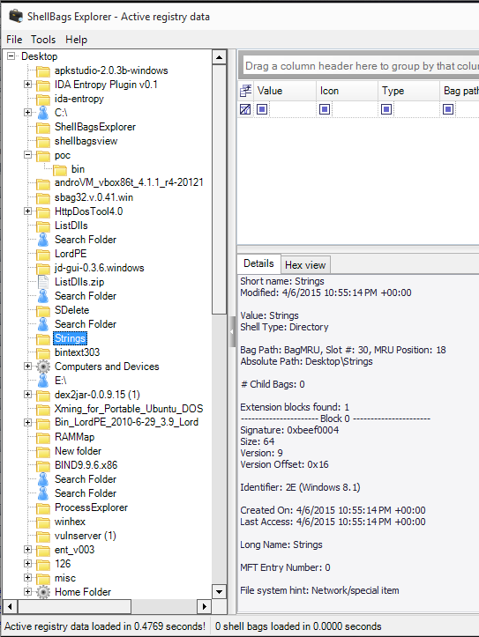
ShellBags Explorer
Free
Link Ch 13m

Slide 33
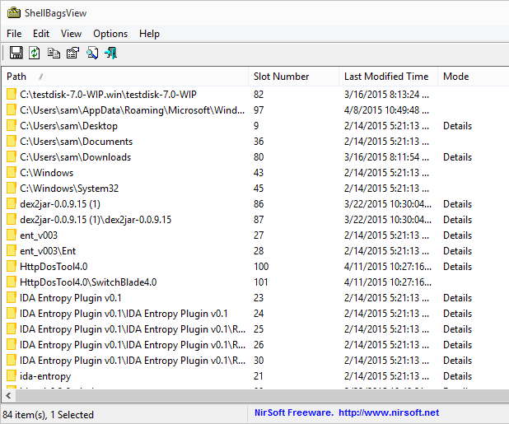
ShellBagsView
Free
Link Ch 13l

Slide 34
Case History

Slide 35
Web Developer
Web development company was losing a major client in 90 days
To a different company, for a major upgrade
Would lay off staff
A developer wanted to jump ship to the new company
To impress them, he downloaded the whole site by FTP to start working on it early

Slide 36
Customer Data
He also downloaded 100,000 customer records that were kept in archival files on the Web server
  Automatically generated each midnight
Hosting provider noticed the large amount of traffic
Notified the owner, giving filenames and IP address of downloader

Slide 37
Court Order
Company hired a law firm to get a court order
Got customer information from ISP, based on IP address
Developer denied downloading the files
  Agreed to a forensic examination of his laptop

Slide 38
Search Terms
Archival files had a standardized naming convention
Useful as search terms
Thousands of the names found in a partially overwritten log file for WS_FTP (the FTP client the developer used)

Slide 39
Authorized Seizure
This evidence was sufficient to get a judge to authorize seizure of all media at the developer's residence for analysis
  Concerns that the developer had copied the data
Developer admitted to the download
USB drive revealed that the files had been copied to it, but it was then reformatted
Recovered more than 70,000 customer files
No evidence of any other copies

