Slide 1
Computer Forensics
Infosec Pro Guide
Ch 3
Creating a Lab

Slide 2
Topics
Where to put your lab
Tools of the trade
Forensic software
Storing evidence

Slide 3
Where to Put your Lab

Slide 4
Criminal v. Civil Investigations
Only law enforcement officers can perform criminal investigations
  And those they contact
You can do forensic investigations for your employer
  Employee misconduct
Or for customers you represent in civil court

Slide 5
Where to Put Your Lab
Access controls
  Physical and network
Electric power
Air Conditioning
Privacy

Slide 6
Access Controls
You need to maintain chain of custody
  A document stating who had possession of the evidence and where it was stored
  It must be securely stored at all times from collection to court, or it will lose its value as evidence
  Sample form at link Ch 3a

Slide 7
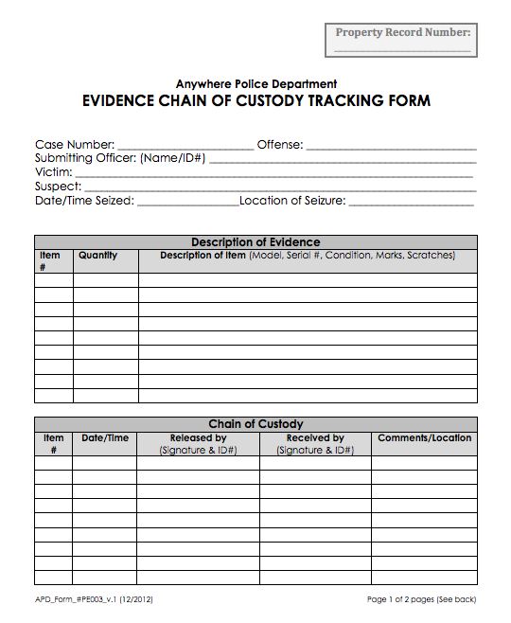

Slide 8
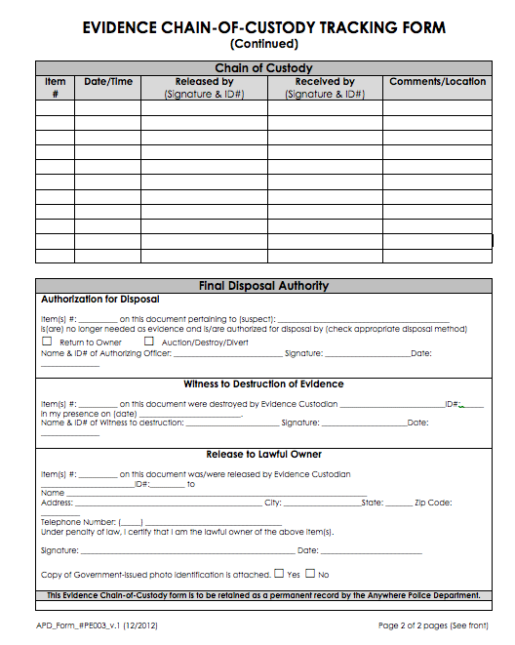

Slide 9
Information to Record About a Forensic Image
Information about the system the evidence was acquired from
  PC, laptop, DVD, thumb drive, phone, etc.
  Make, model. serial number
Where the forensic image is stored
  Make, model, serial # of drive
The forensic image itself
  With a hash value to verify integrity

Slide 10
Hash Algorithms
MD5 is the most common
  Old and not 100% reliable
  128 bits long
SHA-1 is newer and better
  160 bits long
In practice, both are fine for forensic image verification, because you are only trying to detect copy errors, not malicious forgery

Slide 11
Physical Access Controls
Human guard, lock, proximity card sensor, etc.
Do not let cleaning crew or facilities people have access to forensic lab
Logging every entry and exit is desirable
You need to testify in court that you made sure no one tampered with the evidence

Slide 12
Network Access Controls
You must make sure no one can tamper with your images over the network
One good procedure
  Work in isolation (also called Air Gap)
  No Internet connection on any of your forensic devices
  Move files in and out on portable USB devices

Slide 13
Requirements for a Networked Forensic Workstation
You need administrator privileges on your workstation
You need to deny other IT personnel access to your workstation
Your workstation needs to be on a separate domain, and you need to control domain policies that get pushed to it
You need to install and maintain your own firewall and antivirus software

Slide 14
Electrical Power
As lab grows. more power is required
UPS (Uninterruptible Power Supply) protects your systems from brief power outages

Slide 15
Air Conditioning
The more devices, the more heat they generate
Lab must be kept cool all times machines are on

Slide 16

Privacy
You will be viewing materials that are sensitive and often offensive
You need a real door, and you need to work with it closed
  Image from link Ch 3b

Slide 17
Tools of the Trade

Slide 18
Hardware Write Blocker
Hardware device that permits reading from a drive without writing to it
Expensive ($1000 or so)
Not always available for all hardware, such as cell phones

Slide 19
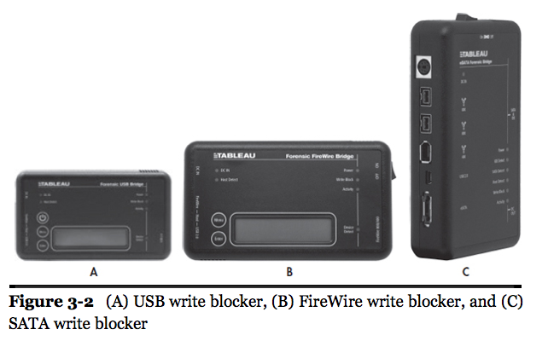

Slide 20
Original Evidence
The actual real device that was seized at the crime scene
  Laptop computer
  Hard drive
  Phone
  CD, DVD, thumb drive, etc.
A copy is much less useful in court, because it is not original evidence

Slide 21
Destroying Evidence
If you mix up source and destination, you can erase the original drive instead of copying it
Pros use expensive write-blockers to avoid this
You can buy very expensive disk duplicators with write-blockers built in, and that are very fast

Slide 22
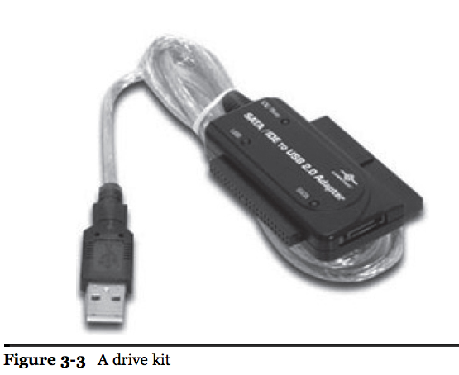
Software Write Blocker
We'll use software write-blocking
  A common feature of Linux-based Forensic LiveCDs such as DEFT
  Windows registry can block writes to USB drives
    Project 5
Drive kit allows you to connect SATA drives through USB 3

Slide 23
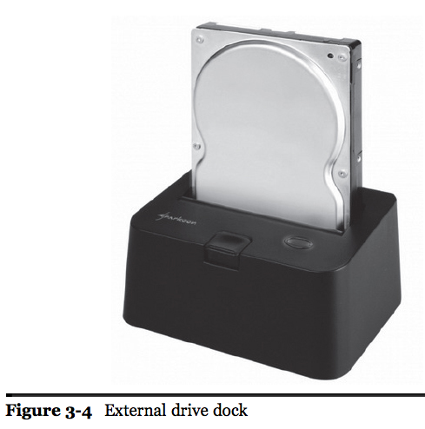
Test Your Equipment
Try to write to a scratch drive to test write-blocker
Make sure devices work before going to client site
External drive dock
  More permanent alternative to a drive kit

Slide 24
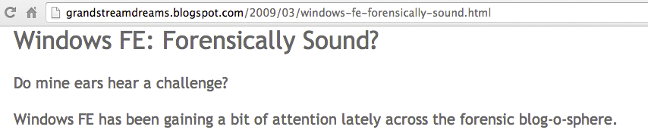
Windows FE, a special version of Windows, can be used to make a forensically sound boot disk
  Link Ch 3c

Slide 25
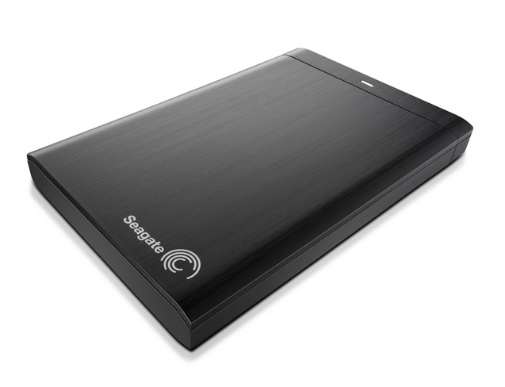
External Storage
Fast connection is very handy
USB 3, eSATA, Thunderbolt
Good heat dissipation
  Drive can overheat and crash
  Image from amazon.com

Slide 26
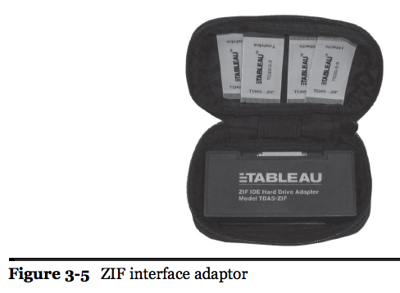
Tools
Jeweler's Screwdrivers, including Torx and star heads
Antistatic bags
Adaptors

Slide 27
Forensic Software

Slide 28
Forensic Workstation
Any good PC works
Lots of processing power, RAM, and storage
Larger cases require larger servers
Processing a case on a laptop can take overnight

Slide 29
Forensic Software
SIFT (SANS Investigative Forensics Toolkit)
  Open source and free, Linux-based
EnCase Forensic
  Expensive, proprietary, on Windows
FTK
  Expensive, proprietary, on Windows
USE MULTIPLE TOOLS, NEVER TRUST JUST ONE

Slide 30
SIFT and DEFT
SIFT is from SANS, under constant vigorous development, and used in their classes
  Download at link Ch 3d
DEFT is an Italian forensic live CD I used in this course previously
  Can image the MacBook Air
  Download at link Ch 3e

Slide 31
Other Tools
ProDiscover – has a free version, runs on Windows
SMART Forensics
X-Ways
There are many others, but they all should end up finding the same evidence if used competently

Slide 32
Storing Evidence

Slide 33
Securing Your Evidence
Locking file cabinet, safe, evidence room
  All that matters is "who has access?"
  If file cabinet has a generic master key, you need to add a secondary lock to it
  File cabinets are notoriously easy to pick
Safe is better, but can fill up fast

Slide 34
Evidence Room
Walls must go to the ceiling
  No way to climb over
  Watch our for drop-down ceiling
Controlled access to room
  Preferably a digital lock
No unsupervised access by cleaning crew, etc.
Fire suppression must be "dry pipe" to avoid damaging evidence

Slide 35
Organizing Your Evidence
Make sure you can find it
Create standards for labeling evidence and drives
Track evidence with a spreadsheet
  Or a shared Google document, etc.
  Record make, model #, serial # of drives
  Exact locationm shelf #, etc.

Slide 36
Disposing of Old Evidence
Ask client before destroying anything
Keep email or other document saying you can destroy it
You can wipe and re-use the drives (!)

