Slide 1
Computer Forensics
Infosec Pro Guide
Ch 5
Choosing Your Procedures

Slide 2
Topics
Forensic imaging methods
How to determine your comfort level with various methods
Standard forms and a lab manual

Slide 3
Forensic imaging methods

Slide 4
Forensic Imaging Methods
With hardware write-blocker
With software write-blocker
On dedicated devices
Of live systems
Using custom boot CD/DVDs
These all make the same images, except for live acquisition

Slide 5
How to determine your comfort level with various methods

Slide 6
Questions
Are you comfortable on Linux command line?
  If not, avoid Linux CD/DVD methods
Can you afford a write-blocker?
  If not, you need to use software write-blocking
  A forensic CD/DVD works too
  Write-blockers are not perfect—test them

Slide 7
Questions
Do you have a large budget but a low tolerance for risk?
  Self-contained forensic imaging systems are available
  Cost $1500 - $4000
  Very easy to use, low chance of mistakes

Slide 8
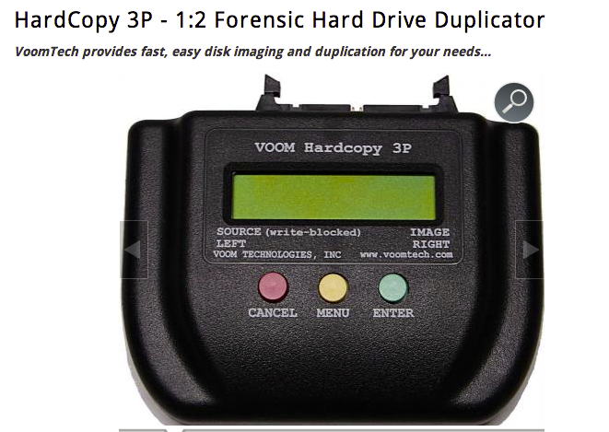
Link Ch 5a

Slide 9
Questions
Are you comfortable testing and explaining Windows registry changes?
  USB registry write-blocking works in Windows XP, 7, or 8 (but not Server 2008!)
Are you comfortable with the Windows command line?
  You can use Windows FE, a bootable forensic CD/DVD (Link Ch 3c)
  Command-line environment

Slide 10
Hardware Write Blocking
Pros and Cons
Pros
  Reliable protection, documented and tested by vendor
  Any forensic imaging program, OS, or analysis tool can be used without the risk of modifying the evidence
  Some device-specific imaging programs allow faster imaging (e.g. Tableaux)

Slide 11
Hardware Write Blocking
Pros and Cons
Cons
  The number of devices you can image at one time is limited by the number of write blockers you have
  The type of devices you can forensically image are limited by the type of write blockers you have
  Hardware write blockers are moderately expensive

Slide 12
Software Write Blocking
Pros and Cons
Pros
  You can image many systems at once, by making more CD/DVDs
  You can image any type of media as long as there are drivers for it in the CD/DVD
  Free
Cons
  Can be slower than hardware write blockers
  Without good prior testing and procedures, software write blockers can fail

Slide 13
Dedicated Unit Pros and Cons
Pros
  Created specifically for forensic imaging
  Fastest method
Cons
  Expensive
  Number of devices you can image is limited by the number of units you have
  Many types of media are not supported
  Issues may require a firmware update to fix

Slide 14
Creating standard forms and a lab manual

Slide 15
Essentials
After creating an image, fill out a form that states:
  Where it came from
  How you forensically imaged it
  Validates that hashes match
  Indicates when the evidence is no longer in your custody

Slide 16
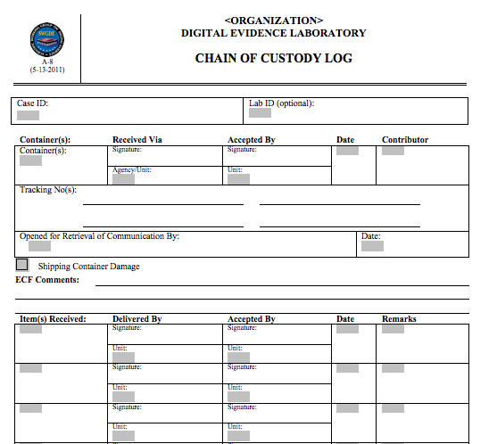
Chain of Custody Form
From Scientific Working Group on Digital Evidence
Link Ch 5b

Slide 17
Request Forms
  Who is requesting the information
  Who is being investigated
  The devices you are being authorized to access
  What you are being asked to investigate
  The date of the request
This document will protect you from unhappy executives if a case gets political

Slide 18
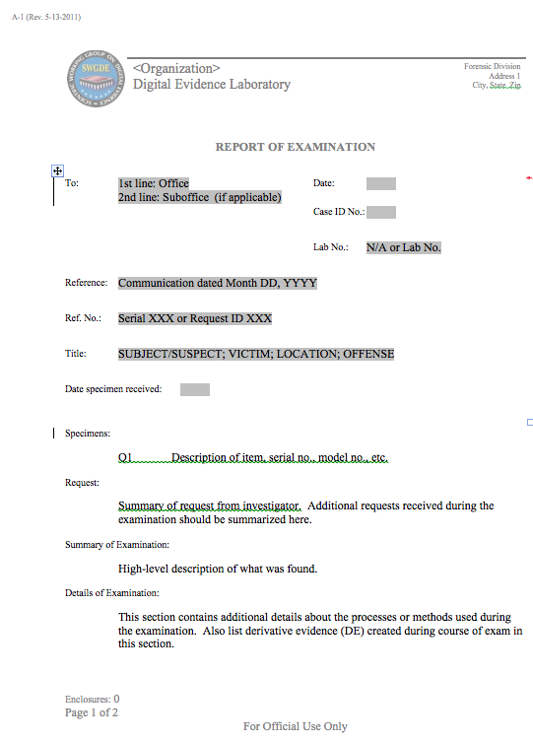
Report Forms
You need to fill out a report tempate
Explain in human terms what you found
Attach the output of a forensic tool as an appendix

Slide 19
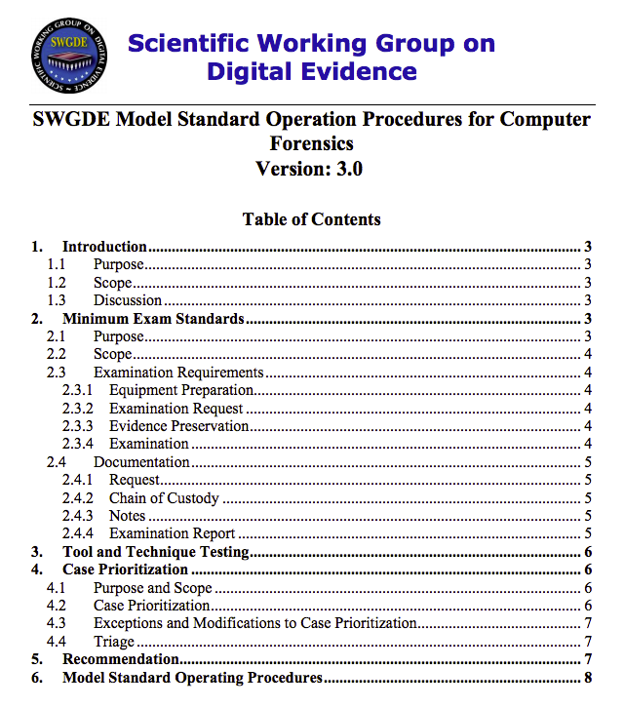
Standard Operating Procedures Manual
Link Ch 5c

