Slide 1
Computer Forensics
Infosec Pro Guide
Ch 6
Testing Your Tools

Slide 2
Topics
How and when to test your tools
Where to get test evidence
How and where to access forensic challenges
How and where to access tool testing images

Slide 3
When Do You Need to Test?
To collect data for public research or presentations
  If you find a new technique, the original case data is probably confidential
  You need public test data
To test a forensic method
To test a tool
For private tests, you can use your own old cases

Slide 4
Evidence File Formats
Raw Images
  Also called "dd images"
  Uncompressed: same size as the original evidence drive
  Simple bitwise copy of the drive, no container
  May be broken into a series of files with fixed siize
  Works in all forensic tools

Slide 5
Evidence File Formats
E01 (Expert Witness format)
  Used by EnCase
  Compressed
  Wrapped in a file with other data, such as hashes
  Not supported by all tools

Slide 6
Evidence File Formats
Not supported by all tools
  AFF (Advanced Forensic Format)
    Open source forensic image format
  S01
    Raw image compressed with gzip
    Geometry and hashes in a separate file
  AD1
    AccessData's format

Slide 7
Creating Your Own Test Images

Slide 8
Using a Virtual Machine
Install the OS
install same applications and service packs/patches as the system you are re-creating
Create same data you are testing for
Exit the VM and either create a forensic image, or feed the virtual drive into your forensic tool directly
  Directly connecting it may risk altering the data

Slide 9
Tools to Work with Virtual Hard Disks
VMXRay (link Ch 6a)
VMware’s Virtual Disk Development Kit
  Link Ch 6b
Encase, FTK, and FTK Imager all support reading virtual hard disks, including VMware

Slide 10
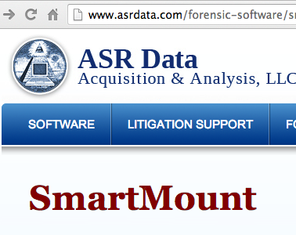
SmartMount from ASR Data
Mount forensic images in VMware and run them (link Ch 6c)
Changes are store in an "overlay" file, so they never affect the forensic image itself

Slide 11
Live View
Free, Java-based tool
Converts dd images to VMware virtual machines
All changes to VM are written to a separate file, to make it easy to return to the original state
  Link Ch 6d

Slide 12
Forensic Challenges

Slide 13
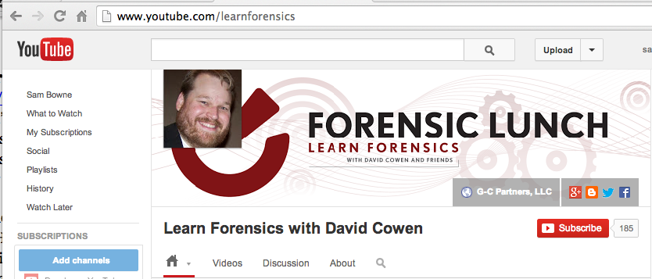
LearnForensics YouTube Channel
Link Ch 6f

Slide 14
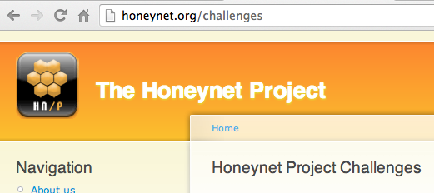
Honeynet Challenges
Link Ch 6g

Slide 15

DC3 Challenge
From US DoD
A year long
Includes unanswered questions that require you to develop new tools
  Ch 6h

Slide 16
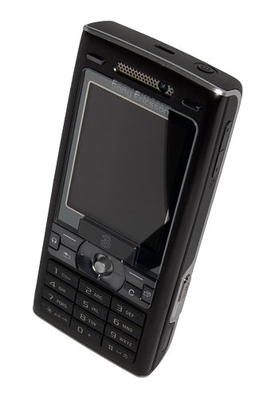
DFRWS Challenge
(Digital Forensics Research Workshop)
Smartphone evidence re: an arms dealer
  Link Ch 6i
  image from Wikipedia

Slide 17
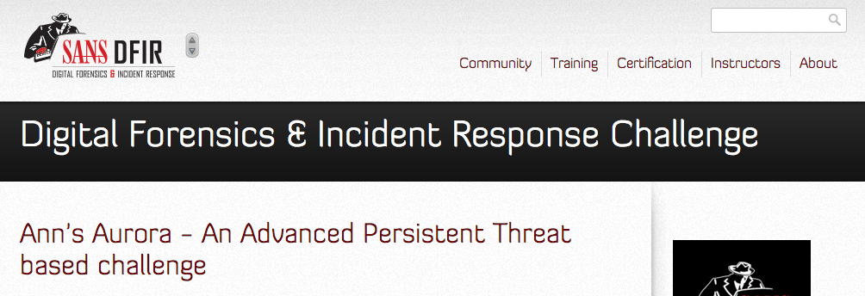
SANS Forensic Challenges
Link Ch 6j

Slide 18
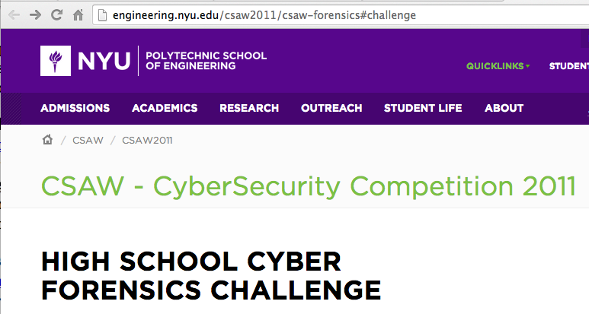
High School Forensic Challenge
Link Ch 6k

Slide 19
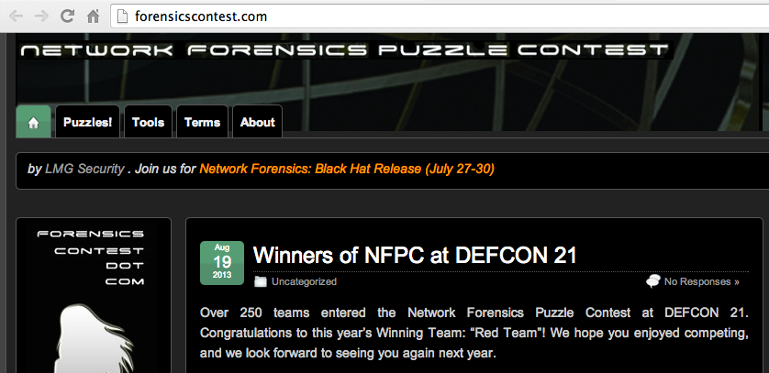
Network Forensics Puzzle Contest

Slide 20
Tool Testing Images

Slide 21
Tool Testing Images
Digital Forensic Tool Testing Images (Sourceforge)
  Link Ch 6k
NIST Computer Forensics Reference Data Sets Images
  Including "The Hacking Case"
  Link Ch 6l

