Slide 1
Computer Forensics
Infosec Pro Guide
Ch 7
Live vs. Postmortem Forensics

Slide 2
Topics
Advantages and risks of live forensics
When live forensics is the best option
Tools for live forensics
Advantages and risks of postmortem forensics
Postmortem memory analysis

Slide 3
Live and Postmortem Forensics
Live Forensics
  Evidence system is running and logged in
  Attach an external storage device, or connect to a network share
  Run a program on the system to capture data, including RAM and the hard disk
Postmortem Forensics
  Evidence system is powered off
  Remove hard drive, image with write-blocker
  Does not capture RAM

Slide 4
Advantages and Risks of Live Forensics

Slide 5
Advantages of Live Forensics
Live forensics can capture RAM
Essential for
  Capturing malware that is only in RAM
  Recovering authentication and encryption passwords from RAM

Slide 6
Risks of Live Forensics
If the system is connected to a network, it may be remotely wiped
Examiner's tools and acts may overwrite data in the page file and cause data loss
In practice, IR (Incident Response) teams are usually not interested in deleted data
  More concerned about rootkits and malware
  RAM is far more important

Slide 7
Imaging the Hard Drive
You can image the hard drive live
That preserves its state and allows you to return to the saved state
Do this before you begin your analysis, because analysis changes files and datestamps

Slide 8
When Live Forensics is the Best Option

Slide 9
When Live Forensics is the Best Option
Live Imaging
Incident Response
Malware Analysis
Encrypted Systems
Nonsupported File Systems
Enterprise Forensic Tools

Slide 10
Live Imaging
Copying a hard drive while the system is running
Required when you cannot take down a system for imaging, such as a shared server
RAID or SAN storage is easier to image live
  Because the drivers may not be available for forensic software, such as live DVDs
  Arrays are difficult to re-create offline

Slide 11
Minimizing Impact
When performing live imaging of a hard drive
  Run your tools from external storage
  Store evidence on external storage
This minimizes the impact to the evidence system

Slide 12
Incident Response
An investigation in reaction to a security incident
  Breach by a hacker
  Malware outbreak
  Network outage
DFIR (Digital Forensics / Incident Response)

Slide 13
Incident Response
Consider response to a hacker intrusion
The only way to track down the attacker is with live forensics to track
  Memory
  Network activity
Postmortem forensics may have a role later after the incident is over

Slide 14
Malware Analysis
Must inspect system memory to see what malware is doing
Captured memory image can be parsed with tools like Memoryze
  The malware is not running
  It cannot hide its actions

Slide 15
Encrypted Systems
Hard disk may be encrypted (e.g. BitLocker)
Live OS has access to the hard drive while it's running, so it can be imaged in a decrypted state
  Without needing the encryption keys
Encryption keys may be in memory
  Can be retrieved from a RAM image with memory analysis

Slide 16
Nonsupported File Systems
Legacy systems may not be supported by any forensic tools
A traditional hard disk image will be of little use
  You can still search for keywords and carve for known file types
  But you won't see the file system structure; folders, owners, timestamps, etc.

Slide 17
Nonsupported File Systems
Back up the live system into an intermediary storage file
  tape, zip, tar, etc.
This may be the only way to preserve the data in a reviewable form
Special cases may require unusual procedures
Document what you did
Note: Updated tools support more old systems

Slide 18
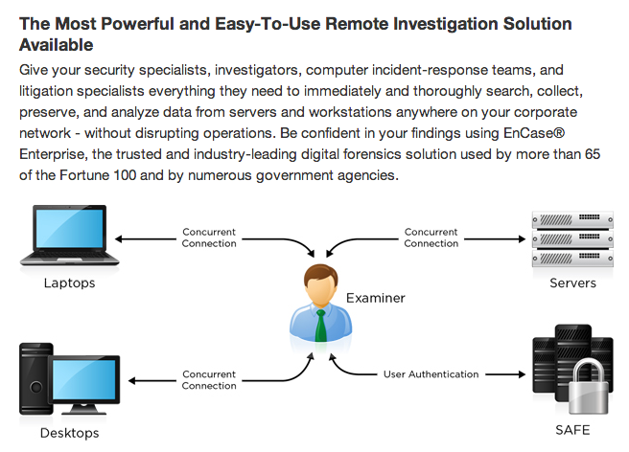
Enterprise Forensic Tools
Link Ch 7a

Slide 19
Enterprise Forensic Tools
Deploy agents to remote systems to collect data while systems are used
That's live forensics
If agent was loaded before the incident, one could argue that it has less effect on evidence

Slide 20
Tools for Live Forensics

Slide 21
Memory Dumping
Must be logged in as administrator or root
Use 64-bit tools for 64-bit systems
All tools should have similar results
  Although not perfectly identical, because the tool changes the RAM somewhat

Slide 22
Memory Dumping from Windows
Memoryze from Mandiant
  Can collect data as well as examine it (link Ch 7b)
Mdd from Mantech
  Captures RAM (updated in 2013) (link Ch 7c)
DumpIt from Moonsols
  Combines win32dd and win64dd into one tool (link Ch 7d)
FTK Imager from AccessData
  Can image RAM and hard disks too (link Ch 7e)

Slide 23
Memory Dumping from Linux
dd
  Could image RAM in older kernels
  No longer possible since 2.6 kernel (2003)
Fmem
  Creates a device named /dev/fmem
  Use dd to image it like any other device
  (link Ch 7f)
Second Look
  Commercial Linux Intrusion Detection and Incident Response tool (link Ch 7g)

Slide 24
Memory Analysis Tools
All tools should find the same information
They differ in cost and convenience

Slide 25
Memory Analysis Tools
Volatility
  Free, very popular (link Ch 7h)
  Included in Kali Linux
FTK
  Can visualize processes to memory locations from a RAM image
Memoryze from Mandiant
  Primarily for malware analysis
  Free (link Ch 7b)

Slide 26
Live Disk Imaging Tools
Caution
  The live system may be untrustworthy
  Rootkit infections can hide data from an imaging tool
  Run tools from your own CD, thumbdrive, etc.
Note
  You must be logged in with Administrator rights to access the physical disks in Windows

Slide 27
Live Disk Imaging Tools
FTK Imager Lite
  Best choice for Windows
  No installation needed
  Runs directly from external storage (CD or thumbdrive)
  Free from AccessData (link Ch 7e)
dd
  Best choice for Linux
  dcfldd is a variant that adds hashes

Slide 28
Advantages and Risks of Postmortem Forensics

Slide 29
Advantages of Postmortem Forensics
Low risk
  System is powered off
  No risk that an external threat can change or destroy the evidence
  No need for a password or other credentials to access the system
    Unless the hard drive is encrypted

Slide 30
Risks of Postmortem Forensics
Errors in imaging process
  Failure to use a write-blocker
  Other accidents
Such errors will be much more heavily scrutinized
  Than live images, which everyone understands have been changed during collection

Slide 31
Postmortem Memory Analysis

Slide 32
RAM Data in a Disk Image
Core dumps
Hibernation files

Slide 33
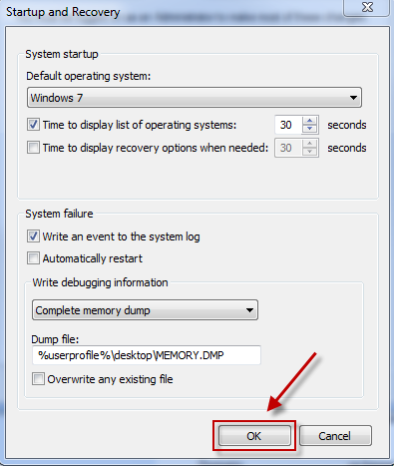
Core Dumps
When Windows crashes with a Blue Screen of Death
It saves some memory on the disk
But it's not usually a complete image
(link Ch 7i)

Slide 34
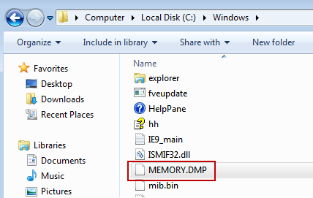
Core Dump Files
Windows dump files end with .DMP
Linux code dumps are named Core or code

Slide 35
Hibernation Files
Hiberfil.sys
  Contains a copy of RAM when a system was placed in Hibernation mode
  Some Hiberfil.sys files are compressed (link Ch 7k)
  Some versions of Windows use "Hybrid Sleep" (link Ch 7l)

