Slide 1
Computer Forensics
Infosec Pro Guide
Ch 8
Capturing Evidence

Slide 2
Topics
Creating forensic images of:
  Hard drives
  External storage drives
  Network shares

Slide 3
Imaging a Hard Drive

Slide 4
Forensically Sound
A forensically sound method does not alter the existing evidence
  Uses some sort of write-blocker
Sometimes there is no forensically sound way to capture evidence
  Then you need to document the procedure you used and why
  Exclude the changes you made from the evidence

Slide 5
Internal Hard Drives
Three methods
  Remove drive and use a hardware write-blocker
  Remove drive and use a USB connection, with Windows registry software write-blocking
  Use a forensic boot DVD including software write-blocking

Slide 6
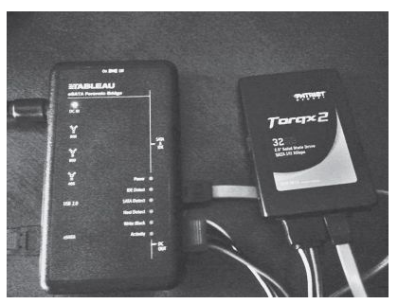
Hardware Write Blocker
Power off evidence machine
Remove drive
Connect write-blocker to evidence drive and forensics computer
Power on write blocker
Use FTK Imager or something similar to capture image

Slide 7
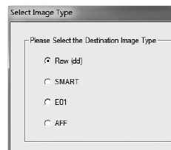
Image Types
All are forensically sound
  Raw (dd) are supported by every tool, but uncompressed
  S01 or SMART are just compressed raw images
  E01 can be compressed and password-protected
  AFF can be compressed and encrypted

Slide 8
Hashes
MD5 is 128 bits long
  Oldest, weakest hash type
  Has known collisions
SHA-1 is 160 bits long
  No known collisions
SHA-2 and SHA-3
  Longer and more secure
  Rarely used
All these hashes are OK for forensic work

Slide 9
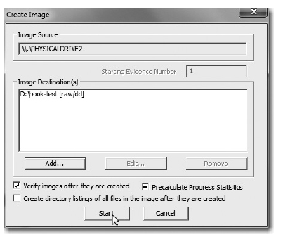
Verify Images
Calculates MD5 and SHA-1 hashes of both the original evidence drive and the image
Verifies that they match

Slide 10
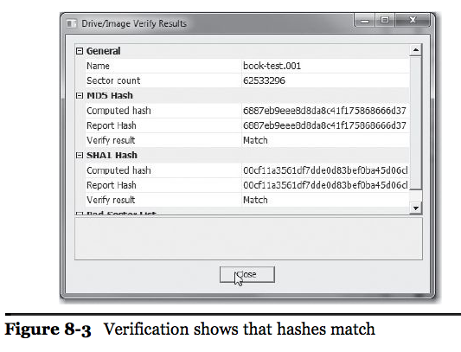

Slide 11
If Hashes Don't Match
You may have bad sectors on the evidence drive
  Image it again
  If hash still doesn't match, that probably means the evidence drive is failing
  Stop using it, document the issue in your chain of custody form, and continue with your investigation
  If necessary, you can send the drive to a data recovery company like Drive Savers for repair

Slide 12
Chain of Custody
Update Chain of Custody form to indicate
  Forensic image made and verified
Put a text file in the same folder as your image
  Including drive make, model, serial number, verification hashes, options selected

Slide 13
USB Software Write-Blocker
Power off evidence system
Block all USB writes on your forensic computer with a Registry change
Remove drive, connect to USB port with a drive kit
Note: you will need to store the image on a PATA or SATA-connected drive, since USB writes are all blocked

Slide 14
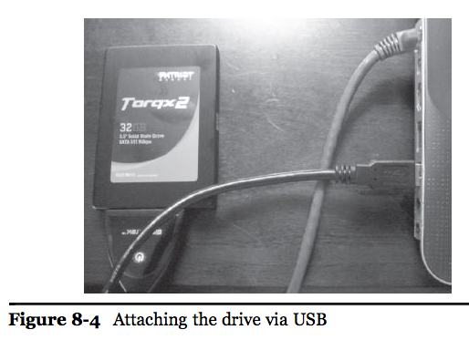

Slide 15
Warning
Software write-blocking is less reliable
OS updates may change it
  This hack is not well-known or publically supported by Microsoft
Test the write-blocking regularly
  Try to write to a USB drive (one without evidence on it, of course)

Slide 16
Forensic Boot DVD
Includes software write-blocking
  For all connection types; USB, PATA, SATA
Can be done on original evidence computer without removing the drive
  But it must be restarted and booted from DVD

Slide 17
Imaging an External Drive

Slide 18
Imaging a USB Drive
Forensic boot disks work well
  Raptor, Win FE, DEFT, etc.
  Mounts all drives as read-only by default
FTK Imager
  With software USB write-blocking, or
  Hardware USB write-blocker

Slide 19
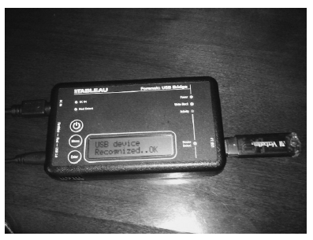
Hardware USB Write Blocker

Slide 20
Imaging a Network Share

Slide 21
Logical Acquisition
Includes contents of a file or directory
Stores the data and provides a hash value to verify data
FTK uses AD1 format, EnCase uses L01
Does not include
  Track and sector information
  Deleted data
  File system metadata

Slide 22
Imaging Mobile Devices
Phones, iPads, Androids, Blackberries, etc.
Methods change rapidly
Expensive proprietary software and hardware devices support mobile devices
Free solutions are more rare
Good topic for research!

Slide 23
Imaging a Mac
(not in textbook)

Slide 24
Mac Issues
Less software available
Special tools & skills needed to disassemble hardware
MacBook Pro with Hard Drive
  HD can be removed & imaged like any other drive
MacBook Air with SSD
  SSD drivers missing from most forensic distributions

Slide 25
Mac Acquisition Tools
Mac Memory Reader
  Acquires RAM
  Not yet updated for Mavericks
  Link Ch 8a
Black Bag's MacQuisition
  Sure-fire commercial solution
  Costs $1000
  Link Ch 8e

Slide 26
Other Acquisition Tools
Raptor, Paladin, Helix, and LinEn all fail
FTK Imager for Mac GUI is available
  As a beta
  Live acquisition only
DEFT reportedly works
  But requires a USB DVD drive
  Won't boot from thumbdrive, as far as I can tell
  Doesn't support Retina displays (link Ch 8g)
EnCase Portable works from CD
  But not USB thumbdrive (link Ch 8d)

Slide 27
Thunderbolt
Place evidence Mac in "Target Disk Mode"
Image to another Mac through the Thunderbolt cable
  Runs at 10 GB/s
  Can also use FireWire
  No write-blocking
  Link Ch 8g

Slide 28
Mac Analysis
Volatility works for RAM analysis
  But only for analysis, not acquisition
  Link Ch 8h
EnCase, FTK, and ProDiscover can all analyze Mac disk images
  They also support remote acquisition over the network
  With expensive versions

