Slide 1
Whitehat Vigilante and
The Breach that Wasn't
HI-TEC
July 26, 2012

Slide 2
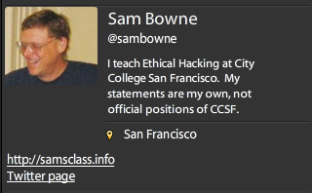
Bio

Slide 3
Levels of Security Knowledge
Theory
  Book-learning
Practice
  Controlled hands-on projects
  Controlled cyber-contests
Underworld contacts
Dangerous knowledge
Accepting responsibility for real problems

Slide 4
Levels of Security Knowledge
Real-world Security Work
  Security officer
  Law enforcement contacts
  Underworld contacts
  Confidential information
  Responsibility for real problems

Slide 5


Slide 6



PBS Hacked

Slide 7


PBS Hacked

Slide 8
Attitudes

Slide 9
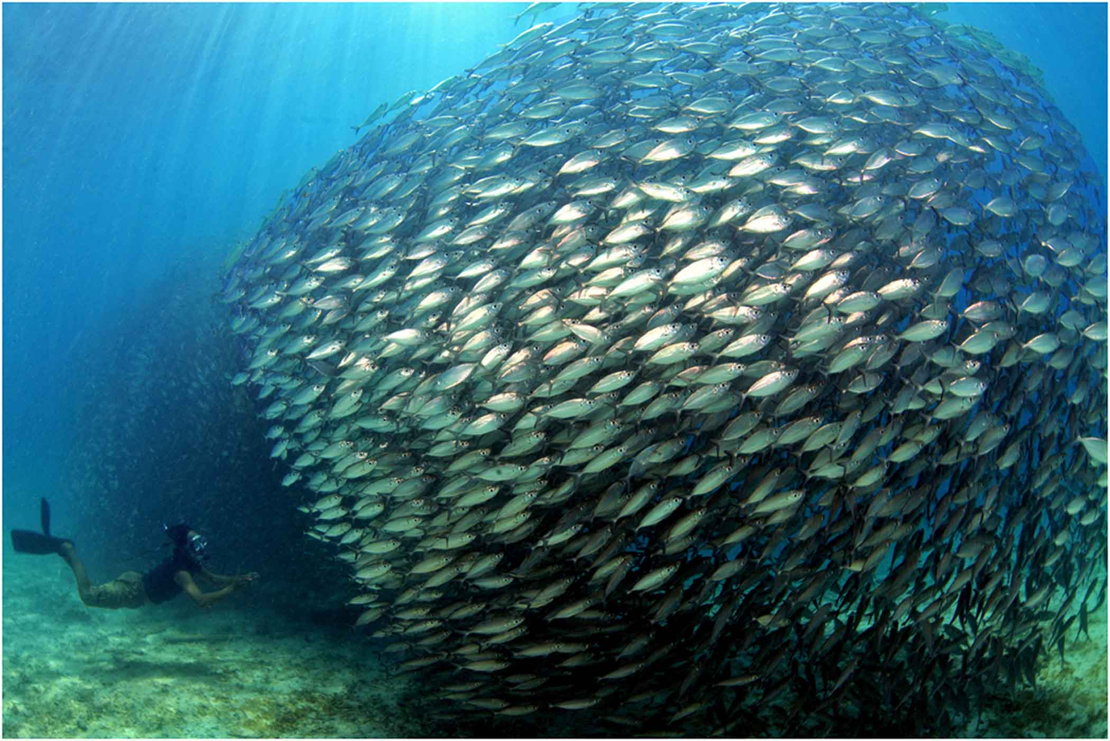
Blend In:
Hide
Image from presenceinbusiness.com

Slide 10


Make Your Own Rules
Images from listentoleon.net & anpop.com

Slide 11


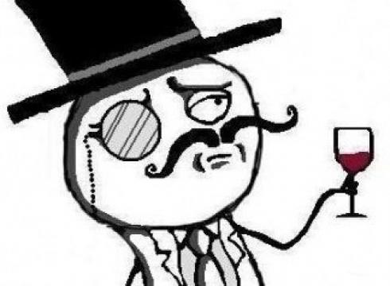
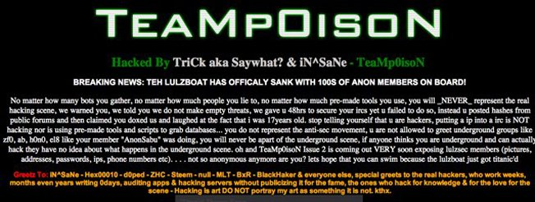
Cyber-Terrorists
Masked Mobs
Create fear
Cause paranoia
Intimidate critics into silence

Slide 12
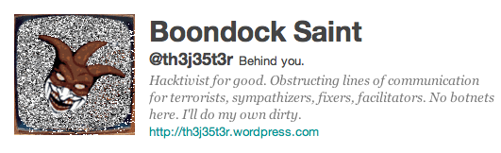
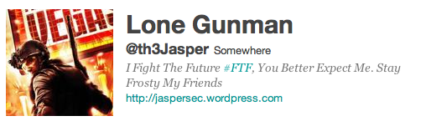
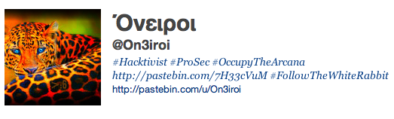
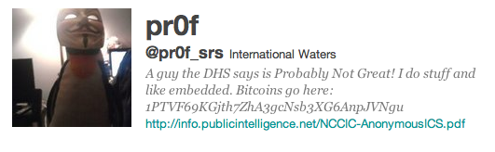
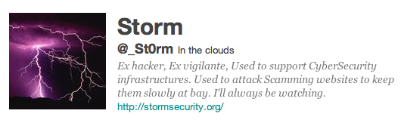
Lone Vigilantes

Slide 13
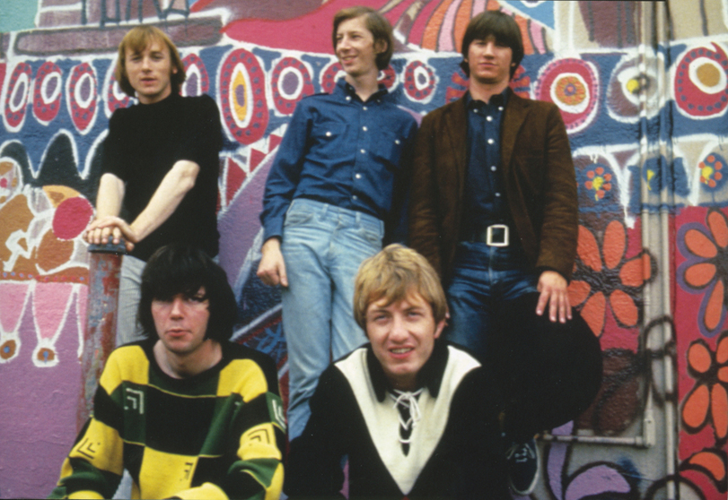
Nobody's Right if Everybody's Wrong
Buffalo Springfield image from freewebs.com

Slide 14
The Middle Way

Slide 15
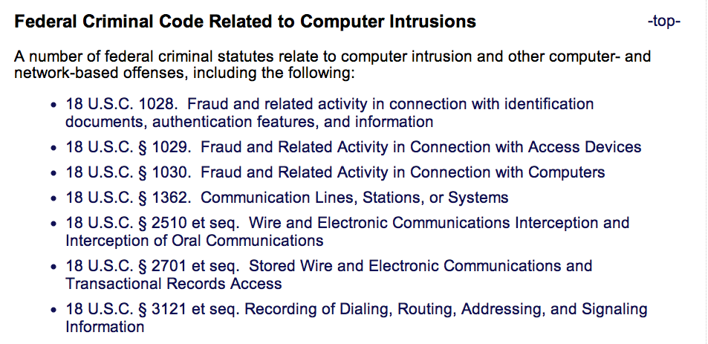
Laws
From cybercrime.gov

Slide 16

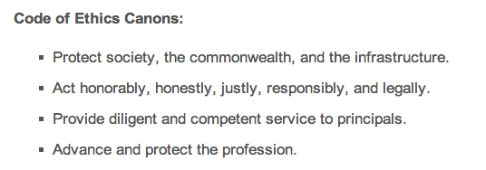
CISSP Code of Ethics

Slide 17
Cold Calls

Slide 18
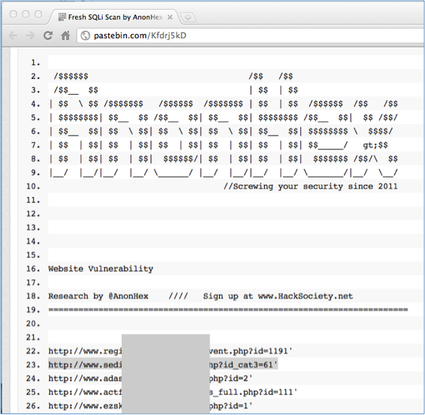
Find Vulnerable Sites
Dumped on Pastebin

Slide 19
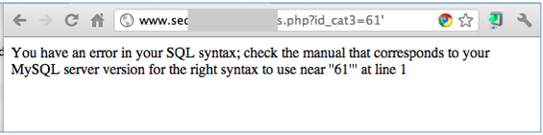
Verify the Vulnerability
Do NOT explore any further
Actually injecting commands is a crime

Slide 20
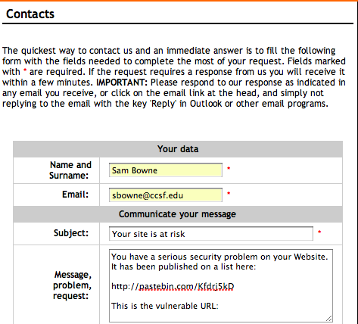
Find a Contact Address

Slide 21
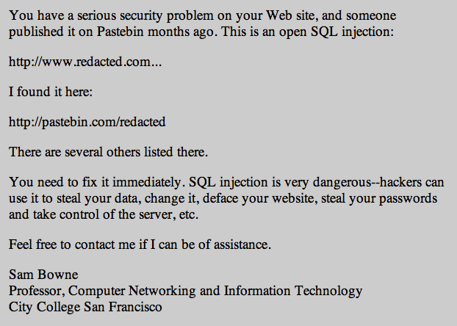
My Letter

Slide 22
Letter Design
Simple management-level summary of the problem
No technical details
Give your real name & contact information
Don't demand anything
Don't make any threats

Slide 23
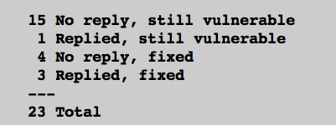
Pilot Study
3 days after notification
7/23 Fixed (30%)
  http://samsclass.info/lulz/cold-calls.htm

Slide 24
Student Projects
Done by CISSP-prep students at CCSF
Contacted over 200 sites with SQL injections
> 15% of them were fixed

Slide 25
Major Breaches or Vulnerabilities

Slide 26
Breaches or Vulnerabilities
I Reported
FBI (many times)
UK Supreme Court
Chinese Government
Police departments (many of them)
Other Courts
CNN, PBS
Apple
Schools (many of them)

Slide 27




I Sought Personal Contacts

Slide 28
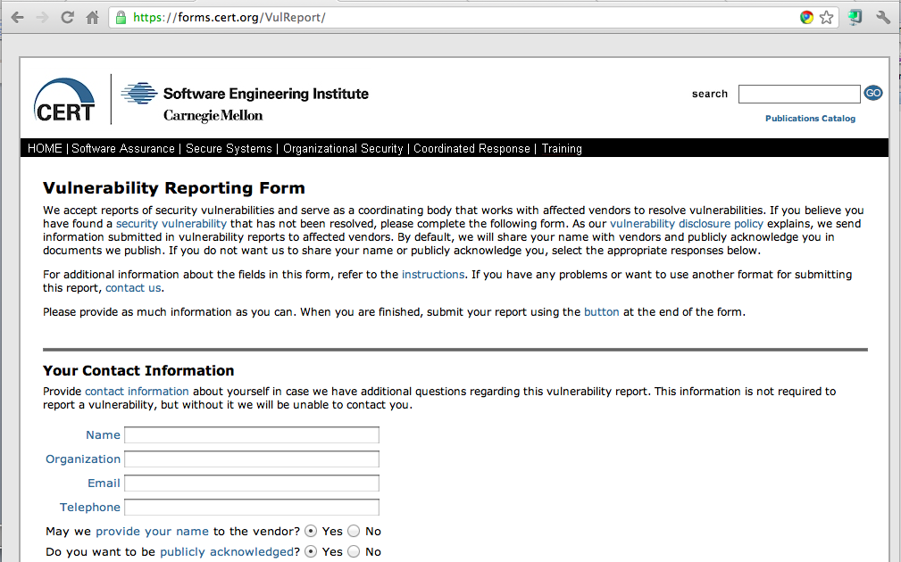
CERT

Slide 29
Positive Results
Several good security contacts inside corporations, law enforcement, and government agencies
Many problems fixed, several before they were exploited

Slide 30
Negative Results
A few of my Twitter followers were offended and suspicious when I found so many high-profile vulnerabilities so fast
Accusations
  Performing unauthorized vulnerability scans
  Peddling bogus security services
  Betraying the USA
All 100% false & baseless

Slide 31
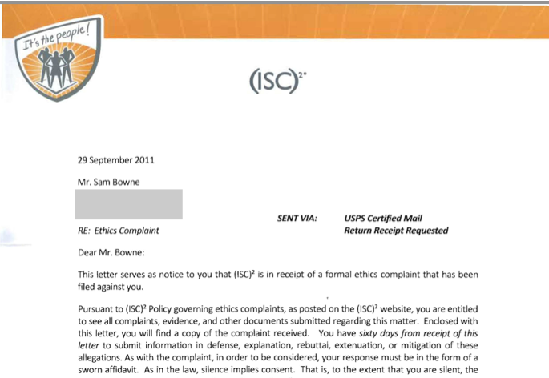
Ethics Complaint
http://samsclass.info/125/ethics/

Slide 32
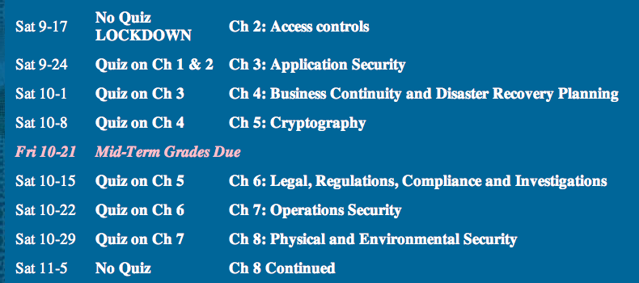
Fortuitous Timing

Slide 33
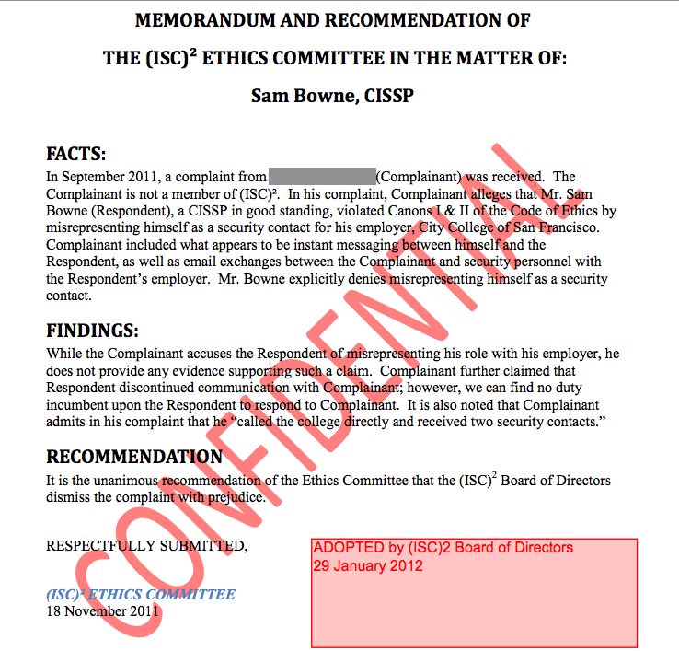

Slide 34
Recommendations for Cold Calls

Slide 35
Be Respectful
No abuse or criticism
Sincere desire to help
Accept being ignored without protest
Demand nothing
Respect their right to leave their servers unpatched

Slide 36
Be Right
Report clear-cut vulnerabilities, widely understood and important, like SQL Injection
Do nothing illegal or suspicious
  No vulnerability scans
  No intrusion or exploits
  Report only vulnerabilities that are already published by others

Slide 37
Clarity of Purpose
Genuine desire to help the people you are contacting
No hidden agenda
  Desire to sell a product
  Desire to belittle or mock
  Desire to dominate or control others
  Plans to attack sites yourself
  Revenge

Slide 38
Expect Abuse
If you become visible in the hacking community, you are a target
It doesn't matter what you say or do
Many hackers are arrogant, insecure, and emotionally immature
Cruelty, abuse, and bullying are common

Slide 39
Be Fearless
Understand the importance of the sites you are helping
Are they worth more than your
  Inconvenience
  Time expended
  Exposure to criticism and humiliation

Slide 40
Acknowledgements
I am very grateful for the support of CNIT, MPICT, and CCSF
Especially
  Carmen Lamha
  Maura Devlin-Clancy
  Pierre Thiry
  James Jones
  Tim Ryan
It would be much simpler to just fire me than to support my mad actions

Slide 41
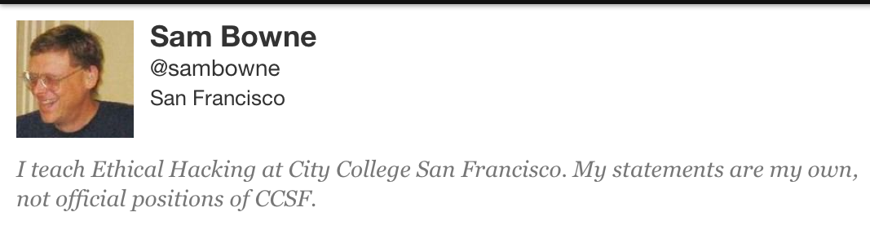
The Breach that Wasn't

Slide 42
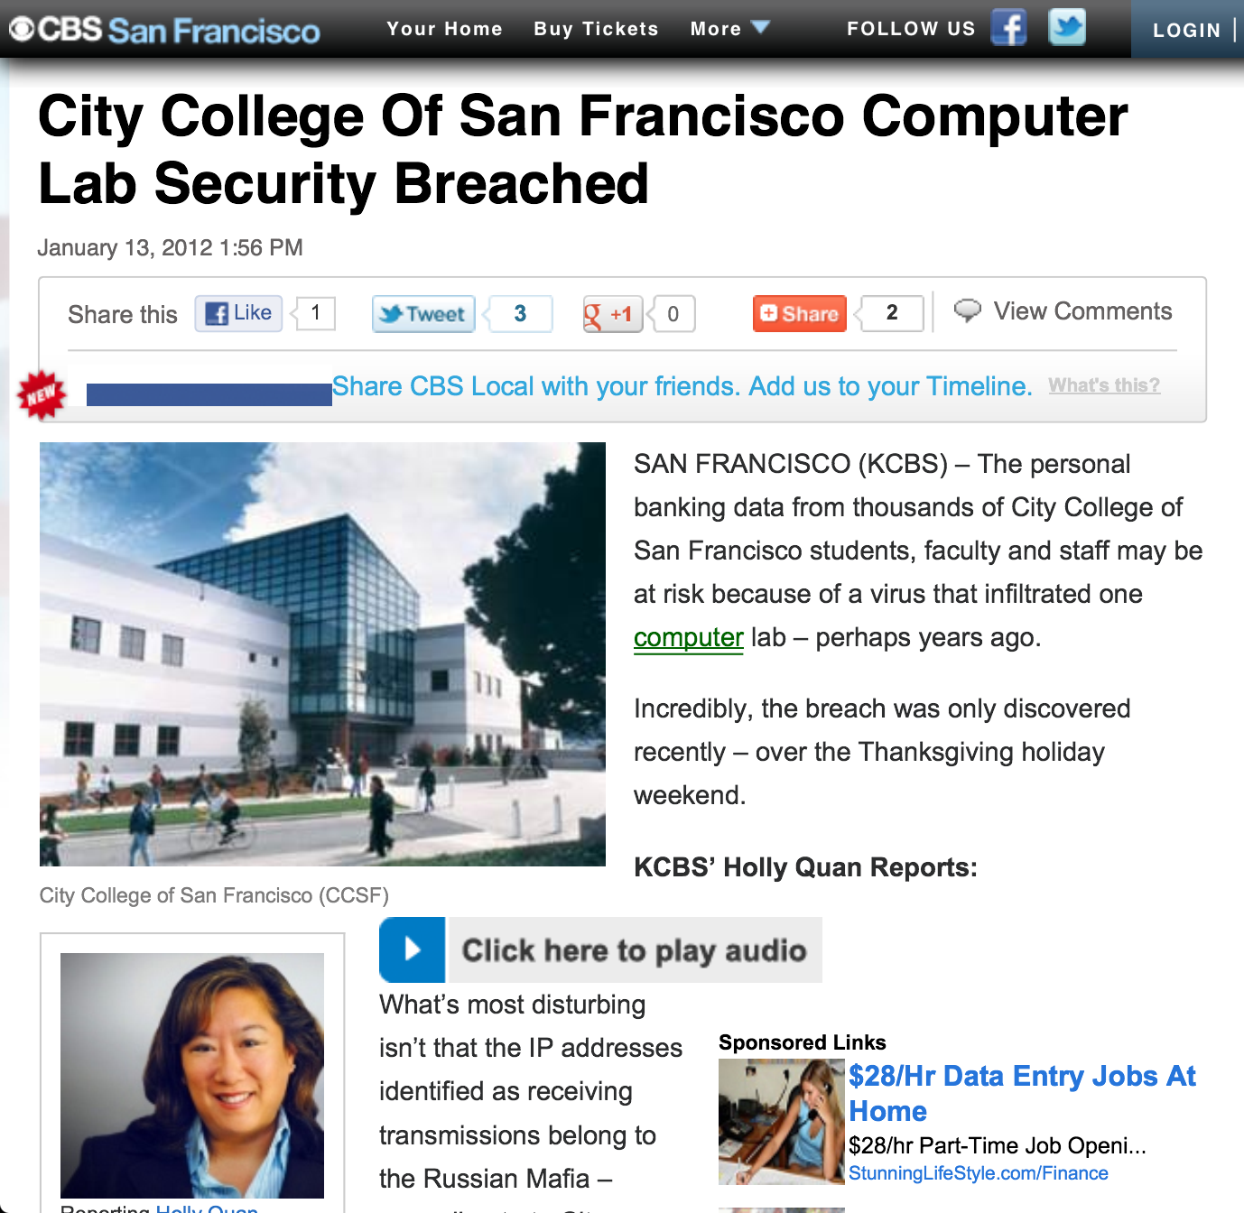

Slide 43
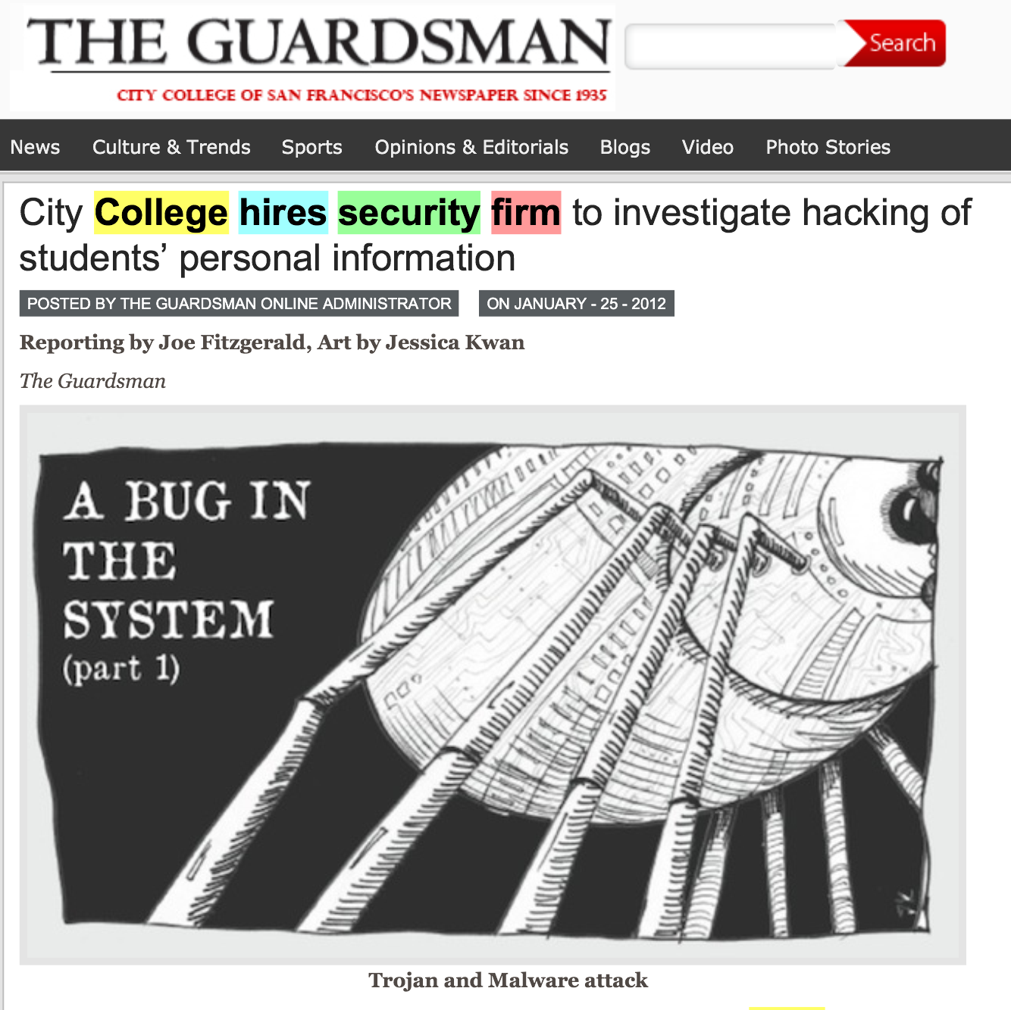

Slide 44
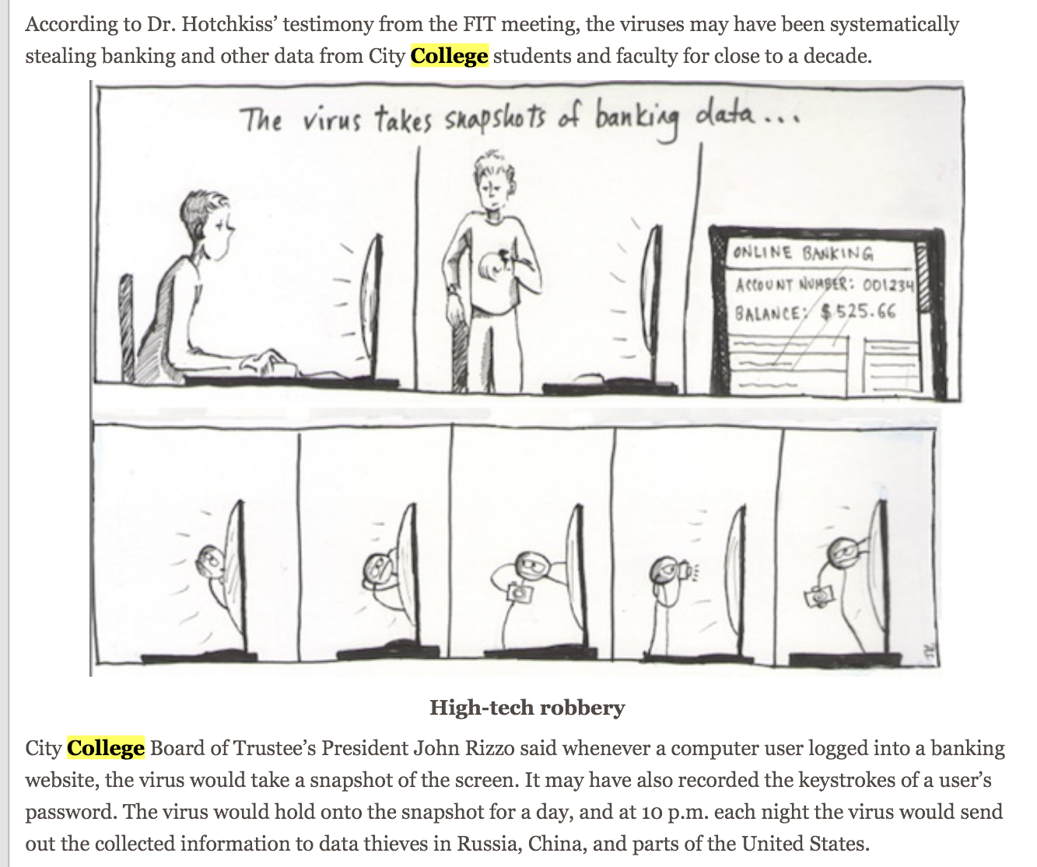

Slide 45
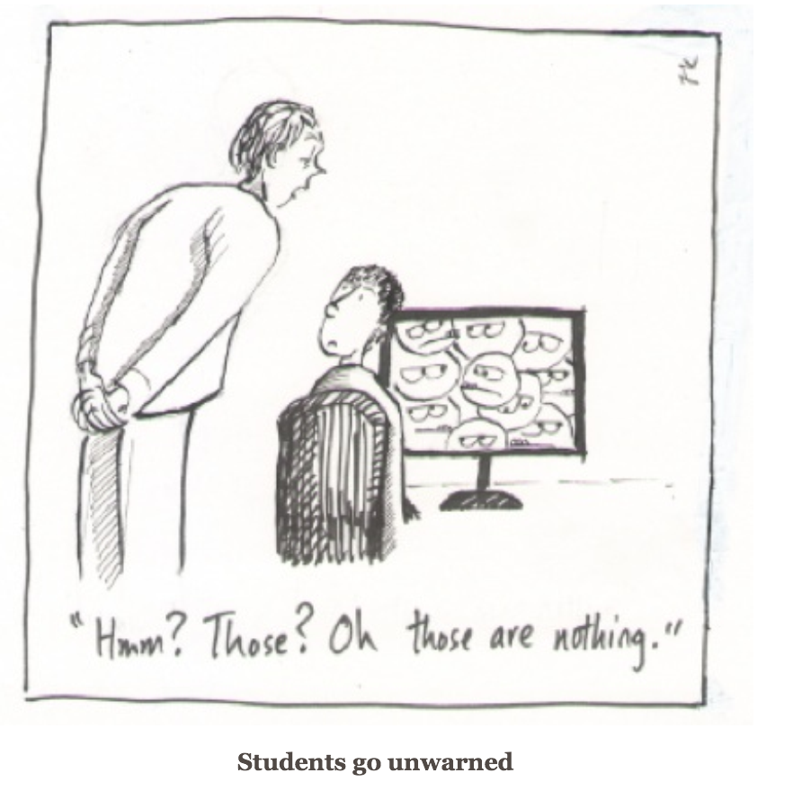

Slide 46
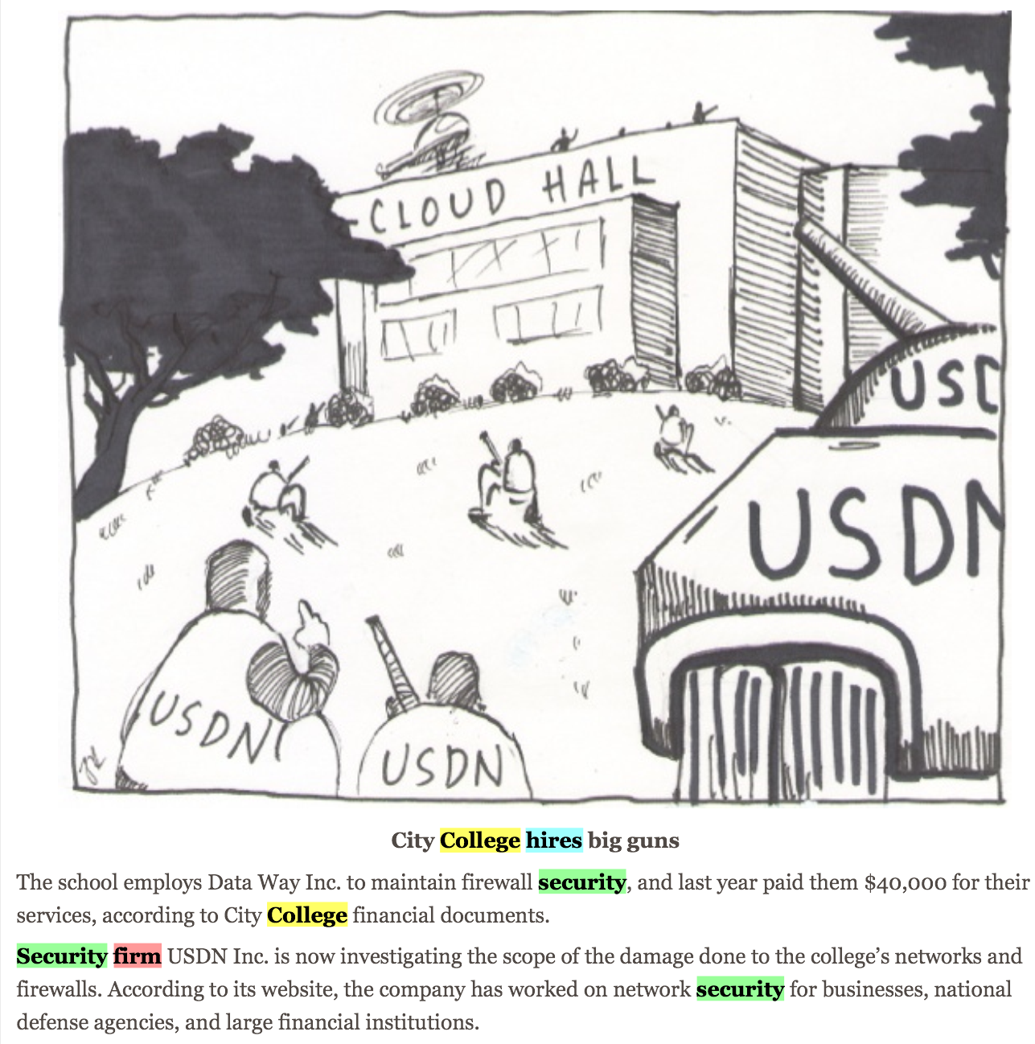

Slide 47
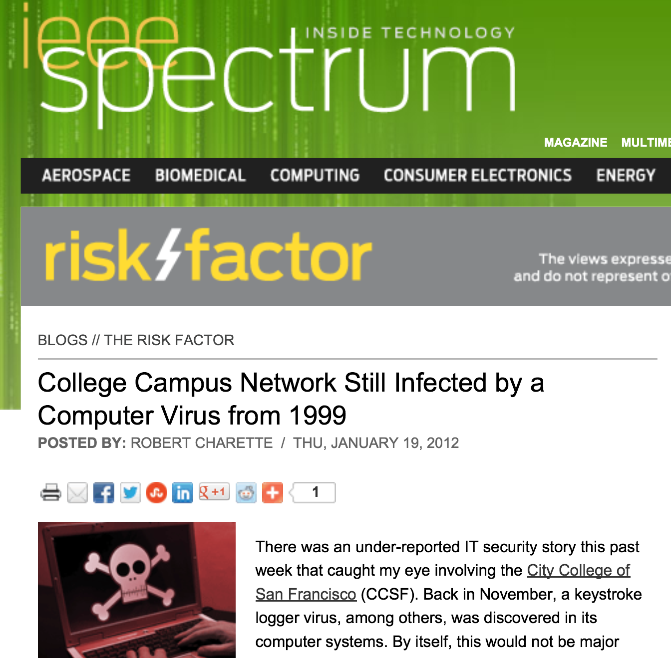

Slide 48
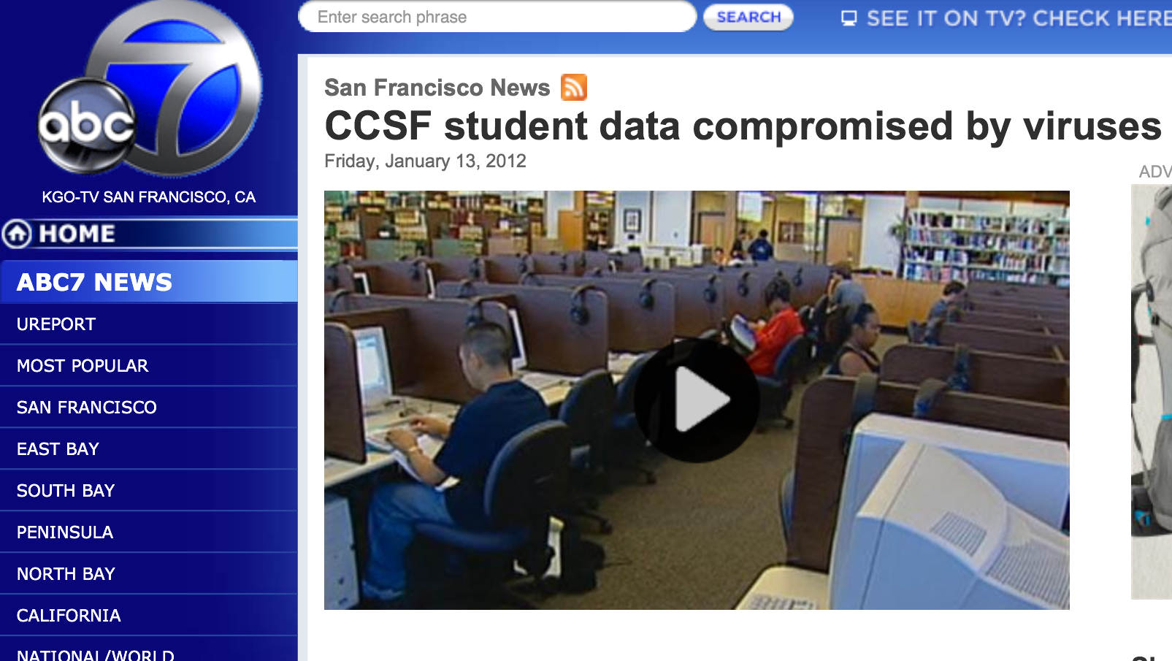

Slide 49
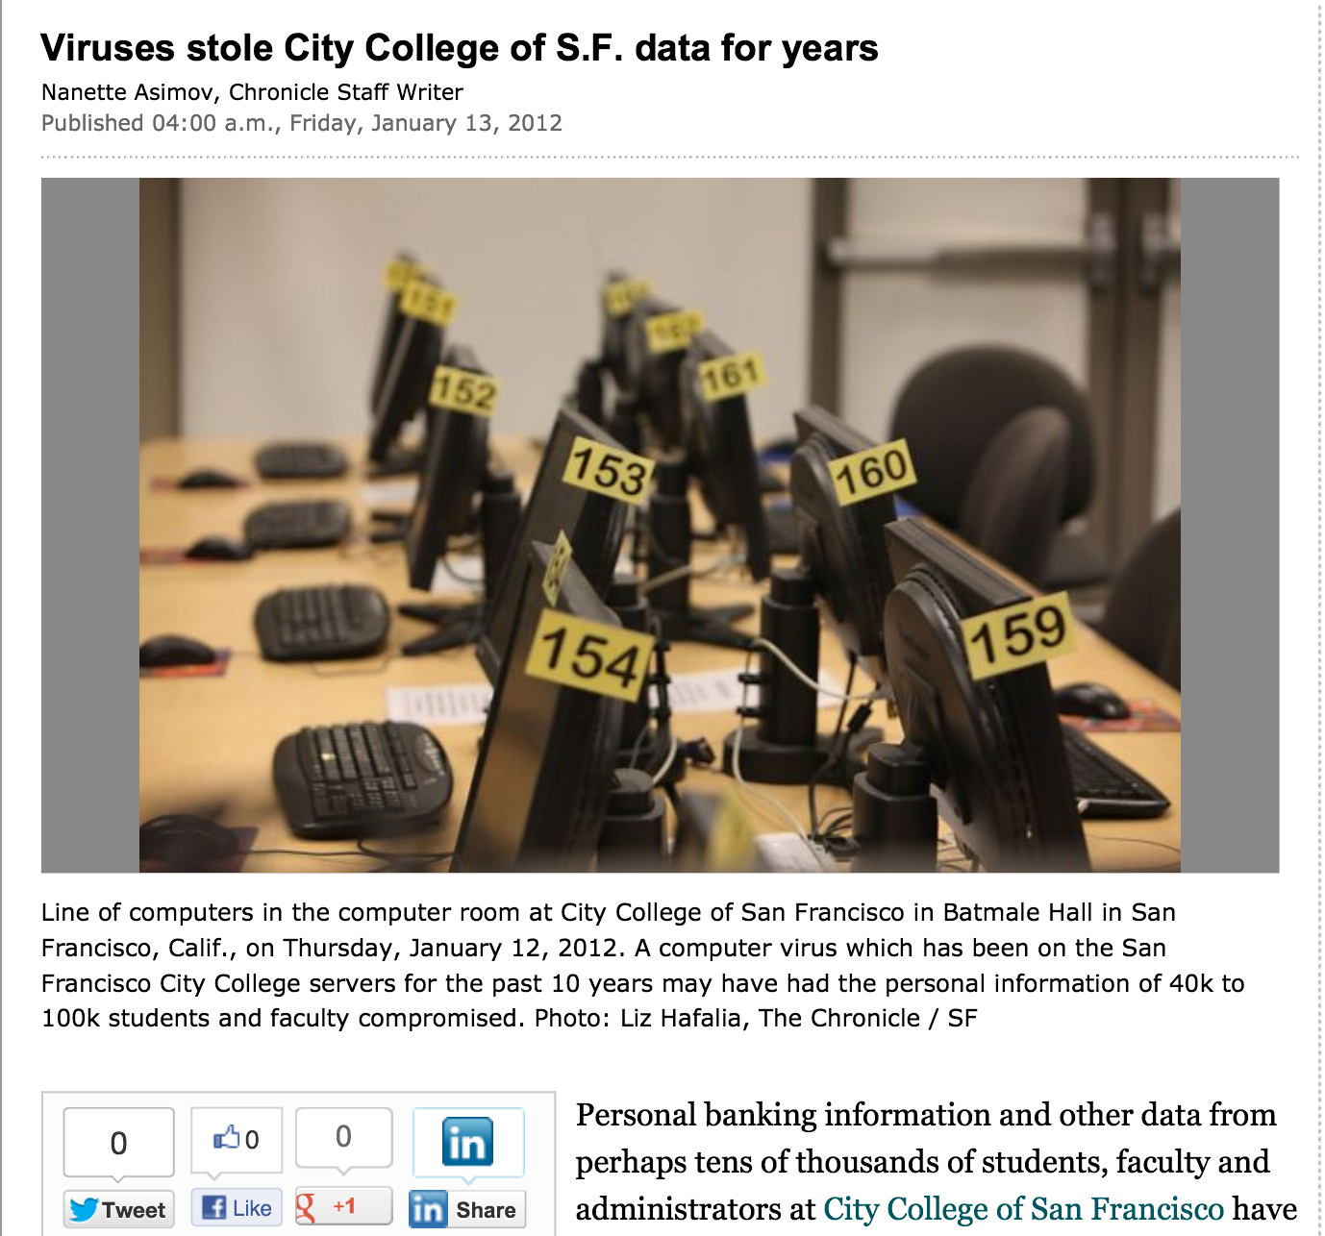

Slide 50
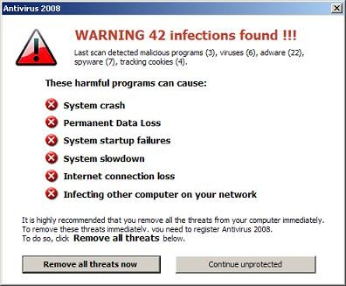
You are a manager, and a contractor says you have a scary virus infection. Who do you call immediately?
Upper management
Your IT Staff
Tell no one, keep it a secret
The FBI
The San Francisco Chronicle

Slide 51
Outside attacks
Insider threat
Deluded Insider Threat

Slide 52
IT Management Flow Chart
Chancellor & Vice-Chancellor
Board of Trustees
CTO
IT Staff, Faculty, Students

Slide 53
IT Management Flow Chart
SF Chronicle
CTO & Outside Contractor
Chancellor & Vice-Chancellor
FBI
IT Staff, Faculty, Students

Slide 54
Security at CCSF
Two generations of complete hardware replacement in the last ten years
McAfee Enterprise antivirus
Deep Freeze
Palo Alto layer 7 firewall

Slide 55
Security Audits
There was a security audit and remediation process performed in 2007-2008 by a contractor
I did another security audit in 2010 with my CISSP students
  No major problems found

Slide 56
Evidence for these "Viruses"
A report was supposedly prepared by USDN in Nov 2011, but we were never able to get a copy of it at all
The presentation from the CTO that went to the press was in Jan. 2011
We finally got a partial report on Jan. 31, lacking the appendices that were the evidence
  "Proprietary and Confidential" but later published in the newspaper

Slide 57
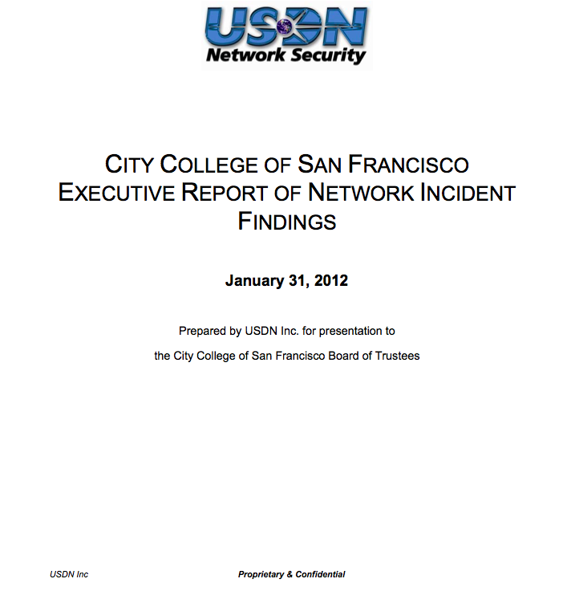

Slide 58
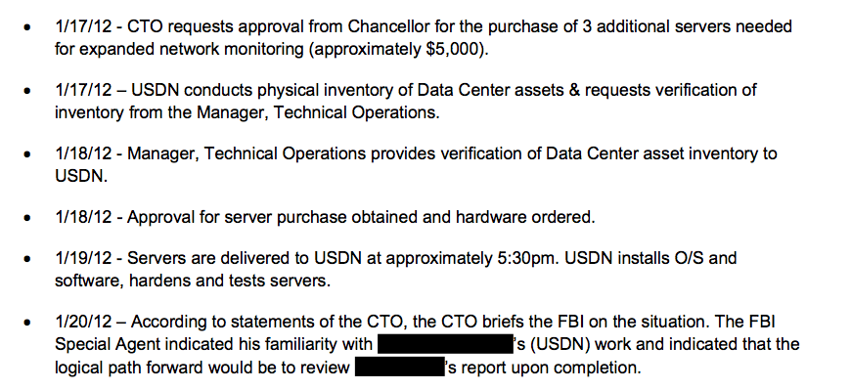

Slide 59
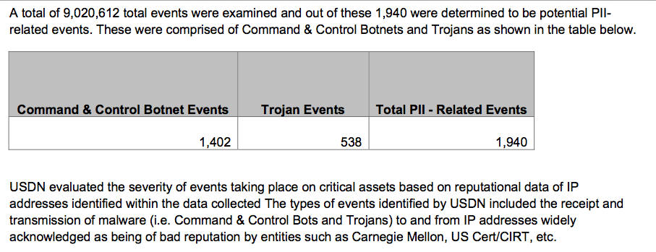

Slide 60
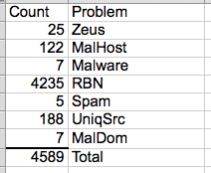
The List
On April 3, we finally got a list of the "infected machines"
Direct inspection of samples showed no real infections

Slide 61
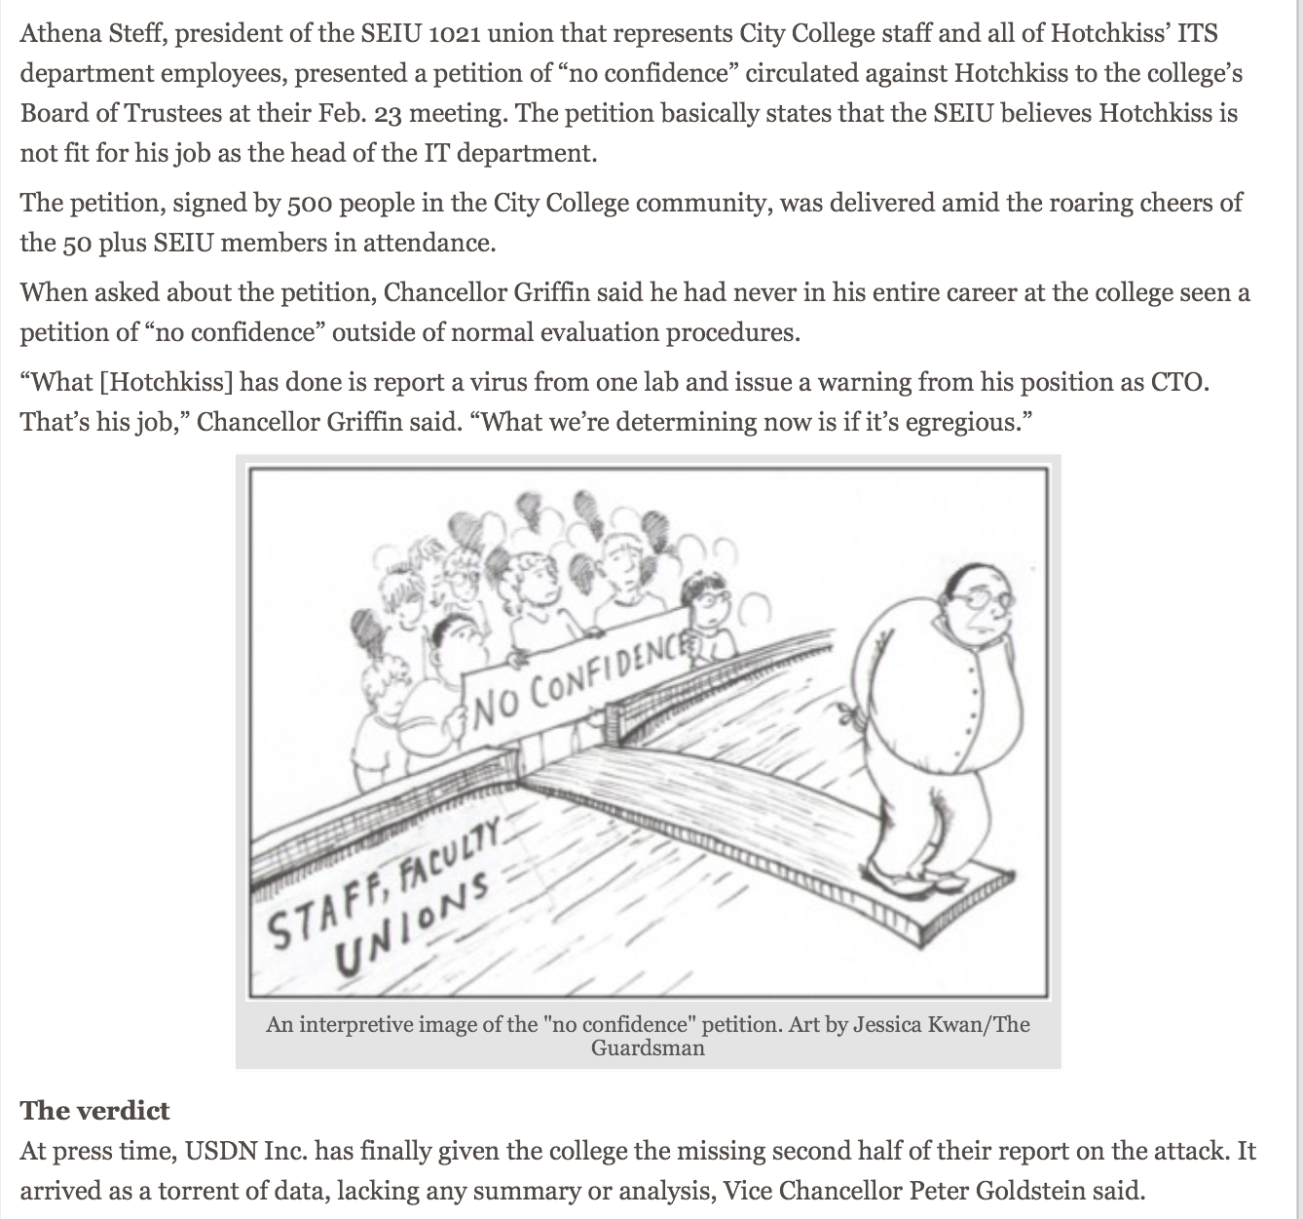

Slide 62
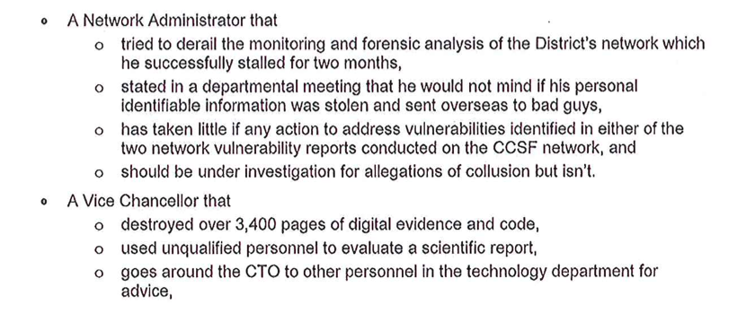
Letter to Trustees & Published in Newspaper

Slide 63
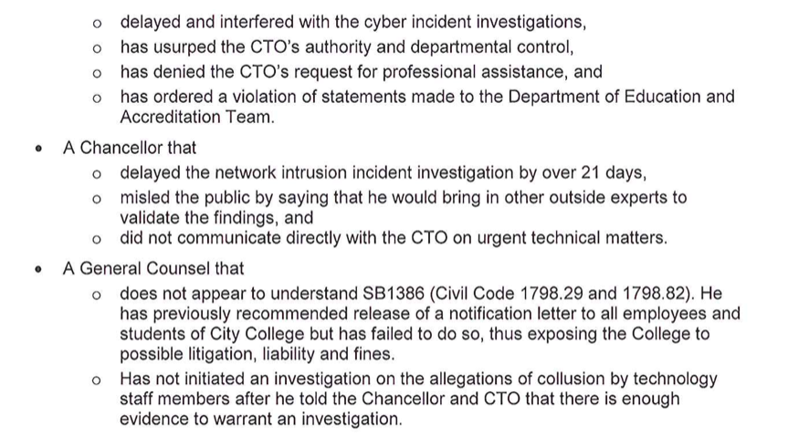

Slide 64
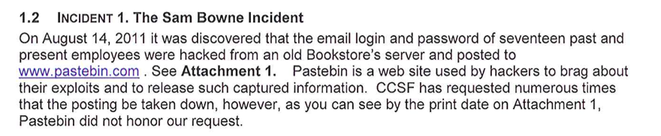

Falsified Breach in 2011

Slide 65
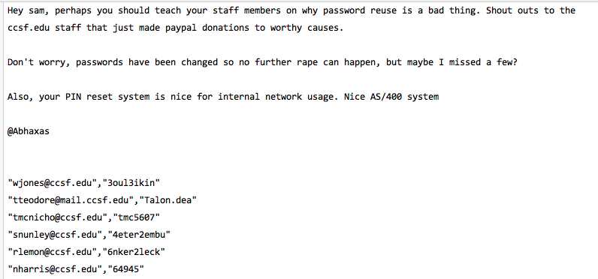
Proven False at the Time

Slide 66
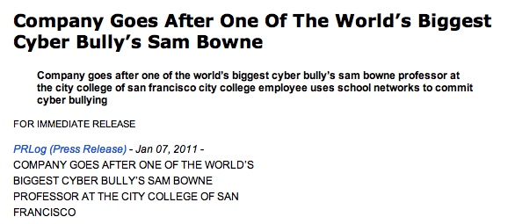
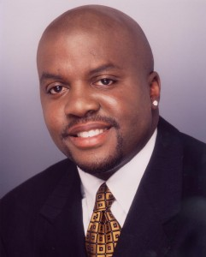
Cyber-Bullying

Slide 67
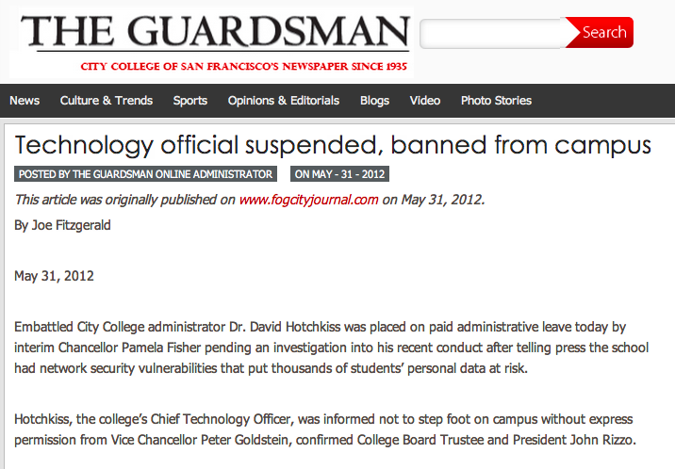

Slide 68
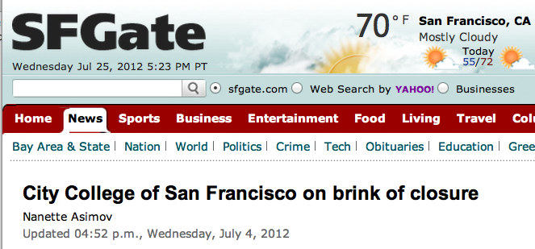
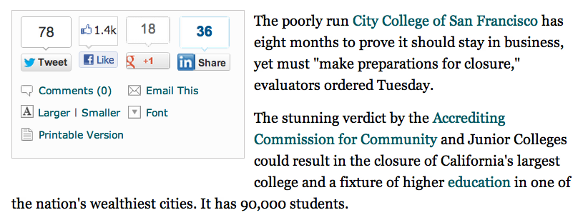

Slide 69
In your experience, how do security vendors exaggerate risks to sell products?
All the time
Very frequently
Frequently
Rarely
Never

Slide 70
At your company, do end-users violate security policy?
All the time
Very frequently
Frequently
Rarely
Never

Slide 71
At your company, do managers violate security policy?
All the time
Very frequently
Frequently
Rarely
Never

Slide 72
At your company, how often do employees leak information inappropriately to the press?
All the time
Very frequently
Frequently
Rarely
Never

