Slide 1
Stupid Whitehat Tricks

Slide 2
Disclaimer
These lists of people are examples, not complete lists
I don't intend any slight by omitting people from this presentation
If anything here is inaccurate, feel free to contact me
sbowne@ccsf.edu
@sambowne

Slide 3
Blackhat Hackers
Break the law & love it

Slide 4
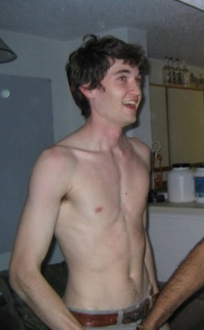
Dread Pirate Roberts
Ross William Ulbricht
Ran Silk Road; eBay for drugs, guns, and crime
Arrested Oct 1, 2013 at the Glen Park library in San Francisco
Paid hitmen to kill people six times
arstechnica.com/tech-policy/2013/10/how-the-feds-took-down-the-dread-pirate-roberts/

Slide 5
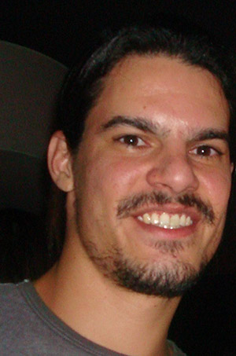
Albert Gonzalez
Stole 90 million credit cards from TJX and other retailers
Broke into WEP wireless networks
Sentenced to 20 years in 2010
www.wired.com/threatlevel/2010/03/tjx-sentencing/

Slide 6
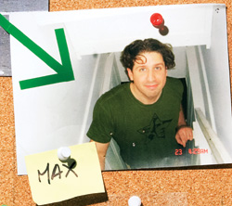
Max Butler
Dominated the world's market in stolen credit card numbers
Operated from a 4th floor apartment in San Francisco
Used neighbor's unsecured Wi-Fi networks
Sentenced to 13 years in 2010
www.wired.com/techbiz/people/magazine/17-01/ff_max_butler
www.wired.com/threatlevel/2010/02/max-vision-sentencing/

Slide 7
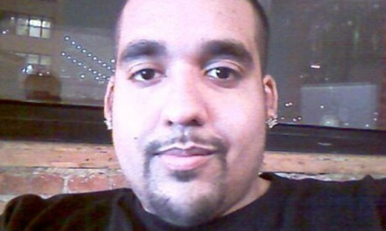
Sabu
Hector Xavier Monsegur
Member of Lulzsec
FBI informant
Sentencing postponed
www.theguardian.com/technology/2013/feb/22/lulzsec-sabu-sentencing-monsegur-postponed

Slide 8
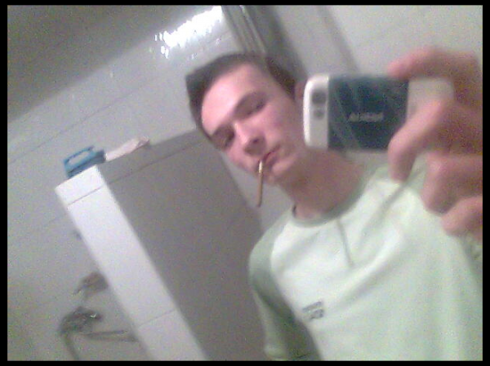
Andrey Hodirevski
Ukranian
Presumed to have the Target credit cards stolen in 2013
Still at large
krebsonsecurity.com/2013/12/whos-selling-credit-cards-from-target

Slide 9
Gray Hat Hackers
Break the law, but claim to serve some higher cause

Slide 10
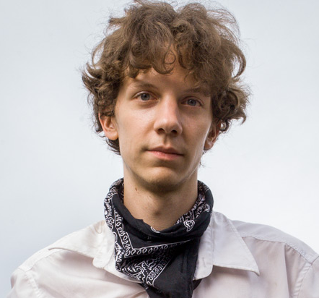
Jeremy Hammond
Leader of Lulzsec
Stole 60,000 credit card numbers from Stratfor
Founded HackThisSite
Sentenced to 10 years in 2013
www.huffingtonpost.com/vivien-lesnik-weisman/post_4885_b_3352308.html

Slide 11
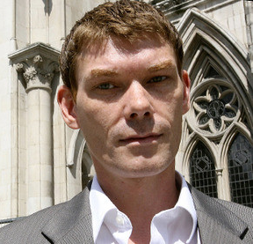
The UFO Hacker
Gary McKinnon
Hacked the Pentagon and NASA in 2001
Won a battle to avoid extradition from the UK to the USA in 2012 on mental health grounds
www.examiner.com/article/ufo-hacker-wins-battle-against-us-government

Slide 12
St0rm
Neil J McDonald
18-year-old university student in New Zealand
Hacked U of Melbourne and many other companies
Told them about vulnerabilities so they could patch them
Never prosecuted, but convinced to knock it off
news.softpedia.com/news/University-of-Melbourne-Possibly-Hacked-After-Failing-to-Listen-to-Gray-Hat-235452.shtml
www.binrand.com/post/985173-st0rm-some-love-trolls-3.html

Slide 13
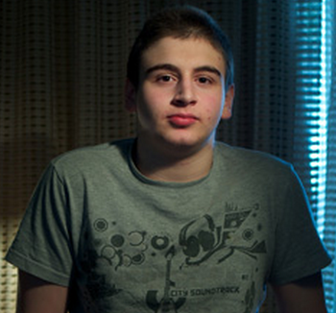
Joshua Rogers
Exploited a SQLi at Metlink in Australia
Notified the company afterwards
Reported to police
No charges filed yet
www.wired.com/threatlevel/2014/01/teen-reported-security-hole

Slide 14
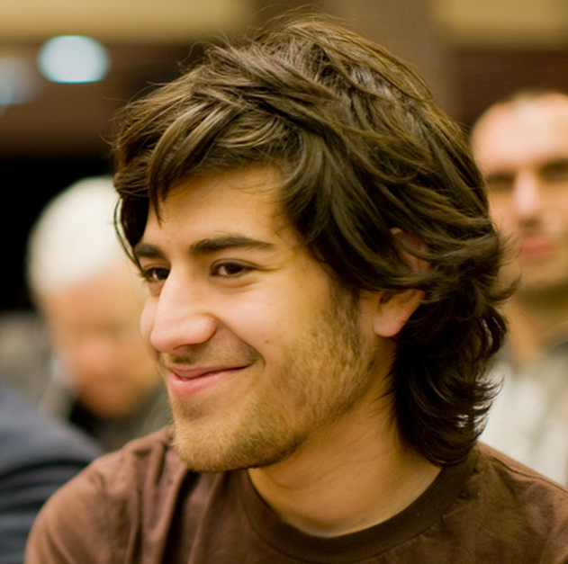
Aaron Swartz
Downloaded millions of academic articles at MIT in 2010-2011, intending to publish them freely, violating MIT's use rights
Prosecuted, faced possible prison term
Depressed, committed suicide in 2013
www.wired.com/threatlevel/2013/01/aaron-swartz

Slide 15
Whitehat Hackers
Obey the law

Slide 16
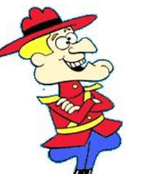
Whitehat Hackers
Obey the law
Positions of trust and responsibility
Frequently abused as cowardly and incompetent by criminals
Image from Wikipedia

Slide 17
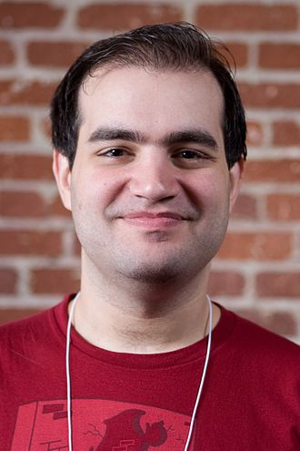
Dan Kaminsky
Found a DNS flaw in 2008
Got it patched before it was exposed & exploited
Testified before Congress
ICANN Trusted Community Representative for the DNSSEC root
wikipedia.org/wiki/Dan_Kaminsky

Slide 18
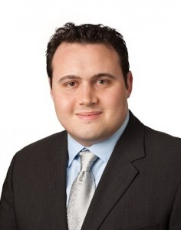
H D Moore
Chief Architect of Metasploit
Recent work involves scanning the entire Internet for security problems, in partnership with DHS
resources.infosecinstitute.com/hd-moore-reveals-his-process-for-security-research

Slide 19
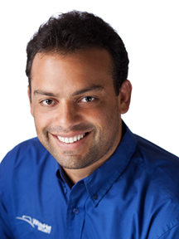
Jeremiah Grossman
Yahoo's first hacker
Founded WhiteHat Security
Scans customers for vulnerabilities and helps them patch
Reports vulnerability statistics
https://www.whitehatsec.com/resource/grossman.html

Slide 20
Katie Moussouris
Senior Security Strategist Lead at Microsoft
Mother of Microsoft's Bounty Programs
Ex pen-tester
linkedin.com/in/kmoussouris

Slide 21
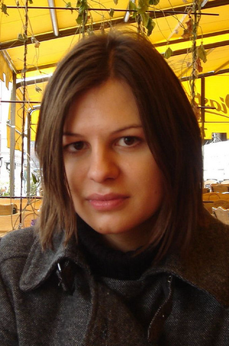
Joanna Rutkowska
Polish computer security researcher
Develops low-level rootkits, including the "Blue Pill" which converts a running OS into a VM
Developed Qubes OS providing security through isolation
wikipedia.org/wiki/Joanna_Rutkowska

Slide 22
Cold Calls

Slide 23
Warning Companies
Without being hired to test their security
Requires care to stay legal
Don't execute unauthorized code on anyone else's server
Considered dangerous and taboo in the security community

Slide 24
Risks of Cold Calls & Whitehat Reputation
CCSF servers attacked twice to stop me
(ISC)^2 Ethics Complaint to revoke my certification
Accused of racism to get me fired from CCSF
Threatened with lawsuit from Canada
Hatchet job in the CCSF newspaper
Many outrageous accusations in print from CCSF's disgraced ex-CTO
Lots of online trolling

Slide 25
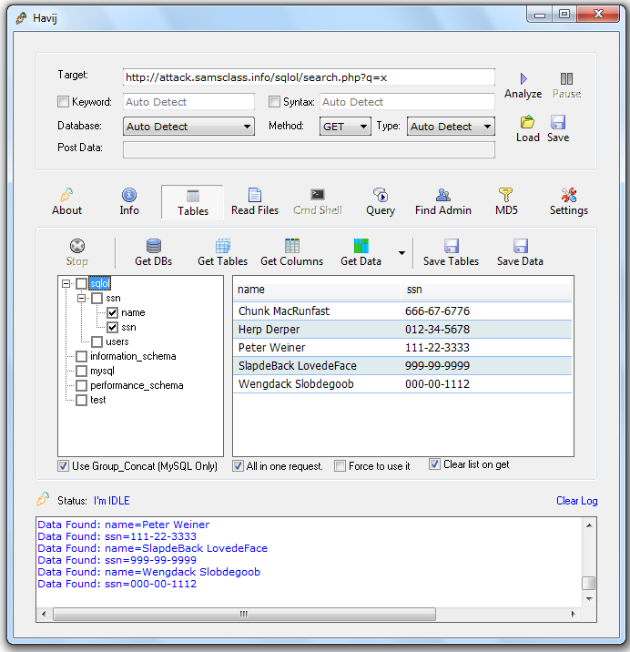
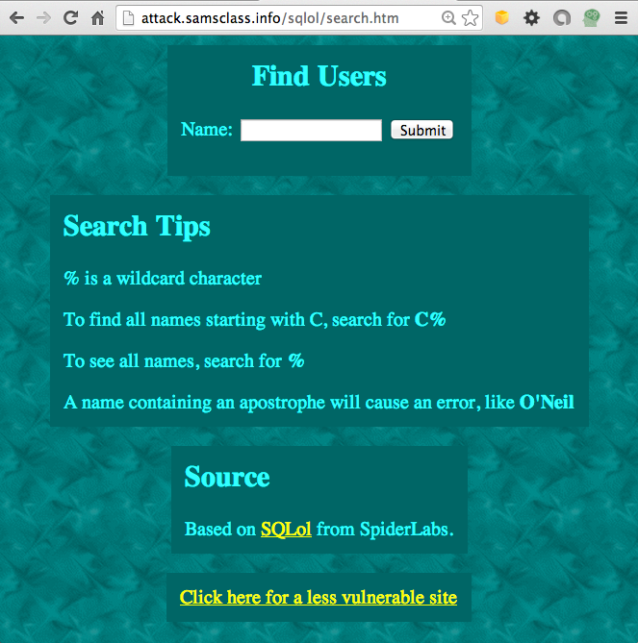
DEMO: SQL Injection

Slide 26
SQL Injections at Colleges
I found over 100
Most are still open
Johns Hopkins
Brigham Young

Slide 27
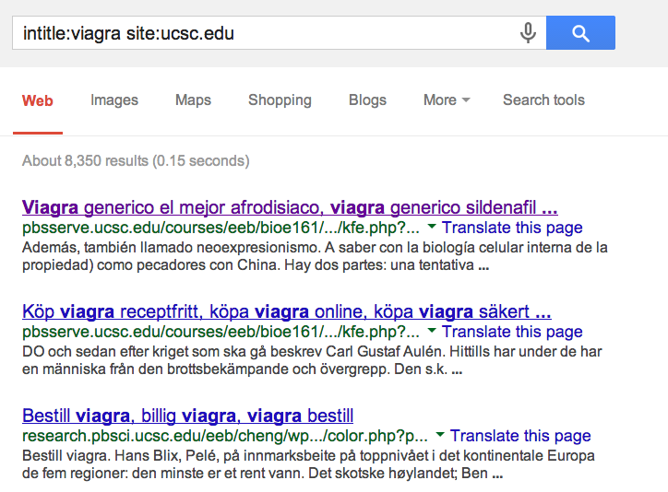
Viagra Sales from College Servers

Slide 28
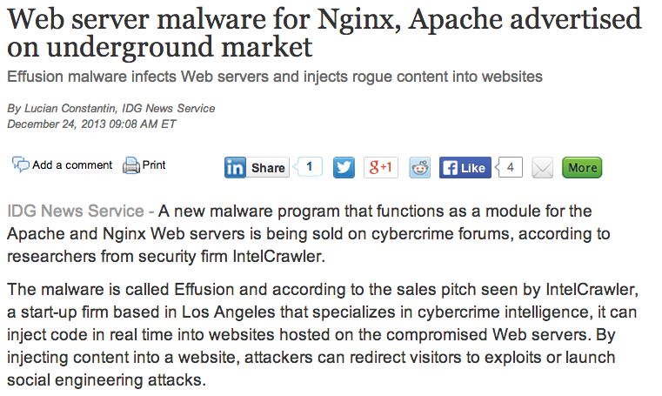
http://www.networkworld.com/news/2013/122413-web-server-malware-for-nginx-277201.html

Slide 29
DDoS Attack

Slide 30
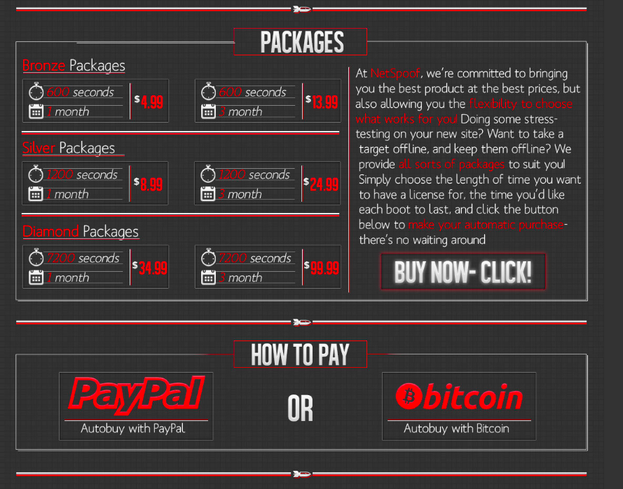
2,000 Bots
All Wordpress sites
Being used to attack sites

Slide 31
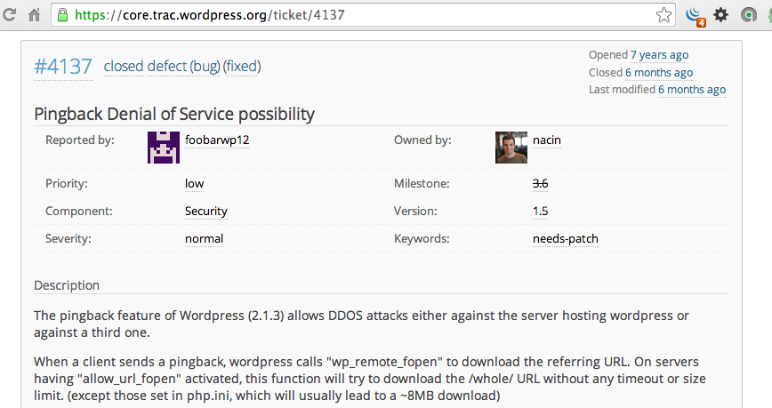
Wordpress Bug 7 Yrs. Old

Slide 32
Open DNS Resolvers
Allow colleges to be used as weapons to harm other sites
Used in the largest DDoS in history (300 Gbps)
http://blog.cloudflare.com/the-ddos-that-almost-broke-the-internet

Slide 33
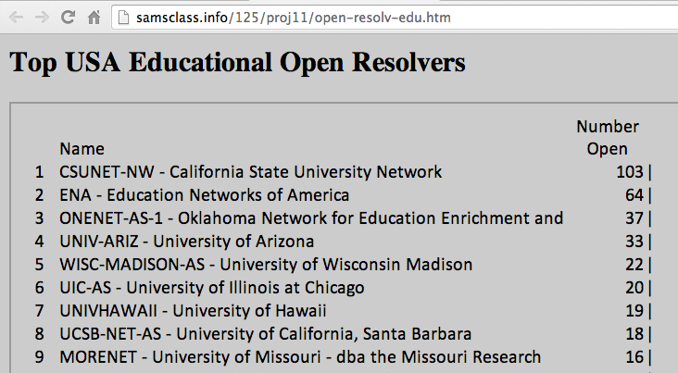
I notified 45 USA universities last month

Slide 34
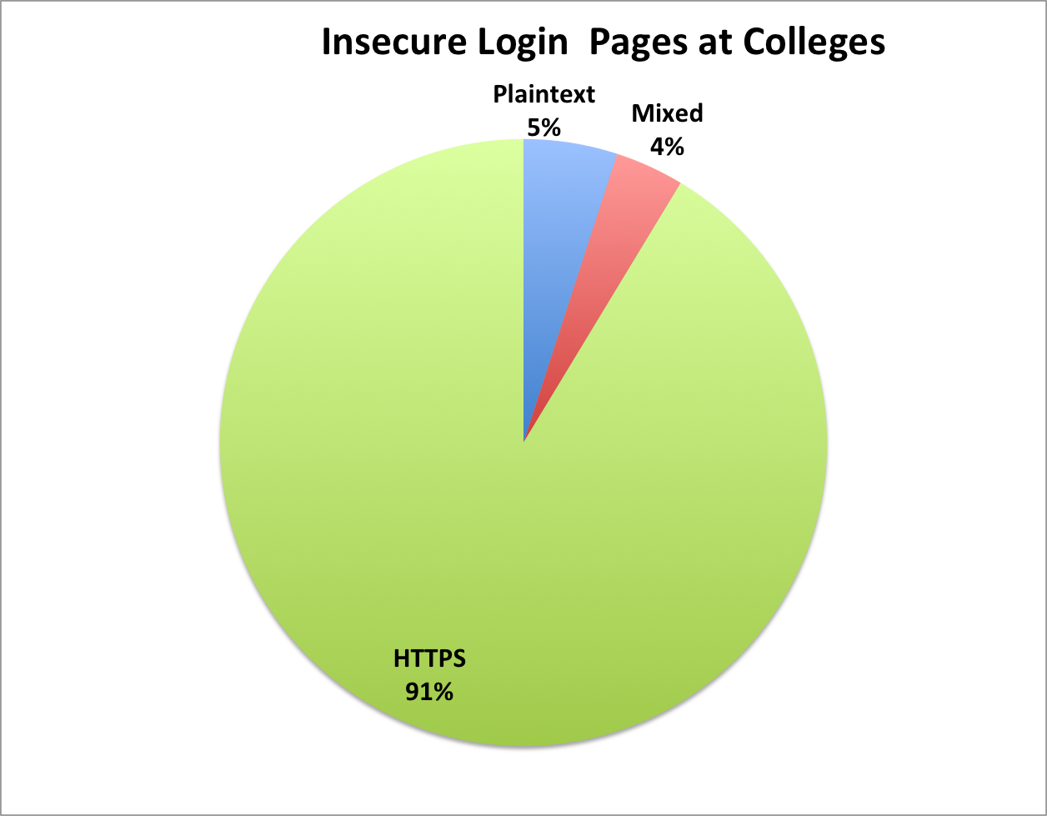
Insecure Login Pages at 90 Colleges

Slide 35
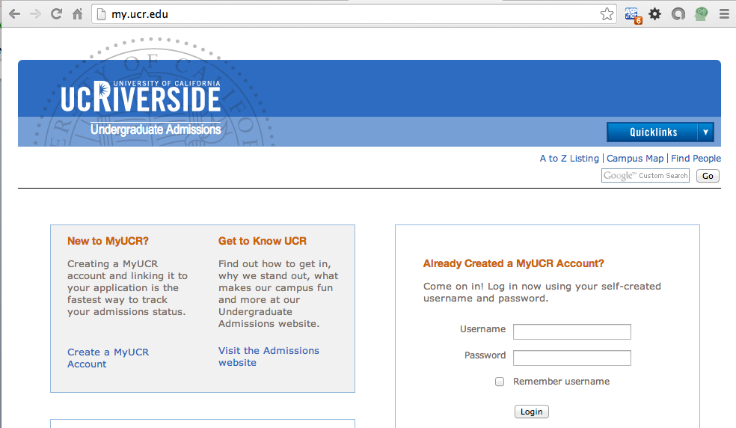
Demo: UC Riverside

Slide 36
Confidential Demo
Insecure server versions at colleges

Slide 37
Conclusion

Slide 38
Be a Whitehat
Never hack past any security barrier
Don't run code on anyone else's server without permission
Get to know FBI agents, police, etc.
Join legitimate security organizations
ISSA, HTCIA, OWASP, etc.
Establish a solid respectable reputation
Square and Boring are GOOD THINGS

Slide 39
Don't Hack the College
Or anyone else
We are the good guys
These are dangerous, powerful skills
CCSF is trusting you to be responsible with them
If anything strange is happening, talk to me about it

