Slide 1
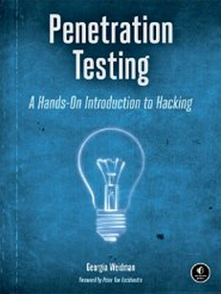
CNIT 124: Advanced Ethical Hacking
Ch 7: Capturing Traffic

Slide 2
Topics
Switches, Hubs and Wireless networks
Wireshark
  Promiscuous mode and Monitor mode
  Filters
  Following a Stream
ARP Cache Poisoning
DNS Cache Poisoning
SSLstrip

Slide 3
Switches, Hubs and Wireless Networks

Slide 4
Hubs
Operate at OSI layer 1
Repeat every bit out all ports
  Except the receiving port
Don't read addresses or any other content
Ethernet NICs were designed for hubs

Slide 5
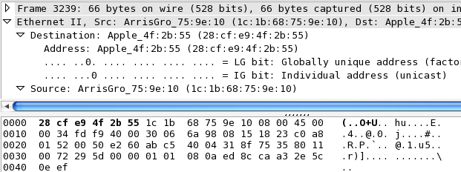
Ethernet
NIC reads Destination MAC address
First 6 bytes of frame

Slide 6
Ethernet Promiscuous Mode
If Destination MAC != NIC's hardware address
  Packet is discarded
Unless NIC is in "Promiscuous mode"
  Every packet passed on to higher levels, regardless of MAC address
Also applies to outgoing traffic

Slide 7
Wireless LANs
No Encryption is just like Hubs
WEP uses same key for every packet
WPA generates a different key for each device
  WPA and WPA2 use keys derived from an EAPOL handshake, which occurs when a machine joins a Wi-Fi network, to encrypt traffic. Unless all four handshake packets are present for the session you're trying to decrypt, Wireshark won't be able to decrypt the traffic.

Slide 8
Wireshark

Slide 9
Promiscuous Mode in Wireshark
Edit, Preferences
Click "Capture" on left side
"Capture packets in promiscuous mode on all network cards" on right side

Slide 10
Monitor Mode in Wireshark
Edit, Preferences
Click "Capture" on left side
On the right side, on the "Interfaces" line, click Edit
Wireless adapter may show a "Monitor mode" option
Not all cards or drivers allow this

Slide 11
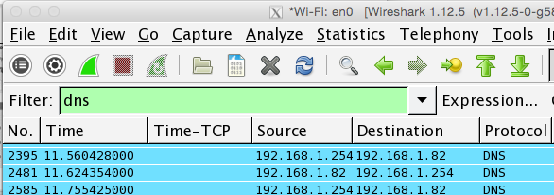
Display Filters
frame contains attack
Expression... button

Slide 12
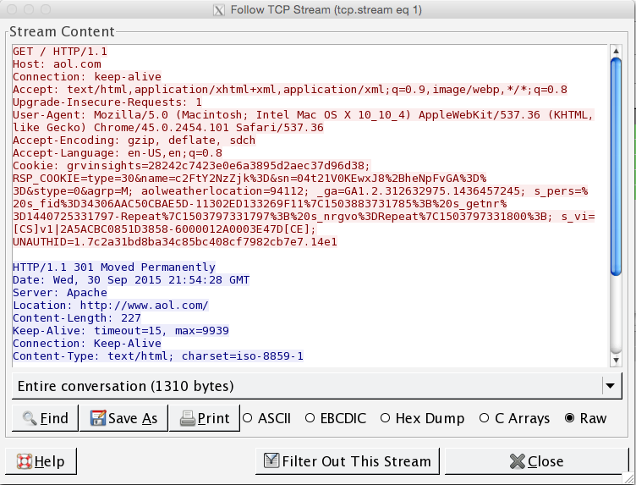
Following a Stream

Slide 13
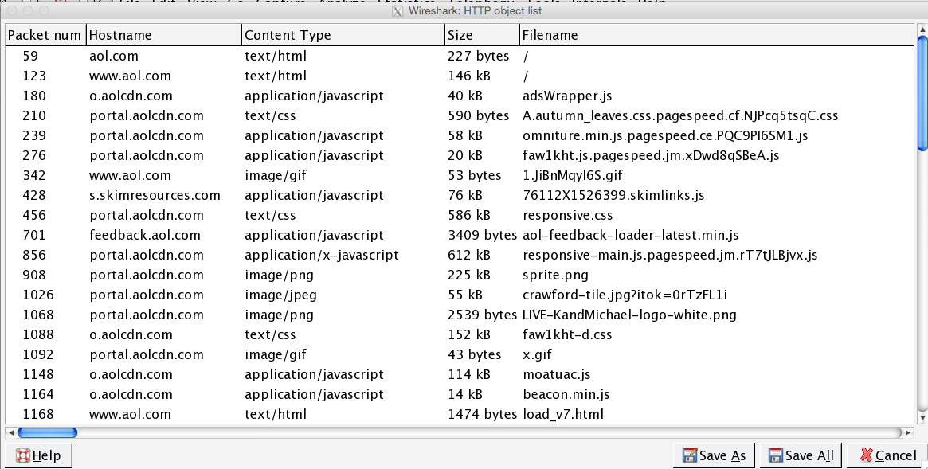
Extracting Files
File, Export Objects, HTTP

Slide 14
ARP Cache Poisoning

Slide 15
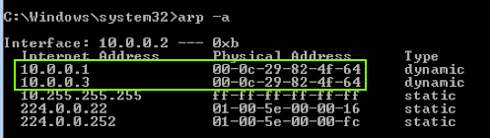
ARP Cache Poisoning
Client tricked into sending packets to the wrong MAC Address
Attacker must be on target's LAN

Slide 16
DNS Cache Poisoning

Slide 17
DNS Cache Poisoning (Client)
Attacker sends false DNS replies
Target is tricked into storing the wrong IP address for a domain name
Attacker is usually on the same LAN
  May not always be required
DNSSEC might stop this someday
  But not today

Slide 18
DNS Cache Poisoning (Server)
Attacker can poison remote, shared DNS servers
  Like Comcast DNS servers
Affects many users
Dan Kaminsky figured this out
Patched in 2008
DNSSEC will patch it more thoroughly

Slide 19
SSLstrip

Slide 20


sslstrip Proxy Changes HTTPS to HTTP
To Internet
HTTPS
Attacker:
sslstrip Proxy
in the
Middle
HTTP
Target
Using
Facebook

