Slide 1
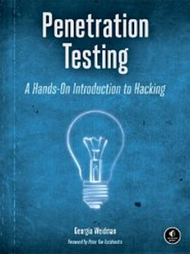
CNIT 124: Advanced Ethical Hacking
Docker (not in textbook) &
Ch 8: Exploitation

Slide 2
Docker

Slide 3
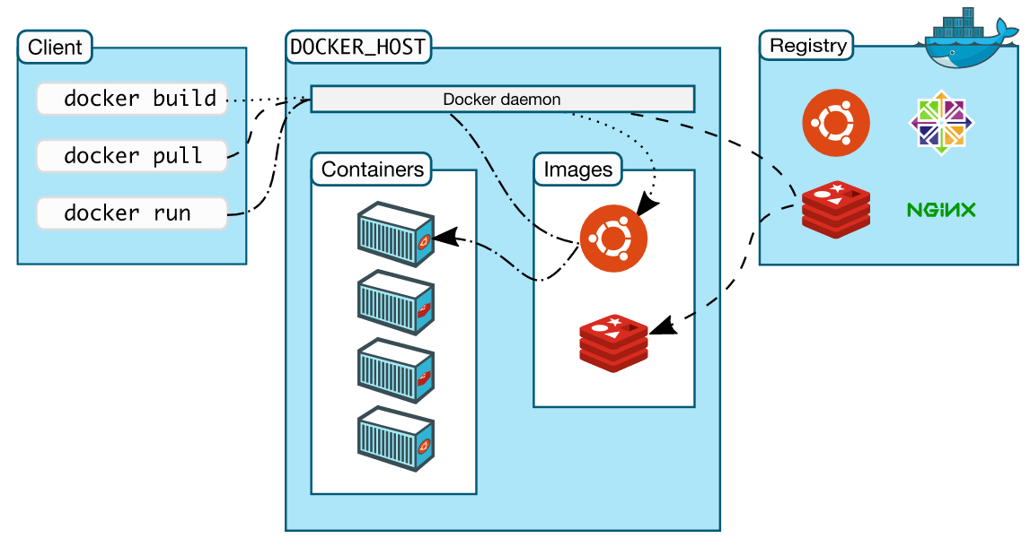
Docker Architecture

Slide 4
Main Docker Components
Docker
  the open source container virtualization platform
Docker Hub
  Software-as-a-Service platform for sharing and managing Docker containers
  The primary public Docker registry

Slide 5
Images and Registries
Docker images
  Read-only templates with OS and installed software
  Used to build servers
Docker registries
  Stores that hold images. May be public or private.
  You upload or download images from stores
  Used to distribute servers

Slide 6
Images, Registries, and Containers
Docker containers
  Like virtual machines
  Can be run, started, stopped, moved, and deleted
  Used to run servers

Slide 7
UnionFS
Docker uses UnionFS
  Mounts an entire file system on top of another file system, in layers
  Priority is defined, so it knows which file is the current one if more than one copy of a file is present
Makes docker containers MUCH smaller than virtual machines
  Because they don't make extra copies of files

Slide 8
64-Bit v. 32-Bit
Docker is intended for 64-bit systems
It can be used to a limited extent on 32-bit systems, but that is not supported

Slide 9
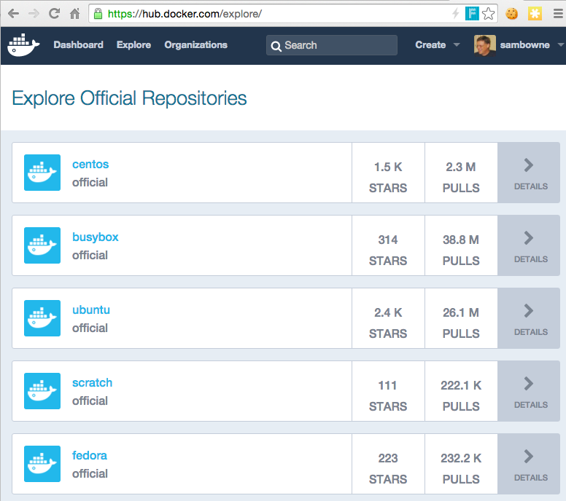
Docker Hub

Slide 10
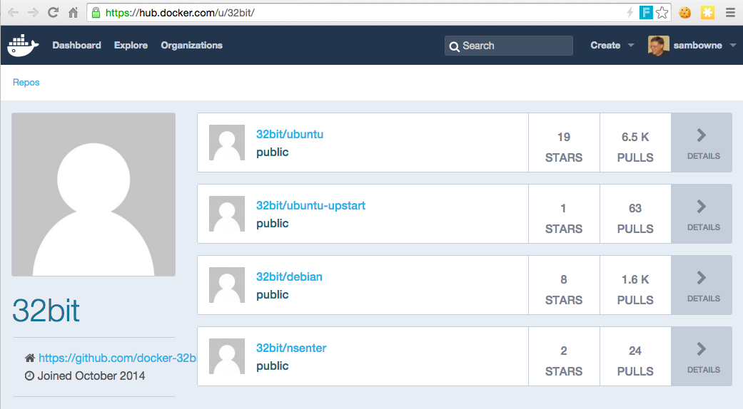
Docker 32-Bit Images

Slide 11
Important Docker Commands
docker pull <image>
  Downloads <image> from Docker Hub
docker images
  Shows local images
docker run -it <image> bash
  Creates a container based on <image> , starts it, and shows a Bash shell

Slide 12
Important Docker Commands
docker ps
  Lists running containers
  With "-a" switch, shows all containers
docker start <container-name>
  Starts a container
docker attach <container-name
  Attaches to a running container
  Shows a "sh" command-line

Slide 13
Important Docker Commands
Ctrl+P, Ctrl+Q
  Detaches from a running container without stopping it
docker run -p 8080:80 -it <image-name> bash
  Creates a container, forwarding port 8080 on the host to port 80 inside the container, showing a bash shell

Slide 14
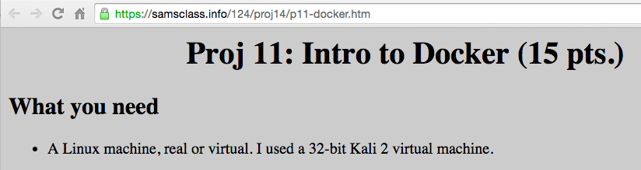
Project Walkthrough

Slide 15
iClicker Questions

Slide 16
Which item can be started and stopped like a virtual machine?
Docker
Docker hub
Docker image
Docker registry
Docker container

Slide 17
If CCSF makes a private server full of proprietary templates, what have they created?
Docker
Docker hub
Docker image
Docker registry
Docker container

Slide 18
What is the primary public repository Docker provides, containing many versions of Linux?
Docker
Docker hub
Docker image
Docker registry
Docker container

Slide 19
Which docker command creates a new container?
pull
run
images
ps
attach

Slide 20
Which docker command allows you to control a running container?
pull
run
images
ps
attach

Slide 21
CNIT 124: Advanced Ethical Hacking
Ch 8: Exploitation

Slide 22
Exploiting Default XAMPP Credentials

Slide 23
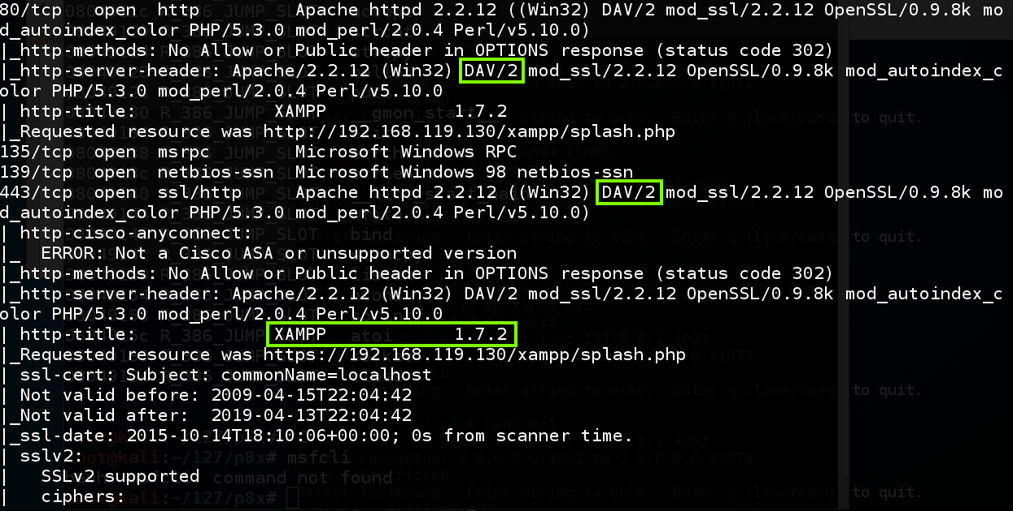
Nmap Scan

Slide 24
WebDAV
Web Distributed Authoring and Versioning
  An extension to HTTP
  Allows developers to easily upload files to Web servers

Slide 25
XAMPP
A convenient way to run a LAMP server on Windows
  LAMP: Linux, Apache, MySQL, and PHP
Includes WebDAV, turned on by default, with default credentials
  In older versions

Slide 26
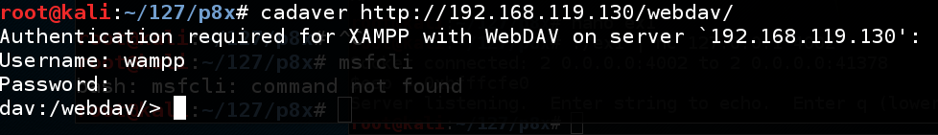
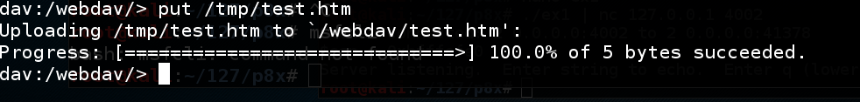
Cadaver
A command-line tool to use WebDAV servers
Default credentials allow file uploads

Slide 27
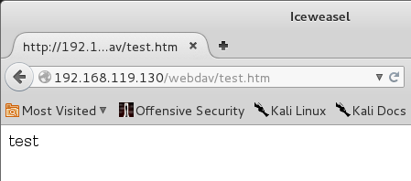
Website Defacement
Violates Integrity, but not as powerful as Remote Code Execution

Slide 28
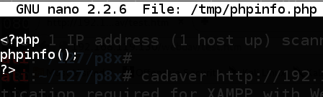
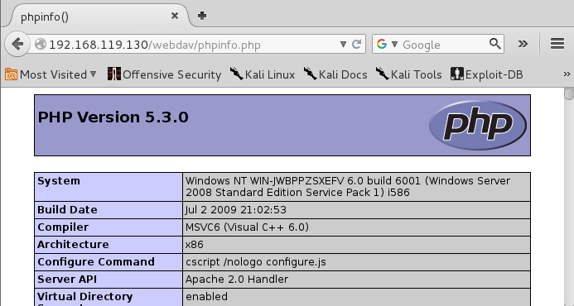
Upload a PHP File
PHP file executes on the server!
This is Remote Code Execution

Slide 29
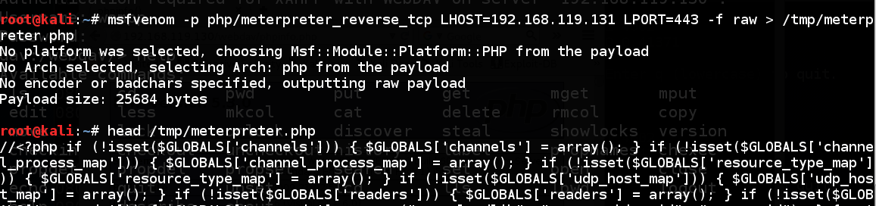
Msfvenom Creates Malicious PHP File

Slide 30
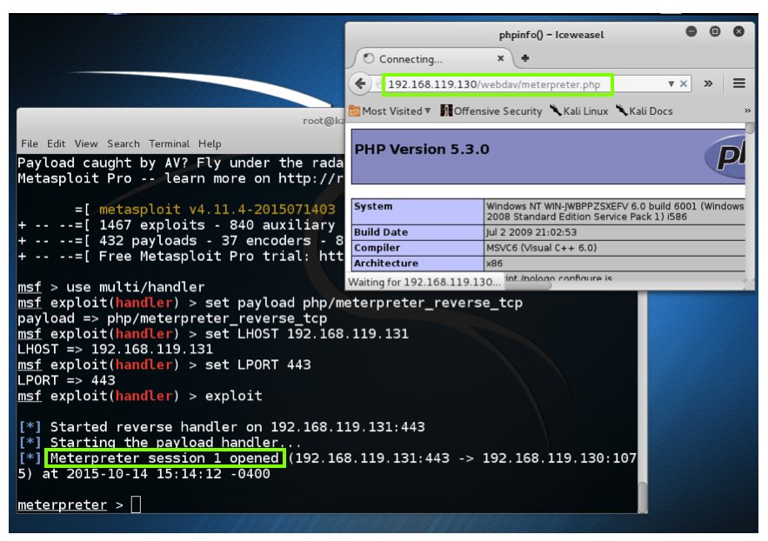
Meterpreter Reverse Shell

Slide 31
Exploiting phpMyAdmin

Slide 32
Purpose
phpMyAdmin provides a convenient GUI
Allows administration of SQL databases

Slide 33
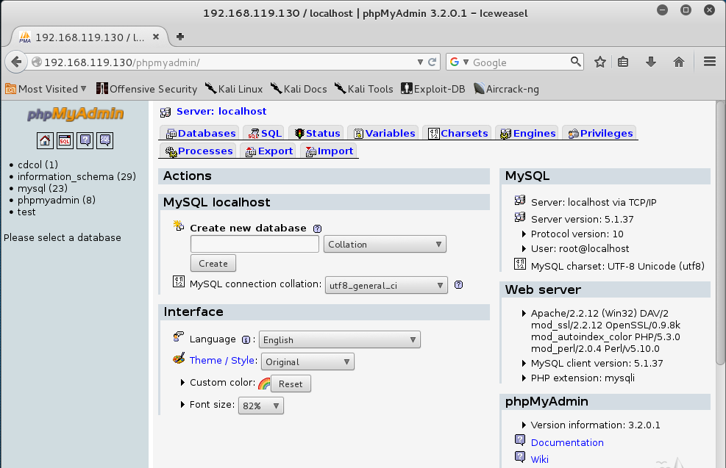
phpMyAdmin

Slide 34
Should be Protected
phpMyAdmin should be limited-access
  With a Basic Authentication login page, or a more secure barrier

Slide 35
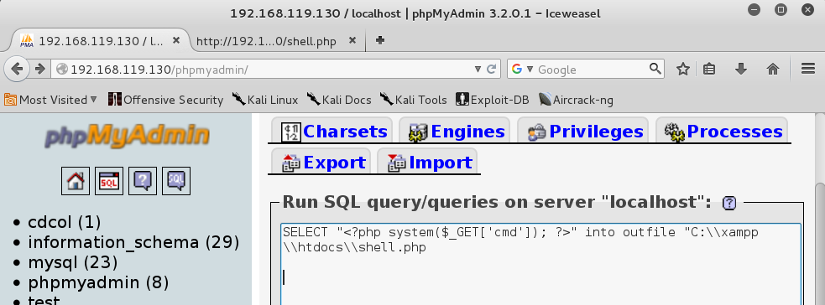
SQL Query
Can write text to a file
This allows defacement

Slide 36
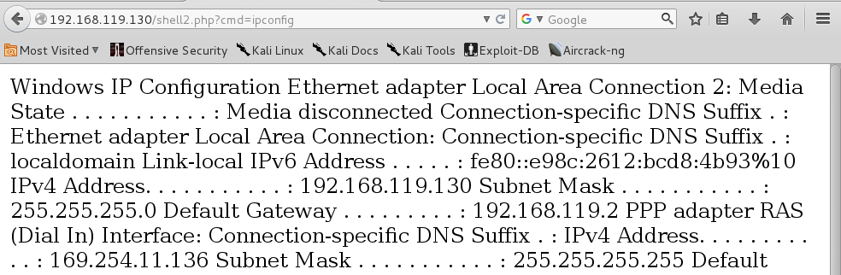
PHP Shell
Can execute one line of CMD at a time

Slide 37
Staged Attack
Initial attack sends a very small bit of code, such as a single line of CMD
That attack connects to a server and downloads more malicious code
Very commonly used by malware

Slide 38
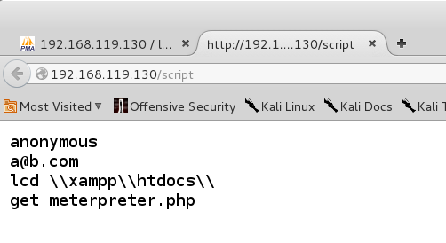
FTP Scripts
File contains text to be executed by command-line FTP client

Slide 39
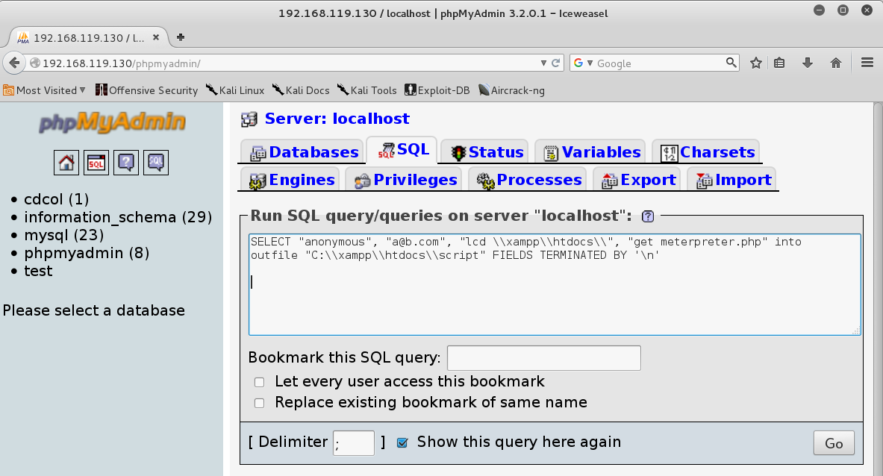
Making the Script File with SQL

Slide 40
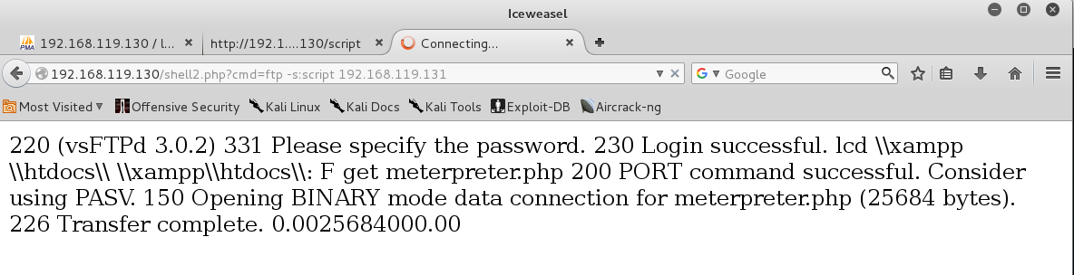
Run the FTP –s:script Command

Slide 41
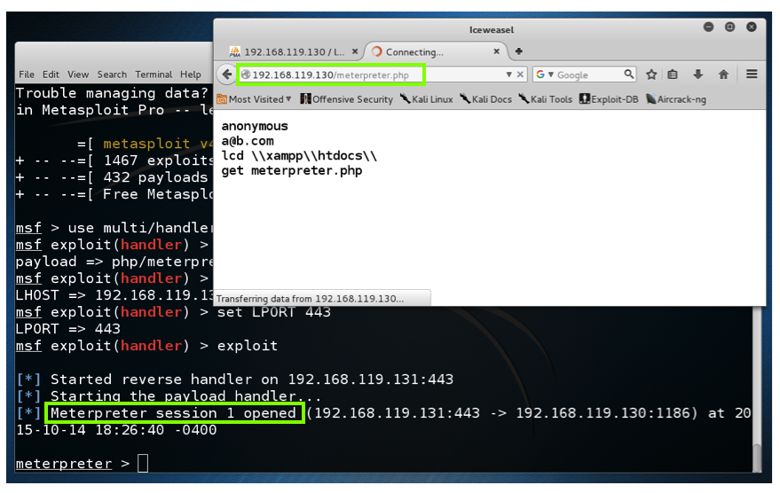
Owned

Slide 42
iClicker Questions

Slide 43
Which item is a Web page that should not be visible to casual Web surfers?
XAMPP
phpMyAdmin
WebDAV
Cadaver
msfvenom

Slide 44
Which item can create malicious PHP files?
XAMPP
phpMyAdmin
WebDAV
Cadaver
msfvenom

Slide 45
Which item is an extension to the HTTP protocol?
XAMPP
phpMyAdmin
WebDAV
Cadaver
msfvenom

Slide 46
Which language places commands between <? and ?> tags?
SQL
HTML
Bash
PHP
FTP

Slide 47
Which technique is commonly used to load larger portions of staged attacks?
SQL
HTML
Bash
PHP
FTP

