Slide 1
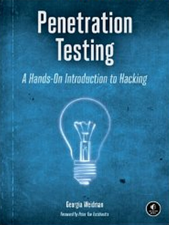
CNIT 124: Advanced Ethical Hacking
Ch 9: Password Attacks

Slide 2
Topics
Password Management
Online Password Attacks
Offline Password Attacks
Dumping Passwords from RAM

Slide 3
Password Management

Slide 4
Password Alternatives
Biometrics
Two-factor authentication
Digital certificates

Slide 5
Common Password Errors
Short passwords
Using dictionary words
Re-using passwords
Attackers know that a stolen password can often be re-used elsewhere

Slide 6
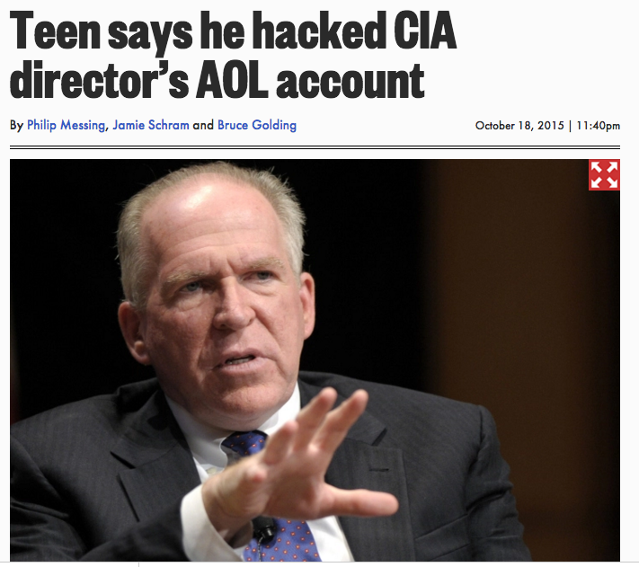
Password Reset
A weak spot for cloud services, especially free ones

Slide 7
Online Password Attacks

Slide 8
Multiple Logins
Scripts try to login with passwords from a list
Can be blocked by lockout policies
After five failed logins, must wait an hour
Brute-forcing is possible
Trying every combination of characters
Impractical except for very short passwords

Slide 9
Wordlists
Usernames
Look at valid account names, try to deduce the pattern
CCSF uses first letter of first name, then last name, then 2 digits, like psmith01
Find a list of real usernames, or use a list of common names

Slide 10
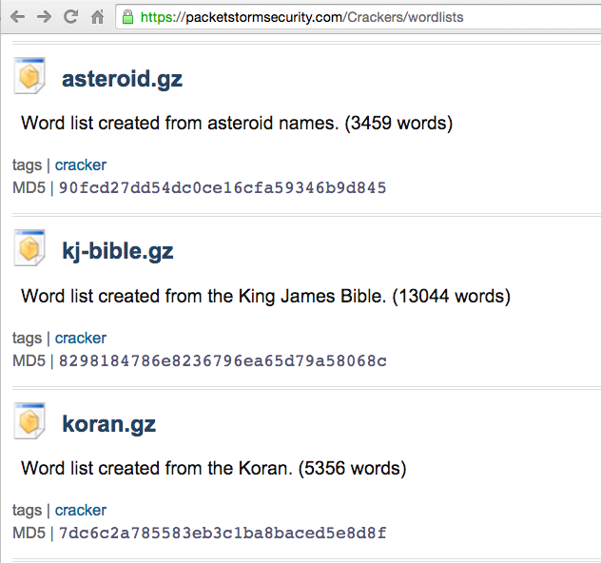
Password Lists
Packetstorm
For special purposes
Openwall has more general ones, but they cost money
Link Ch 9d

Slide 11
Targeting Wordlists
Use information about the targeted person
Such as a Facebook page
Generate passwords from clues
TaylorSwift13!

Slide 12
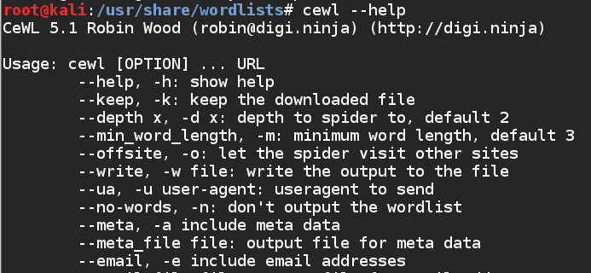
Cewl
Included in Kali
Creates wordlist from URL, reading words from pages

Slide 13
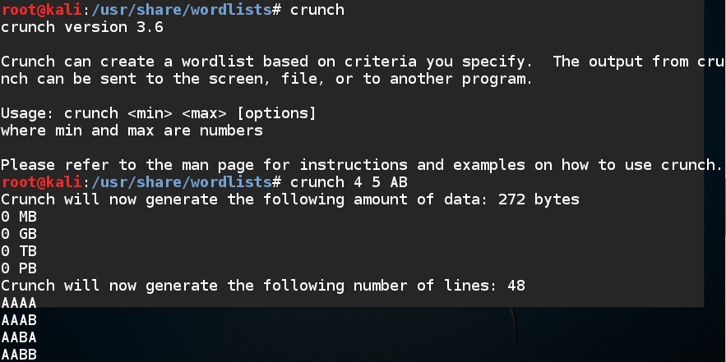
Crunch
Generates a wordlist from characters you specify (included in Kali)

Slide 14
Hydra
Online password cracker
Can use wordlists or pattens

Slide 15
Offline Password Attacks

Slide 16
Getting the Hashes
Most operating systems and Web services now hash passwords
Although some use plaintext, and most use weak hashing techniques
Windows stores hashes in an encrypted C:\Windows\SAM file, but the key is available in the SYSTEM file

Slide 17
Two Ways to Strengthen Hashes
Salting
Add random bytes before hashing
Store them with the hash
This prevents attackers from pre-computing 'Rainbow Tables" of hashes
Stretching
Many rounds, typically 5000, of hashing
Slows down attackers

Slide 18
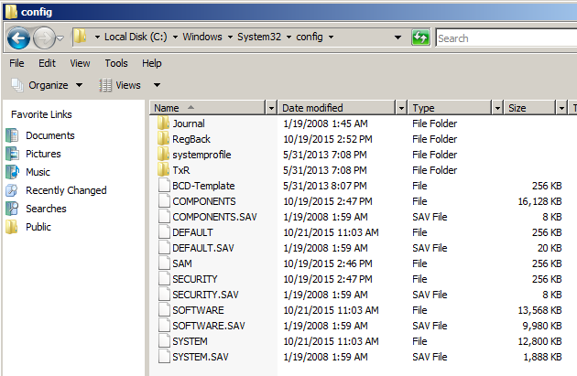
SAM and SYSTEM Files

Slide 19
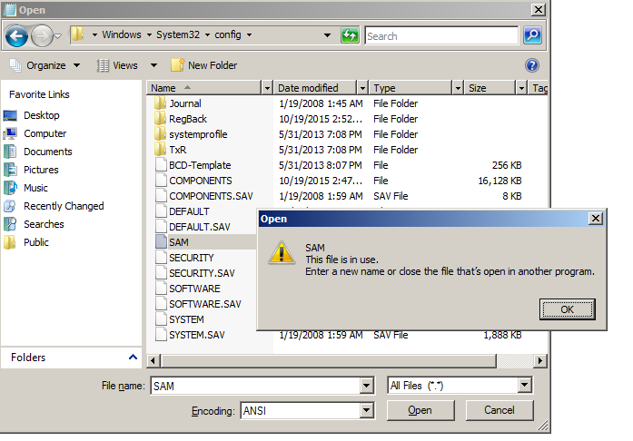
Unavailable when Windows is Running

Slide 20
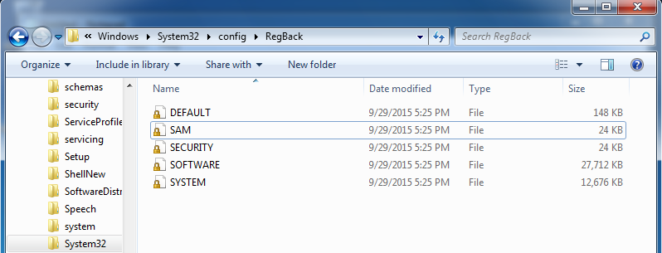
Win 7 Backup Files
Also unavailable when system is running
Win XP had C:\Windows\Repair but it seems to be gone now

Slide 21
Reg.exe
Works on Windows 7
Link Ch 8i

Slide 22
SAM is Encrypted
128-bit RC4

Slide 23
Key is in SYSTEM
apt-get install bkhive FAILS on Kali 2
Must install old versions of bkhive and samdump2 (link Ch 8l)

Slide 24
Extracting Hashes
LM Hash on the left (now obsolete)
NT hash on the right (designed in 1991)

Slide 25
Linux Boot Disk
You can gather hashes by booting the target system from a LiveCD or USB
Copy the files while Windows is not running

Slide 26
Cracking Windows Passwords
Hashcat tests 500,000 passwords in a few seconds
Because algorithm is 1 round of MD4
Proj X16 in CNIT 123

Slide 27
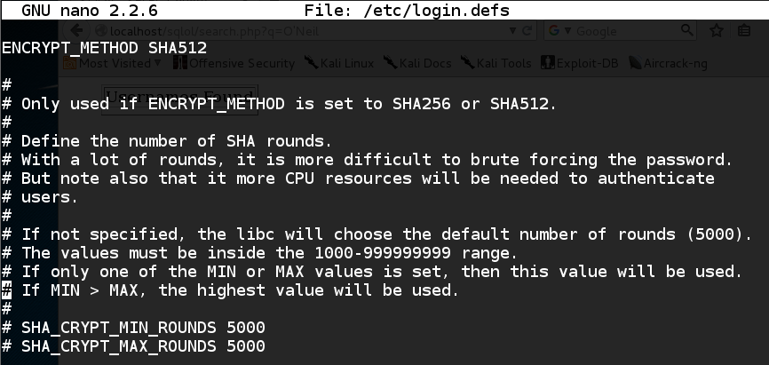
Kali's Password Hashes
5000 rounds of SHA-512 with a salt
Mac OS X is the same

Slide 28
Cracking Kali Hashes
Can only try 500 words in a few seconds

Slide 29
John the Ripper & Hashcat
Cracks many types of hashes
Auto-detects the algorithm
Can perform brute force, or dictionary, or modified dictionary attacks
Hashcat is newer and claims to be faster
oclHashcat
Designed to run in parallel on many GPUs

Slide 30
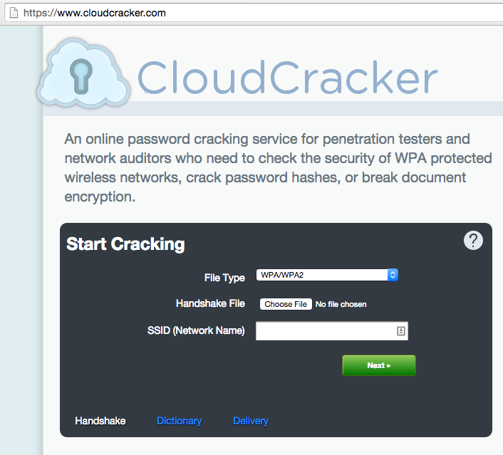
CloudCracker
Moxie Marlinspike's service
Runs on AWS machines

Slide 31
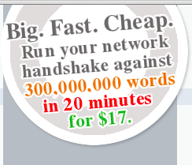
Cheap!

Slide 32
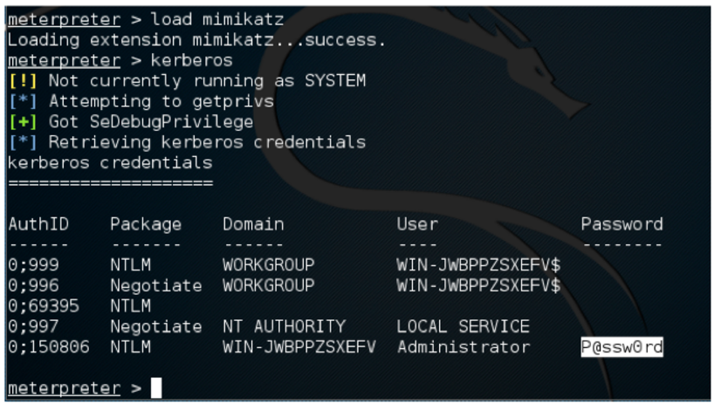

Slide 33
Stolen Password Lists
Lists of millions of real stolen passwords are now available
The rockyou list is included in Kali
in /usr/share/wordlists
Link Ch 9e

Slide 34
Passphrases are Vulnerable

Slide 35
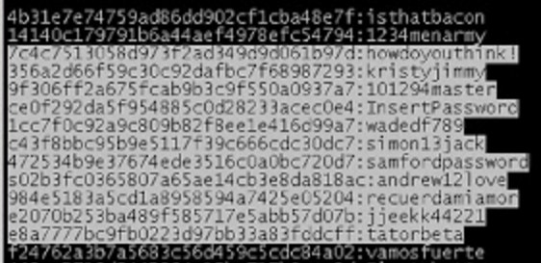
Hashed with MD5 (link Ch 9g)

Slide 36
Link Ch 9h

Slide 37
Dumping Passwords from RAM

Slide 38
Plaintext Passwords
Windows stores the password of the currently logged-on user in RAM with "reversible encryption"
It can be recovered with Windows Credential Editor or mimikatz
No matter how long or complex it is

Slide 39
Analysis of Stolen Data Dumped by TEAMGHOSTSHELL on Aug 25, 2012

Slide 40
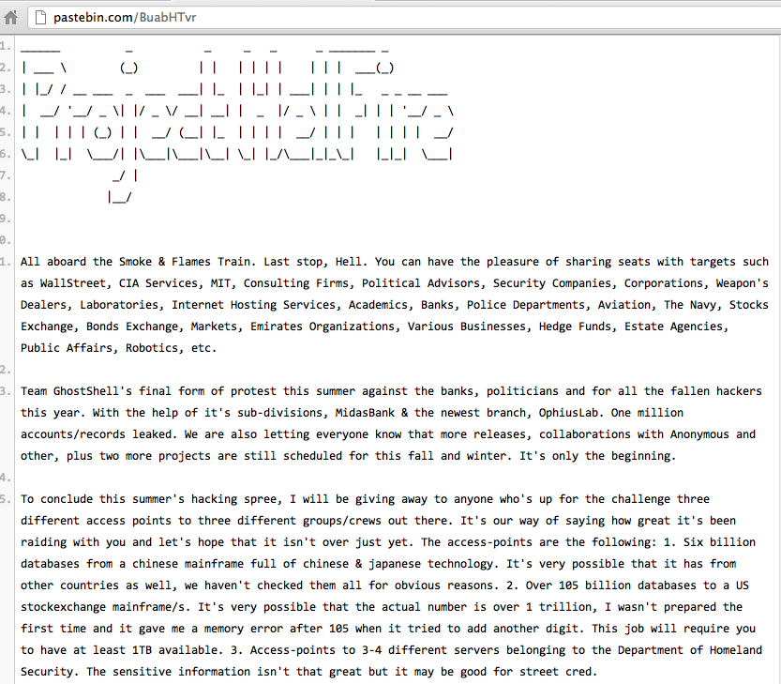

Slide 41
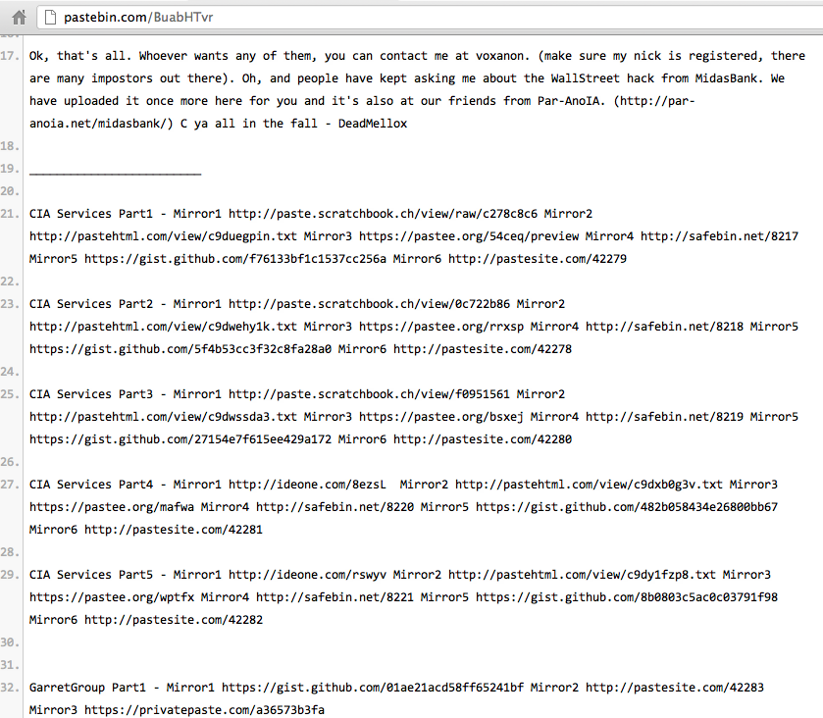

Slide 42
Password Storage: Awful Beyond Belief
Plaintext, obvious, all the same

Slide 43
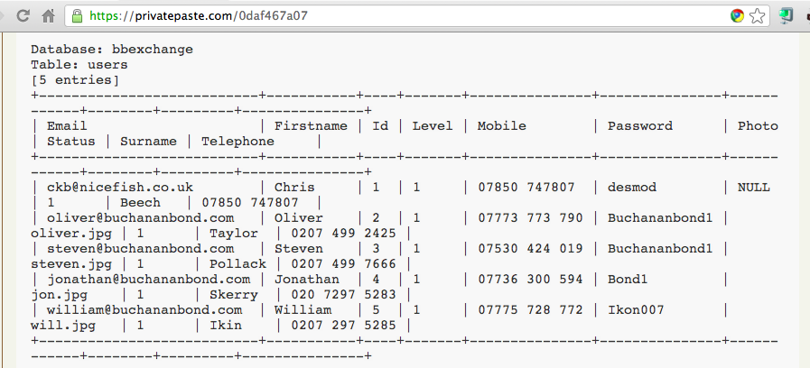
Plaintext Passwords, Easily Guessed

Slide 44
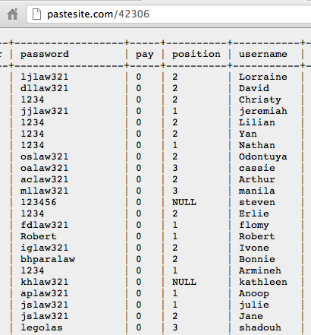

Slide 45
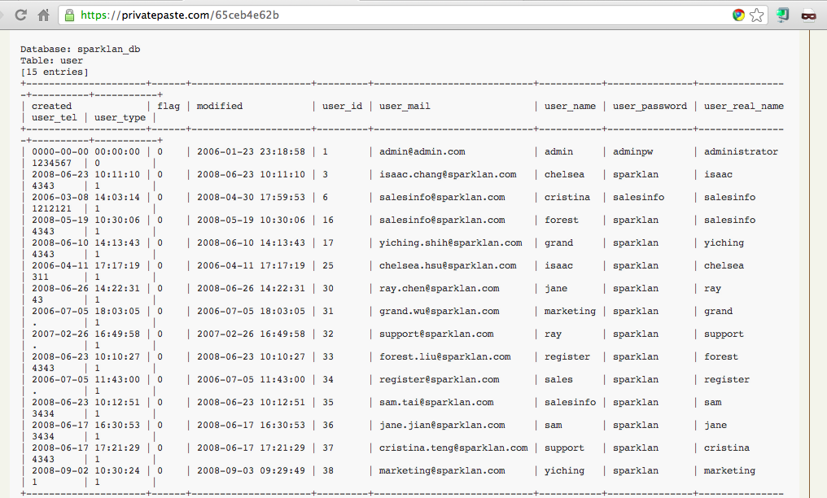
Sparklan Passwords

Slide 46
Beforward Transactions with PII

Slide 47
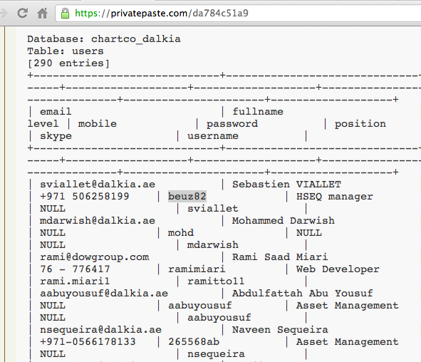
Plaintext Passwords

Slide 48
Password Storage: BASE64
Obfuscated, not hashed

Slide 49
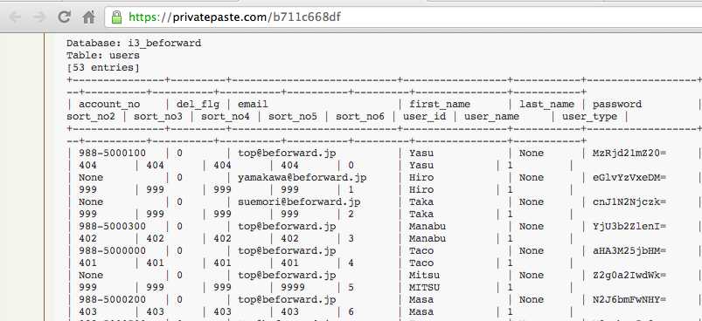
Beforward.jp

Slide 50
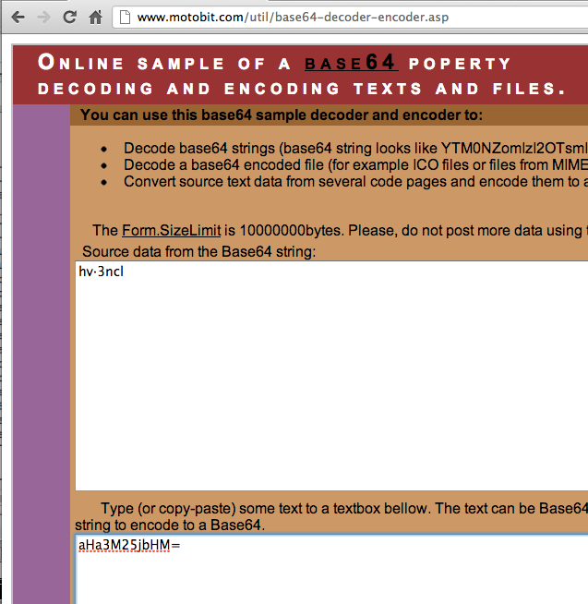
BASE64 Encoding

Slide 51
Password Storage: Unsalted MD5 or SHA-1
Real hashing, but very easy to crack

Slide 52
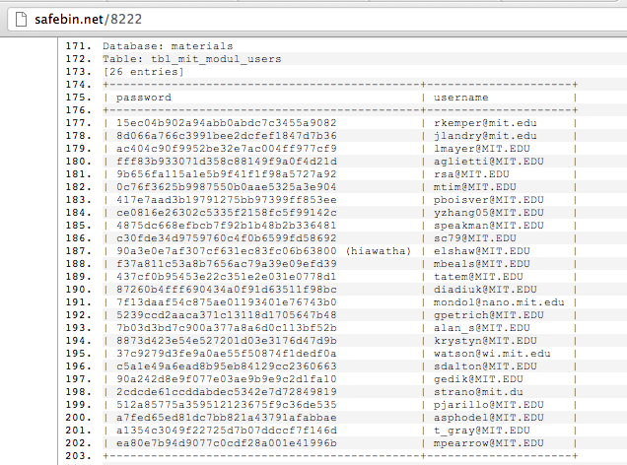
MIT – MD5 Password Hashes

Slide 53
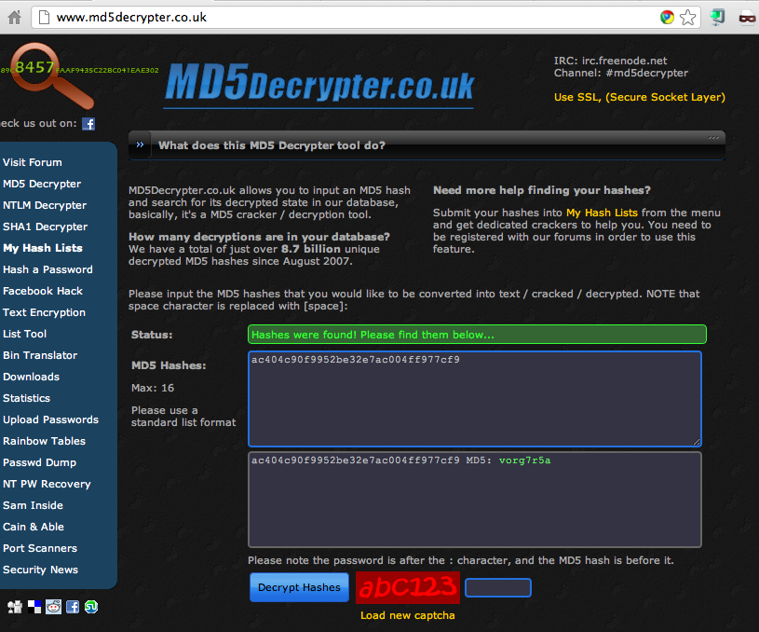

Slide 54
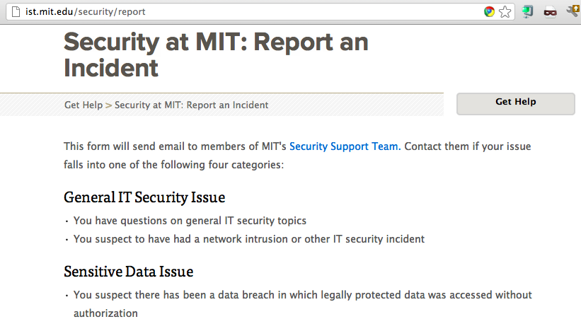

Slide 55
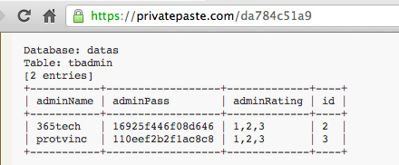
MySQL323 Password Hashes

Slide 56
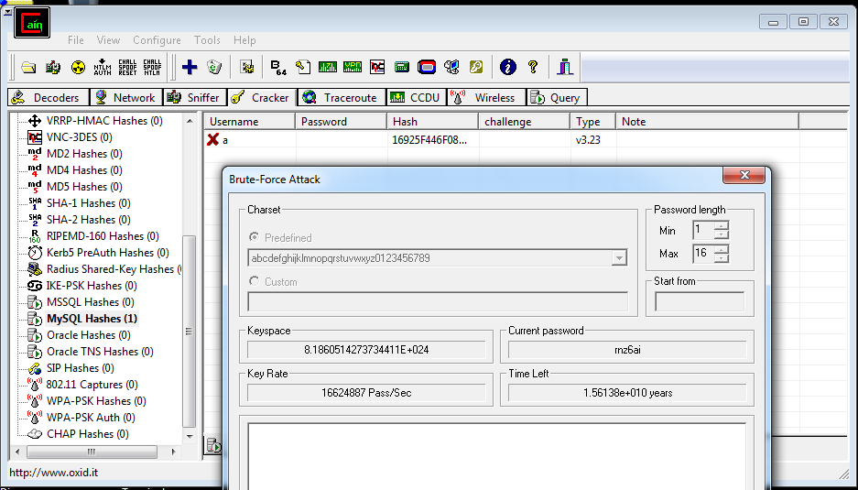
Cracking Hashes with Cain

Slide 57
SHA-1 Hash

Slide 58
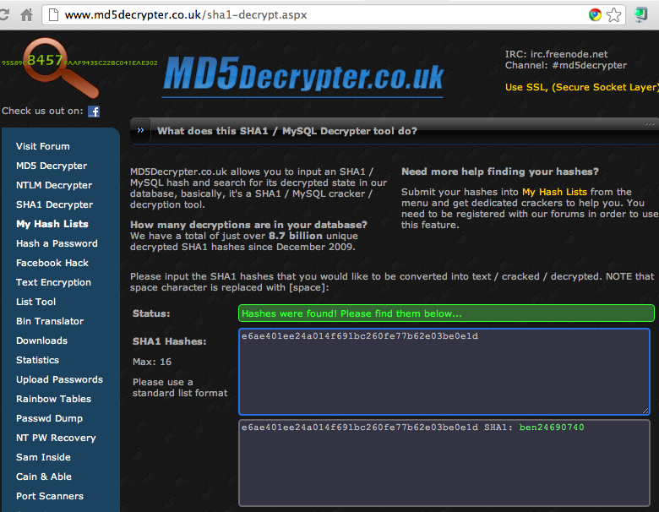
Cracked!

Slide 59
MySQL 5 Password Hashes

Slide 60
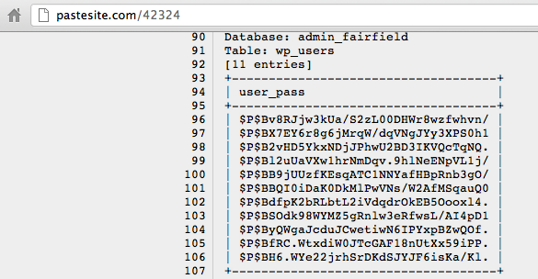
Wordpress Password Hashes

Slide 61
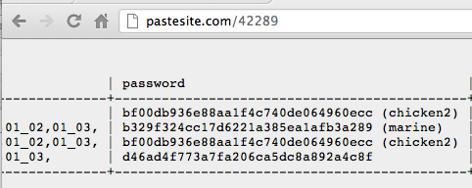
Relative Space

Slide 62
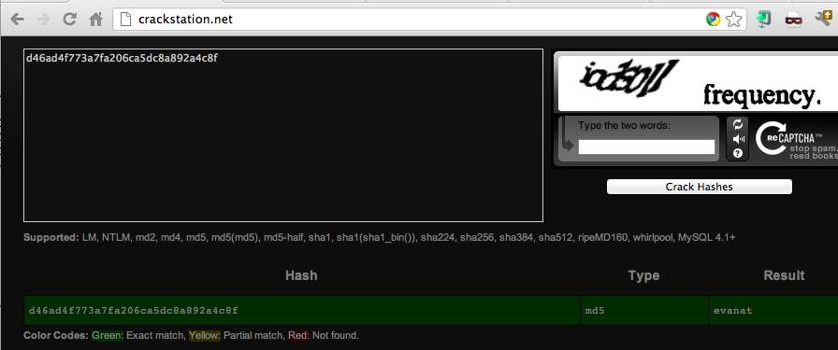
Cracked!

Slide 63
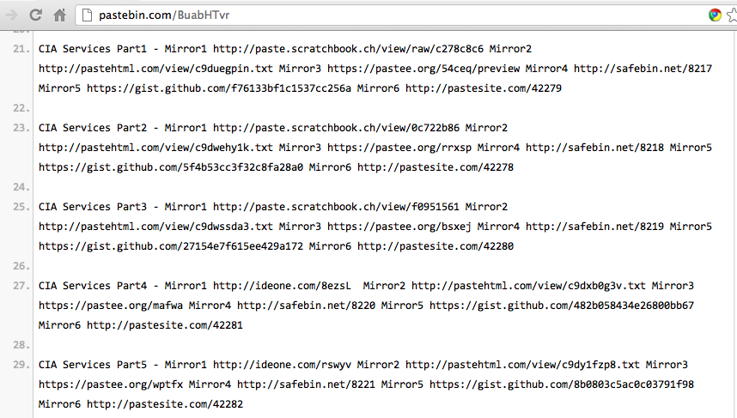

Slide 64
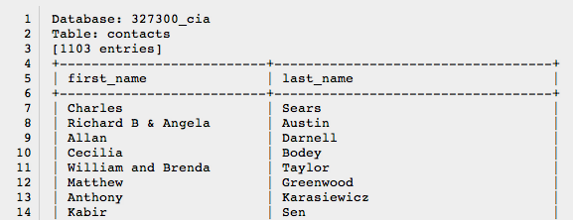
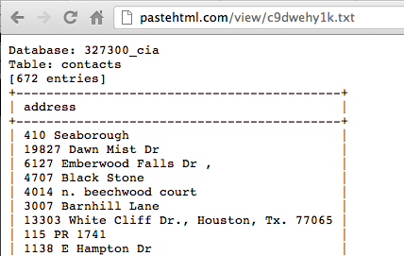
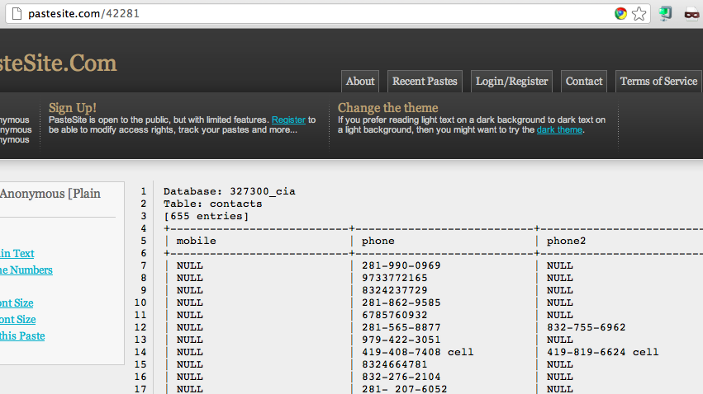

Slide 65
Password Hashing Algorithms

Slide 66
Hashing Passwords
Three essential steps
One-way hash function
MD5, SHA-1, SHA-256, etc.
Salt
Random characters added to each password
Prevents rainbow-table attack
Stretching
Repeat the hash function many times (typically 5000)
Make it take 50 ms to calculate the hash
Minimally slows login
Makes attack MUCH slower

Slide 67
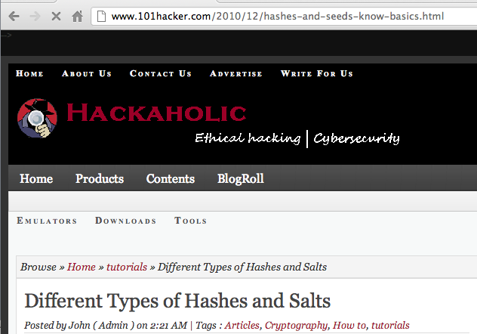

Slide 68
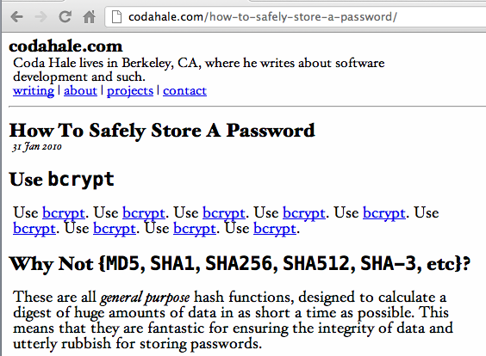
The Right Way

Slide 69
Popular Password Hashes
Type | Projected time to crack 1,000 hashes* | Hash Function | Salt (# chars) | Stretching (# rounds)
Drupal 7 | 1.7 years | SHA-512 | 8 | 16385
Linux (Debian) | 58 days | SHA-512 | 8 | 5000
Wordpress 3.5.1 | 17 hours | MD5 | 8 | 8193
Windows (all current versions) | 5.4 min | MD4 | None | 1
Joomla | 4.6 min | MD5 | 16 | 1
Calculation assumes the passwords are found in a dictionary of 500,000 guesses
One virtual machine running Kali
A clusters of GPUs would be much faster

