Slide 1
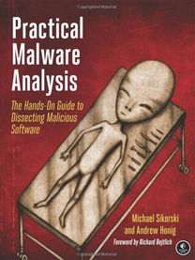
Practical Malware Analysis
Ch 12: Covert Malware Launching
Last revised: 11-17-14

Slide 2
Launchers

Slide 3
Purpose of a Launcher
Sets itself or another piece of malware
For immediate or future covert execution
Conceals malicious behavior from the user
Usually contain the malware they're loading
  An executable or DLL in its own resource section
Normal items in the resource section
  Icons, images, menus, strings

Slide 4
Encryption or Compression
The resource section may be encrypted or compressed
Resource extraction will use APIs like
  FindResource
  LoadResource
  SizeofResource
Often contains privilege escalation code

Slide 5
Process Injection

Slide 6
Process Injection
The most popular covert launching process
Injects code into a running process
Conceals malicious behavior
May bypass firewalls and other process-specific security mechanisms
Common API calls:
  VirtualAllocEx to allocate space
  WriteProcessMemory to write to it

Slide 7
DLL Injection
The most commonly used covert launching technique
Inject code into a remote process that calls LoadLibrary
Forces the DLL to load in the context of that process
On load, the OS automatically calls DLLMain which contains the malicious code

Slide 8
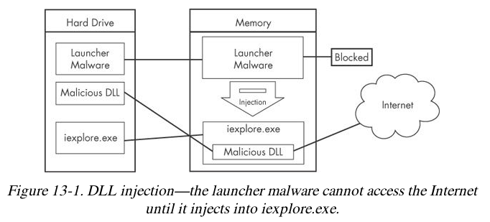
Gaining Privileges
Malware code has the same privileges as the code it is injected into

Slide 9
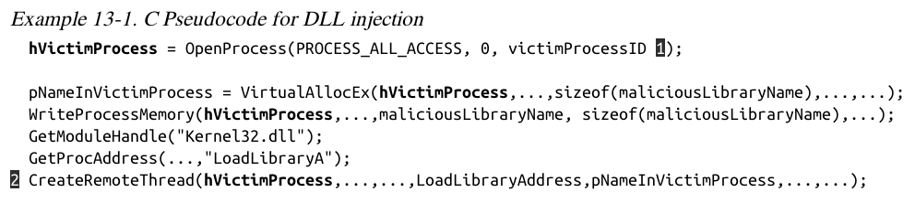
CreateRemoteThread uses 3 parameters
  Process handle hProcess
  Starting point lpStartAddress (LoadLibrary)
  Argument lpParameter Malicious DLL name

Slide 10
Direct Injection
Injects code directly into the remote process
Without using a DLL
More flexible than DLL injection
Requires a lot of customized code
To run without negatively impacting the host process
Difficult to write

Slide 11
Process Replacement

Slide 12
Process Replacement
Overwrites the memory space of a running object with malicious code
Disguises malware as a legitimate process
Avoids risk of crashing a process with process injection
Malware gains the privileges of the process it replaces
Commonly replaces svchost.exe

Slide 13
Suspended State
In a suspended state, the process is loaded into memory but the primary thread is suspended
  So malware can overwrite its code before it runs
This uses the CREATE_SUSPENDED value
in the dwCreationFlags parameter
In a call to the CreateProcess function

Slide 14
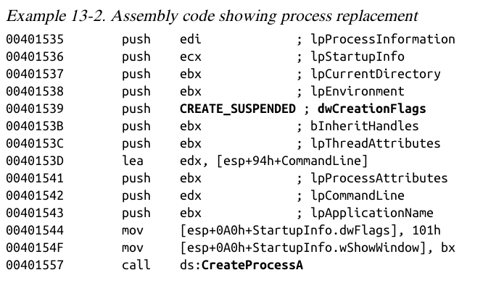

Slide 15
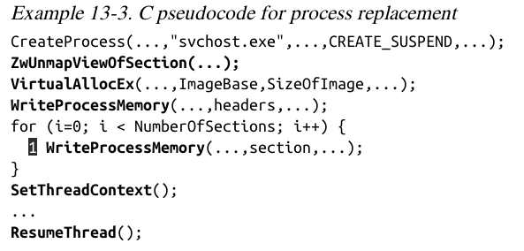
ZwUnmapViewOfSection releases all memory pointed to by a section
VirtualAllocEx allocates new memory
WriteProcessMemory puts malware in it

Slide 16
SetThreadContext restores the victim process's environment and sets the entry
ResumeThread runs the malicious code

Slide 17
Hook Injection

Slide 18
Hooks
Windows hooks intercept messages destined for applications
Malicious hooks
  Ensure that malicious code will run whenever a particular message is intercepted
  Ensure that a DLL will be loaded in a victim process's memory space

Slide 19
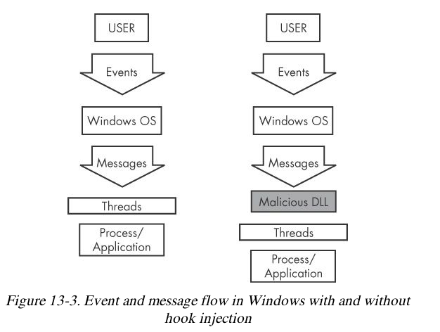

Slide 20
Local and Remote Hooks
Local hooks observe or manipulate messages destined for an internal process
Remote hooks observe or manipulate messages destined for a remote process (another process on the computer)

Slide 21
High-Level and Low-Level
Remote Hooks
High-level remote hooks
  Require that the hook procedure is an exported function contained in DLL
  Mapped by the OS into the process space of a hooked thread or all threads
Low-level remote hooks
  Require that the hook procedure be contained in the process that installed the hook

Slide 22
Keyloggers Using Hooks
Keystrokes can be captured by high-level or low-level hooks using these procedure types
  WH_KEYBOARD or WH_KEYBOARD_LL

Slide 23
Using SetWindowsHookEx
Parameters
  idHook – type of hook to install
  lpfn – points to hook procedure
  hMod – handle to DLL, or local module, in which the lpfn procedure is defined
  dwThreadId– thread to associate the hook with. Zero = all threads
The hook procedure must call CallNextHookEx to pass execution to the next hook procedure so the system continues to run properly

Slide 24
Thread Targeting
Loading into all threads can degrade system performance
May also trigger an IPS
Keyloggers load into all threads, to get all the keystrokes
Other malware targets a single thread
Often targets a Windows message that is rarely used, such as WH_CBT (a computer-based training message)

Slide 25
Explanation
Malicious DLL hook.dll is loaded
Malicious hook procedure address obtained
The hook procedure calls only CallNextHookEx
A WH_CBT message is sent to a Notepad thread
Forces hook.dll to be loaded by Notepad
It runs in the Notepad process space

Slide 26
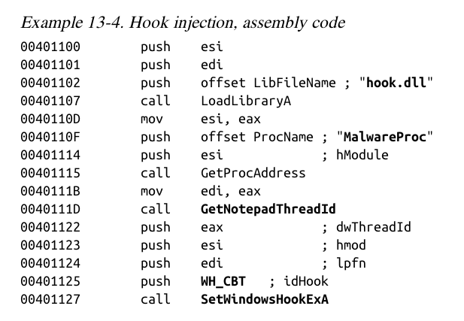

Slide 27
Detours

Slide 28
A Microsoft Product
Detours makes it easy for application developers to modify applications and the OS
Used in malware to add new DLLs to existing binaries on disk
Modifies the PE structure to create a .detour section
Containing original PE header with a new import address table

Slide 29
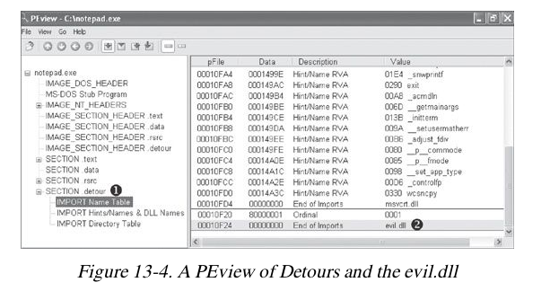
setdll is the Microsoft tool used to point the PE to the new import table
There are other ways to add a .detour section

Slide 30
APC Injection

Slide 31
Asynchronous Procedure Call
(APC)
Directs a thread to execute other code prior to executing its regular path
Every thread has a queue of APCs attached to it
These are processed when the thread is in an alterable state, such as when these functions are called
  WaitForSingleObjectEx
  WaitForMultipleObjectsEx
  Sleep

Slide 32
Two Forms of APCs
Kernel-Mode APC
  Generated for the system or a driver
User-Mode APC
  Generated for an application
APC Injection is used in both cases

Slide 33
APC Injection from User Space
Uses API function QueueUserAPC
Thread must be in an alterable state
WaitForSingleObjectEx is the most common call in the Windows API
Many threads are usually in the alterable state

Slide 34
QueueUserAPC Parameters
hThread handle to
pfnAPC defines the function to run
dwData parameter for function

Slide 35
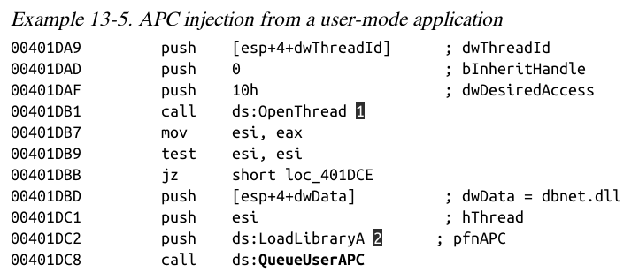
1: Opens a handle to the thread
2: QueueUserAPC is called with pfnAPC set to LoadLibraryA (loads a DLL)
dwData contains the DLL name (dbnet.dll)
Svchost.exe is often targeted for APC injection

Slide 36
APC Injection from Kernel Space
Malware drivers and rootkits often want to execute code in user space
This is difficult to do
One method is APC injection to get to user space
Most often to svchost.exe
Functions used:
  KeInitializeApc
  KeInsertQueueApc

Slide 37
