Slide 1
Practical Malware Analysis
Ch 2: Malware Analysis in Virtual Machines

Slide 2
Dynamic Analysis
Running malware deliberately, while monitoring the results
Requires a safe environment
Must prevent malware from spreading to production machines
Real machines can be airgapped –no network connection to the Internet or to other machines

Slide 3
Real Machines
Disadvantages
  No Internet connection, so parts of the malware may not work
  Can be difficult to remove malware, so re-imaging the machine will be necessary
Advantage
  Some malware detects virtual machines and won't run properly in one

Slide 4
Virtual Machines
The most common method
We'll do it that way
This protects the host machine from the malware
  Except for a few very rare cases of malware that escape the virtual machine and infect the host

Slide 5
VMware Player
Free but limited
Cannot take snapshots
VMware Workstation or Fusion is a better choice, but they cost money
You could also use VirtualBox, Hyper-V, Parallels, or Xen.

Slide 6
Windows XP
The malware we are analyzing targets Windows XP, as most malware does
The DVD handed out in class contains a Win XP SP3 virtual machine for you to use

Slide 7
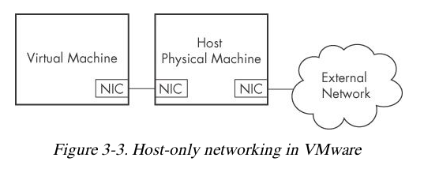
Configuring VMware
You can disable networking by disconnecting the virtual network adapter
Host-only networking allows network traffic to the host but not the Internet

Slide 8
Connecting Malware to the Internet
NAT mode lets VMs see each other and the Internet, but puts a virtual router between the VM and the LAN
Bridged networking connects the VM directly to the LAN
Can allow malware to do some harm or spread – controversial
You could send spam or participate in a DDoS attack

Slide 9
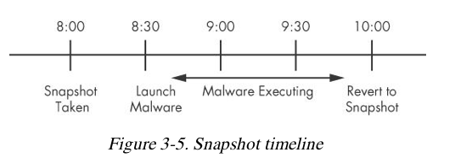
Snapshots

Slide 10
Risks of Using VMware for Malware Analysis
Malware may detect that it is in a VM and run differently
VMware has bugs: malware may crash or exploit it
Malware may spread or affect the host – don't use a sensitive host machine
All the textbook samples are harmless

Slide 11
Practical Malware Analysis
Ch 3: Basic Dynamic Analysis

Slide 12
Why Perform Dynamic Analysis?
Static analysis can reach a dead-end, due to
  Obfuscation
  Packing
  Examiner has exhausted the available static analysis techniques
Dynamic analysis is efficient and will show you exactly what the malware does

Slide 13
Sandboxes: The Quick-and-Dirty Approach

Slide 14
Sandbox
All-in-one software for basic dynamic analysis
Virtualized environment that simulates network services
Examples: Norman Sandbox, GFI Sandbox, Anubis, Joe Sandbox, ThreatExpert, BitBlaze, Comodo Instant Malware Analysis
They are expensive but easy to use
They produce a nice PDF report of results

Slide 15
Running Malware

Slide 16
Launching DLLs
EXE files can be run directly, but DLLs can't
Use Rundll32.exe (included in Windows)
rundll32.exe DLLname, Export arguments
The Export value is one of the exported functions you found in Dependency Walker, PEview, or PE Explorer.

Slide 17
Launching DLLs
Example
  rip.dll has these exports: Install and Uninstall
rundll32.exe rip.dll, Install
Some functions use ordinal values instead of names, like
rundll32.exe xyzzy.dll, #5
It's also possible to modify the PE header and convert a DLL into an EXE

Slide 18
Monitoring with Process Monitor

Slide 19
Process Monitor
Monitors registry, file system, network, process, and thread activity
All recorded events are kept, but you can filter the display to make it easier to find items of interest
Don't run it too long or it will fill up all RAM and crash the machine

Slide 20
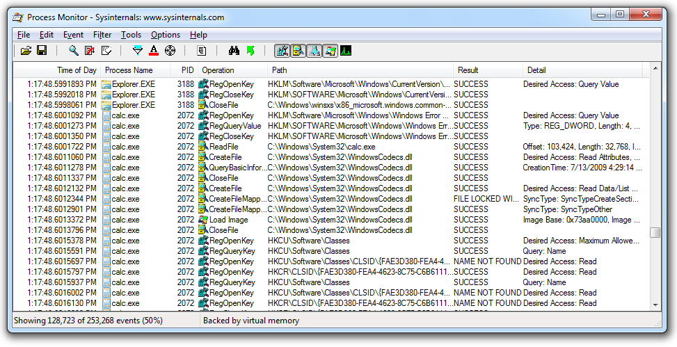
Launching Calc.exe

Slide 21
Process Monitor Toolbar
Default Filters
Registry, File system, Network, Processes
Start/Stop
Capture
Erase
Filter

Slide 22
Filtering with Exclude
One technique: hide normal activity before launching malware
Right-click each Process Name and click Exclude
Doesn't seem to work well with these samples

Slide 23
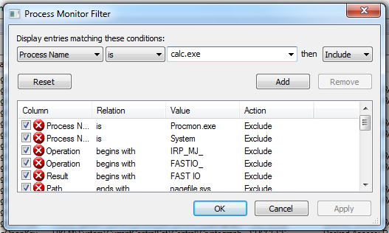
Filtering with Include
Most useful filters: Process Name, Operation, and Detail

Slide 24
Viewing Processes with
Process Explorer

Slide 25
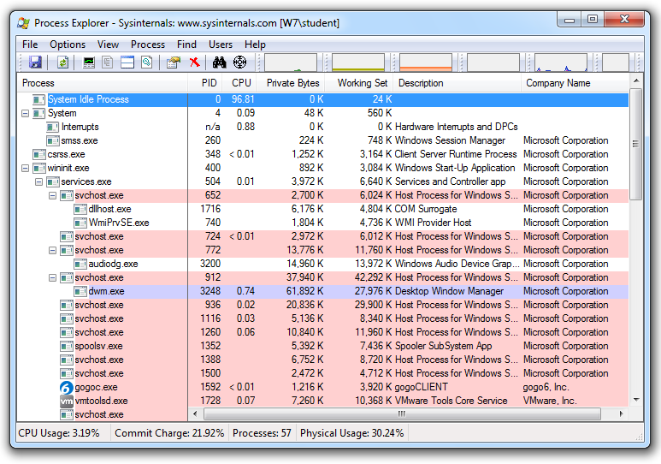

Slide 26
Coloring
Services are pink
Processes are blue
New processes are green briefly
Terminated processes are red

Slide 27
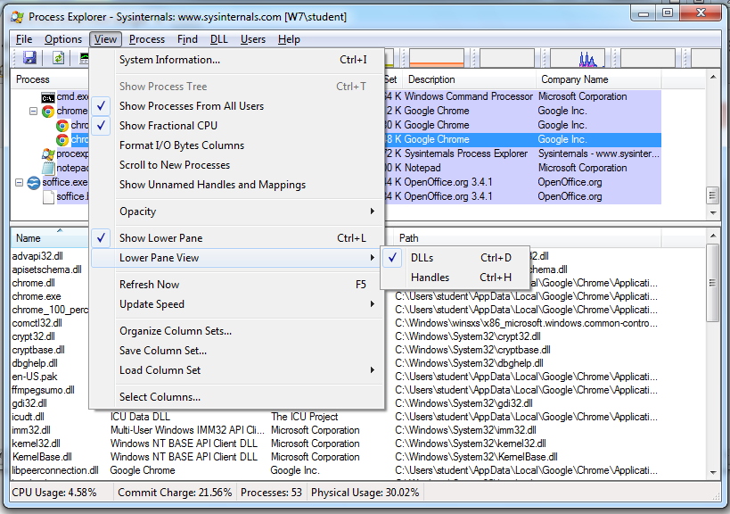
DLL Mode

Slide 28
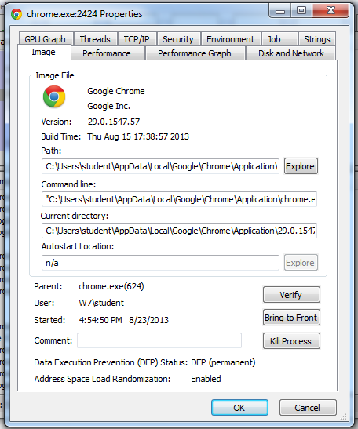
Properties
Shows DEP and ASLR status
Verify button checks the disk file's Windows signature
  But not the RAM image, so it won't detect process replacement

Slide 29
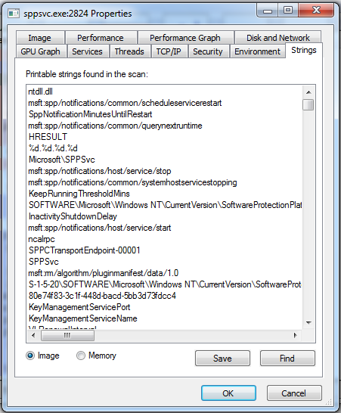
Strings
Compare Image to Memory strings, if they are very different, it can indicate process replacement

Slide 30
Detecting Malicious Documents
Open the document (e.g. PDF) on a system with a vulnerable application
Watch Process Explorer to see if it launches a process
The Image tab of that process's Properties sheet will show where the malware is

Slide 31
Comparing Registry Snapshots with Regshot

Slide 32
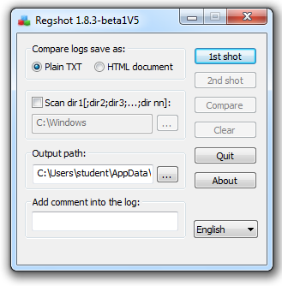

Slide 33
Faking a Network

Slide 34
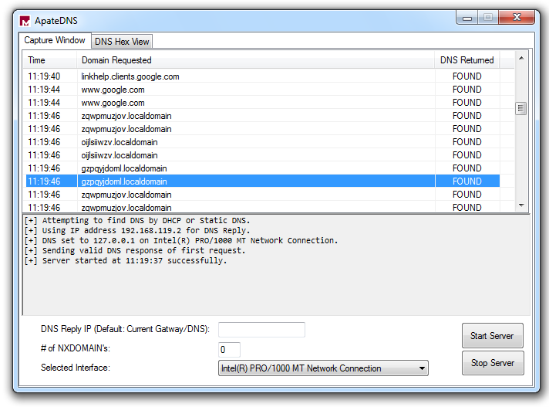
Using ApateDNS to Redirect DNS Resolutions

Slide 35
ApateDNS Does Not Work
I couldn't get it to redirect any traffic in Win XP or 7
nslookup works, but you don't see anything in a browser or with ping
I decided to ignore it and use INetSim instead

Slide 36
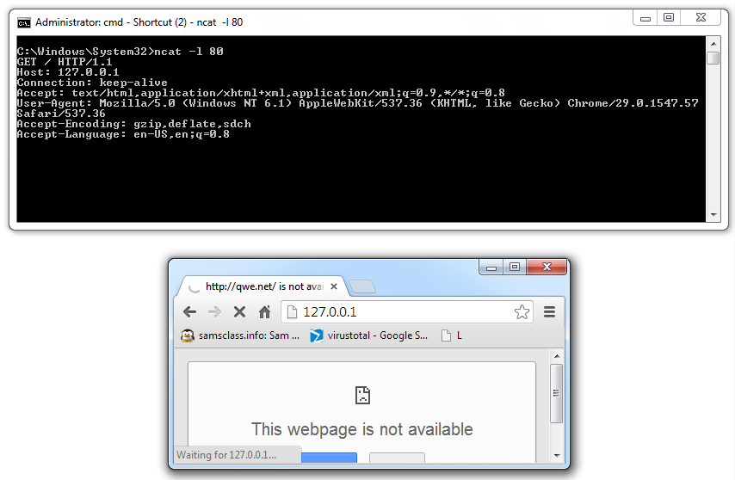
Monitoring with Ncat
(included with Nmap)

Slide 37
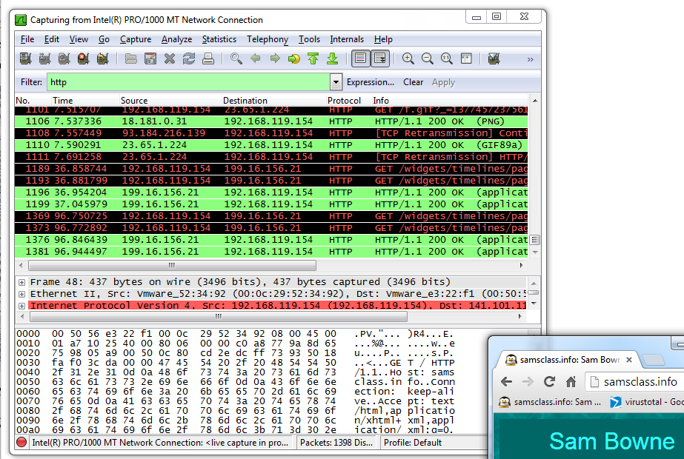
Packet Sniffing with Wireshark

Slide 38
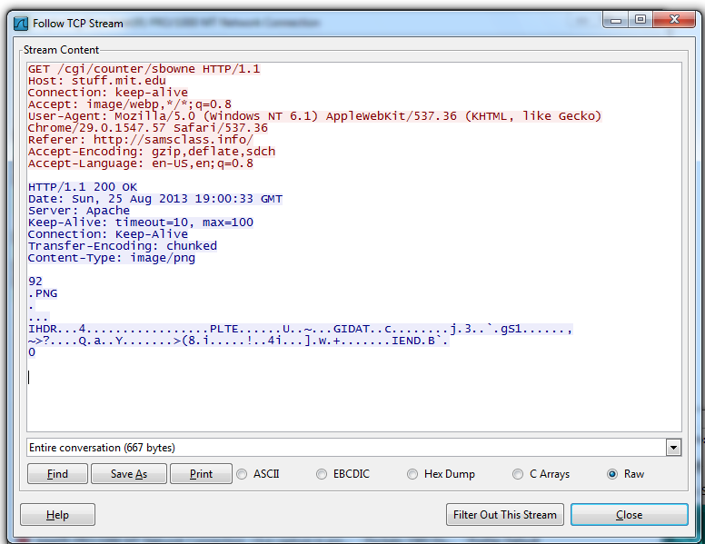
Follow TCP Stream
Can safe files from streams here too

Slide 39
Using INetSim

Slide 40
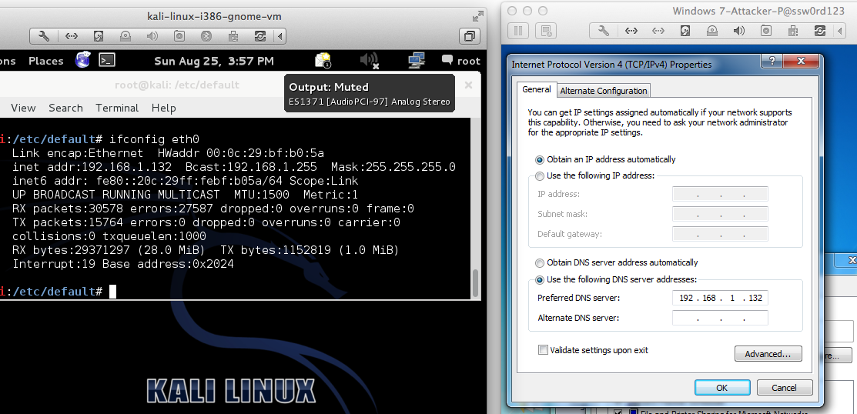
inetsim

Slide 41
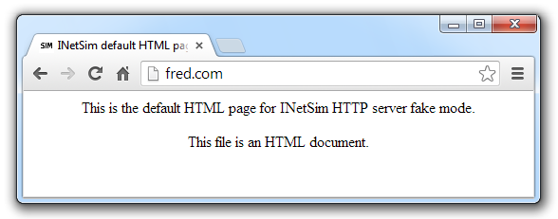
INetSim Fools a Browser

Slide 42
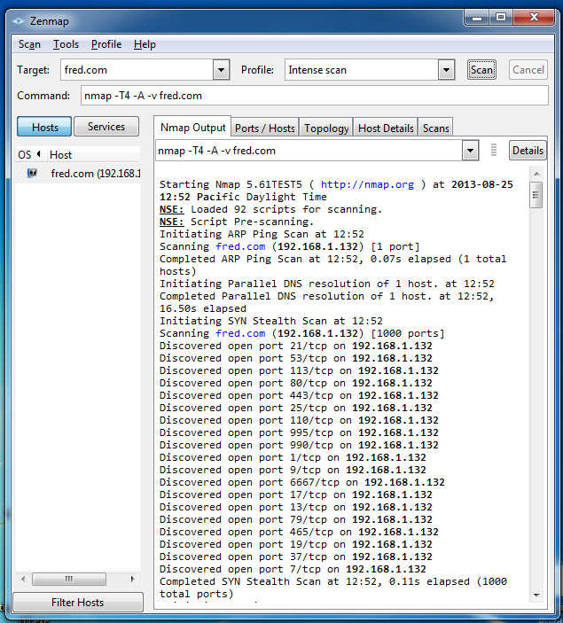
INetSim
Fools
Nmap

Slide 43
Basic Dynamic Tools in Practice

Slide 44
Using the Tools
Procmon
  Filter on the malware executable name and clear all events just before running it
Process Explorer
Regshot
Virtual Network with INetSim
Wireshark

Slide 45
