Slide 1
Buffer Overflow

Slide 2
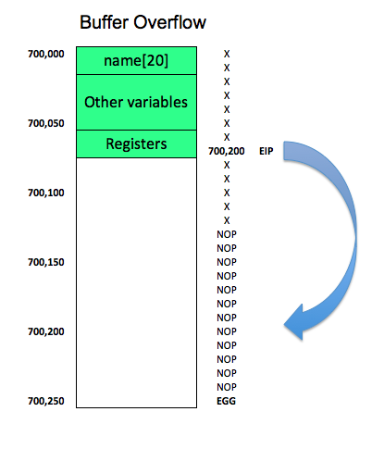

Slide 3
Buffer Overflow Defenses

Slide 4
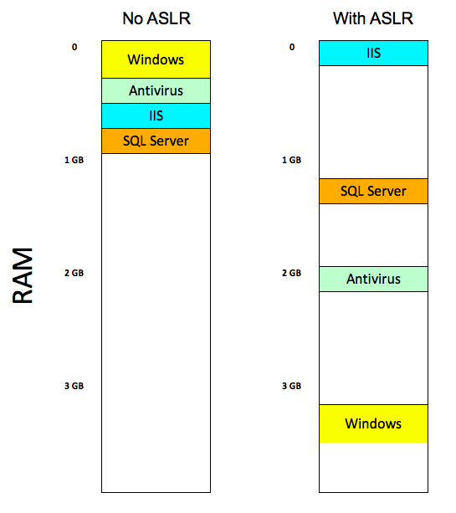

Slide 5
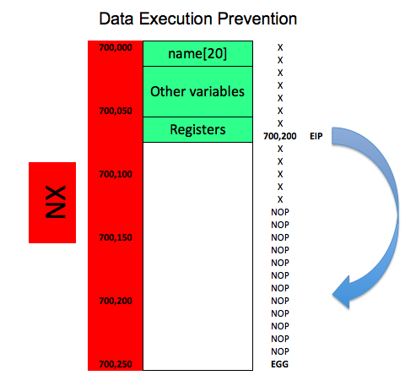

Slide 6
Detecting stack smashing with a canary value
CANARY

Slide 7
Game Show Questions

Slide 8
Which item is a random 32-bit value?
Overflow
EIP
ASLR
DEP
Canary

Slide 9
Which item is the address of the next instruction to be executed?
Overflow
EIP
ASLR
DEP
Canary

Slide 10
Which item is implemented by the NX bit?
Overflow
EIP
ASLR
DEP
Canary

