Slide 1
CNIT 127: Exploit Development
Lecture 7: 64-bit Assembler
Not in textbook

Slide 2
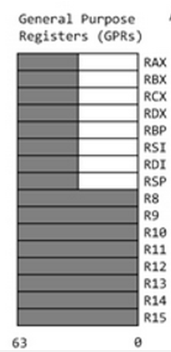
64-bit Registers
rip = Instruction pointer
rsp = top of stack

Slide 3
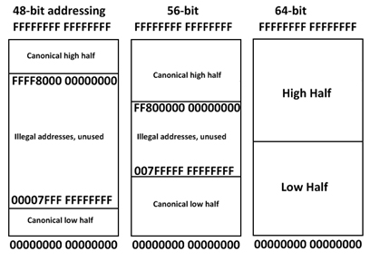
OS Limitations
OS uses top half
User programs use lower half

Slide 5
Windows Limitations
Windows 2008 Server uses 44 bits
  Max. 16 TB RAM
Windows 8.1, 2015 revision, uses 48 bits
  Max. 256 MB RAM
Links Ch L7d, L7e

Slide 6
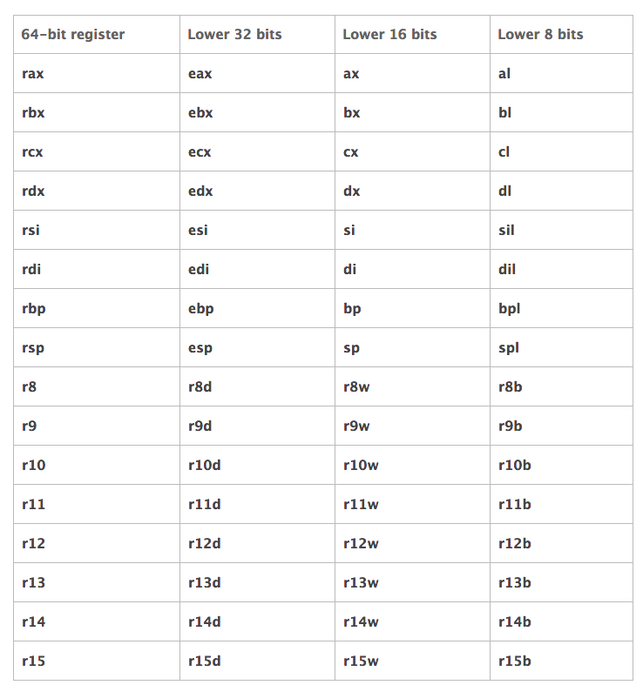

Slide 7
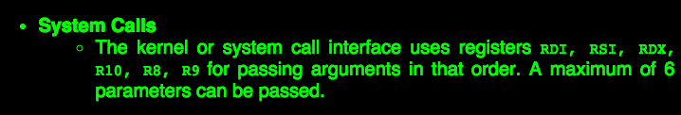

System Calls
syscall replaces INT 80

Slide 8
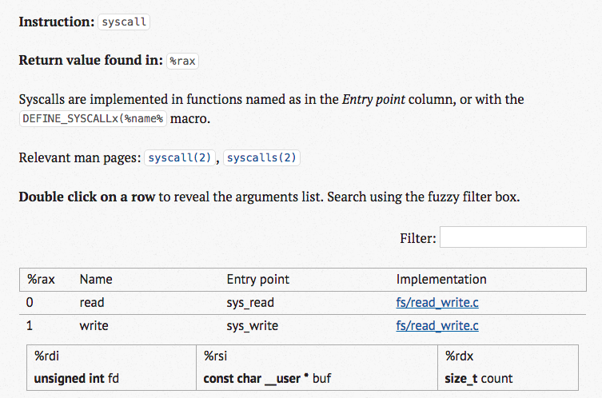
L7h: Searchable Linux Syscall Table

Slide 9
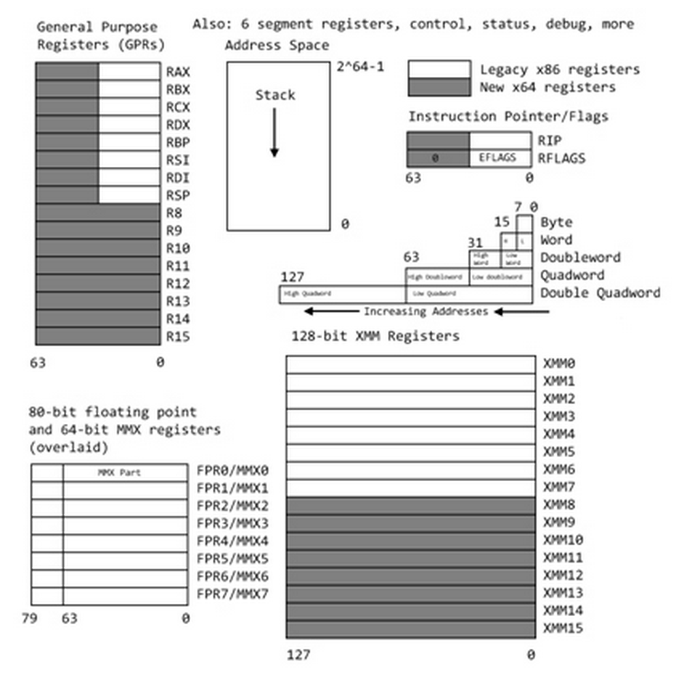
L7c: Introduction to x64 Assembly | Intel Developer Zone
More details about registers

Slide 10
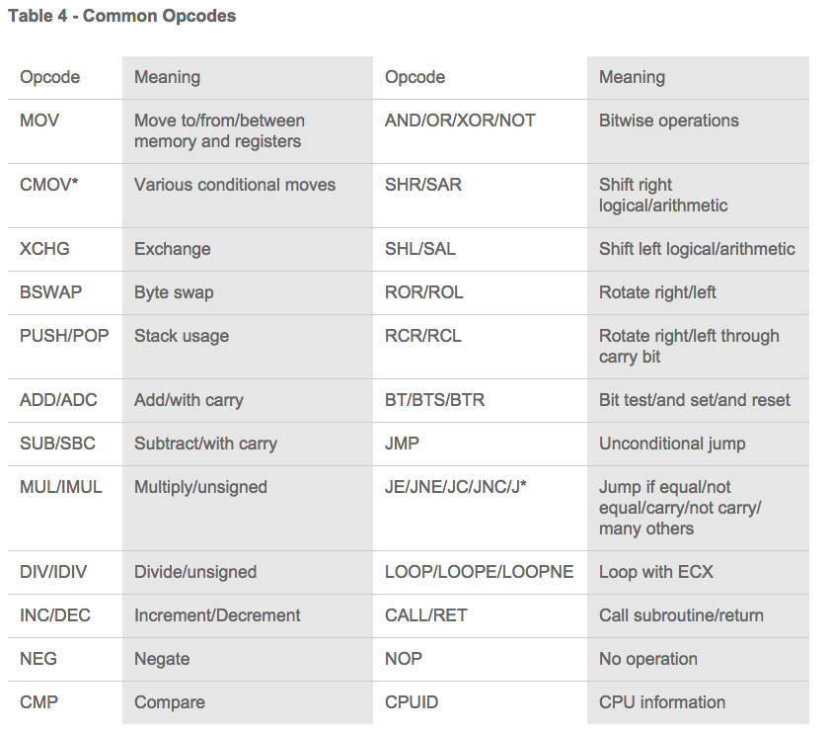

Slide 11
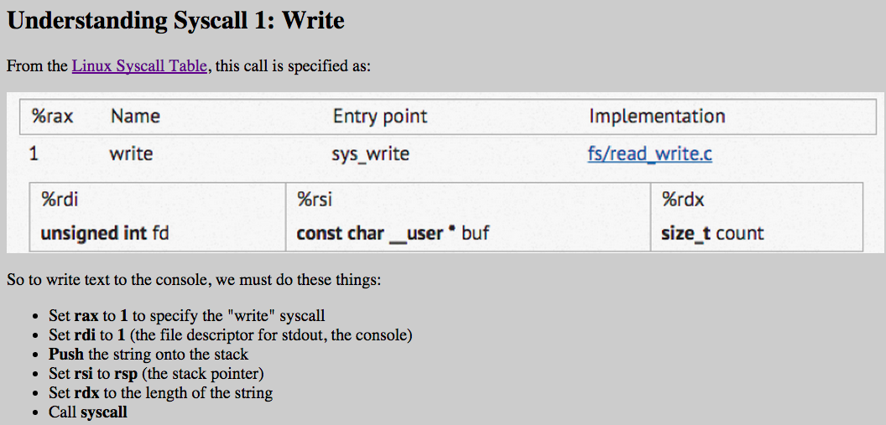
Syscall 1: Write

Slide 12
Simplest Program: ABC

Slide 13
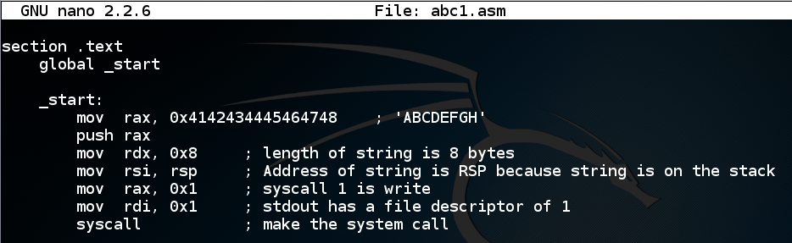
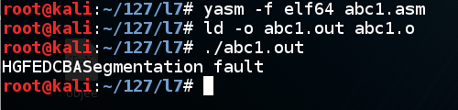
Works, then Crashes

Slide 14
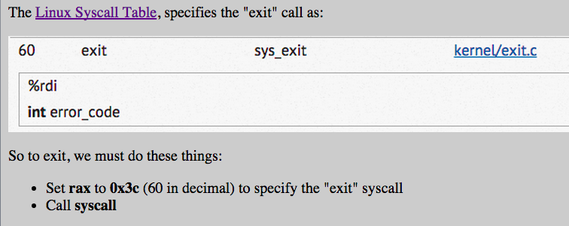
Exit

Slide 15
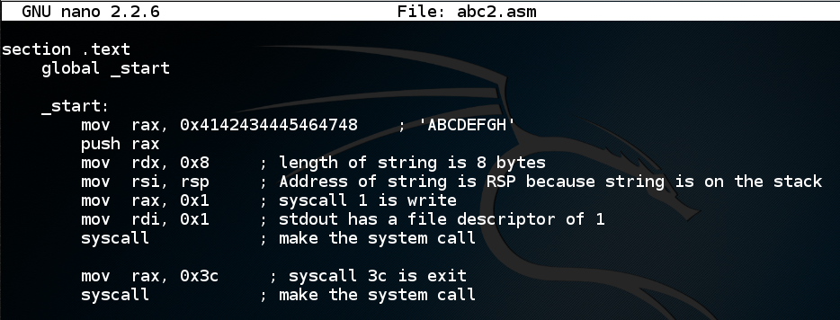

Works Without Crashing

Slide 16
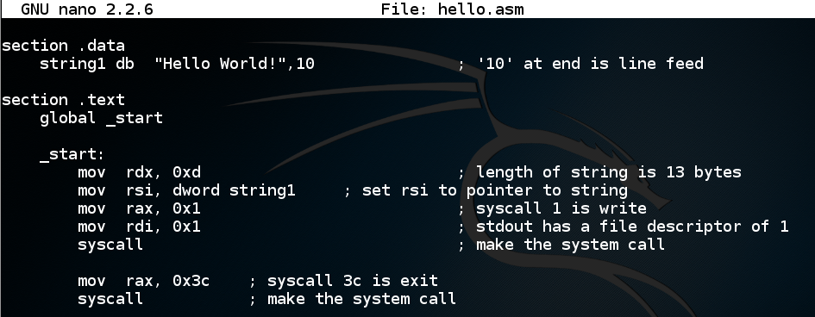
Using a .data section

Slide 17
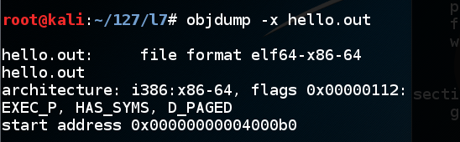
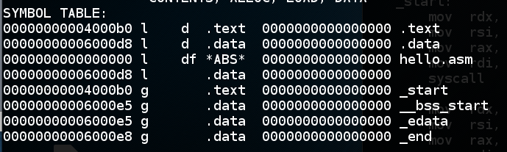
Objdump

Slide 18
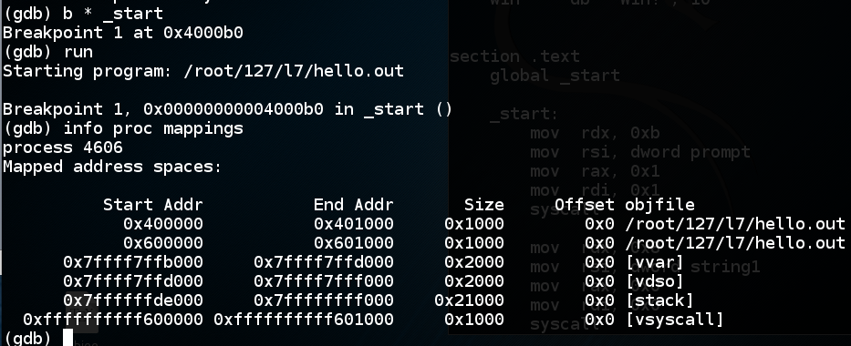
Using gdb
.data and .text sections appear the same

Slide 19
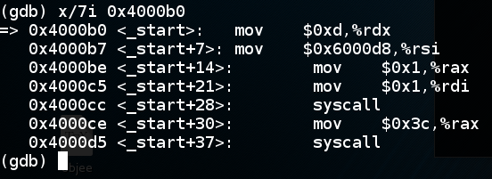
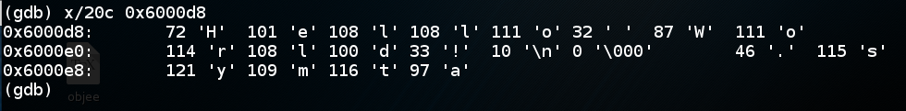
.text and .data Sections

Slide 20
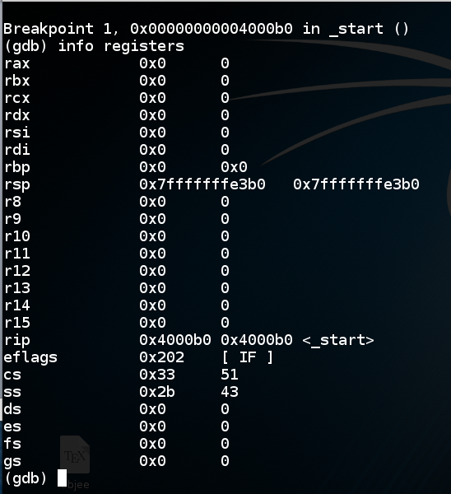
info registers

Slide 21
Using read

Slide 22
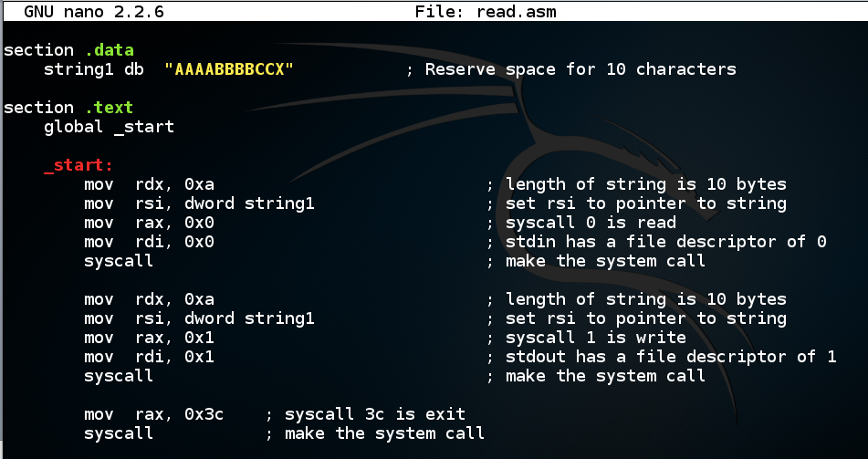
"echo" with a .data section

Slide 23
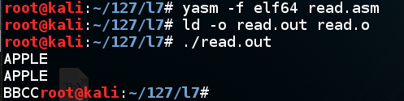
Works with Junk at End

Slide 24
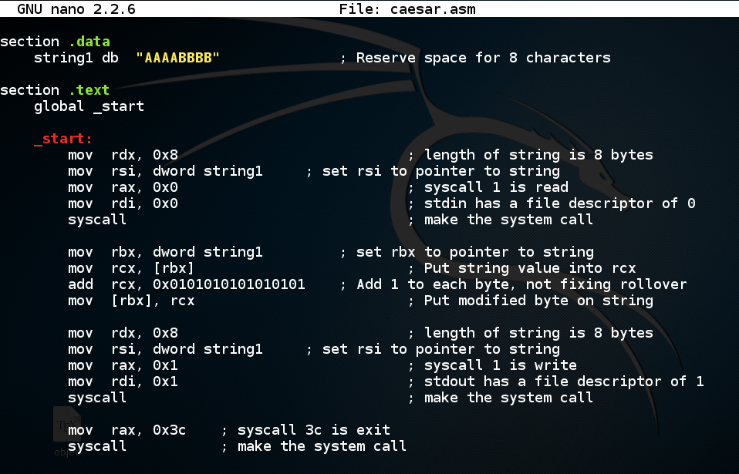
Caesar Cipher

Slide 25
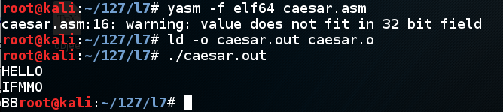
Works for 4 Bytes Only

Slide 26
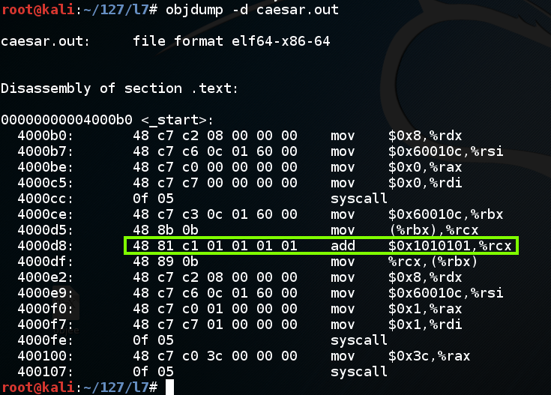
Objdump Shows a 32-bit Value

Slide 27
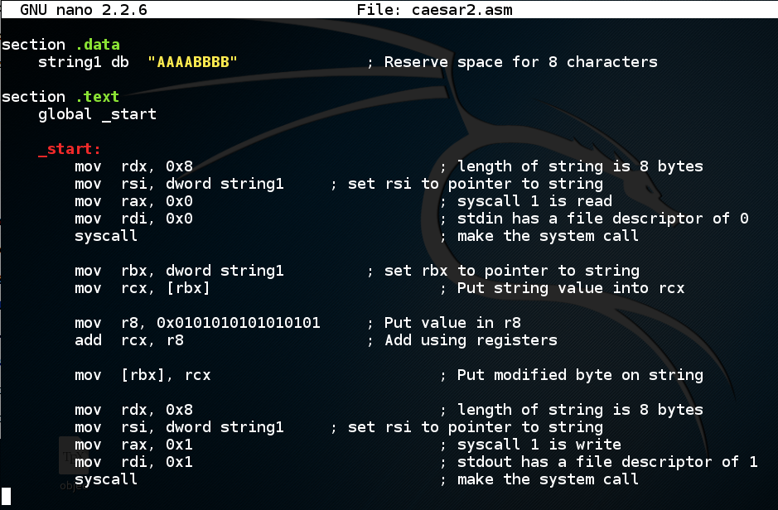
Must use a Register

Slide 28
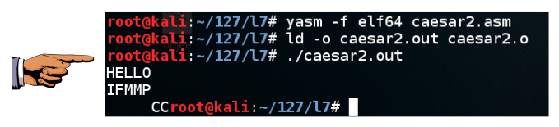
Now it Works

Slide 29
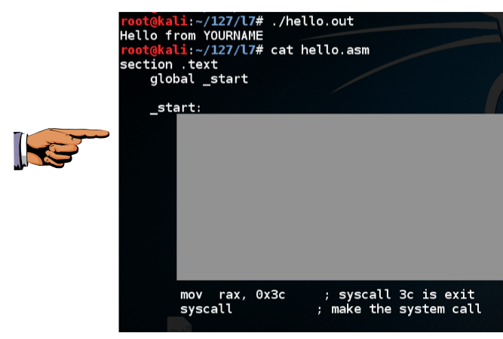
Challenge 1
"Hello from YOURNAME"

Slide 30
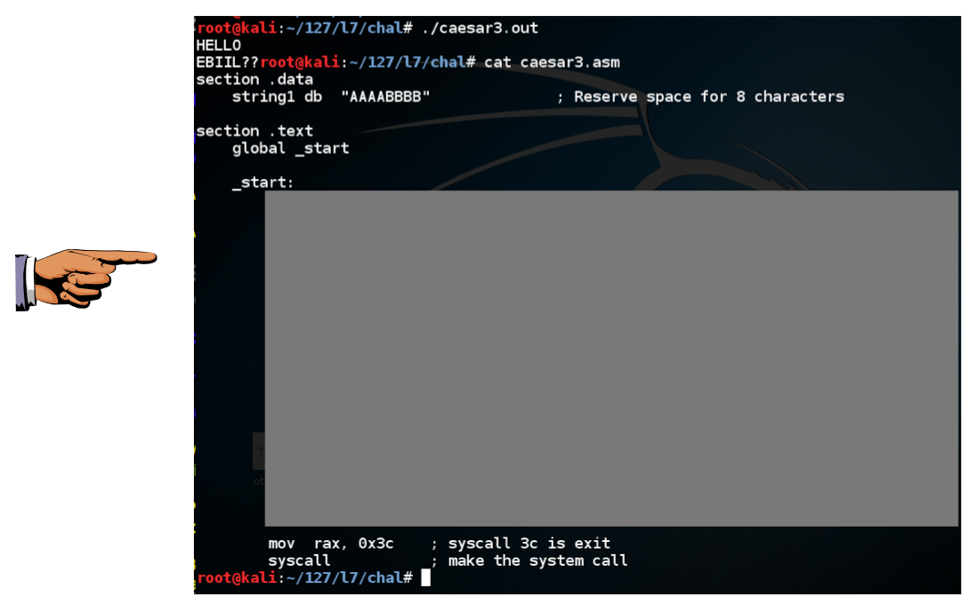
Challenge 2
Caesar (3 steps back)

Slide 31
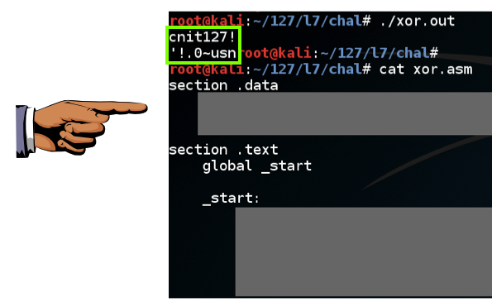
Challenge 3: XOR Encryption

