Slide 1
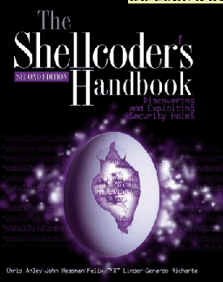
Introduction: Exploiting Linux

Slide 2
Basic Concepts

Slide 3
Vulnerability
A flaw in a system that allows an attacker to do something the designer did not intend, such as
Denial of service (loss of availability)
Elevating privileges (e.g. user to Administrator)
Remote Code Execution (typically a remote shell)

Slide 4
Exploit
Exploit (v.)
To take advantage of a vulnerability and cause a result the designer did not intend
Exploit (n.)
The code that is used to take advantage of a vulnerability
Also called a Proof of Concept (PoC)

Slide 5
Fuzzer
Fuzzer
A tool that sends a large range of unexpected input values to a system
The purpose is to find bugs which could later be exploited

Slide 6
Memory Management
Specifically for Intel 32-bit architecture
Most exploits we'll use involve overwriting or overflowing one portion of memory into another
Understanding memory management is therefore crucial

Slide 7
Instructions and Data
There is no intrinsic difference between data and executable instructions
Although there are some defenses like Data Execution Prevention
They are both just a series of bytes
This ambiguity makes system exploitation possible

Slide 8
Program Address Space
Three types of segments
.text contains program instructions (read-only)
.data contains static initialized global variables (writable)
.bss contains uninitialized global variables (writable)

Slide 9
Stack
Last In First Out (LIFO)
Most recently pushed data is the first popped
Ideal for storing transitory information
Local variables
Information relating to function calls
Other information used to clean up the stack after a function is called
Grows down
As more data is added, it uses lower address values

Slide 10
Heap
Holds dynamic variables
Roughly First In First Out (FIFO)
Grows up in address space

Slide 11
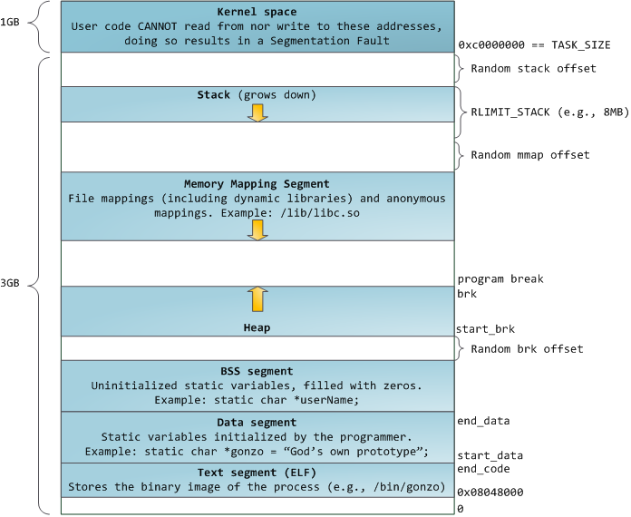
Program Layout in RAM
From link Ch 1a (.bss = Block Started by Symbols)

Slide 12
Assembly

Slide 13
Assembly Language
Different versions for each type of processor
x86 – 32-bit Intel (most common)
x64 – 64-bit Intel
SPARC, PowerPC, MIPS, ARM – others
Windows runs on x86 or x64
x64 machines can run x86 programs
Most malware is designed for x86

Slide 14
Instructions
Mnemonic followed by operands
mov ecx 0x42
Move into Extended C register the value 42 (hex)
mov ecx is 0xB9 in hexadecimal
The value 42 is 0x4200000000
In binary this instruction is
0xB942000000

Slide 15
Operands
Immediate
Fixed values like –x42
Register
eax, ebx, ecx, and so on
Memory address
Denoted with brackets, like [eax]

Slide 16
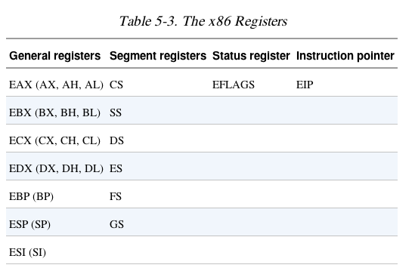
Registers

Slide 17
EIP (Extended Instruction Pointer)
Contains the memory address of the next instruction to be executed
If EIP contains wrong data, the CPU will fetch non-legitimate instructions and crash
Buffer overflows target EIP

Slide 18
Simple Instructions

Slide 19
Simple Instructions
mov source, destination
Moves data from one location to another
AT&T format is favored by Linux developers, with source first
Remember indirect addressing
[ebx] means the memory location pointed to by EBX

Slide 20
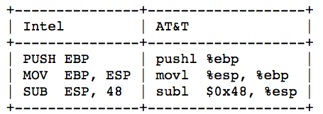
Intel v. AT&T Format
gdb uses AT&T format by default, which is popular with Linux users
mov source, destination
Windows users more commonly use Intel format
MOV DESTINATION, SOURCE

Slide 21
Jasmin
Assembly Language Simulator

Slide 22
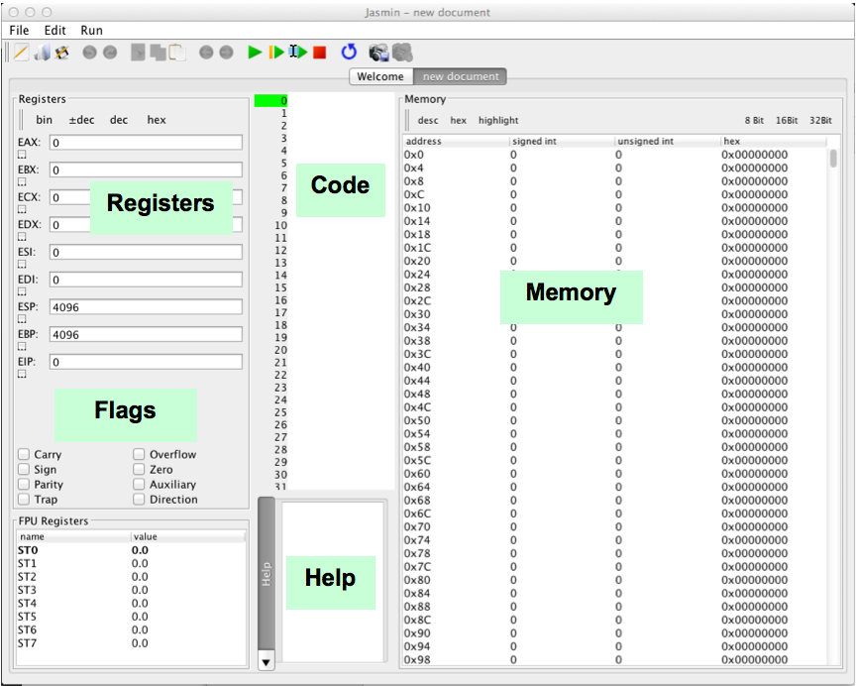

Slide 23
Stack-based Buffer Overflows
Most popular and best understood exploitation method
Aleph One's "Smashing the Stack for Fun and Profit" (1996)
Link Ch 2a
Buffer
A limited, contiguously allocated set of memory
In C, usually an array

