Slide 1
Security Problems at Colleges

Slide 2
OWASP

Slide 3
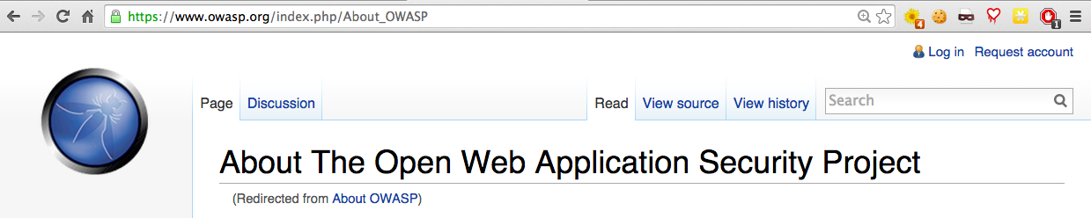
OWASP.org
Security tips, tools, and coding guidance for Web applications

Slide 4
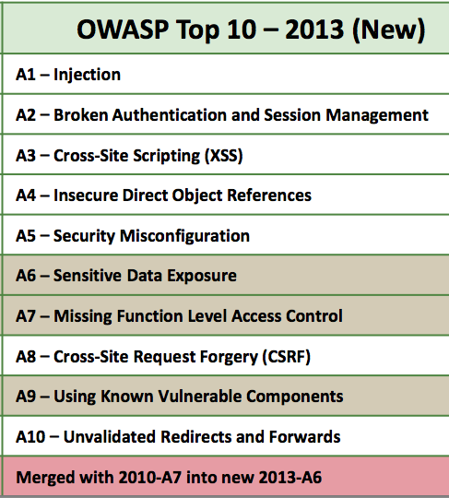
`

Slide 5
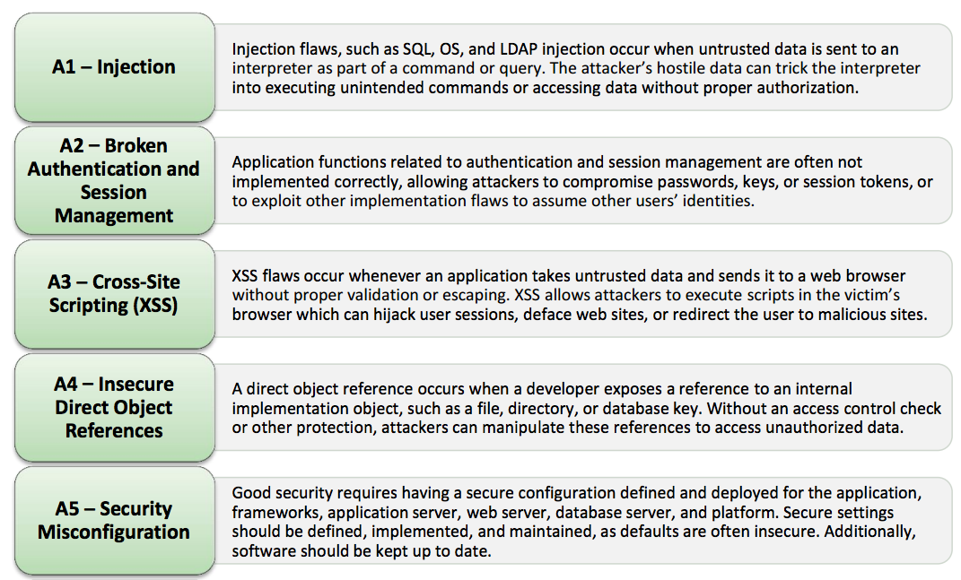

Slide 6
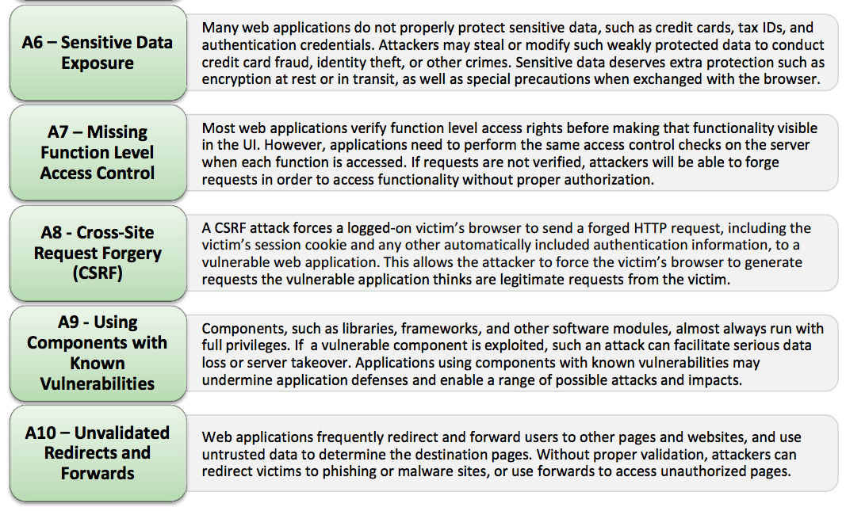

Slide 7
Cross-Site Request Forgery

Slide 8
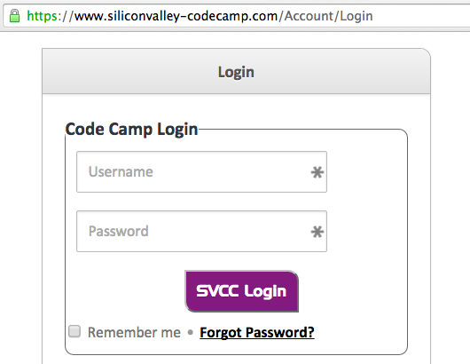
Login Secured with HTTPS

Slide 9
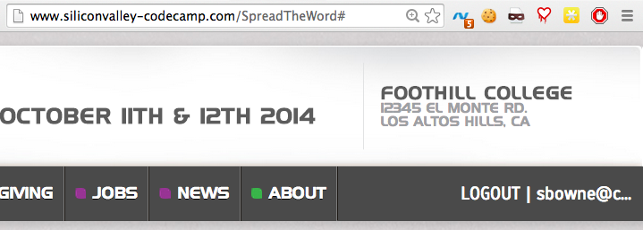
Authenticated Traffic Not Encrypted

Slide 10
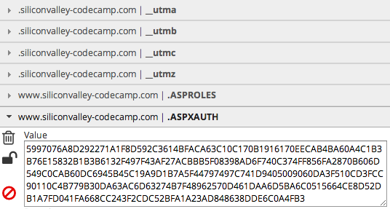
Authentication Cookie

Slide 11

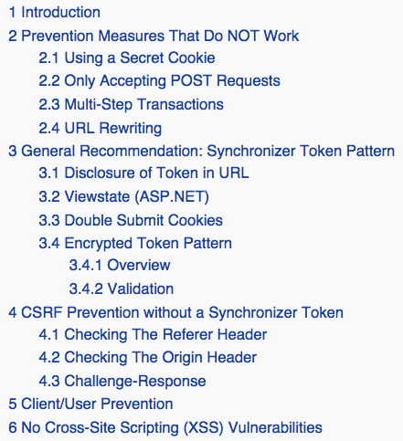

Slide 12
Blanket Solution: HTTPS
Use HTTPS for all transactions
But that might be
  Expensive
  Complicated
  Slow

Slide 13



Slide 14
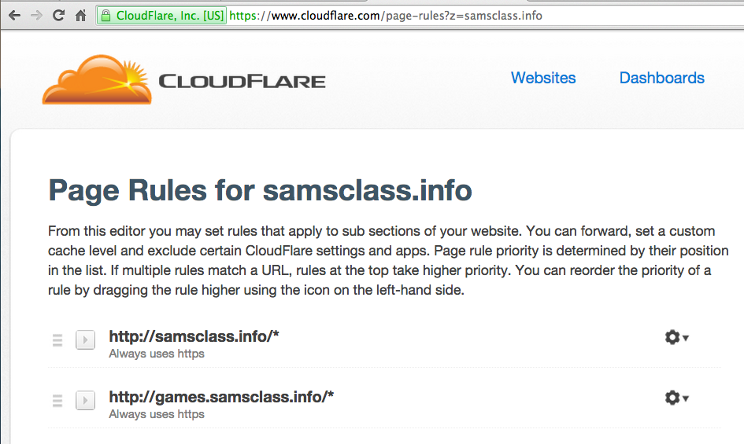

Slide 15
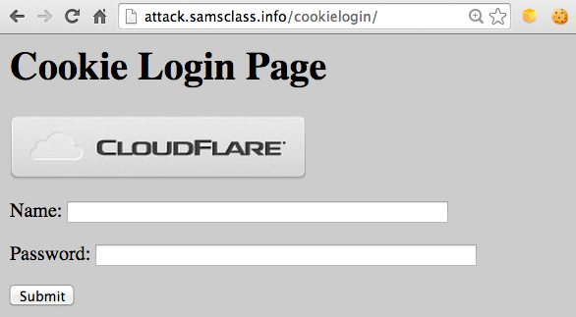
CSRF Demo

Slide 16
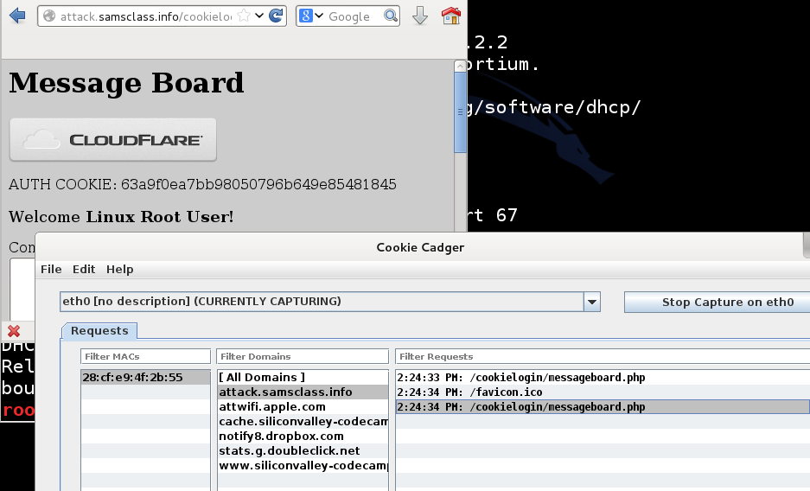
Cookie Cadger

Slide 17
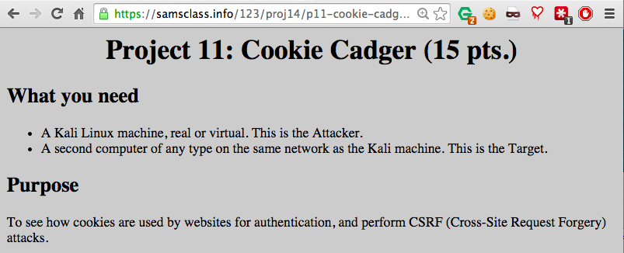
Homework Project

Slide 18
Vulnerable Sites
Amazon.com
AOL.com
siliconvalley-codecamp.com

Slide 19
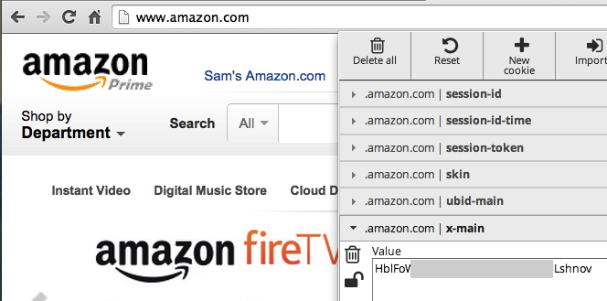
Amazon Sends Authentication Token Unencrypted

Slide 20
HTTPS-Only Sites
Google and Gmail
Live.com (Microsoft)
Yahoo.com
Paypal.com

Slide 21
Partially Vulnerable Sites
Tigerdirect.com
Wordpress.com

Slide 22
SQL Injection

Slide 23
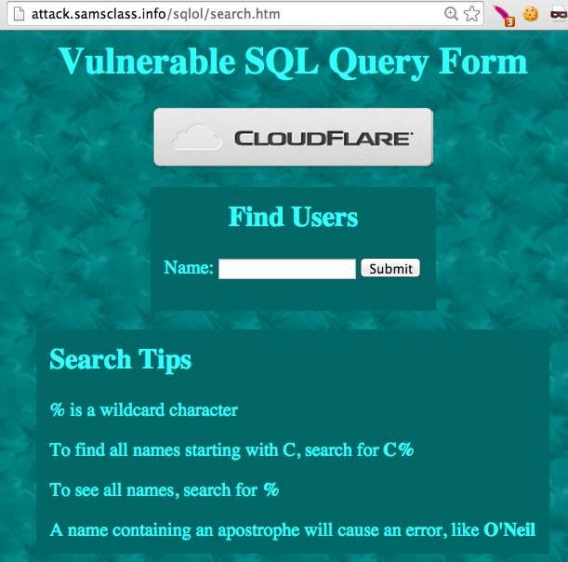

Slide 24
SQL Injection
Vulnerability caused by using input from the user which can be misinterpreted as active code
Weak defense: filter out special characters
Strong defense: parameterized queries

Slide 25
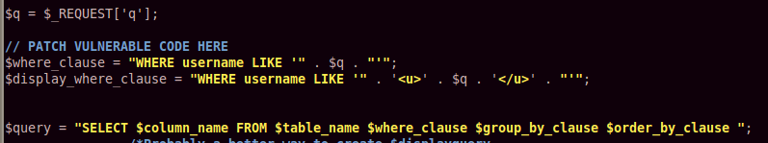
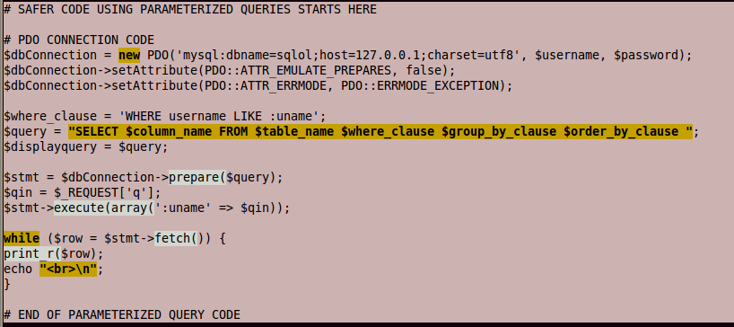

Slide 26
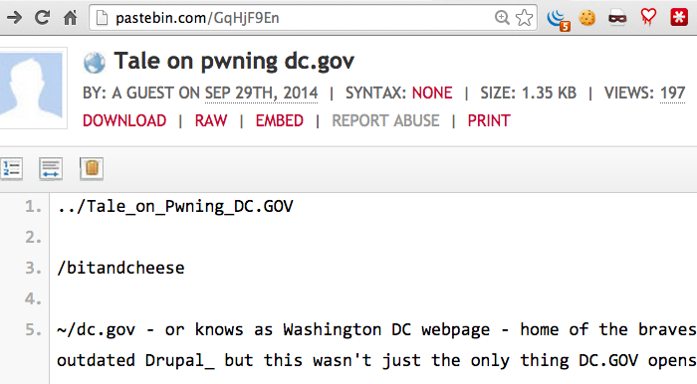
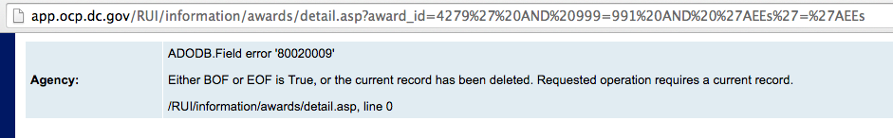
SQLi on Pastebin

Slide 27
URL for Live Demo
http://app.ocp.dc.gov/RUI/information/awards/detail.asp?award_id=4279%27%20AND%20999=991%20AND%20%27AEEs%27=%27AEEs

Slide 28
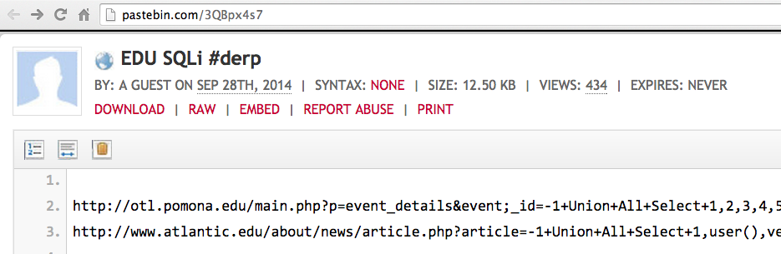


Slide 29
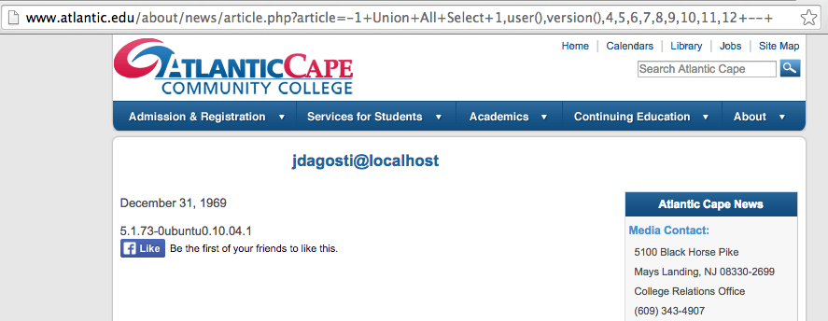
Extracting Data
No apostrophe required

Slide 30
Pharma Infections at Colleges

Slide 31
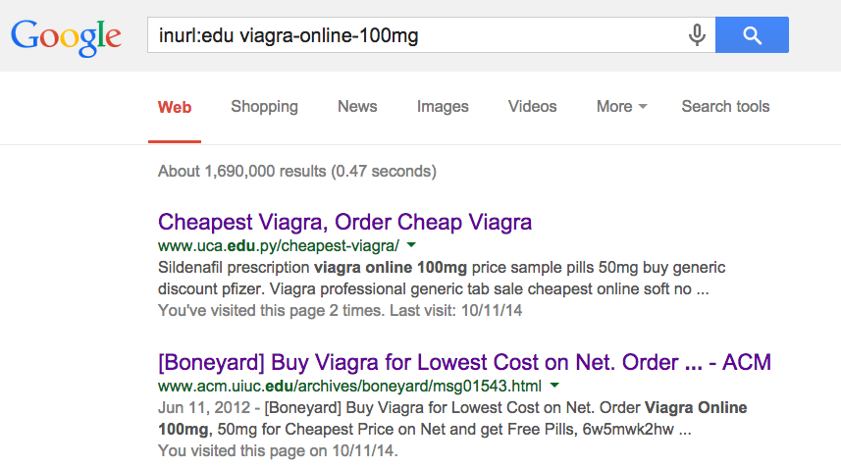

Slide 32
19 Colleges Infected with Pharma
5 Fixed within a few weeks
7 Fixed within 8 months
7 Still Infected on 7-19-14
http://samsclass.info/125/proj11/subtle-infect.htm#19more

Slide 33
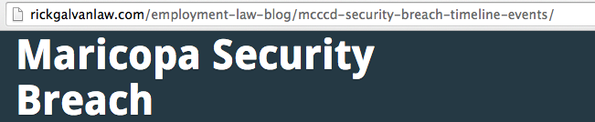
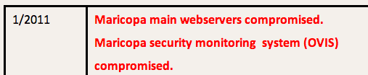
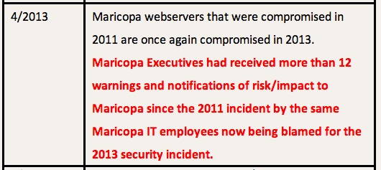

Slide 34
Infections at UC Santa Cruz

Slide 35
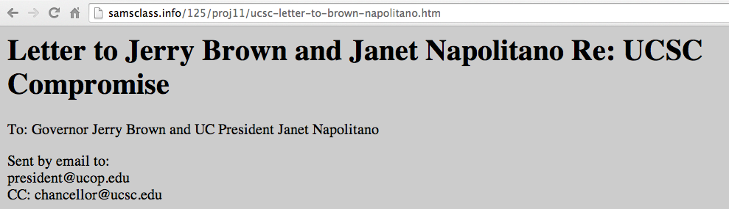
UCSC cleaned their server
Re-infected a week later
NEED ROOT CAUSE ANALYSIS

Slide 36
Many More Pharma Infections
Dozens of other schools, businesses, foreign sites, etc.
http://samsclass.info/125/proj11/subtle-infect.htm#19more

Slide 37
Exposed Data

Slide 38
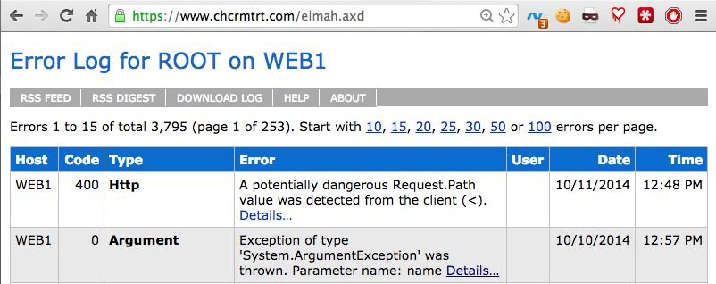
Exposed Error Logs
Can leak cookies
Even when secured by HTTPS

Slide 39
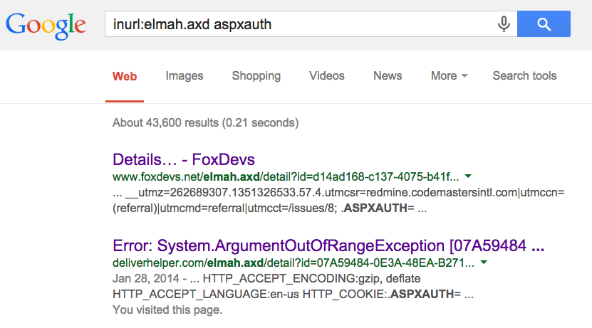
Google Dork for Exposed ELMAH Pages

Slide 40
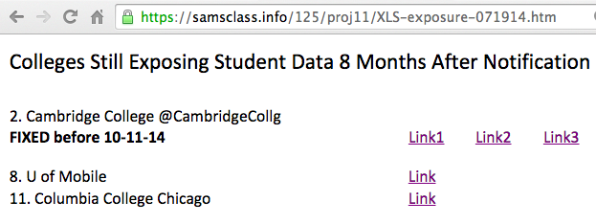
Exposed Student Data

Slide 41
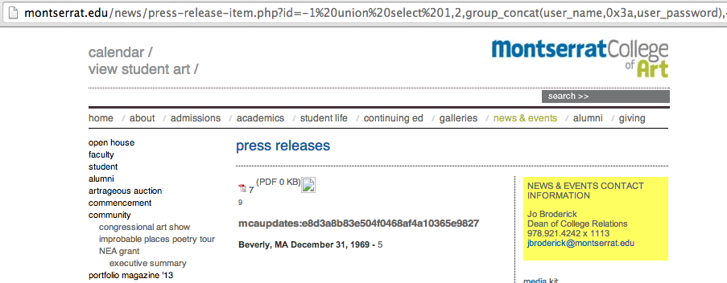
Exposed Password Hash

Slide 42
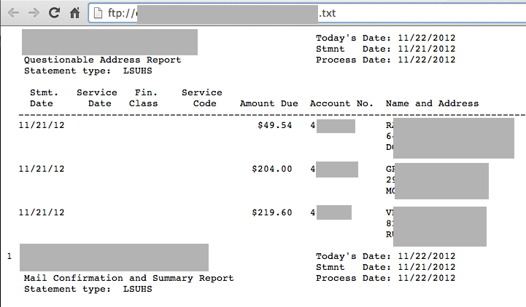
Open FTP Server with Medical Data

Slide 43
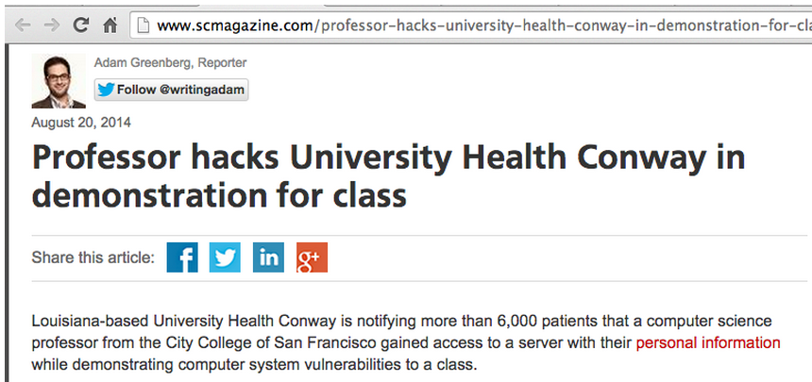
Libel by SC Magazine

Slide 44
Plaintext Login Pages at Colleges

Slide 45
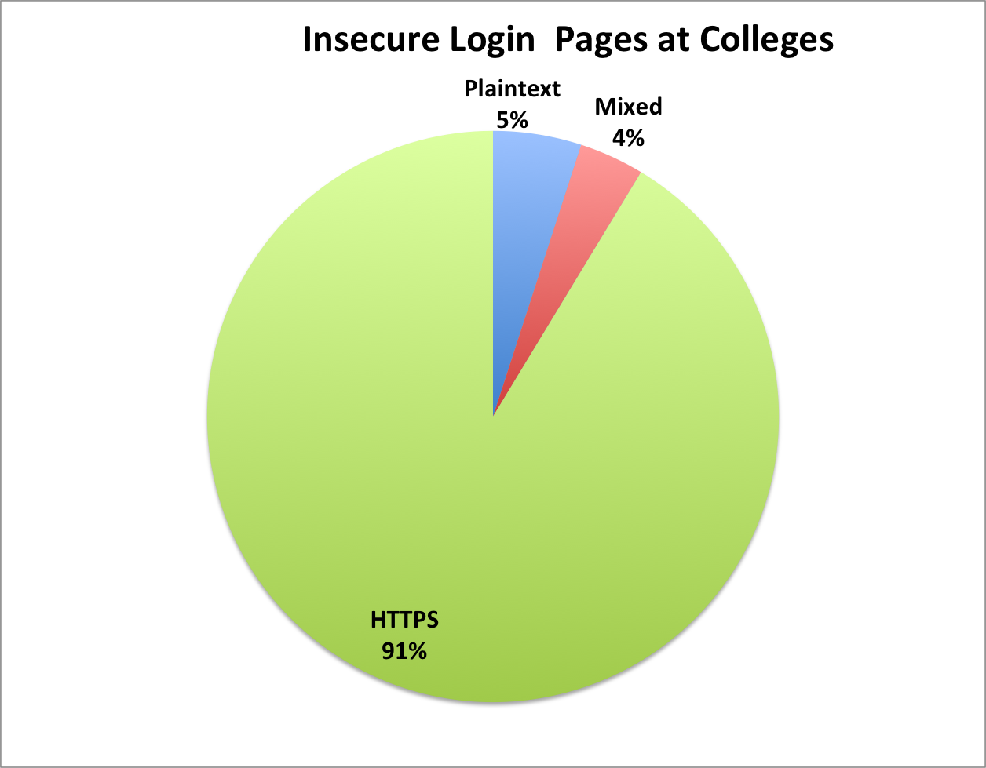
Insecure Login Pages at Colleges
90 colleges notified in Dec, 2013

Slide 46
Big Names
Cornell
Johns Hopkins
Stanford
UC Berkeley

Slide 47
Results
7 months after notification:
16/57 plaintext login pages fixed or improved (28%)
8/33 mixed login pages fixed or improved (24%)

Slide 48
Other Problems

Slide 49
ActiveMQ
Free open-source middleware from Apache
A Defcon talk said it was often insecure, so I looked on SHODAN to see

Slide 50
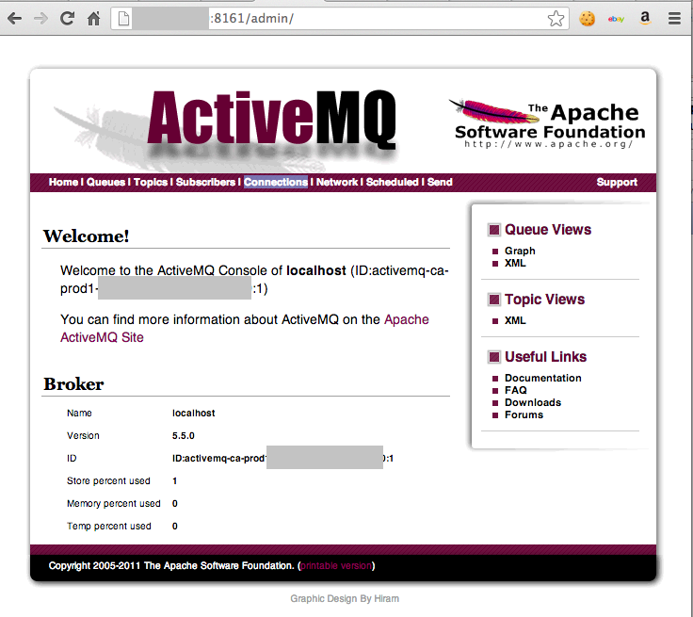

Slide 51
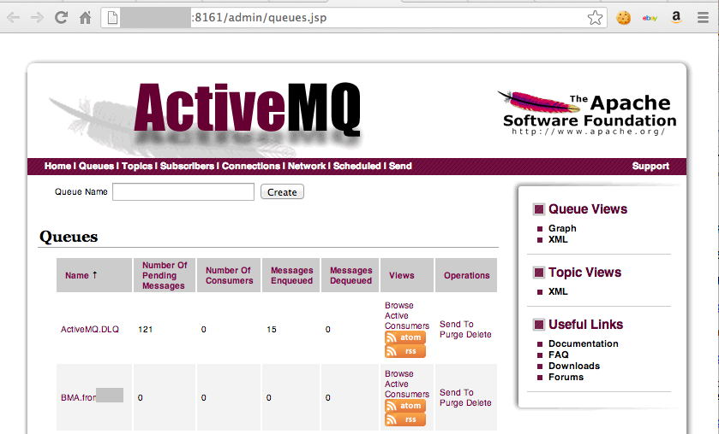

Slide 52
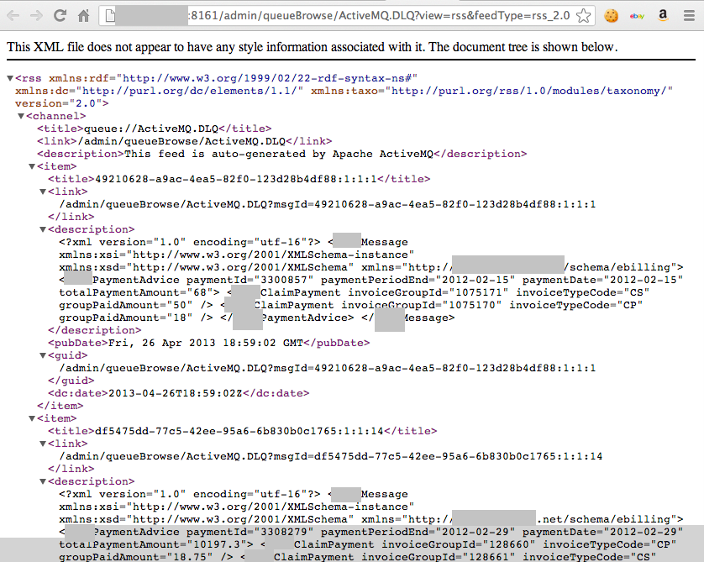
Real Check Data?

Slide 53
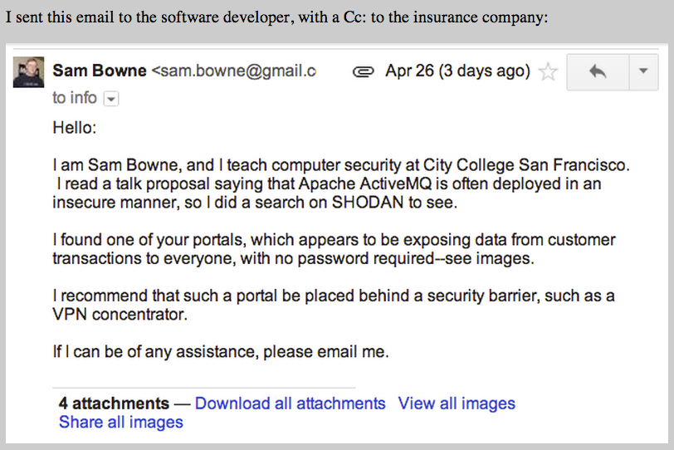

Slide 54
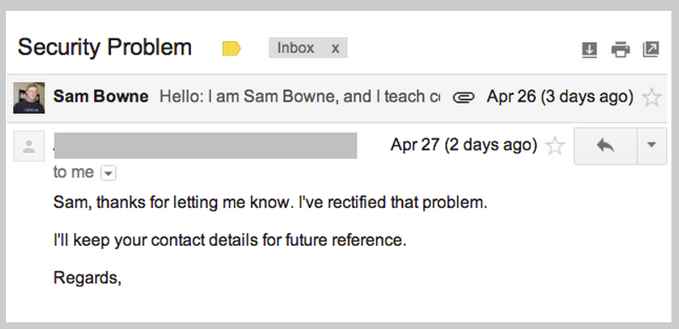

Slide 55
Wordpress Bots

Slide 56
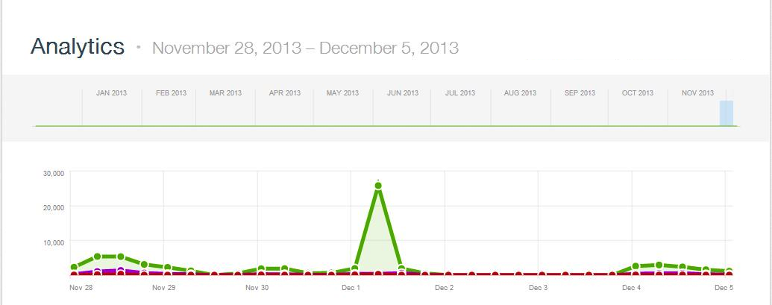
>2000 WordPress Bots
Thanks to Steven Veldkamp

Slide 57
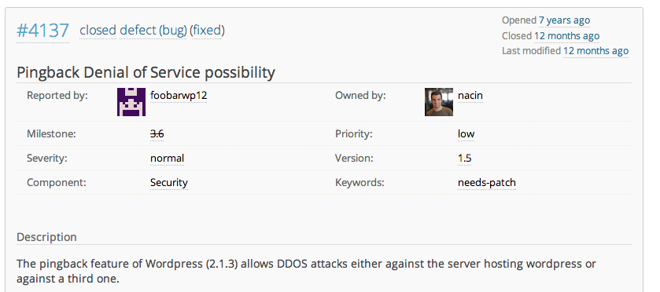
WordPress Has Known for 7 Years

Slide 58
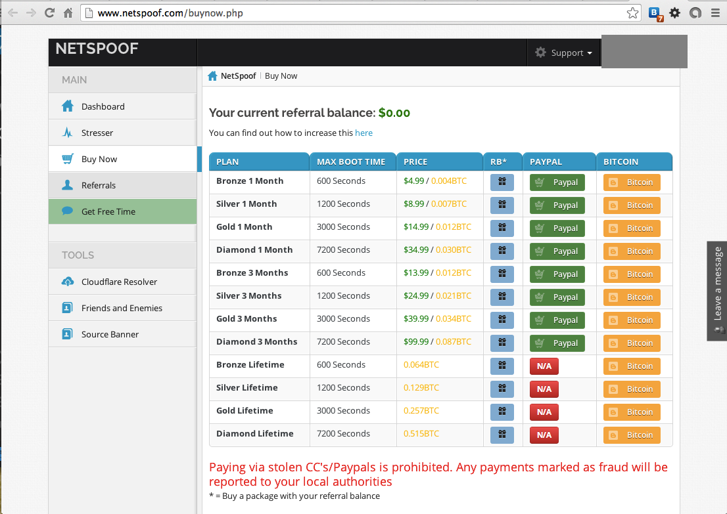

Slide 59
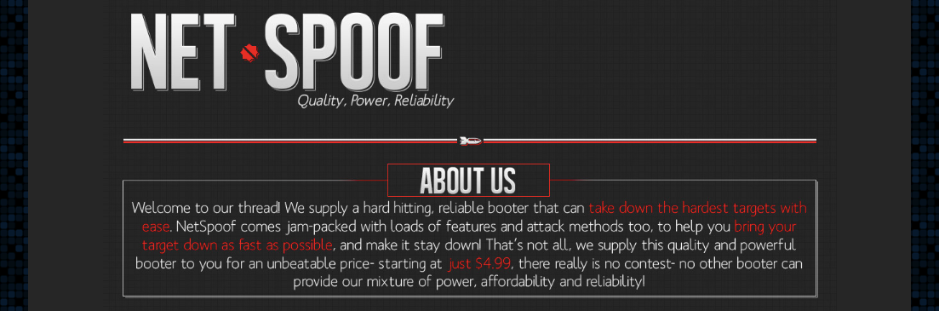

Slide 60
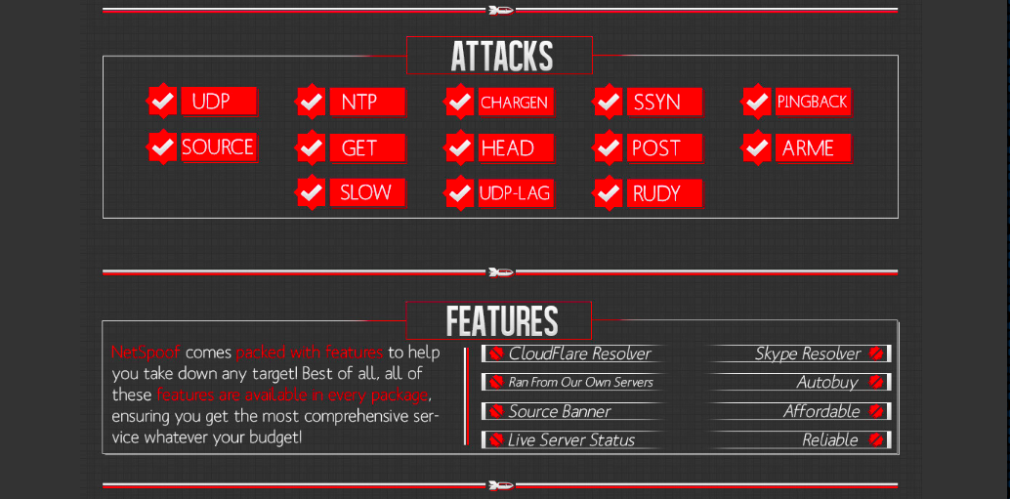

Slide 61
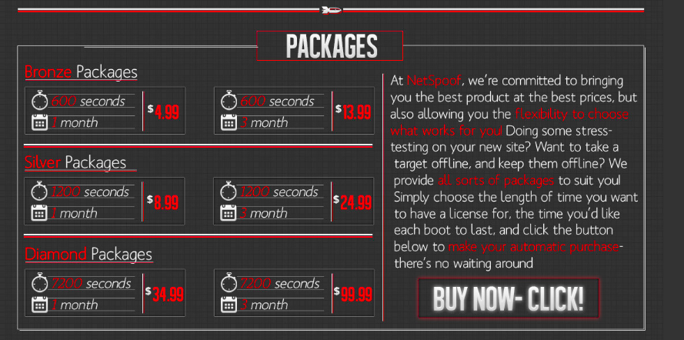

Slide 62
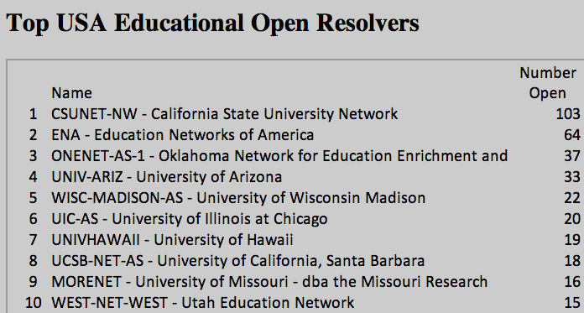
Open DNS Resolvers at Colleges

Slide 63
Results
Seven months after notification
38% decrease in open resolvers, from a total of 682 to 421

Slide 64

Old Wordpress Version
Wall Street Journal
  Wordpress version from 2012
  Ty Ryan Satterfield (@I_am_ryan_S)

