Slide 1
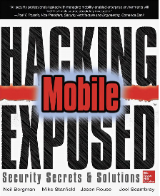
Ch 2: Hacking the Cellular Network
CNIT 128:
Hacking Mobile Devices

Slide 2
Basics

Slide 3
GSM/CDMA
We'll start with a standard carrier network using
  Global System for Mobile (GSM), or
  Code Division Multiple Access (CDMA)
With these functions
  Phone calls
  Text messages via Short Message Service (SMS)
  Multimedia Messaging Service (MMS)
  Data connectivity via IP

Slide 4
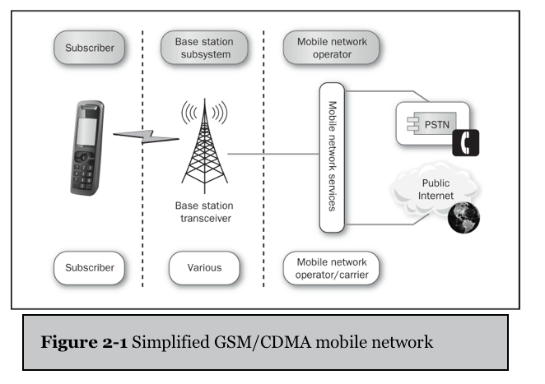

Slide 5
Basic Cellular Network Functionality

Slide 6
Interoperability
Different carriers and connection methods can connect to one another seamlessly
A GSM phone can text or call a CDMA phone

Slide 7
Functions to Target
All major cellular networks support
  Voice calls
  Voice mail (VM)
  Short Message Service (SMS)
  Location-based Services (LBS)
  IP Connectivity
Most also support
  Binary configuration messages
  Multimedia messages (MMS)
  Faxing

Slide 8
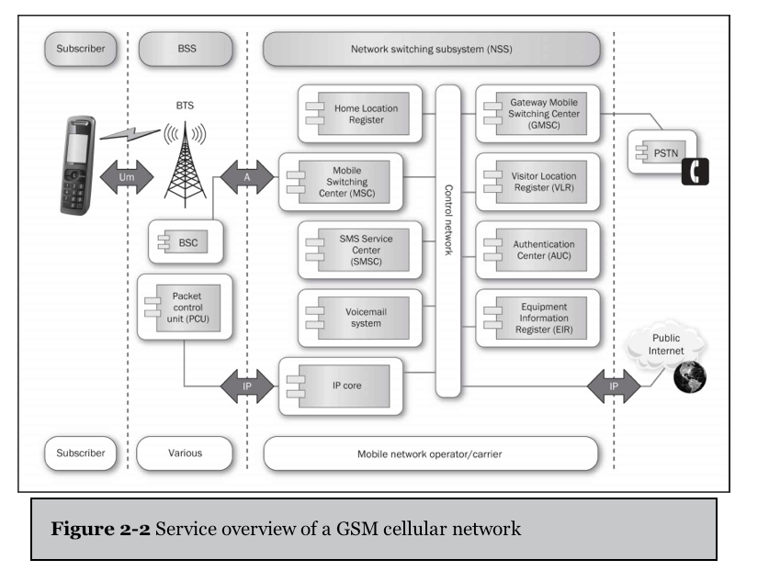

Slide 9
Players
Customer is on the left
  Known as Mobile Terminals (MTs) in GSM
Connect to antennas
  Called Base Transceiver Stations (BTS)
  The connection from a mobile device to a BTS is called an Um (U-channel mobile)

Slide 10
Players
Each BTS connects to a base station
  A rack of equipment that takes the signals the antenna receives and converts them to digital packetized data
  Base station has two components
    Base Station Controller (BSC) for voice and control
    Packet Control Unit (PCU) for forwarding IP packets and managing mobile IP

Slide 11
Players
Base Station Subsystem (BSS)
  Includes BTS, BSC, and PCU
  Can be owned by people who are not part of a large carrier

Slide 12
Voice Calls
Time Division Multiplexing (TDM)
  Tried-and-true method for dividing radio capacity among many devices
Time Division Multiple Access (TDMA)
  Each device gets time slots
  Very successful for slow and medium bit rates
  Devices 1, 2, and 3 might get these time slots
1 | 2 | 3 | 1 | 2 | 3

Slide 13
Control Channels
Traffic channels
  Carry voice data
Control channels
  Manage association, usage, handoff, and disconnection
Cell phone jammer
  A loud, badly tuned, transmitter
  Easy to build
  Illegal

Slide 14
The Broadcast Control Channel:
Learning About the Network
When a device first turns on, it listens on standard frequencies
First thing it hears will be BCCH (Broadcast Control Channel)
  Allows the device to synchronize and understand which network it is attaching to
  Features of the network the BTS (Base Transceiver Station) is serving

Slide 15
RACH (Random Access Channel)
The mobile device then knows how to access the RACH
  The first step in a GSM handshake
  How the mobile asks for information
  Mobile sends a cannel request via the RACH
  BTS tries to service the request

Slide 16
Standalone Dedicated Control Channel (SDDCH) &
Access Granted Channel (AGCH)
  If the BTS has slots available, it assigns a control channel, called the Standalone Dedicated Control Channel (SDDCH) to the mobile device
  The BTS tells the mobile about this assignment via the Access Granted Channel (AGCH)
  Once the mobile has received a SDCCH, it's a member of the network and can request a location update

Slide 17
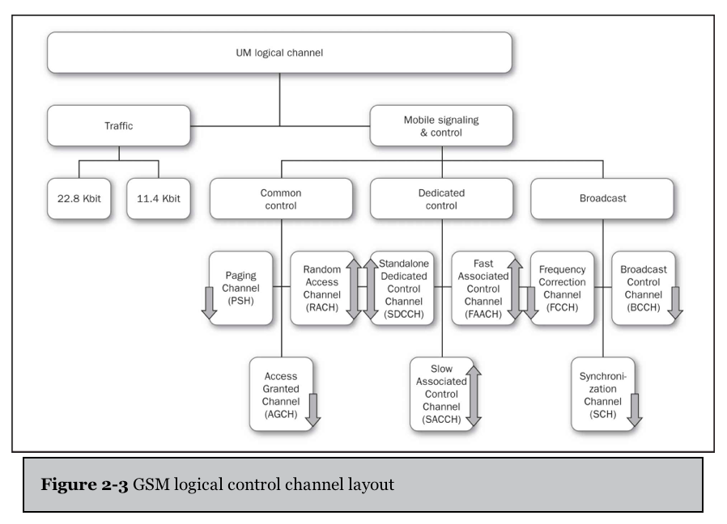

Slide 18
Location Update
Mobile device is telling the GSM network waat area it's in
Requires authentication with the network
Informs the Home Location Register (HLR)
  Database of subscriber information
Of the mobile's geographic area
  Hence, which Mobile Switching Center (MSC) a device is located within

Slide 19
Sleep
Once a mobile device has performed a location update
The BSC tells the mobile to go to sleep
  By deallocating the SDCCH
This maximizes reuse and capacity in dense cells

Slide 20
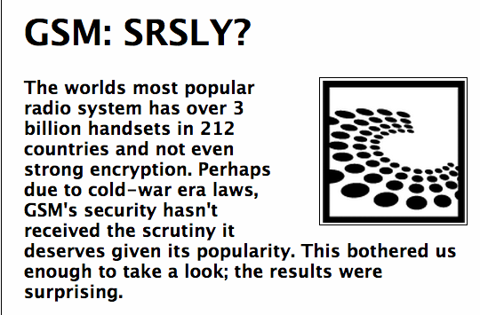
Authentication and A5/1, CAVE, and AKA
A5/* ciphers are used in GSM networks
  Crackable – see link Ch 2a
CAVE and AKA are used in CDMA

Slide 21
Voicemail
Trivial hack: default password
  Enough to make a world of trouble for Rupert Murdoch
Many carriers use IP-based voicemail
  Using IMAP servers (originally designed for email)

Slide 22
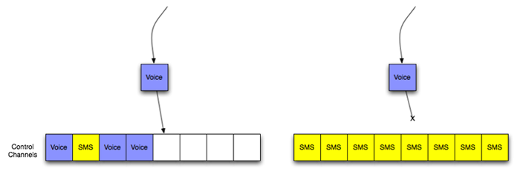
Short Message Service (SMS)
Sent via control channel
An SMS flood could DoS voice service for a whole city from a single attacking device
  Link Ch 2b2

Slide 23
SMS Channels
SMS messages are delivered over either
  SDCCH when a user is not on a call
  or the Slow Associated Control Channel (SACCH) if the user is talking at the time
Reasonably achievable SMS floods wouldn't stop voice calls in practice

Slide 24
SMS Service Center (SMSC)
SMSCs carry most of the SMS messages when SMS message storm happens
It's the hardest working piece of equipment in modern cellular provider networks

Slide 25
Other Uses for SMS Messages
Java implemented per-application messaging using
Java Mobile Information Device Profile (MIDP) and Connected Limited Device Configuration (CLDC), which use a
User Data Header (UDH) specifying a port to send the message to
  Ports are not UDP or TCP ports, but similar

Slide 26
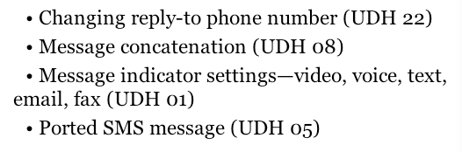
Other SMS Messages
SMS is used not just between users
But between network elements, like configuration servers
For peer-to-peer Java apps
UDH features

Slide 27
SMS Lacks Security Controls
SMS messages have
  No authentication
  No integrity checking
  No confidentiality
So apps shouldn't trust what they get too much

Slide 28
SMS Origin Spoofing
iOS displays the number in the "reply-to" field in the SMS header as the origin of an SMS message
  Instead of the actual origin number
So it's easy to send SMS messages that appear to come from someone else
  Link Ch 2c

Slide 29
Fake SMS Messages
On Android, a malicious app can fool your device into displaying a fake SMS message
  Link Ch 2d

Slide 30
Attacks and Countermeasures

Slide 31
Hacking Mobile Voicemail
MNOs often configure voicemail accounts insecurely
  No authentication required if the user's own phone is used to fetch the messages
With a PBX sever like Asterisk, anyone can easily spoof any caller ID value
All they need is your phone number

Slide 32
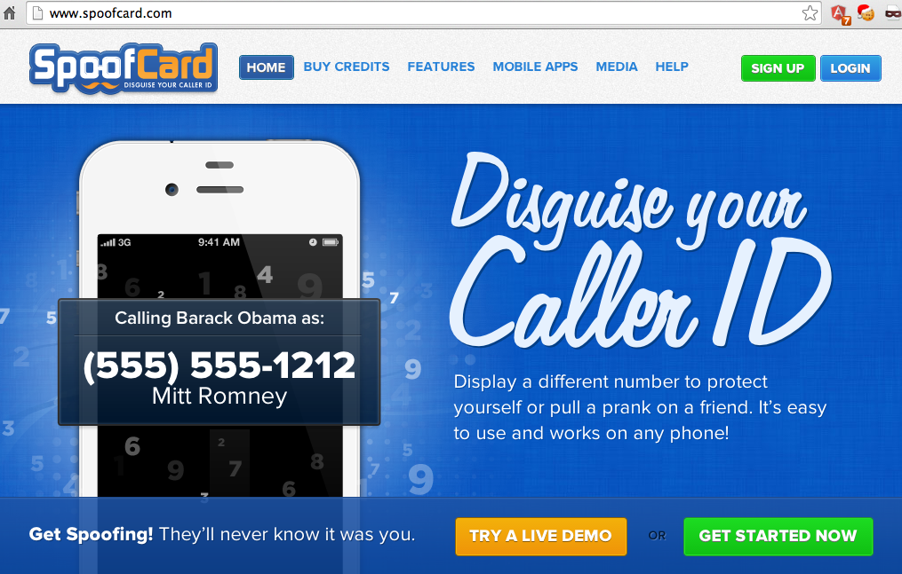
Internet Spoofing Services
Link Ch 2f

Slide 33
Countermeasures for Mobile Voicemail Hacks
Set a voicemail password
Configure access so that entering the password is required from all phones, including yours

Slide 34
Rogue Mobile Devices
An evil phone could attack the mobile network (theoretical attack only)
Phone OS is not hard to understand, basically
  iOS is BSD
  Android is Linux
A modified phone could jam or modify broadcast signals from a BTS
  But it would only affect a small area

Slide 35
Rogue Mobile Device Countermeasures
The cellular network is carved up into many small parts
Radio earshot is only a few hundred yards in a city, or a few miles on flat terrain
Just a normal radio jammer would be more effective

Slide 36
Early Rogue Station Attacks
Until recently, carriers assumed that attackers lacked the skill to build a base station, so
Network required authentication from the phone, but
Phone didn't require authentication from the network
So it was simple to emulate a cellular network

Slide 37
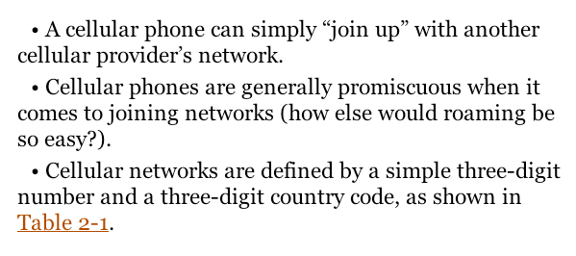
Attacking in the 1990s

Slide 38
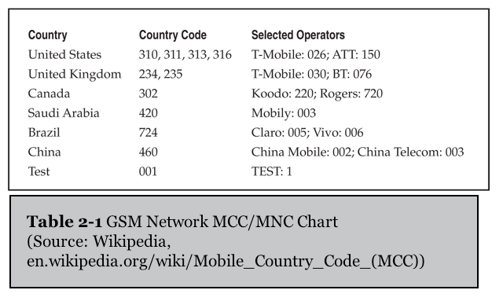

Slide 39
Base Station Hardware
A normal cell phone could act as a base station with only a software change
A phone in "engineering mode" could sniff radio traffic on all bands at the same time
Packets can be logged via RS232
You get voice and SMS traffic
Flash phone via USB cable

Slide 40
Legal Warning
This was all fantastically illegal, of course
Wiretapping laws are scary
We will be careful in this class only to capture our own phone signals

Slide 41
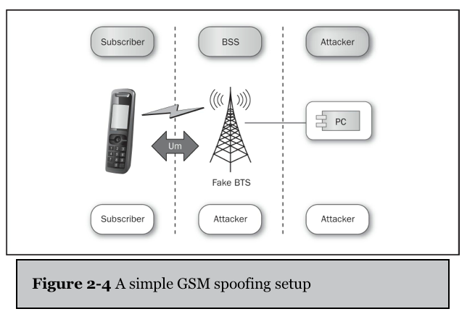
Hacking in 2002
Rhode & Schwartz sold test gear for SMS networks, including BTS emulation
Cost was six
figures

Slide 42
Rogue Base Station Countermeasures
It's up to the carriers to authenticate their networks
There's nothing an end-user can do

Slide 43
Rogue Femtocell Attacks
OpenBTS: free software that can be used to make a fake base station for about $1500 in 2009
Femtocells are even simpler

Slide 44
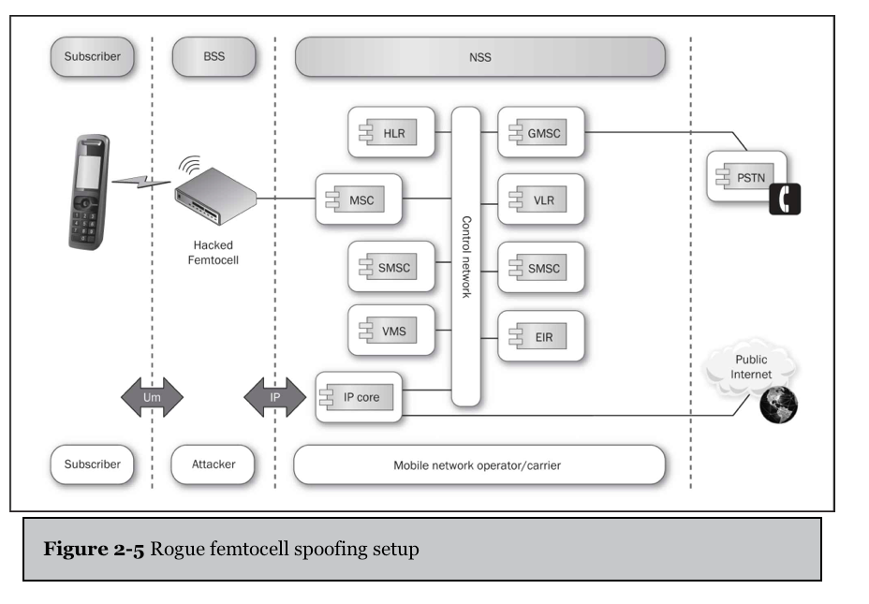

Slide 45
Femtocell
A tiny box with connectors for antenna, power, and Ethernet
Generic Linux distribution running several specialized apps
Loads a couple of drivers
Includes some simple radios

Slide 46
Femtocell Functions
Control signaling
  Call setup and teardown and SMS messaging
Converting normal voice calls into real-time protocol streams
Associated SIP setup
Backhaul link uses IPsec connections to special security gateways on the mobile network operator side

Slide 47
Information Disclosure
Femtocells receive raw secrets used to authenticate devices from carriers
They are encrypted in transit with IPsec, but they are present in the femtocell's software and hardware
  Hacking AT&T Femtocell (link Ch 2g)
  Hacking a Vodaphone Femtocell (link Ch 2h)

Slide 48
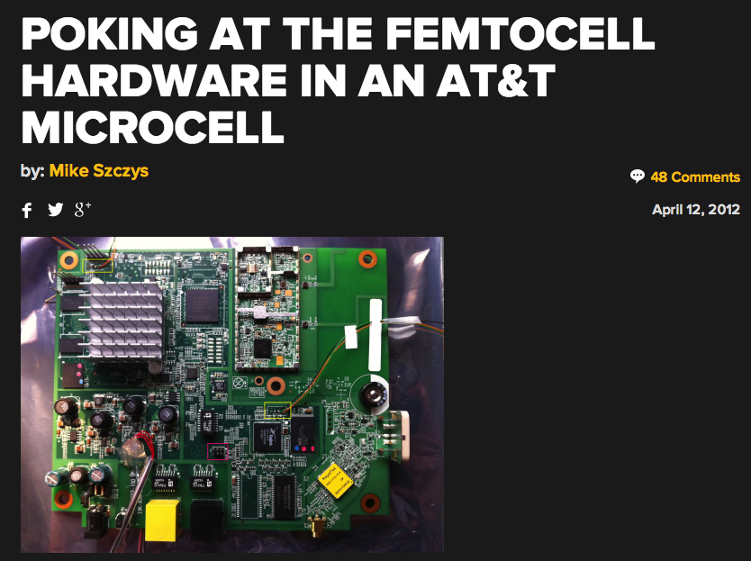

Slide 49
Femtocell Membership
Carriers could limit membership to a few cell phones for a single femtocell
But why not let everyone in? That expands their coverage for free!
But it also means customers are using untrustworthy devices and they have no way to know that

Slide 50
Countermeasures for Rogue Femtocells
Femtocells should be more limited in function
Networks need to authenticate themselves to the handsets reliably
SIP and IPsec allow for strong authentication
We just need new standards that use them

Slide 51
The Brave New World of IP

Slide 52
IMS (IP Multimedia Subsystem)
Carriers are moving to an IP-only system
No more
  Packetized voice
  Loss of data service while on a phone call
  Low-speed data links
Everything will use a baseband that connects to a high-speed IP network

Slide 53
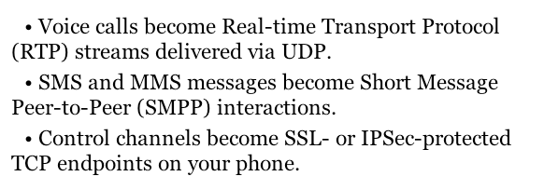
Changes to Services

Slide 54
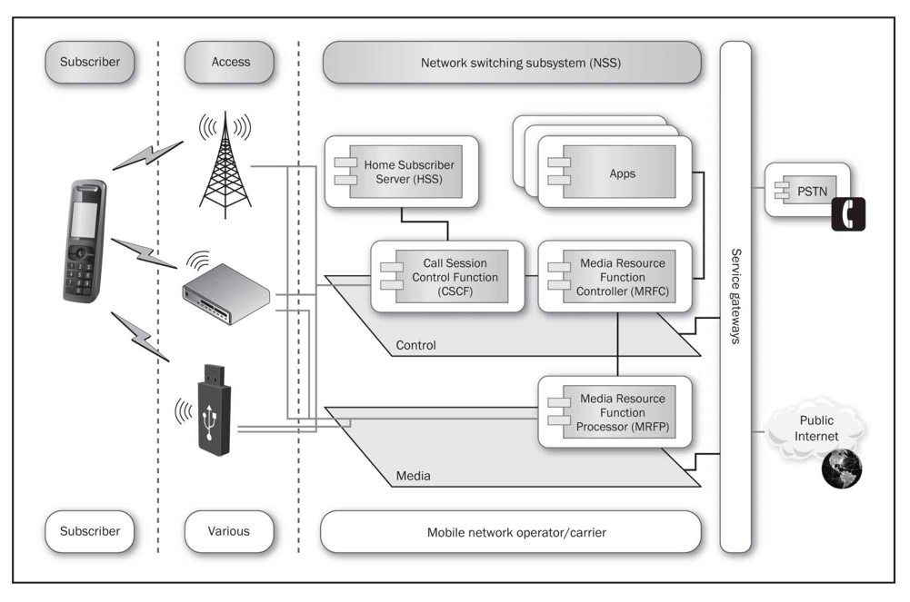
IMS Architecture

Slide 55
Long-Term Evolution (LTE)
Devices connect via IP networks to services, protected by gateways
As networks move from GSM or CDMA to LTE, these changes occur:
  Unified bearer protocol—IP
  IMS network can service any IP client, including PC, laptop, tablet, smartphone
  All these devices could interoperate and replace one another, someday

