Slide 1
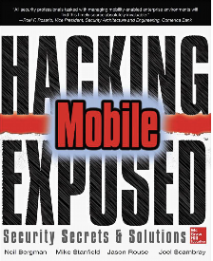
Ch 5: Mobile Malware
CNIT 128:
Hacking Mobile Devices

Slide 2
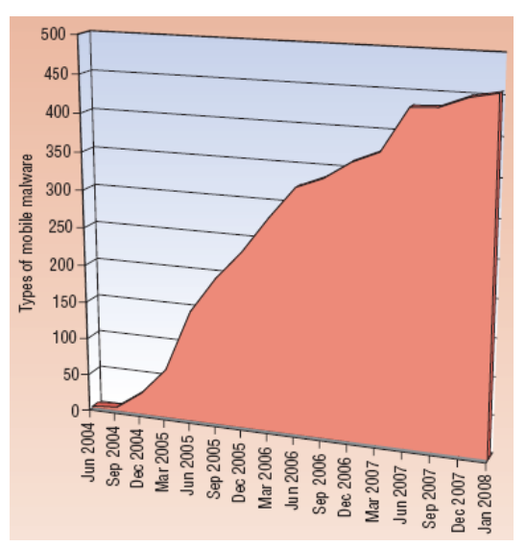
Increase in Mobile Malware
From link Ch 5a

Slide 3
Early Malware
LibertyCrack (2000)
  Trojan masquerading as pirated software for Palm OS
  Restored device to factory defaults

Slide 4
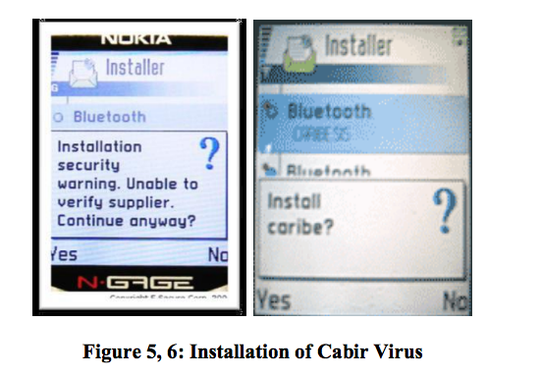
Early Malware
Cabir (2004)
  First phone worm
  Infected Symbian phones
  Spread via Bluetooth
    Image from link Ch 5a

Slide 5
Android Malware

Slide 6
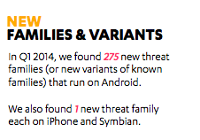
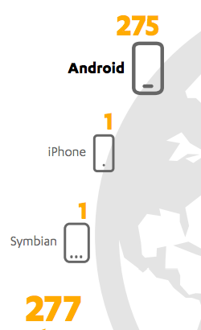
Android is #1
Link Ch 5b

Slide 7
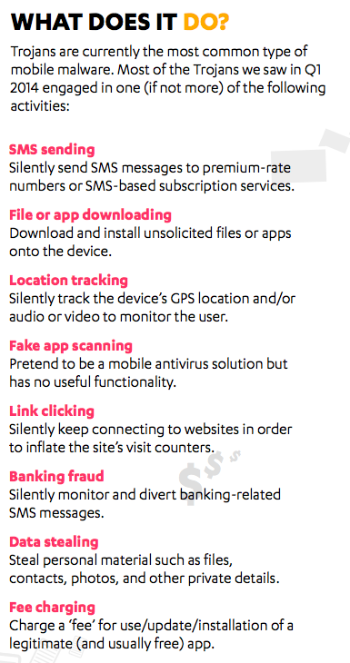

Slide 8
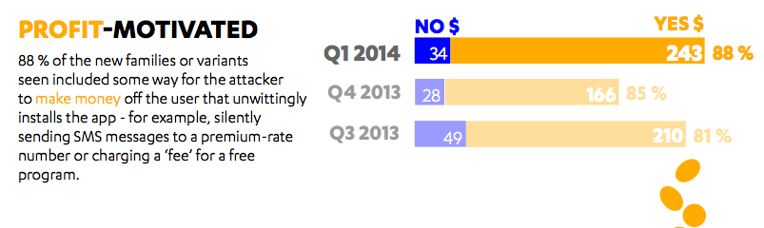

Slide 9
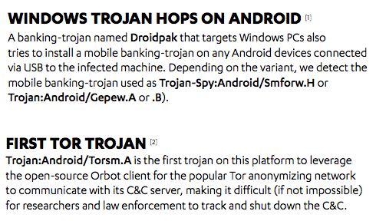

Slide 10
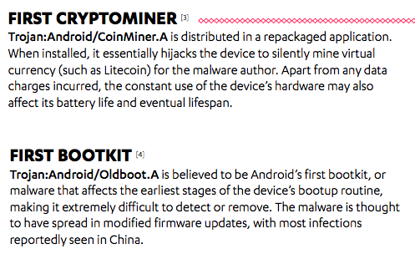

Slide 11
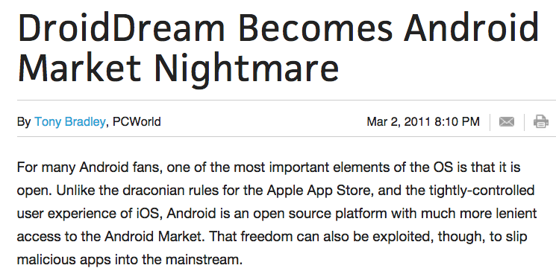
DroidDream (2011)
Was primarily distributed by the Google Play store
Legitimate apps were repackaged to include DroidDream and then put back in the Play store

Slide 12
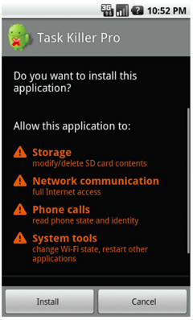
Excessive Permissions
App trojaned by DroidDream asks for too many permissions

Slide 13
Information Theft
When it is installed, DroidDream launches a "Setting" service
Steals private information and sends it to a remote server
  International Mobile Station Equipment Identity (IMEI)
  International Mobile Subscriber Identity (IMSI)

Slide 14
Botted
DroidDream then roots the device
Hijacks the app downloading and installing code
Makes it a bot under remote control

Slide 15
Google's Response
Google removed the repackaged apps from the Play Store
But 50,000 – 200,000 users were already infected

Slide 16
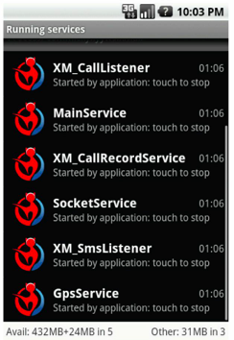
NickiSpy
Packaged into other software
At next reboot, it launches the services shown to the right
Steals IMEI, location, SMS messages and records voice phone calls
Records sound when phone is not in use

Slide 17
Google's Response to NickiSpy
Android 2.3 removed the ability for an application to change the phone state without user interaction
So an app could no longer turn on the microphone as stealthily

Slide 18
SMSZombie
Packaged inside live wallpaper apps in a Chinese marketplace names Gfan
Makes fraudulent payments using China Mobile SMS Payment
No permissions are requested during installation
  No clue to warn the user

Slide 19
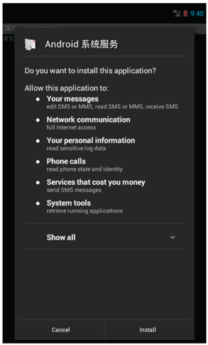
Malicious App
It then downloads another app and shows the user a box with only one option "Install" to get "100 points!"
That installs another app that does ask for permissions

Slide 20
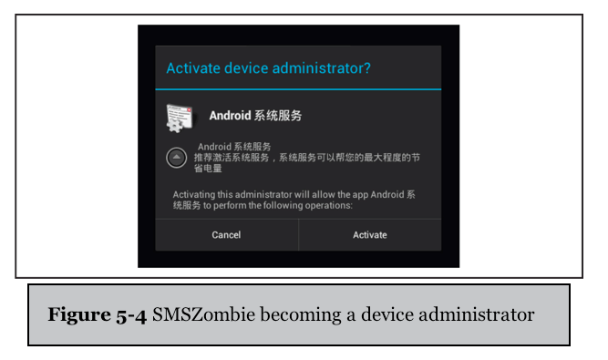
Becoming Administrator

Slide 21
Payload
SMSZombie sends all SMS messages currently on the device to a target phone #
It then scans all SMS messages to stealthily steal and delete ones that are warning the phone user about fraudulent SMS transactions

Slide 22
Banking Malware

Slide 23
Man-in-the-Browser (MITB) Attack
A Trojan installed on a PC hooks Windows API networking calls such as HttpSendRequestW
Allows attacker to intercept and modify HTTP and HTTPS traffic sent by the browser
Can steal banking credentials and display false information to the user

Slide 24
Two-Factor Authentication (2FA)
This was the response by banks to resist MITB attacks
Use an SMS to a phone as the second factor for 2FA
  Message contains a mobile transaction authentication number (mTAN)
Customer types mTAN into the banking web app on the PC

Slide 25
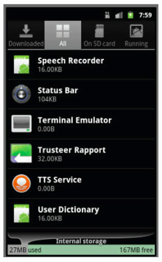
Zeus and Zitmo Defeat 2FA
Zeus malware on the PC
  Manipulates HTTPS traffic to encourage user to install fake Trusteer mobile security software
  Looks like legitimate security software on the phone
  Steals SMS messages from the phone to defeat 2FA

Slide 26
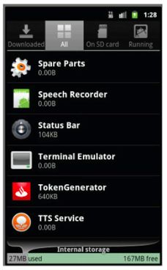
FakeToken
User is tricked into installing TokenGenerator app
It requests suspicious permissions, including
  Install and delete apps
    An error by the malware designers: only system apps can have that permission
  Send and receive SMS messages

Slide 27
Payload
TakeToken steals SMS messages to defeat 2FA
Can also steal contact list

Slide 28

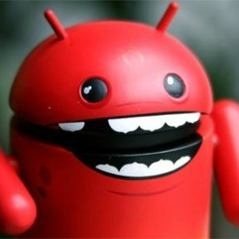
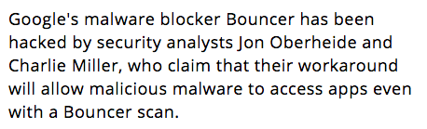

Slide 29
How Bouncer was Hacked
Researchers submitted an app containing a remote shell
When Bouncer ran the app in a virtual machine, it phoned home to the researchers
They explored the VM and exploited Bouncer itself
With a remote shell inside Bouncer, they explored it and found ways to defeat it

Slide 30
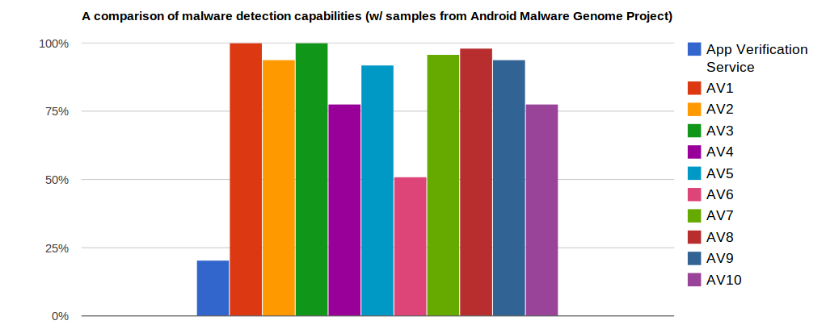
Google Application Verification Service
Launched in 2012
Tries to detect malicious apps
Much less effective than 3rd-party AV
  Link Ch 5e

Slide 31
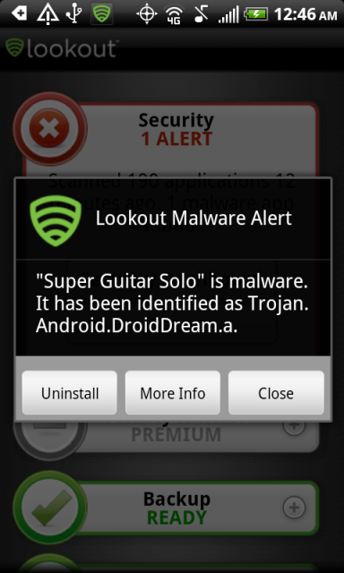
Moral: Get Real AV
Avast! won in a review from Feb., 2015
  Link Ch 5g
There are plenty of others, including
  Lookout
  AVG
  Kaspersky
  Norton
  McAfee

Slide 32
iOS Malware
What iOS malware?

Slide 33
Risk is Very Small
Very few items of malware, very few users actually infected, no real harm done
An academic exercise in theoretical computer security, not a real risk for users

Slide 34
Fake Update
"iPhone firmware 1.1.3 prep software"
Only for jailbroken devices
Supposedly written by an 11-year-old
Broke utilities like Doom and SSH
A minor annoyance

Slide 35
Jailbroken iPhones with Default SSH Password
Dutch teenager scanned for iPhones on T-Mobile's 3G IP range
  Pushed ransomware onto phones in Nov. 2009
Australian teenager wrote the iKee worm to Rickroll iPhones in 2009
  A later version made an iPhone botnet

Slide 36
iOS Malware in the Apple App Store
"Find and Call"
  First seen in 2012
  Also in Google Play
  Uploads user's contacts to a Web server
  Sends SMS spam to the contacts with install links
  Spreads but does no other harm

Slide 37
Malware Security:
Android v. iOS

Slide 38
Why the Huge Difference?
Market share
App approval process
  $25 to register for Google Play
    Apps appear within 15-60 min.
  $99 to register for Apple's App Store
    A week of automated & manual review before app appears in the store
Third-party app stores
  Allowed on Android, but not on iOS (unless you jailbreak)

