Slide 1
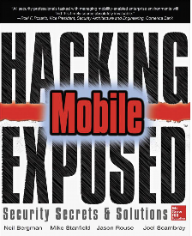
Ch 6: Mobile Services and
Mobile Web
Part 1
CNIT 128:
Hacking Mobile Devices

Slide 2
Server-Side Technologies
SQL (Structured Query Language)
  Servers that manage databases
  Contain SSNs, credit card numbers, sometimes passwords, etc.
SOAP (Simple Object Access Protocol)
  XML-based middleware to exchange data between servers and clients
  Can operate over any transport protocol such as HTTP, SMTP, TCP, UDP, or JMS (link Ch 6a)

Slide 3
Server-Side Technologies
JSON (JavaScript Object Notation)
  Lightweight data-interchange format
  An alternative to XML (link Ch 6b)
ReST (Representational State Transfer)
  Uses HTTP to transfer data between machines
  The World Wide Web can be viewed as a REST-based architecture (link Ch 6c)

Slide 4
Server-Side Vulnerabilities
Expose far more data than client-side vulnerabilities
Larger attack surface than client
  Server runs services, some for clients, others for business logic, internal interfaces, databases, partner interfaces, etc.

Slide 5
General Web Service Security Guidelines

Slide 6
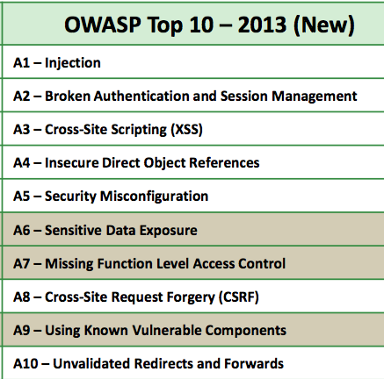

Slide 7
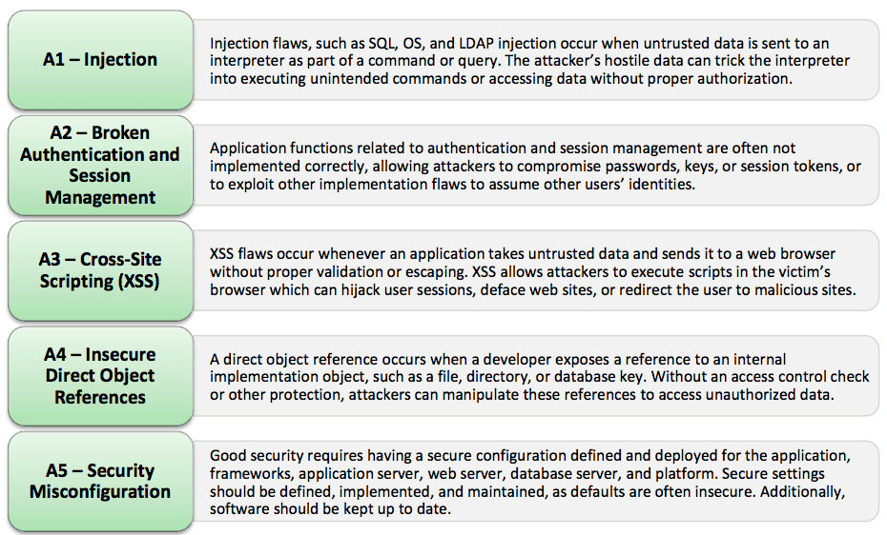

Slide 8
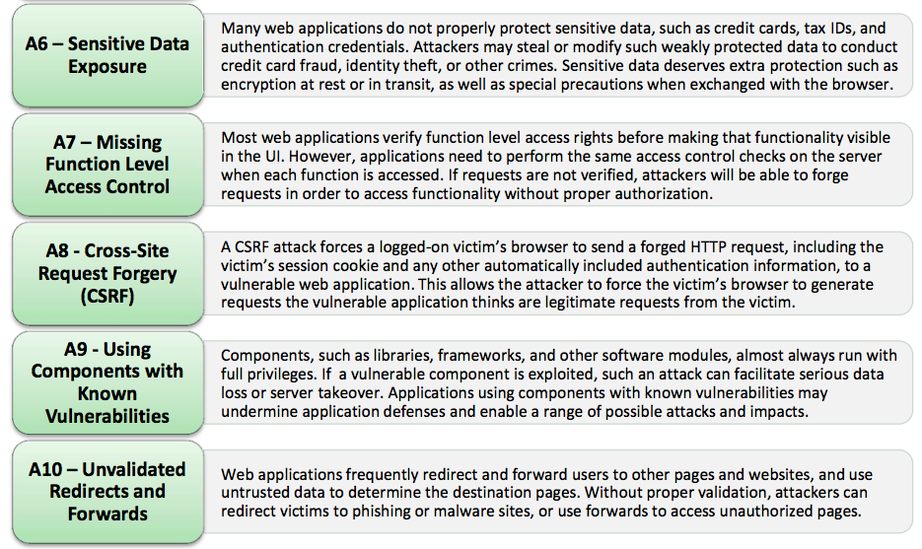

Slide 9
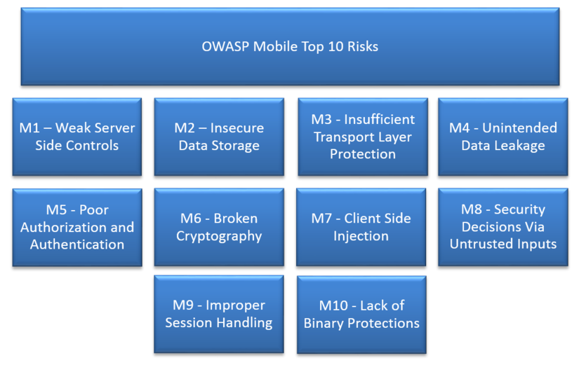

Slide 10
Attacks Against XML-Based Web Services

Slide 11
Security Audit of XML-Based Web Service
Identify web service endpoints
  By examining source code of client
  Or examining Web traffic while client runs
Craft legitimate web service requests
  For all endpoints and operations
Vulnerability Discovery
  By altering structure of contents of XML documents sent to the web service endpoints

Slide 12
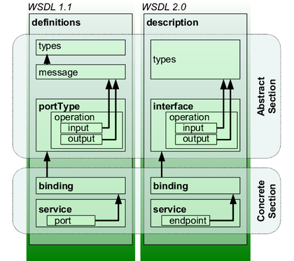
Web Services Description Language (WSDL)
An XML-based interface description language
  Used to describe functionality offered by a Web service
  Image from Wikipedia (link Ch 6f)

Slide 13
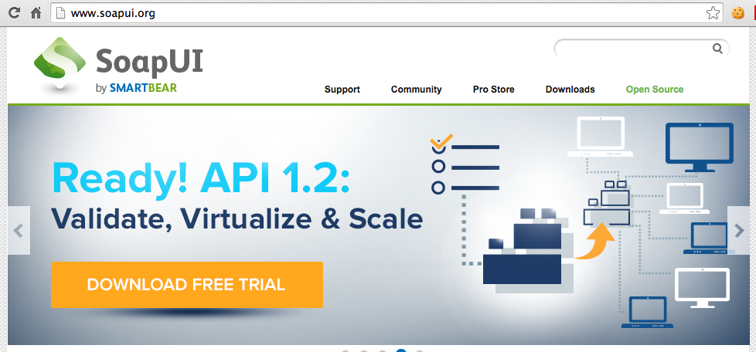
SoapUI
SoapUI can build a set of base test cases given a URL to an identified WDSL
  Link Ch 6g

Slide 14
XML Injection Example
Client sends
    <?xml version="1.0"?>
    <ProductRequest>
    <Id>584654</Id>
    </ProductRequest>
Sever replies, echoing Id from client
    <?xml version="1.0"?>
    <ProductResponse>
    <Id>584654</Id>
    <Price>199.99</Price>
    </ProductResponse>

Slide 15
XML Injection Example
Client sends an Id of
    584654</Id><Price>0.99</Price>
    </ProductResponse>
    <ProductResponse><Id>123
Sever reply becomes
    <?xml version="1.0"?>
    <ProductResponse>
    <Id>584654</Id><Price>0.99</Price>
    </ProductResponse>
    <ProductResponse><Id>123
    </Id>
    <Price>199.99</Price>
    </ProductResponse>

Slide 16
Effect of XML Injection
Depends on how server handles a strange response like that
Most would accept the first XML portion with the modified price

Slide 17
XML Injection Countermeasures
Input validation
  Best done with whitelisting
Output encoding
  Change "<" to "&gt;"
Use encoding functions from a trusted source, such as OWASP

Slide 18
XML Entity Expansion
A Denial-of-Service (DoS) attack using XML entities that expand greatly at process time
The example sends a 662-byte request that expands to 20 MB at the server
Enough of these requests can stop a server by RAM exhaustion

Slide 19
XML Entity Expansion
<?xml version="1.0"?>
<!DOCTYPE root [ <ENTITY a1 "I've often seen a cat without a grin..."> ]>
<someElement1><someElement2>&a1;</someElement2></someElement1>
Expands to
<?xml version="1.0"?>
<someElement1><someElement2>
I've often seen a cat without a grin...</someElement2></someElement1>

Slide 20
XML Entity Expansion Example
POST /SomeWebServiceEndpoint HTTP/1.1
Host: www.example.com
Content-Length: 662
<?xml version="1.0"?>
<!DOCTYPE root [
<ENTITY a1 "I've often seen a cat without a grin...">
<ENTITY a2 "&a1;&a1;"><ENTITY a3 "&a2;&a2;">
<ENTITY a4 "&a3;&a3;"><ENTITY a5 "&a4;&a4;">
...
<ENTITY a20 "&a19;&a19;">
]>
<someElement1><someElement2>&a20;</someElement2></someElement1>

Slide 21
XML Entity Expansion Countermeasures
Disable Document Type Definitions (DTDs) in the XML parser
Set a limit on the depth of entity expansions in the parser
Note: phones have XML parsers too, and can be attacked the same way
  The iOS NSXMLParser parser is protected
  But not Android's SAXParser

Slide 22
XML Entity Reference
Abuse XML entities to acquire the contents of files on the Web server
The example on the next page defines an external entity reference "fileContents" that points to the host file on Windows and uses it

Slide 23
XML Entity Reference Example
POST /SomeWebServiceEndpoint HTTP/1.1
Host: www.example.com
Content-Length: 196
<?xml version="1.0"?>
<!DOCTYPE fileDocType = [
<ENTITY fileContents SYSTEM "C:\Windows\System32\drivers\etc\bosts">
]>
<someElement1><someElement2>&fileContents;</someElement2></someElement1>

Slide 24
XML Entity Reference
If the XML parser supports DTDs with external entities
  Many parsers do by default
  The parser will fetch the host file and may display the file in the XML response to the attacker
  It's limited only be file permissions
  If the Web service runs as root, it can read any file

Slide 25
XML Entity Reference
Can be used for DoS by
  Requesting a special device file, or
  Forcing the parser to make many HTTP requests to remote resources, exhausting the network connection pool

Slide 26
XML Entity Reference Countermeasures
Disable DTDs altogether if you don't need them
Allow DTDs that contain general entities, but
  Prevent the processing of external entities
Set up an EntityResolver object to limit access to a whitelist of resources

Slide 27
XML Entity Reference
Can attack phones too
  Android is vulnerable and same countermeasures apply
  The iOS NSXMLParser class does not handle external entities by default, but a developer an enable this dangerous functionality

Slide 28
Common Authentication and Authorization Frameworks

Slide 29
Authentication Issues
Web apps typically authenticate with passwords
  So do mobile apps
Users don't want to type in the password every time they use an app
  Storing user's credentials in plaintext is unwise

Slide 30
Credential Storage Options
Secure Element (SE)
  A special tamper-resistant hardware component
  Not present in all phones, although some have one for NFC payment (link Ch 6h)
Authorization Framework
  Such as OAuth
  First authenticates a user with a password
  Creates a token to be stored on the phone
  Less valuable than a password to an attacker

Slide 31
Recommendations
Token can be made less dangerous
  Set reasonable expiration dates
  Restrict token's scope
  Revoke tokens that are known to be compromised
For financial apps
  Don't store any token at all on client-side
  Force the user to authenticate each time the app is used

Slide 32
OAuth 2
Open Authorization
Popular
  Used by Google, Facebook, Yahoo!, LinkedIn, and PayPal
Allows one app to access protected resources in another app without knowing the user's credentials
  Like Microsoft's Federated Identity Management

Slide 33
Main Actors in OAuth 2
Resource owner
  End-user with access to credentials, who owns the protected resources
Resource server
  Server hosting protected resources
  Allows client access to the protected resources when provided a valid access token

Slide 34
Main Actors in OAuth 2
Client
  App seeking to access protected resources
  Typically a mobile app or web app
Authorization Server
  Server that provides the client application with access tokens
    After the resource owner has provided valid credentials

Slide 35
OAuth 2 has Four Grant Types
Authorization Code
Implicit
Resource Owner Password Credentials
Client Credentials

Slide 36
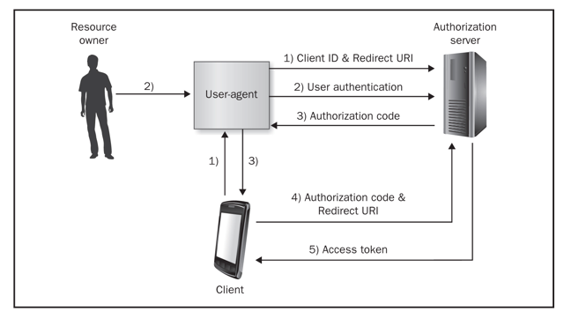
OAuth Authorization Code Grant Type

Slide 37
OAuth Authorization Code Grant Type
1. Client directs user-agent (browser or WebView component) to authorization endpoint
Request includes
  Client identifier
  Requested scope
  Local state
  Redirection URI

Slide 38
Using Mobile WebView to Steal Credentials
In theory, client app cannot access resource owner's credentials
  Because resource owner types credentials on the authorization server's web page
  Via user-agent, typically a browser
If a mobile app uses a WebView component instead of an external mobile browser
  Client app can steal credentials with malicious JavaScript

Slide 39
URL Redirection Attacks
The URI in steps 1 and 4 could be malicious, sending the client to a dangerous website
  This could phish users, or steal tokens
URIs should be validated, and enforced to be equal in steps 1 and 4

Slide 40
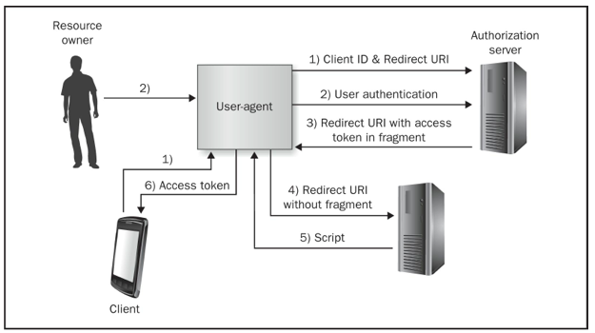
OAuth Implicit Grant Type

Slide 41
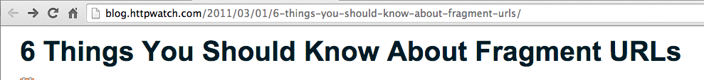
https://samsclass.info/128/128_S15.shtml#projects
The "#projects" is a fragment
Not sent to server in HTTP request
  Used only by the browser to display the specified potion of the page
  Link Ch 6i

Slide 42
OAuth Implicit Grant Type
Token not sent to server in step 4
In step 5, server sends JavaScript to get the token
Intermediate servers cannot see data stored in the fragment
Fragment does not appear in an unencrypted form in client or web server logs
  Limits some information leakage vulnerabilities

Slide 43
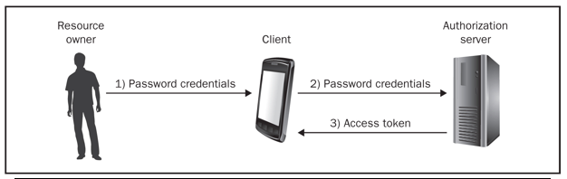
OAuth Resource Owner Password Credentials Grant Type
App is trusted with credentials, but need not save them
It can save the token instead

Slide 44
OAuth Resource Owner Password Credentials Grant Type
OK if
  Client app is trusted not to leak credentials to a third party
  Same entity controls authorization server, resource server, and client app
Better than storing credentials in plaintext on the mobile device and submitting them in every HTTP request

Slide 45
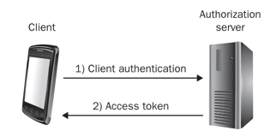
OAuth Client Credentials Grant
Should only be used for confidential clients
  That can maintain the confidentiality of their credentials
Not usually appropriate for mobile devices because of device theft

Slide 46
OAuth Client Credentials Grant
OK if mobile app has access to a Secure Element (SE)
  But most mobile apps cannot interface with a SE
This grant type should be avoided
  Unless app takes additional steps to protect authentication info
  Such as forcing user to enter a complex password every time the app launches
  Password used to encrypt/decrypt authentication info

Slide 47
General OAuth Threats

Slide 48
Lack of TLS Enforcement
OAuth does not support message-level confidentiality or integrity
Must use TLS to prevent sniffing of
  Authorization tokens
  Refresh tokens
  Access tokens
  Resource owner credentials

Slide 49
Cross-Site Request Forgery (CSRF)
Attacker can steal a token by tricking the user into visiting a malicious URL like
  <img src="http://www.example.com/oauth_endpoint?code=attaker_code">
Will steal token
Tokens can be re-used, unless optional "state" parameter is enabled in OAuth 2

Slide 50
Improper Storage of Sensitive Data
Server-side has many tokens and credentials
Must be secured against attack with cryptographic controls

Slide 51
Overly Scoped Access Tokens
Scope: level of access a token grants
Token may enable
  Sending social networking messages on your behalf, or
  Merely viewing portions of your social messaging profile
Follow principle of least privilege

Slide 52
Lack of Token Expiration
Tokens that don't expire and are overly scoped are almost as good as stealing credentials
  Sometimes even better
  A password reset may not cause old tokens to expire

