Slide 1

Ch 7: Mobile Device Management
CNIT 128:
Hacking Mobile Devices

Slide 2
What is MDM?
Frameworks that control, monitor, and manage mobile devices
Deployed across enterprises or service providers
Provide these functions remotely:
  Monitoring
  Control
  Manage

Slide 3
MDM Frameworks
Policies and features that administrators can control and enforce
iOS, Android and BlackBerry
  Each provide their own MDM frameworks
MDM solutions from third parties
  MobileIron
  AirWatch
  BlackBerry Enterprise

Slide 4
MDM Frameworks
Policies and features that administrators can control and enforce
iOS, Android and BlackBerry
  Each provide their own MDM frameworks
  Third-party vendors develop products that use the frameworks

Slide 5
Top Five MDM Solutions (2015)
MobileIron
AirWatch
Citrix (XenMobile)
IBM (MaaS360)
Good Technology
  Provides MDM without leveraging platform framework and support
Link Ch 7a

Slide 6
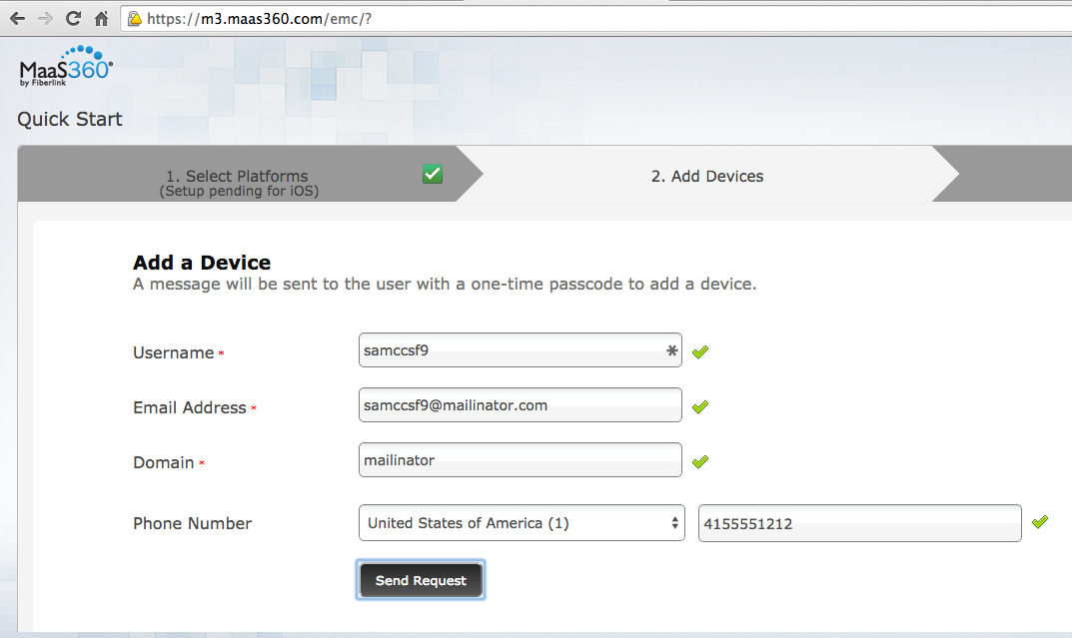
Project 11: MaaS360 from IBM

Slide 7
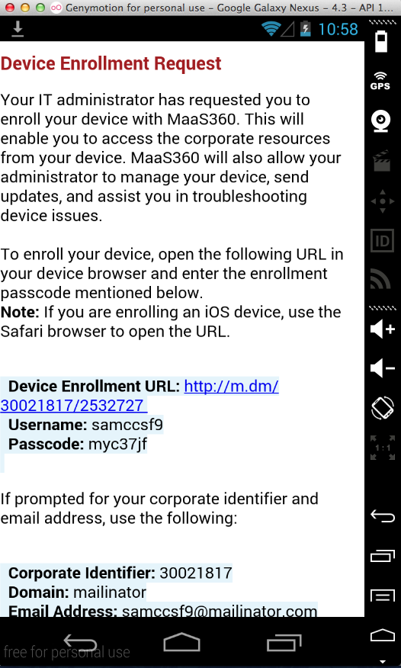
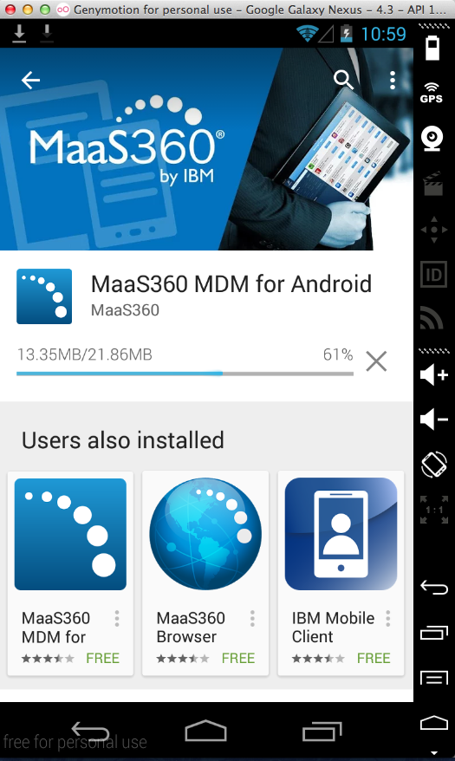
Project 11: MaaS360 from IBM

Slide 8
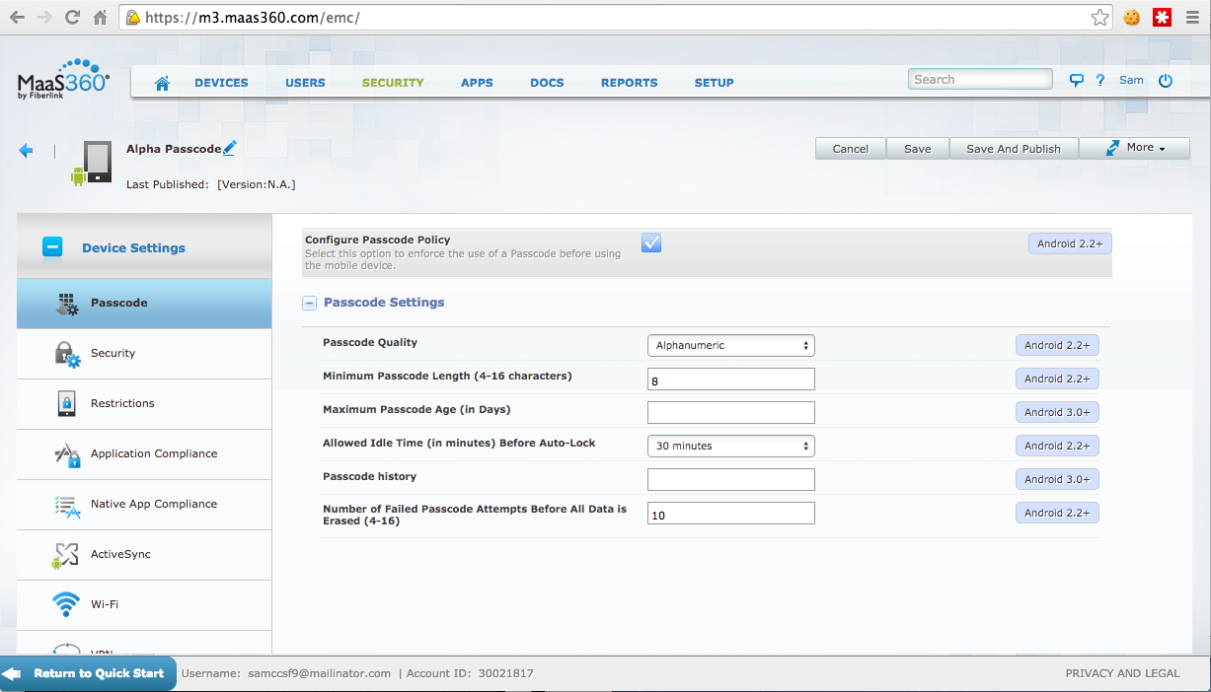
Project 11: MaaS360 from IBM

Slide 9
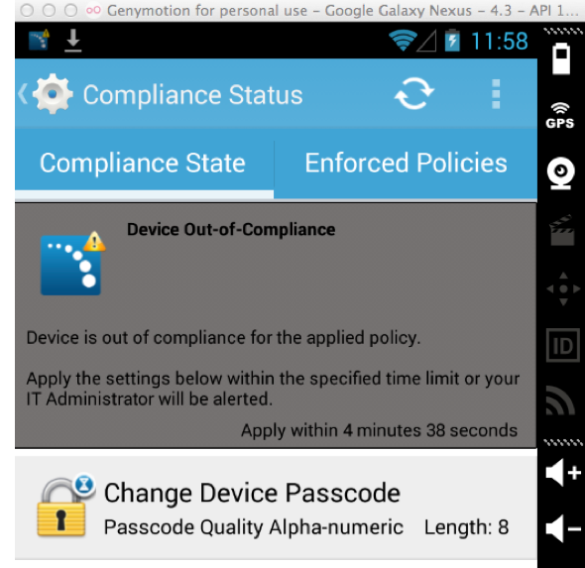
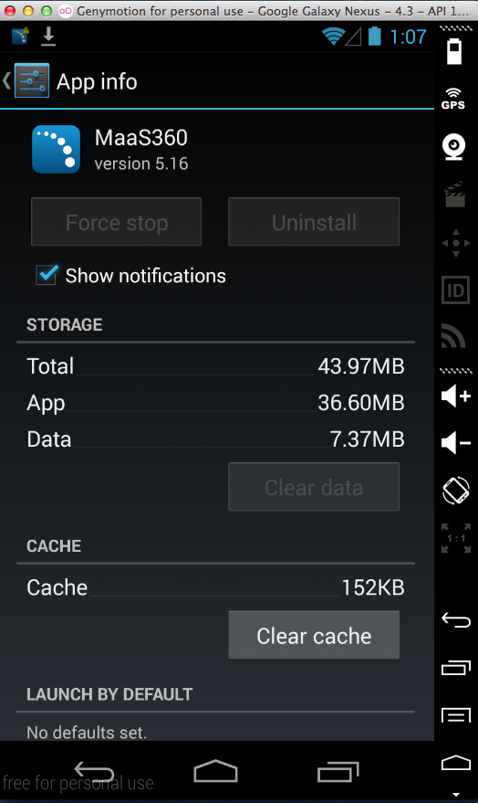
Project 11: MaaS360 from IBM

Slide 10
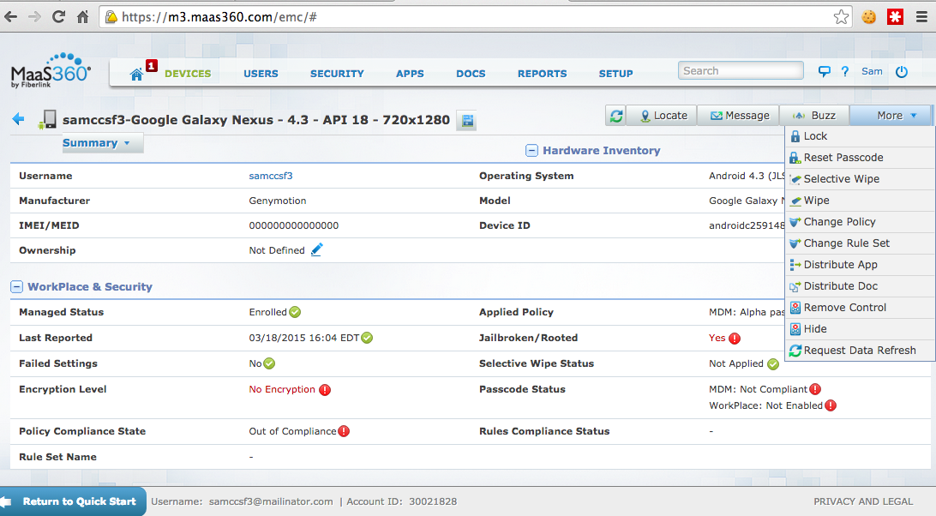
Project 11: MaaS360 from IBM

Slide 11
Categories of MDM Frameworks

Slide 12
Device-Centric Model
Leverages platform capabilities and feature sets
To configure, secure, and harden the mobile device
Uses underlying framework to detect changes in device security and configuration
Includes: MobileIron, AirWatch, and Tangoe

Slide 13
Data-Centric Model
Focuses on securing data/content of interest
  Not on controlling or securing the whole device
Ensures security and integrity of data
  Without relying on platform capabilities
Relies on a custom mobile app
Example: Good for Enterprise

Slide 14
Hybrid Model
Combines platform MDM framework with solution-specific features
Protects data and provides device management

Slide 15
Common Features

Slide 16
Device Provisioning
Deploy and enforce policies and restrictions on mobile devices
Provide access to resources controlled by the MDM server
Often use MDM client apps

Slide 17
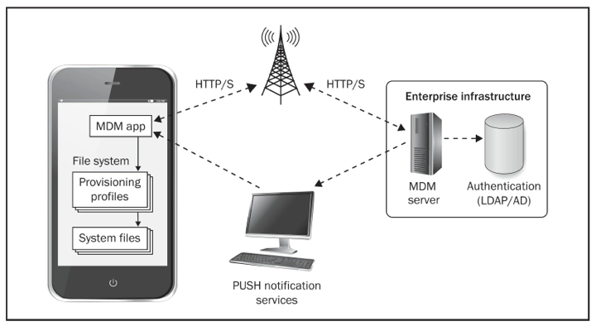
Device Provisioning

Slide 18
Provisioning Profile
Installed on the device by the MDM client
An XML or text file
Specifies configuration and provisioning information for the mobile device
May be
  Plan-text
  Signed
  Encrypted & signed

Slide 19
Policy Enforcement
Device receives a provisioning profile; it's verified and decrypted, then parsed
Mobile platform populates system files with the configuration information required to enforce policies from the provisioning profile
System files are parsed by system services and implement the configuration settings

Slide 20
iOS
MDM server sends provisioning profiles through Apple's Mail client (ActiveSync) or the MDM app installed on the device
Mobile device stores the profiles at
  /private/var/mobile/Library/ConfigurationProfiles
Stored as XML files (plists) with .stub file extensions

Slide 21
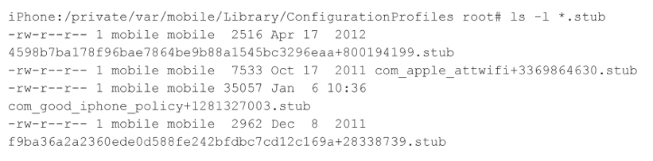
Example Provisioning Profile
Plist files with .stub extensions

Slide 22
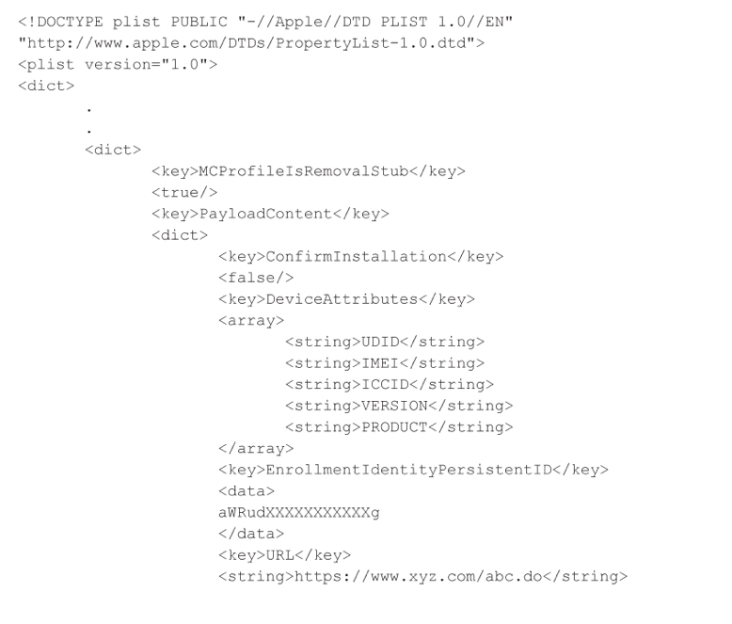
Sample of iOS Provisioning Profile

Slide 23
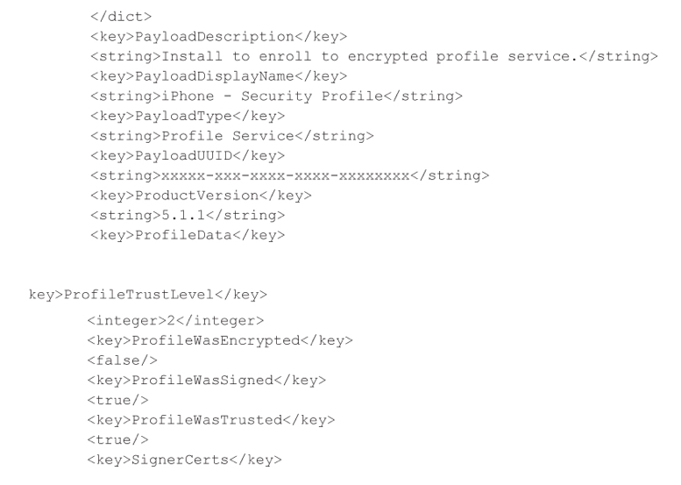
Sample of iOS Provisioning Profile

Slide 24
Provisioning Process
Verify and store provisioning profile in .stub files
Profile installation
  Parsing the profile
  Updating appropriate system files to enforce policies

Slide 25
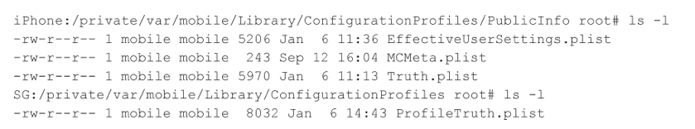
System Files Populated in iOS
EffectiveUserSettings.plist and
Truth.plist
  System files that determine an iOS device's security posture
  Truth.plist contains PIN/passcode policies, device restrictions, device timeout, etc.

Slide 26
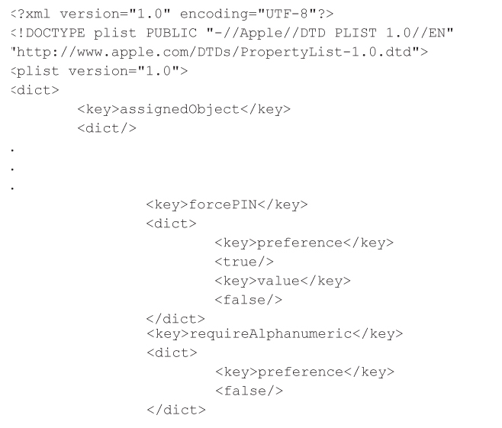
Truth.plist

Slide 27
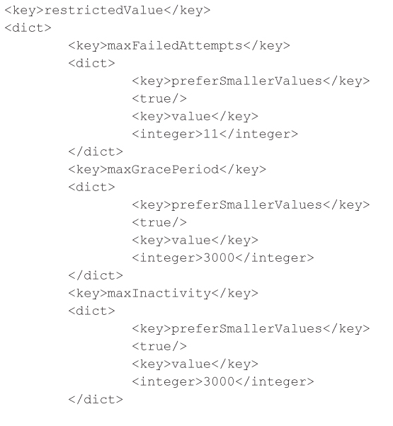
Truth.plist

Slide 28
Provisioning Status
Once the system files repopulated
Profile is considered installed
Status updated to the MDM server
Server grants access to protected resources

Slide 29
Android
MDM for Android works the same way
Files are different in details

Slide 30
Bypassing MDM

Slide 31
Modifying MDM Policy Files
On a jailbroken or rooted device
Any user with sudo or root permission can modify system files
Can modify Truth.Plist
  To change passcode restrictions
Mitigation
  Proprietary jailbreak detection capabilities

Slide 32
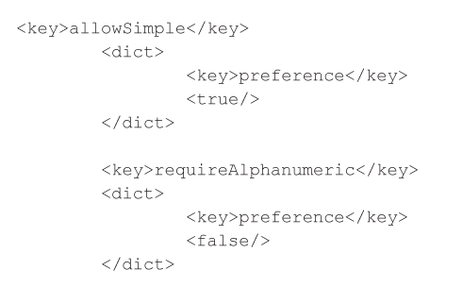
Enabling Simple Numerical Passcode
Set allowSimple to true
Set requireAlphaNumeric to false

Slide 33
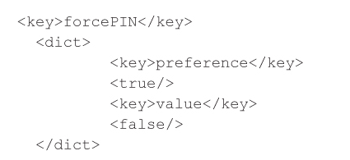
Enabling No Passcode
Set forcePIN to false

Slide 34
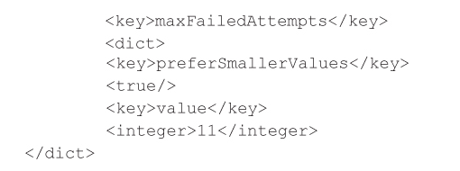
Increase Number of Failed PIN Attempts
Set maxFailedAttempts to a higher value

Slide 35
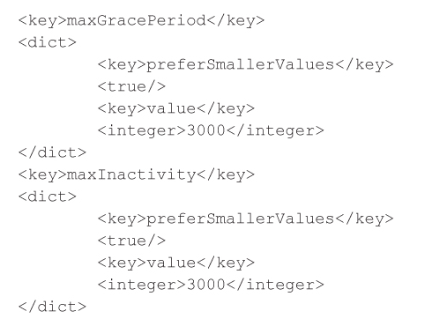
Set Inactivity and Lock Grace Period
If a device locks due to inactivity, it can be unlocked without a passcode if it's within the grace period

Slide 36
Detecting MDM Bypass
End-user can modify the provisioning profiles and system files
Administrators need to detect those changes
MDM client apps poll mobile devices to monitor their security posture (Check-In)
If a device is out of compliance, MDM server can
  Remote wipe, remote lock, remote locate, etc.

Slide 37
Weak MDM Bypass Detection
Some leading MDM solutions only monitored provisioning files
Changes made to system files were undetected by the back-end servers
  Even though the devices were sending data indicating noncompliance
This was patched

Slide 38
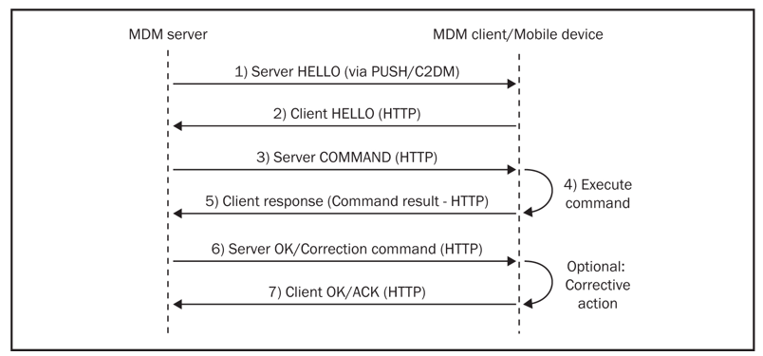
MDM Server-Client Interaction

Slide 39
App Patching and Modification Attacks
APK file can be decompiled to Smali code and modified
Android accepts self-signed certificates
Attacker can execute the PackageManager command at a Linux shell to install or uninstall packages silently

Slide 40
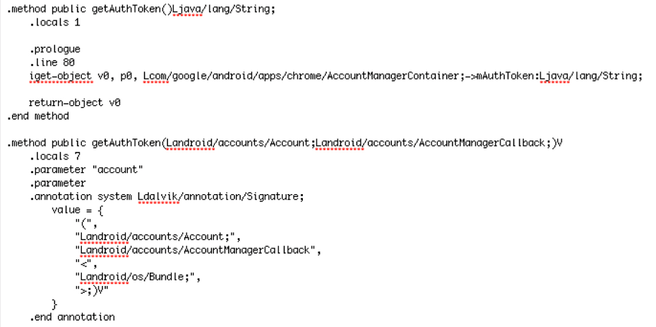
Smali Code for Authentication

Slide 41
iOS Modification
(on Jailbroken Devices)
Code can be injected into running processes with MobileSubstrate
Allows runtime patching of system functions
Captain Hook and Logo are widely used frameworks that use MobileSubstrate

Slide 42
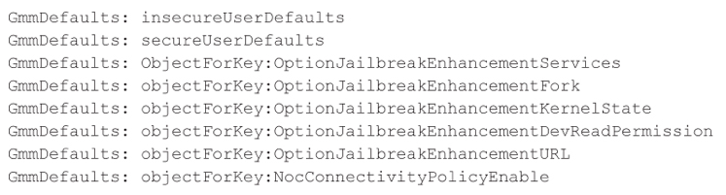
XCon
Prevents MDMs from detecting jailbroken devices
Patched these functions to fool GOOD

Slide 43
Decompiling and Debugging Apps

Slide 44
Android Reverse Engineering
APK files can be converted to Smali or even Java code with
  apktool
  dex2jar
  JAD

Slide 45
Android Code Obfuscation
ProGuard changes some filenames to provide weak protection
DashO is much more powerful
All obfuscation is of limited utility
A determined attacker can still modify code

Slide 46
iOS Reverse Engineering
Apps written in Objective-C
Compiled into low-level machine language
Reverse-engineering tools:
  Class-dump
  Class-dump-x
  Class-dump-z
Scan binary iOS apps to extract interface names

Slide 47
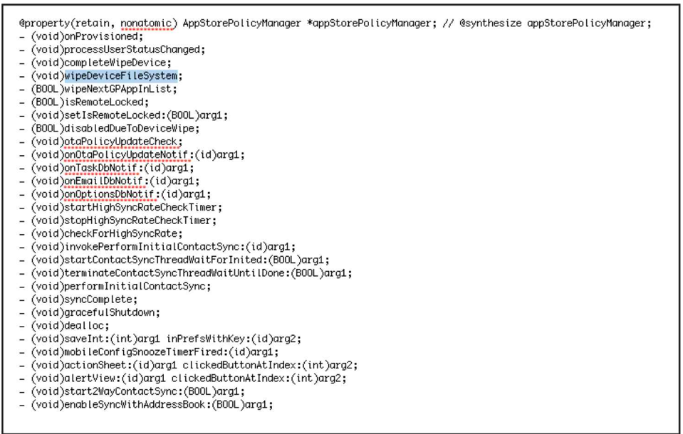
iOS Class Dump from an MDM App

Slide 48
iOS Anti-Decompilation Tips
Move critical logic to low-level Simula-style programming languages such as C++ that don't use message passing
Ensure more generic naming conventions for publicly exposed interfaces and declarations
Strip symbols when deploying in XCode
Use dynamic UI components for handling sensitive data and user input, not global variables (to avoid swizzling attacks)

Slide 49
Swizzling Attacks
A way to log all uses of a class
Works on global objects
  Link Ch 7c

Slide 50
iOS Anti-Decompilation Tips
Put all sensitive app logic in private methods, protocols, or anonymous methods
  To avoid swizzling attacks
Anti-tamper techniques and solutions that inject guards and protections in the app
  Such as EnsureIT by Arxan

Slide 51

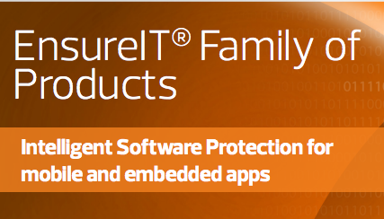

Slide 52
Detecting Jailbreaks

Slide 53
Jailbreak Detection
iOS 4.2 can detect jailbreaks in the OS itself
Other mobile platforms don't
MDM solutions use local apps to detect jailbreaks
  Methods and effectiveness varies widely
  May just detect presence of Cydia

Slide 54
Jailbreak Detection Bypass
Look for Cydia
  Try writing files with fopen() to look for specific files, and/or look for su
Bypass:
  Scan app binaries for interface names such as isDeviceJailBroken and checkDeviceSecurity
  Dynamically patch those methods with MobileSubstrate

Slide 55
Jailbreak Detection Bypass
Don't install Cydia
MDMs responded by detecting
  su, apt-get, or file-write permissions
Those detections still use method calls and platform features that can be circumvented by skilled attackers

Slide 56
Jailbreak Detection Bypass Countermeasures
Perform multiple checks at different locations in the app code
Move jailbreak detection logic to C++
Perform compensatory controls and actions on the server rather than on-device logic
Implement anti-debugging and/or code obfuscation tools/techniques like Arxan

Slide 57
Remote Wipe and Lock

Slide 58
Mobile Wipe and Lock
Two of the most widely used features in MDM solutions
Response to a security incident
  Device lost
  Device breached
  Device out of compliance with security policy

Slide 59
Ways to Prevent Remote Wipe and Lock
Put device in Airplane Mode
Patch MDM app so it won't perform remote wipe or lock
  And send false responses back to the server
Most MDM solutions are susceptible to patching
  But modern MDMs can use client-side logic to wipe or lock devices without communicating with the server

