Slide 1


Android Security Auditing
Mar. 13, 2015

Slide 2
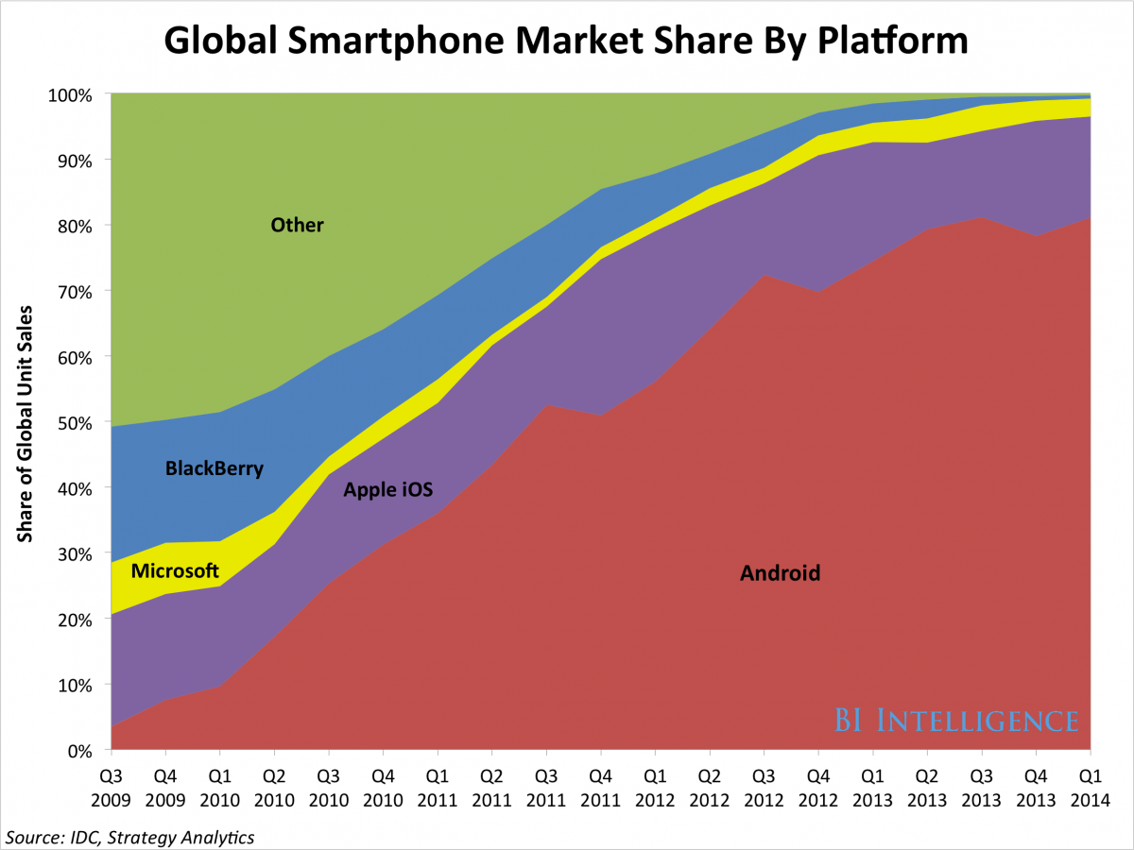
Android is #1
80% market share in 2014
  Link Ch 4a

Slide 3
Open Source
Android itself is open source (Link Ch 4b)
But the Google apps included with most Android phones are closed-source
Many device manufacturers and carriers modify Android
  Closed-source device drivers and apps
  Leads to fragmentation: two devices with the same hardware but different carriers can be running very different software
  More total sales, many different Android devices

Slide 4
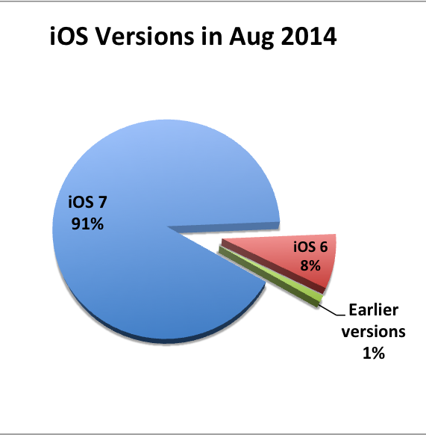
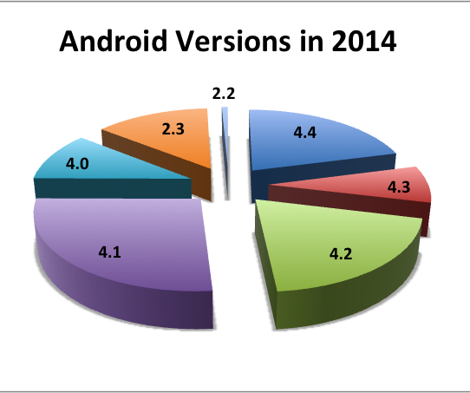
Fragmentation
Updates are essential for security
Very big problem for Android
  Link Ch 1f

Slide 5
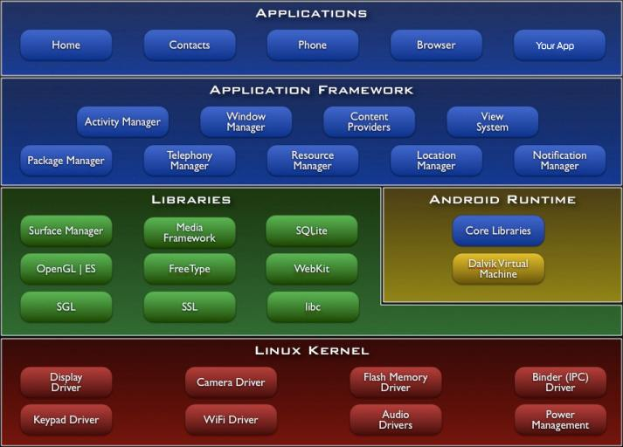
Android Architecture

Slide 6
Kernel Permissions
Each app has a unique user ID
  File ownership based on User ID
Can only access the resources and functionality it has explicit permissions for
This is "sandboxing"
  Apps cannot access resources of other apps
  Apps cannot access hardware components they have not been given permission to use

Slide 7
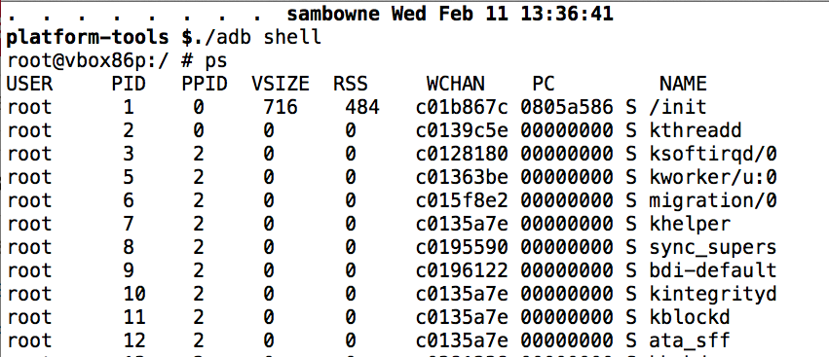
Viewing Users with ps
System processes run as root

Slide 8
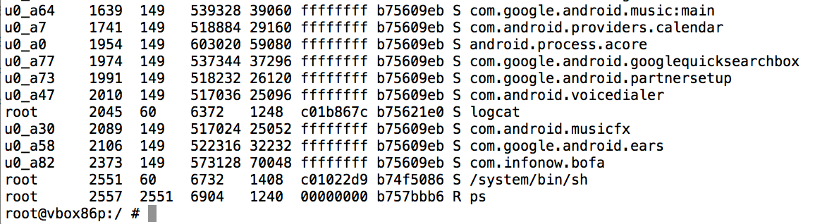
Viewing Users with ps
Apps run as u0_a1, u0_a2, etc.
Permissions for data directories

Slide 9
App Signing
All apps must be signed to be installed
Android allows self-signed certificates
  Developers can generate their own signing certificates
The only security mechanisms that use signatures are the signature or signatureOrSystem permissions

Slide 10
SDK (Software Development Kit)
Allows developers to build and debug Android apps
  Runs on Windows, Mac OS X, or Linux
In Dec., 2014, Google released Android Studio
  A full IDE (Integrated Development Environment)
  Links Ch 4e, 4f

Slide 11
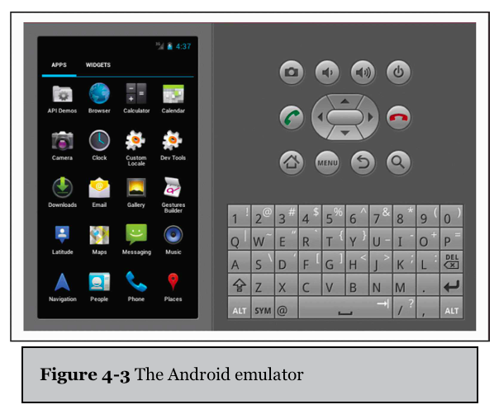
Android Emulator
Helps developers test apps without an actual mobile device
Simulates common hardware
  ARMv5 CPU
  SIM card
  Flash memory partitions

Slide 12
Value of the Emulator
Allows developers and researchers to test Android apps quickly in different versions of Android
Drawbacks
  Android Virtual Device (AVD) cannot send or receive phone calls or SMS messages
  But it can emulate them, and send them to other AVDs
Can define an HTTP/HTTPS proxy to intercept and manipulate Web traffic

Slide 13
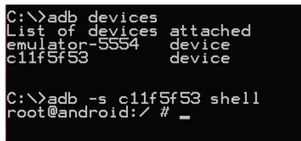
Android Debug Bridge
Command-line tool
Allows you to communicate with a mobile device via a USB cable or an SVD running within an emulator
Connects to device's daemon running on TCP port 5037

Slide 14
Useful ADB Commands
push
  Copies a file from your computer to the mobile device
pull
  Copies a file from the mobile device to your computer
logcat
  Shows logging information on the console
  Useful to see if an app or the OS is logging sensitive information

Slide 15
Useful ADB Commands
install
  Copies an application package file (APK) to the mobile device and installs the app
  Useful for side-loading apps (so you don't have to use Google Play)
shell
  Starts a remote shell on the mobile device
  Allows you to execute arbitrary commands

Slide 16
Decompiling and Disassembly

Slide 17
Static Analysis
Source code is generally kept confidential by app developers
A binary, compiled app can be analyzed by disassembling or decompiling them, into
  Smali assembly code (used by Dalvik VM), or
  Java code

Slide 18
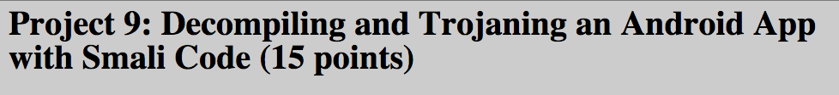
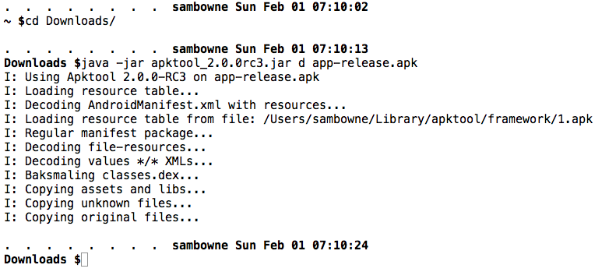

Slide 19
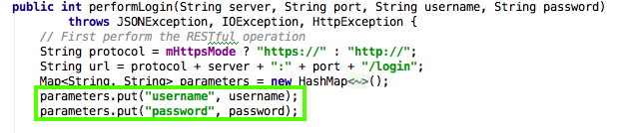
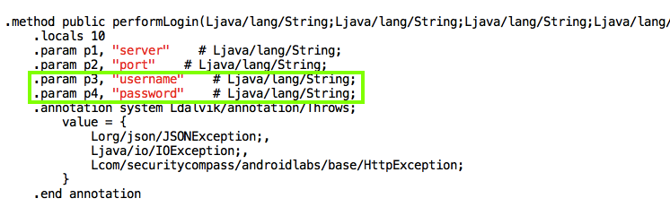
Java v. Smali Code

Slide 20
Building & Signing an App

Slide 21
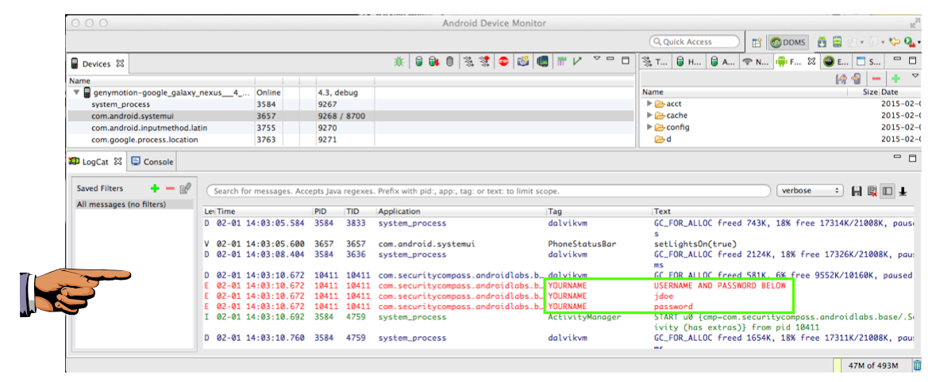
Monitoring the Log

Slide 22
Attacks via Decompiling and Disassembly
Insert Trojan code, like keyloggers
Find encryption methods & keys
Change variables to bypass client-side authentication or input validation
Cheat at games

Slide 23
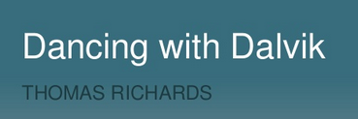
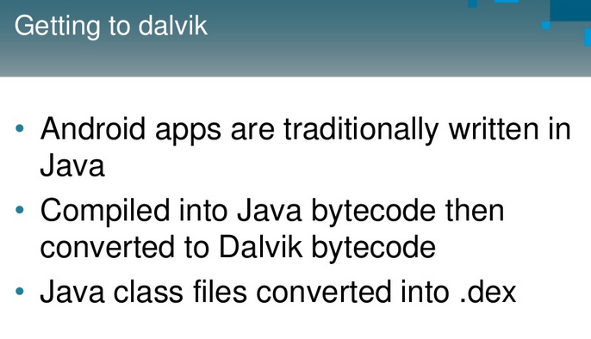
Link Ch 4z43

Slide 24
Decompiling, Disassembly, and Repackaging Countermeasures
Every binary can be reverse-engineered
  Given enough time and effort
Never store secrets on the client-side
Never rely on client-side authentication or client-side validation
Obfuscate source code
  ProGuard (free) or Arxan (commercial)

Slide 25
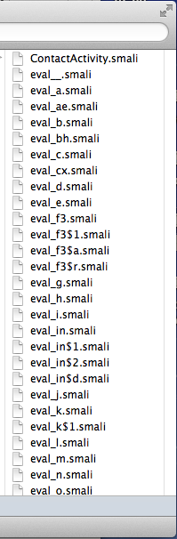
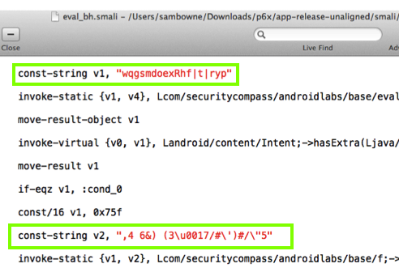
DashO – Powerful Obfuscator

Slide 26
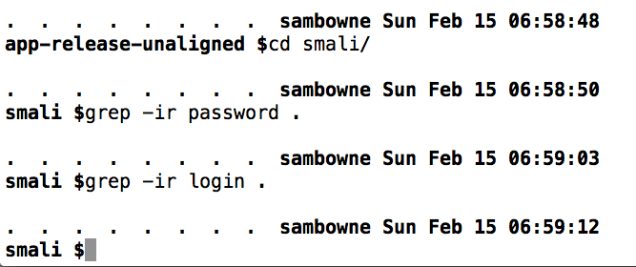
All Strings Concealed
BUT it costs $2000

Slide 27
Information Leakage via Logs
Every app can read the logs, if it requests the android.permission.READ_LOGS permission at install time
Some developers don't realize this and put sensitive information into the logs

Slide 28
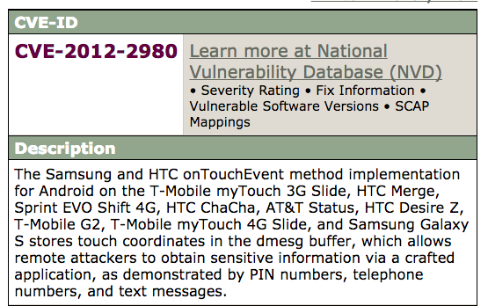
Link Ch 4z68

Slide 29
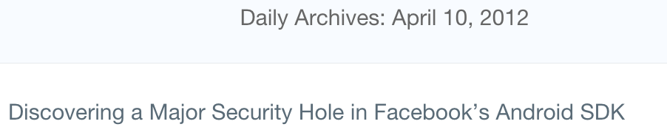
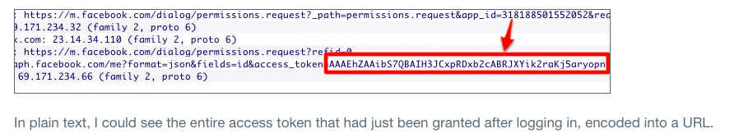
Facebook SDK Information Disclosure in the Log
Facebook promptly patched it
  Link Ch 4z69

Slide 30
Facebook SDK Information Disclosure Countermeasures
Update Facebook SDK to latest version
App developers should not log any sensitive information

Slide 31
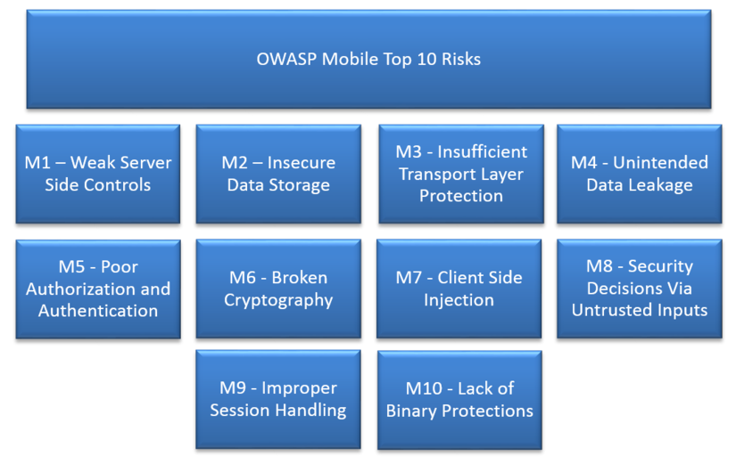

Slide 32
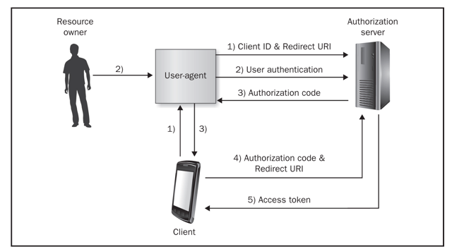
OAuth Authorization Code Grant Type

Slide 33
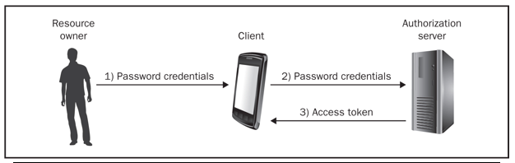
OAuth Resource Owner Password Credentials Grant Type
App is trusted with credentials, but need not save them
It can save the token instead

Slide 34
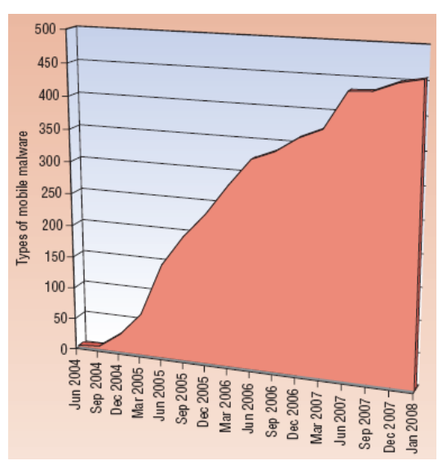
Increase in Mobile Malware
From link Ch 5a

Slide 35
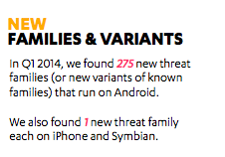
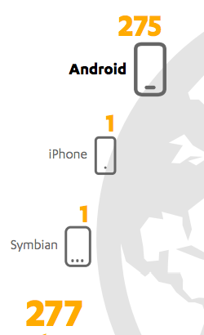
Android is #1
Link Ch 5b

Slide 36
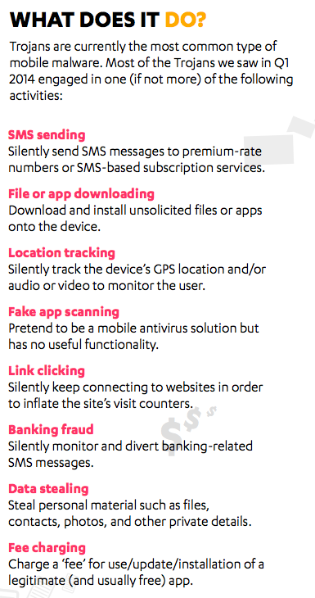

Slide 37
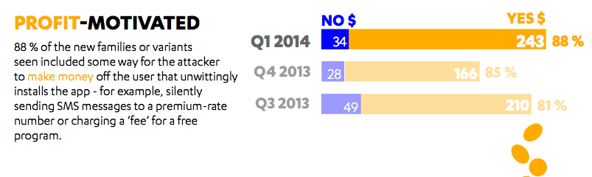

Slide 38
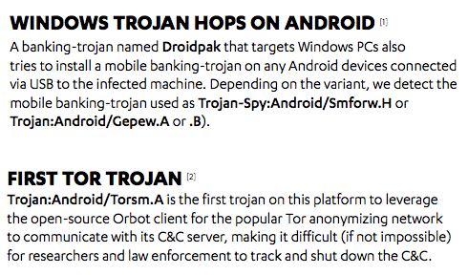

Slide 39
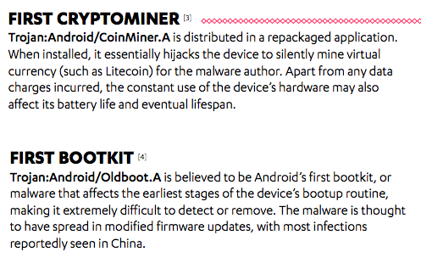

Slide 40
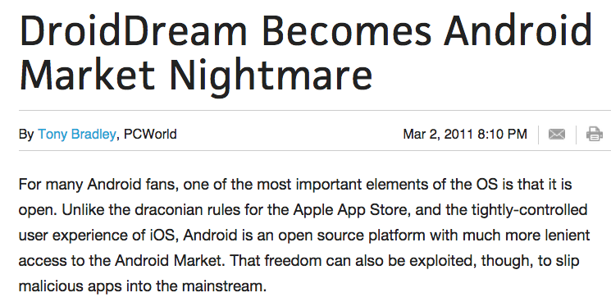
DroidDream (2011)
Was primarily distributed by the Google Play store
Legitimate apps were repackaged to include DroidDream and then put back in the Play store

Slide 41
Google's Response
Google removed the repackaged apps from the Play Store
But 50,000 – 200,000 users were already infected

Slide 42
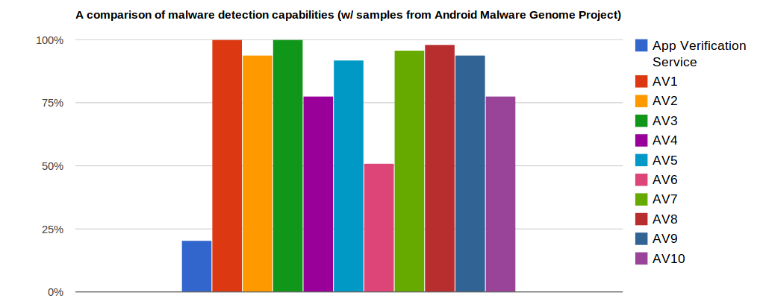
Google Application Verification Service
Launched in 2012
Tries to detect malicious apps
Much less effective than 3rd-party AV
  Link Ch 5e

Slide 43
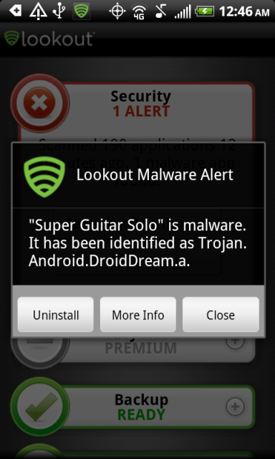
Moral: Get Real AV
Avast! won in a review from Feb., 2015
  Link Ch 5g
There are plenty of others, including
  Lookout
  AVG
  Kaspersky
  Norton
  McAfee

