Slide 1

How to Trojan Financial Android Apps
& SSL Validation Failures
Sam Bowne
City College San Francisco

Slide 2
Adding Trojans to Apps

Slide 3
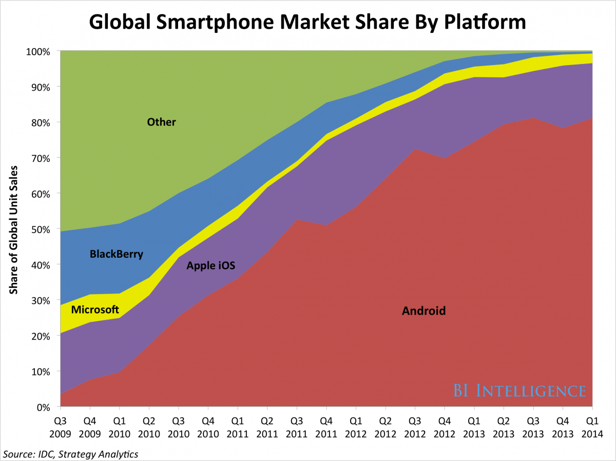
Android is #1
80% market share in 2014
  Link Ch 4a

Slide 4
App Signing
All apps must be signed to be installed, BUT
  Android allows self-signed certificates
Google Play is the "official" app store, BUT
  Google doesn't police it well
  Apps can be installed from email, Web pages, etc.

Slide 5
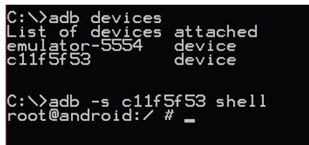
Android Debug Bridge
Command-line tool
Allows you to communicate with a mobile device via a USB cable or an SVD running within an emulator
Connects to device's daemon running on TCP port 5037

Slide 6
Useful ADB Commands
push
  Copies a file from your computer to the mobile device
pull
  Copies a file from the mobile device to your computer
logcat
  Shows logging information on the console
  Useful to see if an app or the OS is logging sensitive information

Slide 7
Useful ADB Commands
install
  Copies an application package file (APK) to the mobile device and installs the app
  Useful for side-loading apps (so you don't have to use Google Play)
shell
  Starts a remote shell on the mobile device
  Allows you to execute arbitrary commands

Slide 8
Decompiling and Disassembly

Slide 9
Static Analysis
Source code is generally kept confidential by app developers
A binary, compiled app can be analyzed by disassembling or decompiling them, into
  Smali assembly code (used by Dalvik VM), or
  Java code

Slide 10
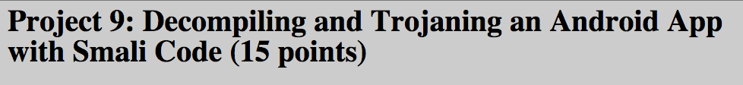
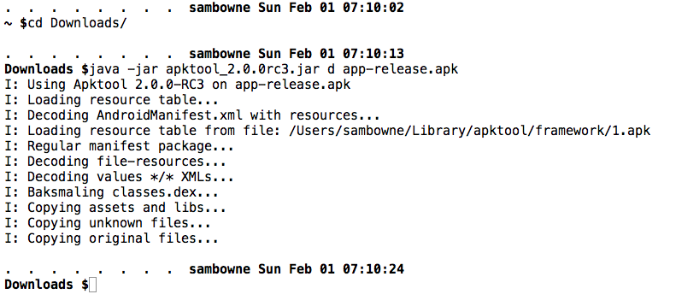

Slide 11
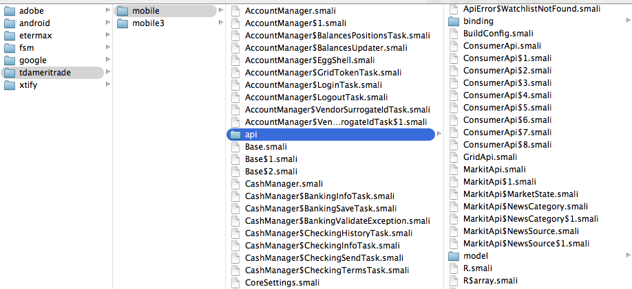
TD Ameritrade
No obfuscation

Slide 12
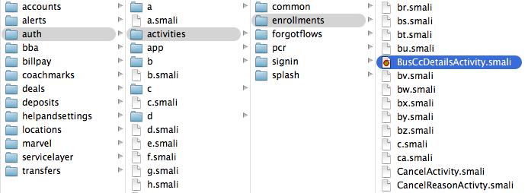
Bank of America
ProGuard Free Obfuscator
  Worthless

Slide 13
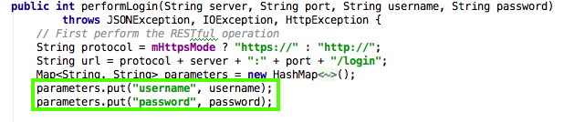
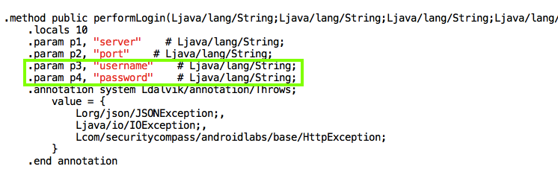
Java v. Smali Code

Slide 14
Building & Signing an App

Slide 15
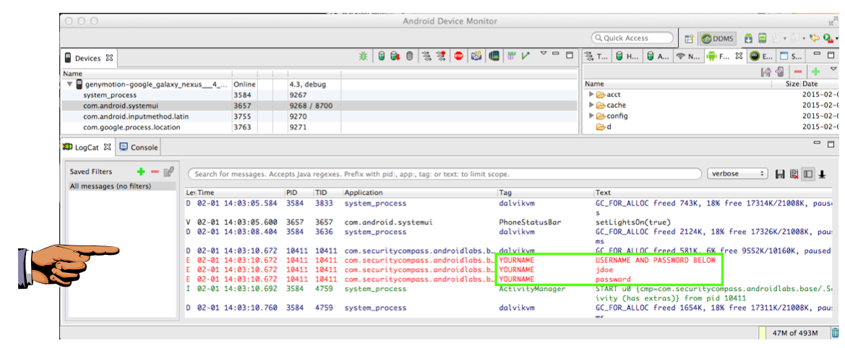
Monitoring the Log

Slide 16
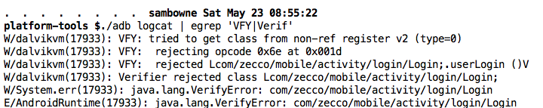
./adb logcat
Much better way to monitor log
Filter with grep

Slide 17
Attacks via Decompiling and Disassembly
Insert Trojan code, like keyloggers
Find encryption methods & keys
Change variables to bypass client-side authentication or input validation
Cheat at games

Slide 18
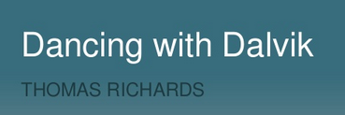
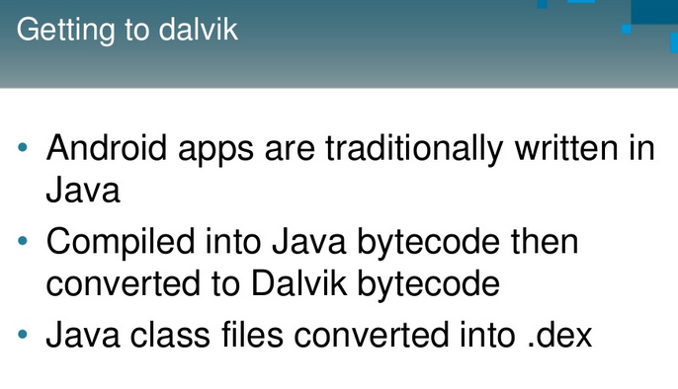
Link Ch 4z43

Slide 19
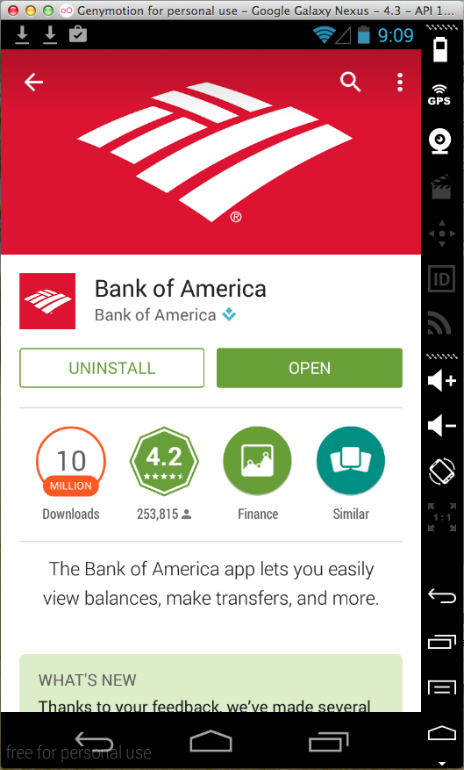
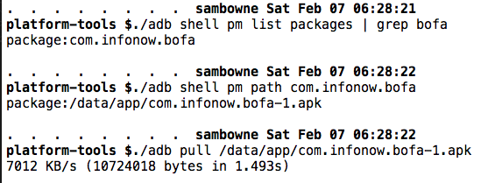
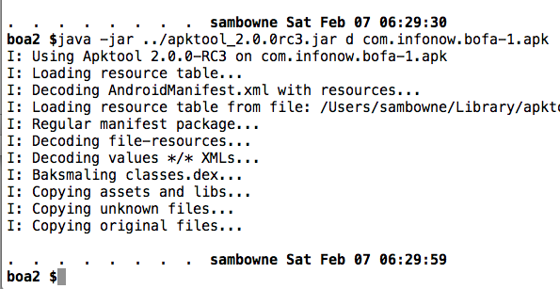
Step-by-Step: Bank of America

Slide 20
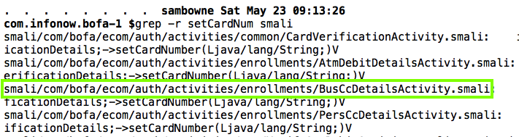
Step-by-Step: Bank of America

Slide 21
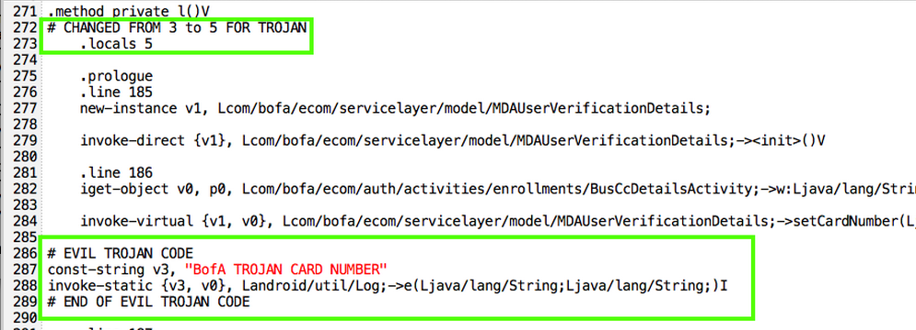
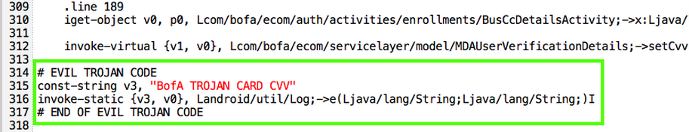
Step-by-Step: Bank of America

Slide 22
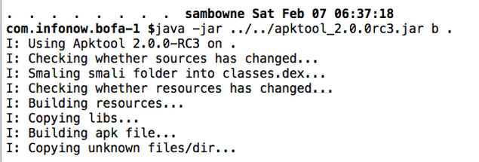
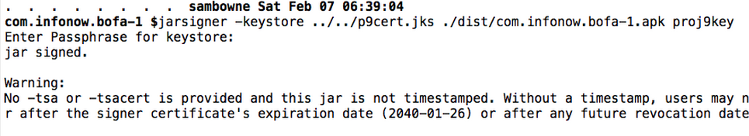
Step-by-Step: Bank of America

Slide 23
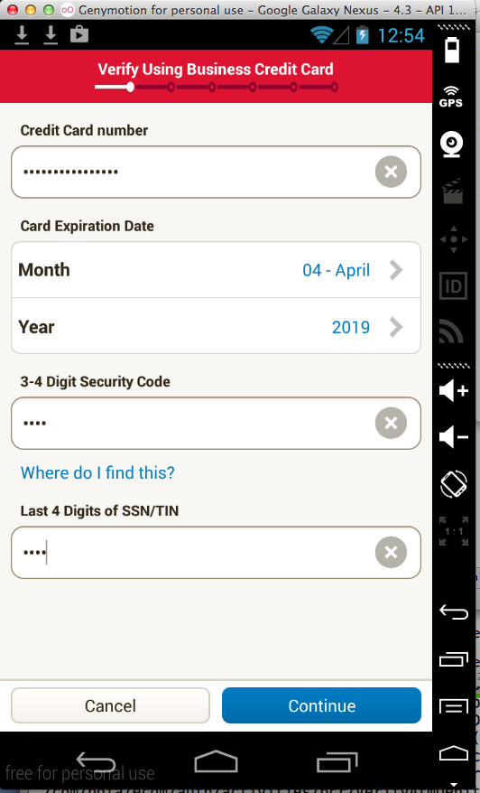

DEMO: Bank of America

Slide 24
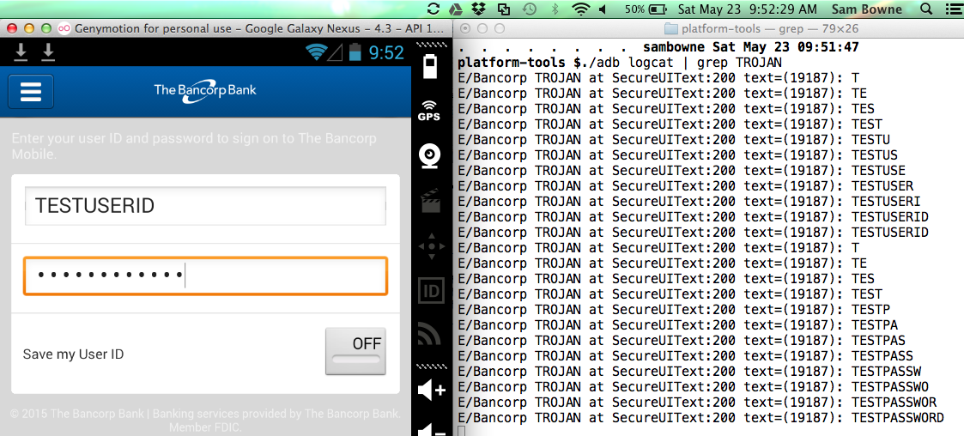
DEMO: The Bancorp

Slide 25
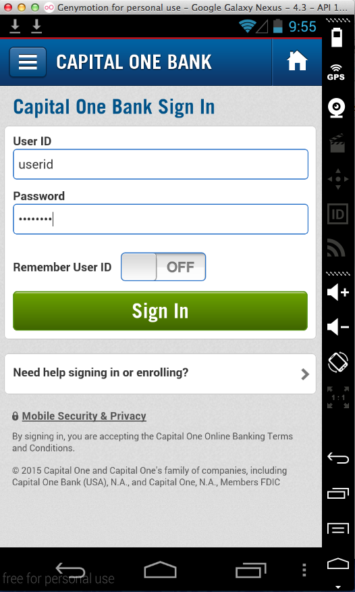
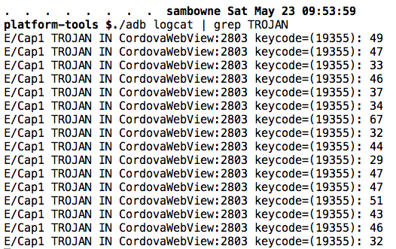
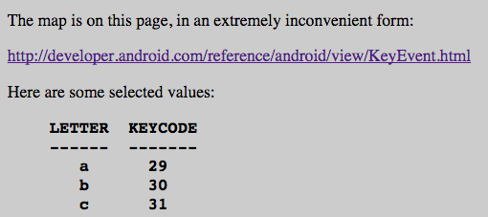
DEMO: Capital One

Slide 26
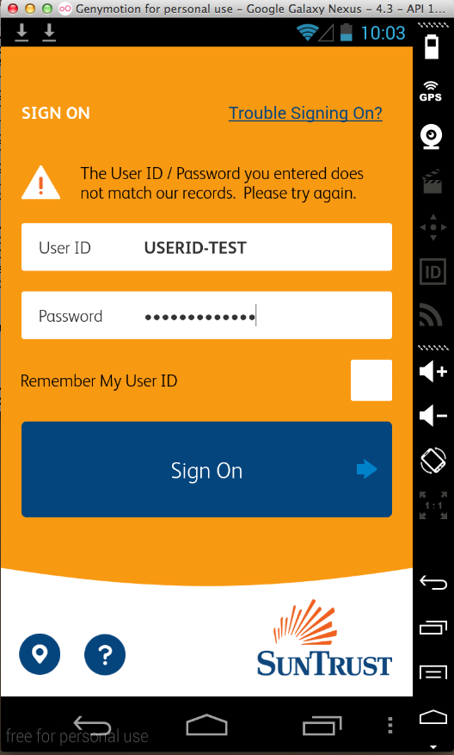
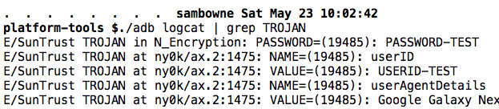
DEMO: SunTrust
Konylabs
Capture HTTP Parameters

Slide 27
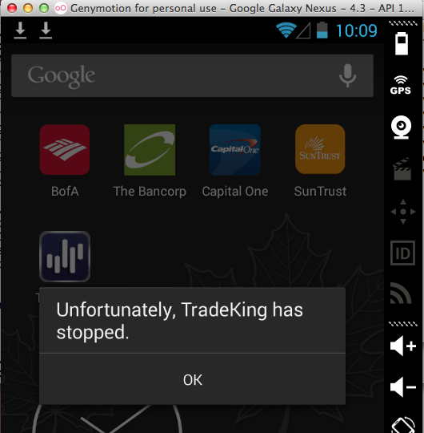
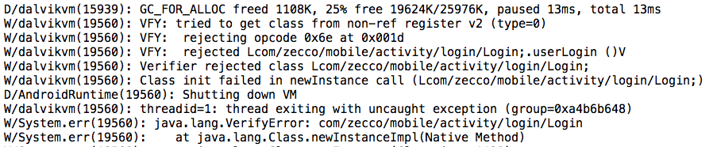
DEMO: TradeKing
App is patched!
"Verifier" detects the Trojan

Slide 28
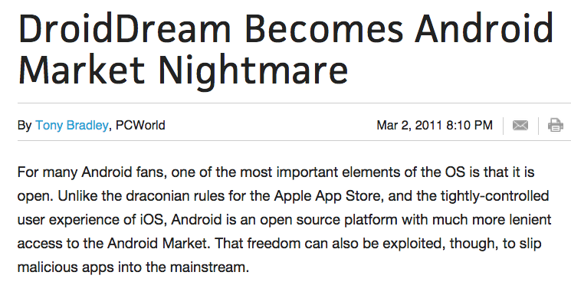
DroidDream (2011)
Was primarily distributed by the Google Play store
Legitimate apps were repackaged to include DroidDream and then put back in the Play store

Slide 29
Google's Response
Google removed the repackaged apps from the Play Store
But 50,000 – 200,000 users were already infected

Slide 30
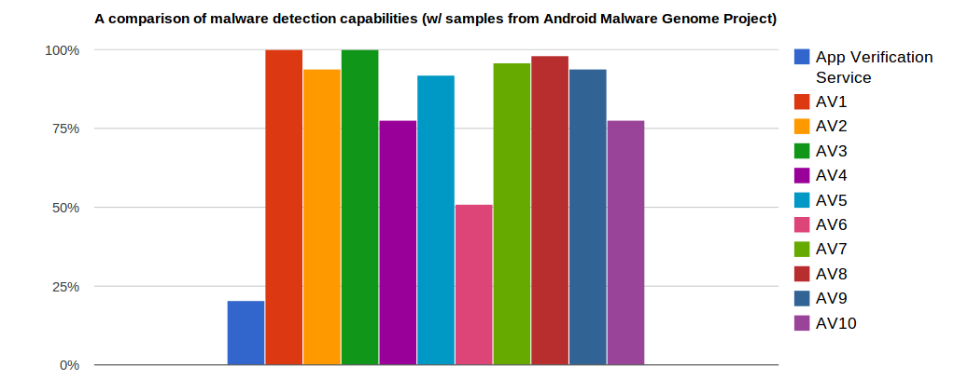
Google Application Verification Service
Launched in 2012
Tries to detect malicious apps
Much less effective than 3rd-party AV
  Link Ch 5e

Slide 31
Decompiling, Disassembly, and Repackaging Countermeasures
Every binary can be reverse-engineered
  Given enough time and effort
Never store secrets on the client-side
Never rely on client-side authentication or client-side validation
Obfuscate source code
  ProGuard (free) or Arxan (commercial)

Slide 32
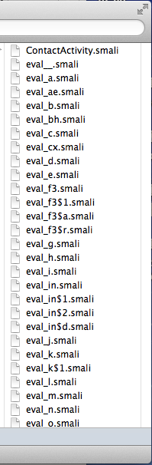
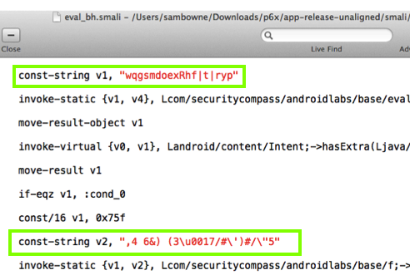
DashO – Powerful Obfuscator

Slide 33
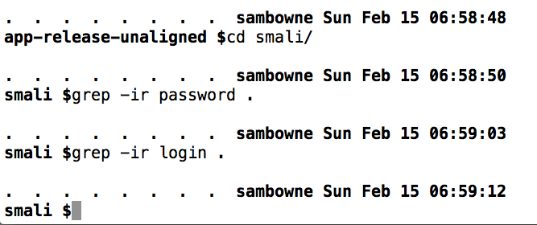
All Strings Concealed
BUT it costs $2000

Slide 34
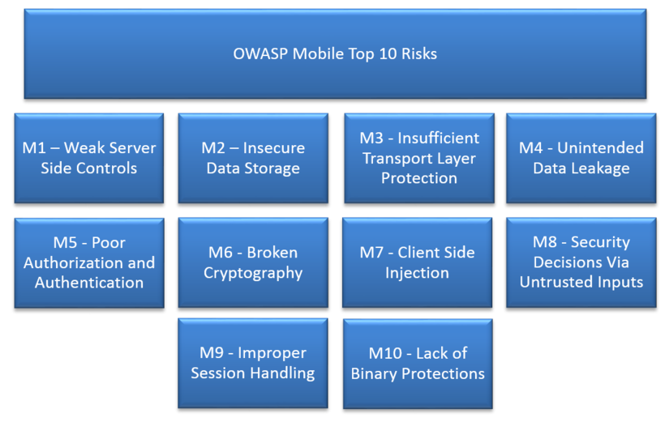

Slide 35
Broken SSL
Repeating Old Work

Slide 36
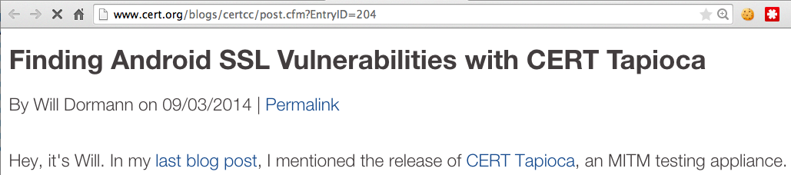

CERT's Test in 2014
23,667 vulnerable apps
All warned in 2014 by CERT

Slide 37
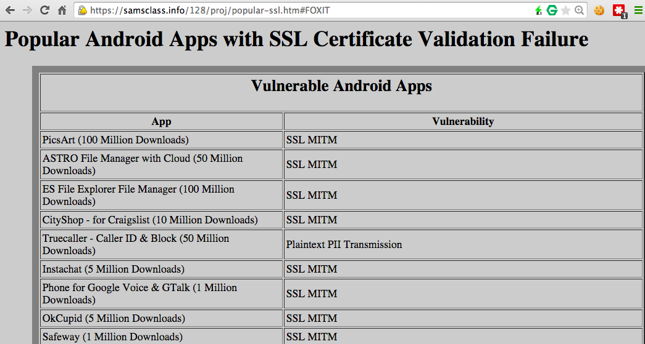
Still Vulnerable

Slide 38
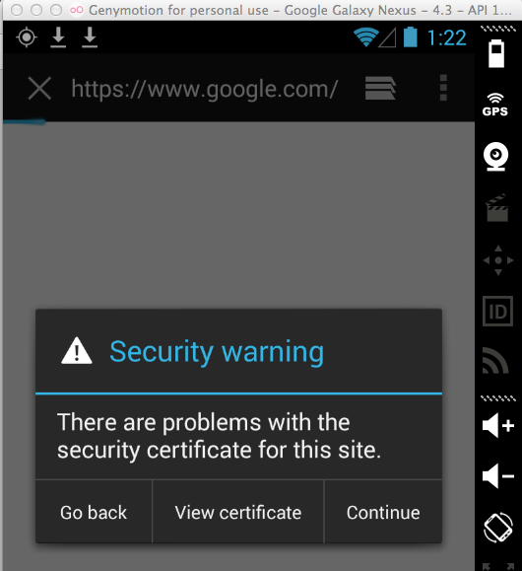
Simple SSL Test
Route Android traffic through Burp Proxy
Don't install the PortSwigger root certificate
This is a MITM attack
The default browser detects it

Slide 39
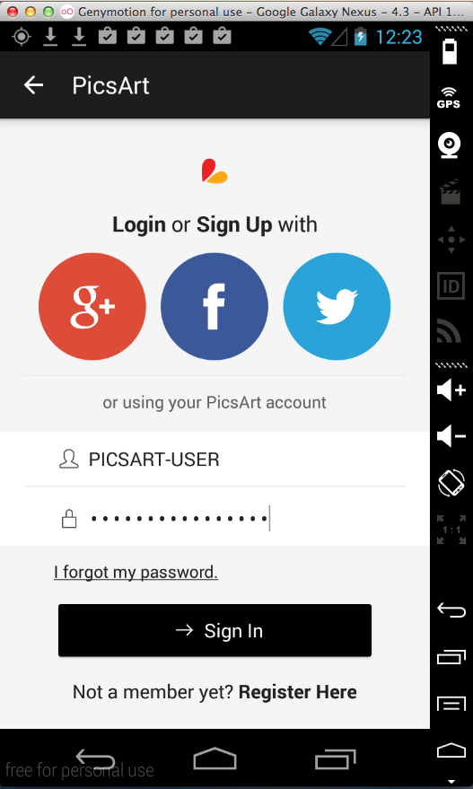
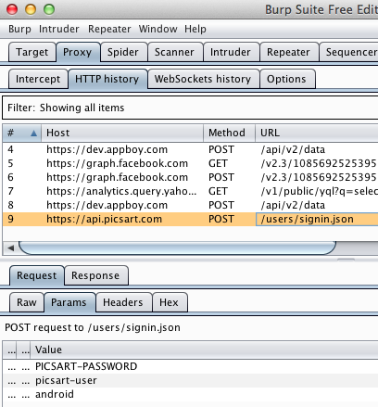
DEMO: PicsArt (100 Million)

Slide 40
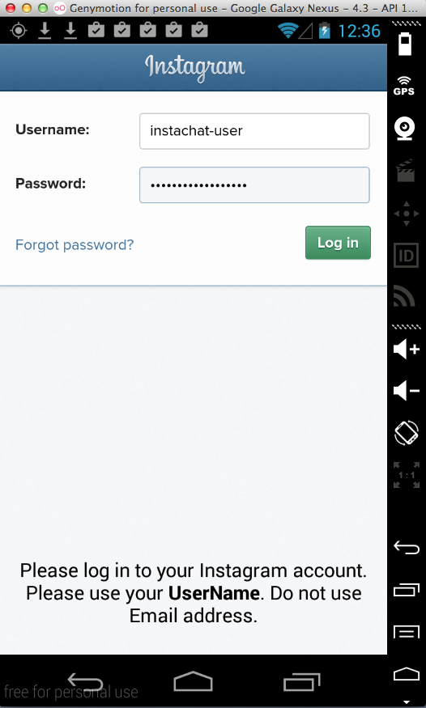
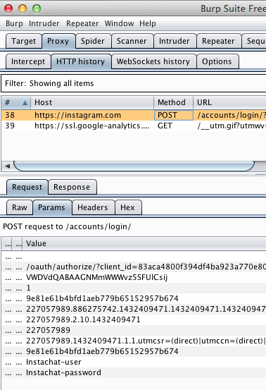
DEMO: InstaChat(100 Million)

Slide 41
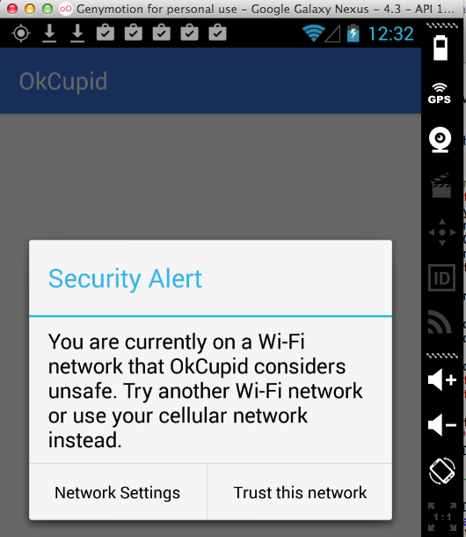
DEMO: OKCupid – FIXED!

Slide 42
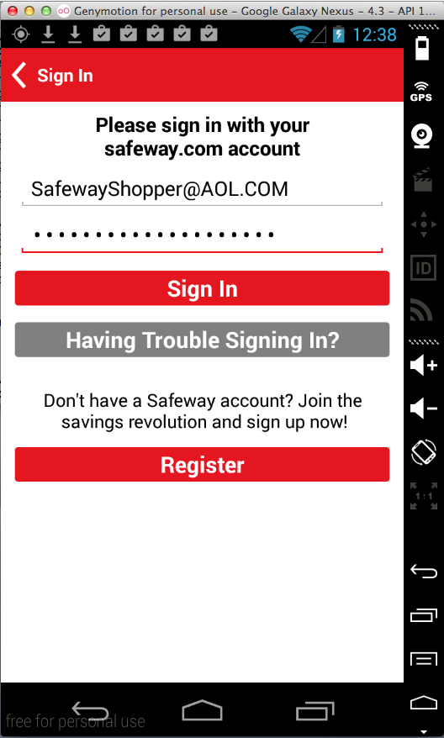
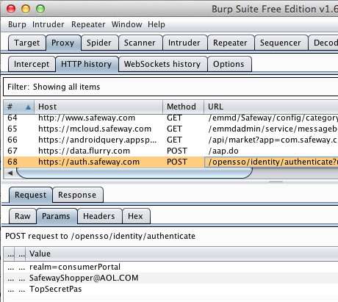
DEMO: Safeway (1 Million)

Slide 43
Broken SSL
Medical Apps

Slide 44
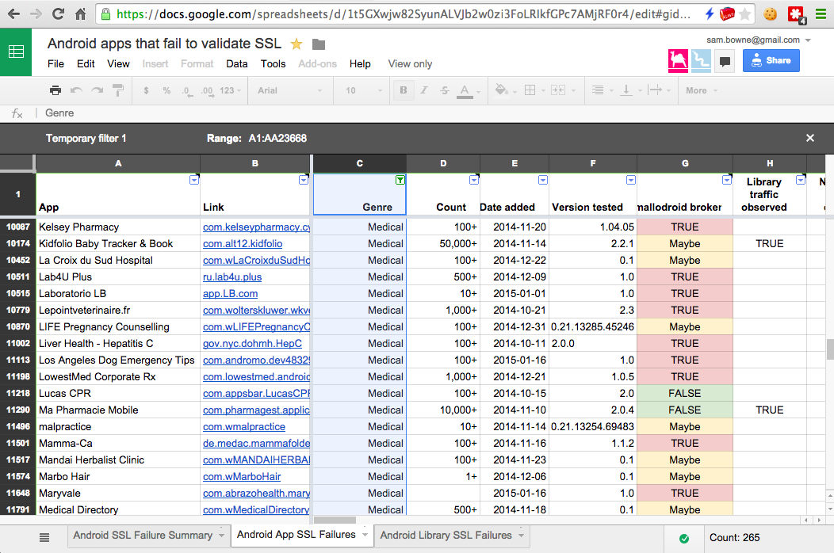
CERT found 265 Vulnerable Medical Apps

Slide 45
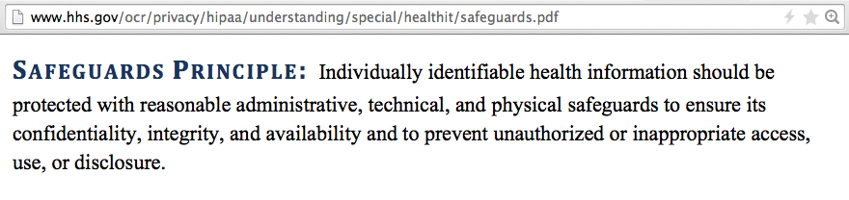
HIPAA

Slide 46
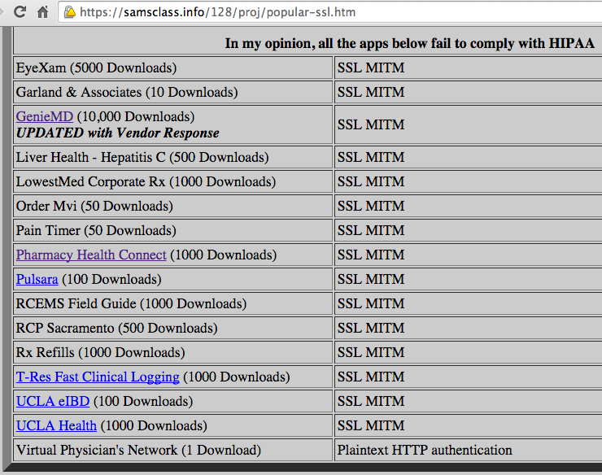
My Repeat of CERT Tests

Slide 47
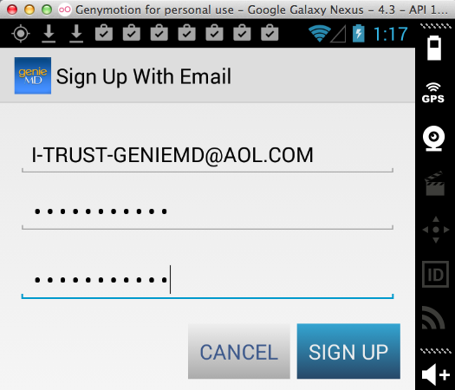
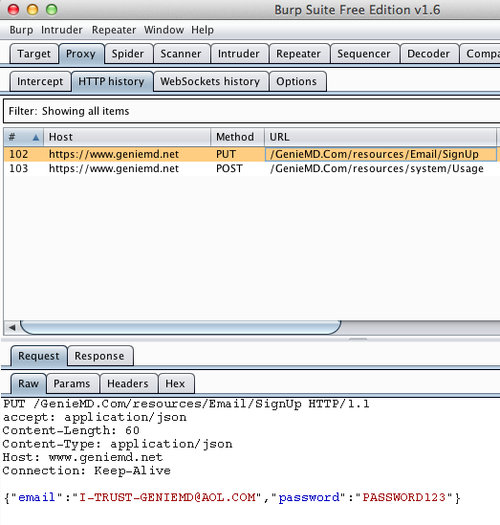
DEMO: GenieMD

Slide 48


DEMO: LowestMed corporate

Slide 49
LowestMed Response
Phone call to President of CCSF threatening a lawsuit
After I contacted their lawyer, he told me that there is no PII in the app beyond this point, so it is not a covered entity under HIPAA

Slide 50
Broken SSL
Testing New Apps

Slide 51
Responsible Disclosure
I need to give these guys time to respond, so most of them are still confidential
I can discuss one, because they fixed it really fast!

Slide 52


Blue Cross Blue Shield of North Carolina

Slide 53

Leaked Blue Cross Credentials
Also leaked Facebook, Twitter, and YouTube credentials

Slide 54

Fixed in Two Days
New version refuses to use invalid SSL certificates

Slide 55
Security Products

Slide 56


AIG MobileGuard
Security app required for insurance coverage
Removed from Google Play after my reports

Slide 57

Already Trojaned ☺

Slide 58

Local Storage of Sensitive Data
Security Answer
Security Question
PIN

Slide 59


DEMO: MobileSuperHero
(10,000)
Logs the PIN
Last update 12-13-12

Slide 60


DEMO: Virgin Mobile Rescue
(100,000)
Logs the PIN
Last update 7-22-13
Must uninstall Mobile Superhero to use it

Slide 61


DEMO: Rebound (50)
Logs the PIN
Last update 7-16-13

Slide 62


DEMO: Rebound Mobile Security (50)
Logs the PIN
Last updated 11-7-2013

