Slide 1




Cybersecurity’s Coming of Age
Sam Bowne

Slide 2

Sam Bowne
Instructor at City College San Francisco
Founder of Infosec Decoded, Inc.
PhD, CISSP, DEFCON Black Badge
Web: samsclass.info
Twitter: @sambowne

Slide 3
Before 2002

Slide 4

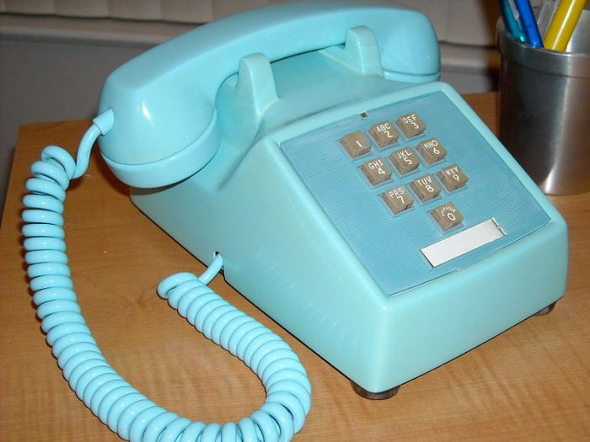
Before 2002
Wired network
Office computer
Work only from 9-5

Slide 5

Network security
One firewall at Internet gateway
”Trusted network”
Flat network
Antivirus was trusted
Most managers didn’t fear hackers

Slide 6
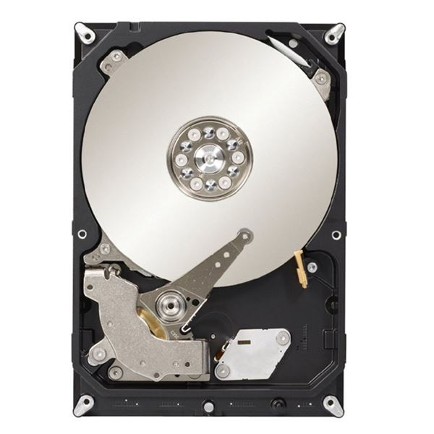
Forensics
Focused on crime and police work
Pull the plug
Image the hard drive
Write-blocker
Perfectly reproducible, integrity assured with MD5 hash

Slide 7
2002-2009

Slide 8


Cloud services
Workers bring in malware
Company data on home devices
No clear network perimeter

Slide 9

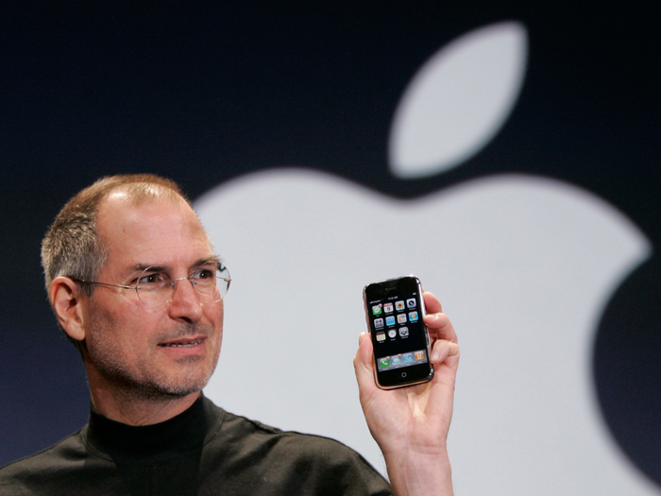

Mobile computing
Workers bring in malware
Company data on home devices
No clear network perimeter

Slide 10
Network security
Unified Threat Management at gateway
Blocks spam, malware, DoS attacks, and more
Host-based firewalls
Network segmentation

Slide 11
Forensics
Still focused on crime and police work
“Innocent Images”
RAM data considered useless
No timestamps or owner information

Slide 12
2010: Operation aurora

Slide 13
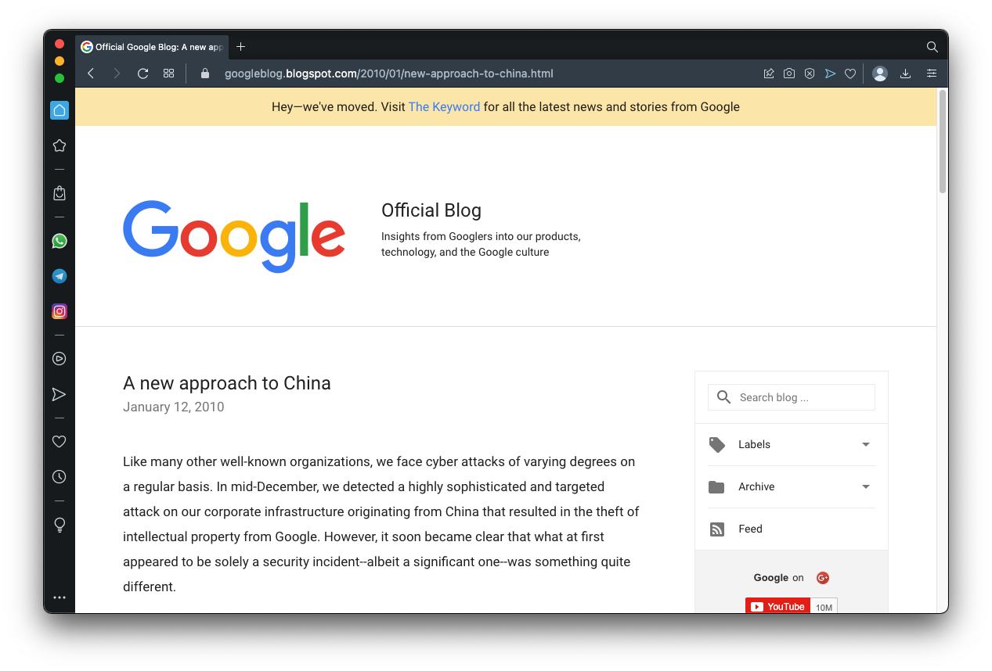
China hacked google

Slide 14
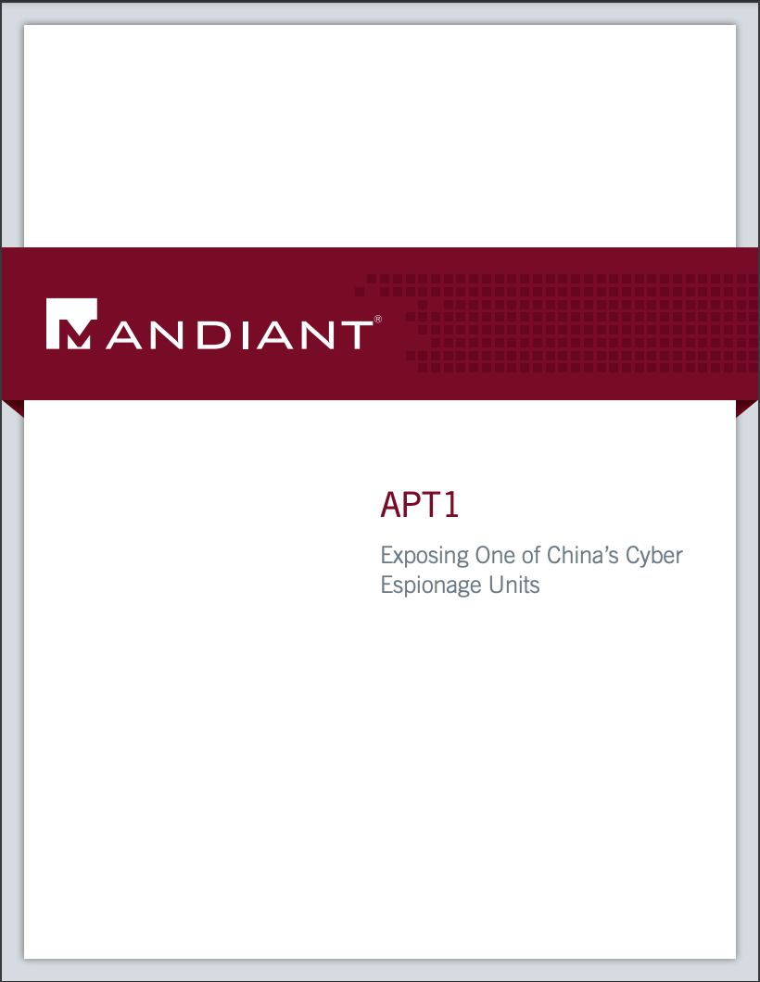

Slide 15
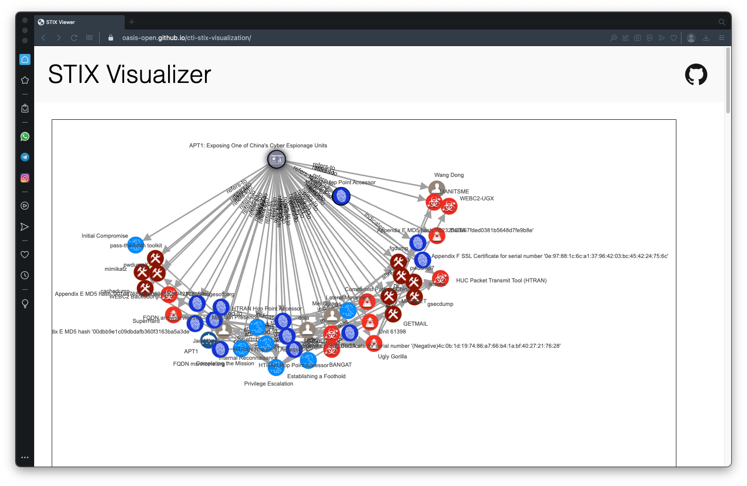

Slide 16
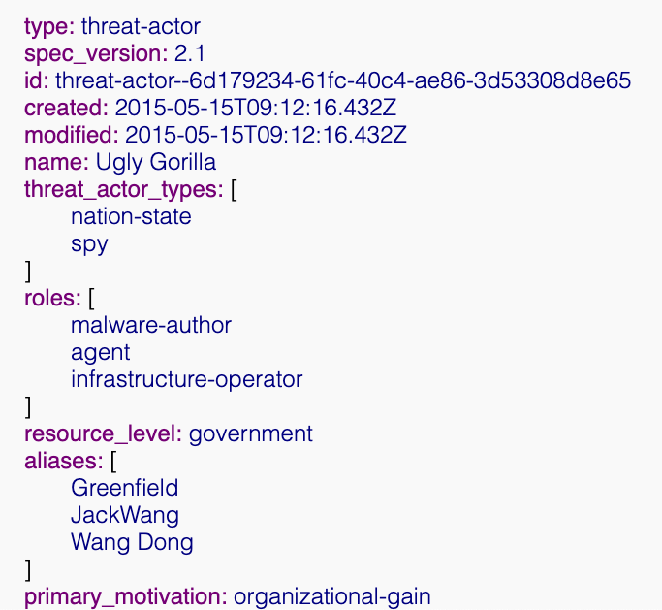
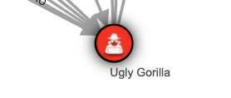
Threat actor

Slide 17
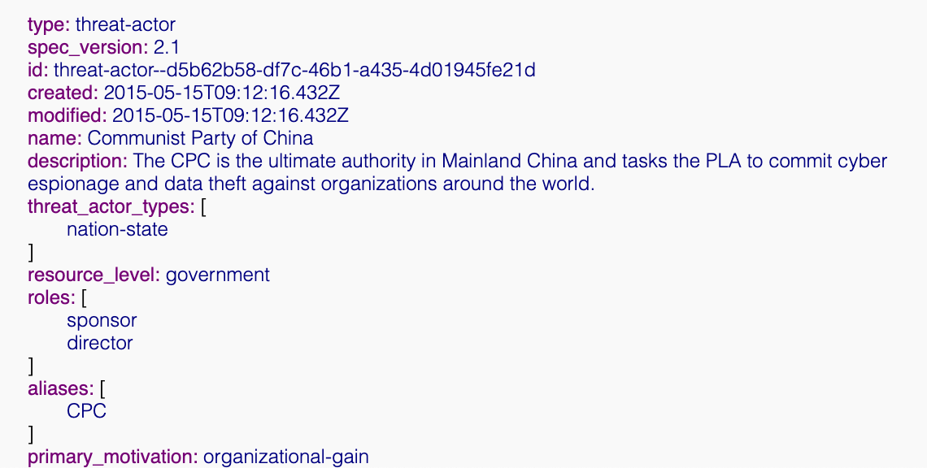
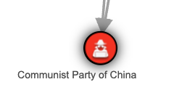
Threat actor

Slide 18
Modern network defenses

Slide 19
Defense in depth
Prevention
Firewalls
Intrusion detection
Endpoint protection
Detection
Network monitoring
Incident Response
Locate and isolate compromised systems
Investigate to find root cause
Perform a single eradication event
Restore systems
Monitor for residual threats

Slide 20
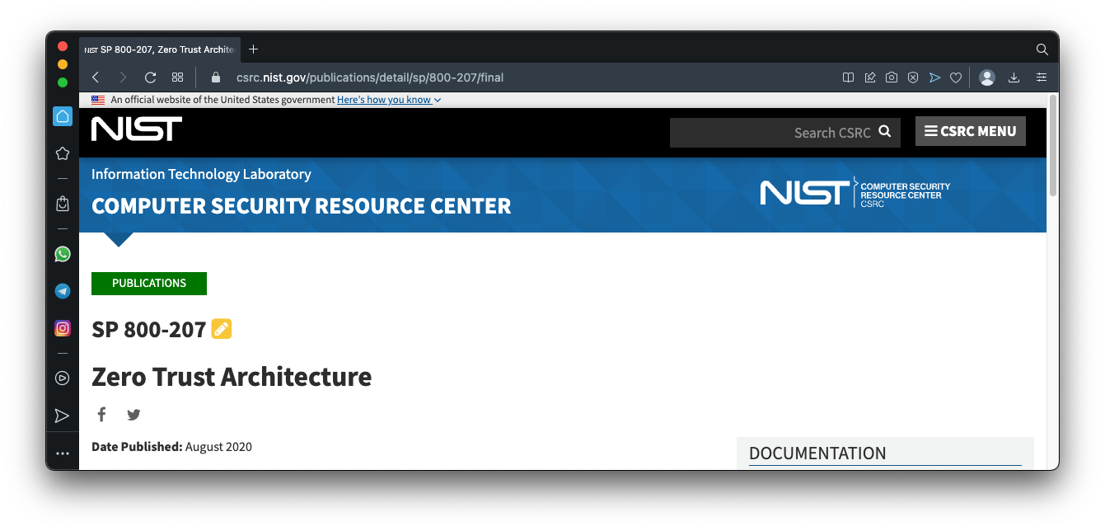
Zero trust

Slide 21
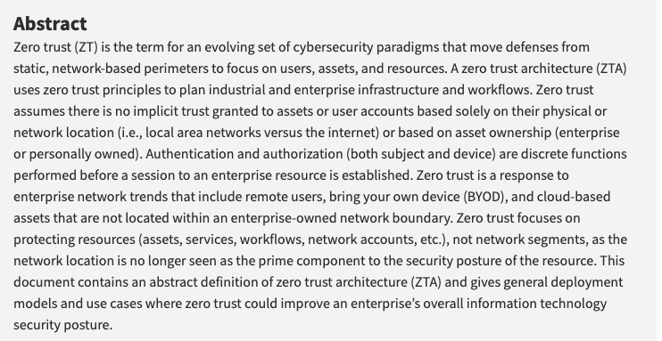

Slide 22
Incident response

Slide 23
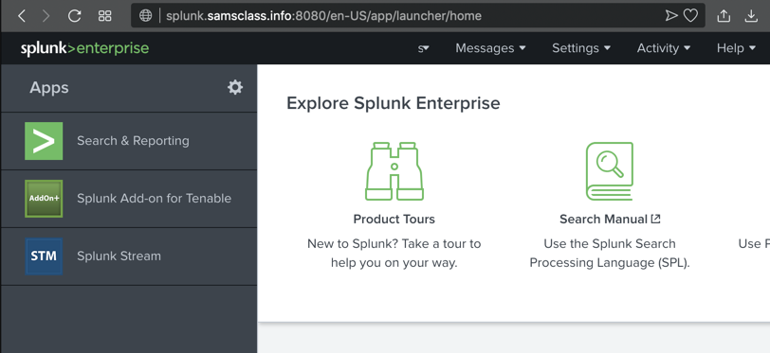
Network monitoring
SIEM: Security Information and Event Management
One central place to see events across the enterprise

Slide 24
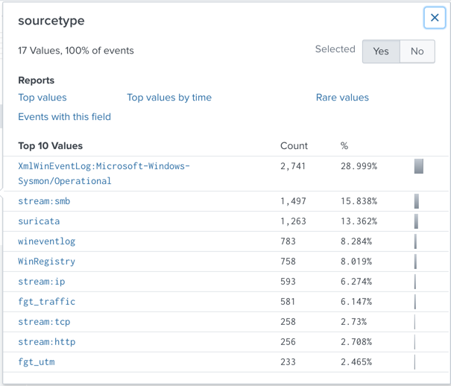
splunk
Gathers logs from
Firewalls
Servers
IDS
Endpoints
Raw network traffic

Slide 25
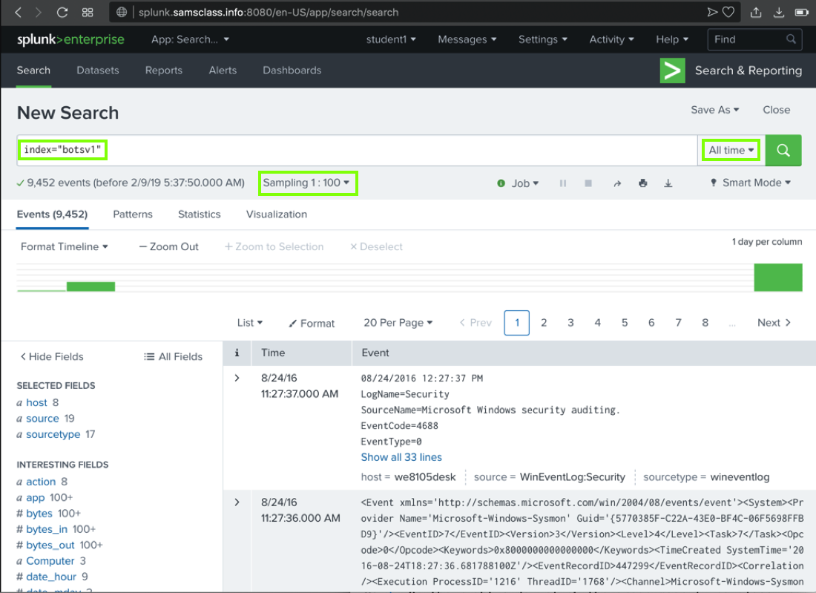
splunk
Search for events
“Google for log data”

Slide 26
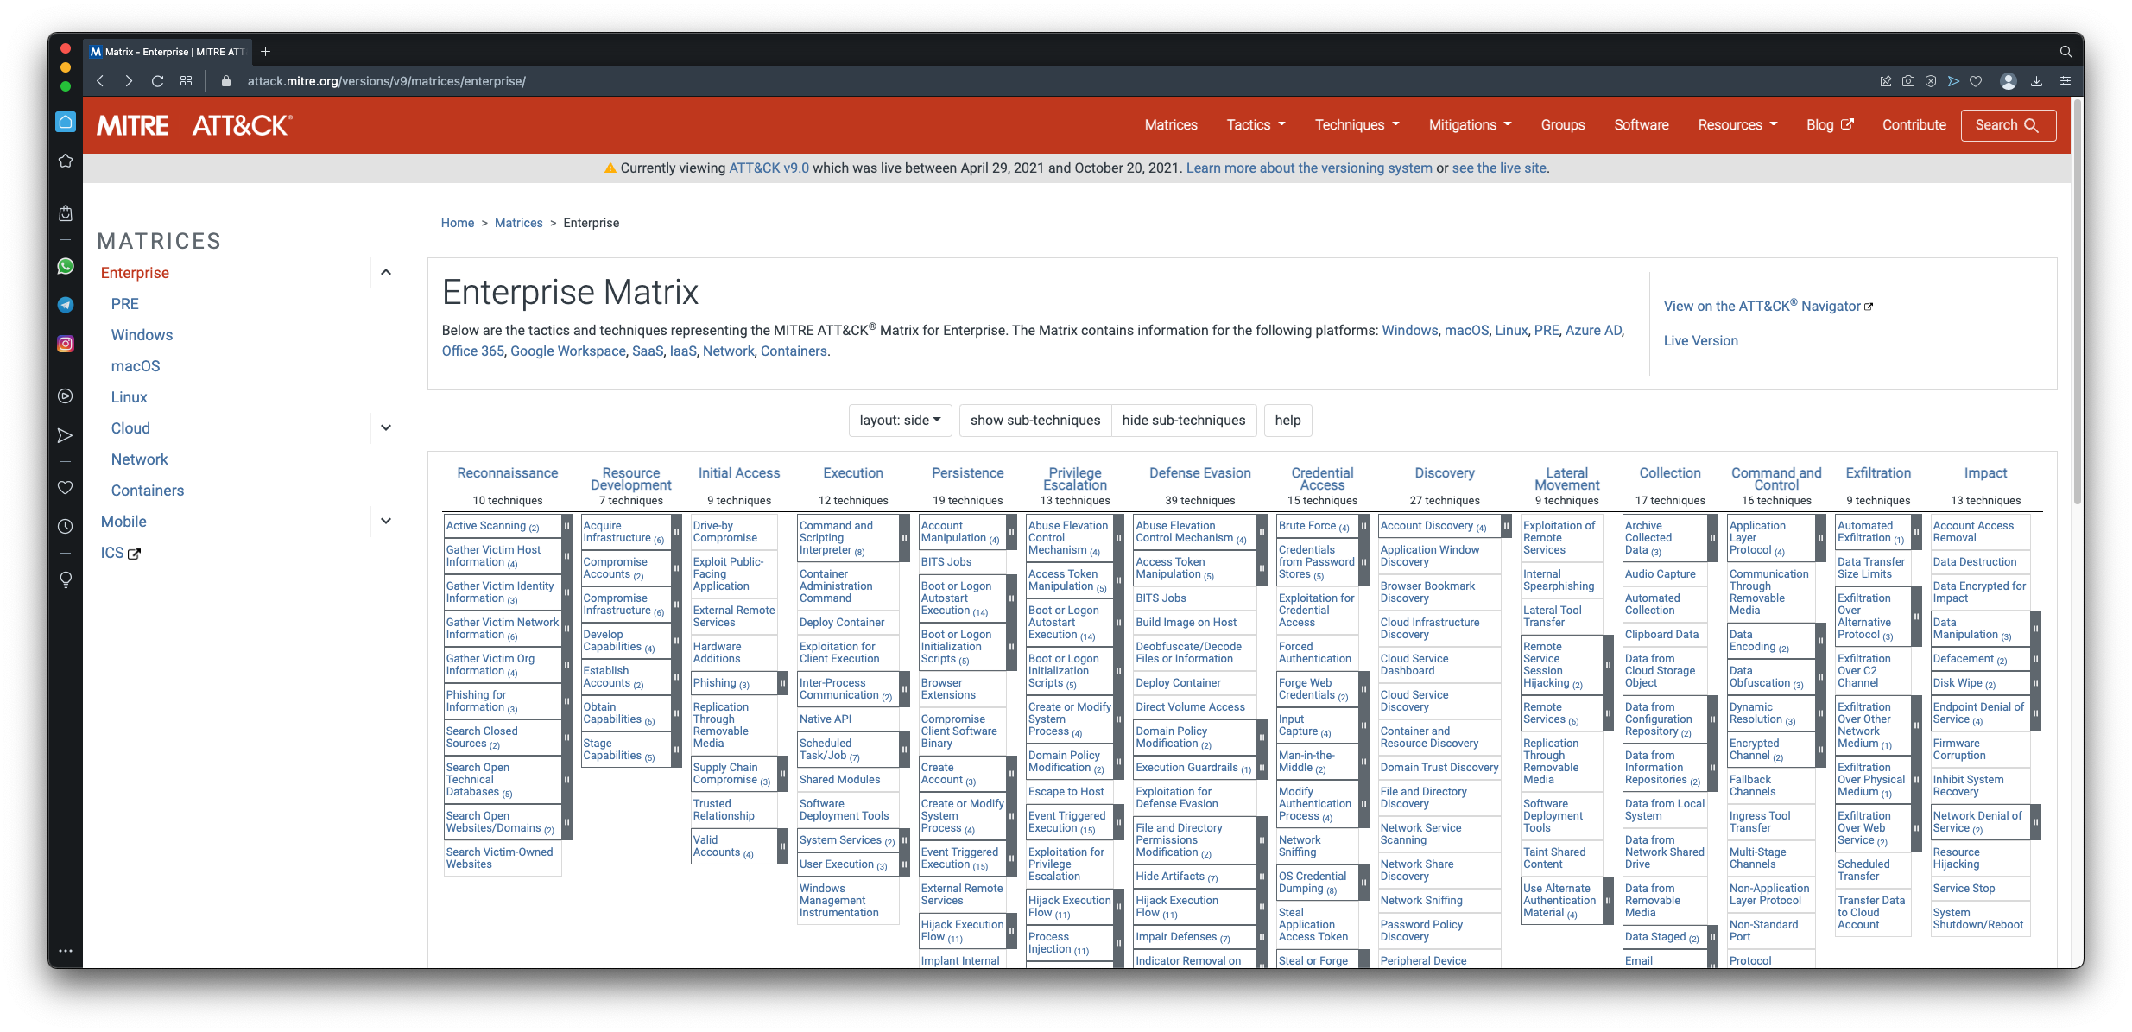
ATT&CK

Slide 27
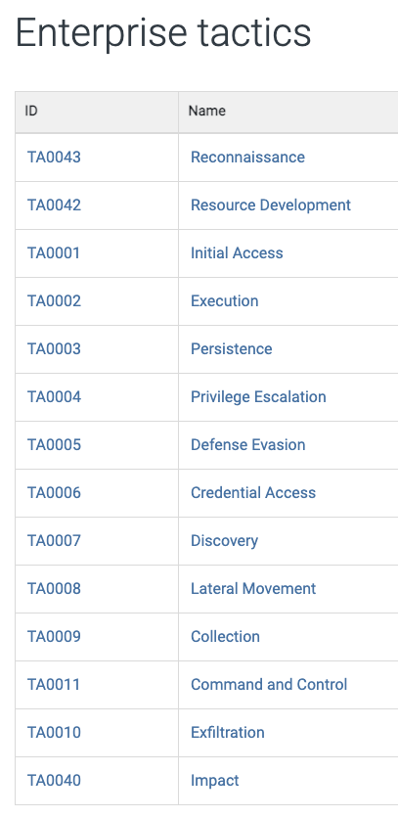

Slide 28
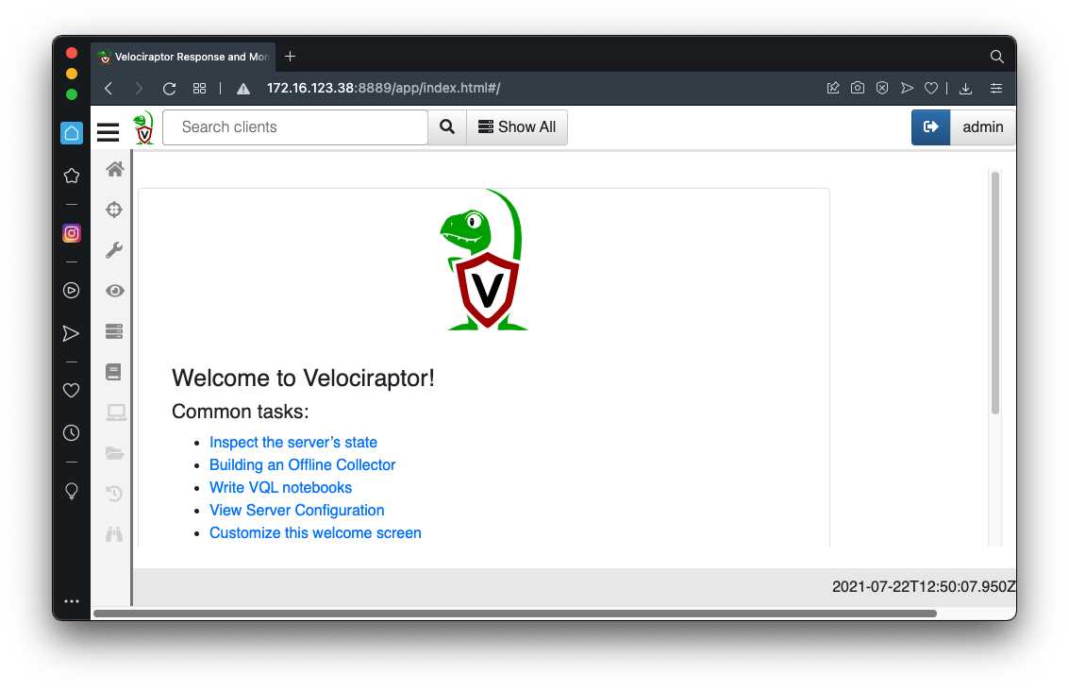
velociraptor
Investigate
Find Indicators of Compromise (IOC)
Hunt
Remediate

Slide 29
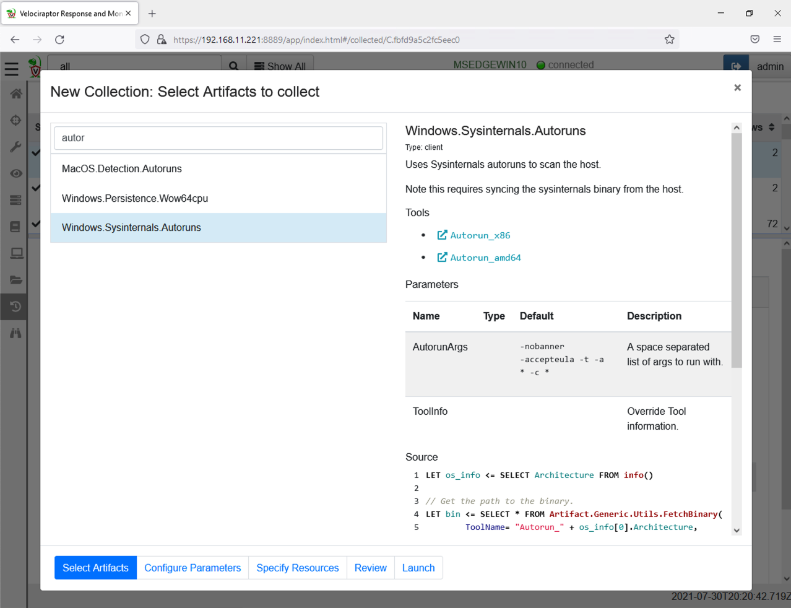
Find automatically launching software
Persistence

Slide 30
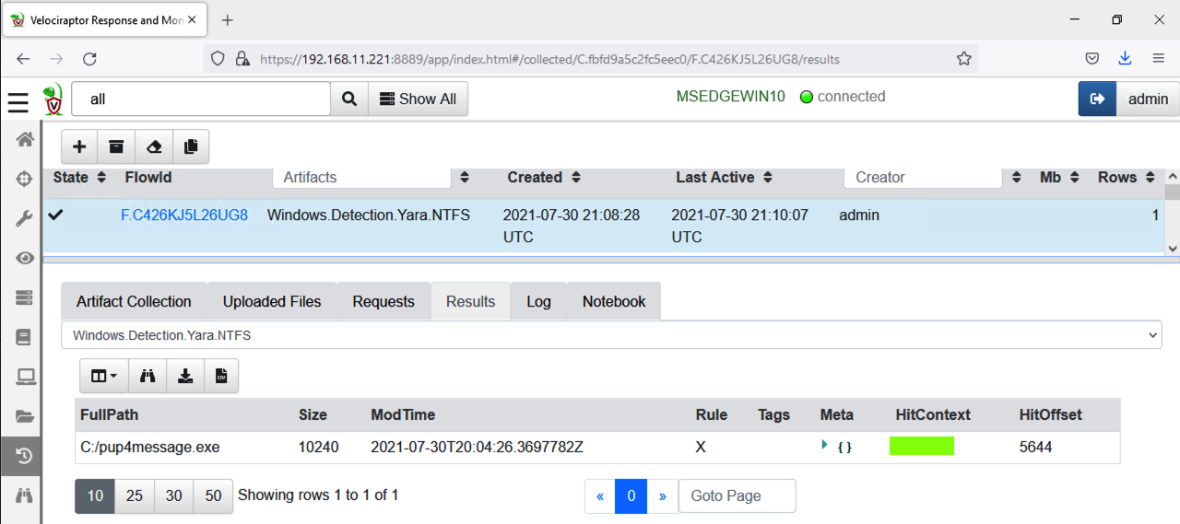
Velociraptor and yara
Find files containing suspicious strings

Slide 31
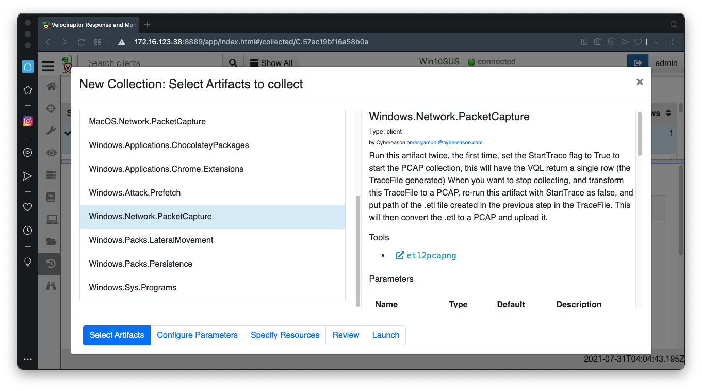
Packet capture
Gather live network traffic from endpoints

Slide 32
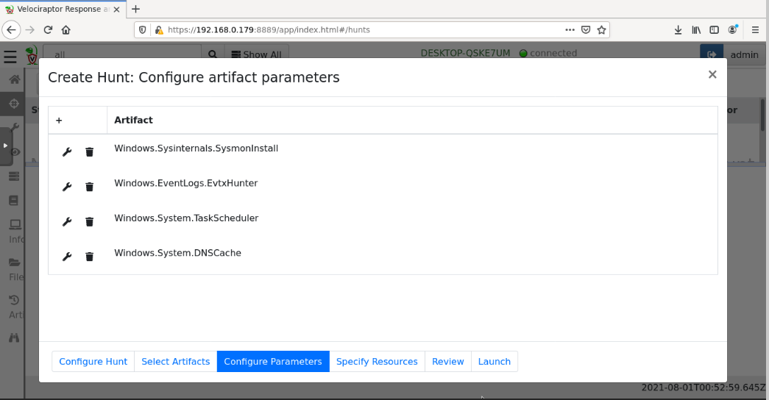
Threat Hunting
Gather several items of evidence from endpoints
Asynchronous
Limited resource demands

Slide 33
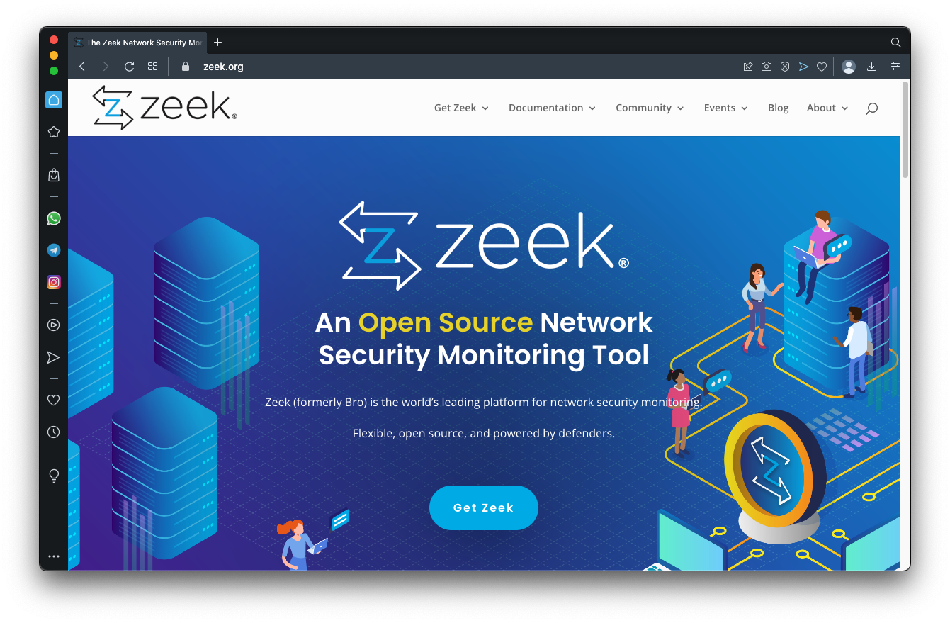

Slide 34
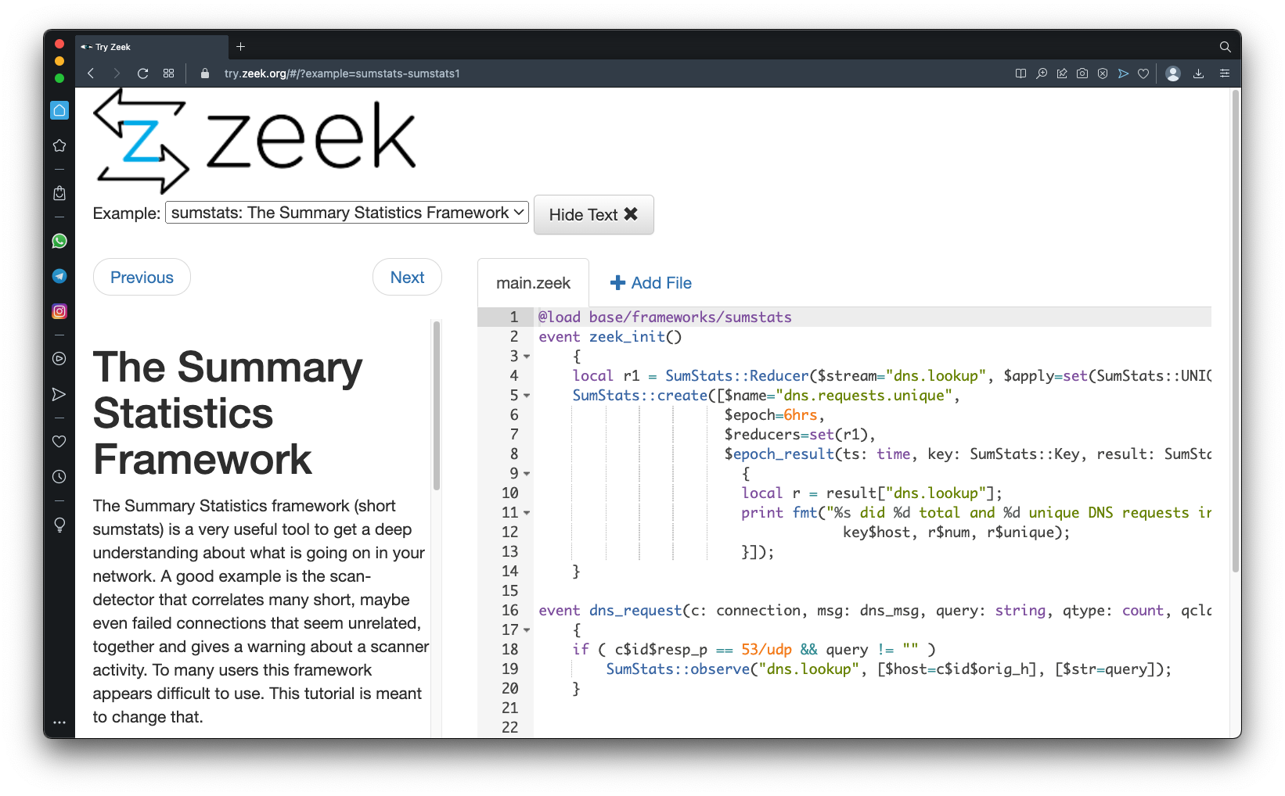
zeek
Programmable firewall replacement

Slide 35
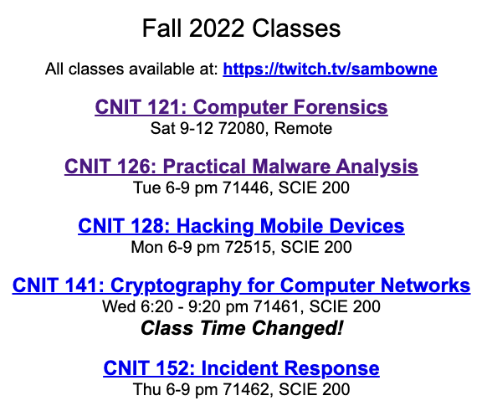
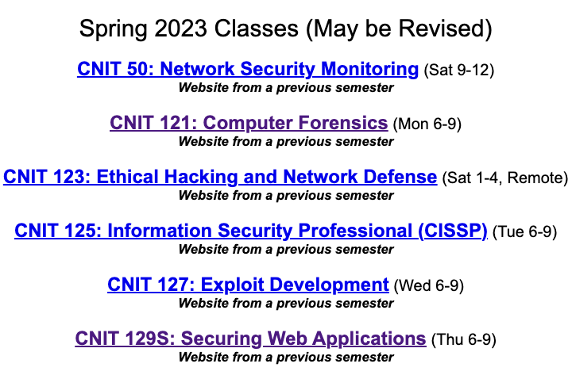
Free classes

Slide 36
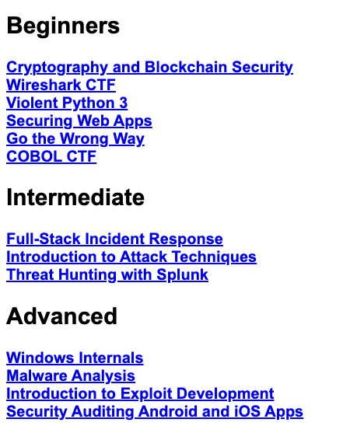
workshops

Slide 37

Questions?

