Slide 1
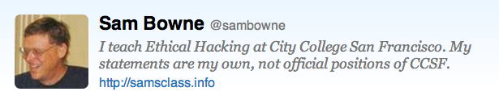
DNS Security
Pacific IT Pros
Nov. 5, 2013

Slide 2
Topics
DoS Attacks on DNS Servers
DoS Attacks by DNS Servers
Poisoning DNS Records
Monitoring DNS Traffic
Leakage of Internal Information
Domain Name Hijacking
Typosquatting

Slide 3
DNS is Essential
Without DNS, no one can use domain names like ccsf.edu
Almost every Internet communication begins with a DNS resolution

Slide 4
Normal DNS Function

Slide 5
DNS Delegation
Root
.com
.net
.edu
Servers cache content
local

Slide 6
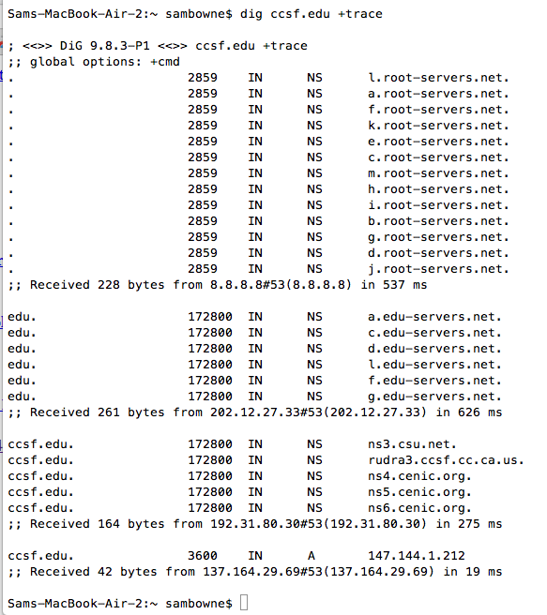
Recursive DNS Query

Slide 7
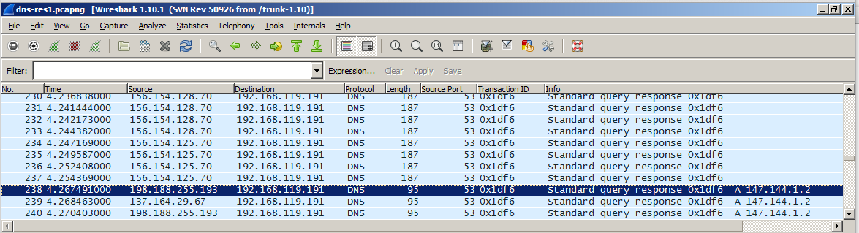
Demo
Resolving a domain through a Windows DNS server
238 packets, 4.3 sec
dig @192.168.119.191 hills.ccsf.edu

Slide 8
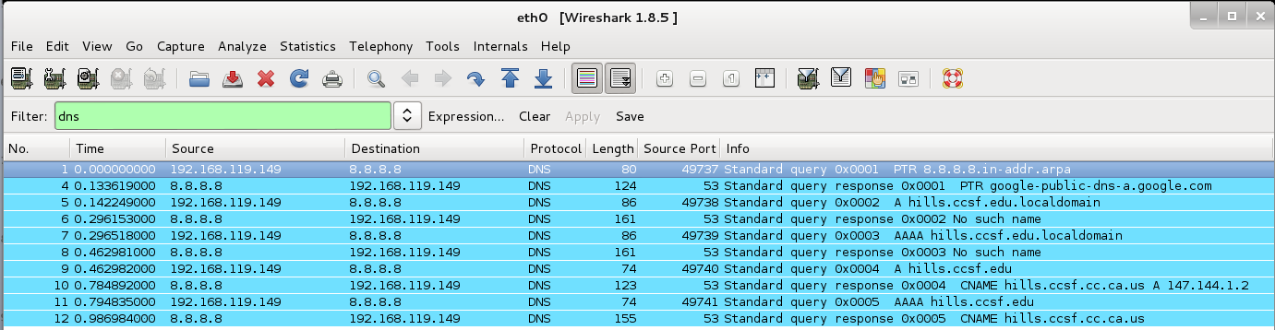
Linux DNS Server
10 packets, 1 sec.
Windows client
nslookup hills.ccsf.edu 192.169.119.223

Slide 9
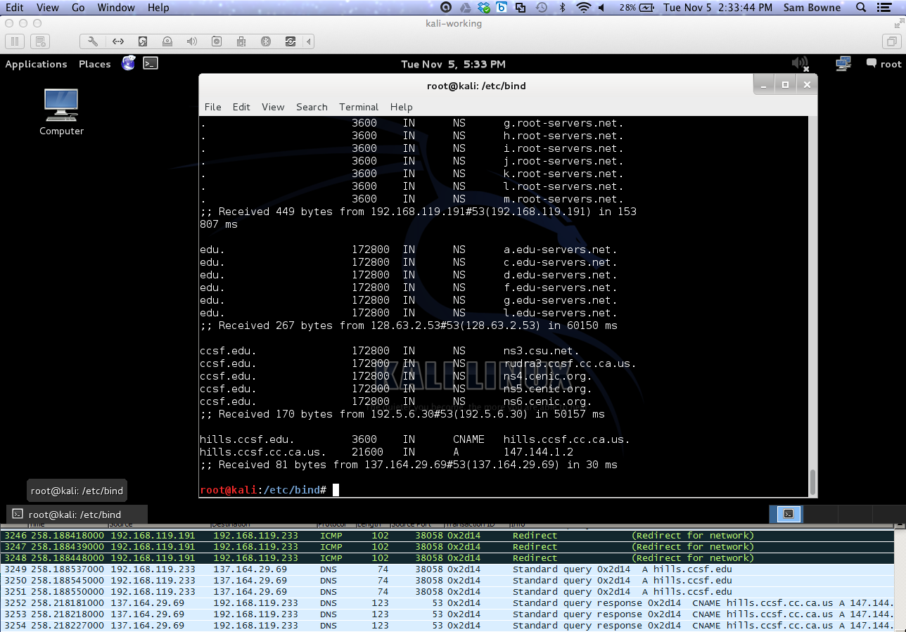
Over 3000 packets and 4 minutes for
dig @192.168.119.191 hills.ccsf.edu +trace
Linux used 317 packets and 2 seconds

Slide 10
DoS Attacks on DNS Servers

Slide 11
2007 Attack on DNS Root
Six root servers attacked from Asia
Volume 1 Gbps per server, bogus DNS requests
Only two were affected, because they did not yet have Anycast configured
Anycast allows one IP address to be shared by many different servers
Traffic automatically goes to closest working serer via BGP
Link Ch 1e

Slide 12
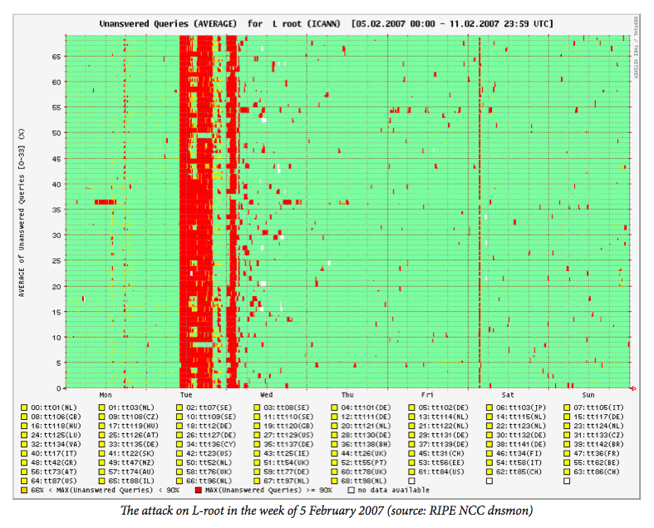
2007 Attack on DNS Root

Slide 13
DoS Attacks by DNS Servers

Slide 14

DNS Amplification
Find a domain name that gives a large response
Also called "DRDoS Attack" (Distributed Reflection and Amplification Denial of Service)
Target is attacking me!
DNS Server is attacking me!
Attacker
DNS Queries
Source IP: Target
DNS Server
DNS Responses
Destination IP: Target
Target

Slide 15
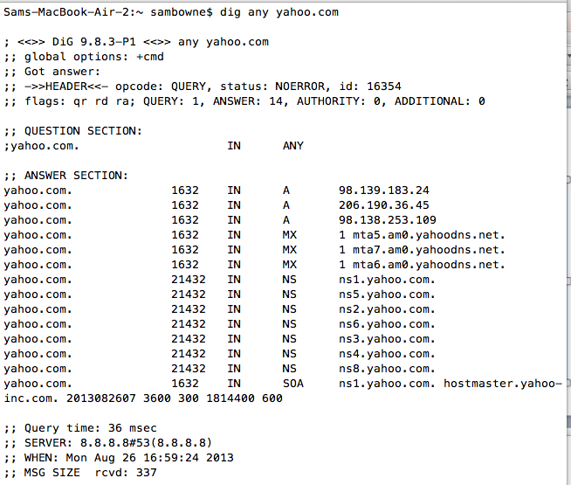
dig any yahoo.com

Slide 16
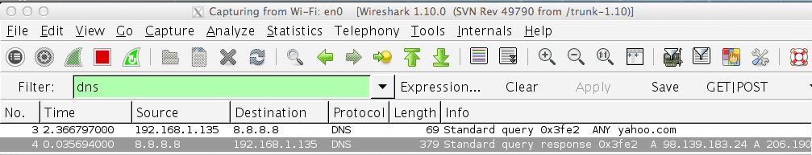
dig any yahoo.com
Request: 69 bytes
Reply: 379 bytes
Amplification: 5.5 x

Slide 17
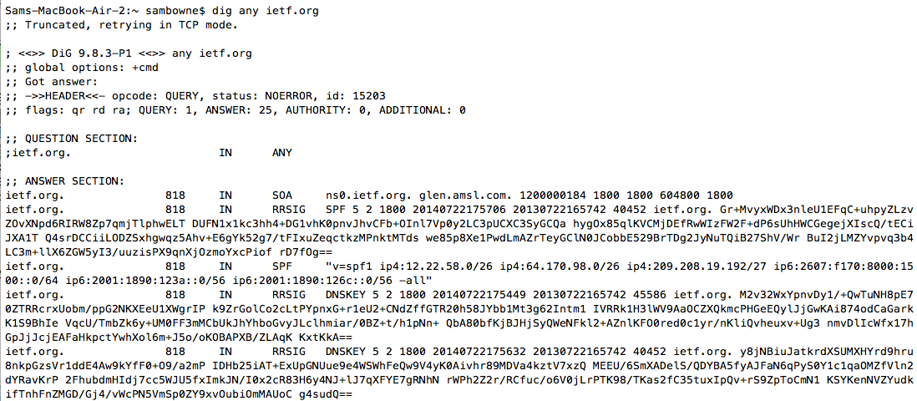
dig any ietf.org
Large DNSSEC signatures

Slide 18
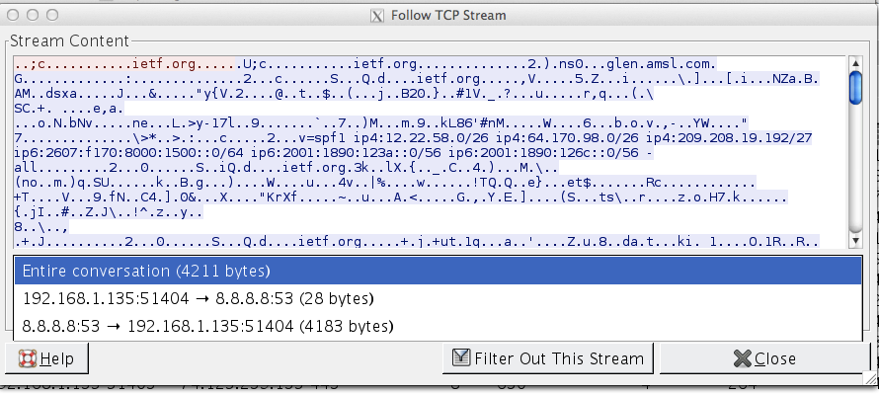
dig any ietf.org
Request: 28 bytes (+66 header)
Reply: 4183 bytes (+ headers)
Amplification: 45 x (but via TCP)

Slide 19
Extension Mechanisms for DNS (EDNS)
Allows transmission of larger packets via UDP
Normal max. is 512 bytes
This extends it to larger values, such as 4096
Essential for DNSSEC efficiency, but will make DNS amplification much more powerful
Link Ch 1k

Slide 20
Failure to Restrict Access
Recursive DNS servers should only accept queries from your own clients
Block outside addresses with access control lists

Slide 21
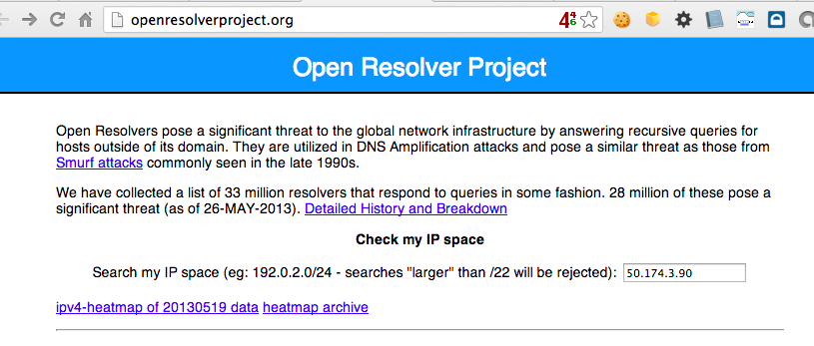
Open Resolver Project
Link Ch 3b

Slide 22
Testing CCSF's DNS Servers
dig ns ccsf.edu shows 6 servers
ns5.cenic.org 137.164.29.69 CLOSED
ns4.cenic.org 137.164.29.67 CLOSED
rudra3.ccsf.cc.ca.us 147.144.3.238 CLOSED
ns6.cenic.org 198.188.255.193 CLOSED
ns1.csu.net 130.150.102.100 OPEN
ns3.csu.net 137.145.204.10 OPEN

Slide 23
Poisoning DNS Records

Slide 24
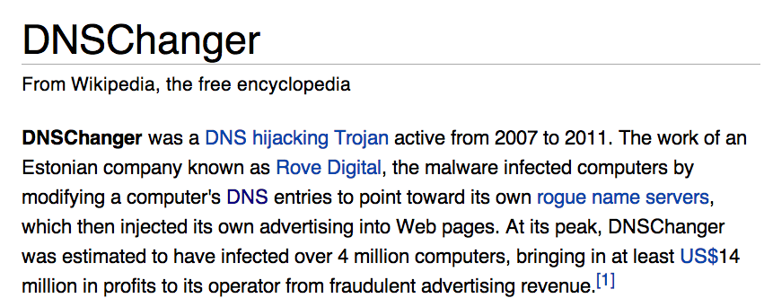
Changed local DNS server address
Link Ch 1h

Slide 25
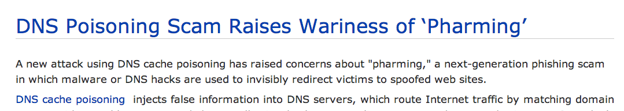
DNS Cache Poisoning
Malicious altering of cache records redirects traffic for users of that server
2005 attack redirected traffic for more than 1000 companies
Link Ch 1g, from 2005

Slide 26
DNS Cache Poisoning
A false response that tricks the client puts a false entry into its cache

Slide 27
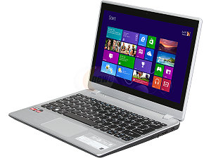
DNS Cache Poisoning
Where is www.yahoo.com?
Attacker
1.2.3.4
www.yahoo.com is at 1.2.3.4
Where is www.yahoo.com?
DNS Resolver
www.yahoo.com is at 1.2.3.4
Target

Slide 28
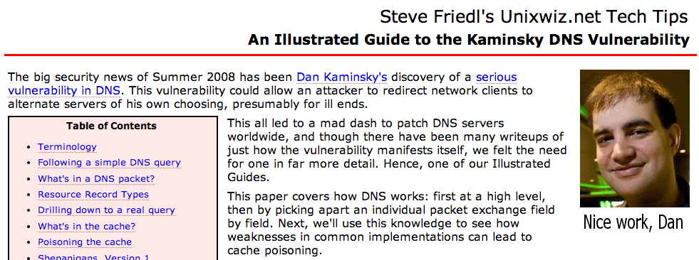
Kaminsky DNS Vulnerability
Serious vulnerability in 2008
Allowed poisoning caches on many servers
Patched before it was widely exploited
Link Ch 1h

Slide 29
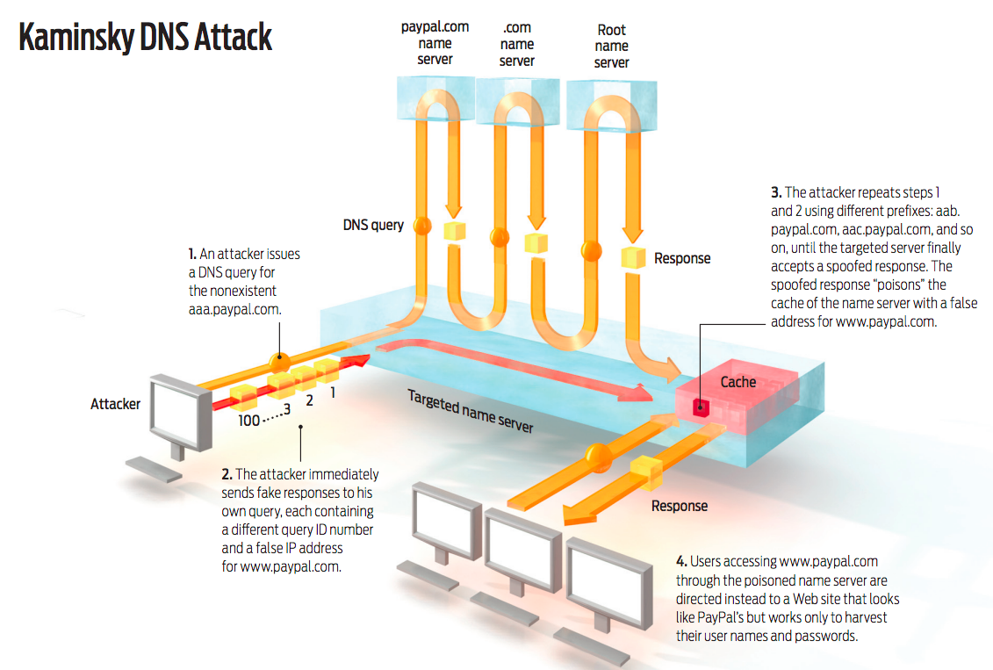
Link Ch 3f

Slide 30
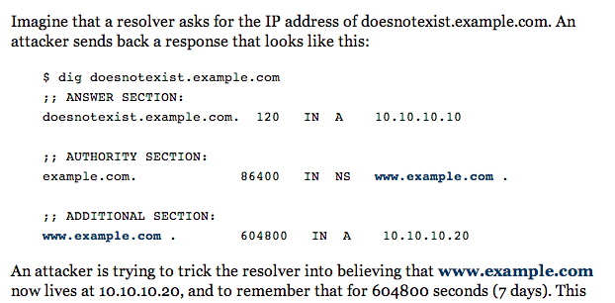
Link Ch 3g

Slide 31
Consequences of the Kaminsky Attack
Attack can be placed in a Web page
Many img tags
<img src=aaaa.paypal.com>
<img src=aaab.paypal.com>
<img src=aaac.paypal.com>
<img src=aaad.paypal.com>
etc.
If one Comcast customer views that page, all other Comcast customers will be sent to the fake paypal.com
Poisoning can take as few as 10 seconds

Slide 32
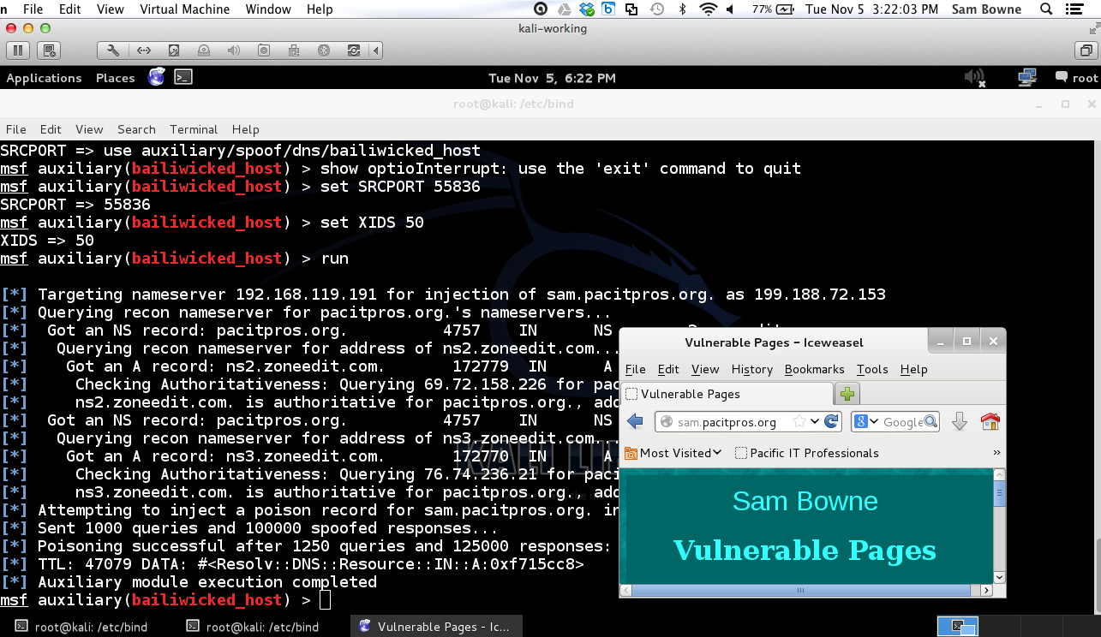
DEMO

Slide 33
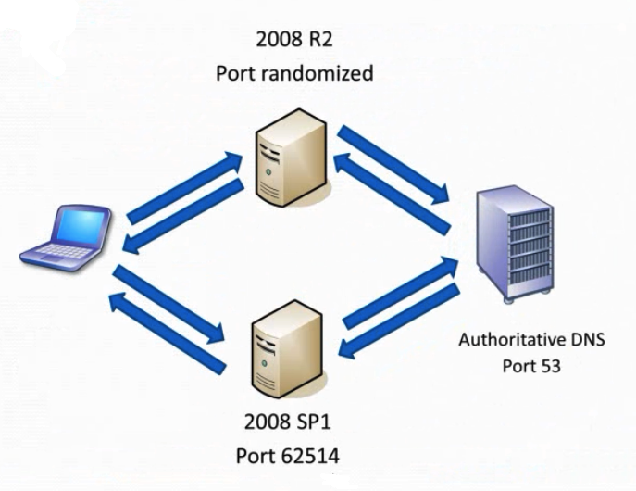
Source Port Randomization
This was patched in Windows Server 2008
Good video
Link Ch 3e

Slide 34
Randomness of Transaction ID
Each DNS query and response has a TXID field
16 bits long (65,536 possible values)
Should be random
Bind 8 & 9 used predictable transaction IDs
So only ten guesses were needed to spoof the reply

Slide 35
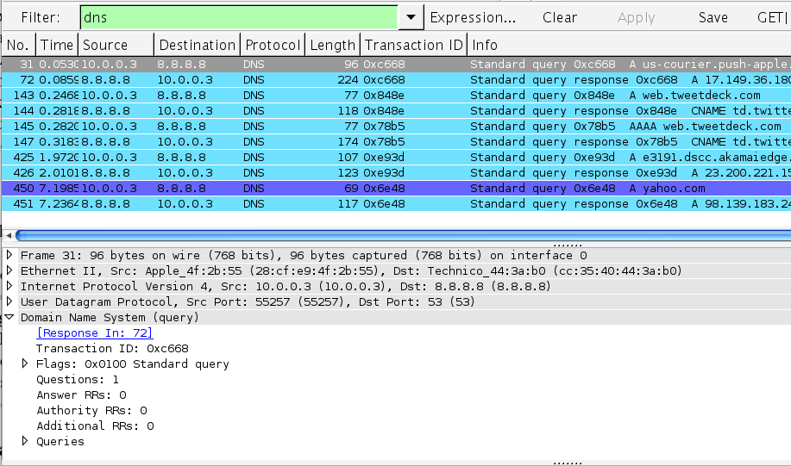
Randomness of Transaction ID

Slide 36
DNS Traffic as a Gauge of Malicious Activity

Slide 37
DNS Monitoring
Infected machines often make many DNS queries
Spam relays make DNS requests to find addresses of mail servers
Botnets often make many DNS requests to obscure domains

Slide 38
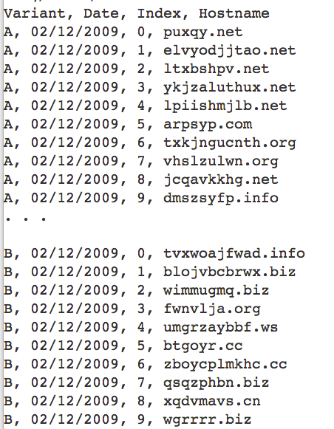
Conficker Worm Domains
Algorithm made 50,000 new domains per day
Registrars tried to block them all
Links Ch 1u, 1v

Slide 39
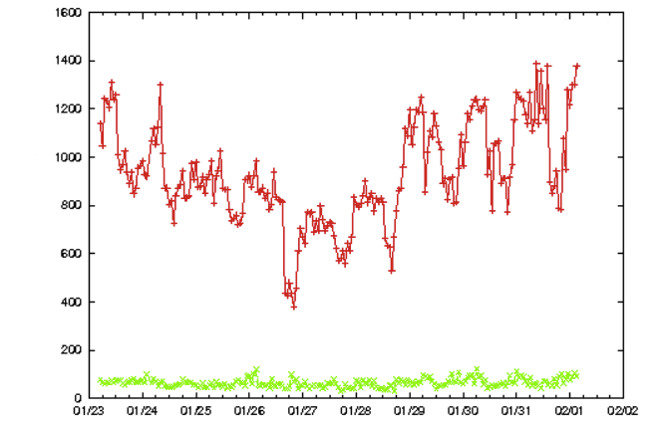
Requests per hour
Bots
Normal Traffic
From Link Ch 1q

Slide 40
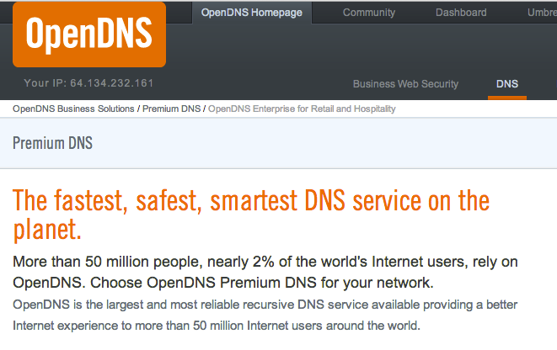
Blocking DNS Resolution for Known Malicious Domains

Slide 41
OpenDNS
Anycast for reliability
Reports of DNS activity for management
Blocks malicious servers
Can enforce other rules like Parental Controls

Slide 42
Leakage of Internal Information

Slide 43
Exposure of Internal Information
Only public Web-facing servers should be in the external DNS zone files
Your DNS server is a target of attack and may be compromised

Slide 44
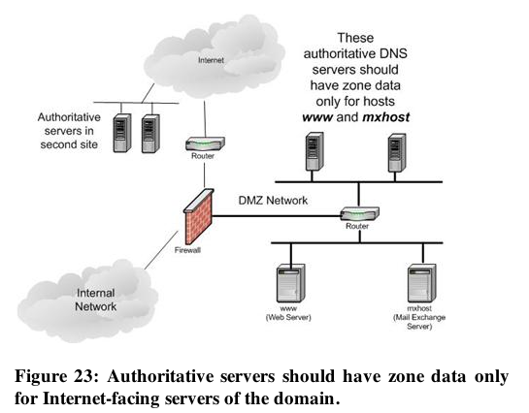

Slide 45
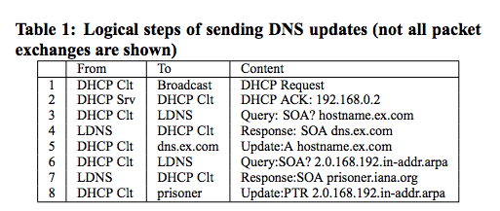
Leakage of Internal Queries to the Internet
Some Windows DHCP clients leak dynamic DNS updates to the Internet
Link Ch 3a

Slide 46
Windows Versions
These packets were sent from Windows 2000, Windows XP, and Server 2003
When tested in 2006
To prevent this, configure local DNS servers not to refer internal machines to external name servers
And block DNS requests directly to the Internet

Slide 47
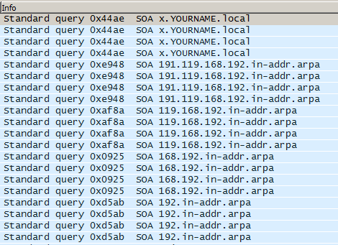
Dynamic DNS Registration Stupid Requests

Slide 48
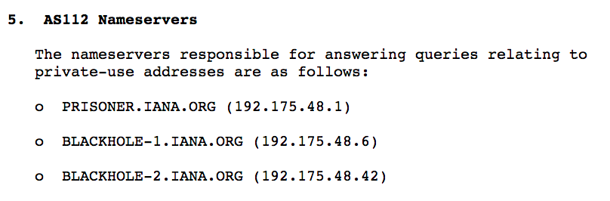
AS 112: RFC 6304
Special autonomous system set up just to handle these stupid queries

Slide 49
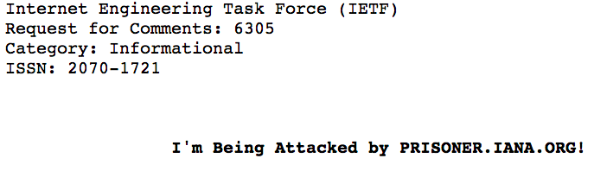
RFC 6305

Slide 50
Domain Name Hijacking

Slide 51
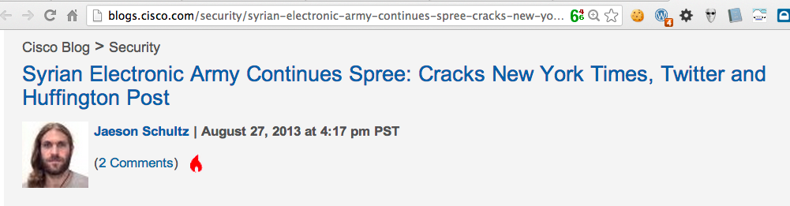
DNS Registrars
Registrar connects your domain name to its authoritative servers (SOA)
Changing that data hijacks your domain

Slide 52
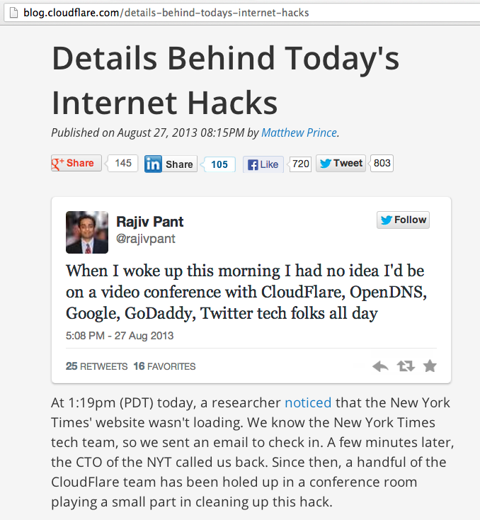
NY Times Rapid7

Slide 53
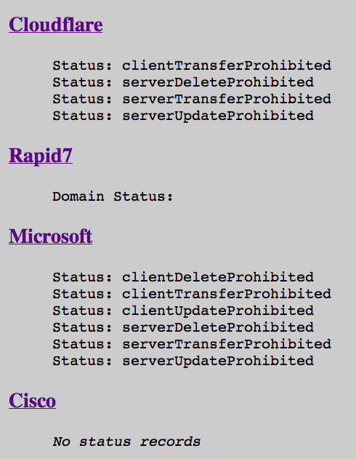
Defense: Registry Locks
"Test of Domain Locking"
In "Domain Name Hijacking" section

Slide 54
Typosquatting

Slide 55
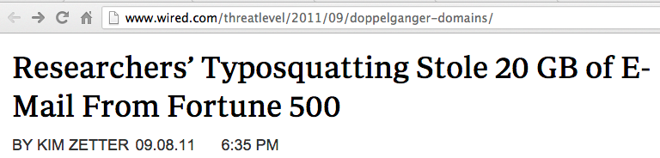
Doppelganger domains are spelled almost identically to legitimate domains
seibm.com
instead of
se.ibm.com (IBM's division in Sweden)

