Slide 1
DNS Security
Ch 1: The Importance of DNS Security

Slide 2
DNS is Essential
Without DNS, no one can use domain names like ccsf.edu
Almost every Internet communication begins with a DNS resolution

Slide 3
DNS Under Attack

Slide 4
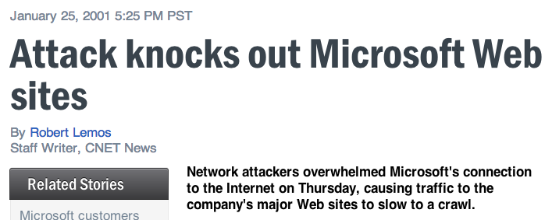
Microsoft (2001)
In 2001, Microsoft's DNS servers were attacked
  Link Ch 1a

Slide 5
Single Point of Failure
Microsoft's network went through a single switch at that time
25% of the 1000 largest companies had a centralized DNS architecture at that time
Companies moved to distributed architectures

Slide 6
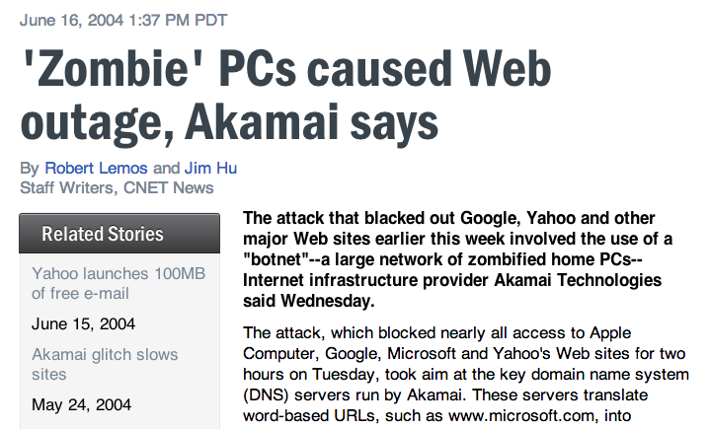
Botnet defeated distributed architecture
  Link Ch 1b

Slide 7
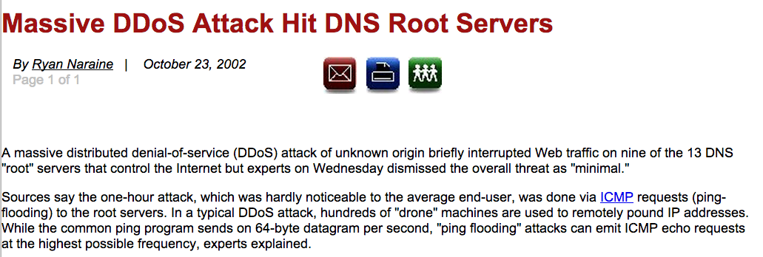
2002 Attack on DNS Root Servers
Attacked all 13 root servers simultaneously
ICMP flood, 900 Mbps
  Links Ch 1c, 1d

Slide 8
Defenses in 2002
The attack had little effect, because
Root DNS servers are vastly over-provisioned
Attack was short; 1 hour
  DNS records were cached in downstream servers

Slide 9
2007 Attack on DNS Root
Six root servers attacked from Asia
Volume 1 Gbps per server, bogus DNS requests
Only two were affected, because they did not yet have Anycast configured
Anycast allows one IP address to be shared by many different servers
  Traffic automatically goes to closest working serer via BGP
  Link Ch 1e

Slide 10
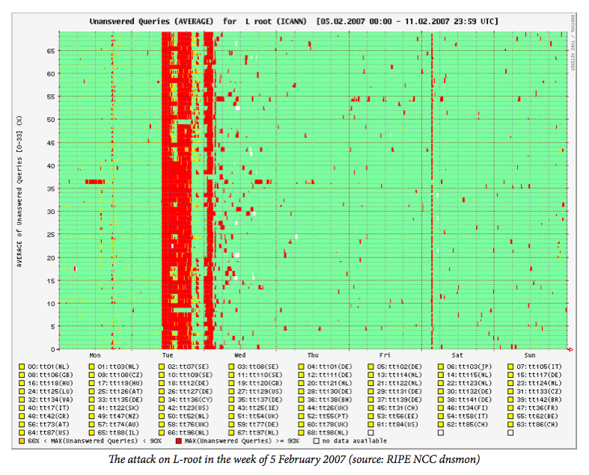
2007 Attack on DNS Root

Slide 11
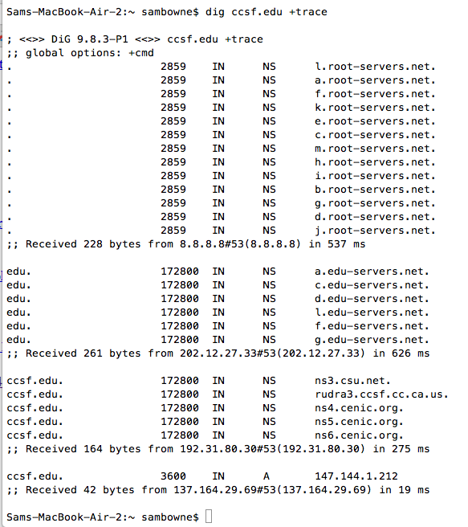
Recursive DNS Query

Slide 12
DNS Delegation
Root
.com
.net
.edu
Servers cache content
local

Slide 13
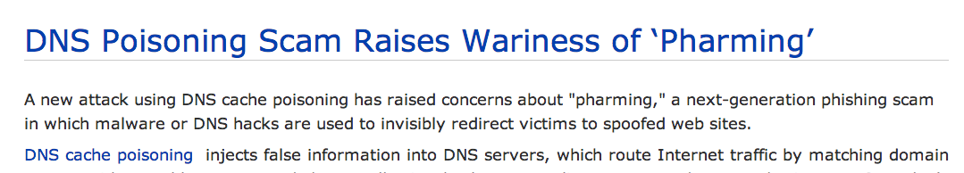
DNS Cache Poisoning
Malicious altering of cache records redirects traffic for users of that server
2005 attack redirected traffic for more than 1000 companies
  Link Ch 1g, from 2005

Slide 14
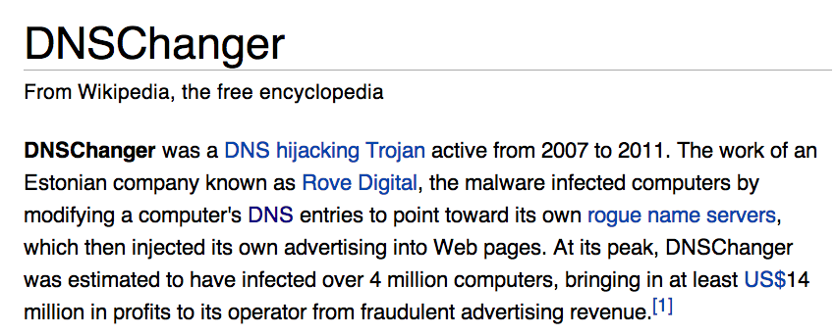
Changed local DNS server address
  Link Ch 1h

Slide 15
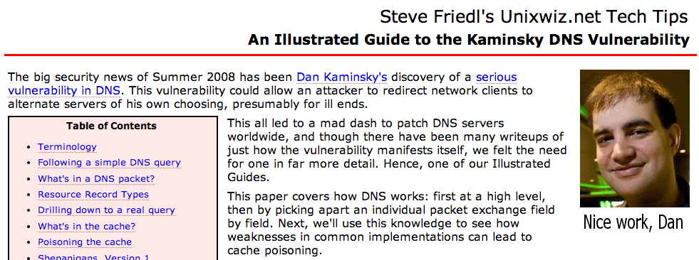
Kaminsky DNS Vulnerability
Serious vulnerability in 2008
Allowed poisoning caches on many servers
Patched before it was widely exploited
  Link Ch 1h

Slide 16
DNS Assisting Attacks

Slide 17
Dynamic DNS (DDNS)
Allows the IP address of a domain name to change quickly
This allows home users to host servers on transient addresses
Abused by botnet operators, phishers, and malware download sites
  Change address rapidly to avoid detection and shutdown

Slide 18
Fast Flux DNS
Changes DNS addresses rapidly
Hides servers behind reverse proxies that rapidly change
Makes it difficult to find the central servers
  Link Ch 1j

Slide 19
Packet Amplification
Smurf attack
  PING echo request sent to a broadcast address
  Many replies for each request
Attacker
Target

Slide 20
DNS Amplification
Find a domain name that gives a large response
Also called "DRDoS Attack" (Distributed Reflection and Amplification Denial of Service)
  Link Ch il
Attacker
DNS Server
Target

Slide 21
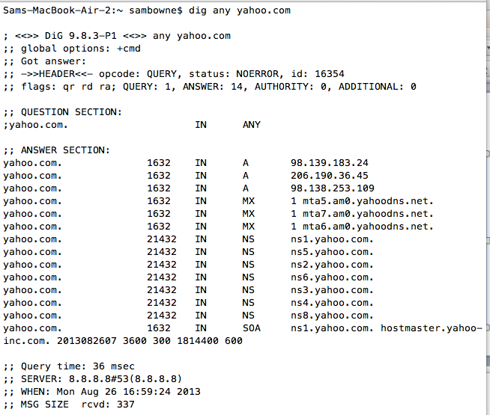
dig any yahoo.com

Slide 22
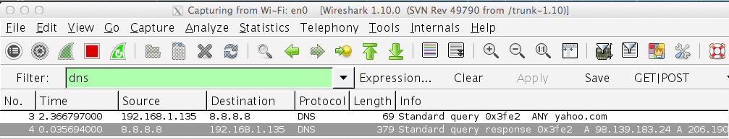
dig any yahoo.com
Request: 69 bytes
Reply: 379 bytes
Amplification: 5.5 x

Slide 23
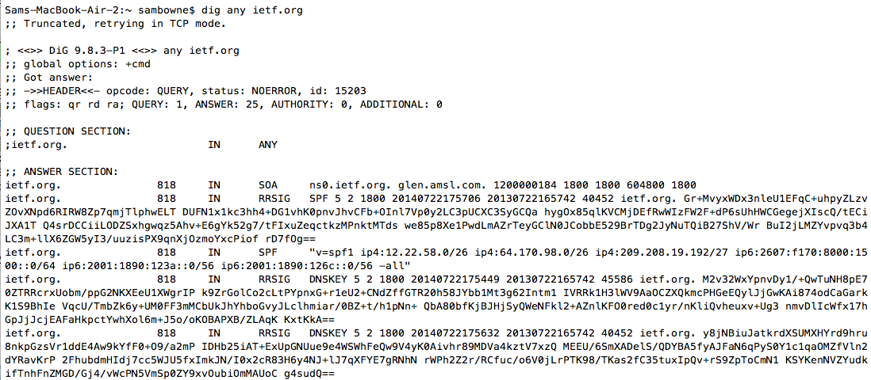
dig any ietf.org
Large DNSSEC signatures

Slide 24
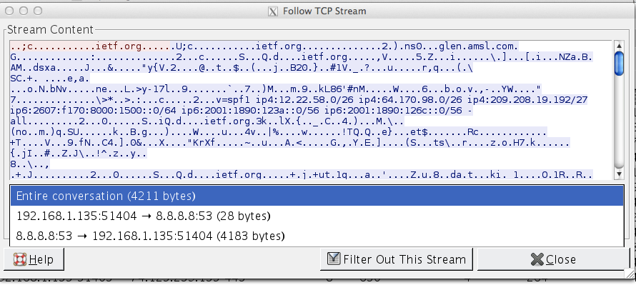
dig any ietf.org
Request: 28 bytes (+66 header)
Reply: 4183 bytes (+ headers)
Amplification: 45 x (but via TCP)

Slide 25
Extension mechanisms for DNS (EDNS)
Allows transmission of larger packets via UDP
Normal max. is 512 bytes
This extends it to larger values, such as 4096
Essential for DNSSEC efficiency, but will make DNS amplification much more powerful
  Link Ch 1k

Slide 26
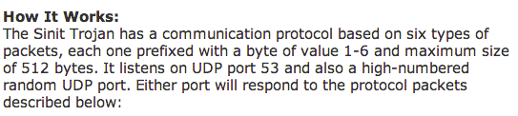
DNS as a Conduit of Attacks
Sinit Trojan (2003)
  Used port UDP 53
  Allowed by firewalls
    Link Ch 1m

Slide 27
DNS Traffic as a Gauge of Malicious Activity

Slide 28
DNS Monitoring
Infected machines often make many DNS queries
Spam relays make DNS requests to find addresses of mail servers
Botnets often make many DNS requests to obscure domains

Slide 29
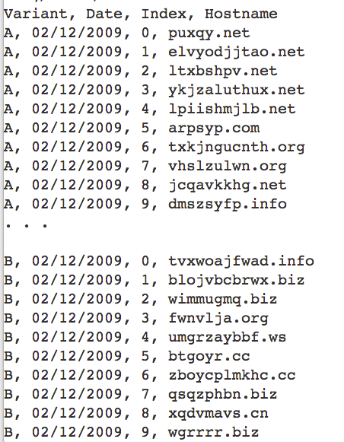
Conficker Worm Domains
Algorithm made 50,000 new domains per day
Registrars tried to block them all
  Links Ch 1u, 1v

Slide 30
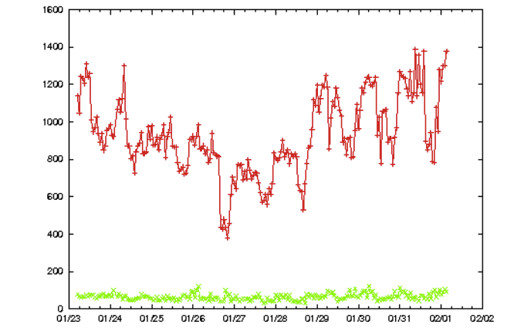
Requests per hour
Bots
Normal Traffic
From Link Ch 1q

Slide 31
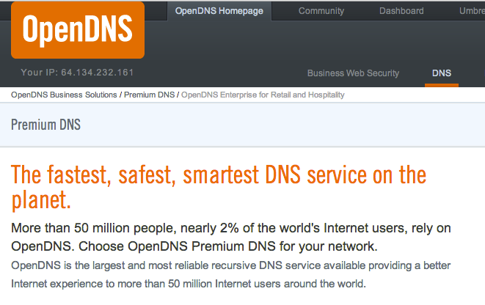
Blocking DNS Resolution for Known Malicious Domains

Slide 32
OpenDNS
Anycast for reliability
Reports of DNS activity for management
Blocks malicious servers
Can enforce other rules like Parental Controls

Slide 33
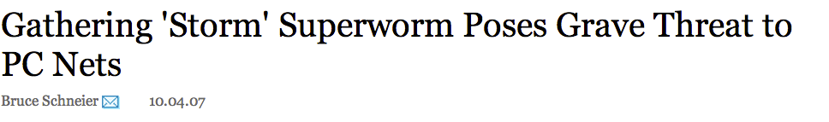
Storm Worm (2007)
Distributed C&C (Command and Control) via a peer-to-peer system
Fast flux DNS
Mutates every 30 minutes
  Link Ch 1s

Slide 34
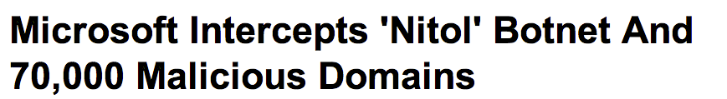
Microsoft took over the 3322.org domain, with authorization from a court order, in 2012
Controversial process
  Only temporary botnet disruption
  Takes down C&C servers controlled by other researchers; "collateral damage"
  Link Ch 1t

Slide 35
Lack of DNS Authentication and Privacy

Slide 36
Intrinsic Protocol Weakness
DNS requests and responses are not encrypted
No strong authentication
  Responses cannot be fully trusted
Responses can be spoofed or intercepted and modified
Altered responses may be cached for a long time

Slide 37
Financial Impacts and Intangible Losses
Availability: DNS outage causes direct loss of revenue
Fraud: Modified DNS services can
  Send spam
  Drive users to phishing sites
  Connect bots to C&C servers
  Locate malware download sites

Slide 38
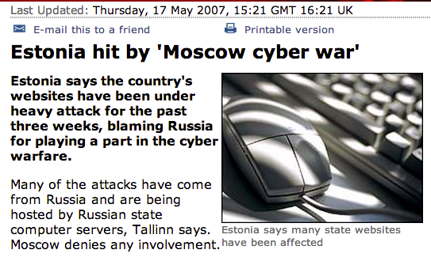
Cyberwar

