Slide 1
DNS Security
Ch 2: DNS Overview: Protocol, Architecture, and Applications
Updated 2-10-15

Slide 2
History
On ARPANet, host names were mapped to IP addresses in a hosts.txt file stored on a single master server
Other machines downloaded copies of hosts.txt periodically
Unix stored this information in /etc/hosts
This technique didn't scale well. DNS started in 1983.

Slide 3
Design Principles
Distributed storage
DNS data split across many servers
Smaller storage requirements for each server
Faster transfer of information
No single point of failure
Hierarchical organization of data
Allows local control of names and avoids name conflicts

Slide 4
DNS Name Structure
Up to four labels separated by dots form a Fully Qualified Domain Name (FQDN)
Top Level
Domain
(TLD)
Host
name
{
{
hills.ccsf.edu
{
Second Level
Domain (SLD)

Slide 5
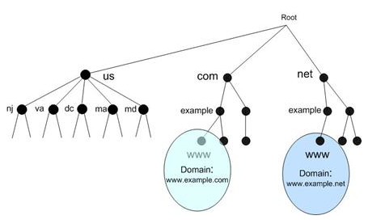
Hierarchical DNS Namespace

Slide 6
DNS Zones
Data for a domain and all or some of its subdomains is called a zone
All of CCSF could be one zone, containing
ns.ccsf.edu
www.ccsf.edu
mail.ccsf.edu
.
edu
ccsf
ns
www
mail

Slide 7
Domain Delegation
.
edu
CCSF could have separate nameservers on each campus, each responsible for their own subdomain
The ccsf.edu parent domain would delegate responsibility for a subdomain to each campus, making many zones
URLs would be longer
www.ocean.ccsf.edu
ccsf
ocean
mission
evans
ns
www
ns
www
ns
www

Slide 8
DNS Clients, Servers, and Resolvers
DNS Client
A program like a Web browser using a domain name like www.ccsf.edu
DNS Server
Stores and serves DNS data
DNS Resolver
Software that accepts a query from a client, queries one or more DNS servers, and replies to the client

Slide 9
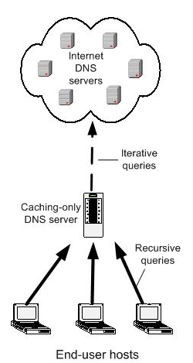
DNS Servers
Authoritative servers manage information about a domain
SOA (Start Of Authority)
Caching servers store data they copied from other servers
Not authoritative for any domain
Cache records have a Time To Live (TTL)
Specified by SOA for each record

Slide 10
DNS Queries
Recursive query
Server will find the answer, even if it has to query other servers to get it
Server will not respond with a referral to another server
Iterative query
If server does not have the answer, it will send a referral to another DNS server
Requester has to send another query to hunt for the answer

Slide 11
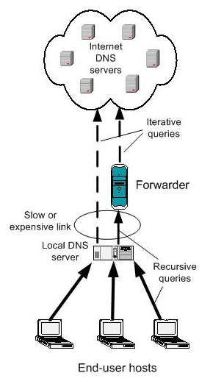
DNS Forwarder
Only external queries are sent to the forwarder in this example
Can reduce traffic through slow or expensive links
Because it can cache more records

Slide 12
DNS Resolvers
Receive requests from client applications
Query DNS servers
Can cache data
Stub resolver
Resolver connected to only one recursive server
Cannot follow referrals
Part of the operating system on the end device
Windows stub resolver caches
Linux stub resolver does not cache

Slide 13
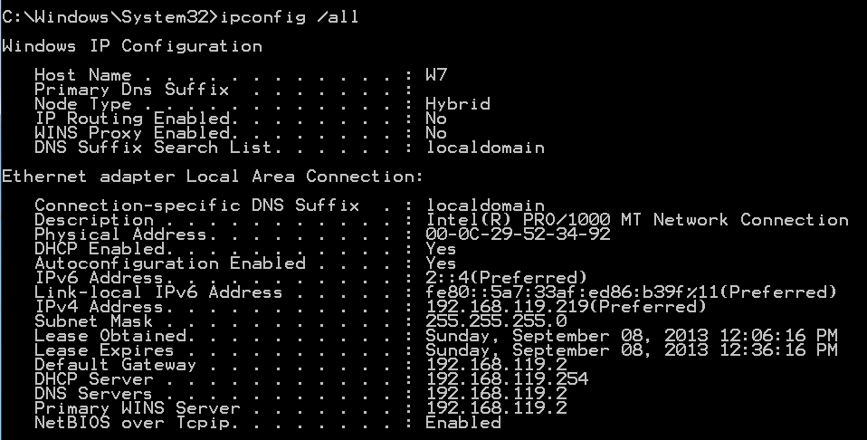
Local DNS Server
Provided by Internet Service Provider (ISP)
Configured at the client manually or by DHCP

Slide 14
Typical Name Resolution Scenario
.
Query: Where is the SOA for edu?
Query: Where is the SOA for ccsf.edu?
Query: Where is www.ccsf.edu?
edu
Query: Where is www.ccsf.edu?
ccsf
Local
DNS
Server
Stub
resolver
in OS
ns

Slide 15
DNS Replication
Master server contains primary zone files
Slave servers have copies of the zone files
Zone transfer
The process of copying the files

Slide 16
Root Servers
Named .
"dot"
Has pointers to the top-level domains
com, biz, mil, net, and so on
If a DNS server has no data in the cache, e. g. after a reboot
Receives a recursive query
Is not the SOA for that domain
Must query root to find the TLD servers

Slide 17
Root Servers
Hundreds of servers
Dispersed around the world
13 domain names
a.root-servers.net
b.root-servers.net
...
m.root-servers.net

Slide 18
DNS Resource Record Types and Classes
Each data element in DNS is called a Resource Record (RR)

Slide 19
Common RR Types
A IPv4 address of host
AAAA IPv6 address of host
MX Mail exchange
PTR Host name corresponding to IP address
NS Host name of SOA name server
CNAME Canonical Name: alias
SOA Attributes of zone
TXT General information

Slide 20
Common RR Types
NAPTR Naming Authority Pointer
SRV Service (for specific applications)
SPF Sender Policy Framework
(used to control spam)
Also included in TXT records as a
transitional mechanism
DNSKEY, DS, RRSIG, NSEC for DNSSEC

Slide 21
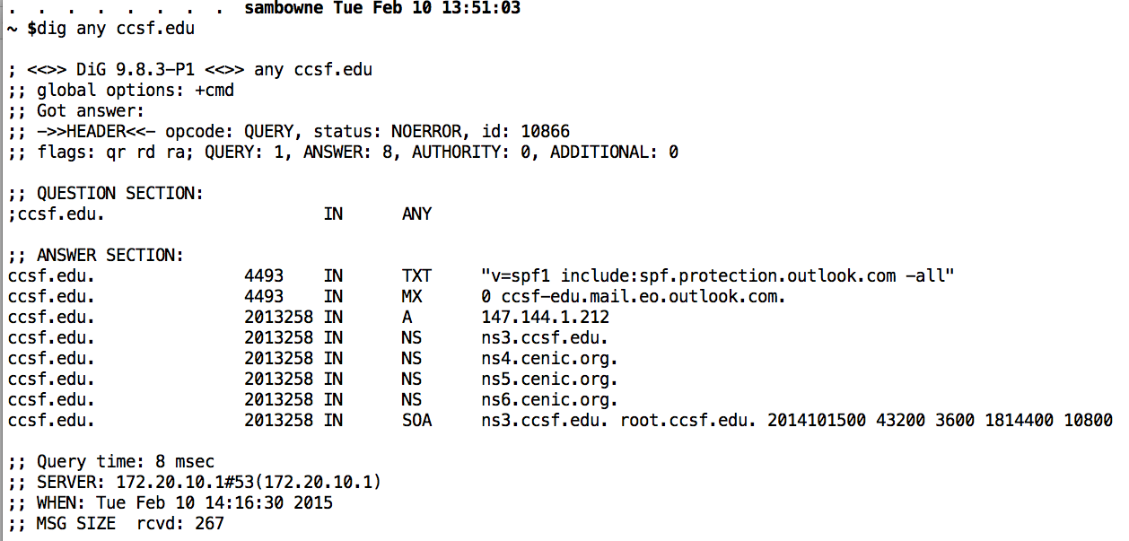
From Feb 10, 2015

Slide 22
Reverse DNS Resolutions
Start with IP address and query to find the domain name
Used to block spam email
If IP address of server doesn't have a valid domain name, or the domain name is blacklisted, the email is rejected

Slide 23
PTR Records for RDNS
Reverse the order of the IP address
Add "in-addr.arpa"
For example, 147.144.1.212 becomes
212.1.144.147.in-addr.arpa.

Slide 24
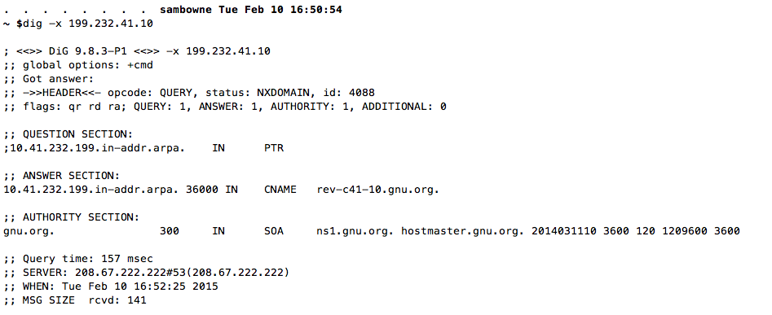
Reverse DNS Lookup

Slide 25
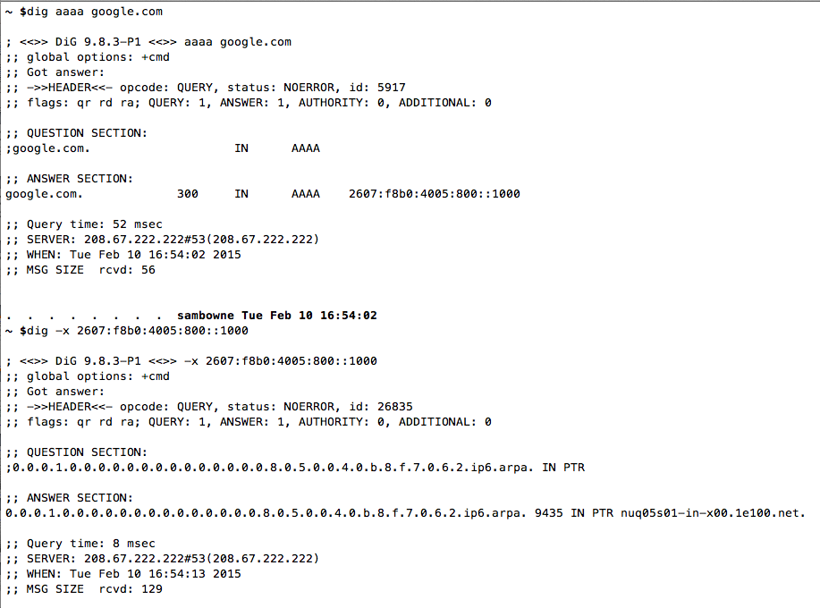

Slide 26
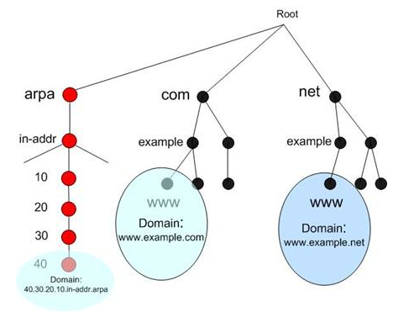

Slide 27
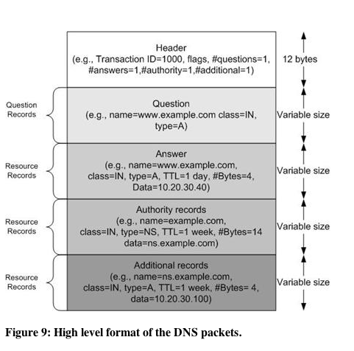

Slide 28
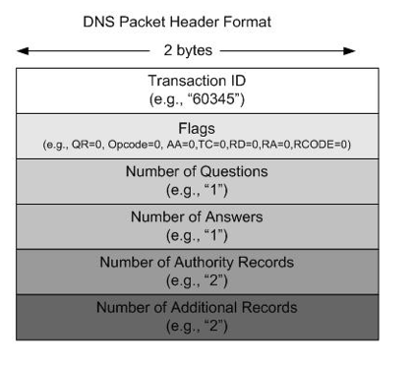

Slide 29
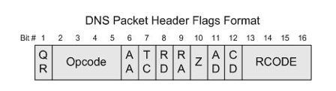
Flags specify:
Query or Response
Forward or Reverse
Recursive or Iterative

Slide 30
Glue Records
If the SOA for ccsf.edu is ns.ccsf.edu the system fails
Q: Where is www.ccsf.edu?
A: Ask ns.ccsf.edu
Q: Where is ns.ccsf.edu?
A: Ask ns.ccsf.edu
To prevent this, each domain has a glue record in their top-level domain zone specifying the IP address of the SOA

Slide 31
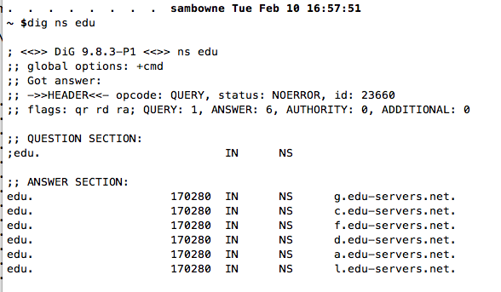
Viewing Glue Records with dig
1. Find a .edu root NS server

Slide 32
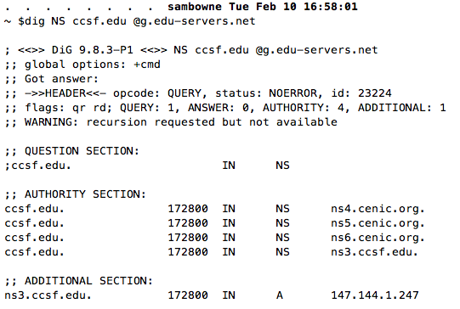
2. dig NS domain @root

Slide 33
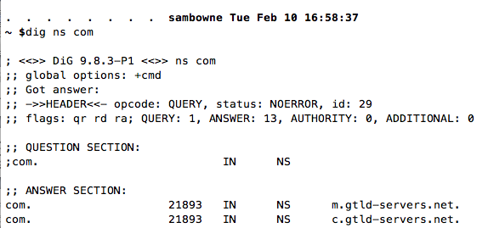
IPv4 Glue for Google
1. NS servers for .com

Slide 34
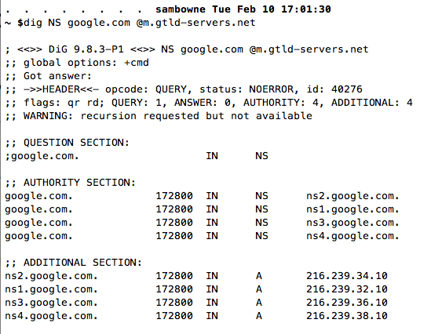
IPv4 Glue Records for Google

Slide 35
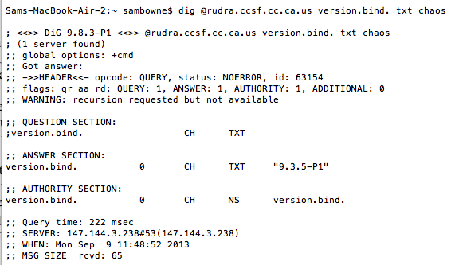
Bind Version Query

Slide 36
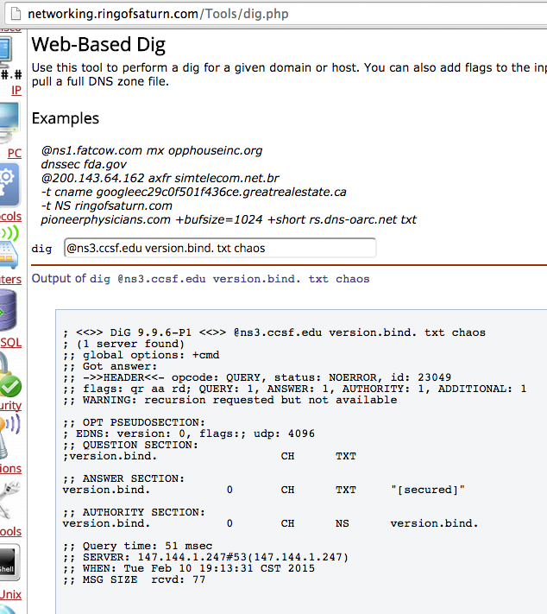
Now Fixed

Slide 37
Common Server Architectures

Slide 38
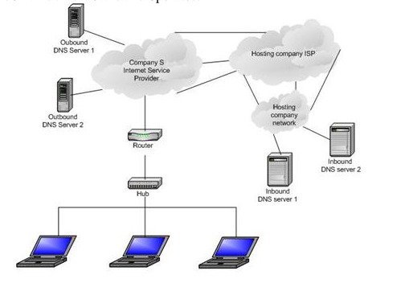
Small Company: Outsource DNS

Slide 39
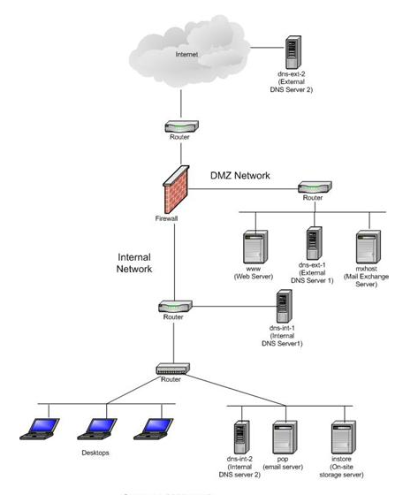
Medium Company
Internal and external DNS servers
Only public servers like www and mx on external DNS servers

Slide 40
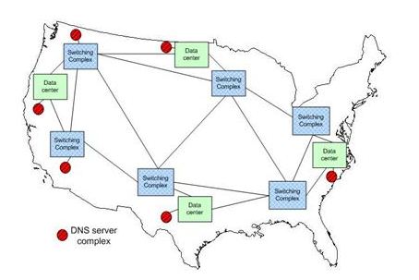
Large Company

Slide 41
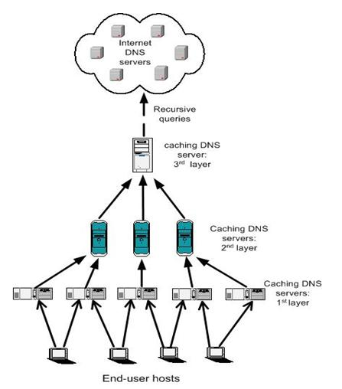
Hierarchical Caching Architecture

Slide 42
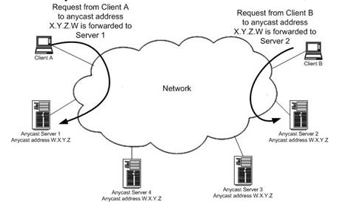
Anycast

