Slide 1
Ch 3: DNS Vulnerabilities

Slide 2
Causes of Vulnerabilities
Configuration errors
Architecture mistakes
Vulnerable software implementations
Protocol weaknesses
Failure to use the security extensions in the protocol

Slide 3
DNS Architecture Mistakes

Slide 4
Single Point of Failure
The SOA could be a single server at a single site
  If the server crashes, clients would be unable to resolve any of the domains in the zone
  Also Internet connection outage, power failure, fire, storm, etc.
If a single server is the recursive resolver for clients in an intranet
  They'll all lose DNS service if it goes gown

Slide 5
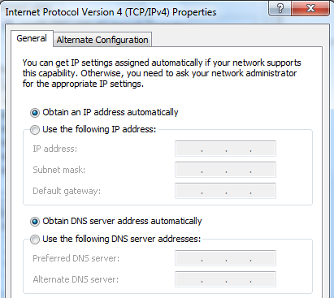
Two Servers
Many hosting providers do not allow delegation of DNS service to a single DNS server name
End devices are typically provisioned with two DNS server addresses

Slide 6
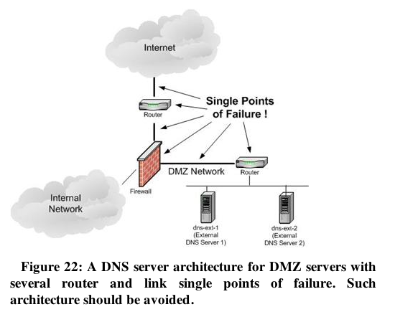
Router or Link

Slide 7
Data Center or Single Site
If all DNS servers are at a single site or data center, a regional event could take them all down
  Earthquake
  Power failure
The more critical the DNS service is, the more distributed servers should be
  Geographically and topologically
  Like the 13 root servers

Slide 8
Common Configuration Errors

Slide 9
Exposure of Internal Information
Only public Web-facing servers should be in the external DNS zone files
Your DNS server is a target of attack and may be compromised

Slide 10
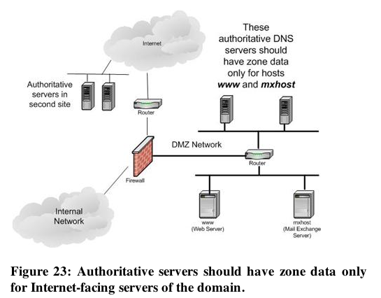

Slide 11
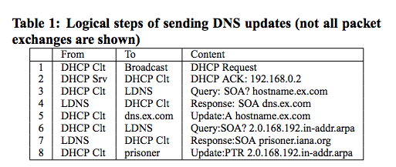
Leakage of Internal Queries to the Internet
Some Windows DHCP clients leak dynamic DNS updates to the Internet
  Link Ch 3a

Slide 12
Windows Versions
These packets were sent from Windows 2000, Windows XP, and Server 2003
  When tested in 2006
To prevent this, configure local DNS servers not to refer internal machines to external name servers
  And block DNS requests directly to the Internet

Slide 13
Unnecessary Recursiveness
Not all name servers need to be recursive
  Authoritative servers don't need to
  Recursion is complex and burdens servers
  Added function means more potential vulnerabilities
Recursion may be on by default
  Thousands of open recursive resolvers on the Internet

Slide 14
Failure to Restrict Access
Recursive DNS servers should only accept queries from your own clients
  Block outside addresses with access control lists

Slide 15
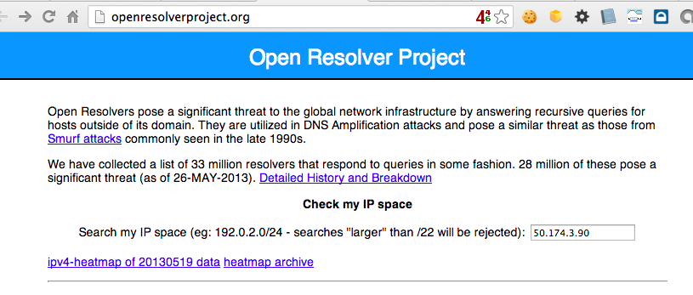
Open Resolver Project
Link Ch 3b

Slide 16
Testing CCSF's DNS Servers
dig ns ccsf.edu shows 6 servers
  ns5.cenic.org 137.164.29.69 CLOSED
  ns4.cenic.org 137.164.29.67 CLOSED
  rudra3.ccsf.cc.ca.us 147.144.3.238 CLOSED
  ns6.cenic.org 198.188.255.193 CLOSED
  ns1.csu.net 130.150.102.100 OPEN
  ns3.csu.net 137.145.204.10 OPEN

Slide 17
Unprotected Zone Transfers
Data transfers from a master to a slave authoritative server
  Update the zone files on the slave
Can be requested by any other host
Reveals information about all hosts in the zone
  Information disclosure vulnerability

Slide 18
Running Server in Privileged Mode
root on Unix/Linux
Administrator on Windows
  Makes any security flaws more dangerous
  Attacker who owns DNS then owns the server

Slide 19
Weakness in Software Implementations
DNS servers have bugs and vulnerabilities
  Buffer overflows
  Other errors
Search CVE List for "ISC Bind"

Slide 20
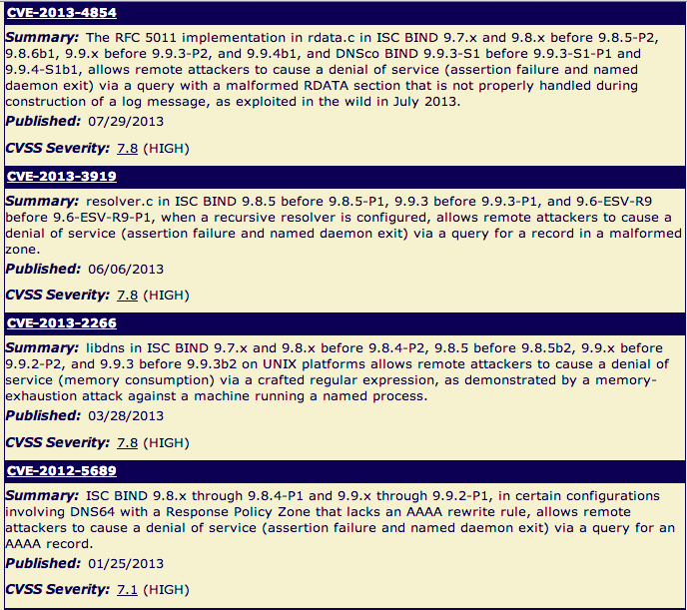

Slide 21
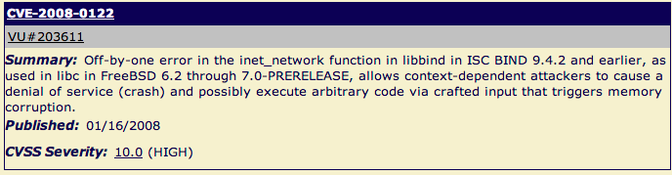
Severe 2008 Bind Vulnerability
Attack used an IP address like
  1.2.3.4.xxxxxxxx-exploit-code-here-xxxx
Another list of DNS vulns at link Ch 3d

Slide 22
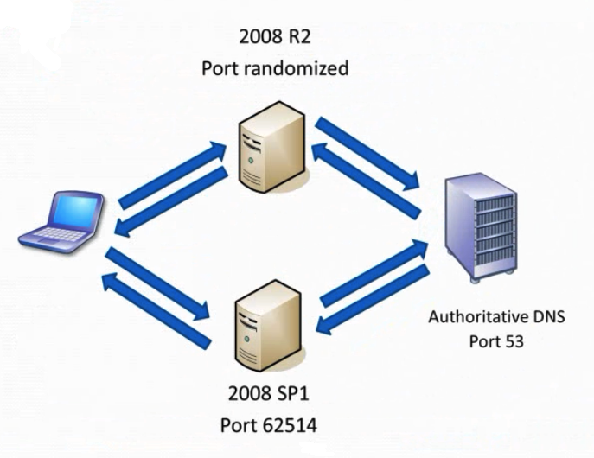
Source Port Randomization
Good video
Link Ch 3e

Slide 23
Randomness of Transaction ID
Each DNS query and response has a TXID field
  16 bits long (65,536 possible values)
  Should be random
Bind 8 & 9 used predictable transaction IDs
  So only ten guesses were needed to spoof the reply

Slide 24
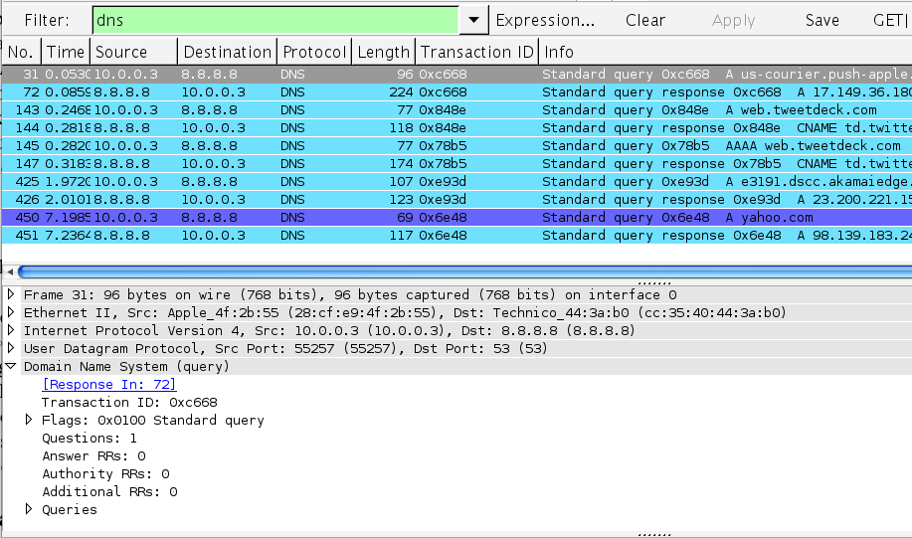
Randomness of Transaction ID

Slide 25
Tricking a Target into Using Your DNS Server
Run a domain evil.com with a SOA you control ns1.evil.com
  Send the target an email with a link to server.evil.com and hope someone clicks it
  Send email from joe@evil.com to target email address
    The server will automatically perform a reverse lookup to detect spam

Slide 26
Tricking a Target into Making Multiple DNS Queries
CNAME Chaining
  www.evil.com is a CNAME for www1.evil.com
  www1.evil.com is a CNAME for www2.evil.com
  www2.evil.com is a CNAME for www3.evil.com
  etc.

Slide 27
Tricking a Target into Making Multiple DNS Queries
NS Referral Chaining and NS Chains
  a.a.a.a.evil.com has SOA ns.evil.com
  ns.evil.com delegates to ns.a.evil.com
  ns.a.evil.com delegates to ns.a.a.evil.com
  etc.

Slide 28
Protocol Design Weaknesses

Slide 29
Weak Authentication
DNS uses these elements to match a request and a response
  Transaction ID (16 bits)
  Question
  Source and destination IP
  Source and destination ports
    But request destination port is known (53)
Client accepts the first response that meets these criteria, and caches the result

Slide 30
DNS Cache Poisoning
A false response that tricks the client puts a false entry into its cache

Slide 31
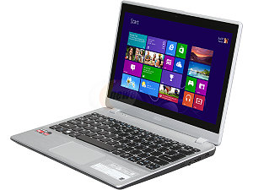
DNS Cache Poisoning
Where is www.yahoo.com?
Attacker
1.2.3.4
www.yahoo.com is at 1.2.3.4
Where is www.yahoo.com?
DNS Resolver
www.yahoo.com is at 1.2.3.4
Target

Slide 32
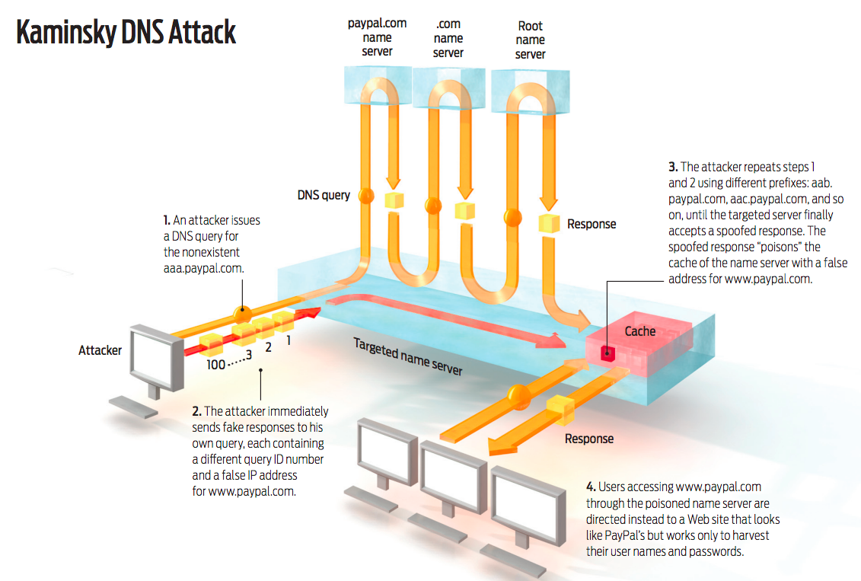
Link Ch 3f

Slide 33
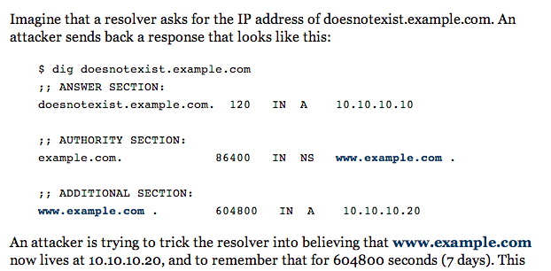
Link Ch 3g

Slide 34
Consequences of the Kaminsky Attack
Attack can be placed in a Web page
  Many img tags
  <img src=aaaa.paypal.com>
  <img src=aaab.paypal.com>
  <img src=aaac.paypal.com>
  <img src=aaad.paypal.com>
  etc.
If one Comcast customer views that page, all other Comcast customers will be sent to the fake paypal.com
Poisoning can take as few as 10 seconds

Slide 35
Man-in-the-Middle Attacks
Attacker in the middle has enough info to perfectly forge responses
  Unless DNSSEC is used
Target
Attacker
DNS Resolver

Slide 36
DNS as a DoS Amplifier
Small requests lead to large responses
UDP allows spoofing the source IP address
Target
Open DNS Resolver
Attacker

